Slide 1




Joint CALMet XVI - CONECT 3 Conference
CALMet XVI
Notes:
With this presentation i would like to start sharing the insights of the CALMet part of this conference and the feedback from the regional discussions

Slide 2
Thank you!
Roro Purwanti (BMKG / WMO)
Marina Baldi (CNR-IBE/ WMO RTC Italy)
Vieri Tarchiani (CNR-IBE/ WMO RTC Italy)
Lucianne Veeck (WMO)
Barbara Bourdelles (MeteoFrance)
Nacéra Chergui (MSC)
Tsvetomir Ross-Lazarov (COMET)
Stephen Kerr (MSC)
Markus Zygmuntowski (DWD)
Vesa Nietosvaara (EUMETSAT)
Winifred Jordaan (CONECT )
Mick Pope (BoM)
Jingrong SUN (CMATC)
Felipe Vannucci (SMN)
Romina Mezher (SMN)
Vagner Anabor (USM)
Notes:
First of all I would like to thank #klik#
Roro,
Marina,
Vieri
and Lucianne
for their very hard work to make this Joint Conference happening and running it in an excellent way
#klik#
Next to that i like to thank the Members of the CALMet Working Group, being
Barbara Bourdelles (ENM MeteoFrance)
Nacéra Chergui (MSC)
Tsvetomir Ross-Lazarov (COMET)
Stephen Kerr (ECCC)
Markus Zygmuntowski (DWD)
Vesa Nietosvaara (EUMETSAT)
Winifred Jordaan (CONECT )
Mick Pope (BoM)
Jingrong SUN (CMATC)
Felipe Vannucci (SMN)
Romina Mezher (SMN)
Vagner Anabor (USM)
for their support actions to make the work of Roro, Lu, Marina en vieri a bit easier..
Everytime I am really proud to see what we have accomplished.
This time, I think, we started together not an easy task to organise this conference as a hybrid conference across multiple time zones!

Slide 3
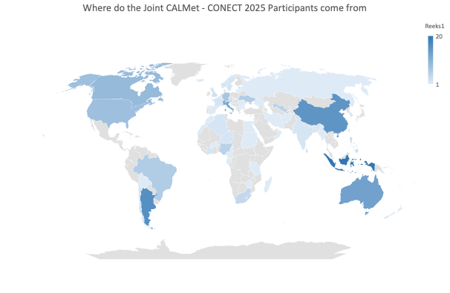
Joint CALMet XVI - CONECT 3 Conference
223 registered participants
174 online
49 in-person
from 65 different countries
160 of these participants have landed in the
conference environment
Notes:
Most of you already have seen this information with regard to the participants Yesterday
#klik#

Slide 4
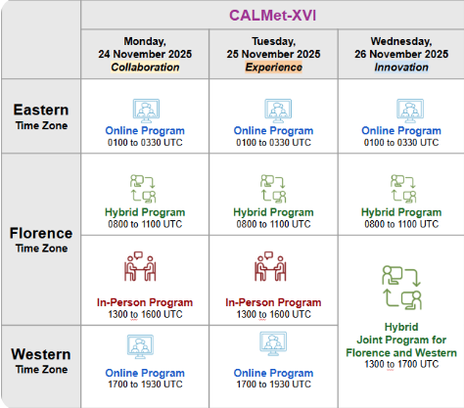
CALMet XVI
Thank you!
Online
Hybride
In person
24 Keynote presentations
8 workshops
3 regional discussions
43 posters
Collaboration projects
Experiences
innovative projects
Notes:
Next to that you heard the information about the available sessions yesterday already too so i won’t recall that and continue to my observations....#klik#

Slide 5
General observations
Cross-pollination
More participants online that you expect at a first glance
Active discussions
Online participation, using the recordings.
Online interaction options
Online vs Hybrid vs. In-Person
Notes:
By attending all the online sessions I have learned that
#klik#
the cross-pollination (- crosspollenation-) took place not only in Florence, where people from all over the world came together in-person en online,.... but also online in the Eastern and Western time zones, where regularly someone living in an other timezone showed up in sessions from neighbouring timezones..
#klik#
although the average number of people per session in the Eastern and Western sessions were mostly between 18 and 24 participants, there were definitely more participants in those sessions.
In addition to a number of participants who followed the sessions from start to finish, there were also a considerable number of participants who had clearly selected the contributions they wanted to hear more about and/or experience in real life and jumped in and out of sessions
#klik# after the keynotes and during regional discussion sessions an active discussion took place which was great
#klik#
Therefore I am also really curious to see how many people will watch the recordings of the sessions afterwards.
#Klik#
Further I feel that the online interaction options, like the online discussion forms and the poster area is used a lot less then during the past couple of times when this online way of having idiscussions with eachother was the only option.
# klik#
Last but not least
A joint conference like this is a great opportunity to strengthen our community.
I understand the wish to meet in person—and that an in-person programme helps make that meaningful. But not everyone in our community has the option to travel. I did, but many others did not.
To me, everyone in our network is equally important. Some of our most valuable contributors may be the ones who can only join online.
Participating in a conference like we have organised is not always easy for fully online particpants. Often it is the sound quality, which was great this time but I have experienced that online participants who were very interested in parts of the in-person programme but could not access them. It would be unfortunate if colleagues start to disengage because they feel unintentionally excluded.
So my message is simple: let’s make sure we do not, even unintentionally, create a two-class community in the future for both this CALMet AND CONECT forum.
Having said that i like to continue with the feedback from the regional discussions #klik#

Slide 6
Regional Discussions
Eastern Time zone / run by Kirsty Tunner and presented by Mick Pope
Florence Time Zone / Winifred Jordaan
Western Time Zone / Romina Mezher
Notes:
We have put the regional discussion in the programme with the goal to also give a voice to those in different regions who are not necessarily involved in the CONECT group and might be the target group for our collaborative work.
So during those session the discussion leaders asked many question to identify available training activities, the most urgent needs and difficulties in the region and how to address these all, possibly, even with the help of new technologies, and exploring communities of practice.
Next Mick, Winifred and Romina will share their finding of those sessions with you and we hope that these can be the start of the discussies that will happen today and tomorrow.
Mick please go ahead!

