Slide 1
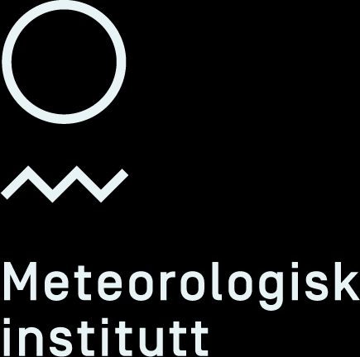
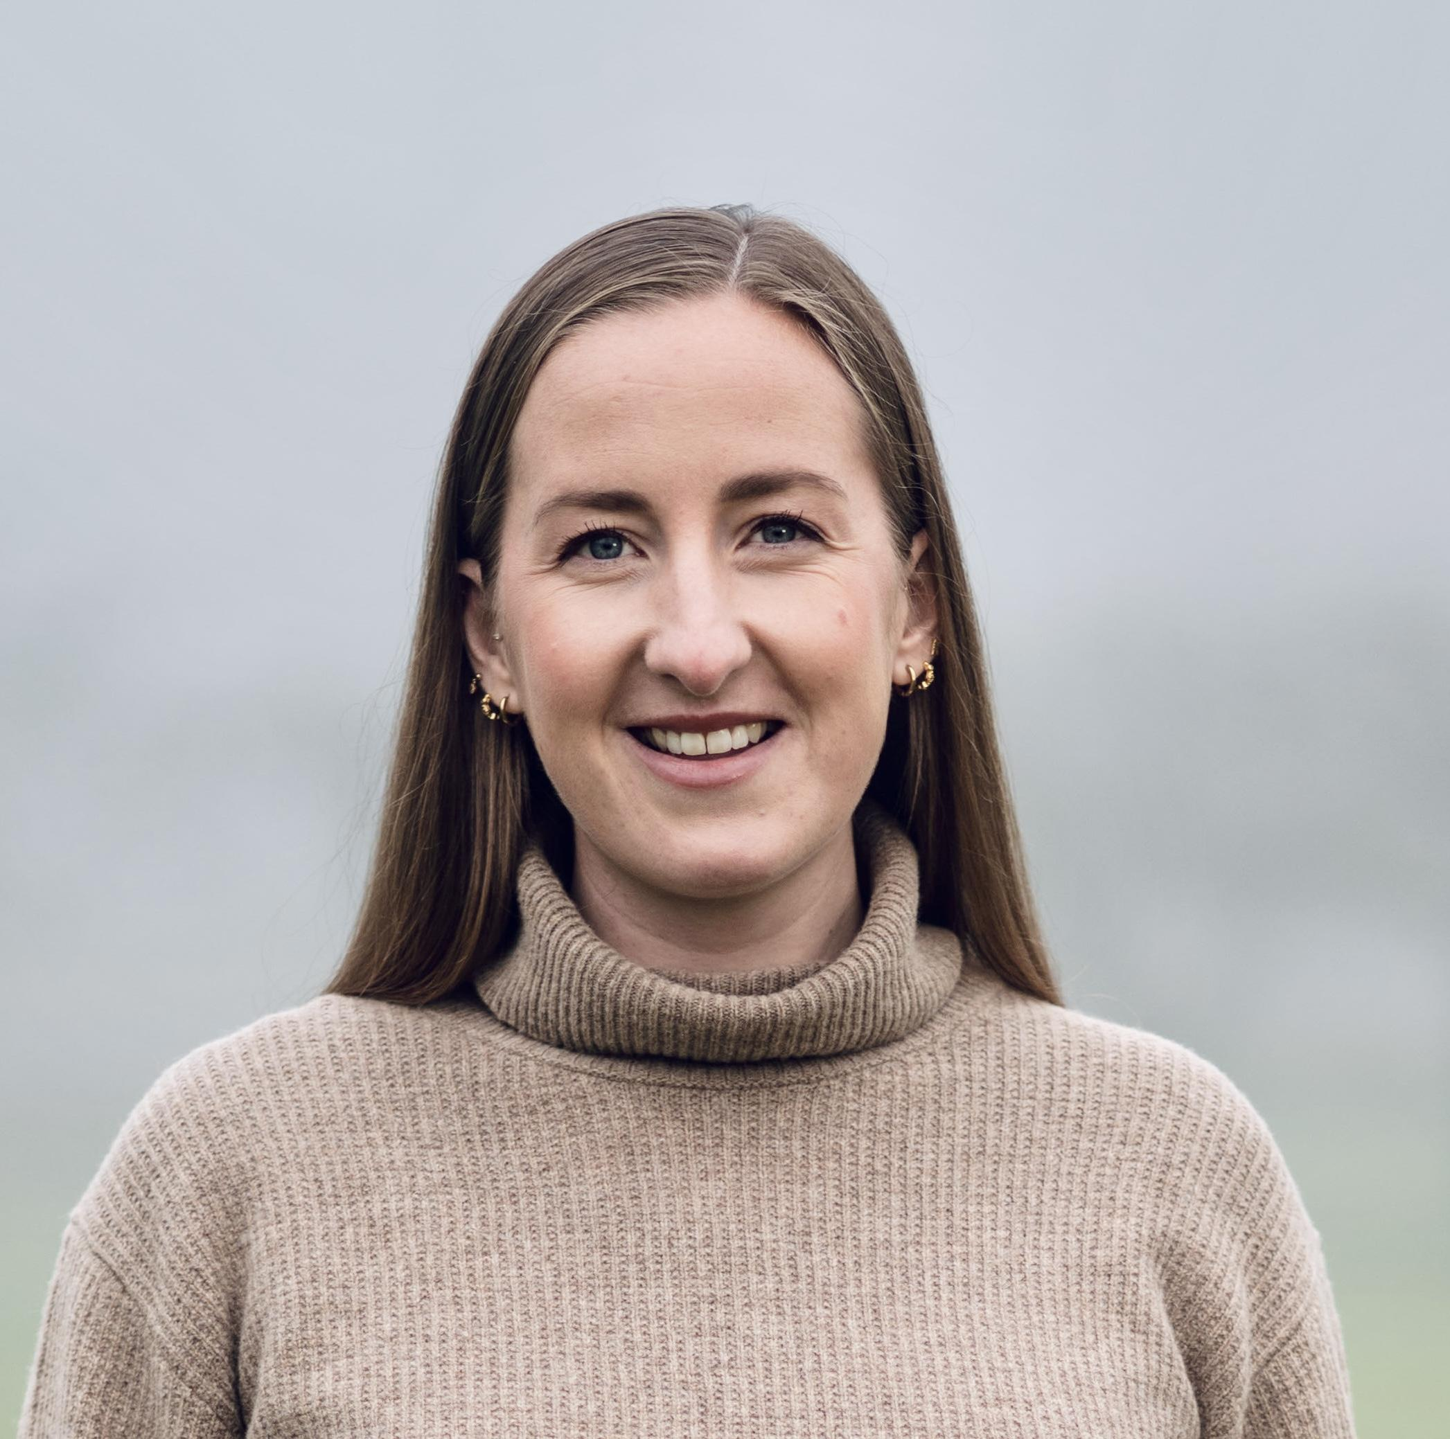
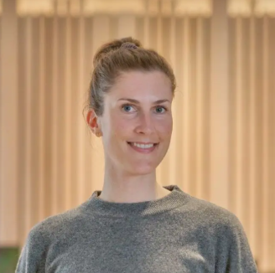

Bridging Knowledge and Practice
How we train operational forecasters
at The Norwegian Meteorological Institute
Joint CALMet-XVI and CONECT-3 Conference, 24-28. November 2025
Pernille Borander
Magni Svanevik
Notes:
Hello, my name is Pernille Borander, and I am a state meteorologist at the Norwegian Meteorological Institute.
Today I’m going to tell you a bit about how we train our weather forecasters, and joining the discussion digitally from Bergen is my colleague Magni.

Slide 2
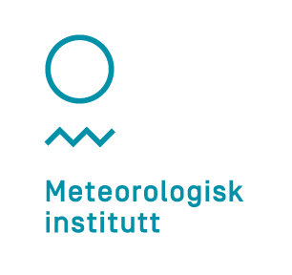

Todays talk
Who are MET Norway?
Our annual training program
  Some highlights
How we preserve institutional knowledge
Summary
Notes:
I’ll start with a short introduction to who we are, what our annual training cycle looks like, and highlight a few examples of training that we believe work particularly well.
I’ll also talk briefly about our strategy for maintaining competence, for example when people retire, and finally I’ll give a short summary.

Slide 3
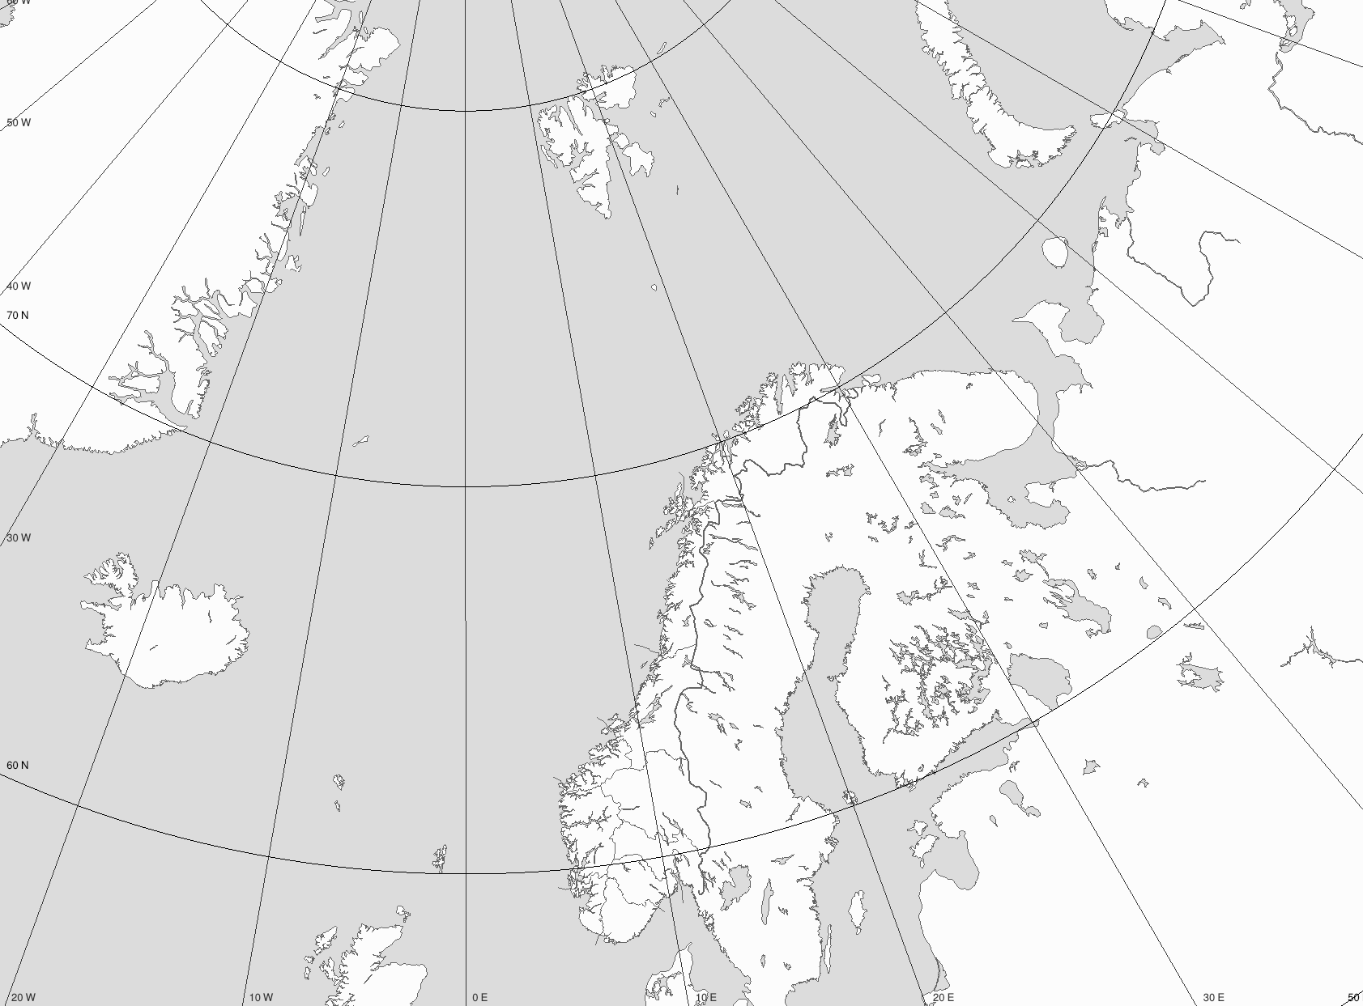
The Norwegian Meteorological Institute
502 employees at
9 locations
85 operational forecasters
Longyearbyen
Hopen
Bjørnøya
Jan Mayen
Tromsø
Bardufoss
Ørlandet
Regional forecast centers
Meteorological offices
Weather observation stations
Bergen
Oslo
Notes:
The Norwegian Meteorological Institute consists of just over 500 employees spread across nine locations. The regional forecasting centres are in Oslo, Bergen, and Tromsø. Bardufoss and Ørlandet have meteorological offices largely connected to cooperation Norwegian Armed Forces. On Svalbard we have one person responsible for aviation traffic for the archipelago, and we also have personnel conducting observations for us on the Arctic islands Jan Mayen, Bjørnøya, and Hopen.
It is a large forecasting area we are responsible for—sea, seaice, coast, land, fjords, and mountains—and we have 85 meteorologists to forecast for it.

Slide 4
Our main purpose is to protect lives and assets.
Notes:
The Norwegian Meteorological Institute is a government agency, so it is the Norwegian government that decides what we do. Our most important societal mission is to safeguard lives and property through our weather forecasting.
Try to explain who the typical norwegian weather forecaster is.

Slide 5

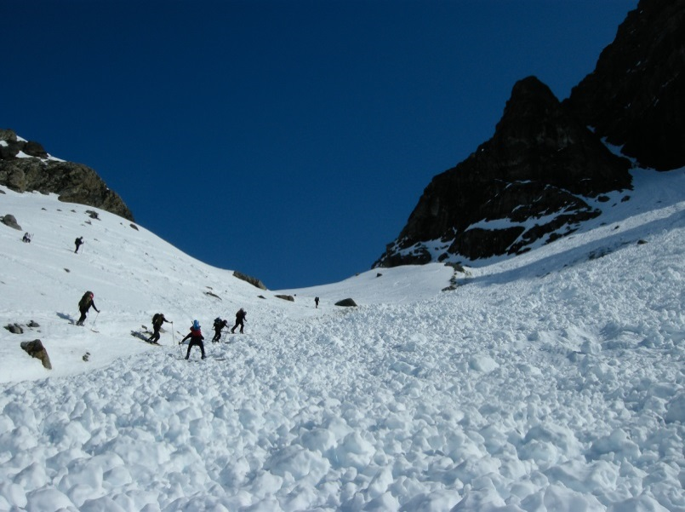
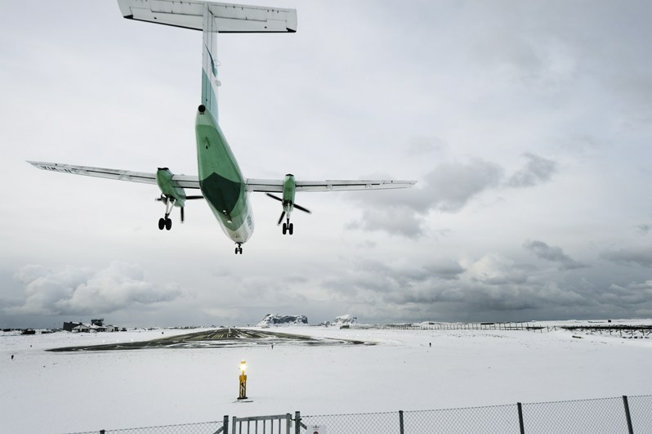
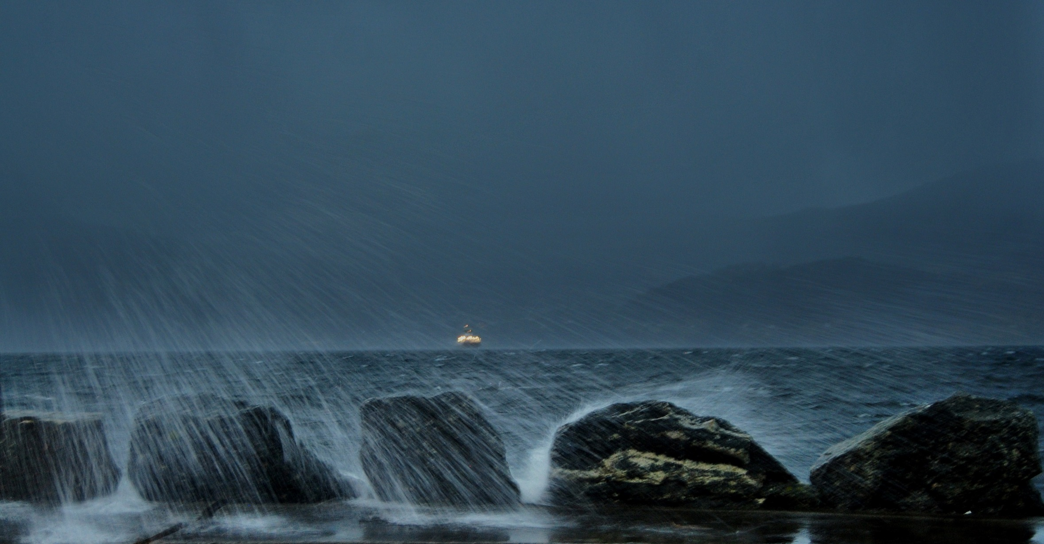
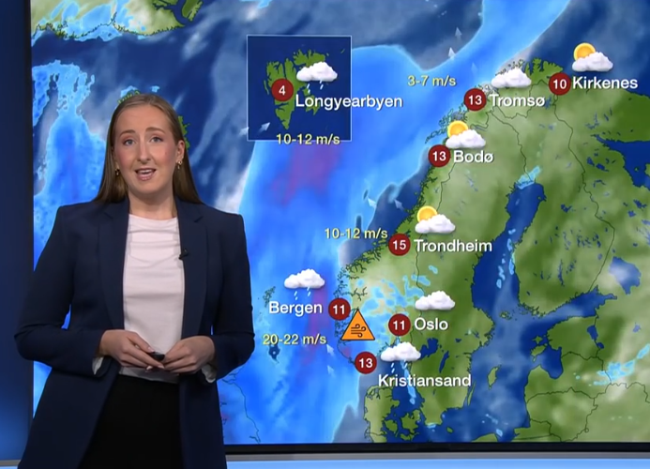
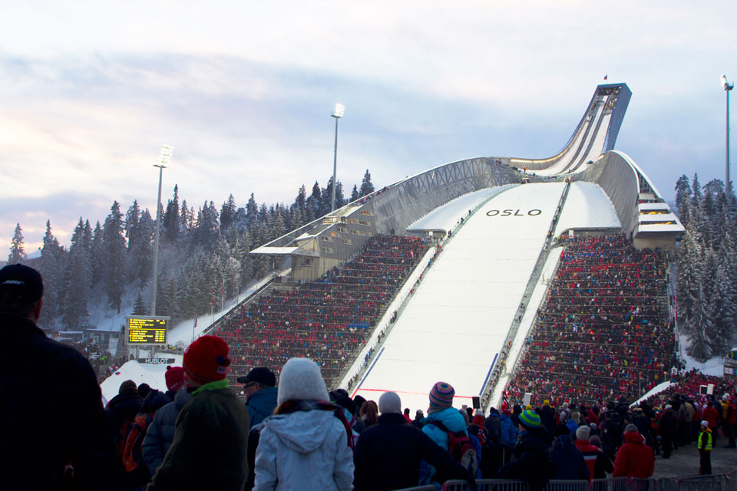
The “typical” Norwegian weather forecaster
General
Avalanche
Aviation: Military and Civil
Maritime
TV and Editorial/SoMe
Commercial
Notes:
We are responsible for general public weather forecasting,
and the way we do this is through impact-based forecasting, which we introduced in 2018. Here, cooperation with partners is key: we know the weather, and they know the consequences. Our partners are in the energy market, aviation, and road sectors. Some of them we brief daily, and they also contribute to training—something I will return to.

Slide 6



Consequence based warning
Consequences of the weather
  collaboration is key
  e.g. The Norwegian Air Ambulance Foundation, The Norwegian Public Roads Administration
Briefings and contribute to training
Notes:
We are responsible for general public weather forecasting,
and the way we do this is through impact-based forecasting, which we introduced in 2018. Here, cooperation with partners is key: we know the weather, and they know the consequences. Our partners are in the energy market, aviation, and road sectors. Some of them we brief daily, and they also contribute to training—something I will return to.

Slide 7
The “typical” Norwegian weather forecaster
General
Avalanche
Aviation: Military and Civil
Maritime
TV and Editorial/SoMe
Commercial
Notes:
We are responsible for avalanche forecasting, both civil and military aviation weather services, maritime services, TV meteorologists for the state-owned broadcaster NRK (and just to mention it, MET and NRK together operate Yr). We also have our own editorial team for communication on social media, and we have some commercial services—for example for sporting events and the energy sector.

Slide 8



Notes:
We are responsible for avalanche forecasting, both civil and military aviation weather services, maritime services, TV meteorologists for the state-owned broadcaster NRK (and just to mention it, MET and NRK together operate Yr). We also have our own editorial team for communication on social media, and we have some commercial services—for example for sporting events and the energy sector.

Slide 9
The “typical” Norwegian weather forecaster
General
Avalanche
Aviation: Military and Civil
Maritime
TV and Editorial/SoMe
Commercial
Notes:
We are responsible for avalanche forecasting, both civil and military aviation weather services, maritime services, TV meteorologists for the state-owned broadcaster NRK (and just to mention it, MET and NRK together operate Yr). We also have our own editorial team for communication on social media, and we have some commercial services—for example for sporting events and the energy sector.

Slide 10

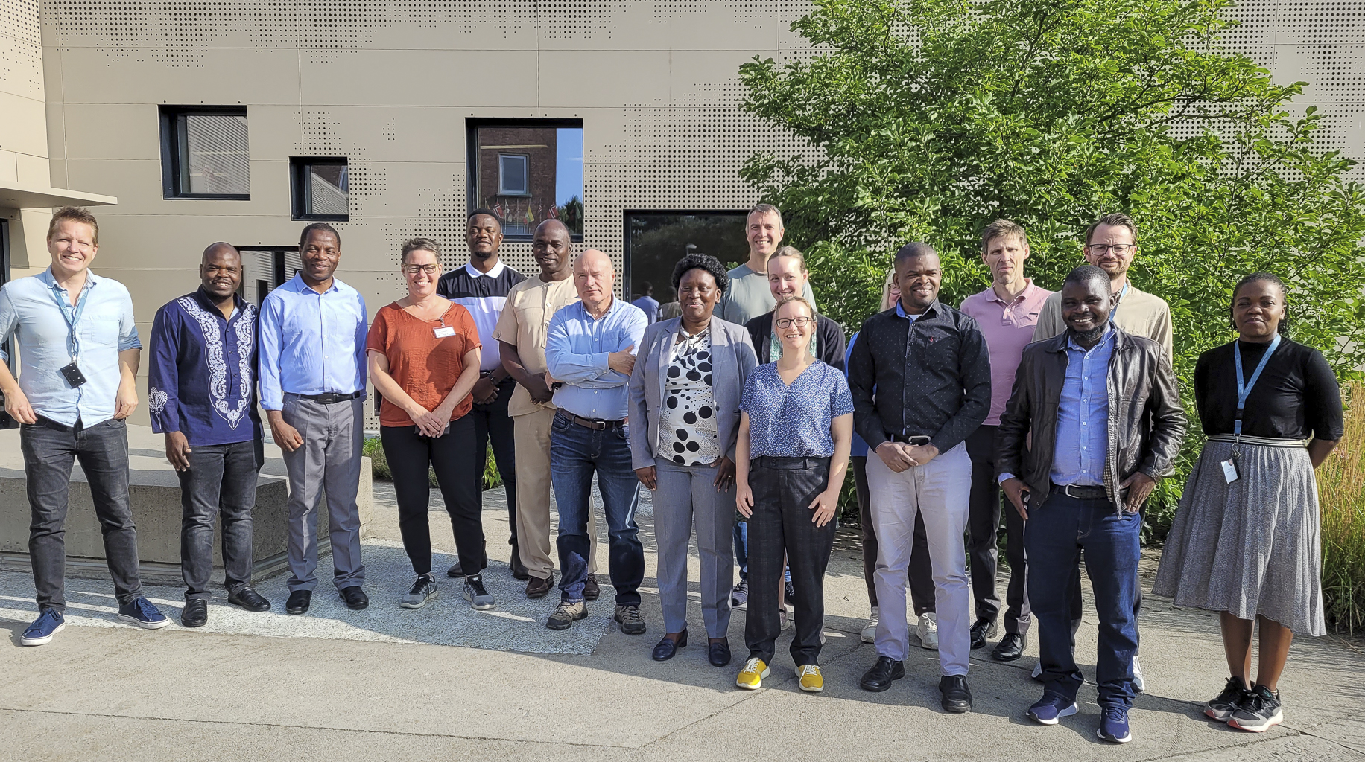
The “typical” Norwegian weather forecaster
Development
International collaboration
Notes:
And in addition to operational forecasting, some are involved in development of the weather service and international collaboration - as one of the topics was after lunch yesterday, MET collaborates with the public meteorological institutes in Bangladesh, Etiopia, Malawi, Mosambik, Tanzania og Vietnam
So the typical Norwegian meteorologist often works across many forecasting domains, some of us feels like a potato I guess. A few only cover one type of shift, but most work a combination, and there are many fields to stay updated on.

Slide 11
New Forecasters
Necessary with M.Sc.
Training period 6-7 months
  classroom teaching
  “shadowing”
Last 5 years:
  on average 8-9 new forecasters employed each year
Notes:
Where does the training begin?
To start a career with us, we require a master’s degree in meteorology or another relevant field. Training lasts about 6–7 months before one can take operational shifts alone. The duration depends somewhat on how many forecasting areas the person will cover, and the time is divided roughly equally between classroom training and shadow shifts. Over the past five years, we have hired an average of 8–9 new meteorologists per year. This also done by forecasters.

Slide 12
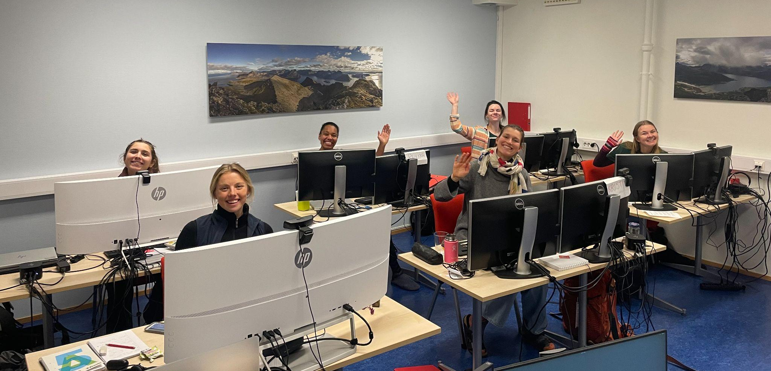
New Forecasters - Greetings!
Notes:
on average 8,8 new forecasters employed each year

Slide 13
Our governmental mission is to provide public meteorological services for civilian and military purposes, including monitoring and forecasting weather, as well as calculating climate.
Notes:
What is all the training based on? of course, by WMO requirements, but also The competence required of our forecasters is partly defined by our governmental mandate…
We have therefore compiled everything into a comprehensive overview called SOS – Standard Training for State Meteorologists. These requirements guide how we design training programmes, both for new and experienced meteorologists.

Slide 14
Competence requirements
WMO requirements
SOS
Standard training for State Meteorologists
MET requirements
Notes:
What is all the training based on? of course, by WMO requirements, but also The competence required of our forecasters is partly defined by our governmental mandate…
We have therefore compiled everything into a comprehensive overview called SOS – Standard Training for State Meteorologists. These requirements guide how we design training programmes, both for new and experienced meteorologists.

Slide 15
Good opportunities for internal and external skill development.
Notes:
And if I may say so myself, there are good opportunities for both internal and external professional development with us.
I won’t go into the external courses and meetings, but this is what our internal annual training cycle looks like. This is in Norwegian, but as you can see, there is quite a lot of training throughout the year—joint sessions, self-study, digital, hybrid, and in-person.

Slide 16
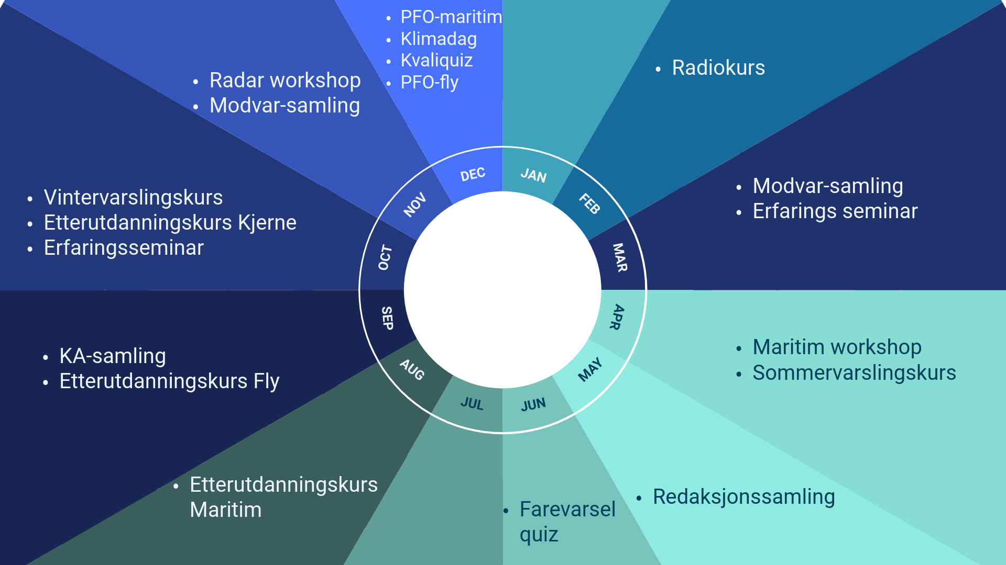
Notes:
And if I may say so myself, there are good opportunities for both internal and external professional development with us.
I won’t go into the external courses and meetings, but this is what our internal annual training cycle looks like. This is in Norwegian, but as you can see, there is quite a lot of training throughout the year—joint sessions, self-study, digital, hybrid, and in-person.

Slide 17
Notes:
Now I’ll tell you a bit more about two of the courses.

Slide 18
Courses tailored for forecasters by forecasters.
Notes:
As I’ve now learned many of you are a part of the Training section at your institute. At MET Norway it is the forecasters who create and run it. I’m starting to think a Training Section is not a bad ide, That gives ownership of the course and allows the agenda to be shaped according to actual needs.

Slide 19
Advanced Course for Aviational forecasters
Annual, in-person
Group work and discussions
Collaboration
  e.g. The Norwegian Air Ambulance Foundation
  Airport visits
Goal:
User meetings, news in aviation forecasting at MET, professional development
Notes:
Every year we run a continuing education course for aviation forecasters—about 15 people participate each time, so participation rotates yearly. It is held in person, and the goal is to have user meetings, receive updates, strengthen routines, and develop professionally through group work and discussion. This course is a good example of why including partners is important. They visit us, and we visit them—for example the air ambulance service or the air defence forces. It’s a great arena to discuss what works well in our cooperation and what needs improvement.

Slide 20
We monitor, forecast, and communicate the weather with high quality and regularity, and calculates the climate in the present and future - and communicate the results of our work.
Notes:
Now, to a self-study. Since, as mentioned earlier, we have a governmental mission…
I will also say a few words about a self-study course we offer.

Slide 21
“The Climate Day”
WMO 1083
Mostly based on our own climate competence requirements
Annual, mandatory self-study
Theory + quiz in moodle
Goal:
Provide meteorologists the tools to serve as climate communicators
Notes:
t is called Climate Day. The background for this exercise is partly based on WMO requirements, but mainly on our own—because of our societal mandate. The goal is that state meteorologists should be able to communicate about climate to some extent, although of course not at the same level as climate researchers. It is created by meteorologists, held annually, and is mandatory. It consists of theory modules followed by a quiz, all done in Moodle.

Slide 22
Our strategy is to keep employees for as long as possible.
Notes:
These were a couple of examples of what we do. And when you invest heavily in developing employees with high competence, you naturally want to preserve that competence for as long as possible. Our strategy is simply that we want employees to stay in their jobs as long as they can.

Slide 23
Preserve institutional knowledge
From age 62: total 8 weeks paid vacation
Possible to work until the age of 72
Senior forecasters are seen as an resource
Our strategy is to keep employees for as long as possible
Notes:
So how do we do that? One way is to adapt the workday. As a state-employed meteorologist in Norway, you receive eight extra weeks of paid vacation after the age of 62, something that the work unions have negotiated. And although it is possible to retire between 62–65, you can keep working until 72, which has a significant impact on pensions - the money you get after retiering.
Senior forecasters are considered a resource, and with their experience - - possess a lot of experience-based knowledge
, many play an important role in training new employees - through presentations on courses, in the training of new employees.

Slide 24
To ensure competence for the future, all shared training is recorded and stored.
Notes:
For example by giving lectures, and all joint training sessions are recorded and stored so they can be viewed later.

Slide 25
Summary
MET prioritise competence development
  Collective vs individual
Courses tailored for forecasters by forecasters
Close collaboration with partners
Strengthening an internal team identity
Notes:
So, in summary:
MET places a high priority on training and allocates substantial time in the shift schedule throughout the year to make it happen. In practice, there is a bit of a difference between what gets done jointly and individually—joint sessions are easier to accomplish, whereas self-study can sometimes suffer when you need to step into the shift schedule, and there is quite a lot of self-study.
We believe it is important that forecasters are involved in developing courses and self-study materials, so they have ownership and can shape the content to a large extent.
Something our meteorologists appreciate greatly is the contribution from our partners to these courses—the exchange of experience is extremely valuable.
And finally, as an institute spread across so many locations, in-person gatherings and courses help strengthen the internal team spirit - one institute feeling.
Thank you!

Slide 26
Thank you for your attention!
pernilleb@met.no
Pernille Borander

Slide 28
Climate Competence Requirements at MET
Knowledge about (historical) climate and climate data
Knowledge about climate change and how it affects us us and the field of forecasting
Be able to present information about climate to our users, and know how to manage difficult inquiries about climate
Knowledge about tools and websites used to find necessary information about climate

