Slide 1
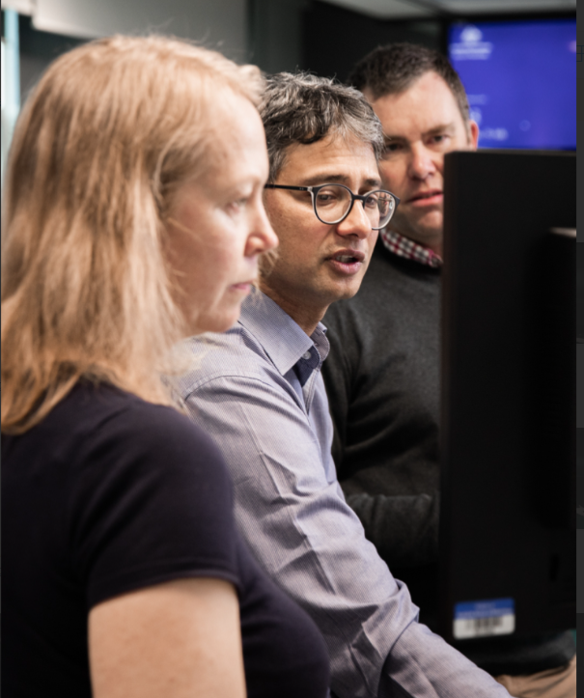
Enabling new capability and preserving knowledge through peer-to-peer learning
Gina Lawrie
Australian Bureau of Meteorology
Acknowledgement
Special thanks to Harrison Burns-Fabb for sharing his experiences and insights with me

Slide 2
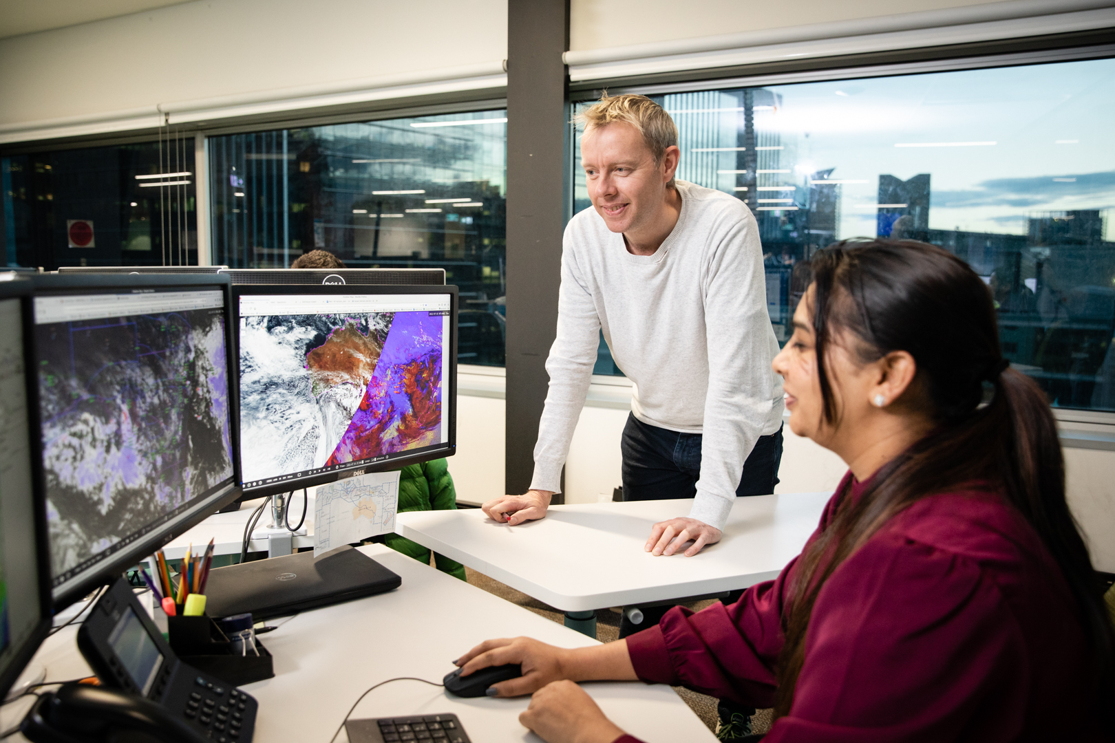
What is peer-to-peer learning?
Workers teach each other.
Learning occurs through both structured and unstructured approaches.
Shadow shifts are an example of structured learning.
Spontaneous interactions can lead to unstructured learning.
Remote or hybrid workforces may have less spontaneous interactions.

Slide 3
How do adults learn?
Andragogy is based on 5 assumptions
Self-concept
Experience
Readiness
Orientation
Motivation
Andragogy supports learners to construct their understanding through collaboration with peers

Slide 4
Why is peer-to-peer learning effective in the workplace?
Principles of adult education
Teamwork
Communication
Leadership
Comfort with peers
Relevance
Subject matter experts

Slide 5
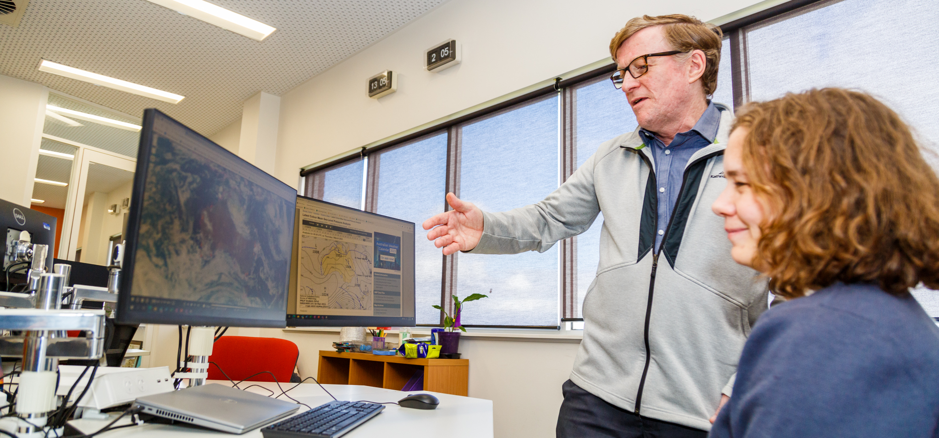
What are the benefits of peer-to-peer learning?
Institutional knowledge is preserved.
Mets are valued, supporting engagement in their role.
Confidence is built.
Cost effective, with resources developed.

Slide 6
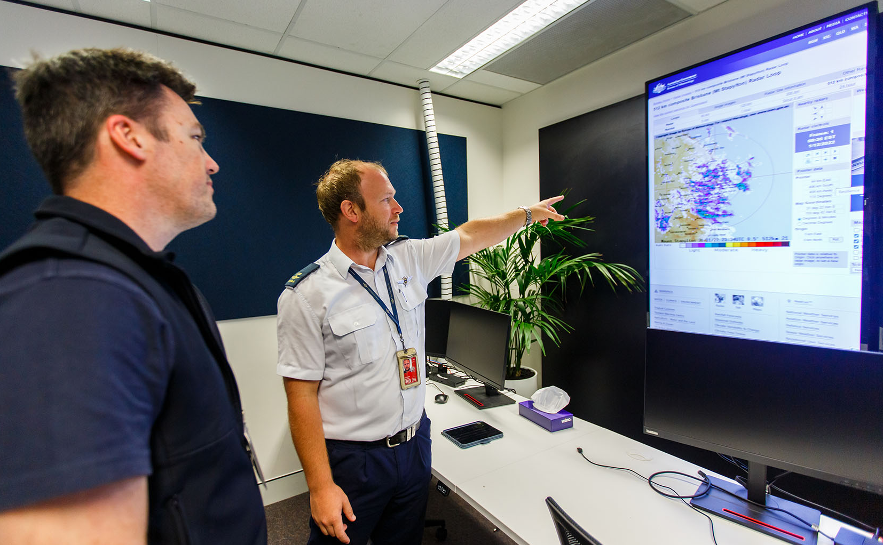

Peer learning sessions – what are they and how did the BoM Aviation Centre implement them?
Mets were invited to share their knowledge.
People from other parts of the organisation and outside of the organisation were invited to present.
A range of topics were presented.
76 sessions have been presented over the last 5 years.

Slide 7

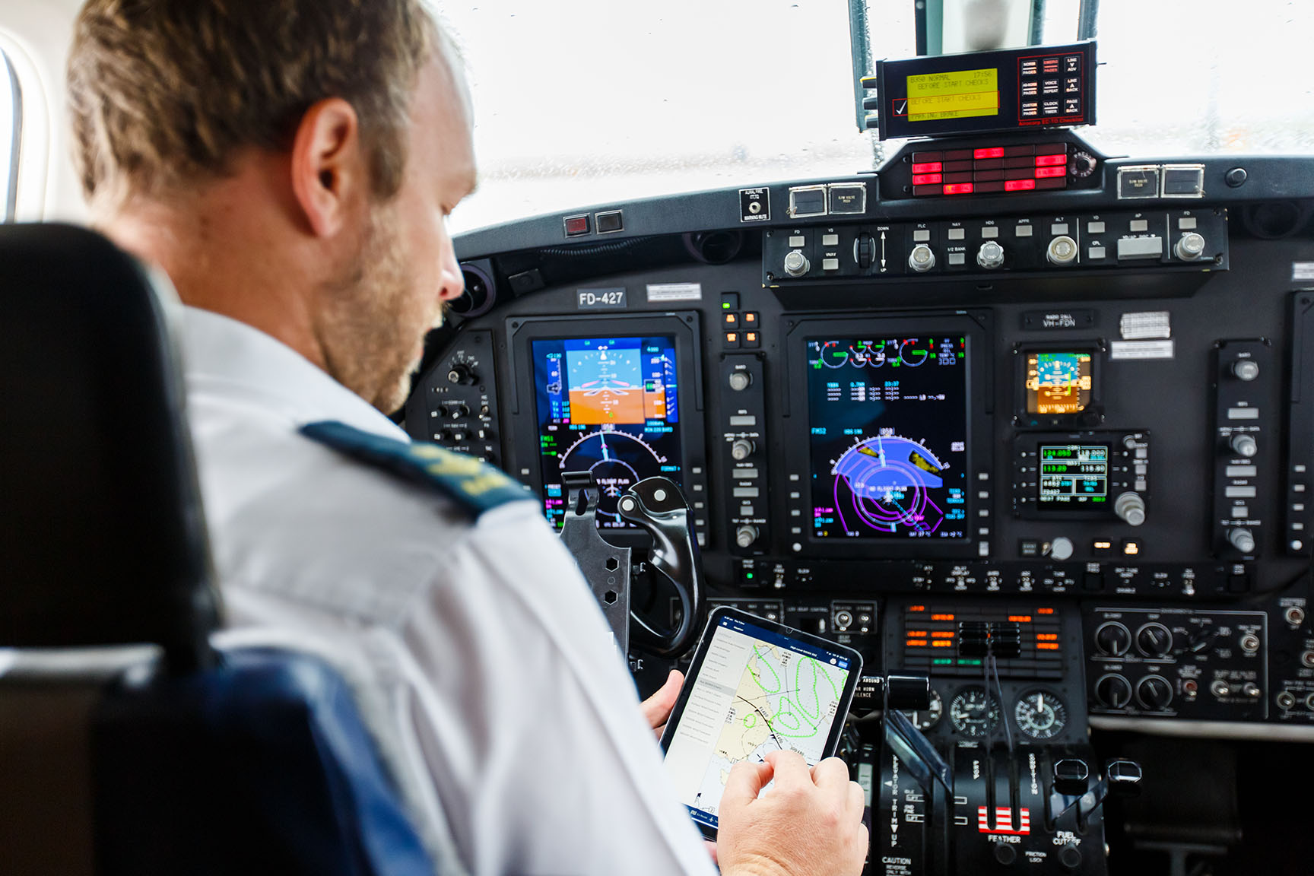

What worked well, challenges and key lessons leaned
Sessions prompted valuable discussions.
Sessions were scheduled at quiet times of a shift, ideally during business hours.
Weather sometimes disrupted scheduled sessions!
There was a broad range of topics, which varied in relevance.
Presenting offered benefits to the group, while supporting individual career development.
Time limitations present a challenge for presenters.

Slide 8
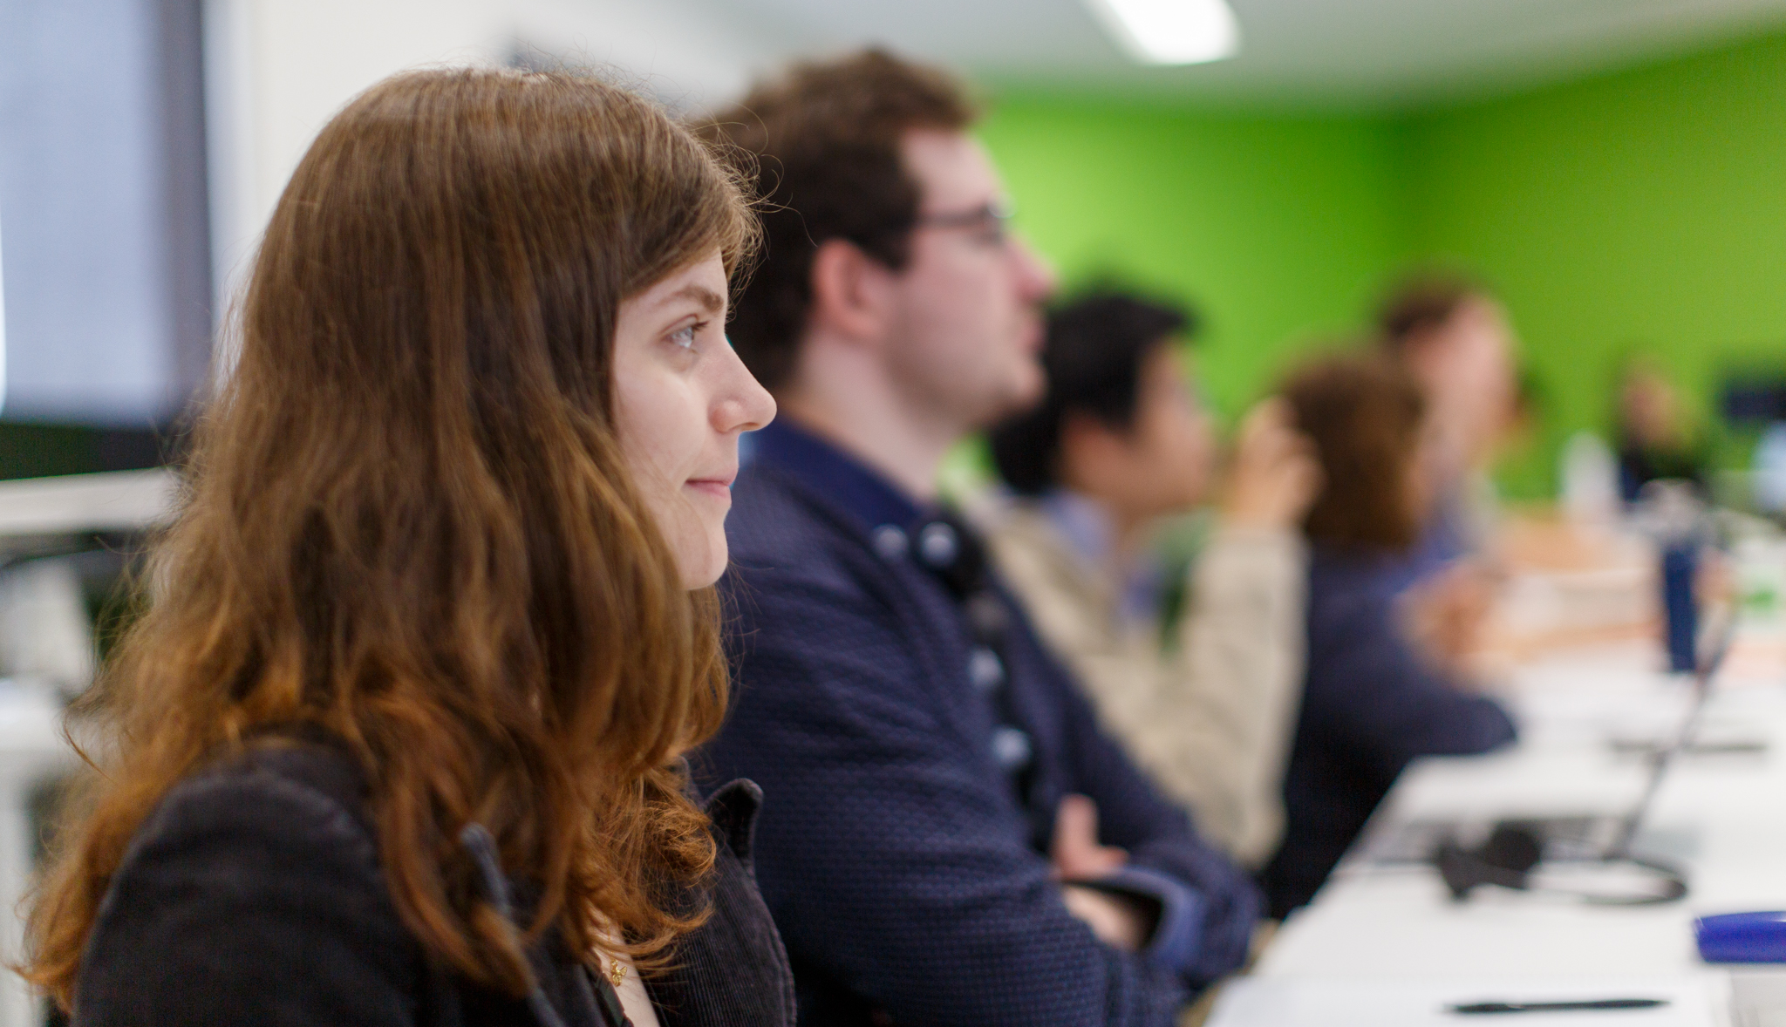
Conclusion
Peer learning sessions are simple to implement.
Knowledge is preserved.
A culture of teamwork, collaboration and continuous improvement is promoted.

Slide 9
Thank you
Gina Lawrie
Gina.Lawrie@bom.gov.au

