Slide 1

Blooming BIP-Ms: Transformation of graduate training at the Bureau of Meteorology
Dr Mick Pope

Slide 2
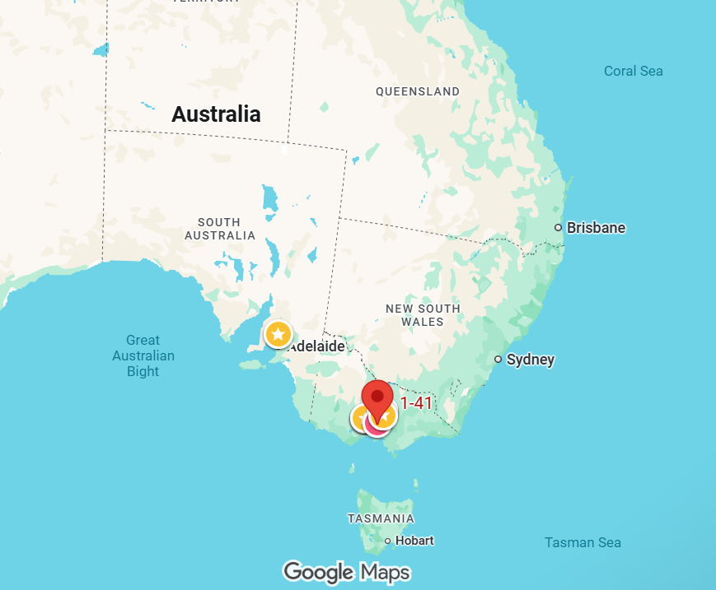
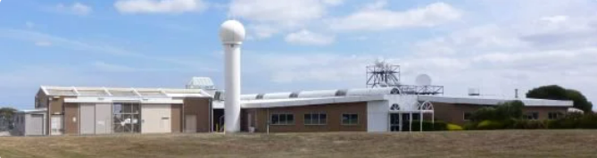
BMTC

Slide 3

Changing needs
Steady need → increased demand
Fixed pre-reqs → flexible entry
Imbalance → diversity
"Sage on the stage approach" → contemporary andragogy
One size fits all → options
Single ops role → diverse new roles
Single entry → multiple intakes
Controllable plagiarism → AI
Focus on in house → collab & share

Slide 4
What does a BIP-M do?
Builds conceptual models of the atmosphere based on physical & mathematical reasoning
Applies those models to meteorological data (obs & NWP)
"Apply, develop, and communicate that science professionally for the benefit of society."

Slide 5
What does transformation look like?
De-siloing
From single SME to collaborative delivery
Flipping classroom releases the expertise
Getting ride of single points of failure
Rethinking order
Better logical progression & new subjects
Reduced overlap & repetition
Enable synthesis & reinforcement

Slide 6
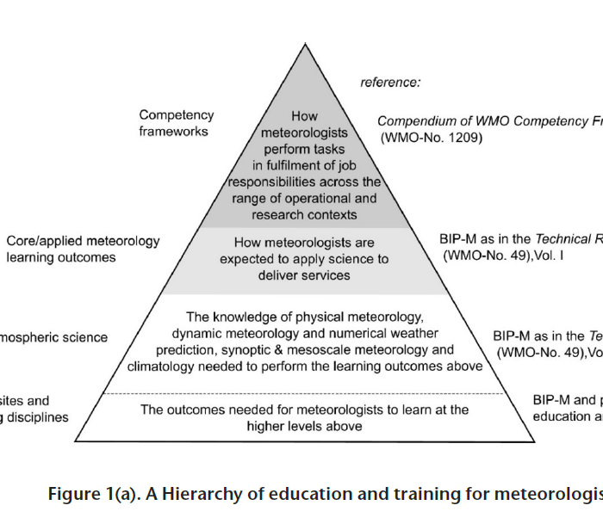
BIP-M in context
1083 LOs in context of job roles
Researchers vs operational mets – a false dichotomy?
"It's too theoretical"
Justifying every learning element – from classroom to operations
Beyond theory vs practical to preparing to be professional

Slide 7
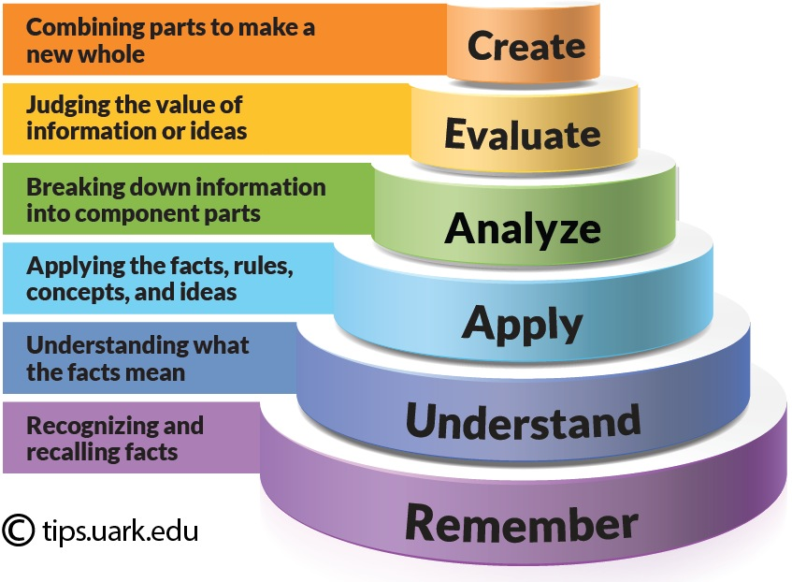
Bloom's taxonomy

Slide 8
Remember
Essential to everything
Easy to access using AI, Google, etc – need meta skills
SOPs, ICAO – instant recall is useful
Standard knowledge checks

Slide 9
Understand
Beyond facts to what they mean
The role of derivations? AI can do these also
Visualisation & manipulation of data

Slide 10
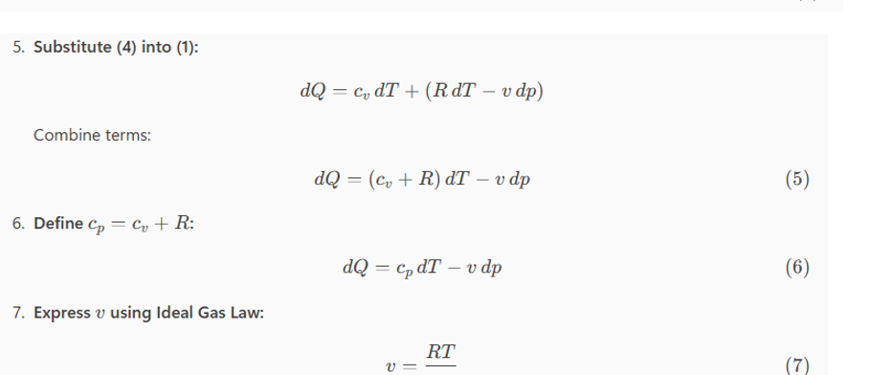
Co-pilot does thermodynamics

Slide 11
Apply
The risk of the new "but we haven't seen that before"
Pattern recognition
Drill & practice
Canned cases
Realtime data

Slide 12
Analyse
Paper charts & chart discussions
Onscreen tools – targeted LOs
Canned data & risk of nothing
Authenticity & role of ops

Slide 13
Evaluate
Critique the ideas of others
Defend your decisions
Understanding uncertainty
Timeliness

Slide 14
Create
Operational expertise
Real life products
Co-design
Sprint development
Real time data
Portfolios
Simulation

Slide 15
Bloom's taxonomy applied
Create TAFs, GAFs SIGMETs
Evaluate diverse NWP output &
current forecasts
Analyse wind regime wrt topography & aerological diagram for mountain wave & rotor set up
Apply wave theory to flow over topography & visualise solutions
Explain physics of internal gravity waves, wave breaking, rotors, etc
Recall wave fundamentals
Produce products using operational tools
Construct a written policy describing your meteorological thinking
Pattern recognition drill & practice, real time monitoring
Use visualisation tools
Short answer, oral exams
Multiple choice, short answer, drag and drop

Slide 16
Some (radical?) suggestions
The end of the assignment – out of hours work, inauthentic
Real world projects, value of groups
Ongoing in-class assessments – synthesis, capture non-technical skills
Authenticity & communities of practice
From sage on stage to guide on side – the irreplicable "expert"

Slide 17
A call
Commonality
Time
Money
Widgets

Slide 18

Thank you
mick.pope@bom.gov.au

