Slide 1
WMO Projects contribution to
Capacity Development Panel
Project Development and Management Unit & Technical Coordination Unit
September 2025
Julia Chasco,
Programme Officer

Slide 2

SUPPORT TO MEMBERS I General Overview
Direct implementation of projects funded through extrabudgetary contributions at national or regional level (CREWS, Adaptation Fund, others)
WMO supports Members through
Provision of technical advisory & support to Members who are currently implementing projects (Burkina Faso)
Provision of technical expertise & support to development partners such as GCF, UNDP, UNEP, BW. (WB Central Asia HydroMet Project, Climate Science Information for Climate Action, UNEP)
All projects aim to strengthen the NMHS value cycle either and target different services and sectors

Slide 3


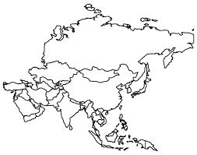
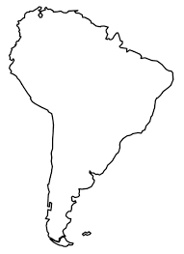
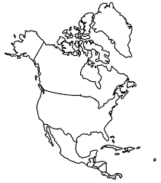


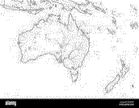


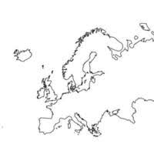
  SEPTEMBER 2025| Project Portfolio Overview
Amount & Volume
Regional Distribution (CHF M)
Funding Partners (%)
56
Active Projects & TAS
CHF 116. M
Major Hazards
Storms
Drought
Heavy Rains
Flooding

Slide 4


Examples of Project contributions to LTG 4: close the capacity gap
SO: 4.3. SCALE-UP EFFECTIVE PARTNERSHIPS FOR INVESTMENT IN SUSTAINABLE AND COST-EFFICIENT INFRASTRUCTURE AND SERVICE DELIVERY
SO: 4.1. ENABLE DEVELOPING COUNTRIES TO PROVIDE AND UTILIZE ESSENTIAL SERVICES.
SO: 4.2. DEVELOP AND SUSTAIN CORE COMPETENCIES AND EXPERTISE
Regional:
Pacific EWEA Legislative Guide
Model meteorological legislation and policy developed for the Caribbean
National:
Between 2022 and 2025, 19 NSPs were supported globally through extrabudgetary resources
17 NSPs under development or planned
Trainings across the value chain are supported on national and regional level in collaboration with WMO regional centres
National (Djibouti)
Planned competency Assessment and, training on observation and forecasting, numerical weather prediction, and community-based flood management.
Partner coordination Mechanisms rolled out in Africa (APCM) and the Pacific (PPCM). Will expand to further regions.
MHEWS Private Sector Engagement Roadmap supported in the Caribbean (CREWS).
Technical Assistance Proposal developed to Indian Ocean Commission (IOC) following AFD Hydromet Steering Committee
NMHS - Institutional strengthening is a key aspect of WMO Projects
>30% of project deliverables are
trainings and competency development
PPE enhancement, SEB studies, Business Continuity models.
Notes:
(NSP, NFCS, Ew4All Roadmaps, NAP technical assistance, SEB Studies, among others)
WIS, WIGOS, IBF, CAP, Severe Weather Forecasting, Tropical Cyclone Prediction, Data Collection & Management, S2S prediction, Remote sensing Products, gender mainstreaming in HydroMet Services, sectoral trainings, etc.

Slide 5
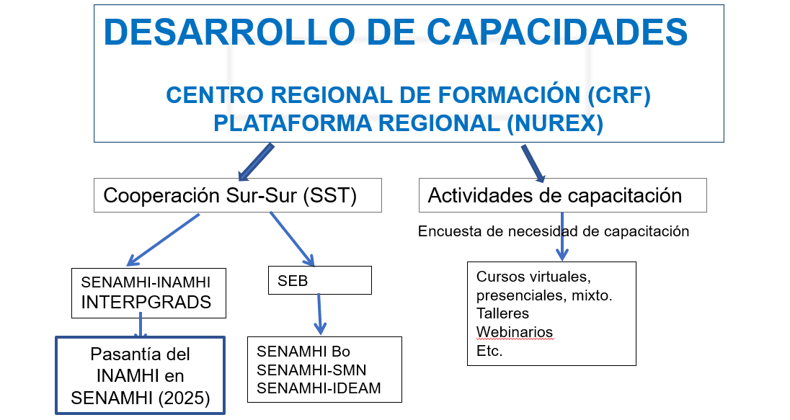
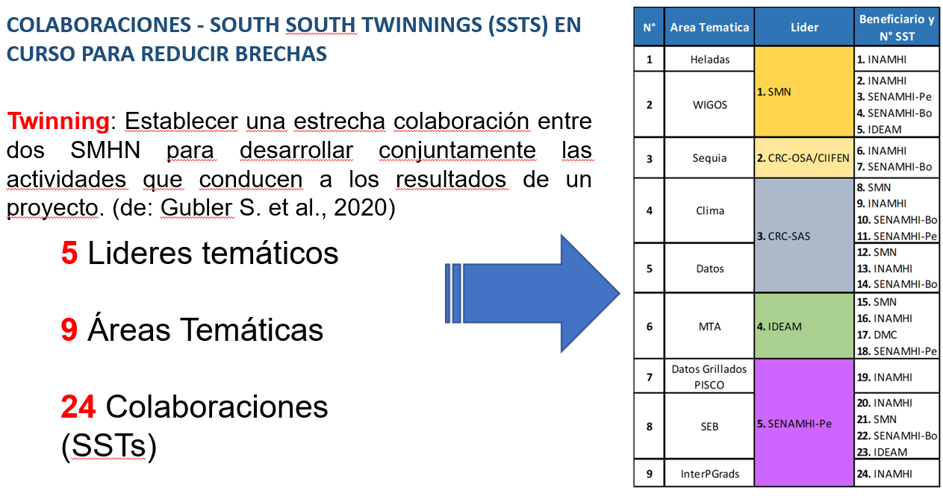
How do projects interact with regional training centers?
Recognized in 2011 by the WMO- Cg16 and after CLIMANDES was launched (2012) SENAMHI has accumulated considerable experience on the organization and implementation of short training courses and blended-mode efforts combining virtual and classroom environments
After EC recommendation, SENAMHI was incorporated as a new Member of the RTC Peru. CLIMANDES Project was vital in supporting RTC in pursuing accreditation.
The evolution of the WMO Regional Training Center in Peru was directly linked with the outcomes of CLIMANDES Project.
2012-2018
2021-2026
Building on successful capacity development and training experiences, the ENANDES Project gives a central role to the Regional Training Centres of the Andean Region
Regional Training Center of Argentina (SMN- ARG)
Regional Climate Center for the Western South America
Twinning arrangements
Regional Training Center of Peru (SMN- ARG)
Regional Climate Center for the South of South America
MeteoSwiss expertise
Beneficiary countries I Peru, Colombia, Chile, Ecuador, Argentina, Bolivia.
Donors I Adaptation Fund (AF), Swiss Agency for Development and Cooperation (SDC)

Slide 6
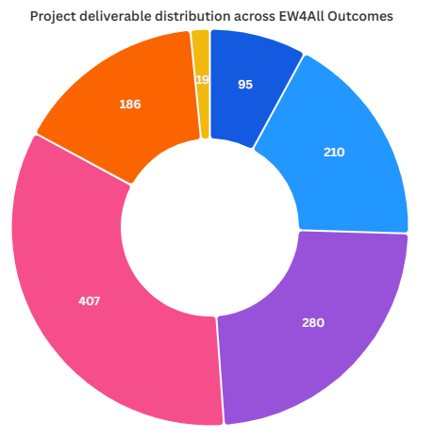
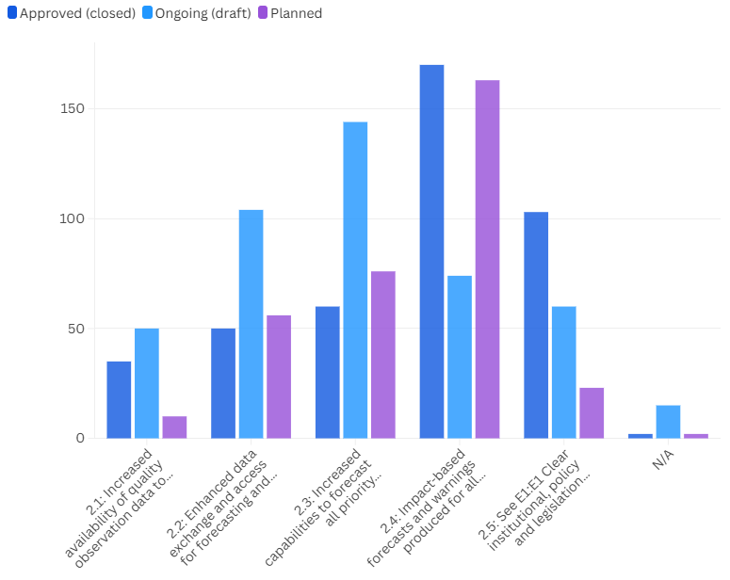
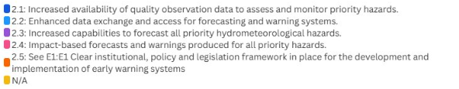
  FLAGSHIP INITIATIVES I EW4All Implementation
Nearly three-quarters of the project's deliverables focus on strengthening the capacity for forecasting and service delivery across different temporal and spatial scales and sectors. This includes improving Early Warning Services for priority hazards.

Slide 7
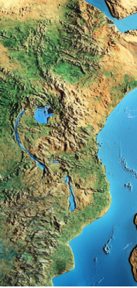

AI for Leapfrogging Service Delivery through Capacity-Building Twinning
Norway has a long-standing capacity development relation with Malawi through projects that aims to provide institutional support and capacity building for weather and climate services, improving the quality of forecasts to enhance the countries preparedness and prevention.
CREWS ASW comes to reinforce the collaboration by boosting innovative pilots.
Artificial Intelligence (AI) for Early Warnings for All (EW4All)—Malawi Pilot Project (USD 250,000) 2025 -2026
The Project aims to pilot the use of Artificial Intelligence (AI) to enhance weather prediction capabilities and strengthen early warning systems in Malawi through a powerful partnership between MET Norway and Department of Climate Change and Meteorological Services of Malawi.
Integrating the AI-WP system into DCCMS’s forecasting workflow;
Providing targeted training and technical support to DCCMS staff;
Evaluating improvements in forecast accuracy, lead time, and usability;
Gathering feedback on operational integration through forecaster interviews, focus groups, and participatory workshops;
Producing actionable insights and a roadmap for potential scale-up in other regions.
ACCESS HERE TO READ MORE!
There is growing interest in leveraging AI technology to help countries without sophisticated super-computers to “leapfrog” to the latest most advanced prediction systems, not only through technology transfer but also through CAPACITY transfer.
Notes:
Deploy and test an AI-based Weather Prediction (AI-WP) system, building on the Bris model developed by the Norwegian Meteorological Institute (MET Norway) and the “forecast-in-a-box” concept being advanced under WMO’s Integrated Processing and Prediction System (WIPPS).
Evaluating improvements in forecast accuracy, lead time, and usability: Evaluate how an AI-WP system can contribute to closing critical capacity gaps in NMHSs, especially in LDCs and SIDs particularly those with limited infrastructure, constrained human resources, and outdated forecasting systems.
Malawi’s Department of Climate Change and Meteorological Services (DCCMS) will gain hands-on experience running AI-enabled forecasts locally, assessing their operational feasibility, forecast skill, and potential to support timely early warnings for high-impact weather events.
Gathering feedback on operational integration through forecaster interviews, focus groups, and participatory workshops;
Producing actionable insights and a roadmap for potential scale-up in other regions.

Slide 8
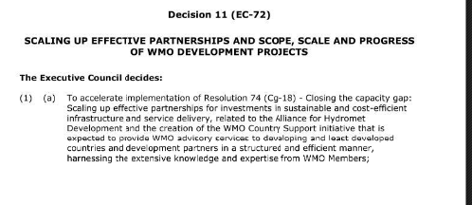
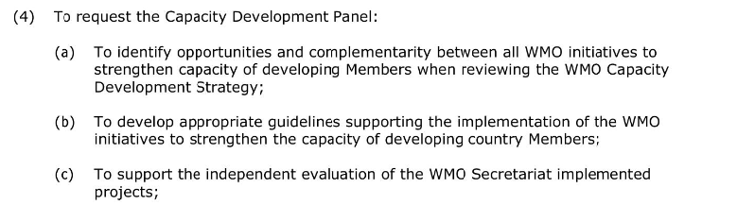
Project Management Improvement processes - ON GOING
The consultancy mandated by Decision 11 was reinstated in 2024 to complete the external evaluation of WMO's approach to projects. The final report is currently under review.
Furthermore, an internal evaluation was carried out by the project teams and the Project Management Board to gain a deeper understanding of opportunities, challenges, and areas for improvement.
2024
2025
Both evaluations served the Secretariat to build a project management improvement plan that aims the optimization of resource utilization and professionalizing processes, prioritizing the needs of Members and the technical expertise provided.
A full report and the PM strategy will be presented/shared at the Executive Council, highlighting the progress in strengthening WMO's project space, expanding partnerships, and reinforcing the Organization's commitment to becoming more Member-driven and responsive in delivering on strategic needs and priorities.
The engagement with the Technical Commissions (SERCOM, INFCOM) has increased. Overview of the Portfolio is provided every 6 months to SERCOM and INFCOM has established a temporary group of discussion on Infrastructure needs and expertise involvement in Projects.

Slide 9
  Project Pipeline beyond 2025 | Key Developments
Project | Contribution | Donor | Commitment planned | Approval Status | Income expected
2026
Enhancing Africa’s Climate Resilience: Strengthening Early Warning Systems for All through South-South Cooperation | CIDCA | CHF 3,2 M | Not submitted | 2026
Integrated Drought Management for the Riverine Countries of the Drin Basin | AF | CHF 11.4 M | Pre-Concept Approved | 2026
Adapting National and Regional Water Resources Management - Costa Rica & Panama | AF | CHF 11.4 M | Pre-Concept Approved | 2026
An Integrated System for Evaluating Hydrological Status and Outlooks - South America | AF | CHF 11.4 M | Pre-Concept Approved | 2026
Integrated Drought Management Central Asia | AF | CHF 11.4 M | 1st AF approval ongoing | 2026
To be prioritized by WMO & CREWS | Potentially Benin, Nepal & Bangladesh, ... | CREWS | TBD | Pipeline Briefs submitted | 2026
Tentative expected commitments | 2026 |  | Minimum 53.6 M CHF
Projects currently under development
With high probability of approval
2027
Integrated Drought Management for South Asia | AF | CHF 24.8 M | Submitted | 2027/2028
Too early to estimate tentative commitments | 2027
Negotiations for additional contributions, as well as new project development
ongoing with potential to generate additional income in 2026 and beyond

Slide 10
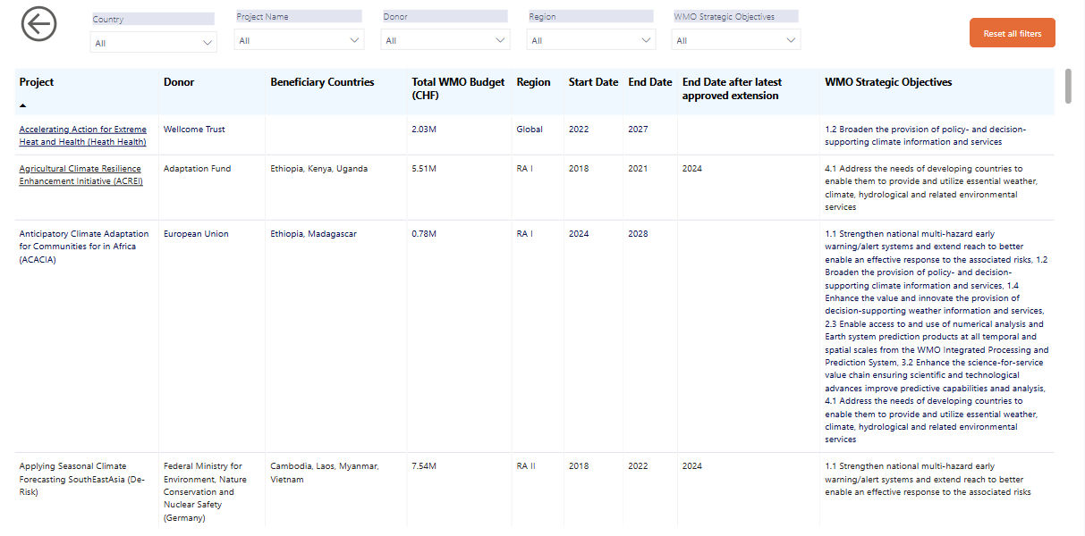
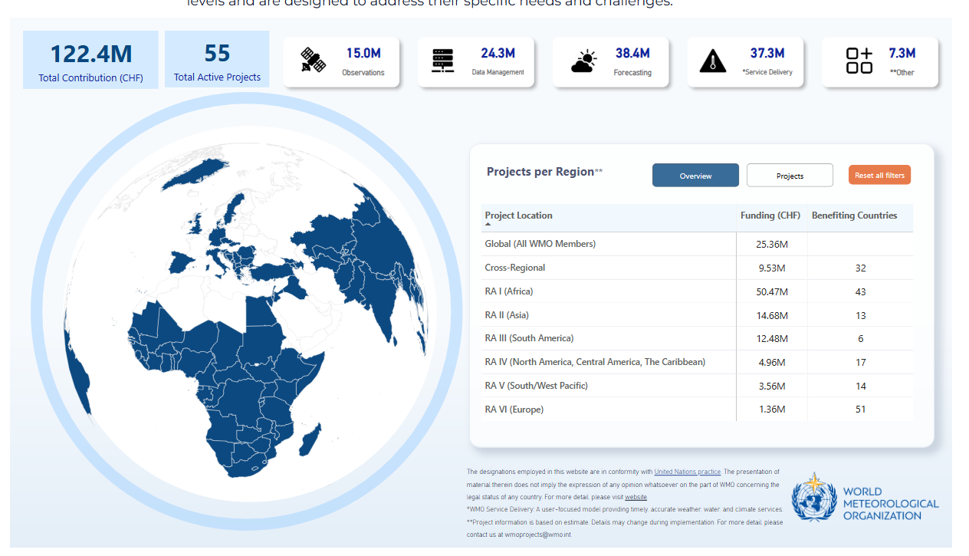
Projects information available on WMO site
Detailed information on WMO projects, deliverables, objectives, contribution to WMO priorities and beneficiary countries is now available!
Access WMO Project Website HERE

Slide 11
Thank you!
^{wmo.int}

