Slide 1

Online webinar on moving towards SOFF implementation
12 November 2024
Training requirements for maintenance staff
Andrew Harper, Chair ET-Transition to Modern Measurements

Slide 2
Outline
Context
ET-TMM workplan (past and present) as relates to GBON
Training outline example and experiences
Lessons learnt
Existing resources / guidance

Slide 3
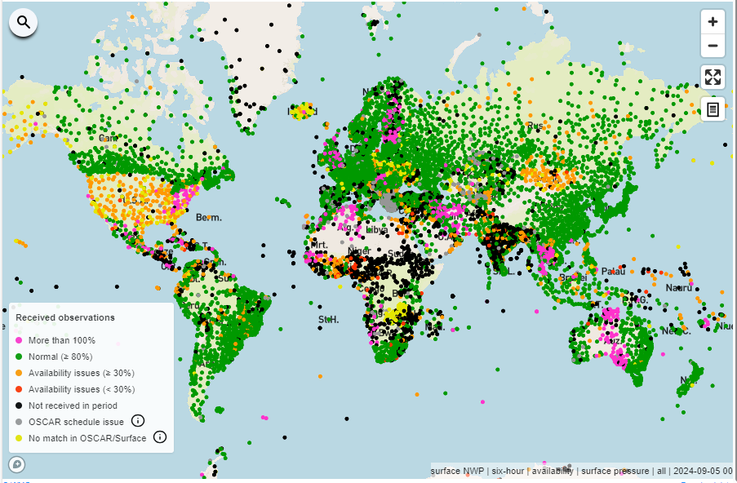
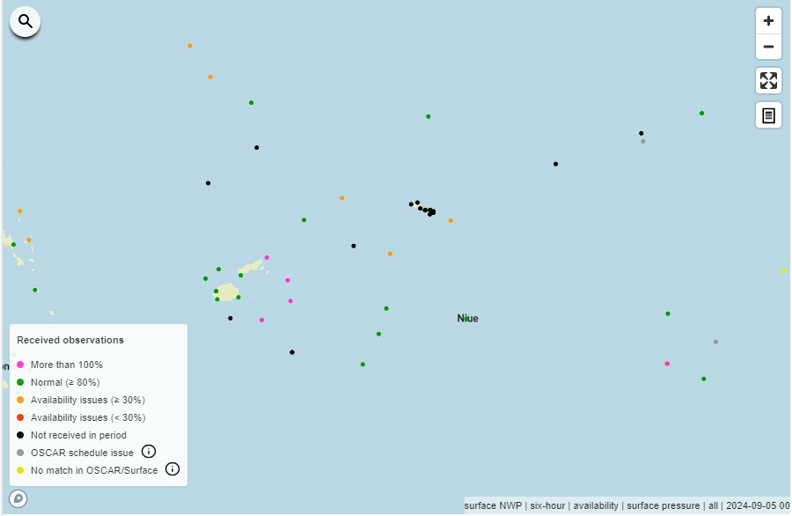
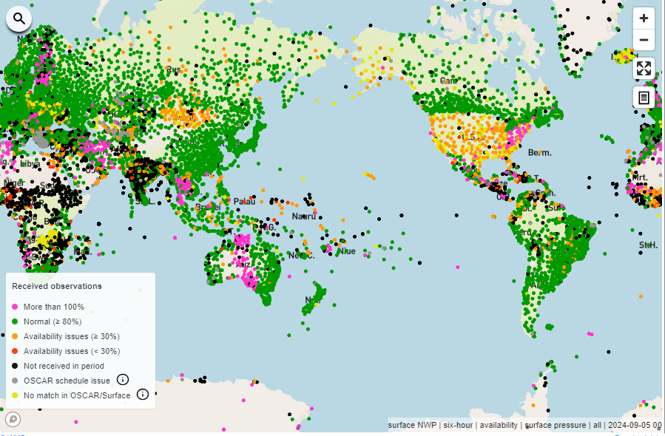
Notes:
Blue continent
Very small land masses.

Slide 4
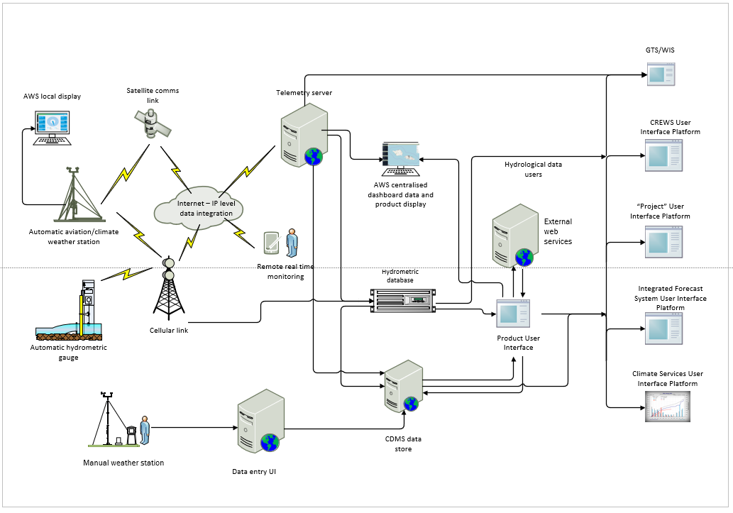
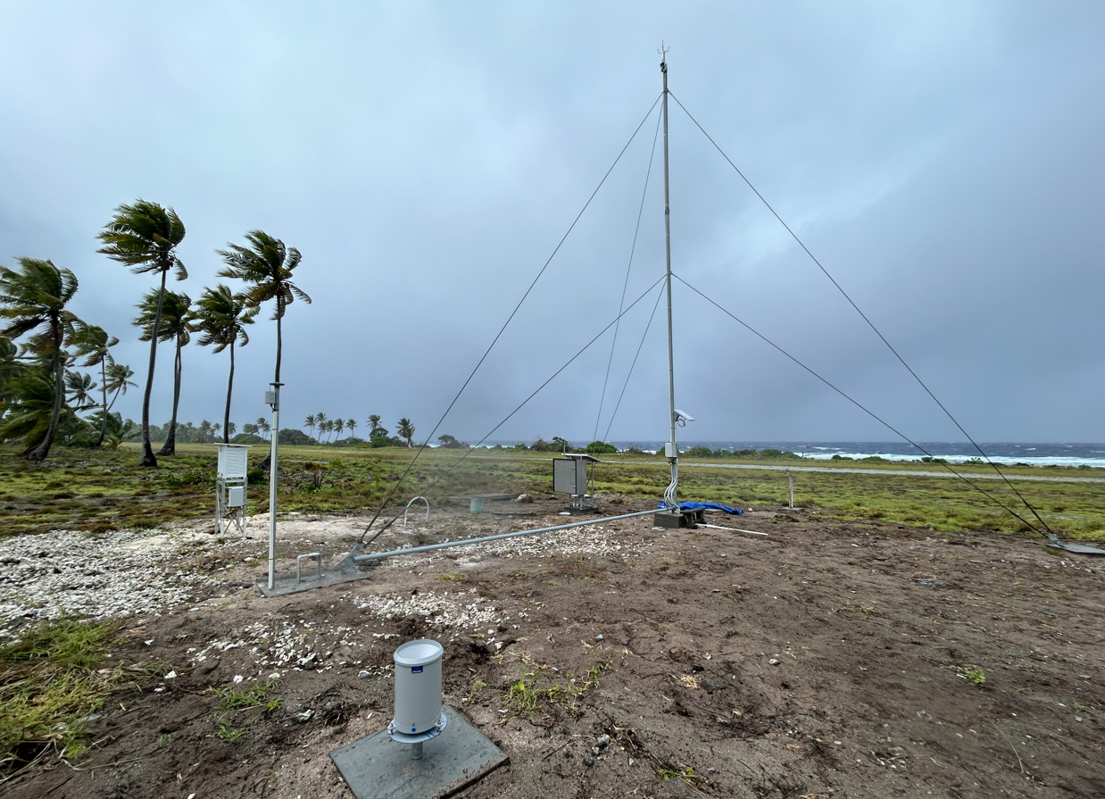
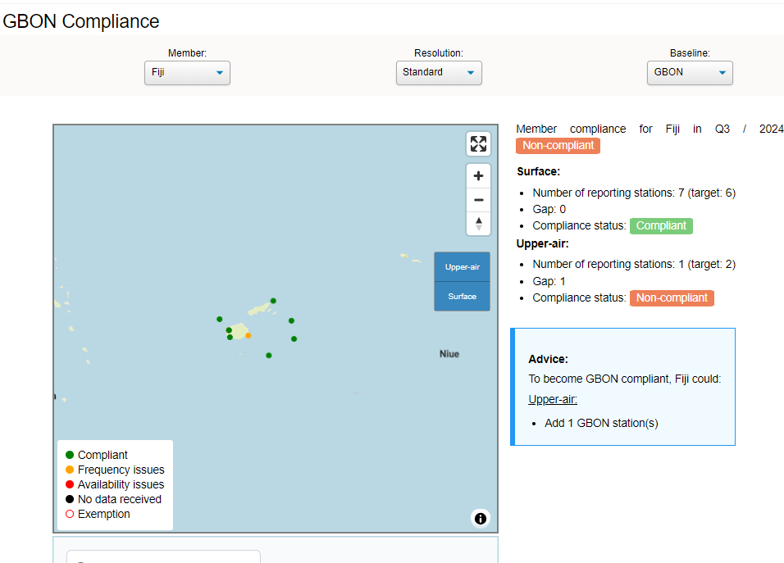
What do we mean by an AWS, and AWS maintenance?
Notes:
The bits in the ground?
Are the stations reporting to GBON?
Or all the bits in the middle and beyond?
My experience is the lot. In fact much of our effort is on the middle! Any many reasons for the Black dots are due to one or more of the many components in the middle!
Also OSCAR, no WIS nodes
Also need to be mindful of other WMO priorities and programmes such as the GFCS etc.
Today try to focus on the AWS itself.

Slide 5
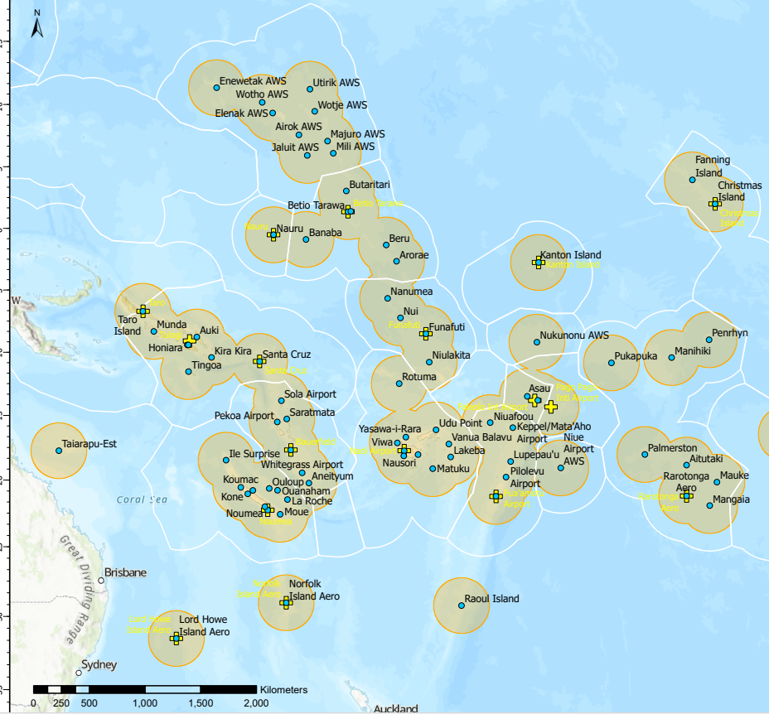
Challenges to operating and maintaining AWS (SIDS)
Significant constraints on resourcing and funding
Small islands, large geographic area
High cost of freight
High cost of travel
Moving between islands/atolls
Limited capacity (small populations, staff numbers, high turnover)
Communication/power systems are limited
Notes:
Many of you well aware of limited budgets and NMHS size disparity - <10 to >100!
Total land area of 26km2 over 9 island/atolls – by contrast - Lake Geneva – 580 km2!
This is spread over 500,000 Km2 - By contrast Italy has a land area of 301,000km2
15 islands/atolls 6 low lying atolls
Islands range from <1 sqkm to 67!
2,200,000 sqkm total area
1400km north to south
~150 EURO to send some suncards and field books. (Customs)
Small populations on islands so transport options are often limited (personnel/tools/equipment etc)
Recent visit – 20 people on island, 3 week trip one station!
Even sat comms is difficult. Solar/diesel generators limited.
With this in mind, the following is a mix of aspirational with a big dose of pragmatism.

Slide 6
Previous ET/TT work
Transition to Modern Measurements workshops for RA-1 (2021, 2023 include French and Arabic translation), RA-V (2021) Course: Transition to Automation Training Material (Ver 2.0) | ETRP Moodle Site
Guidance on Transition to Automated Measurements (Still to be published)
Mapped competency framework to training requirements

Slide 7
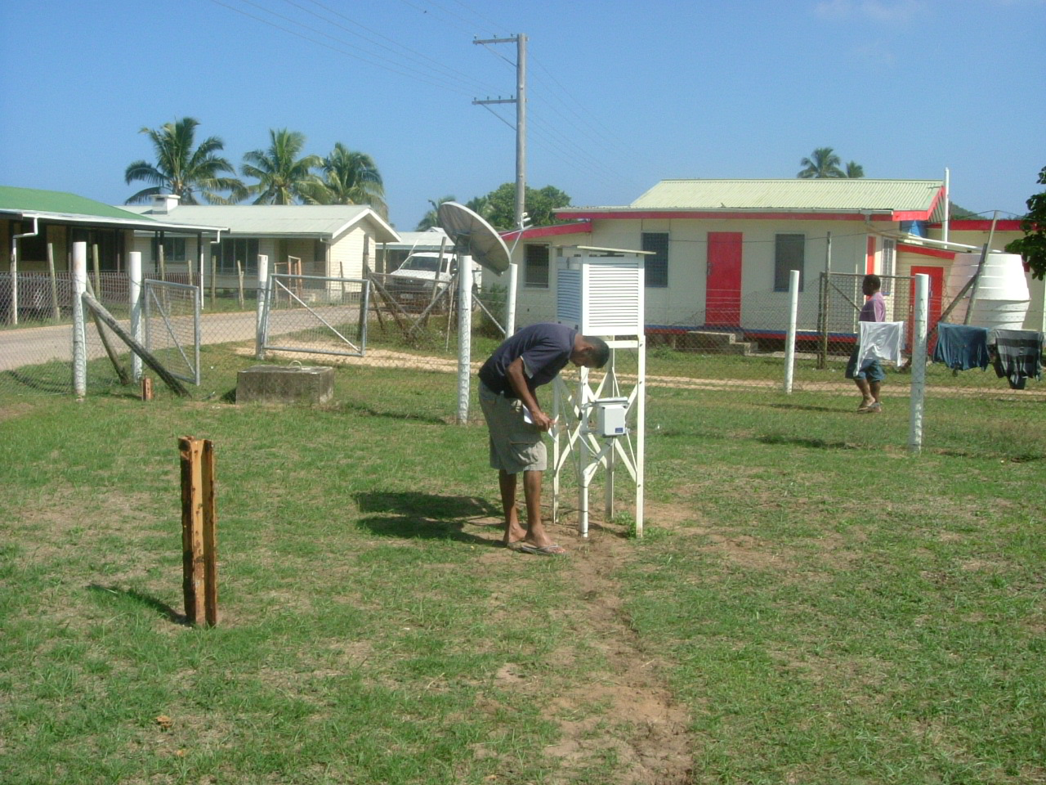
Objective: Introduction to instrument upgrades, changes and transitions – preparing for success
Full scope of tasks needed to ensure sustained success
Resources/training available to plan and carry out a successful transition to automation

Slide 8
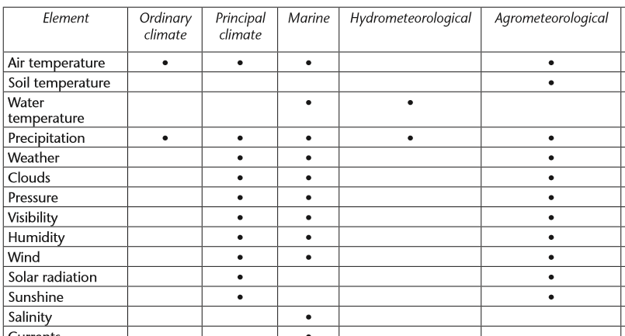
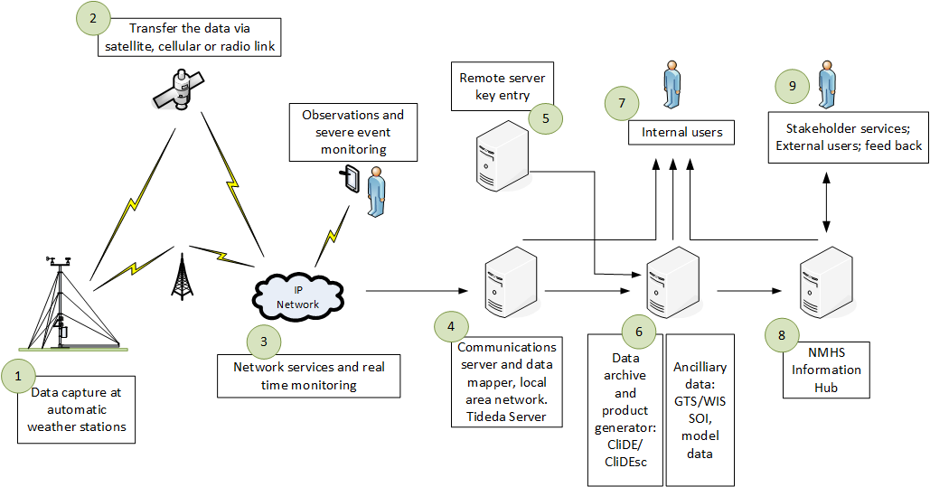
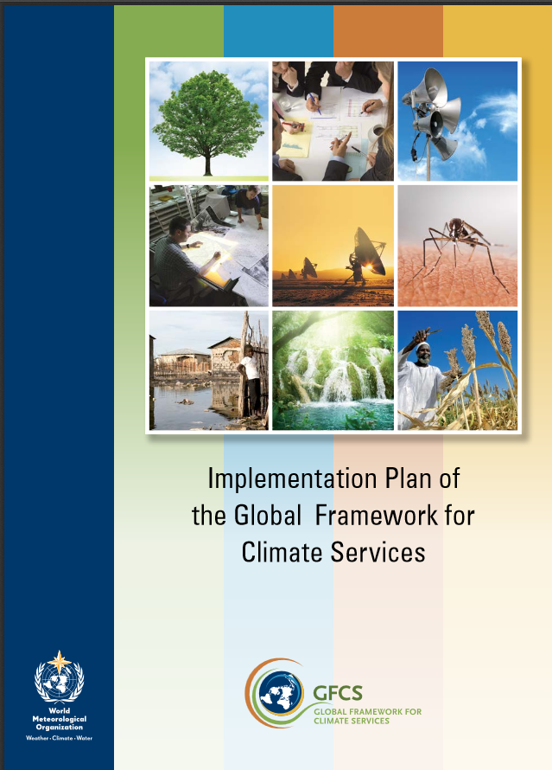

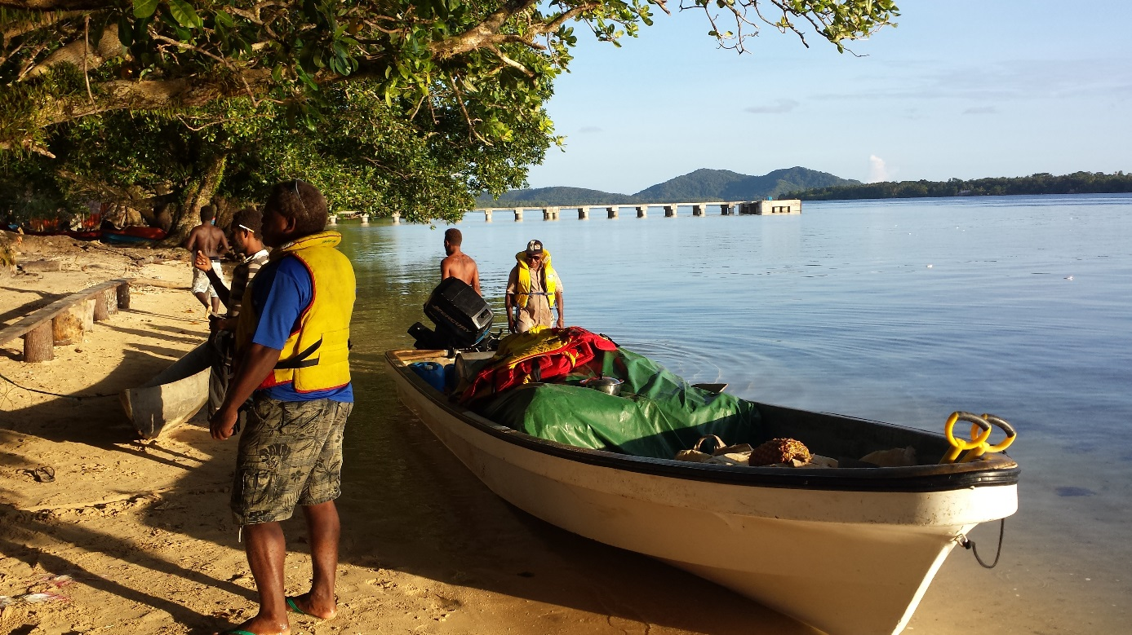
Workshop format
5 days – 2 hours each
Transition strategy
Network planning
Project planning and management
Generic AWS tender specifications
People change and change management
Risks
Options exercise/wrap-up
Notes:
Where to find help was a key message.

Slide 9

Starting the discussion
All our national observing capabilities are different
Therefore, all our automations are different
They are not easy (many fail) but it can be done ☺
Integrated or multiple application areas – WIGOS Plan, GBON
Tiered networks
There is not a single and simple ‘How to’
Success comes from a strategy that
  Trains and ‘empowers’ Teams
  Sets up well considered projects
WMO has guidance on how to do that
Notes:
No surprises here, but sometimes you need to hear it said out loud!

Slide 10
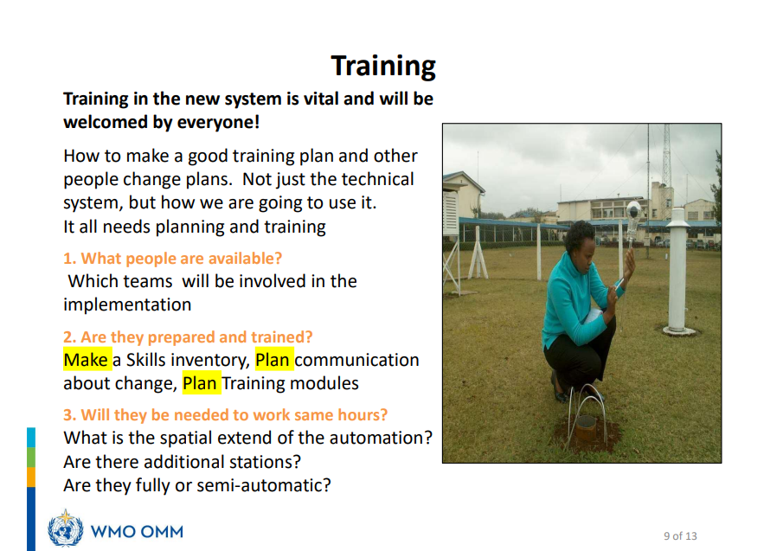
People change
Notes:
One of the key things that we have to deal with as Peer Advisors is people change.
I don’t think this is a huge surprise, but training is often neglected or just an add on….
Some NMHS are very small, and staff take on multiple roles with competing priorities.
If you don’t look at any other of the modules, please look at this one.

Slide 11
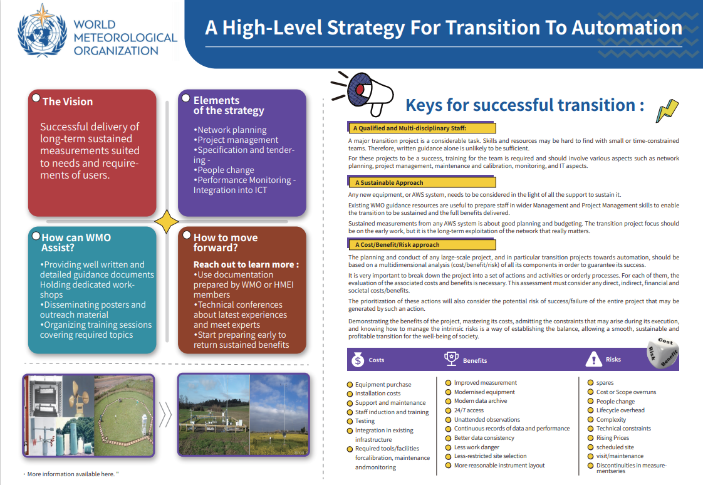
TECO-2024 Presentations | World Meteorological Organization
Notes:
Landscape version of the poster we shared at the past two TECOs. Our attempt to summarise some of the key points.
Difficulty is getting this in front of the right people.

Slide 12
Some shared experiences …
Reluctance to expand networks due to operational budget constraints.
    CAPEX is relatively easy to get
    Operating, maintenance and calibration costs always way under-estimated
    Importance (and cost) of training under-estimated
Competing with push towards low-cost options – need to maintain measurement standards
Managing expectations – things do go wrong!
Notes:
No surprises here but stating out loud again some obvious points.

Slide 13
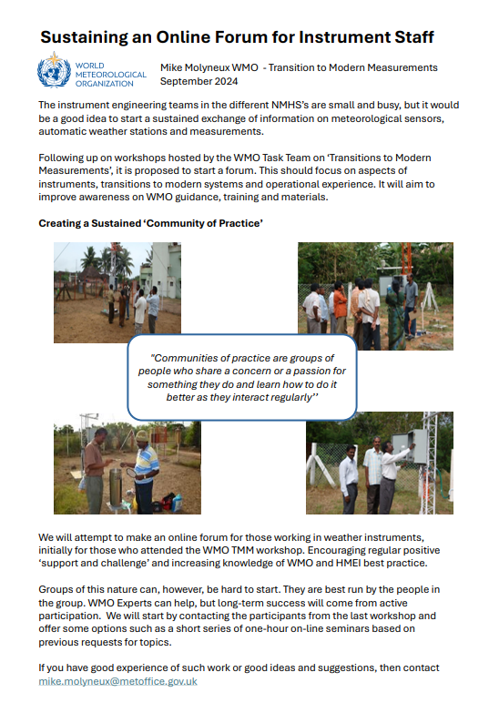
Workplan of ET-TMM
Development of training curriculum on AWS maintenance
Review/update Competency Frameworks for Observations, Instrumentation, Calibration and Networks
Operations and maintenance plans
Training material on implementation of siting classification
Experience sharing on transition to automation (Community of Practice)
Other capacity dev activities
Notes:
So to our workplan. (I would really appreciate any feedback on this workplan and suggestions for improvement)
Very ambitious and very much tailored to GBON, but still trying to consider other application areas and domains. A lot of the groundwork completed.
1. Looking to develop a multi-level curriculum from basic maintenance training for observers to advanced instrument technician training.
2. Mostly OK in a GBON context.
3. Draft O&M Plan was developed by TT-GBON. Currently these are designed as templates. My experience is many NMHS will need an example of a completed template otherwise this won’t get done. We plan to include this as an Annex. There are also potential regional benefits of a common O & M e.g., RA-V. But easier said than done with lots of national variations.
4. Contingent on TT-Classifications, but there is a need for this including in the BIP-MT. Siting requirements is also something often neglected in tender specifications.
5. Main activity is the CoP. This came out strong during the earlier workshops and again during TECO 2024 there was a lot of good feedback/comments on the poster we presented. (also from the TECO proceedings link.)

Slide 14
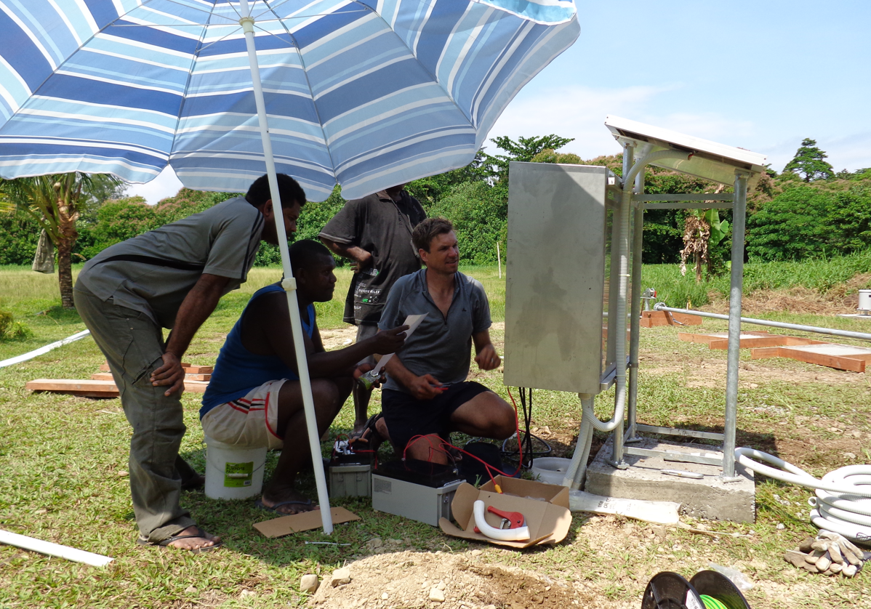
Pre-shipment - workshop assembly/test
Installation
Post installation training
Ongoing peer to peer support
Notes:
Where has some of this come from?
Many early projects only included training during installation of one station! AWS are complex systems and often this was the first experience local staff had. Time was often very limited in country and most NMHS had no specialist workshop space.
Projects then started to bring in some “pre-shipment” factory testing. Usually for only two weeks but still helpful especially in how things go together and troubleshooting as there are usually issues.
More recently, and somewhat of a game changer has been adding a third training and this is the Post installation training. This has been from 1 to 4 years after installation but has been really valuable, especially as the trainees work on “used” instruments that require some work.
I’ve highlighted this last component as it is not included but is vital in ensuring the ongoing operational of stations – this is mostly around data loggers, communications and integration.

Slide 15
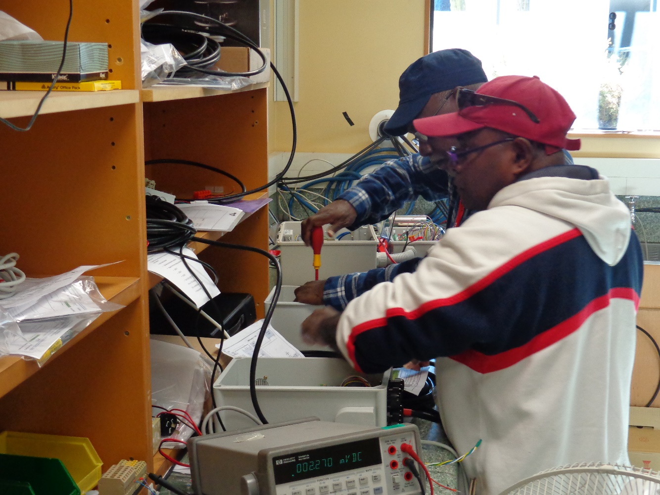
Post installation training
Programme overview
Baseline knowledge sharing/ assessment
Development of activity for review at completion
Workshop / calibration
Sensor / instrument basics
Software introduction
Telemetry introduction
Sensor / instrument to data logger coupling
Notes:
16 topics over 2 weeks
Very similar to the pre-shipment but “a progression”
Usually someone we’ve seen before, occasionally a new person with no previous experience. Also need to consider “train the trainer” – how are they going to transfer the knowledge back home.
Adaptable to the attendee.
#2 and #3 really important. Activities based on competency frameworks.

Slide 16
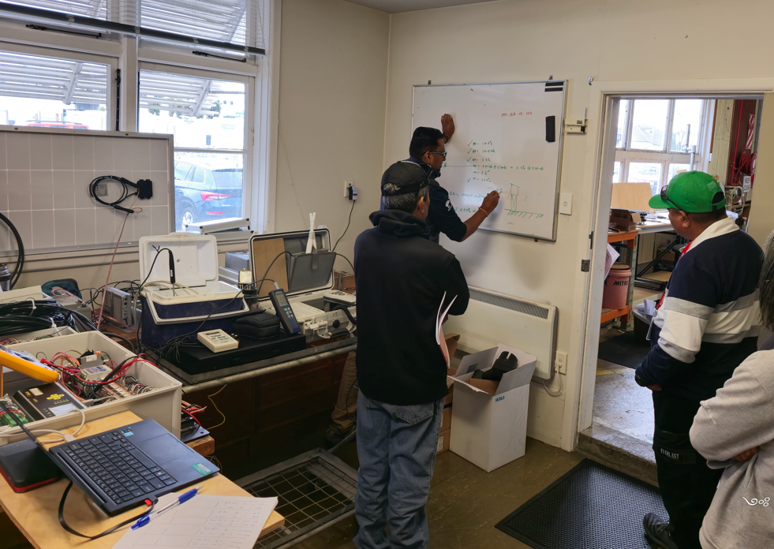
Post installation training
Build from scratch
Data logger and communications configuration
Site visit – prep, inspection, maintenance
Finding north
Metadata – post inspection documentation, CliDE
Post inspection instrument servicing
Visualization
Presentations and discussion
Notes:
#16 usually a highlight.

Slide 17
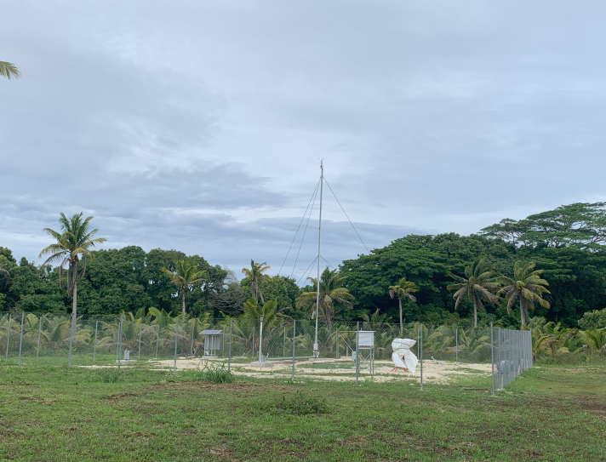
Instrument technician - 6 example tasks
Prepare an installation plan
Assemble and test an AWS
Complete commissioning document for assembled test AWS
Complete daily station checks (telemetry and status of sensors)
Compile a list of spares and consumables required for maintaining an AWS
Create a hazard register
Notes:
A topic from each of the Inst Tech comp framework.
An aim of this programme is to encourage participants to think about the different components of the national network as a whole, rather than, for example, just a climate or aviation station in isolation, and to consider the ongoing operational budget and whole life cycle of an AWS within their network.

Slide 18
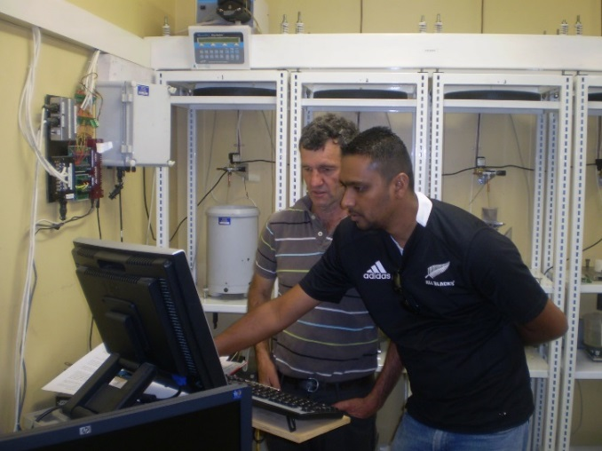
Network management - 6 example tasks
Sketch a tiered network concept for NMHS
Prepare an annual operational budget for AWS network
Prepare site maintenance schedule and contract for remote stations
Collate metadata of all AWS for input into OSCAR
Review existing AWS site inspection form for relevance
Make recommendations for workshop/calibration facilities
Notes:
“Demonstration of knowledge transferred via the development of a draft management plan associated with instrument operations, maintenance and budget”, which can be refined/incorporated into annual workplans upon return home.
An aim of this programme is to encourage participants to think about the different components of the national network as a whole, rather than, for example, just a climate or aviation station in isolation, and to consider the ongoing operational budget and whole life cycle of an AWS within their network.

Slide 19

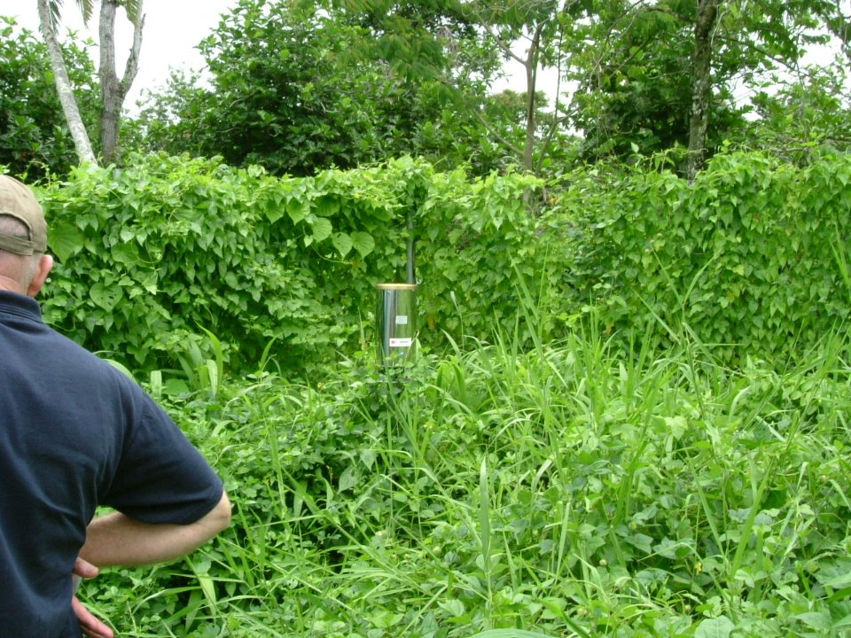
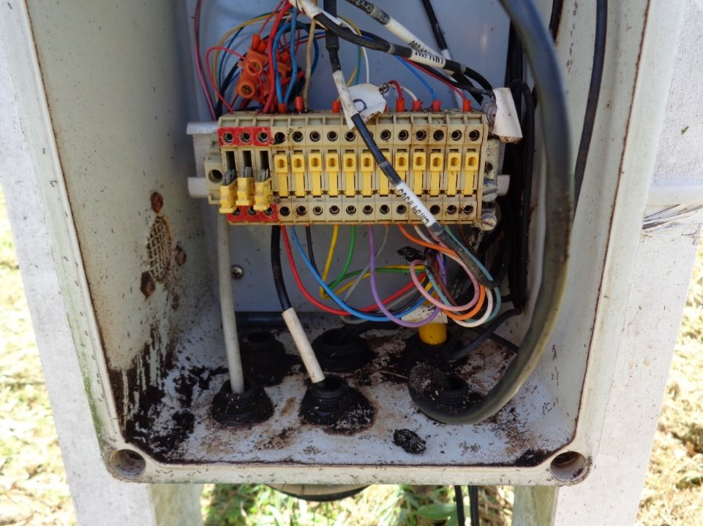
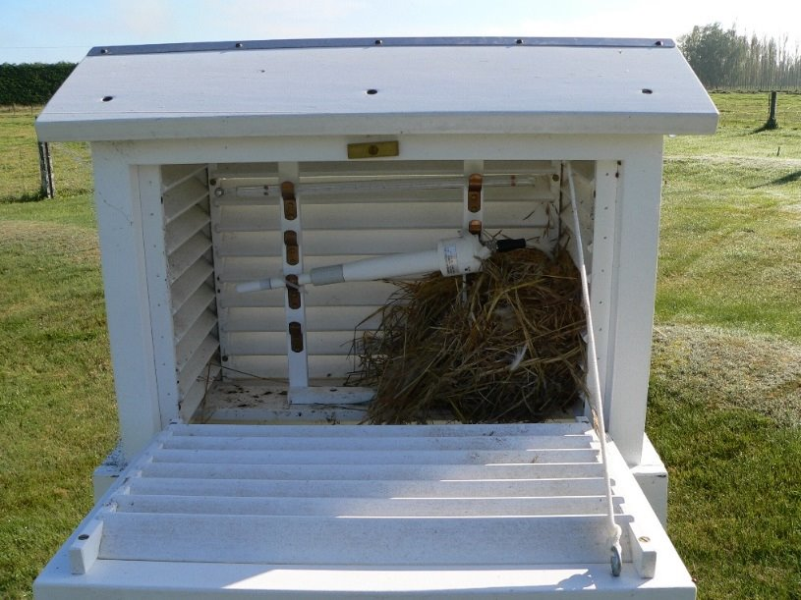
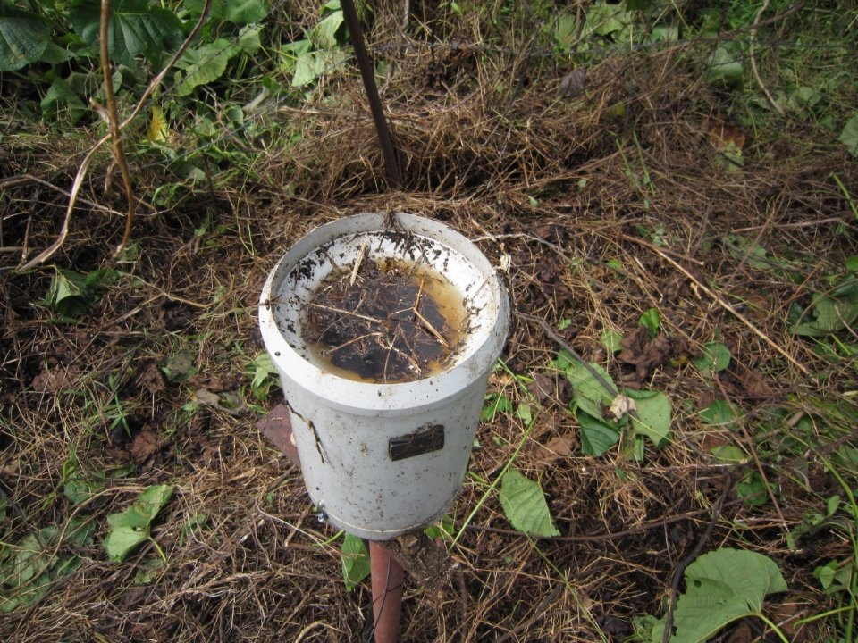
Some lessons learnt
Cleaning!
Two weeks is not long enough!
Repeat training required - progression
Targeted training - not one size fits all
Small groups allow for better interaction
Lots of excellent material exists (WMO, HMEI, World Bank) – awareness is the challenge
Notes:
Keeping things clean – 50% of the challenge
Targeted / adaptable training – train the trainer, PRAGMATIC
Lots of existing material – manuals are fat for a reason.

Slide 20
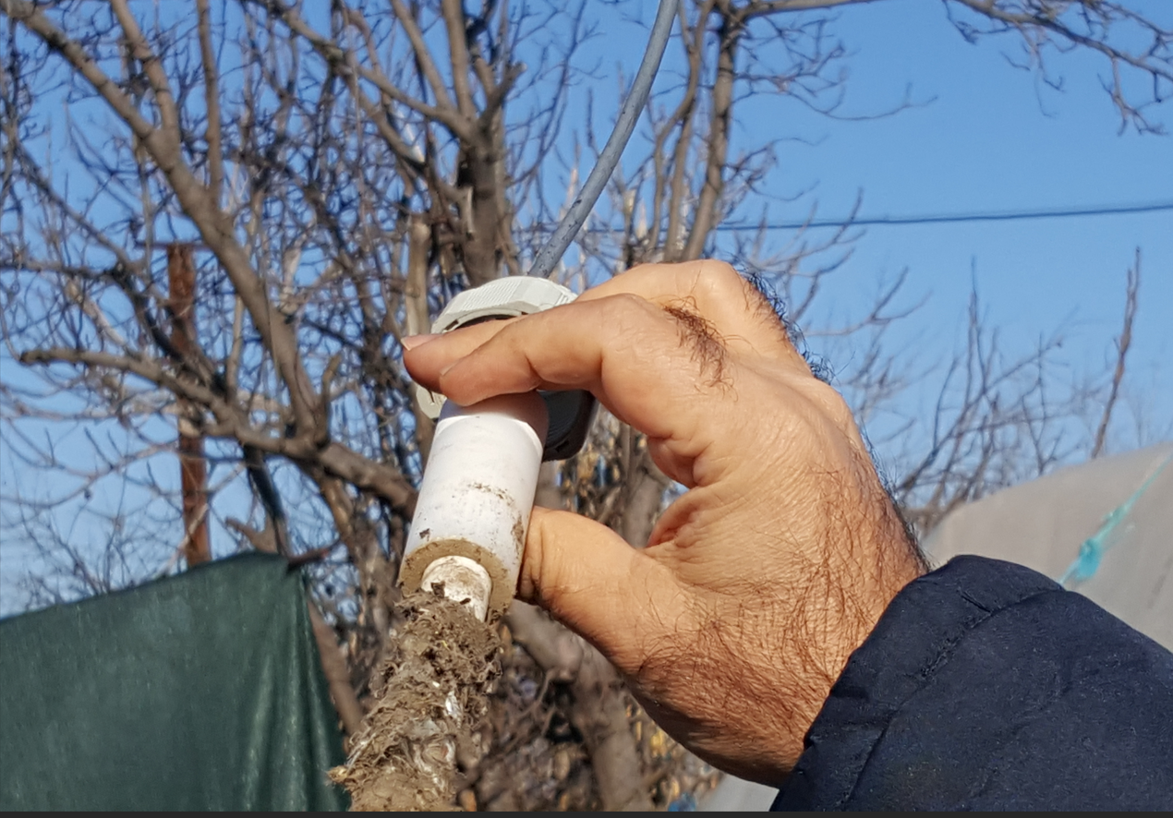
Some lessons learnt
Competency framework (WMO-No. 1209)
Growing requirement for accredited/assessed training
Cultural awareness
Ongoing peer to peer support – continuous effort
Starlink looks to be a real game changer for remote support.
All this comes with a cost! – (including personal)
Notes:
Accredited training vs training for training’s sake! WMO more on “accessed” but …
How to assess training – something we are grappling with.
Cultural awareness / cost – small communities, very shy, sometimes not left island let alone country, the role of family.
Large financial cost – but larger cost of not doing the training !

Slide 21

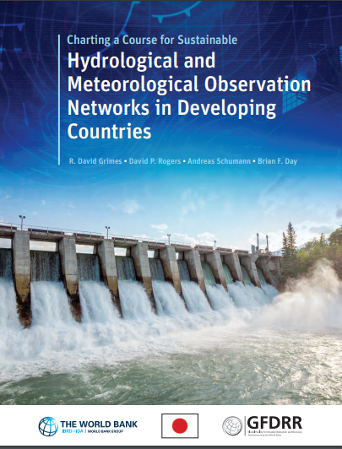
Some useful resources
https://community.wmo.int/en/activity-areas/imop
https://community.wmo.int/en/capacity-development-materials-dashboard
Guide to Meteorological Instruments and Methods of Observation (WMO-No. 8)
  2023 Edition available in all WMO languages
  2024 Edition to come soon in all WMO languages
Strategy for traceability assurance
List of RICs including their contacts and capabilities
Instruments and Observing Methods reports
Knowledge-sharing portal
Some courses on the WMO ETR Moodle platform
Generic AWS tender specifications
  Tender specifications for GBON Automatic Weather Stations
  Tender specifications for GBON upper air stations
Charting a course for sustainable hydromet observation networks
WMO Capacity Development Materials Dashboard

Slide 22
More useful documents
A Compendium of Topics to Support Management Development in National Meteorological Services (ETR-24)
Guide to Instruments and Methods of Observation (WMO-No. 8, Vol I, II, III and V)*
Guide to Climatological Practices (WMO-No. 100)
Guidance on Automatic Weather Systems and Their Implementation (WMO-No. 862)
Manual on the WMO Integrated Global Observing System (WMO-No. 1160)*
Guide to the WMO Integrated Global Observing System (WMO-No. 1165)*
Guidelines on the Role, Operation and Management of National Meteorological and Hydrological Services (WMO-No. 1195)
Challenges in the Transition from Conventional to Automatic Meteorological Observing Networks for Long-term Climate Records (WMO-No. 1202)
Compendium of WMO Competency Frameworks (WMO-No. 1209)
Guidelines on Homogenization (WMO-No. 1245)
Guidelines for Managing Changes in Climate Observation Programmes (WMO-TD No. 1378)
* Regular updates

Slide 23
WMO-No. 8, Volume I, Measurement of Meteorological Variables
Chapter 1. General
Annex 1.A. Operational measurement uncertainty requirements and instrument performance requirements
Annex 1.B. Strategy for traceability assurance
Annex 1.C. Regional Instrument Centres
Annex 1.D. Siting classifications for surface observing stations on land
Annex 1.E. Operating equipment in extreme environments
Annex 1.F. Station exposure description
Annex 1.G. Measurement quality classification for surface observing stations on land
WMO-No. 8, Volume III, Observing Systems
Chapter 1. Measurements at Automatic Weather Stations

Slide 24
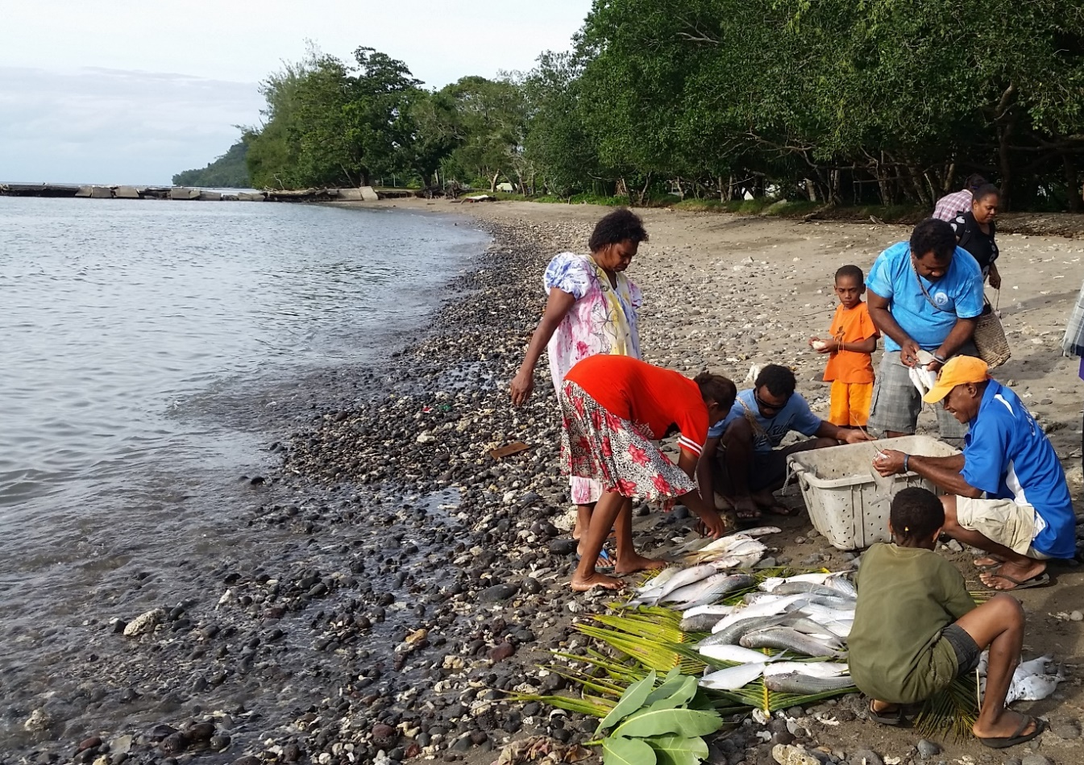

Thank you

