Slide 1

Online webinar on moving towards SOFF implementation –
Calibration and field verification of the instruments in GBON stations
Applicable approaches for traceability assurance in GBON stations
Drago Groselj
12th November 2024

Slide 2
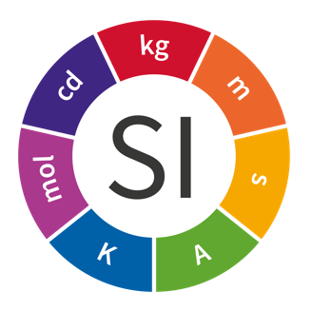

Metrological traceability
Metrological traceability could be described as a direct link between a result of a measurement made in the field and a result obtained by the calibration process in a calibration laboratory.
It ensures that different measurement methods and instruments used in different countries at different times produce reliable, repeatable, reproducible, compatible and comparable measurement results.
When a measurement result is metrologically traceable, it can be confidently linked to the internationally accepted measurement references.
At the top of the metrological traceability chain there is an internationally defined and accepted reference, in most cases the SI, whose technical and organizational infrastructure has been developed and maintained by BIPM.
NMIs are responsible for maintenance of national standards and dissemination of traceability on the national level, either by themselves or by DIs. DIs are experienced institutes operating at the top of the national metrology system.

Slide 3
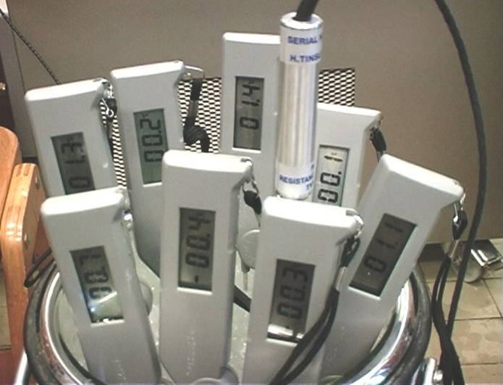
Main objective
The main objective of the calibration strategy for traceability assurance is to ensure the proper traceability of measurement and calibration results to the SI, through an unbroken chain of calibrations, each contributing to the measurement uncertainty.
This strategy applies to meteorological measurements for which a traceability chain to the SI is well established (measurements of temperature, atmospheric pressure, humidity, wind speed, precipitation, … ).

Slide 4
Responsibility
The responsibility for traceability assurance lies with WMO Members, who should ensure all the required calibrations as well as other necessary steps to achieve the objective of the strategy.
It is up to each NMHS to choose the most suitable approach for its traceability assurance, but ensuring the metrological traceability of all measurement results is strongly recommended.

Slide 5
Traceability assurance scenarios
Fully assured traceability – target, high confidence level in measurements;
Assured traceability (without accreditation) – good confidence level but some risks; improvement recommended;
Partially assured traceability – poor confidence and high risk; improvement required;
Lack of traceability – level of confidence cannot be assessed; urgent need for improvement.

Slide 6
Fully assured traceability – target, high confidence level in measurements
Following preconditions have to be met to achieve this status:
NMHS has a calibration laboratory.
Laboratory personnel are well trained and competent to properly operate laboratory standards and equipment.
Calibration standards and equipment meet the target uncertainties required for calibrations.
Calibration standards and equipment are regularly calibrated and maintained.
Quality management system, including all the calibration procedures, working instructions and forms, is well documented and applied in laboratory work.
Calibration laboratory is accredited according to ISO/IEC 17025.
Calibration laboratory participates in ILC.
BIPM / SI Units
CIPM MRA
NMI / DI
ISO / IEC 17025
ISO / IEC 17025
Cal. Lab.
RIC
ISO / IEC 17025
NMHS / Cal Lab
Met. sensor
Met. sensor
Met. sensor

Slide 7
Assured traceability (without accreditation) – good confidence level but some risks; improvement recommended
– NMHS has a calibration laboratory, or at least portable calibration devices covering the whole range of measured meteorological parameters;
– Laboratory personnel are well trained and competent to properly operate calibration standards and equipment;
– Calibration standards and equipment meet the target uncertainties required for calibrations of meteorological instruments;
– Calibration standards and equipment are regularly calibrated and maintained.
In addition, the following are highly recommended:
– Quality management system, including all the calibration procedures, working instructions and forms, should be documented and applied in laboratory work;
– Although not accredited, calibration facilities should follow the requirements of ISO/IEC 17025;
– Participation in the ILC, which will be of great benefit.
BIPM / SI Units
CIPM MRA
NMI / DI
ISO / IEC 17025
ISO / IEC 17025
Cal. Lab.
RIC
NMHS / Cal Lab
Met. sensor
Met. sensor
Met. sensor

Slide 8
Partially assured traceability – poor confidence and high risk; improvement required
Field verification kit should be acquired, with the required metrological characteristics regarding field instruments and with a calibration certificate issued by accredited calibration laboratory.
The field verification kit should be regularly calibrated by NMI or DI, RIC, of by any accredited calibration laboratory, or by non-accredited laboratory at the worst case.
The field verification kit should be checked before and after field use.
Personnel designated to operate the field verification kit should take part in appropriate training courses organized by RIC, NMI or other relevant institutions.
Technical procedures for operating the field verification kit should be documented.
Field verifications should be performed on a regular time base.
The results of field verification must be documented.
NMHS has no calibration laboratory.
NMHS has field verification kit.
BIPM / SI Units
CIPM MRA
NMI / DI
ISO / IEC 17025
ISO / IEC 17025
Cal. Lab.
RIC
NMHS / Field verification kit
Met. sensor
Met. sensor
Met. sensor

Slide 9
  Lack of traceability – not appropriate way
Lack of metrological traceability leads to a lack of reliability of meteorological measurements, and consequently, highly reduces confidence in the implications of measurement data such as weather forecasts, warnings, and climate analyses.
Ultimately this brings into question the usefulness to meteorological measurements for the global community. So the consequences of untraceable measurement results are severe.
Therefore, measurement traceability is essential and WMO Members are urged to assure traceability of all the measurements under their responsibility.

Slide 10
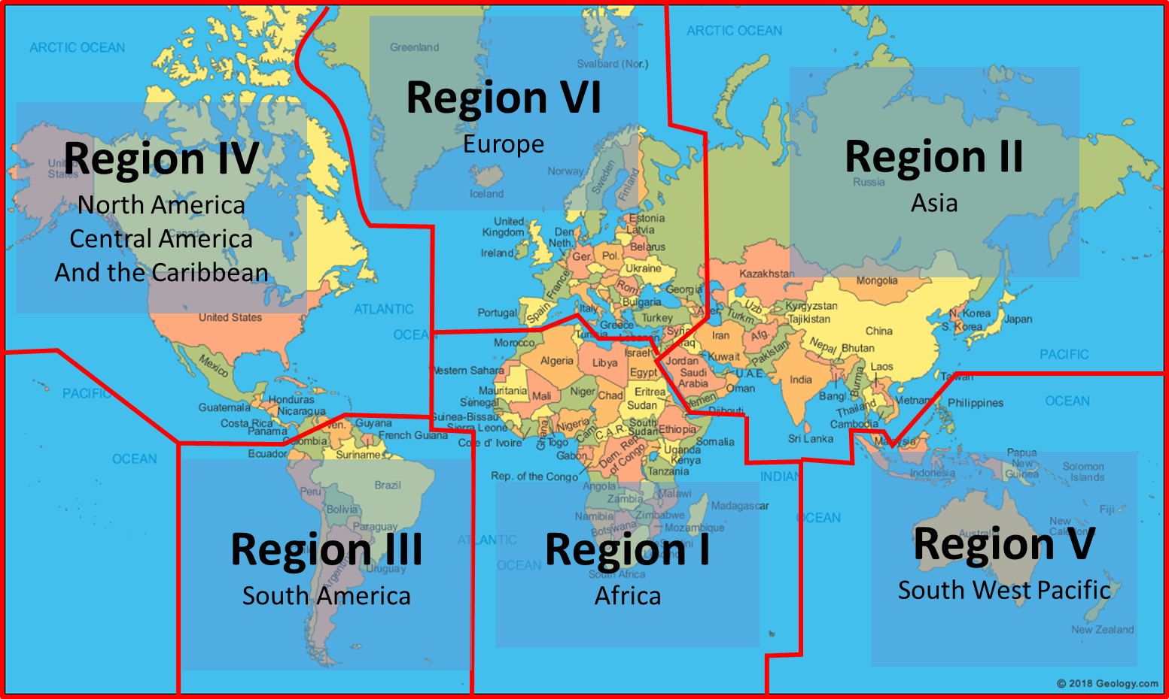
WMO Regional Instrument Centres
RA VI
Toulouse (France)
Bratislava (Slovakia) *
Ljubljana (Slovenia) *
Munich, Hamburg (Germany) *
Ankara (Turkey) *
RA IV
Bridgetown (Barbados)
RA II
Beijing (China) *
Tsukuba (Japan) *
RA V
Manila (Philippines)
Melbourne (Australia) *
RA III
Buenos Aires (Argentina)
RA I
Alger (Algeria)
Cairo (Egypt)
Casablanca (Morocco)
Nairobi (Kenya)
Gaborone (Botswana)
* RIC is accredited according to ISO/IEC 17025.
https://community.wmo.int/activity-areas/imop/Regional_Instrument_Centres

Slide 11
WMO ToR for RIC – corresponding functions
An RIC shall assist Members of the Region, and possibly of other Regions, in calibrating their national meteorological standards and related environmental monitoring instruments;
An RIC shall participate in, and/or organize, interlaboratory comparisons, and support instrument intercomparisons following relevant WMO recommendations;
According to relevant recommendations on the WMO Quality Management Framework, an RIC shall make a positive contribution to Members regarding the quality of measurements;
An RIC shall advise Members on enquiries regarding instrument performance, maintenance and the availability of relevant guidance materials;
An RIC shall actively participate, or assist, in the organization of workshops on calibration and maintenance of meteorological and related environmental instruments;
…

Slide 12
RICs calibration capabilities
 |  |  | Quantity
Region | Country |  | Temperature | Relative humidity | Atmospheric pressure | Wind | Precipitation | Solar radation | Other (air quality) | Other (electrical)
RA I | Algeria
 | Egypt
 | Kenya
 | Botswana |  | N/A
 | Morocco
RA II | China
 | Japan
RA III | Argentina
RA IV | Barbados
RA V | Australia
 | Philippines
RA VI | France
 | Germany
 | Slovakia
 | Slovenia
 | Turkey
 |  |  |  |  | 46 | Calibration capability without ISO/IEC 17025 accreditation
 |  |  |  |  | 29 | Calibration capability with ISO/IEC 17025 accreditation
https://community.wmo.int/activity-areas/imop/Regional_Instrument_Centres

Slide 13
Ground stations traceability
NMI, RIC,
Accreddited laboratory
NMI, RIC,
Accredited Laboratory
External traceability
Internal traceability
NMHS Calibration laboratory
Field verification kit
Field verification kit
Ground stations
Ground stations

Slide 14
Field verification
Field verification offers the ability to check/verify instrument on site.
Suitable also for NMHSs without calibration labs.
Field verification is not calibration.
Verification is usually done at one point against the working standard by placing the working standard as close to the instrument under verification (IUV) as possible.
Verification kit must be periodically recalibrated in calibration laboratory.
Suitable for traditional and AWS instruments.

Slide 15
Field verification
Stabilization time must be allowed to reach temperature equilibrium between the working standard and the IUV.
Attention must be paid to the proximity of the working standard to the IUV, the temperature gradients, the airflow, the pressure differences and any other factors that could influence the verification results.
The most important disadvantage is that the inspection is usually limited to one point.
The second disadvantage is that if an error is reported, the IUV should be removed and replaced with a calibrated instrument.

Slide 16
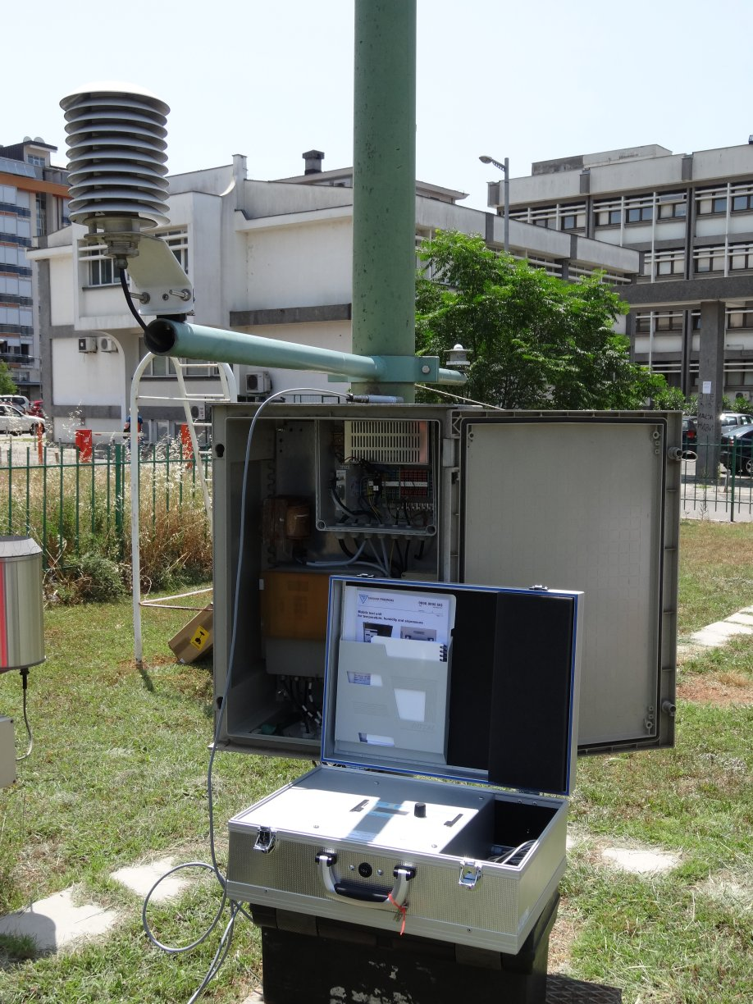
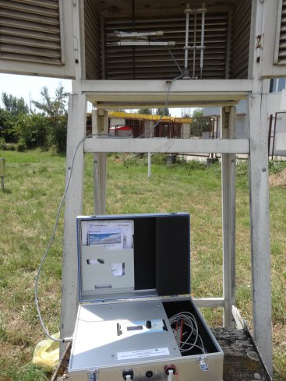
Specification of field verification kit - example
Robust instruments with display
Battery powered with autonomy up to 8h
Barometer with digital display | To measure barometric pressure
Output | Digital display and RS232
Operating temperature range | -10 to 40°C
Power supply | Rechargeable battery pack
Operation time using battery | >8h
Resolution (display) | 0.01hPa
Measurement range | 600 ... 1100 hPa
Linearity | <0.1 hPa
Hysteresis | <0.1 hPa
Temperature dependence | < 0.1 hPa
Total accuracy | <0.2 hPa
Long term stability | < 0.15 hPa/year
Thermometer with digital display | To measure temperature
Output | Digital display
Power supply | Rechargeable battery pack
Operation time using battery | >8h
Measurement range | ​-40 ... +60 °C
​Temperature sensor | ​Pt100 RTD IEC751 1/3 Class B ​
Resolution | 0.1°C
Hygrometer with digital display | To measure relative humidity
Output | Digital display
Power supply | Rechargeable battery pack
Operation time using battery | >8h
Measurement range | ​0 ... 100 % RH
Resolution | 0.1% RH
Accuracy at 20°C | <1%
Long-term stability | <1 %rh / year

Slide 17
Example of field tolerances
Instrument | Comparison method | Laboratory uncertainty | Field tolerance
Pressure | Within Stevenson scr. | 0.3hPa | 0.5hPa
Temperature | Within Stevenson scr. | 0.1K | 0.3K
Relative humidity | Within Stevenson scr. | 2% | 4%
Wind direction | Compass | 5% | 10%

Slide 18
Calibration laboratory | Field verification
Large investment in premises, infrastructure and human resources | Initial calibration of instruments followed by one point field verification
Training of calibration laboratory personnel | Moderate investment in transfer standards for verification
Standard operating procedures for calibration | Periodic recalibration of transfer standard – verification kit (NMI, RIC)
Logistics of equipment to laboratory and back to measuring site | Specific training for personnel providing field verification
ISO/IEC 17025 accreditation | To use calibrated spare instruments
Resources needed for ongoing operation and maintenance – traceability of laboratory standards | Lack of guidance on field verification and field tolerances

Slide 19
References
Guide to Instruments and Methods of Observation, 2018 edition - Volume I: Measurement of Meteorological Variables,, Annex 1.B, Strategy for traceability assurance https://library.wmo.int/doc_num.php?explnum_id=9869,
International vocabulary of metrology – Basic and general concepts and associated terms (VIM)
https://www.bipm.org/documents/20126/2071204/JCGM_200_2012.pdf/f0e1ad45-d337-bbeb-53a6-15fe649d0ff1
Guide on expression of uncertainty
https://www.bipm.org/documents/20126/2071204/JCGM_100_2008_E.pdf/cb0ef43f-baa5-11cf-3f85-4dcd86f77bd6
WMO Knowledge Sharing Portal
https://community.wmo.int/activity-areas/imop/knowledge-sharing-portal
IOM report 119: Guidance on the computation of calibration uncertainties https://library.wmo.int/index.php?lvl=notice_display&id=17152#.YKdmN6FvFaQ

Slide 20

Thank you
Merci

