Slide 1
OSCAR/Surface
Online Training Course
Session 3: Analysis on your national observational network and its representation in OSCAR/Surface

Slide 2
Learning topics
This session is the wrap-up session of the course.
Now you know how to find information in OSCAR/Surface and got to test and compare five different methods how to register and edit stations in OSCAR/Surface:
The OSCAR/Surface graphical user interface (GUI) standard registration dialogue
The OSCAR/Surface GUI templates
The OSCAR/Surface webclient
The OSCAR Surface GUI XML upload (XML representation of stations)
The OSCAR/Surface API (XML representation of stations)
In this session you will do an analysis on your national observational network and its representation in OSCAR/Surface, which will help you to identify future tasks to be done in OSCAR/Surface. You will also reflect on everything you have learned in this course and which methodology is the best to use for the tasks you are planning to do in future.

Slide 3
OSCAR/Surface User Manual
Method | Suitable Scenarios | Target Users | Advantages
GUI Standard Registration Dialogue | Complex metadata input, new station registration/in-depth editing, non-standard scenarios (e.g., custom observing platforms, special instrument specifications) | Advanced users, metadata managers, users requiring detailed control over fields | suited for detailed metadata management and meeting WIGOS complex field requirements (e.g., WSI, coordinate history)
GUI Templates | Quick registration for common station types (SYNOP, AWS, radiosonde stations, etc.), new users, repetitive registration (e.g., similar stations within the same network) | New users, occasional users, administrators handling standardized station types | reduces manual input; embeds WIGOS standards to minimize formatting errors
Web Client Tool | Batch operations (create stations, modify WSIs, update reporting schedules, add program affiliations), cross-station uniform modifications (e.g., adding the same network affiliation to multiple stations) | Regional administrators, users managing large number of station | Efficient handling of large-scale data; supports offline template filling; ideal for national/regional batch management
GUI XML Upload | Inter-system data exchange (e.g., import/export from external databases); advanced customization (supplementing fields not covered by the GUI) | Technical users, data engineers, users performing system-to-system data migration | Supports complex metadata structures; suitable for data migration, and in-depth editing for technical users
API | Real-time interaction with third-party systems, programmable batch processing (script-driven large-scale operations), machine-readable format interaction (JSON/XML) | Developers, organizations requiring automated workflows | Enables automation and large-scale operations; facilitates integration with other WMO systems (e.g., WDQMS); suitable for technical teams and system-level data synchronization

Slide 4
Assignment 7:
Analyse current national network and course reflection
How your national observational network is represented in OSCAR/Surface
Which stations or station information is missing in OSCAR/Surface
Which methods or tools to edit and register stations in OSCAR/Surface are the most useful ones
Focus on future tasks according to your gap analysis (missing stations etc.).
Upload a report using the template provided.

Slide 5
You can use the following steps as a guidance:
1.) Go to OSCAR/Surface (no need to login for this exercise): https://oscar.wmo.int/surface .
2.) Use the advanced search under the search tab to find all stations from your country. Be aware of the reporting status - for a complete comparison it could be helpful to set this to any (or test different options).
3.) Download the station list as a table, import it into excel and compare the output with a list or similar document of your national observational network.

Slide 6
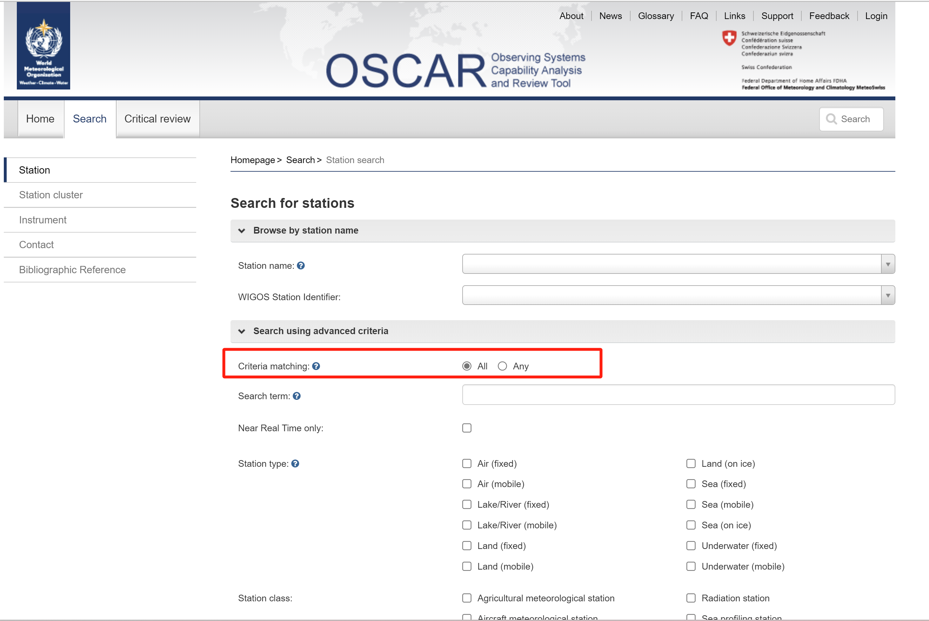
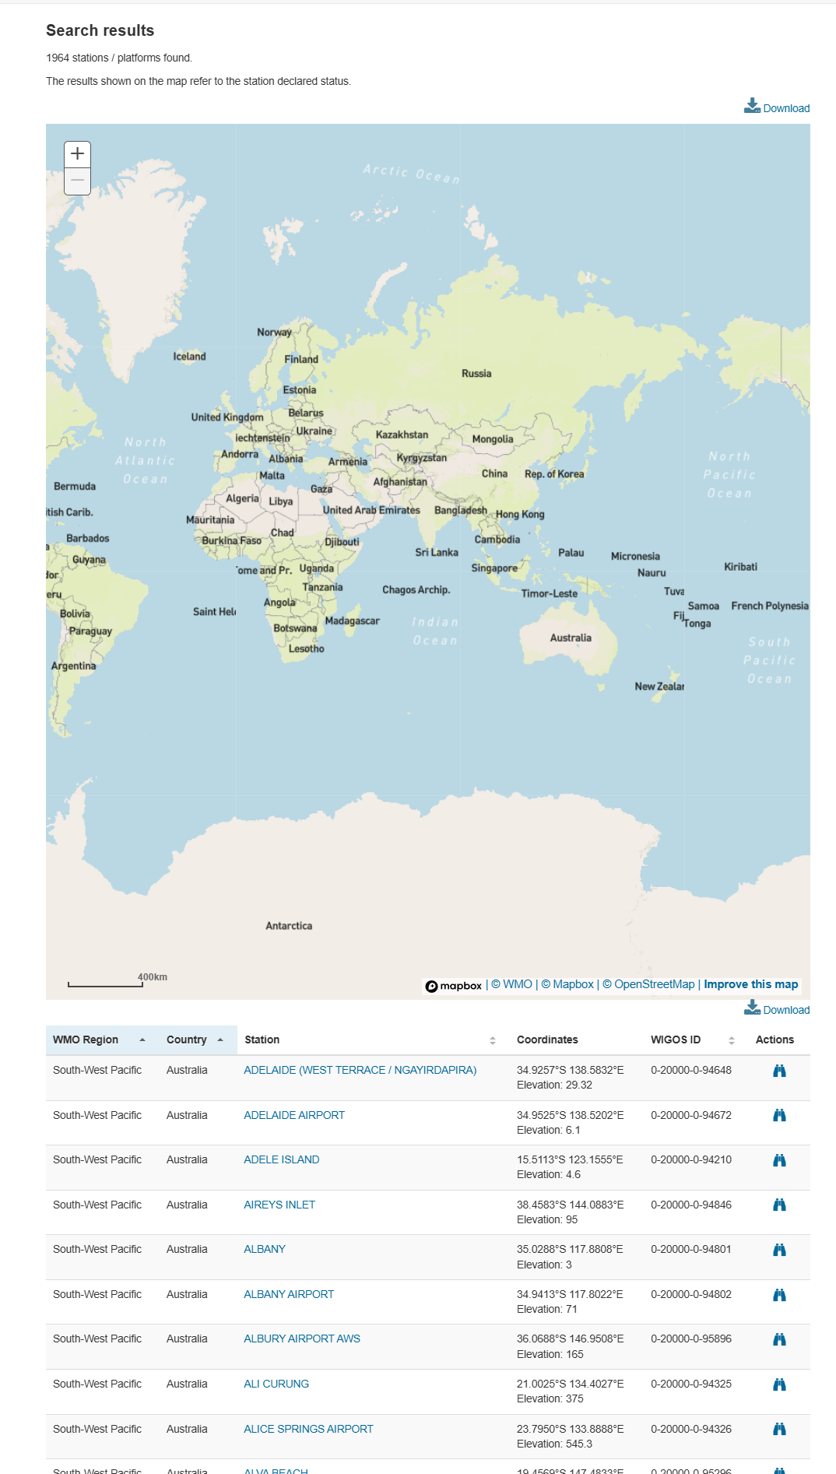
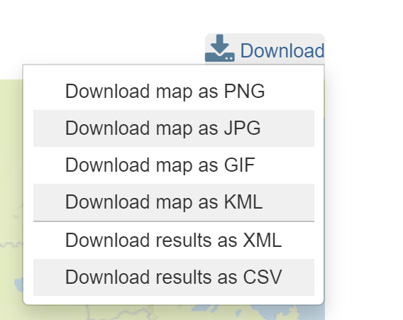
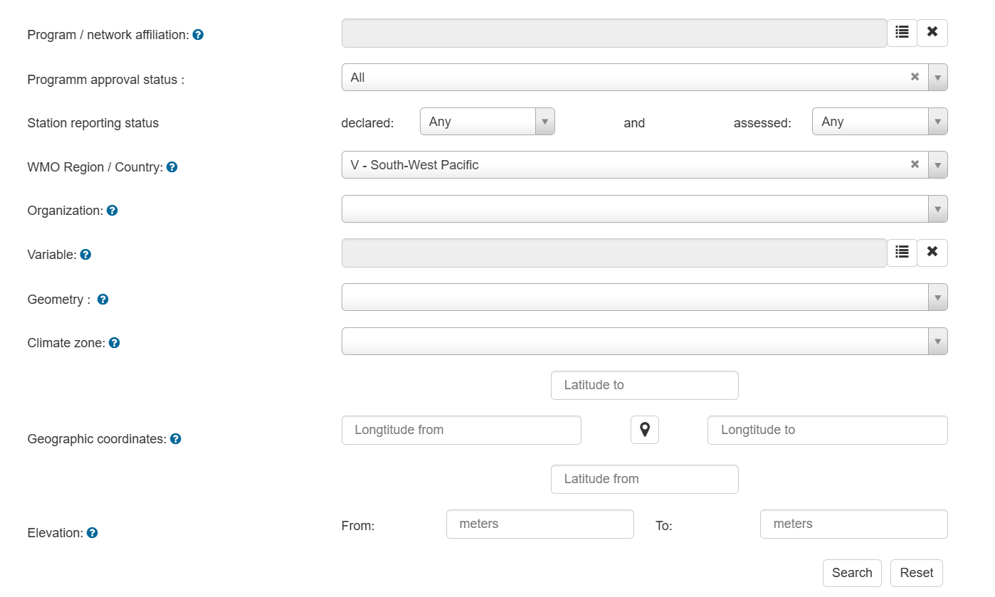
CSV
EXCEL sheet

Slide 7
4.) Analyze the differences in OSCAR/Surface compared to your existing national observing network:
Are all or just a subset of stations represented in OSCAR/Surface? Make a list of the missing stations that you want to add in OSCAR/Surface. Mark the ones that you want to register during the next days.
Are there differences in the detail of representation of the stations/metadata? Which stations do lack metadata in OSCAR/Surface (reporting status, schedule, photo, etc.)? Mark for which stations you want to add metadata in the next days.
Is there other information missing in OSCAR/Surface that need to be filled (station contacts etc.)? Make a list which further information you want to add during this course.
How actual is the information in OSCAR/Surface? Make a list with stations that need to be updated because metadata is outdated .

Slide 8
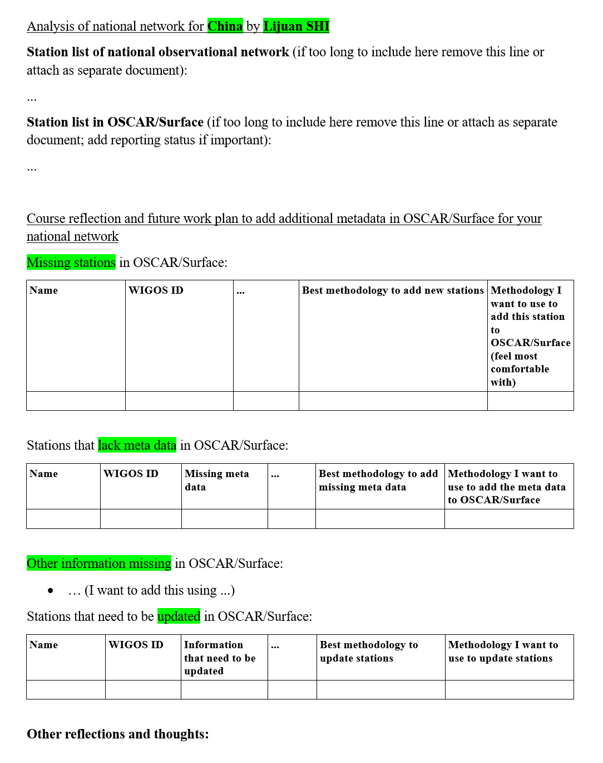
5.) Summarize your results in the Word document (see template below).
Make
a list containing stations missing in OSCAR/Surface,
a list of stations for which you have identified significant differences in the metadata, other missing data and
a list of stations that need to be updated.
You can use the attached Word document as a template for your report.

Slide 9
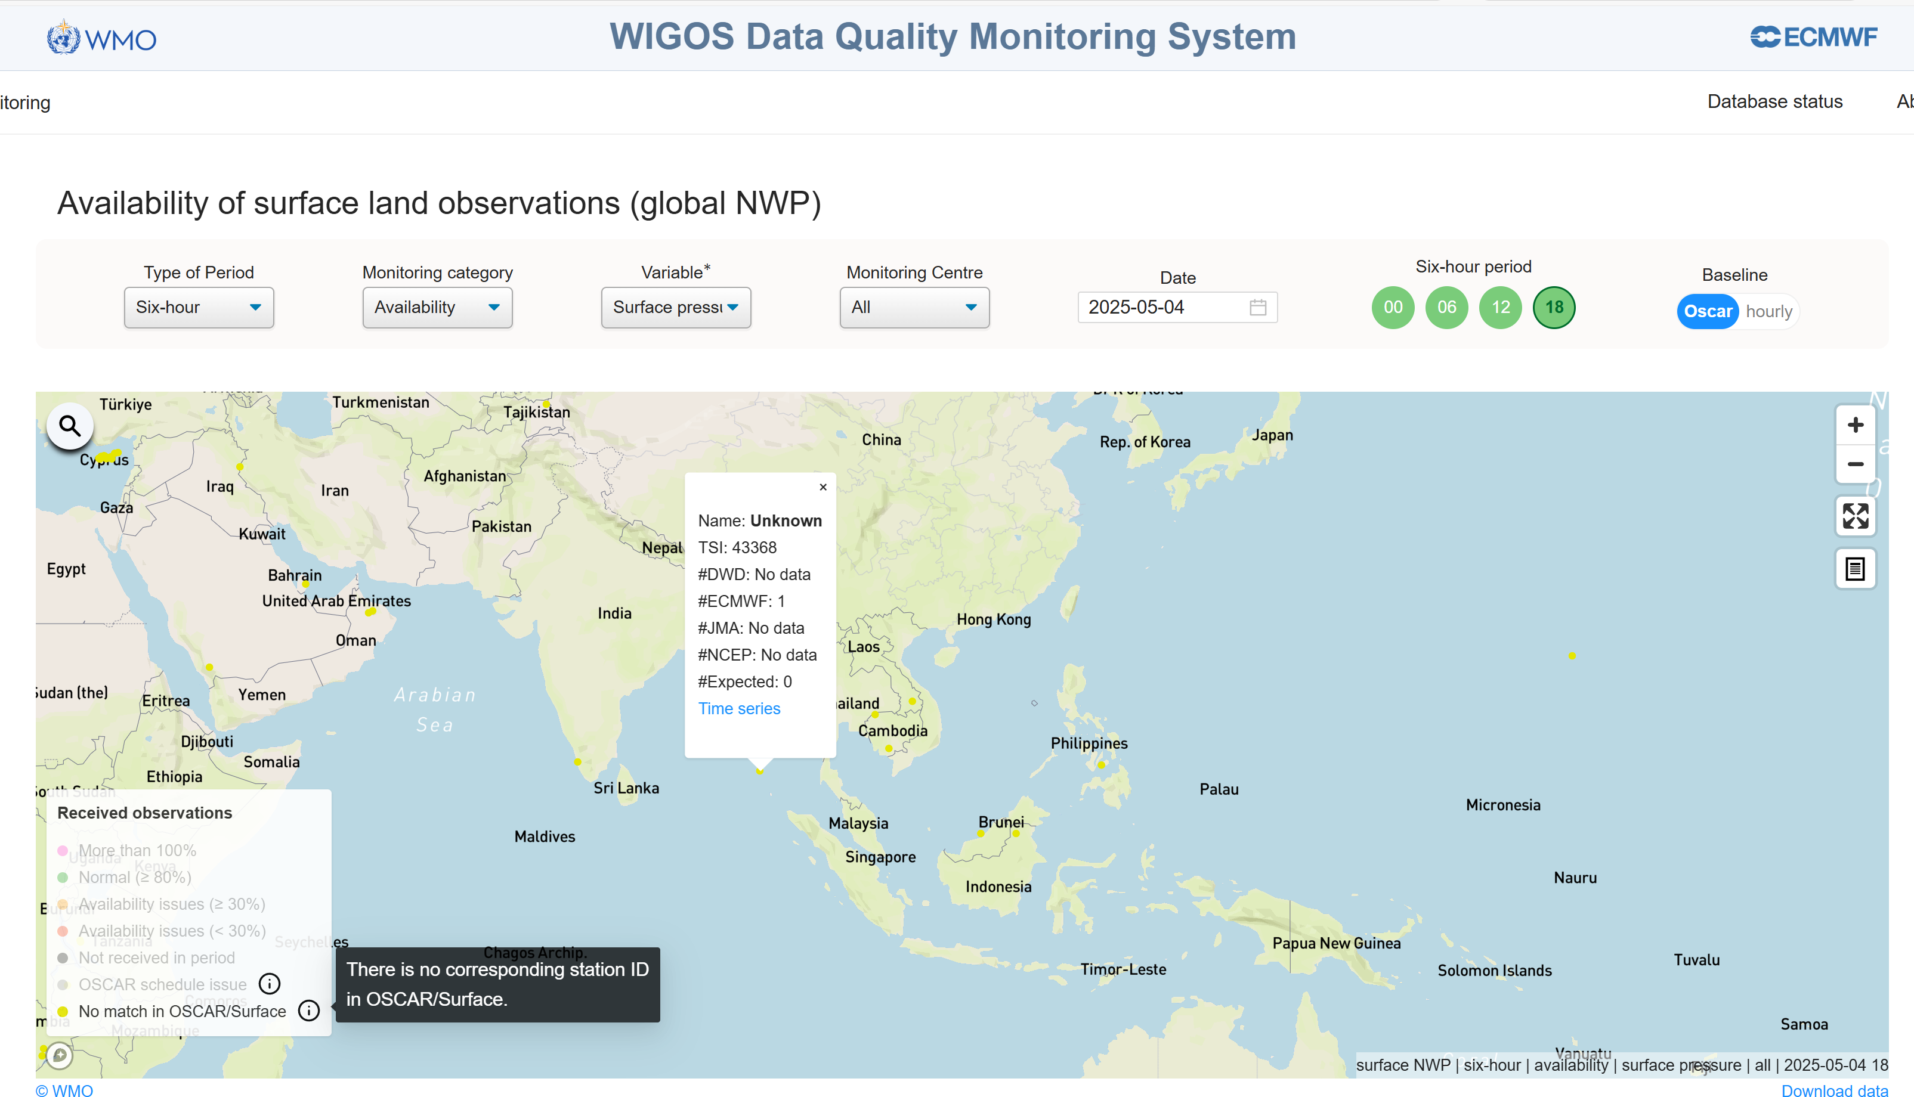
Missing station in OSCAR/Surface
WDQMS: There is no corresponding station ID in OSCAR/Surface.

Slide 10
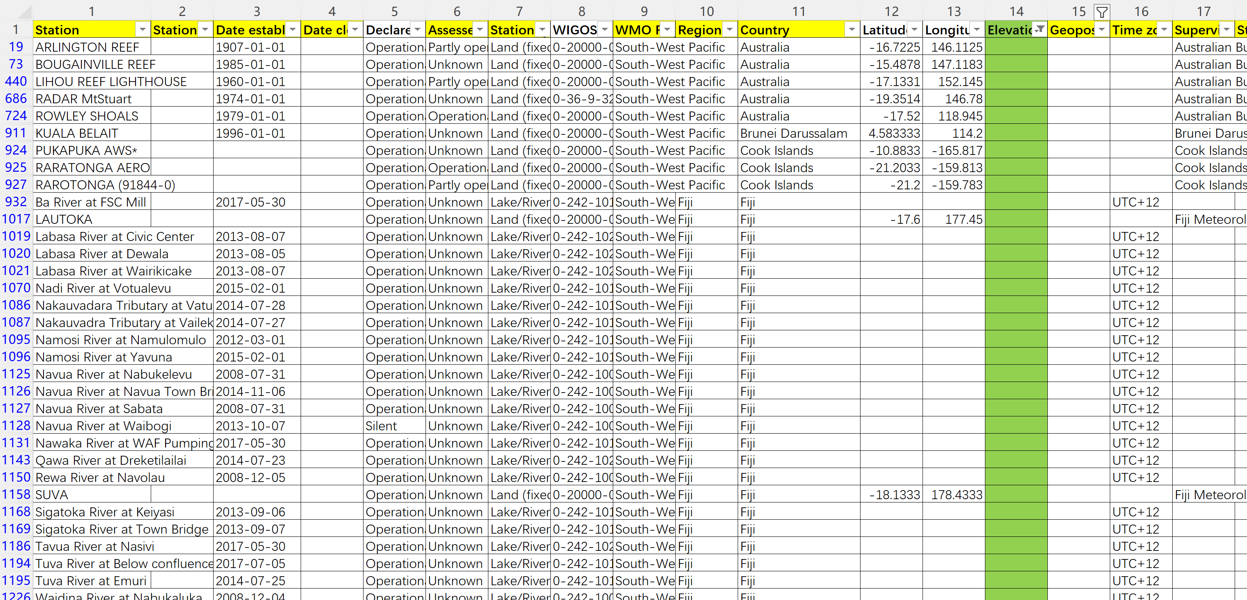
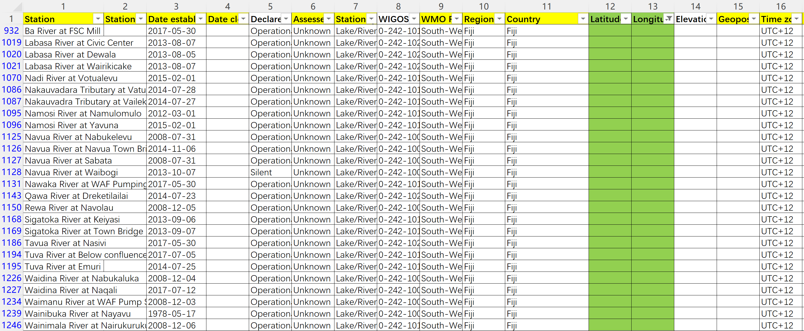
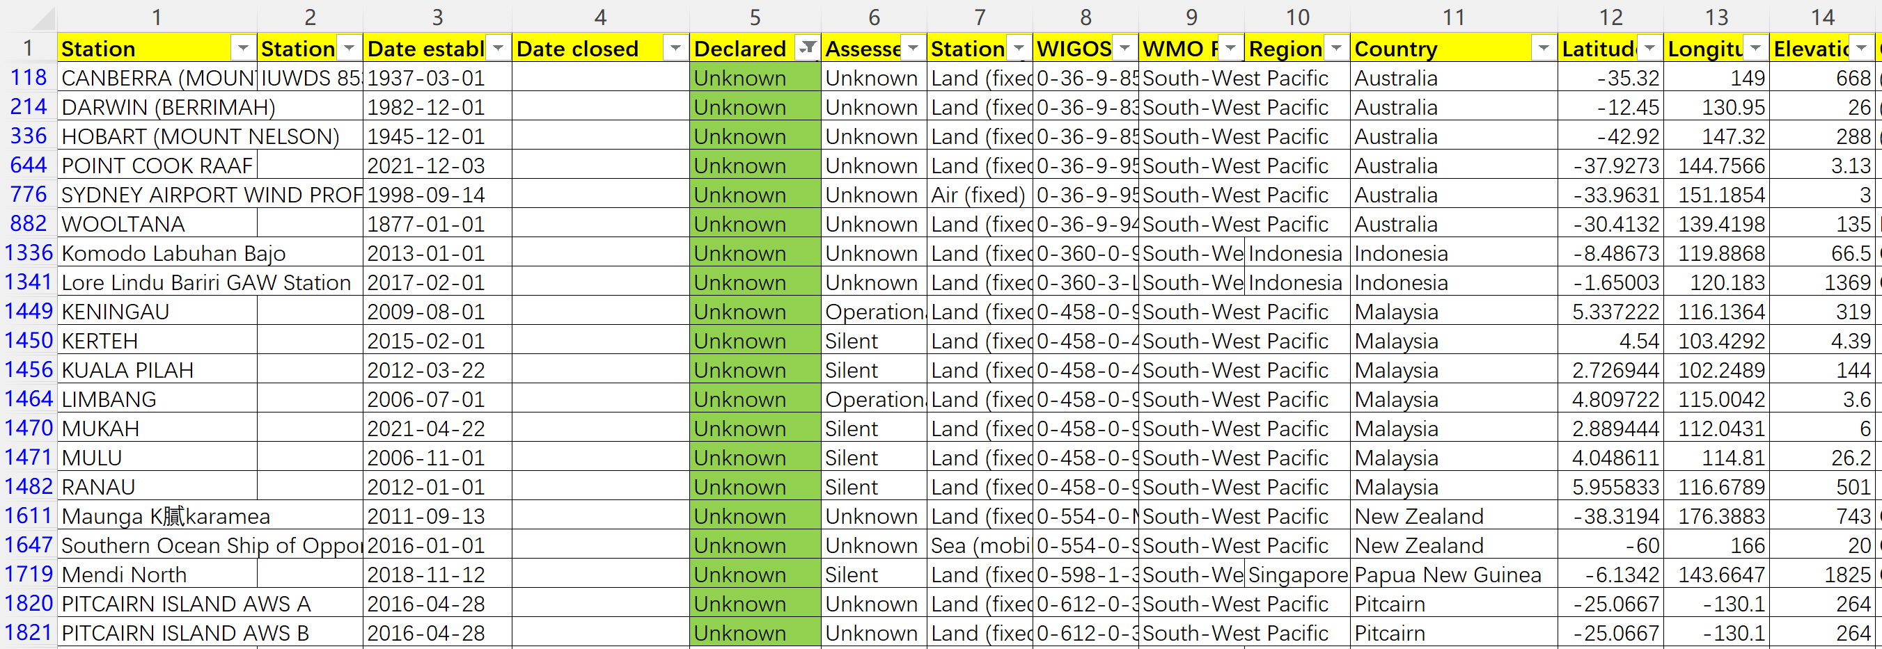
Lack metadata in OSCAR/Surface
Important metadata：
Latitude Longitude Elevation
Declared reporting status
WIGOS Station Identifier(s)
No Elevation 116
Declared reporting Status Unknown 20
No Latitude/Longitude 26

Slide 11
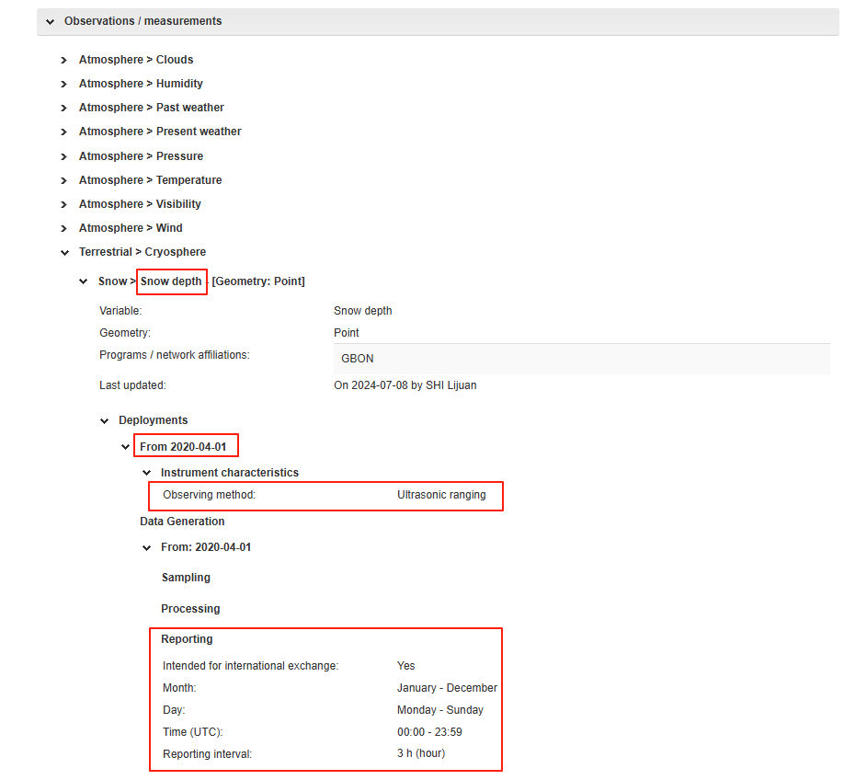
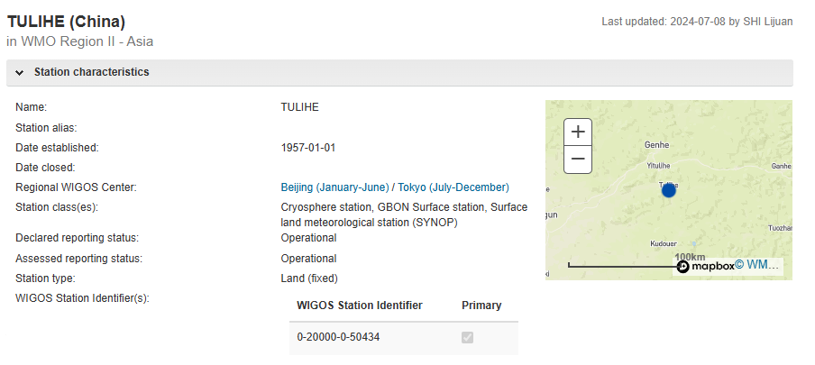
Example of China---lack metadata
Fill in the metadata of snow depth:
The metadata of 306 land surface stations were added by using the Web Client Tool.

Slide 12
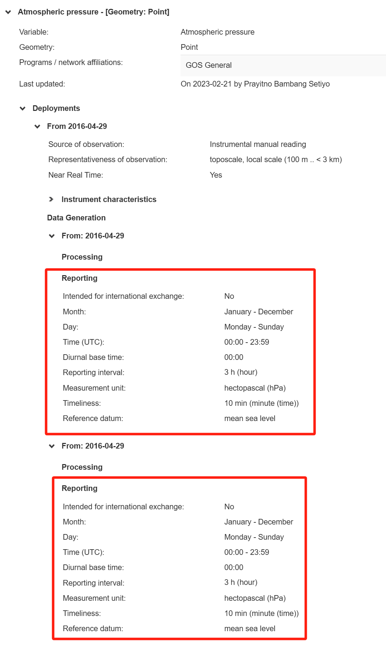
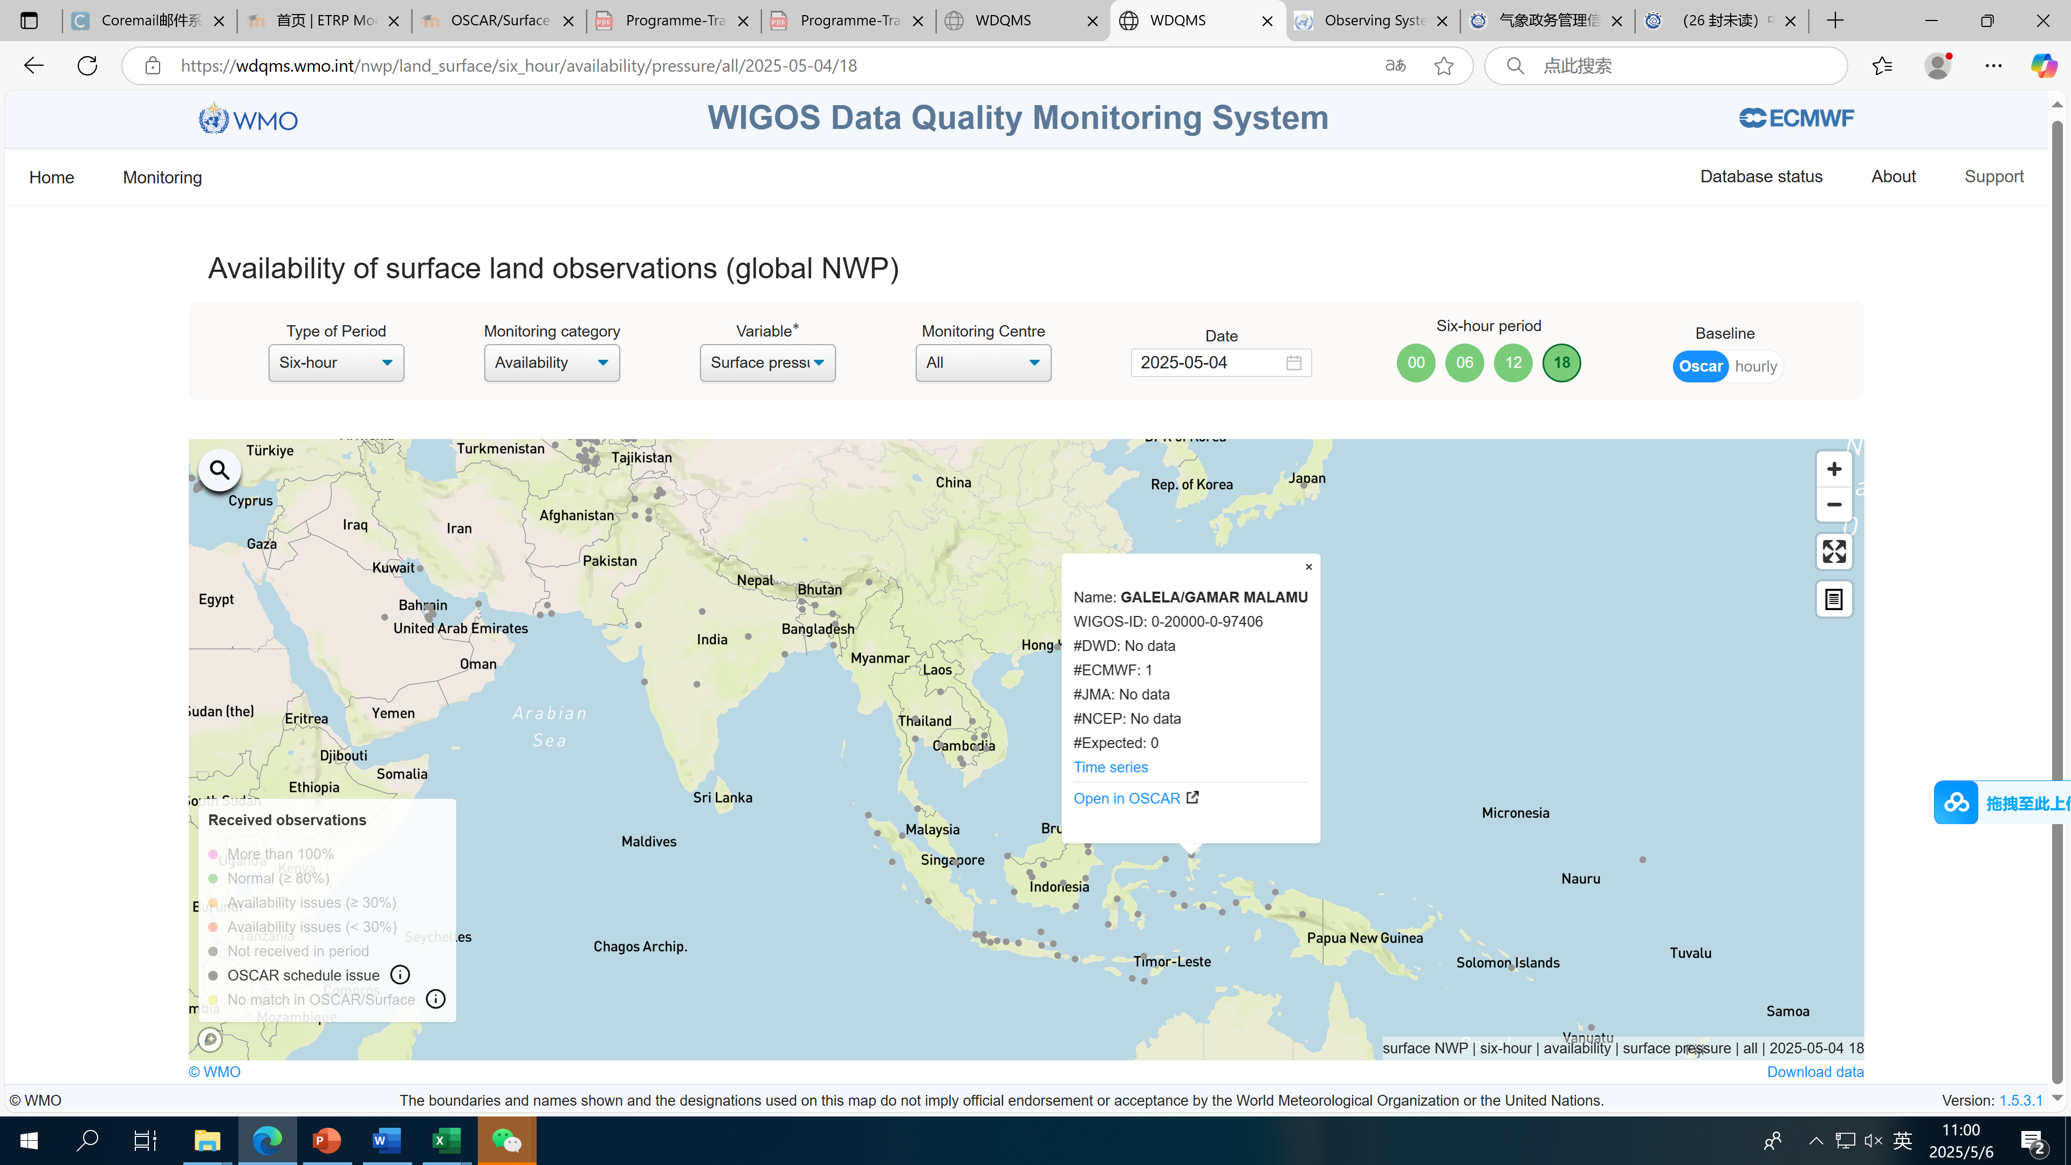
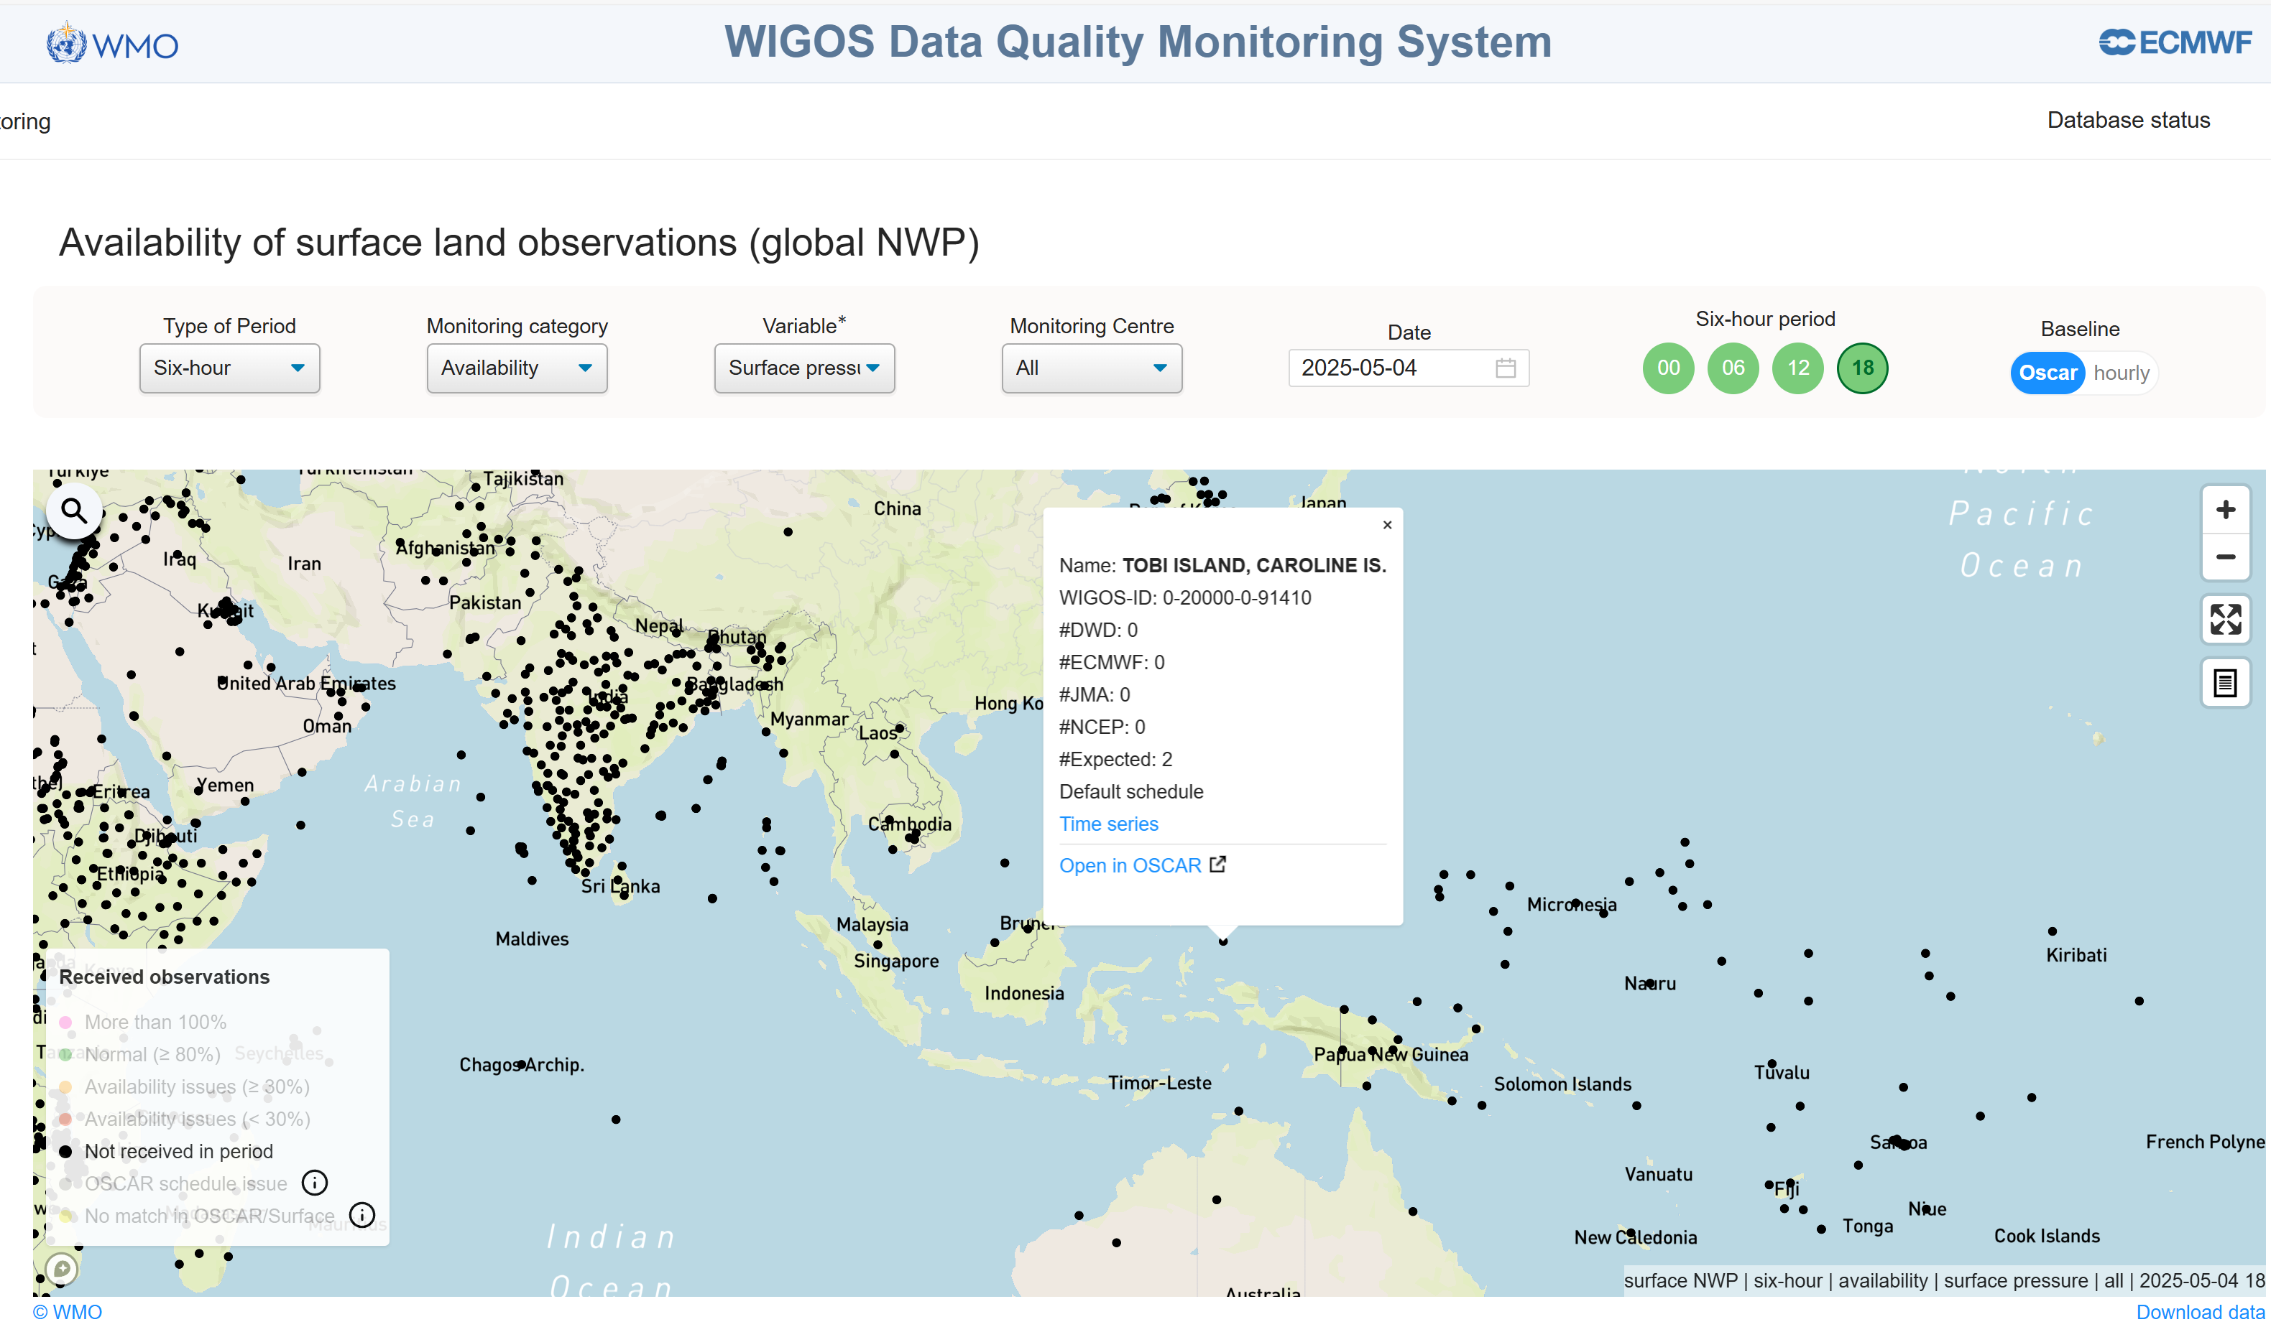
Stations that need to be updated in OSCAR/Surface
WDQMS: Not expected to report during the period according to OSCAR/Surface schedule, yet data was received.

Slide 13
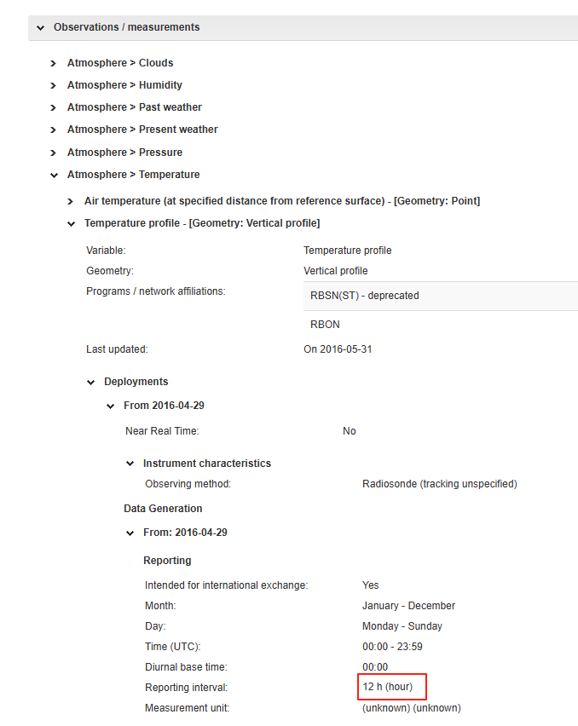
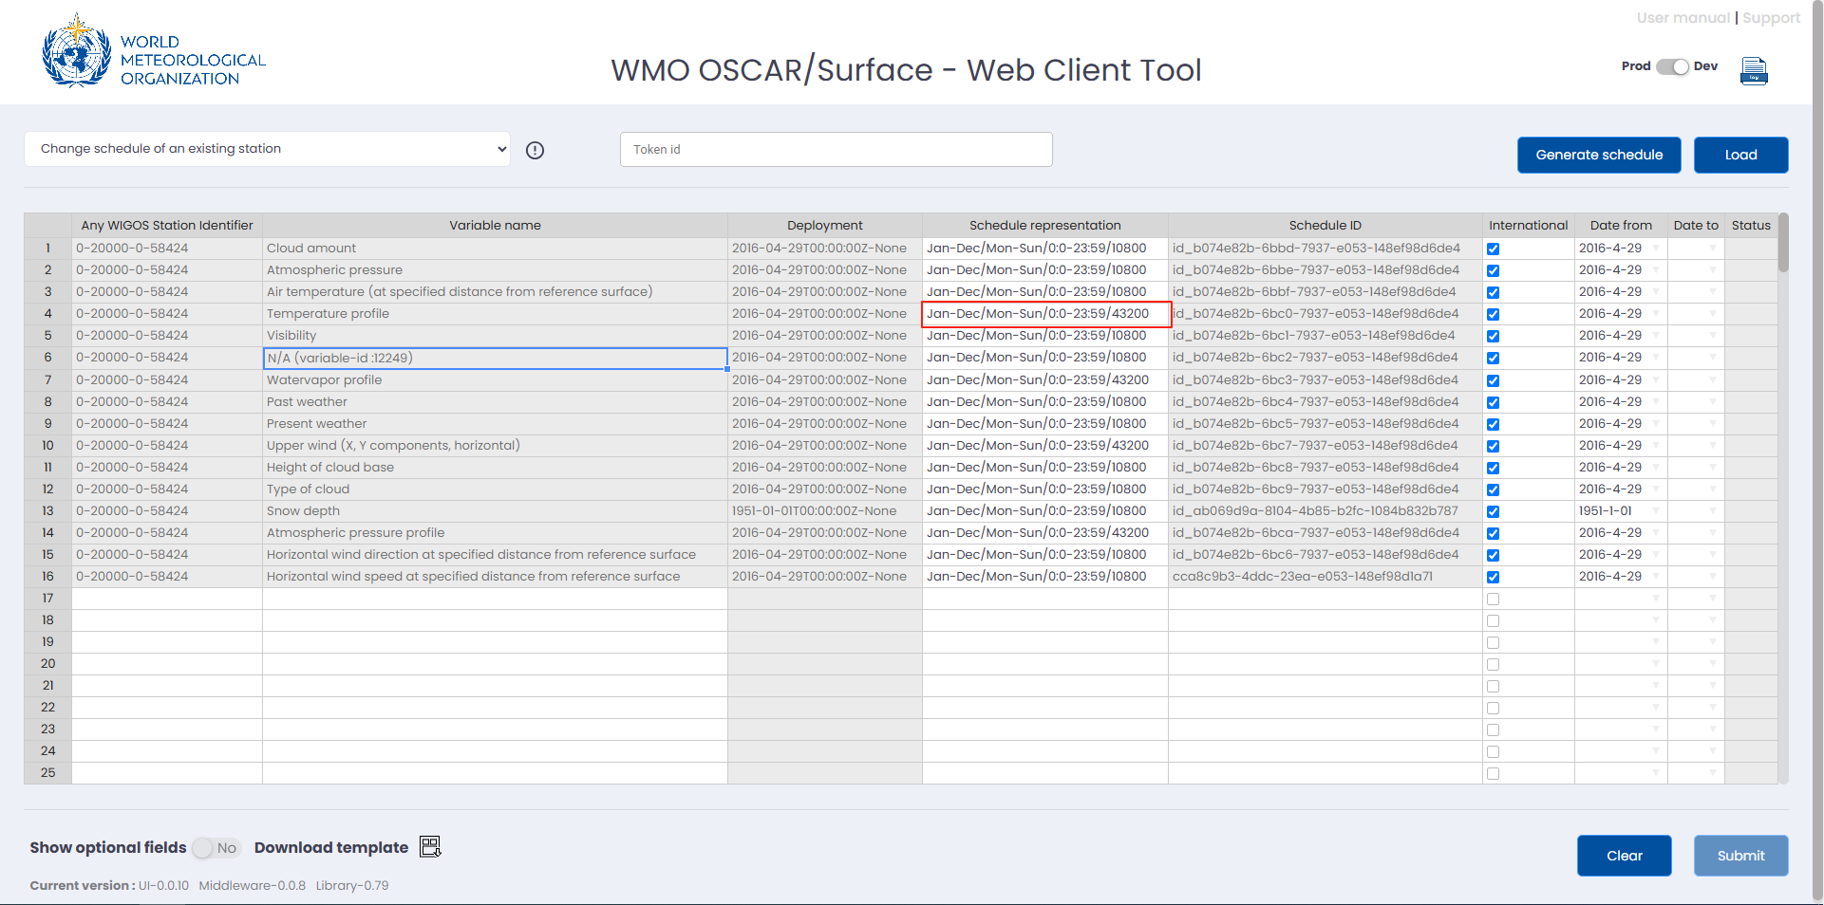
Example of China--- updated metadata
Modification of the frequency of station reports:
The metadata of 58 upper-air stations were updated by using the Web Client Tool.
Eg. 0-20000-0-58424 station
Name | WIGOS ID | Information that need to be updated | Best methodology to update stations | Methodology I want to use to update stations
ANQING | 0-20000-0-58424 | Reporting interval | Web Client Tool | Web Client Tool

Slide 14
6.) Take the station list and evaluate for each category or task which methodology is the best to add the additional meta data to OSCAR/Surface (graphical user interface dialogues, web client, graphical user interface XML upload or API) and what would you feel most comfortable with.
7.) Add this information to the Word document. You can use the attached Word document as a template for your report.
8.) You can add further thoughts and questions to the report.
9.) Upload the report.
If something is unclear check the mentioned parts of the OSCAR/Surface user manual or post your question in the forum (a place to mingle).

Slide 15
Thank you.
^{wmo.int}

