Slide 1
Introduction to the course
OSCAR/Surface Online Training Course for RA V (5-9 May 2025)
WMO Moodle e-learning Platform
In preparation for the hybrid training Workshop on Regional WIGOS Centres Functions and Tools
From 19 to 21 May 2025, Bali, Indonesia
Samantha Linnerts (South Africa)

Slide 2
Welcome to the OSCAR/Surface Online Training Course for RA V,
5 to 9 May 2025.
This course has four online sessions including video material and assignments on different topics. You will learn all the necessary information to work efficiently with OSCAR/Surface.
After you have completed all the course modules you will be able to:
Find information in OSCAR/Surface
Register new stations (using the OSCAR/Surface registration dialogue, the web-client of OSCAR/Surface, templates and the machine-to-machine interface)
Edit existing stations
Understand how the XML representation of stations looks like
Asses how you can use OSCAR/Surface best in your daily work
This course will also give you the opportunity to interact with others from the OSCAR/Surface community, exchange best practices and find answers to more specific questions you encountered while working with OSCAR/Surface.
Note: This is a self-learning training course

Slide 3
How does the course work
This course consists of four sessions (+ an introductory session for the platform). In each session you will learn about a different topic around OSCAR/Surface, which will help you to get familiar with the platform and the according tools.
You will test, practice and demonstrate what you have learned in each session by handing in specific assignments (mandatory for the course certificate).
In each session, one member of the OSCAR/Surface team will provide you with some feedback on your submitted assignments. You will be able to discuss and ask questions using the message interface and the forum. Each session also contains a small quiz to test your knowledge and some reading instructions on where to find more information in the OSCAR/Surface user manual.
You can do each module at your own pace and in the order, you want, also
we recommend starting with module 0 and ending with module 4.
Try to complete all assignments and quizzes by the end of the course.
You can mark and monitor your progress in all sessions on the right side by ticking the check boxes for each element you accomplished. The checkboxes, for the assignments, will be ticked as soon as a member of the OSCAR/Surface team has approved your assignment. Please pay attention to the deadlines for the assignments!
If you have questions or want to discuss topics with all the others, please use the forum - you can find it under "A place to mingle...".

Slide 4
Day 1: 5 May 2025
For the assignments you need to be a registered user at OSCAR/Surface DEPL (deployment system), the test environment of OSCAR/Surface (https://oscardepl.wmo.int/surface/). It is important that you do the assignments on the test system (DEPL) and only switch to the operational system (PROD) at the end or after this course when you feel comfortable implementing your changes.
SESSION 0: Get yourself setup for the course and How to register into OSCAR/Surface
Introduction to the course (Samantha Linnerts 20')
Registration/login into OSCAR/Surface, Q&A (Rabia Merrouchi 20’)
SESSION 1: Using OSCAR/Surface to retrieve information
Introduction to OSCAR/Surface , Q&A(Samantha Linnerts 15')
Search/retrieve information using OSCAR/Surface web tool (Regina Yasmin 20’)
Q&A (All 10')
You will have to complete:
Quiz Session 1
Assignment 1: Generating station reports and station lists with OSCAR/Surface

Slide 5
Day 2: 6 May 2025
This session is about three (of five) pathways how to register (and edit) new stations in OSCAR/Surface. You will learn and test how to register stations using the graphical user interface (GUI) of OSCAR/Surface.
Feedback from sessions 0/1 (day 1) (Samantha Linnerts and all 20’)
SESSION 2: Register stations using the OSCAR/Surface GUI and the Web client
Session 2: Register stations using the OSCAR/Surface GUI (Karl Monnik, including examples and Q&A, 35’)
Session 2/Cont: Register stations using the OSCAR/Surface Templates (Karl Monnik, including examples and Q&A, 35')

Slide 6
Day 3: 7 May 2025
This session is about three (of five) pathways how to register (and edit) new stations in OSCAR/Surface. You will learn and test how to register stations using the web client.
Feedback from session 2A (day 2) (Samantha Linnerts/Karl Monnik 20’)
SESSION 2 (Cont.): Register stations using the Web client
Session 2/Cont: Register stations using the OSCAR/Surface Webclient (Regina Yasmin,including examples and Q&A, 45')
Session2/Cont: Final Q&A (All 25’)
You will have to complete:
Quiz Session 2
Assignment 2: Create a test station in OSCAR/Surface using the GUI (Registration dialogue)
Assignment 3: Advance editing of your test station (GUI)
Assignment 4: Create a new station in OSCAR/Surface using the GUI (templates)
Assignment 5: Create a bunch of new stations in OSCAR/Surface using the web client

Slide 7
Day 4: 8 May 2025
In this session you will do an analysis on your national observational network and its representation in OSCAR/Surface, which will help you to identify future tasks to be done in OSCAR/Surface. You will also reflect on everything you have learned in this course and which methodology is the best to use for the tasks you are planning to do in future
Feedback from session 2B (day 3) (Regina Yasmin 20’)
SESSION 3(Session 4 on Moodle): Analysis on national observing network and its representation in OSCAR/Surface
Session 3: Analysis on your national observational network and its representation in OSCAR/Surface (Lijuan Shi, including examples and Q&A, 40')
Final Discussion (All 15’)
You will have to complete:
Assignment 7: Analyse current national network and course reflection

Slide 8
Day 5: 9 May 2025
This session is about the other two (of five) pathways how to register (and edit) new stations in OSCAR/Surface. You will learn how to register stations using the XML presentation of stations, uploading it through the GUI of OSCAR/Surface or using the API.
Feedback from session 3 (day 4) (Lijuan Shi 15’)
SESSION 4 (Session 3 on Moodle): Register stations (XML representation) using the OSCAR/Surface GUI and Introduction to the Machine-to-Machine Interface (API)
Session 4: Register stations (XML presentation) using the OSCAR/Surface GUI (Rabia Merrouchi including examples and Q&A 20')
Session 4/Cont: Introduction to Machine-to-Machine Interface (API) (Rabia Merrouchi, including Q&A 20')
Closing (Luis Nunes - 5’)
You will have to complete:
Quiz Session 3
Assignment 6: Creating a station using the XML upload (GUI)

Slide 9
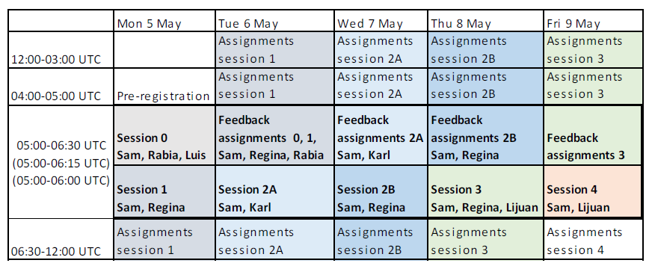
Feedback from trainers
The feedback from the trainers to the assignments, to be performed by the participants, is planned according to the calendar below.
Please note that there will be no assignments from session 3, and the assignments
from session 4 will be discussed during the hybrid workshop 19-21 May, Bali, Indonesia.

Slide 10
We hope you enjoy the course and get the most out of it!

Slide 11
Thank you​
Merci​
Gracias​
شكرا​
谢谢​
Спасибо

