Slide 1
Introduction to OSCAR/Surface A comprehensive overview of OSCAR/Surface and its importance
OSCAR/Surface Online Training Course for RA V (5-9 May 2025)
WMO Moodle e-learning Platform
In preparation for the hybrid training Workshop on Regional WIGOS Centres Functions and Tools
From 19 to 21 May 2025, Bali, Indonesia
Samantha Linnerts (South Africa)

Slide 2
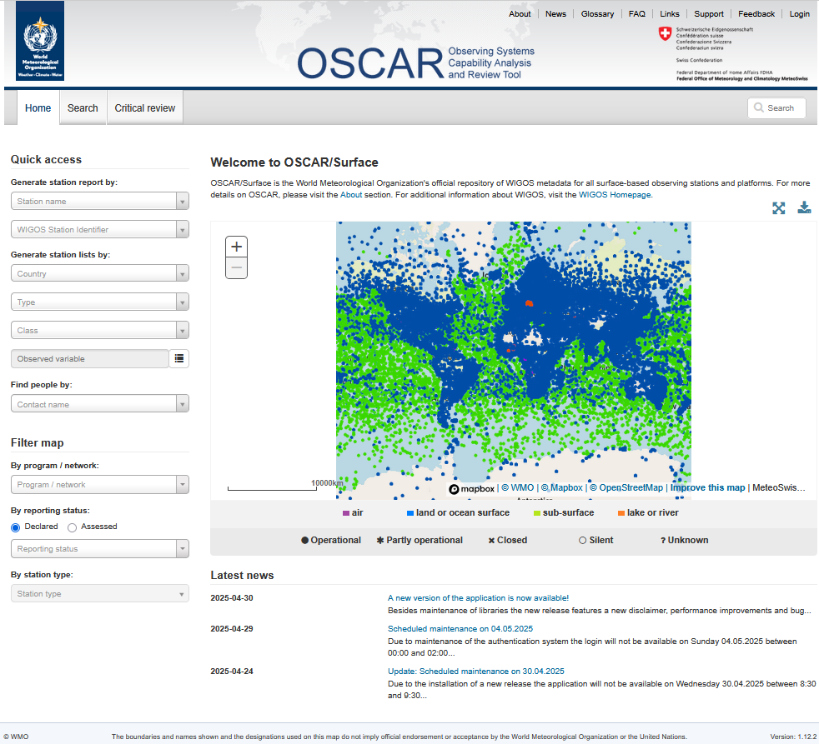
Overview of OSCAR/Surface
OSCAR/Surface is part of the Observing Systems Capability Analysis and Review Tool (OSCAR) of the WMO Integrated Global Observing System (WIGOS) Information Resource (WIR) is a key source of information for WIGOS metadata.
The surface- and space-based components of OSCAR record observing platform/station metadata in accordance with the WIGOS Metadata Standard described in the Manual on the WMO Integrated Global Observing System (WMO-No. 1160) and in the WIGOS Metadata Standard (WMO-No. 1192) and retain a record of current and historical WIGOS metadata.
It is the official repository for the metadata of the WIGOS Stations/platforms

Slide 3
Core features of OSCAR/Surface
Metadata Management
Registers, manages, and archives metadata for Earth observation systems, ensuring effective data handling and retrieval.
Rolling Review of Requirements
Facilitates the Rolling Requirements Review process for integrated planning and enhancing collaboration among stakeholders.
Observation Requirements
Enables users to define and analyse observation requirements quantitatively (identifying data gaps) for more effective resource allocation, and supporting data-driven decision making.
Satellite insights (OSCAR Space)
Provides detailed insights into satellite capabilities and instrument specifications, aiding in mission planning and execution.
Interoperability with other WMO Tools
OSCAR/Surface supports interoperability with other WMO tools and initiatives, promoting collaborative efforts in data sharing

Slide 4
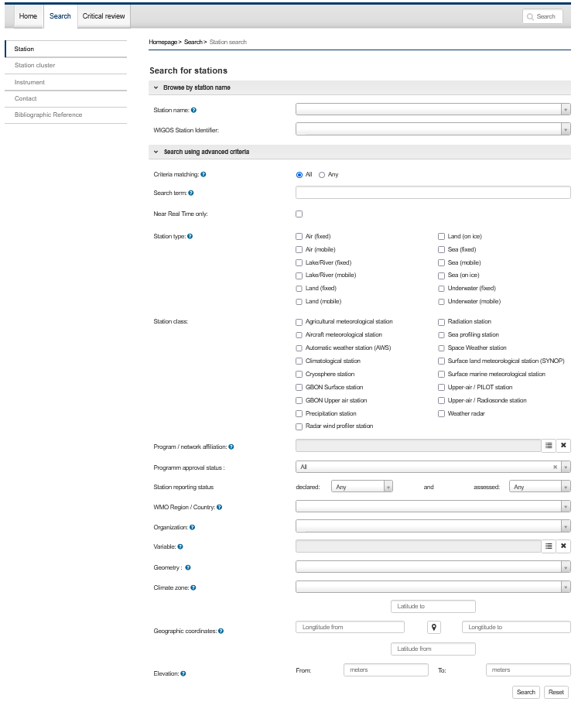
Features and functions of OSCAR/Surface
Finding Information
Navigate the portal
Search for stations
Search for station clusters
Search for instruments
Search for contacts (National focal point or Program Focal Point)
Search for bibliographic references
No login required

Slide 5
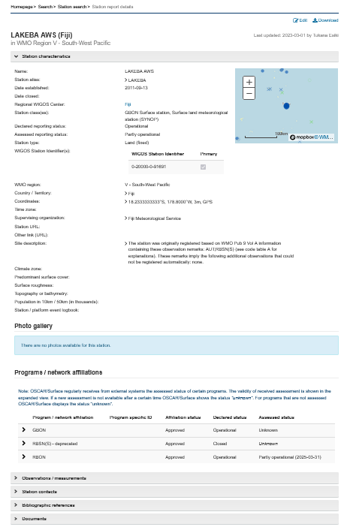
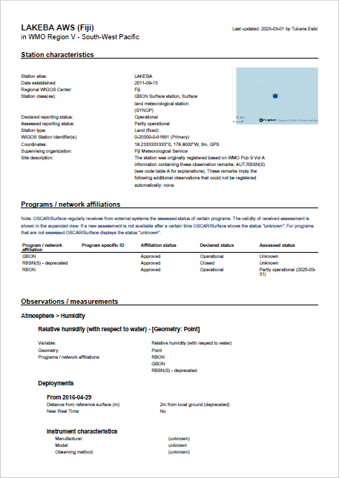

Slide 6
Features and functions of OSCAR/Surface
Changing information
Safely test the editing of information
Authorization and access control module
Log on to OSCAR/Surface or create an account
Register a new station (using Generic form or Station template)
Program/Network affiliation and approval
Edit existing information of a station
How to completely or partly close a station
How to copy a station
Register or edit a station via XML
Oscar/Surface application programming interface
Oscar/Surface Web Cient Tool
Help and learning resources
How to report bugs
Multipurpose station concept/duplicate stations
Login required

Slide 7
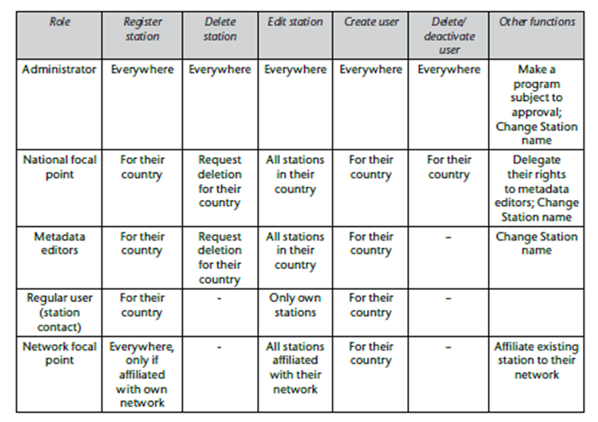
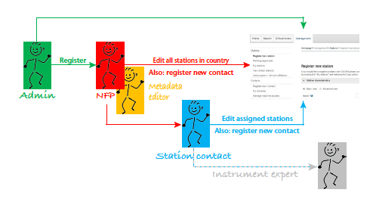
User roles and Access rights
Only registered and authorized users can change information in OSCAR/Surface.
The national focal point can then create and delete additional users and associate them with stations within his/her country, edit all and register new stations in their country, and add contacts to a particular station, granting them editing rights for that station.
National focal points can delegate the role of metadata editor to another contact who will then be able to perform the same functions as the national focal point, without the formal title.
A registered user who is not assigned a specific user role is considered to be a regular OSCAR/Surface user and is authorized to register stations and users for his or her country but only authorized to edit stations assigned to him/her.

Slide 8
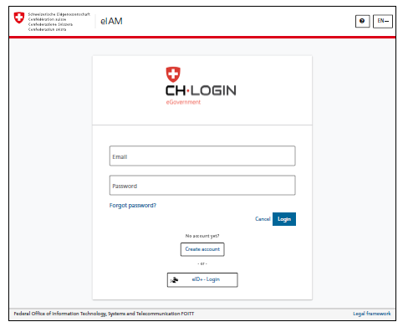
Register and login in OSCAR/Surface
The registration only has to be done once. There are two ways to get an account:
Designation as National Focal Point (NFP) for OSCAR/Surface by Permanent Representative
2. NFP, or other delegee, creates a user in OSCAR/Surface
To complete the Registration procedure,
Step 1: Click on the Login button in the top right corner of the page and then on
Step 2: Click on Create Account
Users need to be registered to be able to update information in OSCAR/Surface

Slide 9
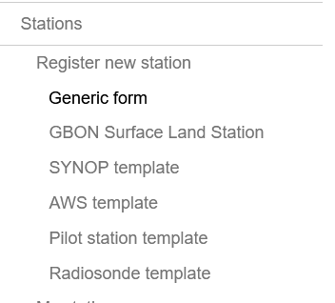
How to register a new station
A new station can be registered either by using the
Generic form: The Generic form offers the possibility to see and manually edit all fields in OSCAR/Surface and is intended for advanced users who want to have full control.
Station template forms make the registration of a station easier and are intended for users who are new to OSCAR/Surface or who want to quickly register a station. The station template forms only show fields relevant to the station type.
The results will be the same

Slide 10
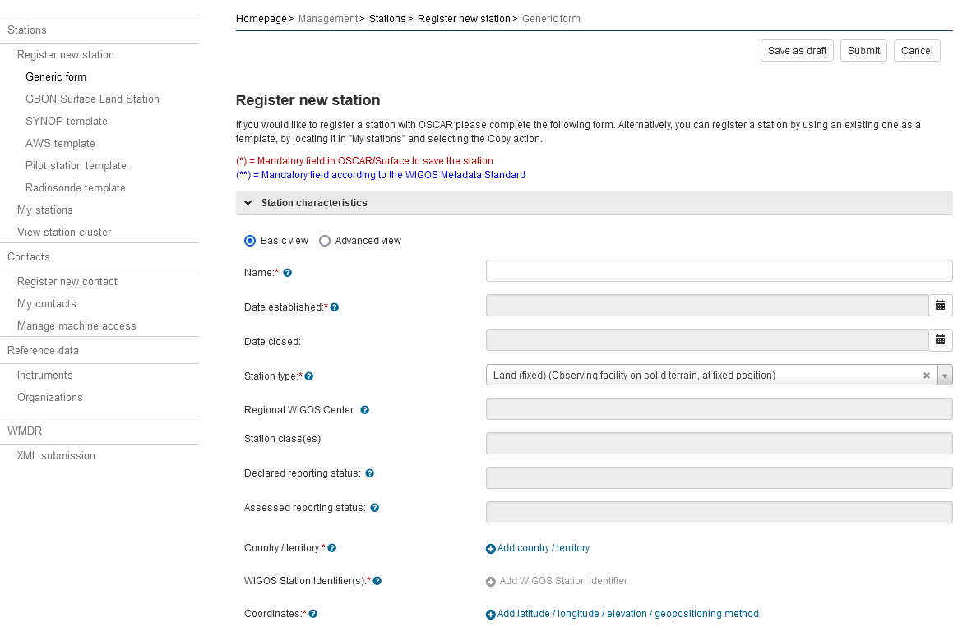
Register a new station

Slide 11
Assign WIGOS Station Identifier (WSI)
WIGOS Station Identifier is used to uniquely identify WMO observing stations and platforms.
Each observing station must have at least one WIGOS identifier (WSI), A WSI can only be associated with one observing station, The station WIGOS identifier(s) link(s) the station to its WIGOS metadata.
The WSI consists of four blocks:
1. The WIGOS identifier series (number): For observing facilities, the number is “0”. This is entered automatically by the system;
2. The issuer of the identifier (number): The ISO 3166-1 numeric country code is used (for example, the Republic of Tunisia: 788). This is entered automatically by the system depending on the country/territory that was chosen.
3. The issue number: Define your own procedure or use “0”;
4. The local identifier (a set of characters, maximum 16): Define your own procedure.
Example: 0 – 792 – 0 - XXXXXXXXXXXXXXXX
Observing stations allocated with WMO station identifiers before the introduction of WSIs (that is, before 1 July 2016) may continue to use those identifiers. These stations use “20000” as the value for the issuer of the identifier and the old WMO ID as the local identifier. For example, Incheon station is recorded as “0-20000-0-47112”.

Slide 12
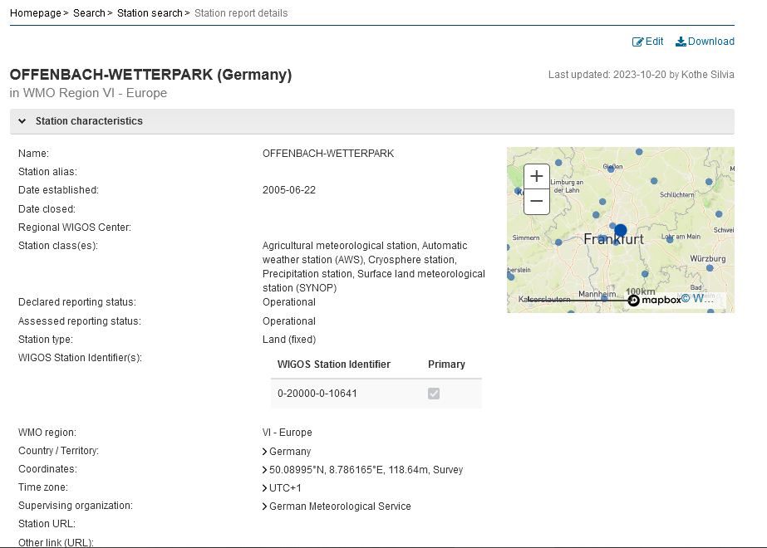
Edit/update existing station metadata
To edit the station information, click on the Edit button, which shows on the station report. To get to the station report, any of the quick access, search or map filter methods can be used.
It is important to remember that the date of the date of the actual change must be documented in OSCAR/Surface. Almost all changes of the information are recorded to keep track of the station history and the development of its capabilities over time. Therefore, most fields in the form have a date input field.
Examples: Information can be updated:
Change of elevation of station or instruments: When the elevation of a station is changed, the new elevation of the installed instruments must be entered also.
Missing information: the system will not save the changes if not all mandatory fields were entered. This situation is especially likely with stations that are being edited for the first time as the station may have been registered with incomplete information when the system was first populated.
Reporting: a) Reporting interval: Hourly/3hourly b) Period of reporting: Custom or 24/7 year-round, Used for international reporting
Completely or partly close a station: If a station needs to be closed completely, a date must be set in the Date closed field to trigger the close station functionality. By clicking on “Continue”, all open-ended Program affiliations, deployments, and data generations of the station will be closed.

Slide 13
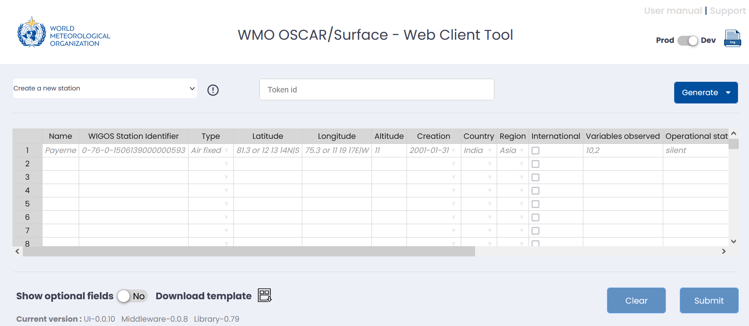
Register or edit a station using OSCAR/Surface web client tool
The OSCAR/Surface Web Client Tool (https:// oscar .tools .wmo .int/ web -client) is an external application that allows for batch operations. This means that operations in OSCAR/Surface can be applied to several stations at once so that the user does not have to manually enter the information one station at a time. The tool makes changes to the XML stations file and uploads them again through a queuing system. The current version supports the creation of stations, changing WSIs, changing schedules, and adding affiliations. When performing changes through the Web Client, the WSI is used to identify a station.

Slide 14
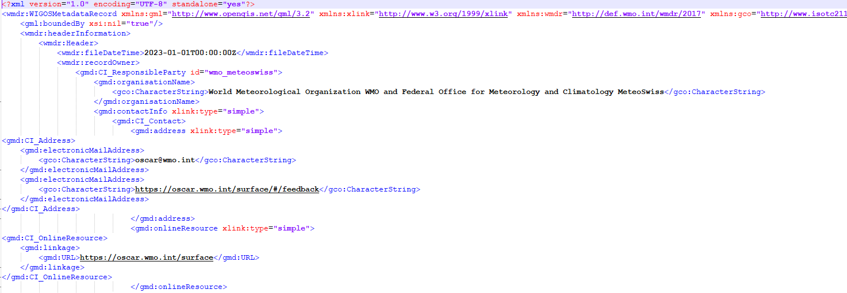
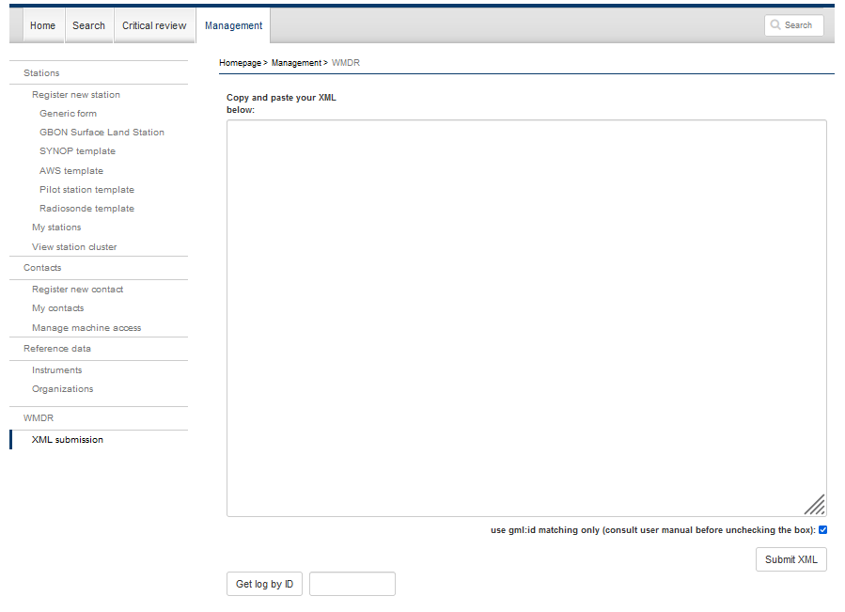
Register or edit a station using XML upload
A station can be registered (new station) or edited via web forms on the graphical user interface (GUI) of OSCAR/Surface or via the submission of a WMDR XML representation of the station (WMDR XML file).
The WMDR XML file for a station can be uploaded by national focal points using the XML submission of the Management tab or by the WMDR XML upload REST API.

Slide 15
Features and functions of OSCAR/Surface
Further guidance on specific Networks and Programs
Global Basic Observing Network (GBON)
Global Cryosphere Watch Programme (GCW)
Introduction
Search for a GBON station
Register a new GBON station*
Editing the metadata of a registered GBON station*
Program/Network affiliation of a GBON station* (add/remove GBON affiliation from a station
Introduction
Station characteristics
Observations/measurements
Bibliographic references
Login required*

Slide 16
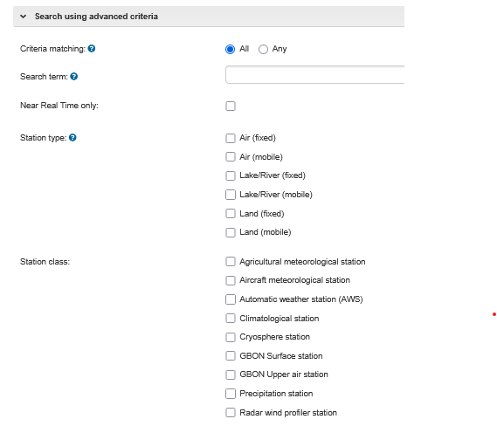
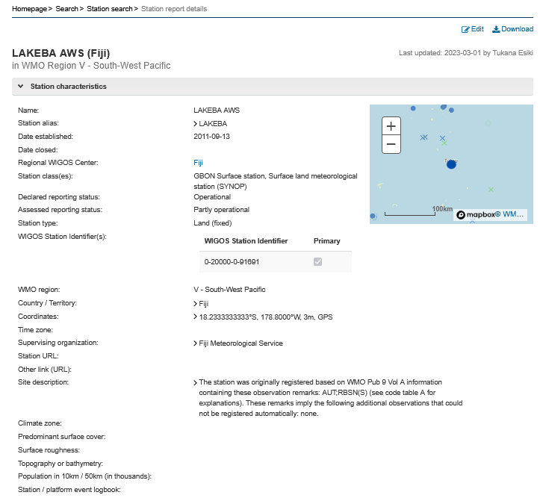
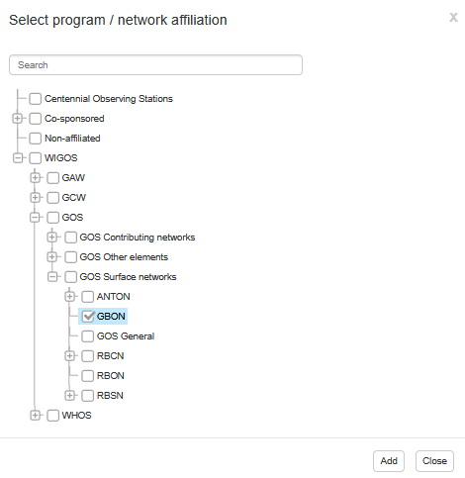
Search
GBON
Edit metadata
Register a new station
Add/remove affiliation

Slide 17
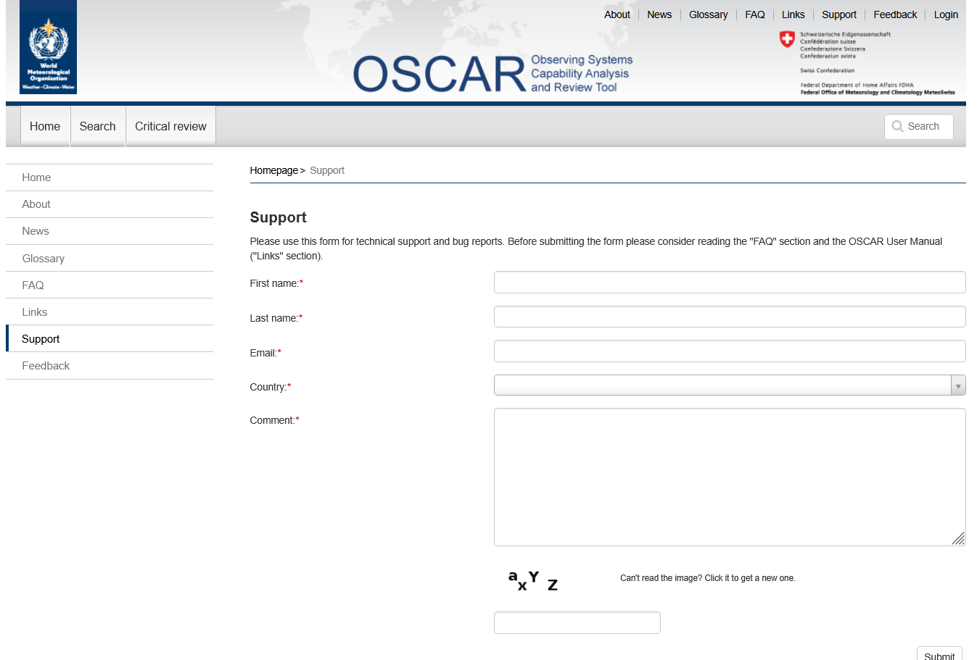
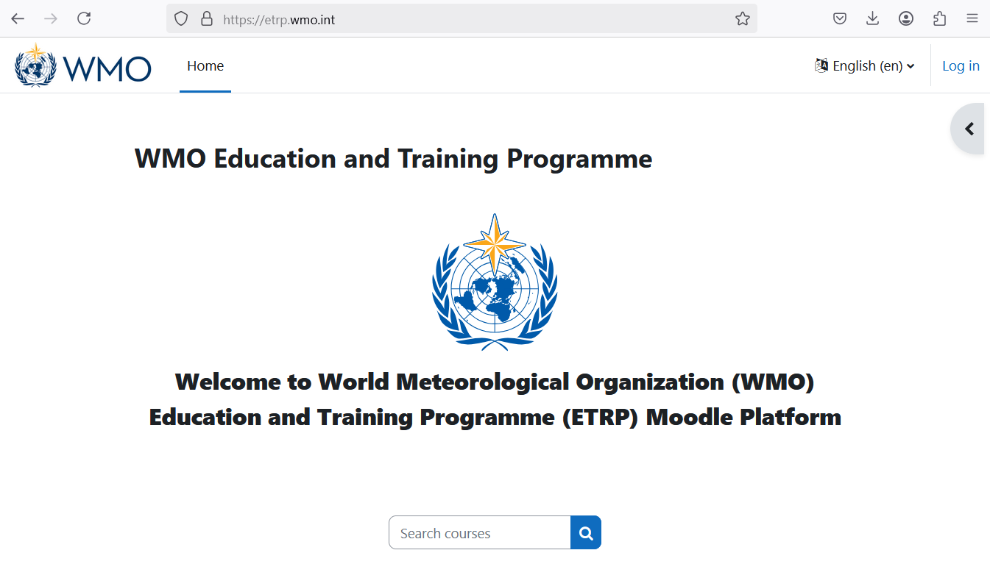
Guidance material, help and learning resources
Manual on the WMO Integrated Global Observing System (WMO-No. 1160): Manual on WIGOS (2024)
WIGOS Metadata Standard (WMO-No. 1192): WIGOS Metadata Standard (2019)
OSCAR/Surface User Manual: OSCAR/Surface User Manual (2024)
WIGOS Learning Portal: https://etrp.wmo.int/
OSCAR/Surface support: https://oscar.wmo.int/surface/#/support
OSCAR/Surface feedback: https://oscar.wmo.int/surface/#/feedback

Slide 18
Thank you​ Merci​ Gracias​ شكرا​ 谢谢​ Спасибо

