Slide 1

Webinar for Regional WIGOS Centres
Technical Guidelines for RWC on WDQMS
(WMO-No. 1224)
Management of Global Basic Observing Network (GBON) incident tickets
5 March 2026

Slide 2
Outline
GBON concept and compliance
Revision of the Technical Guidelines for RWCs 1224, ed 2024 in relation to GBON
Daily and monthly tasks regarding GBON stations monitoring
Procedure for initiating and Incident Management Process

Slide 3

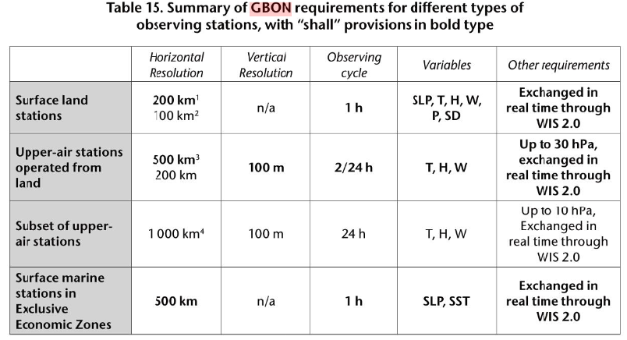
GBON general concepts
The Global Basic Observing Network (GBON) is a fundamental element of the WMO Integrated Global Observing System that responds to the geographical inconsistencies in availability of internationally exchanged data, in support of weather forecasts.
GBON introduces a new approach in which the basic surface-based observing network implemented by WMO Members is designed, defined and monitored at the global level. GBON works to improve the availability of the essential surface-based observational data, which are expected to enhance the quality of weather forecasts, thus helping improve the safety and well-being of citizens throughout the world and bring socioeconomic benefits.

Slide 4
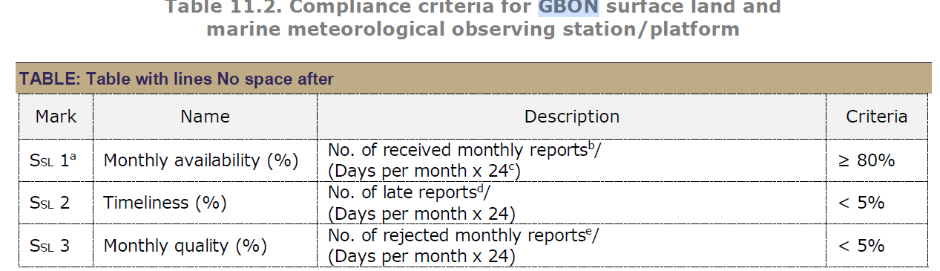
RWCs responsibilities regarding GBON compliance and monitoring
Guide to Wigos
(a) Station-level compliance
This is achieved when a given station reports the required measurements, at the required temporal frequency, with the required reporting quality.
11.4.2.2 GBON station compliance assessment
At present, station compliance is assessed using the criteria outlined in Tables 11.2 and 11.3, applicable only to surface and upper-air land stations.
To enable compliance assessment, a GBON station
must be registered in OSCAR/Surface and include the network affiliation to GBON. If the station does not meet this requirement, it will be assessed as non-compliant.
A surface land observing station/platform is found to be GBON compliant if all three criteria (SSL 1 – SSL 3) from Table 11.2 are met, for at least the measurement of atmospheric pressure.
11.5 MANAGEMENT OF GBON
11.5.1 Roles and responsibilities
Regional WIGOS Centres (RWCs): Monitor compliance of GBON observing stations with GBON requirements, and alert Members via their WDQMS NFPs about identified incidents
Practical approach for RWCs
RWC should seek station compliance rather than members compliance
Early detection of an incident and communication with the NFP might solve issues in time
Monitor compliance (for RWCs) implies that each element on the table is evaluated with appropriate tools
Monitor stations availability, quality and timeliness on daily basis with the WDQMS webtool and proceed as the Technical Guidelines 1224

Slide 5
Technical Guidelines for RWC on WDQMS ed 2024
(WMO-No. 1224)
This publication includes:
Content related to GBON in general, and GBON compliance monitoring in particular
Chapter on metadata management (chapter 2)
Detailed daily task and monthly task (chapter 4.2, 4.3)
Extraction of relevant parts on RWC’s roles, technical infrastructure and staff competences and their inclusion in the WIGOS Guide,
Updated guidance related to WIGOS Tools, particularly WDQMS and Incident Management System websites
Link to the Technical Guideline 1224
All WMO languages available

Slide 6
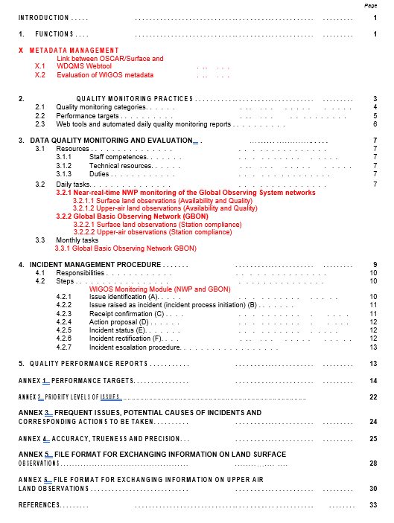

WMO-No 1224: 2024 edition
Link to the Technical Guideline 1224
All WMO languages available

Slide 7

WIGOS metadata management and IMS
(Chapter 2)
METADATA MANAGEMENT
2.1 Links between OSCAR/Surface and WDQMS webtool
Daily Metadata Updates:
The WDQMS webtool retrieves metadata information from OSCAR/Surface on a daily basis. For example, the availability maps both in the GBON and NWP modules, are generated in near-real time by comparing the observations received by the NWP Centres against the schedules retrieved from OSCAR/Surface (in the case of NWP module). Therefore, if the metadata has been updated today, tomorrow's maps should reflect that change. If a new station, for example a GBON station, is added to OSCAR/Surface, it should appear on the WDQMS availability map on the next day. If that does not happen, it means that some fields may have not been correctly populated in OSCAR/Surface or haven’t been defined as GBON, and this needs to be addressed. This new station should be shared by the member in GTS/WIS2 accordingly, so green dots appear in the WDQMS map in the following days in all modules.
OSCAR should look like this when assigning a station as GBON

Slide 8
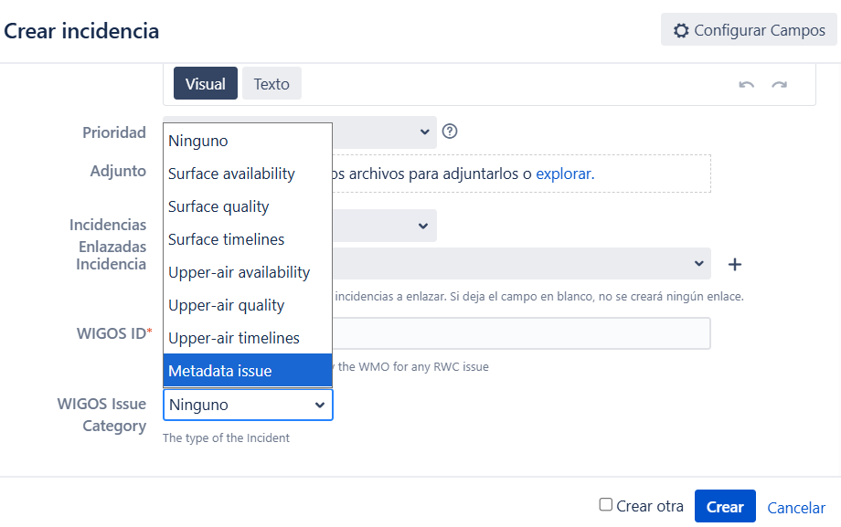
2.2 Evaluation of WIGOS Metadata
Station Metadata:
The received observations are more or less than the required number of bulletins as determined by the observing schedule for international exchange according to OSCAR/Surface for GOS stations;
or the station is not expected to report during the period according to OSCAR/Surface schedule or operational status, yet data was received.
A station may also report data but is not registered in OSCAR/Surface. Such stations can only be identified by their Traditional Station Identifier (TSI), WIGOS Station Identifier (WSI), or location in the WDQMS Webtool.
Comment 1: these metadata is irrelevant for GBON stations performance monitoring. Relevant metadata for GBON:
Station geolocalization, station class, method of obs.
Network: GBON
Observed variables (P,T,U,HR,PP) assigned to GBON
Action: initiate an Incident Management Process with Wigos Issue Category “Metadata Issue”
Comment 2: although the schedule of the station is irrelevant in the GBON module, this schedule is the baseline in the NWP module, and station availability should be consistent with data received at centres. If this is the case, then no IMP is necessary

Slide 9
Data Quality Monitoring and Evaluation
(Chapter 4)
This chapter mainly describes the routine daily/monthly tasks for RWC staff regarding operational observing stations that contribute to GOS general 4.2.1, and GBON stations in particular 4.2.2
The daily tasks describe general activities that can be perform with the WIGOS tools.
GBON stations, because by definition have different performance targets, can be monitored with the GBON module in the WDMWS web tool.
Note about the term “Compliance”:
In this guideline, compliance refers to stations/observations that meet the expected requirements according to the set of targets defined in the different monitoring categories or per type of network.

Slide 10
4.2.2 Global Basic Observing Network (GBON)
1. Surface Land Observations – Station Compliance (Availability of Surface Land Observations (GBON)):
Review the available webtool outputs and other quality monitoring reports to identify stations that show any non-compliance concerning data availability.
If a station did not meet the GBON compliance criteria for surface land observations for 2 or more days, an IMP as described in Chapter 5 should be initiated by raising a ticket in the Incident Management System which is assigned to the WDQMS NFP of the Member operating the station.
2. Upper-Air Land Observations – Station Compliance (Availability of Upper-Air Land Observations (GBON)):
Review the available webtool outputs and other quality monitoring reports to identify stations that show any non-compliance concerning data availability.
If a station did not meet the GBON compliance criteria for surface land observations for 2 or more days, an IMP as described in Chapter 5 should be initiated by raising a ticket in the Incident Management System which is assigned to the WDQMS NFP of the Member operating the station.
RWC approach: identify new potential incidents and proceed with the IMP if necessary. Known long-lasting issues don’t need to initiate an IMP

Slide 11
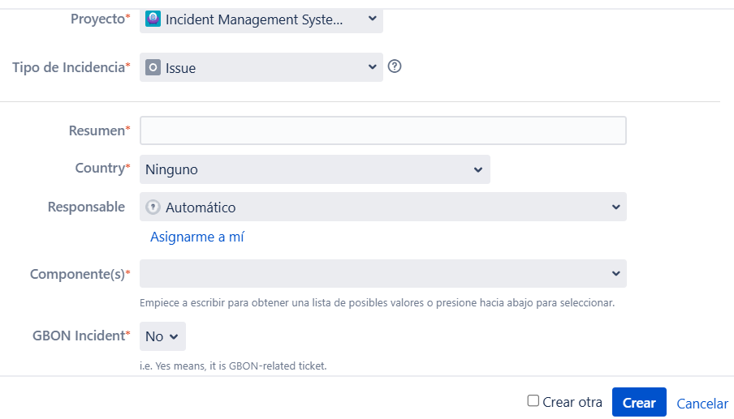
Daily tasks for GBON stations (4.2.2)
(Chapter 4)
Evaluate Station Performance
Daily review of automated quality monitoring reports from WIGOS Monitoring Centres via the GBON module / WDQMS webtool and other supplementary monitoring portals.
Assess compliance with data availability, timeliness, and quality targets (only availability for the moment).
Evaluate possible sources of non-compliance
2. Address Monitoring Centre Discrepancies
Initiate incident management only if most WIGOS Monitoring Centres show similar non-compliance issues. Use the GBON dialog box
3. Incident Ticketing
Raise incident tickets for non-compliant stations, grouping multiple stations with the same issue under one ticket if applicable.
IMS for GBON stations: new fields
New field: Country/territory of the station
GBON Incident set to “yes” for all tickets raised to a station from this network
About quality and timeliness for GBON stations
These Wigos categories are not available under the GBON module for the moment, but both can be addressed with the NWP module using quality and timeliness criteria common to all GOS stations.

Slide 12
4. Check New Reporting Stations
Verify if stations that did not report the previous day have started reporting.
6. Monitor Previous Issues:
  Re-evaluate stations with past issues to check for performance improvement.
  Initiate an Incident Management Process (IMP) if an issue persists for 2 consecutive days.
7. Monitor Incident Tickets:
  Daily tracking of incident tickets to ensure members acknowledge, propose actions, and provide regular updates.
8. Confirm Incident Rectification:
  Verify and close incident tickets after successful rectification by the member's WDQMS NFP.
9. Investigate Metadata Issues:
  GBON monitoring for availability baseline for surface stations is 24 observations or more. The reporting schedule or station status are not considered in this module.
10. Handle "Won’t Fix" and Escalation:
  Update ticket status to "Won’t Fix" if immediate action is not possible and escalate to WMO Secretariat if necessary (when no response from the WDQMS NFP by any means).

Slide 13
4.2.2 Global Basic Observing Network (GBON)
Reasons for noncompliance in GBON module (black, red or orange dots)
Dimension | Surface land | Upper - air land
Data Availability Issues | - The station did not report any data the previous day (black dot). | - The station did not report any complete sounding the previous day (black dot).
 | - The total number of reports is significantly lower than the expected number of observations in the previous day (orange/red dot). | - The station reported only one complete sounding the previous day (orange dot).
Incident Management Process | - If a station does not meet the GBON compliance criteria for surface land observations for 2 or more days, an incident management process should be initiated. | same

Slide 14
Monthly task (only for GBON network)
(Detailed chapter 4.3)
4.3.1 Global Basic Observing Network (GBON)
4.3.1.1 Surface Land Observations – Station Compliance (Availability of Surface Land Observations (GBON))
Review Availability:
  Review the available webtool outputs and quality monitoring reports to identify stations that show any non-compliance concerning data availability.
  Reasons for non-compliance might include:
    The station reported less than 10 days for the month (category: data availability) – white dot in WDQMS webtool.
    The station did not report any data for the month (category: data availability) – black dot in WDQMS webtool.
    The total number of reports is significantly lower than the expected number of observations for the month (category: data availability) – orange/red dot in WDQMS webtool.
Initiate Incident Management Process:
  If a station did not meet the GBON compliance criteria for surface land observations, an Incident Management Process (IMP) as described in Chapter 5 should be initiated by raising a ticket in the Incident Management System (IMS) which is assigned to the WDQMS NFP of the Member operating the station.

Slide 15
4.3.1.2 Upper-Air Land Observations – Station Compliance (Availability of Upper-Air Land Observations (GBON))
Review Availability:
  Review the available webtool outputs and quality monitoring reports to identify stations that show any non-compliance concerning data availability.
  Reasons for non-compliance might include:
    The station did not report any complete soundings for the month (category: data availability) – black dot in WDQMS webtool.
    The total number of complete soundings is significantly lower than the expected number of soundings for the month (category: data availability) – orange/red dot in WDQMS webtool.
Initiate Incident Management Process:
  If a station did not meet the GBON compliance criteria for upper-air land observations, an Incident Management Process (IMP) as described in Chapter 5 should be initiated by raising a ticket in the Incident Management System (IMS) which is assigned to the WDQMS NFP of the Member operating the station.

Slide 16
Monthly task
(Detailed chapter 4.3)
Comment: raise a ticket only if no ticket was issued previously. Is not necessary to initiate a IMP for well known and long-lasting issues
4.3.1 Global Basic Observing Network (GBON)
Reasons for noncompliance in GBON module (black, red, orange and white dots)
Dimension | Surface Land | Upper-air Land
Data Availability Issues | - Station reported less than 10 days for the month (white dot). | -
 | - Station did not report any data for the month (black dot). | same
 | - The total number of reports is significantly lower than the expected number of observations for the month (orange/red dot). | same
Incident Management Process | - If a station does not meet the GBON compliance criteria for surface land observations, an incident management process should be initiated. | same

Slide 17
The Incident Management Process (all networks)
IMP Process | RWC | NFP
Issue Identification (A) | Monitor station performance daily and identify/evaluate issues; create a ticket with detailed information; observe the issue for 5 days in NWP monitoring and 2 days in GBON monitoring before deciding whether to escalate it to an incident. | Can report issues to RWC if noticed, but no specific primary responsibility at this stage.
Issue Raised as Incident (B) | If the issue is serious, change the ticket status to "Incident" in the IMS tool and assign to the NFP; If the issue disappears may choose to further monitor the station performance for 2 more days before closing the issue (no incident); can immediately convert a significant issue to an incident. | Receive the notification from RWC and prepare to take actions to solve the incident.
Receipt Confirmation (C) | Wait for the NFP to confirm the receipt of the ticket and update the ticket status to “Confirm” or “Under Investigation" according to the NFP’s response. | Confirm the receipt of the ticket through the "Comment" section of the IMS tool to indicate the start of the investigation.
Action Proposal (D) | Evaluate the action proposal provided by the NFP and decide whether to update the ticket status to "In Progress". | Identify the cause of the incident and provide detailed action proposals in the ticket.
Incident Status (E) | Understand the incident status based on the monthly updates provided by the NFP; update the ticket to “Won’t fix" if the incident cannot be resolved; close the original ticket and start a new process if the cause is incorrect. | Regularly update the RWC on the incident status through the "Comments" section of the ticket, including actions taken and action logs.
Incident Rectification (F) | Check the rectification reported by the NFP and decide whether to “Resolve” the ticket; if there are still problems, request further actions from the NFP; may choose to further monitor the station performance for 2 days before closing. | Notify the RWC when the incident has been rectified.

Slide 18
IMP Process | RWC | NFP
Incident Escalation Procedure | Escalate the incident to the WMO Secretariat if unable to contact the NFP or the incident is severe and remains a "known problem"; in some cases of bilateral cooperation, can directly contact the Permanent Representative of the member and inform the WMO Regional Office. | Coordinate internally in the NMHS or cooperate with other relevant parties if unable to solve the problem; escalate the unresolved problem to a higher level within the NMHS.

Slide 19
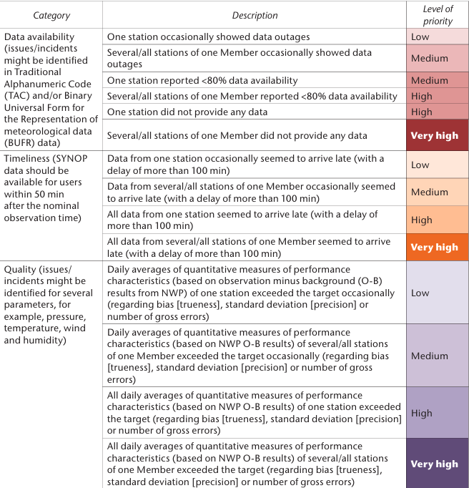
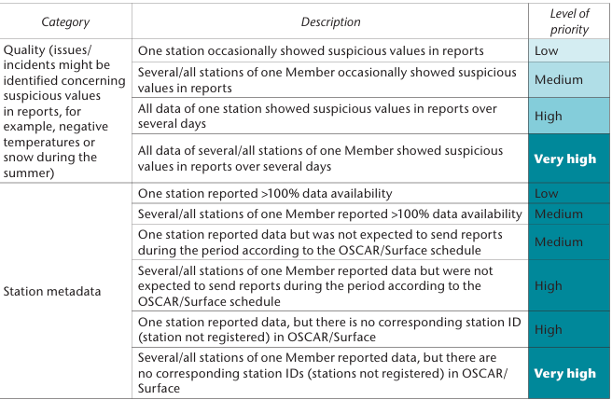
ANNEX ‭1. PRIORITY LEVELS OF ISSUE (all networks) – Surface land stations
The tables can guide the priorities on the daily tasks regarding monitoring, evaluation and ticketing. Top priorities are those defined as Very High and High levels. For GBON stations 2 days of a station not performing as expected on any Wigos category should be assessed with the priority given by the table.

Slide 20
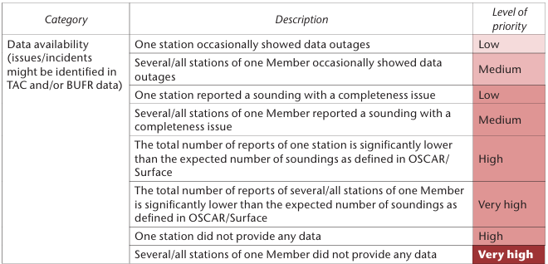
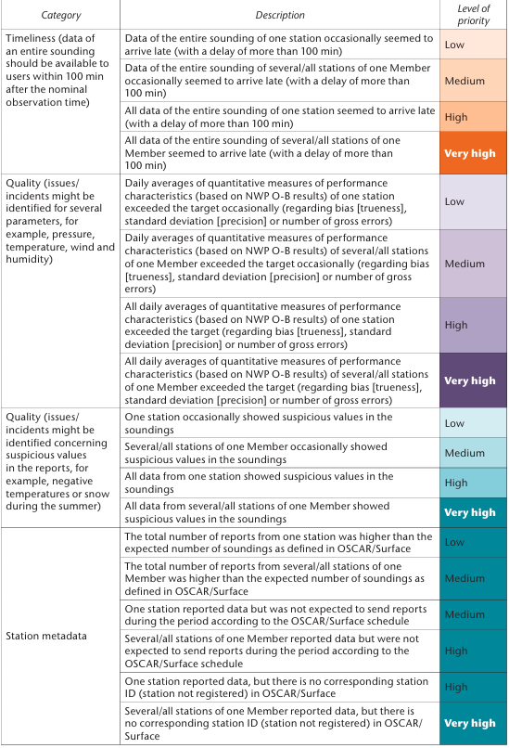
ANNEX ‭1. PRIORITY LEVELS OF ISSUE (all networks) – Upper air land stations

Slide 21
Conclusions
RWC should seek station compliance rather than members compliance.
Early detection of an incident and communication with the NFP might solve issues in time.
Monitor compliance (for RWCs) implies that each category (availability, quality and timeliness) is evaluated with appropriate tools. Availability and surface pressure the most important ones.
Monitor stations availability, quality and timeliness on daily/monthly basis with the WDQMS webtool and proceed with IMP for new incidents. Long-lasting known problems don’t need to be addressed with the IMS.
Follow the priorities for ticket creation when multiple issues are presented
The IMP starts after 2 consecutive days of non-compliance. Use the new fields in IMS to better identify tickets assigned to a GBON station

Slide 22
Thank you.
^{wmo.int}

