Slide 1
Webinar#34: GBON Ticket Management
5 March 2026
Managing IMS Tickets – JIRA Boards
(How to create and configure a JIRA board to help you manage tickets)
Stuart Matthews, RWC EUMETNET

Slide 2
Content
Creating a Board
  from scratch
  using an existing Board as a template
Filter the Board to only show tickets related to your RWC or Country
Customise your Board
Deleting a Board
JIRA Boards can be created by anyone who has access to the IMS.
Ideal for RWCs, and even member countries, to manage their incidents

Slide 3
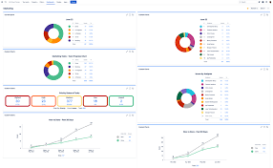
Introduction
JIRA Dashboards v Boards
Jira Dashboards provide a high-level, customizable overview of project progress and key metrics through various "gadgets" like charts and reports.
In contrast, Jira Boards (Scrum or Kanban) offer a visual, day-to-day management tool for a specific project or filter of issues, displaying tasks as cards in columns that represent workflow stages.
This training is related to creating a JIRA Board to help RWCs and Members manage their IMS tickets
There is a lot of training online related to Dashboards. Dashboards might offer you tools to display metrics related to your management of tickets within the IMS.
  This training material does not cover Dashboards.
Other things to note...
Whoever creates the Board will be the owner
Only the owner (and admin) can edit and delete a Board after it has been created
All users can view and copy other Boards, but you shouldn’t be able to change other RWCs Boards

Slide 4
Creating a Board
Some RWCs have created Boards already...
RWC Russia,
RWC EUMETNET,
RWC Sarajevo,
RWC Romania and
RWC Fiji
Currently there no ‘Country’ Boards within the IMS
Board are highly configurable,
Can be aligned with RWC and National incident management processes
Can be easily changed and modified as you refine your processes.
For RWC EUMETNET using Boards has made managing, prioritising and following-up on tickets significantly easier

Slide 5
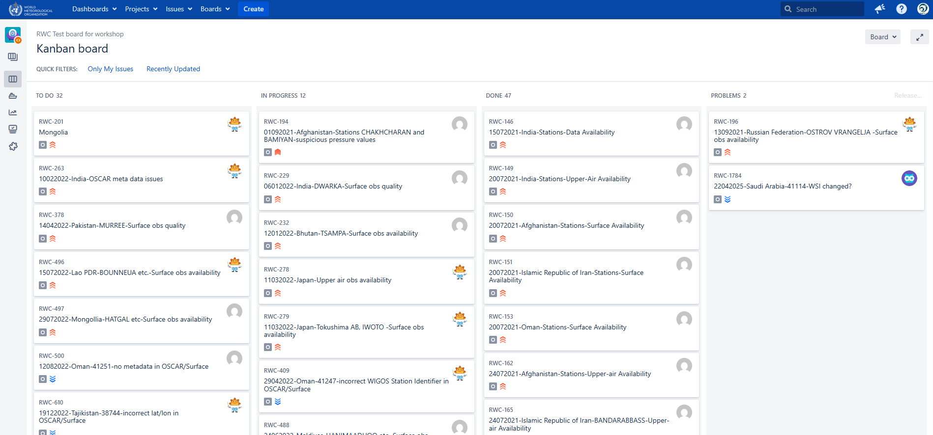
Example board created using the following slides

Slide 6
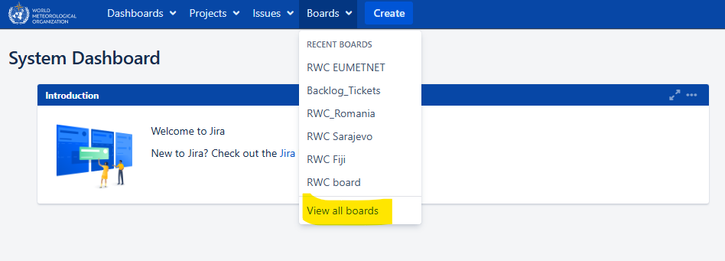
Create a new Board (1)
Log into the IMS
Select “Boards”
  “View all boards”

Slide 7
Creating a Board
...from scratch

Slide 8
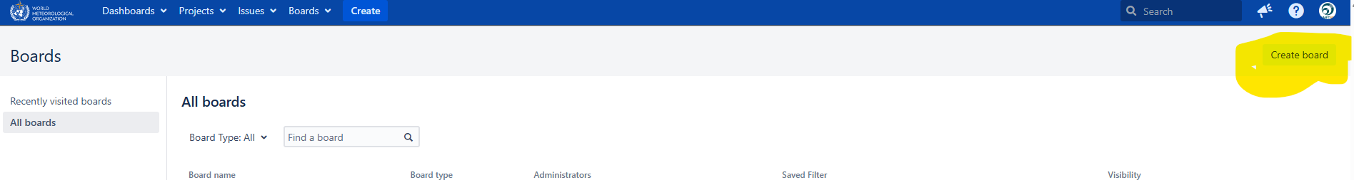
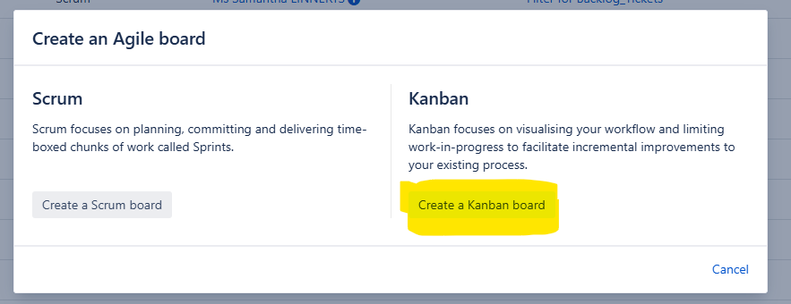
Create a new board (from scratch #1)
Select “Create board” – Top right-hand corner
Select Kanban
“Create a Kanban board”

Slide 9
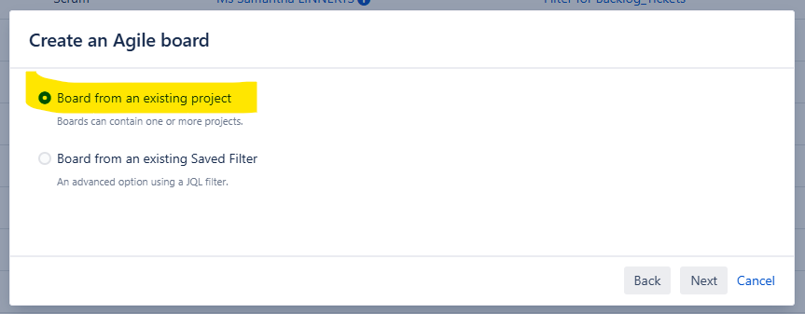
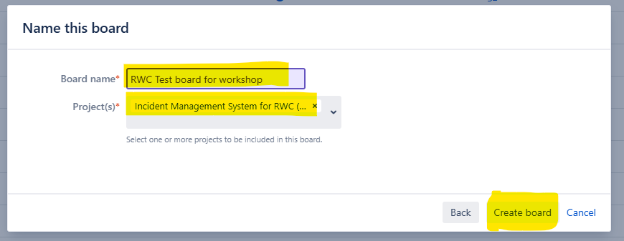
Create a new Board (from scratch #2)
Select “Board from an existing project”
Name the board
Select the “Incident Management System for RWC (...”
“Create board”

Slide 10
Creating a Board
...using an existing Board as a template

Slide 11
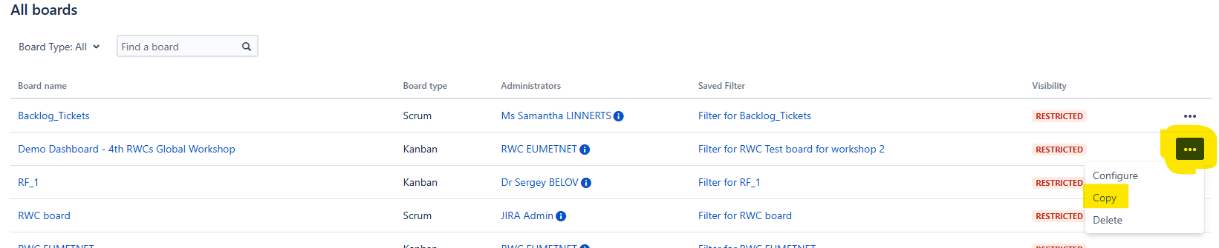
Create a new Board (using an existing board as a template #1)
Select the board you want to copy “...”

Slide 12
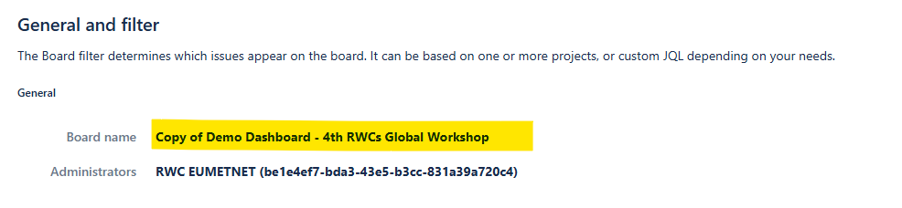
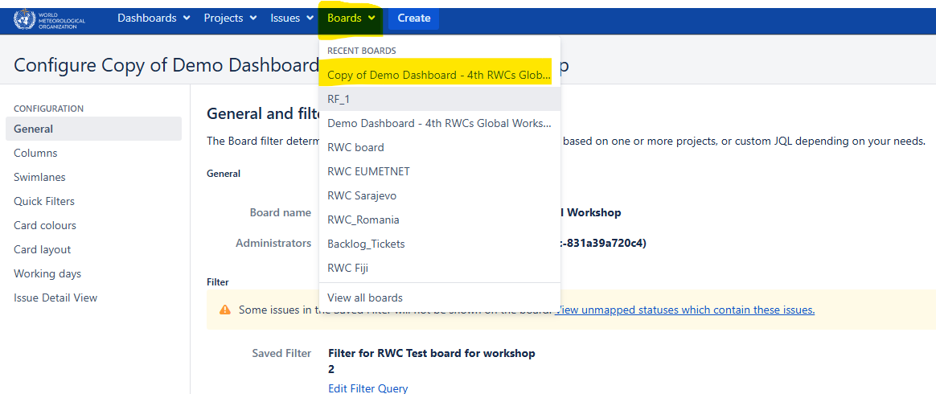
Create a new board (using an existing board as a template #1)
Rename the Board
View the Boards from the main menu and the new board will appear in the list.

Slide 13
Configuring a board
Now you have created the board, you can configure it to show the information you want.
You’ll need to change the ‘filter’ so the board only shows tickets for your RWC or Country.
You can customise the Board, so it further meets your requirements.

Slide 14
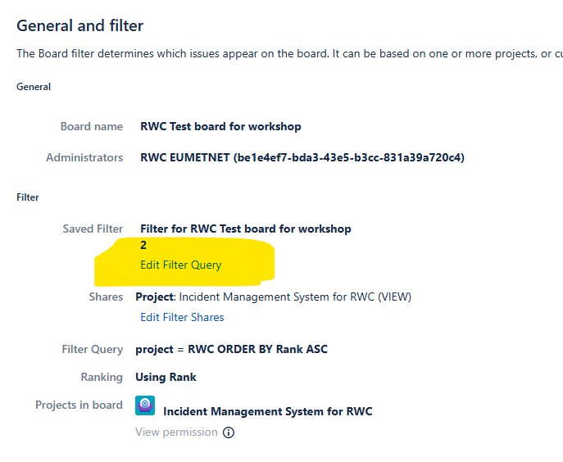
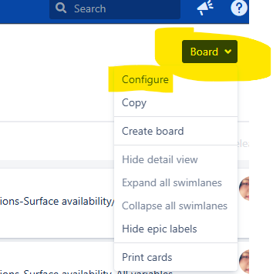
Configure the board – Filter for your RWC or Country (1)
Select “Board” and then “Configure”
Edit the filter for the Board

Slide 15
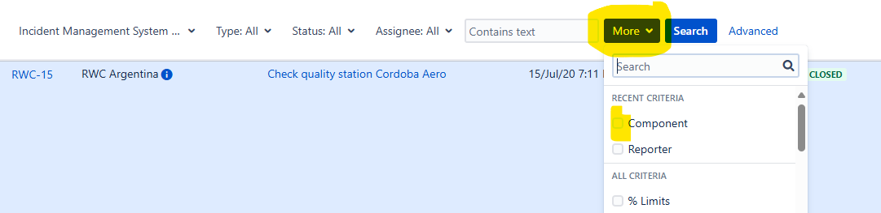
Configure the board – Filter for your RWC or Country (2)
If you started ‘from scratch’
  The new board will show all the tickets in the IMS
  Select “More” and then
    “Component” so you can see the full list of RWCs within the IMS or
    “Country” to see a list of all the Countries within the IMS
If you copied an existing board
  The board will already be filtered to show the tickets of the copied board
You can now select/change the RWC or Country you want to appear in your new Board

Slide 16
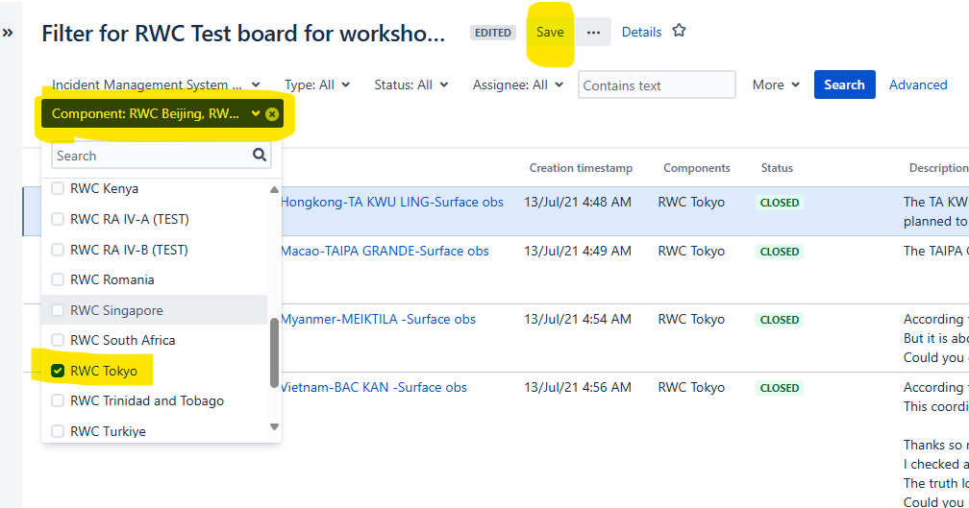
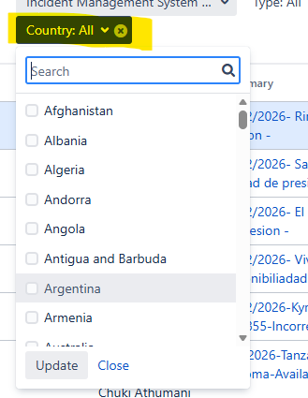
Configure the board – Filter for your RWC or Country (3)
You can now select the RWC(s) or Countries you want to appear in your Board by selecting from the tick boxes
*Where RWCs change responsibility through the year (e.g., RWC Beijing/Tokyo you could create a single Board to help with transition from one ‘node’ to another.
“Save” the changes

Slide 17
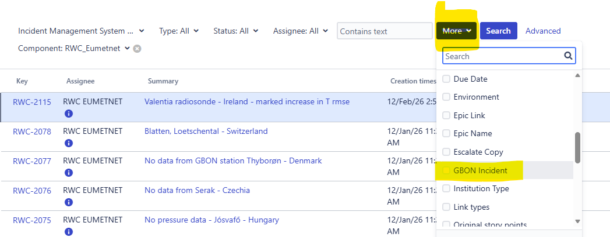
Configure the board – Filter for your RWC or Country (4)
You can also filter on other fields.
  For example. You might choose to only show GBON tickets on your dashboards
“Save” the changes

Slide 18
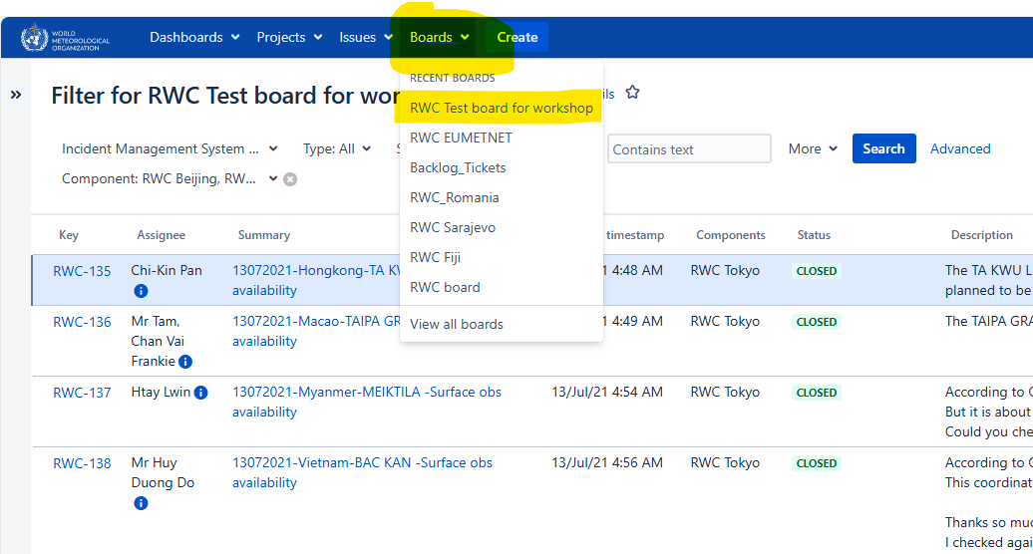
Configure the Board – Filter for your RWC or Country (5)
Go back to your board and you’ll now only see tickets related to the RWC(s) or Country you selected

Slide 19
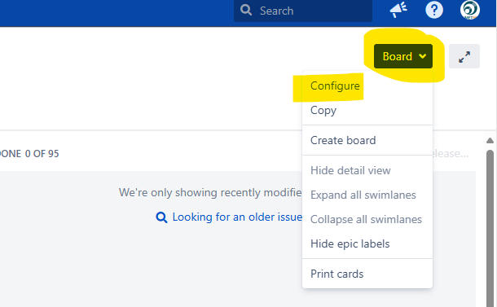
Customise your Board (1)
You can now configure your board further
For example...
Hiding older completed tickets
Which ticket status appears in each column
What information is shown on each ticket displayed

Slide 20
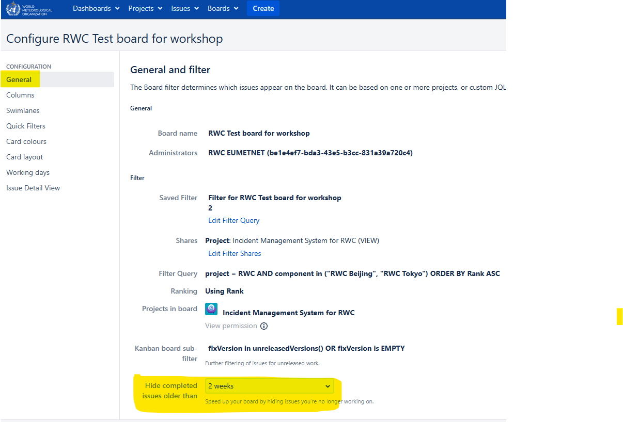
Customise your Board (1)
Hiding older completed tickets
The default hides tickets Closed for over 2 weeks.
  You can change this.
In the General tab select the length of time you want to show closed tickets.

Slide 21
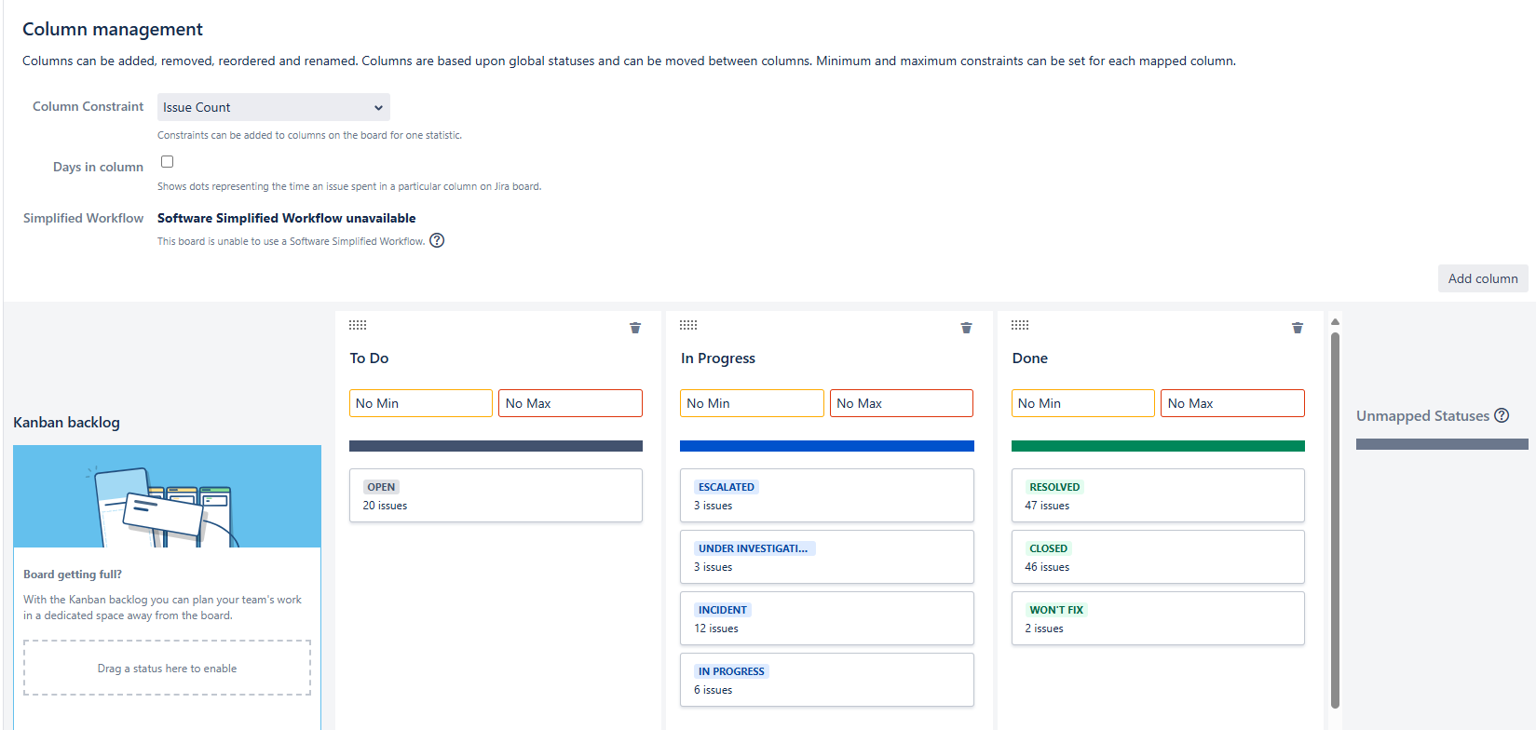
Customise your board (2)
Selecting what appears in each column of the Board
You can add new columns
Move columns
You can rename columns
You can move ticket issue types from one column to another
You can choose not to display an issue type
Simply grab and drop the column or issue type you want to move

Slide 22
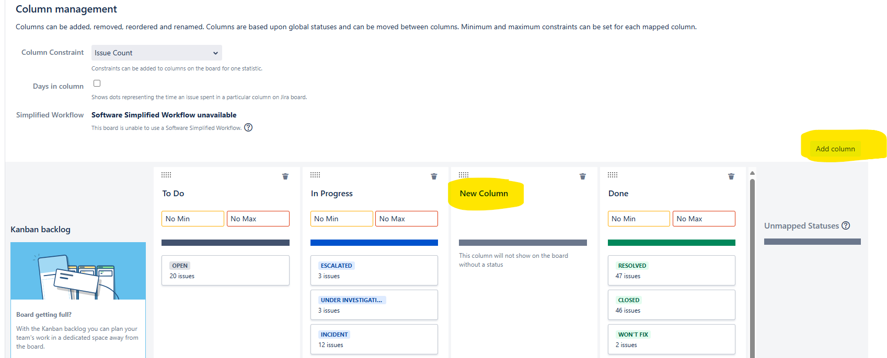
Customise your Board (3) – Add a new column

Slide 23
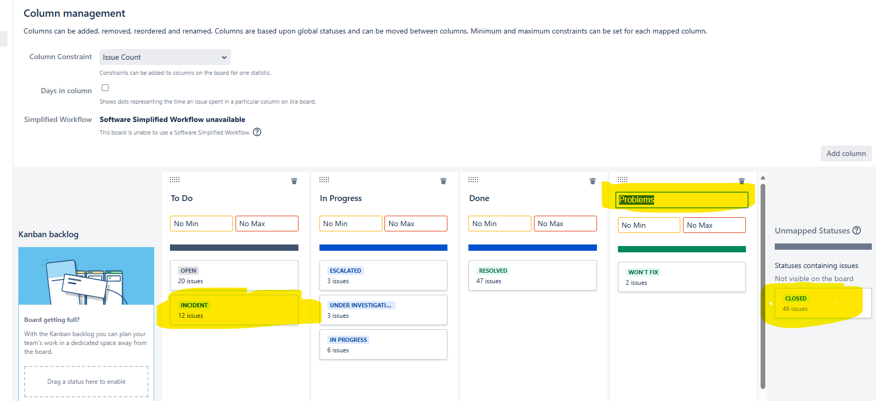
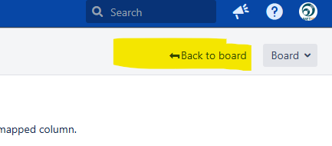
Customise your board (4) – Rename and move column. Move issues types
This example, the...
New column is moved
New column was renamed to “Problems”
Won’t fix tickets moved to the “Problems” column
Incidents moved to “To Do”
Closed tickets are not displayed at all
Select <= Back to board
to view your changes

Slide 24
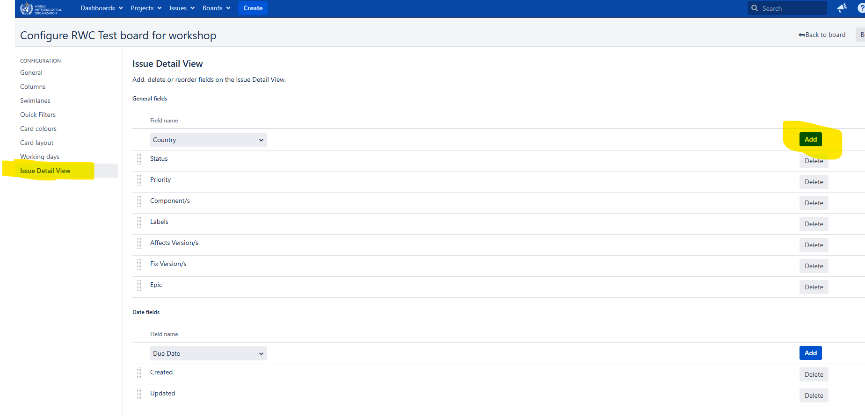
Customise your Board (5) – Changing what’s displayed on a ticket
You can also choose which fields are displayed on the board
Select “Issue Detail View”
You can “Add” or “Delete” fields from the Board
This change just affects the information, for each ticket, displayed on the Board.
The fields are still there when you open the ticket

Slide 25
Here’s an example of the board we’ve just created

Slide 26
Deleting a Board
For example, you might want to create a completely new board.
If you do, it is a good idea to remove/delete your old Board

Slide 27
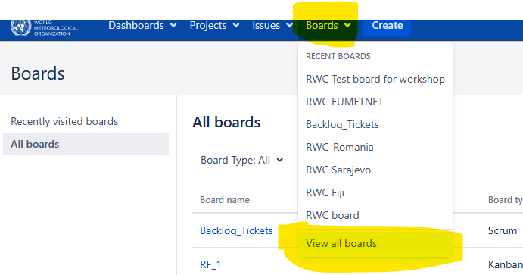
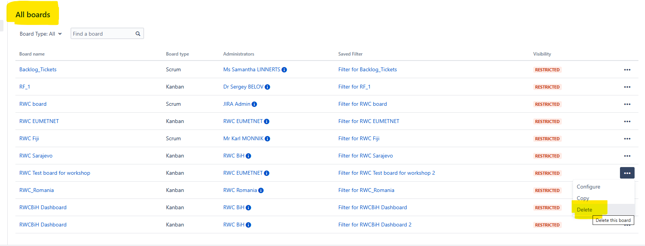
And finally – You can delete a board
Move back to the main Boards menus and select View all boards
Select the Board you want to delete “...” and Delete

Slide 28
Thank you

