Slide 1
Webinar for Regional WIGOS Centres
Update of Technical Guidelines for RWC on WDQMS (WMO-No. 1224)
TT-RWC
25 Feb. 2025

Slide 2
Update of Technical Guidelines for RWC on WDQMS (WMO-No. 1224)
There is a significant update of this publication that includes:
New content related to GBON in general, and GBON compliance monitoring in particular
New chapter on metadata management (chapter 2)
Detailed daily task and monthly task (chapter 4.2, 4.3)
extraction of relevant parts on RWC’s roles, technical infrastructure and staff competences and their inclusion in the WIGOS Guide,
updated guidance related to WIGOS Tools, particularly WDQMS and Incident Management System websites
deletion of annexes 1, 5, 6, 7.

Slide 3
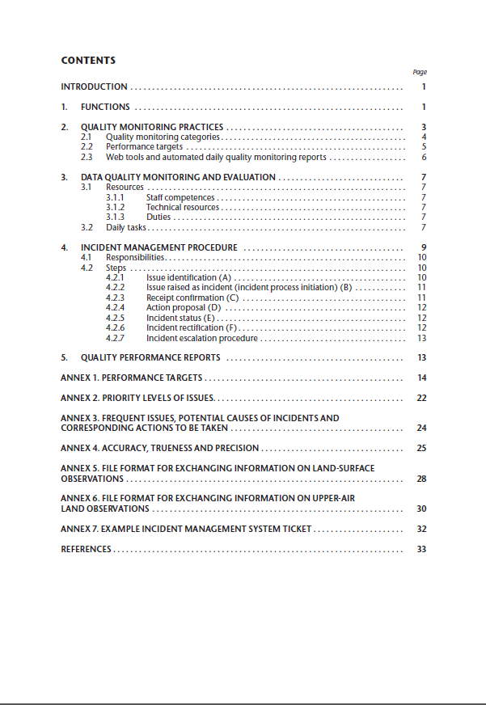
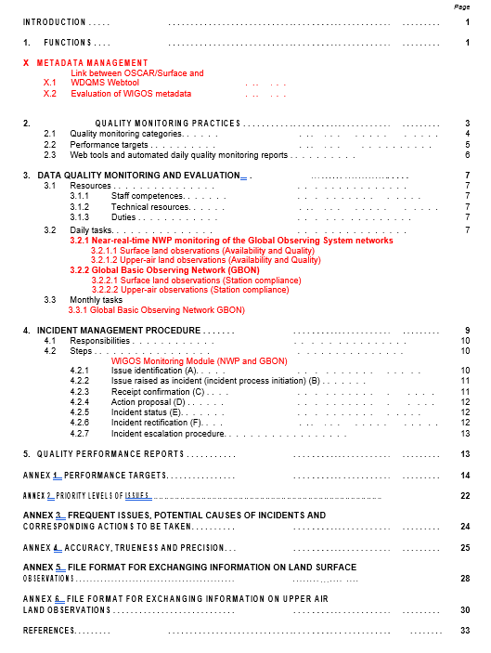
WMO-No 1224: 2018 edition
WMO-No 1224: 2024 edition

Slide 4
WIGOS metadata-related updates
(New chapter 2)
METADATA MANAGEMENT
2.1 Links between OSCAR/Surface and WDQMS webtool
Daily Metadata Updates:
The WDQMS webtool retrieves metadata information from OSCAR/Surface on a daily basis. For example, the availability maps are generated in near-real time by comparing the observations received by the NWP Centres against the schedules retrieved from OSCAR/Surface. Therefore, if the metadata has been updated today, tomorrow's maps should reflect that change. If a new station is added to OSCAR/Surface, it should appear on the WDQMS availability map on the next day. If that does not happen, it means that some fields may have not been correctly populated in OSCAR/Surface and this needs to be reported to the RWCs. This new station should be shared by the member in GTS/WIS2 accordingly so green dots appear in the WDQMS map in the following days.
Monitoring Results for GOS and GBON Stations:
In the case of Global Observing System (GOS) surface and upper-air stations on land, the monitoring results of the actual performance of each station, produced by the WDQMS webtool, are provided to OSCAR/Surface and displayed as “Assessed reporting status”.

Slide 5
2.2 Evaluation of WIGOS Metadata
Station Metadata:
The received observations are more or less than the required number of bulletins as determined by the observing schedule for international exchange according to OSCAR/Surface for GOS stations; or the station is not expected to report during the period according to OSCAR/Surface schedule or operational status, yet data was received. A station may also report data but is not registered in OSCAR/Surface. Such stations can only be identified by their Traditional Station Identifier (TSI), WIGOS Station Identifier (WSI), or location in the WDQMS Webtool.
Important Note:
RWCs are not responsible for correcting station metadata.

Slide 6
Daily task (Detailed chapter 4.2)
Evaluate Station Performance
Daily review of automated quality monitoring reports from WIGOS Monitoring Centres via the WDQMS webtool and other supplementary monitoring portals.
Assess compliance with data availability, timeliness, and quality targets.
Evaluate possible sources of non compliance
2. Address Monitoring Centre Discrepancies
Initiate incident management only if most WIGOS Monitoring Centres show similar non-compliance issues.
3. Incident Ticketing
Raise incident tickets for non-compliant stations, grouping multiple stations with the same issue under one ticket if applicable.
4. Check New Reporting Stations
Verify if stations that did not report the previous day have started reporting.
5. Address Reported Issues
Evaluate performance of stations reported by users (e.g., WIGOS Monitoring Centres, Global NWP Centres, or RA Members).

Slide 7
6. Monitor Previous Issues:
Re-evaluate stations with past issues to check for performance improvement.
Initiate an Incident Management Process (IMP) if an issue persists for 5 consecutive days.
7. Monitor Incident Tickets:
Daily tracking of incident tickets to ensure members acknowledge, propose actions, and provide regular updates.
8. Confirm Incident Rectification:
Verify and close incident tickets after successful rectification by the member's WDQMS NFP.
9. Investigate Metadata Issues:
Request WDQMS NFPs to investigate and update OSCAR/Surface entries if metadata errors are suspected.
10. Handle "Won’t Fix" and Escalation:
Update ticket status to "Won’t Fix" if immediate action is not possible, and escalate to WMO Secretariat if necessary (when no response from the WDQMS NFP by any means).

Slide 8
4.2.1 Near Real-Time NWP Monitoring of the GOS Networks
Surface Land Observations (Global NWP) – Availability, Quality, Timeliness, and Station Metadata:
Review the available WDQMS webtool outputs (maps and graphics) and other quality monitoring reports to identify stations that show any non-compliance concerning data availability, timeliness, quality, and station metadata regarding the WDQMS performance targets.
Upper-Air Land Observations (Global NWP) – Availability, Quality, Timeliness, and Station Metadata:
Review the available webtool outputs and other quality monitoring reports to identify stations that show any non-compliance concerning the received upper-air (soundings) observations and quality results regarding the WDQMS performance targets.

Slide 9
4.2.1 Near Real-Time NWP Monitoring of the GOS Networks
Dimension | Surface Land | Upper-air Land
Data Availability Issues | - Station did not report any data since the previous day (black dot) | same
 | - The total number of reports is significantly lower than the expected number of observations as defined in the observing schedule in WIS and OSCAR/Surface (orange dot/red) | Daily: same (orange dot) Six hours: incomplete launch (missing variables) (orange dot)
 |  | Daily: same (red dot) Six hours: Incomplete launch (missing layers) (red dot)
Data Quality Issues | - The daily averaged quality results received from WIGOS Monitoring Centres (for example, derived from OB results from Global NWP Centres) exceed the WMO threshold requirements concerning a particular variable or variables (yellow/orange/red dot) | same
Timeliness Issues | The data received with a significant delay, which may lead to a situation where data could not be used in near-realtime applications (not quantified in WDQMS webtool currently) | same
Metadata Issues | - The total number of reports is higher than the expected number of observations defined in the observing schedule for international dissemination in OSCAR/Surface (pink dot) | same
 | - The station is not expected to send reports during the period according to OSCAR/Surface schedule or operational status (grey dot) | same
 | - The station send reports but there is no corresponding station ID (not registered) in OSCAR/Surface (yellow dot) | same

Slide 10
4.2.2 Global Basic Observing Network (GBON)
1. Surface Land Observations – Station Compliance (Availability of Surface Land Observations (GBON)):
Review the available webtool outputs and other quality monitoring reports to identify stations that show any non-compliance concerning data availability.
If a station did not meet the GBON compliance criteria for surface land observations for 2 or more days, an IMP as described in Chapter 5 should be initiated by raising a ticket in the Incident Management System which is assigned to the WDQMS NFP of the Member operating the station.
2. Upper-Air Land Observations – Station Compliance (Availability of Upper-Air Land Observations (GBON)):
Review the available webtool outputs and other quality monitoring reports to identify stations that show any non-compliance concerning data availability.
If a station did not meet the GBON compliance criteria for surface land observations for 2 or more days, an IMP as described in Chapter 5 should be initiated by raising a ticket in the Incident Management System which is assigned to the WDQMS NFP of the Member operating the station.

Slide 11
4.2.2 Global Basic Observing Network (GBON)
Dimension | Surface land | Upper - air land
Data Availability Issues | - The station did not report any data the previous day (black dot). | - The station did not report any complete sounding the previous day (black dot).
 | - The total number of reports is significantly lower than the expected number of observations as defined in the observing schedule for international dissemination in OSCAR/Surface (orange/red dot). | - The station reported only one complete sounding the previous day (orange dot).
Incident Management Process | - If a station does not meet the GBON compliance criteria for surface land observations for 2 or more days, an incident management process should be initiated. | same

Slide 12
Monthly task (Detailed chapter 4.3)
4.3.1 Global Basic Observing Network (GBON)
4.3.1.1 Surface Land Observations – Station Compliance (Availability of Surface Land Observations (GBON))
Review Availability:
Review the available webtool outputs and quality monitoring reports to identify stations that show any non-compliance concerning data availability.
Reasons for non-compliance might include:
The station reported less than 10 days for the month (category: data availability) – white dot in WDQMS webtool.
The station did not report any data for the month (category: data availability) – black dot in WDQMS webtool.
The total number of reports is significantly lower than the expected number of observations for the month (category: data availability) – orange/red dot in WDQMS webtool.
Initiate Incident Management Process:
If a station did not meet the GBON compliance criteria for surface land observations, an Incident Management Process (IMP) as described in Chapter 5 should be initiated by raising a ticket in the Incident Management System (IMS) which is assigned to the WDQMS NFP of the Member operating the station.

Slide 13
4.3.1.2 Upper-Air Land Observations – Station Compliance (Availability of Upper-Air Land Observations (GBON))
Review Availability:
Review the available webtool outputs and quality monitoring reports to identify stations that show any non-compliance concerning data availability.
Reasons for non-compliance might include:
The station did not report any complete soundings for the month (category: data availability) – black dot in WDQMS webtool.
The total number of complete soundings is significantly lower than the expected number of soundings for the month (category: data availability) – orange/red dot in WDQMS webtool.
Initiate Incident Management Process:
If a station did not meet the GBON compliance criteria for upper-air land observations, an Incident Management Process (IMP) as described in Chapter 5 should be initiated by raising a ticket in the Incident Management System (IMS) which is assigned to the WDQMS NFP of the Member operating the station.

Slide 14
Monthly task (Detailed chapter 4.3)
4.3.1 Global Basic Observing Network (GBON)
Dimension | Surface Land | Upper-air Land
Data Availability Issues | - Station reported less than 10 days for the month (white dot). | Not the case
 | - Station did not report any data for the month (black dot). | same
 | - The total number of reports is significantly lower than the expected number of observations for the month (orange/red dot). | same
Incident Management Process | - If a station does not meet the GBON compliance criteria for surface land observations, an incident management process should be initiated. | same

Slide 15
The Incident Management Process (Detailed chapter 5)
IMP Process | RWC | NFP
Issue Identification (A) | Monitor station performance daily and identify/evaluate issues; create a ticket with detailed information; observe the issue for 5 days in NRT monitoring and 2 days in GBON monitoring before deciding whether to escalate it to an incident. | Can report issues to RWC if noticed, but no specific primary responsibility at this stage.
Issue Raised as Incident (B) | If the issue is serious, change the ticket status to "Incident" in the IMS tool and assign to the NFP; If the issue disappears may choose to further monitor the station performance for 2 more days before closing the issue (no incident); can immediately convert a significant issue to an incident. | Receive the notification from RWC and prepare to take actions to solve the incident.
Receipt Confirmation (C) | Wait for the NFP to confirm the receipt of the ticket and update the ticket status to “Confirm” or “Under Investigation" according to the NFP’s response. | Confirm the receipt of the ticket through the "Comment" section of the IMS tool to indicate the start of the investigation.
Action Proposal (D) | Evaluate the action proposal provided by the NFP and decide whether to update the ticket status to "In Progress". | Identify the cause of the incident and provide detailed action proposals in the ticket.
Incident Status (E) | Understand the incident status based on the monthly updates provided by the NFP; update the ticket to “Won’t fix" if the incident cannot be resolved; close the original ticket and start a new process if the cause is incorrect. | Regularly update the RWC on the incident status through the "Comments" section of the ticket, including actions taken and action logs.
Incident Rectification (F) | Check the rectification reported by the NFP and decide whether to “Resolve” the ticket; if there are still problems, request further actions from the NFP; may choose to further monitor the station performance for 2 days before closing. | Notify the RWC when the incident has been rectified.

Slide 16
IMP Process | RWC | NFP
Incident Escalation Procedure | Escalate the incident to the WMO Secretariat if unable to contact the NFP or the incident is severe and remains a "known problem"; in some cases of bilateral cooperation, can directly contact the Permanent Representative of the member and inform the WMO Regional Office. | Coordinate internally in the NMHS or cooperate with other relevant parties if unable to solve the problem; escalate the unresolved problem to a higher level within the NMHS.

Slide 17
Quality Performance Reports (Detailed chapter 6)
Process | RWC | NFP
Monthly Reports | Use the WDQMS webtool to generate performance reports. Include in the report: total number of observations per station compared to the required number according to OSCAR/Surface; monthly average timeliness per station and number of significantly delayed reports; monthly station metadata reports. | No specific responsibilities
Quarterly Reports | Prepare quarterly reports to the WDQMS NFPs of their affiliated Members and make them available online on the RWC website. Include in the report: list of raised incident tickets within the evaluated period per Member; list of outstanding incident tickets from previous evaluated period; list of activities in relation to correcting/improving the WIGOS metadata of Members; quarterly availability results for the evaluated period per monitoring network per Member; quarterly quality results for the evaluated period per monitoring network per Member; quarterly station metadata results per Member; optional functions conducted by RWC (if any). | Provide necessary information to RWC for the compilation of quarterly reports when requested.

Slide 18
Priority Levels of Issues (Detailed Annex 1)
 |  | Surface land | Upper-air land
Station Metadata (new additions) | Low | One station reported >100% data availability | The total number of reports of one station is higher than the expected number of soundings as defined in OSCAR/Surface
 | Medium | Several/all stations of one Member reported >100% data availability | The total number of reports of several/all station of one Member are higher than the expected number of soundings as defined in OSCAR/Surface
 |  | One station reported data but is not expected to send reports during the period according to OSCAR/Surface schedule | same
 | High | Several/All stations of one Member reported data but is not expected to send reports during the period according to OSCAR/Surface schedule | same
 |  | One station reported data but there is no corresponding station ID (not registered) in OSCAR/Surface | same
 | Very High | Several/All stations of one Member reported data but there are no corresponding station IDs (not registered) in OSCAR/Surface | same

Slide 19
Thank you.
^{wmo.int}

