Slide 1







African emission data processing
Sekou KEITA
University Peleforo Gon Coulibaly Korhogo, Côte d’Ivoire
Email: sekkeith@yahoo.fr

Slide 2
Emissions Needs in Atmospheric Research
→ Analysis and forecasting of atmospheric composition, observations from campaigns
• wide range of chemical species
• high spatial and temporal resolution
→ Global scale, long-range transport
• limited number of chemical species
• moderate spatial and temporal resolution
• long-term variation (a few decades)
• need some coupling emissions/meteorological conditions
→ Climate studies: impact of climate on emissions and of emissions on climate
• long-lived species, aerosols and a few ozone precursors
emissions models or algorithms to take into account land-use and human-related changes
past/future realistic scenarios (decades-century)

Slide 3
Principle of emission inventory preparation
The different types of emitters and sources
General methodology
Activity data and Emissions factors
Spatial/temporal variations

Slide 4
Principle of emission inventory preparation
What is an Air Emissions Inventory?
Air pollution can negatively impact both public health and the environment. These pollutants are generated by human activities such as vehicle use, industrial operations, and agricultural practices, as well as by natural events such as wildfires. Emissions inventories provide a foundation for understanding and addressing air pollution.
Generally, an emissions inventory describes the sources of emissions for a given air pollutant, or pollutants, and how much of each pollutant is emitted by each source. More precisely, an emissions inventory is a comprehensive listing of:
specific air pollutants
emitted by specific sources
within a given geographic area
over a given time period
indicating the quantity of the pollutant(s) emitted
Emissions inventories are fundamental to air quality management because they provide information that can be used to identify, quantify and prioritize pollutants for reductions, emissions sources and geographic areas of focus. For modeling studies inventory must be gridded

Slide 5
Principle of emission inventory preparation
Emissions Inventory development
To develop an emission inventory, we need to :
Identify the sources (emitters) with the relevant pollutants associated, in the space and time zone under consideration.
Determine the activity of each source.
Determine emission for each source using the different method.
Sum over all sources identified

Slide 6
2. The different types of emitters and sources
Different type of pollutants
Commonlly six pollutants are usually adress by Air quality Agency. These pollutants are: ozone, particulate matter (PM), sulfur dioxide (SO₂), nitrogen dioxide (NO₂), carbon monoxide (CO) and lead (Pb).
While most pollutants are directly emitted by sources, some are formed as a result of complex chemical reactions within the atmosphere.
As an example, ozone is not emitted directly into the air, but is created by chemical reactions between oxides of nitrogen (NO_{x}) and volatile organic compounds (VOC).
Additionally, PM is both directly emitted and formed through chemical reactions. Pollutants that react to form these pollutants are called precursor pollutants or simply precursors.
In inventories, the directly-emitted pollutants and their precursors are often addressed.

Slide 7
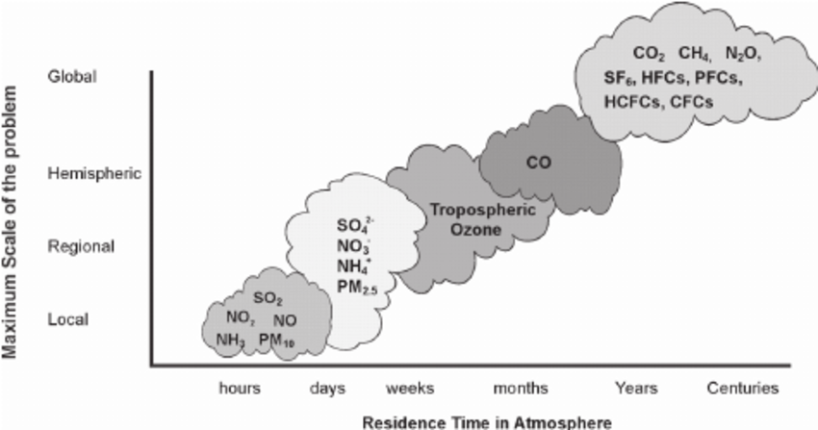
2. The different types of emitters and sources
Different type of pollutants
It is beneficial for emissions inventories that are used for air quality management to contain data on multiple types of pollutants, because emissions sources emit multiple types of pollutants.
It help air agencies develop strategies that will address multiple air pollutants, as well as have the potential to reduce costs and increase the public health and environmental benefits associated with air quality management.
For example, sources that burn fossil fuels emit NO_{X}, PM_{2.5}, CO, VOC (formaldehyde, benzene, ethyl benzene, toluene) and also GHGs (e.g., carbon dioxide, methane).
Aldo Ferreira et al. 2008

Slide 8
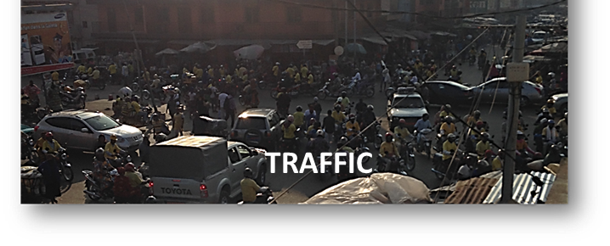
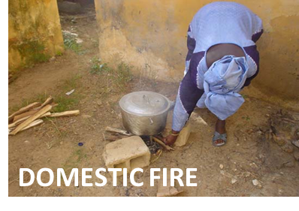
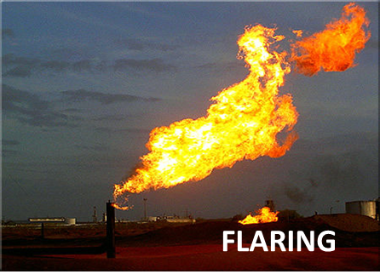
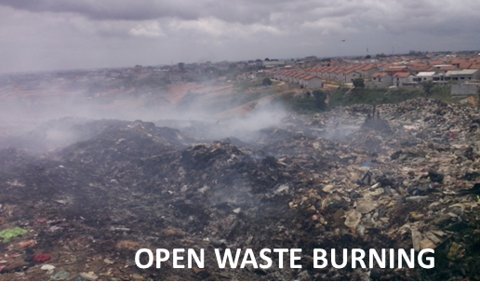

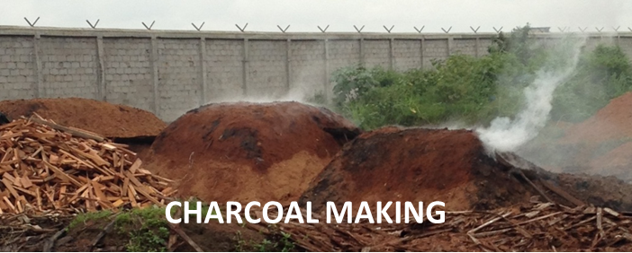
2. The different types of emitters and sources
Anthropogenics sources
Emissions inventories provide source information that identifies the emissions source.
Inventories may contain a variety of different source types, including both anthropogenic (related to human activity) or natural (related to naturally occurring activity).

Slide 9
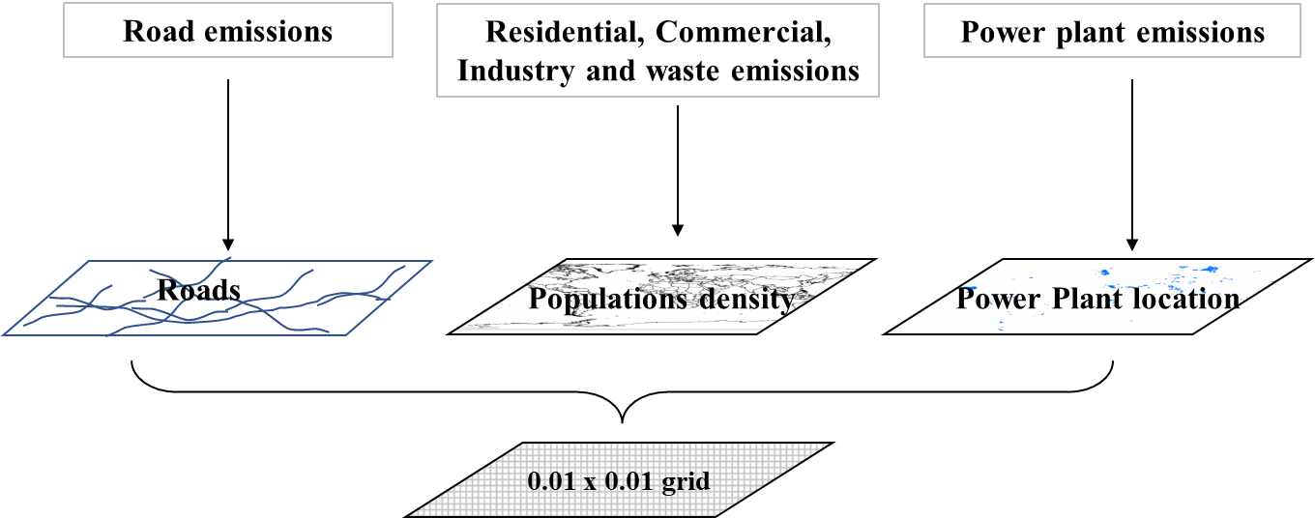
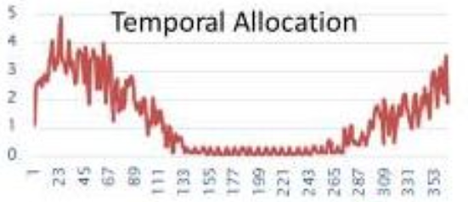
3. General methodology
Emissions
Spatial Surrogates
Hourly gridded emissions for air quality modeling
Notes:
Modeling inventories require extra processing steps to meet the needs of an air quality model. These extra steps include temporal allocation (to create hourly emissions), spatial allocation (to create gridded emissions)

Slide 10
3. General methodology
Emissions Calculation General Methodology
Total mass emissions of compound X
E_{X} = Σ_{S} [EF_{X,S} • A_{S} • (1 – CE_{X,S})]
Effectiveness of control measures for compound X at source S;
Sum up all sources S
Emissions factor = mass of compound X emitted by source S per unit activity; “representative”
Activity of source S, e.g., amount of fuel burned, vehicle miles driven, etc.;
There are two approach to develop an emission inventory :
Bottom-up approach
Top-down approach

Slide 11
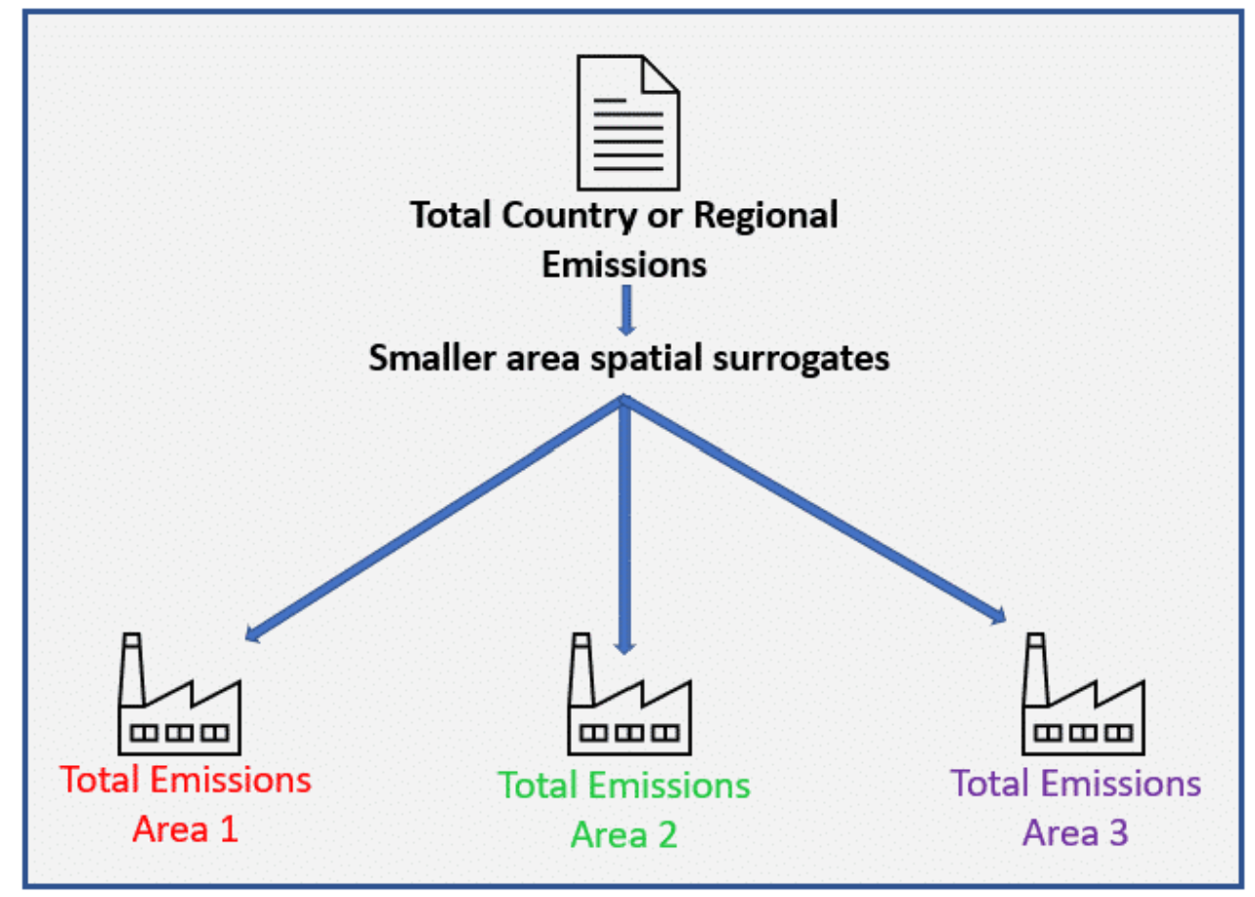
A top-down approach
This approach involves estimating emissions at an aggregated level (e.g., national or state) and then scaling down the data, using activity data, to represent the specific area to be inventoried. For example, if a state-level estimate for a specific emissions source was developed, it could potentially be scaled down to a particular urban area through use of population data for that urban area.
This approach is usually used when:
local data are not available,
the cost to gather local information is prohibitive, or
the end-use of the data does not justify the cost of collecting detailed, site-specific data.
Advantages
An advantage of the top-down approach is that by utilizing readily available activity and emission data, it requires less resources.
Disadvantages
One potential challenge with this approach is that an emission estimate will lose some accuracy due to the uncertainty associated with the estimate, and to the representativeness of the estimate when extrapolated to the local level.

Slide 12
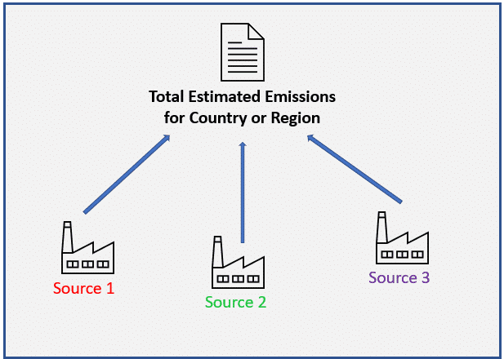
A bottom-up approach
It estimates emissions for the individual sources that are present within the area of interest (state or county, for example) and then sums all sources to obtain total estimates for the area of interest. This method requires more resources to collect the site-specific information (e.g., emission sources, activity levels, and emission factors). The results, however; are generally more accurate than a top-down approach because data are collected directly from the individual sources.
This approach is usually used when:
source/category-specific data are available and/or
the end use inventory justifies the cost of collecting site-specific data.
Advantages
An advantage of the bottom-up approach is that the accuracy of the inventory will be greatly enhanced (if all the sources within the area are identified and estimated accurately).
Disadvantages
One potential challenge with this approach is that it requires more resources (e.g., time, money).

Slide 13
4. Activity data and Emissions factors
What are Activity Data?
Activity data quantify the level of activity of a pollution source.
The level of activity is sometimes expressed as the throughput (i.e. the material input to the process, such as the quantity of fuel used over a month, or the output of the process, such as the number of items produced over a year).
Data collection
Data collection is an integral part of developing (and updating) an inventory.
This data can be gathered from a variety of sources, including other inventories, governmental agencies, research institutes, articles in scientific journals or industry related organizations.

Slide 14

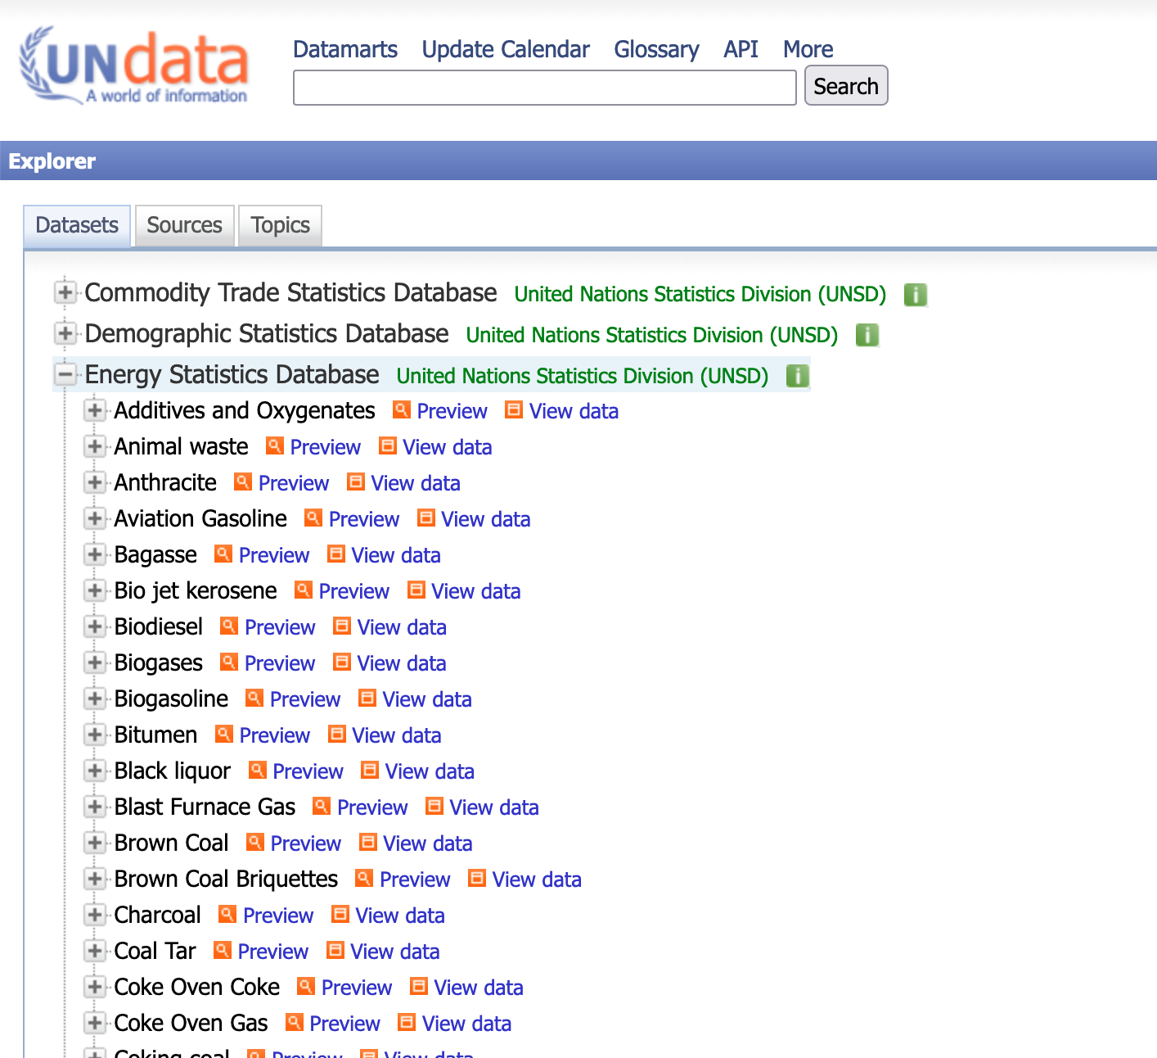
4. Activity data and Emissions factors
Acces to activity data :
National statistical data as disaggregated as possible
International Energy Agency (IEA: https://www.iea.org ) → Data are not free → cannot be put directly on a website and cannot be shared (The dataset used by many groups)
Undata Energy statistics database (http://data.un.org/Explorer.aspx)→ A free dataset → Open to all → can be shared

Slide 15
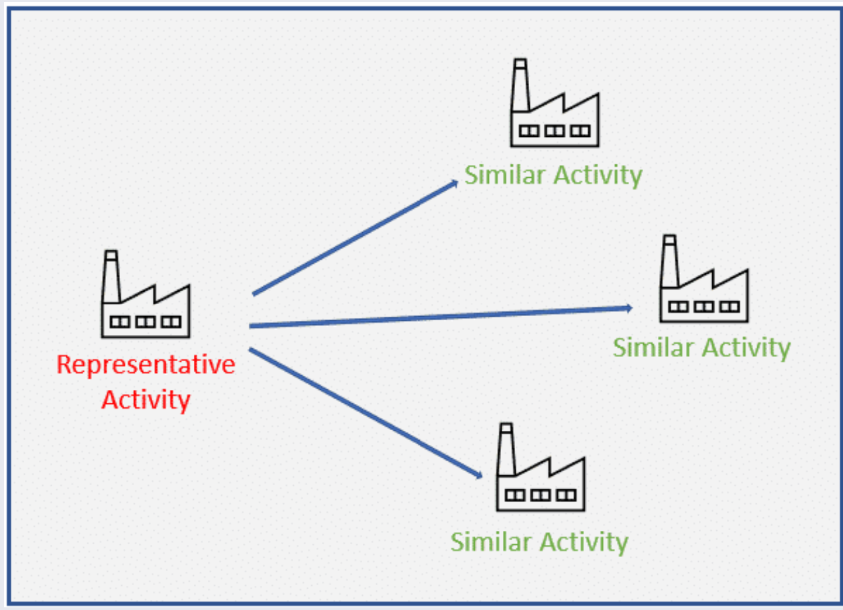
4. Activity data and Emissions factors
Emission Factor
An emission factor is a representative value that attempts to relate the typical quantity of a pollutant, emitted by a specific type of activity. These representative values can then be used to develop emission estimates for other, similar activities or facilities.
Emission factors are generally developed by using the data from one or more sources of a similar emitting activity with the goal of representing the typical values for that process.
However, these are only typical values, and do not necessarily represent what is occurring at a specific source.

Slide 16
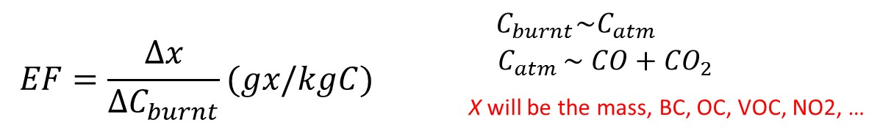

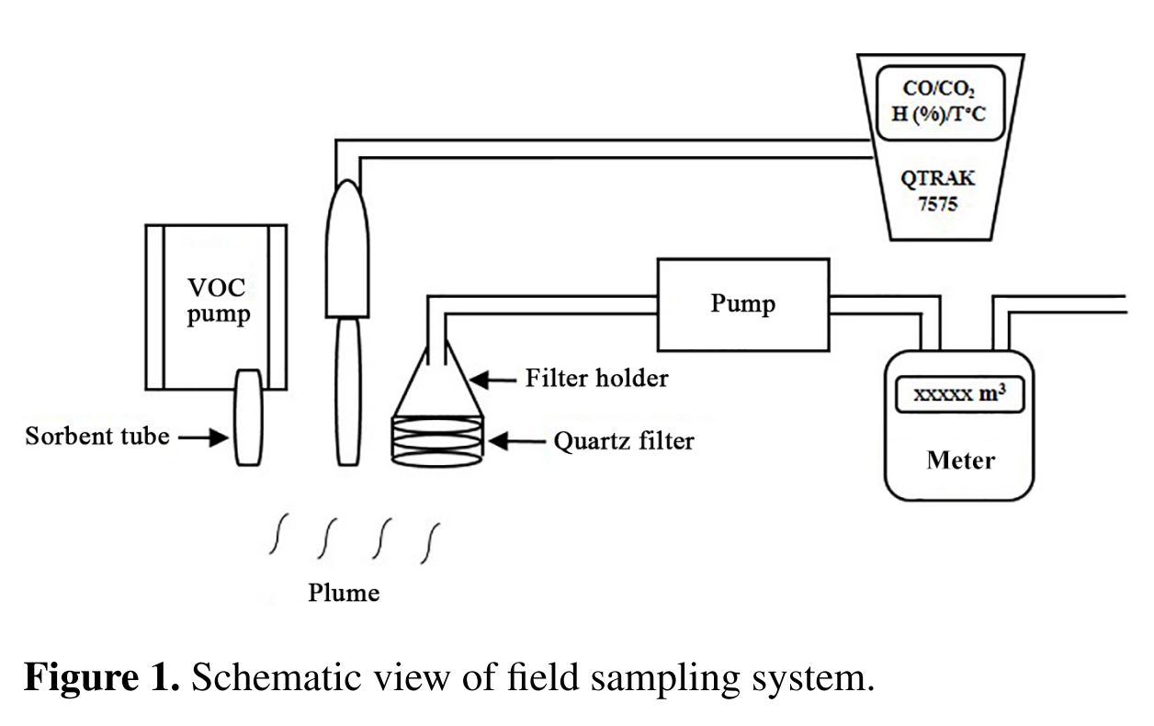
EMISSION FACTORS (EF) measurement
Method : Carbon mass balance method
In this method, emissions are determined based on the amount of material that enters a process, the amount that leaves the process, and the amount destroyed, transformed or created within the process.
EF (g of x / kg of dry matter)
Equipments for measurements on the field
Qtrak (TSI) for CO and CO₂
Filter holder for PM sampling
VOC sampler
Keita et al. (2018)

Slide 17
5. Spatial/temporal variations
Temporal variations
For emissions inventory, there may be information reflecting the temporal variability of the emissions within the inventory time period.
Inventories may provide seasonal, monthly, daily or even hourly variation data for some sources in order to accurately reflect the temporal variation in emissions.
For example, some facilities may operate continuously throughout the year, while others only operate during certain hours of the day or during certain seasons of the year. In addition, the activity levels of fires, residential wood combustion, some mobile sources and agricultural operations are strongly dependent upon the time of day and/or season of the year.

Slide 18
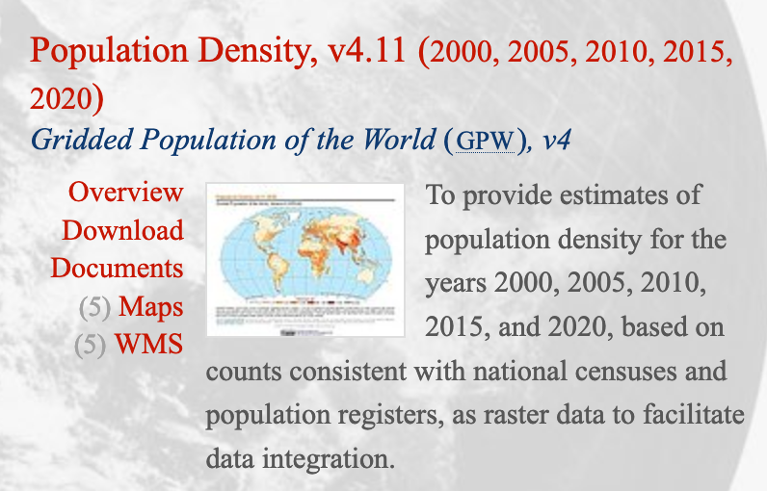
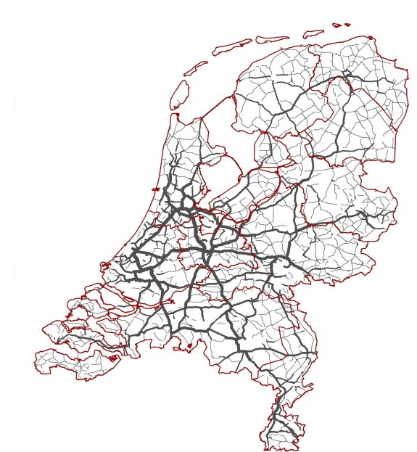
Population data
3. Spatial/temporal variations and VOCs speciation
Data used by many groups: CIESIN
https://sedac.ciesin.columbia.edu/data/collection/gpw-v4.
Shapefile, NetCDF
Road traffic data
Datasets commonly used:
Geographical Information Systems (GIS): public versions exist,
Tomtom (tomtom.com): not all publicly available
Google Community Mobility Reports
Many national and cities datasets

Slide 19
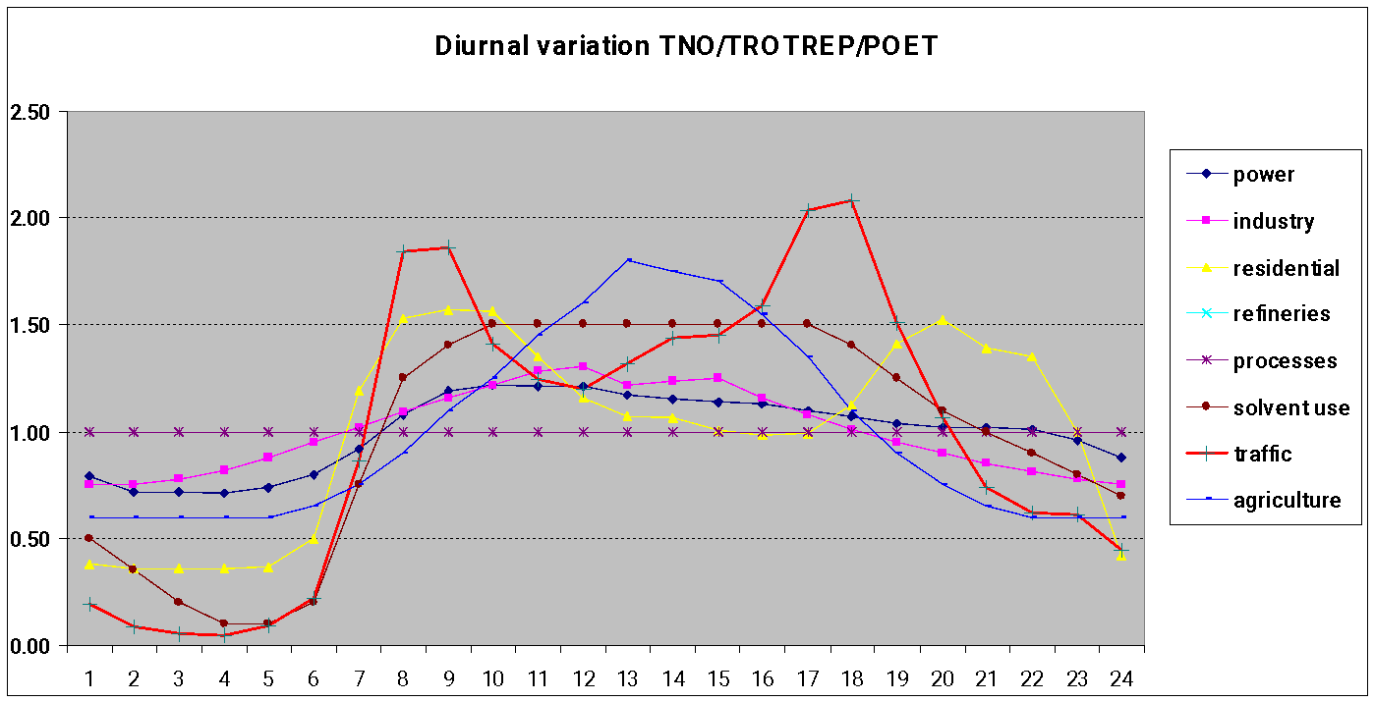
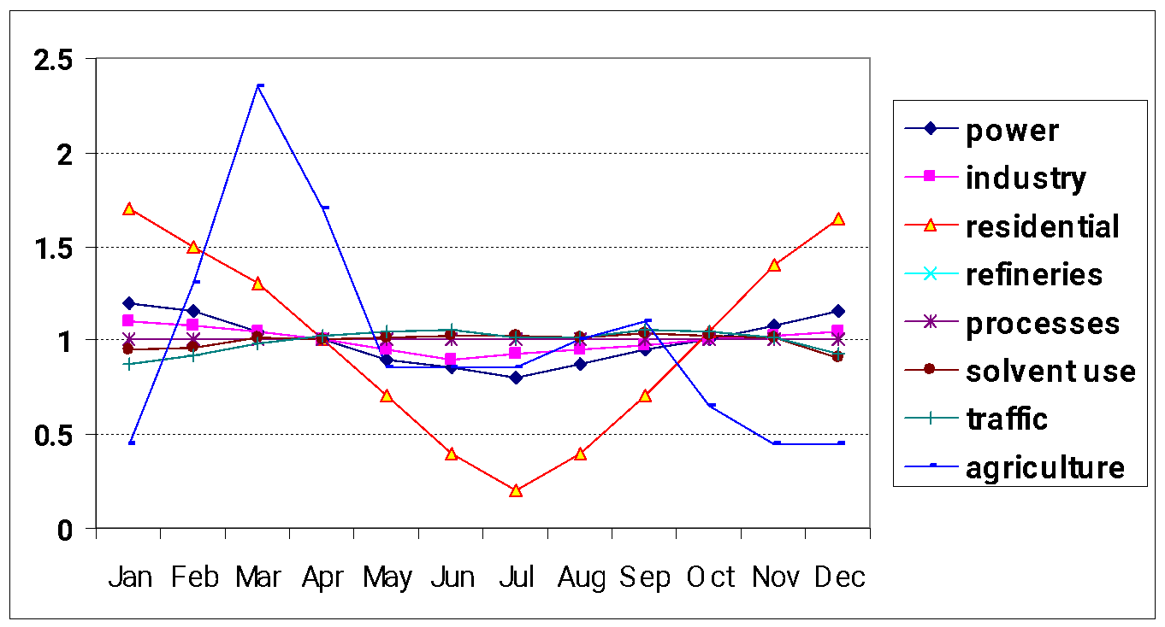
Temporal variations of the emissions: data used for a long time
Many datasets/models use old data from TNO in the Netherlands
Seasonal
Not much details on differences between countries, species, etc.
From RIVM, the Netherlands
diurnal
Some recent works use Guevara et al.(2021) data
Gridded monthly, weekly, daily and hourly temporal profiles → Sectoral coverage: energy & manufacturing industry, residential/commercial combustion, road transport, agriculture aviation, shipping
Need of temporal variation specific for African countries

Slide 20
Thank you

