Slide 1
Air Quality Modeling System in the Egyptian Meteorological Authority
Egyptian Meteorological Authority
Dr. Zeinab Salah
Manager of Air Pollution Research Department

Slide 2
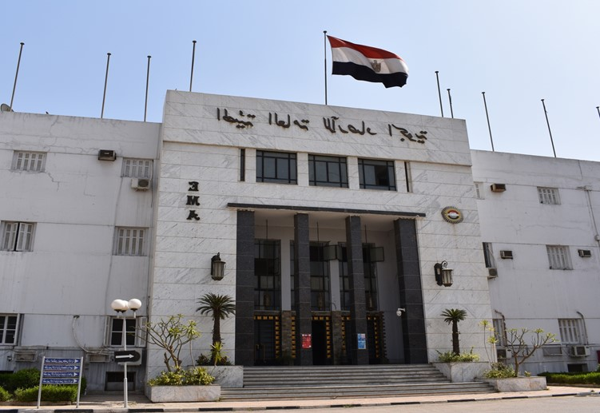
About the Egyptian Meteorological Authority (EMA)
The activity of weather observation began in Egypt in 1829.
Egypt is a member of the World Meteorological Organization (WMO) since 1950.
The Egyptian Meteorological Authority was established in 1971 to be the authority responsible for providing all meteorological services in Egypt.
EMA has a large network of meteorological stations through Egypt for monitoring the meteorological elements, solar radiation, total ozone, and evaporation, in addition to monitoring the background of air pollutants (CO, O3, NOx, SO2, PM10, PM2.5, PM1) and GHG (CO2).
EMA issues weather, marine, and air quality reports, besides the participation in the scientific research on the meteorology and climate change.
EMA has a good operational infrastructure of the numerical weather prediction system.

Slide 3
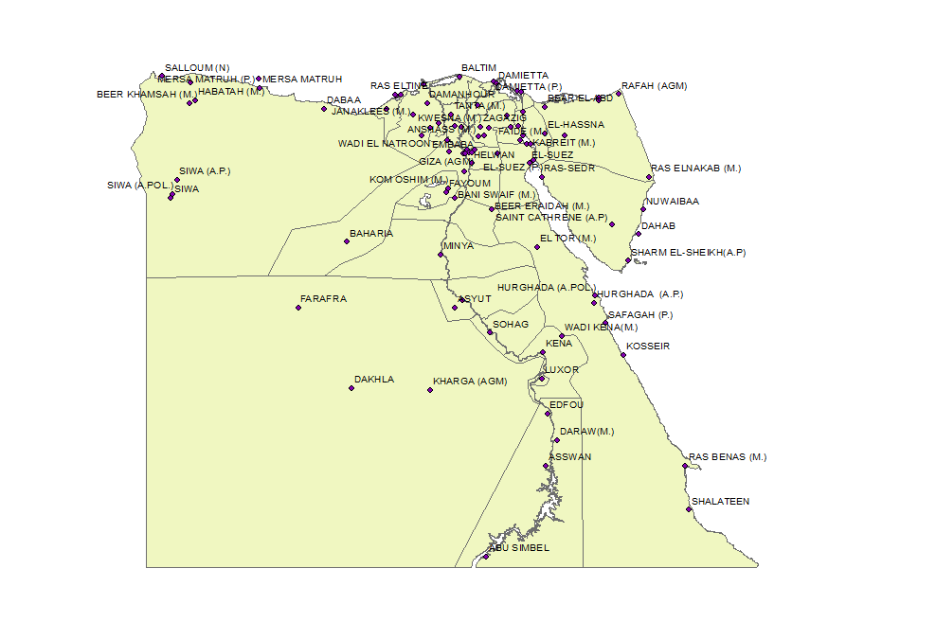
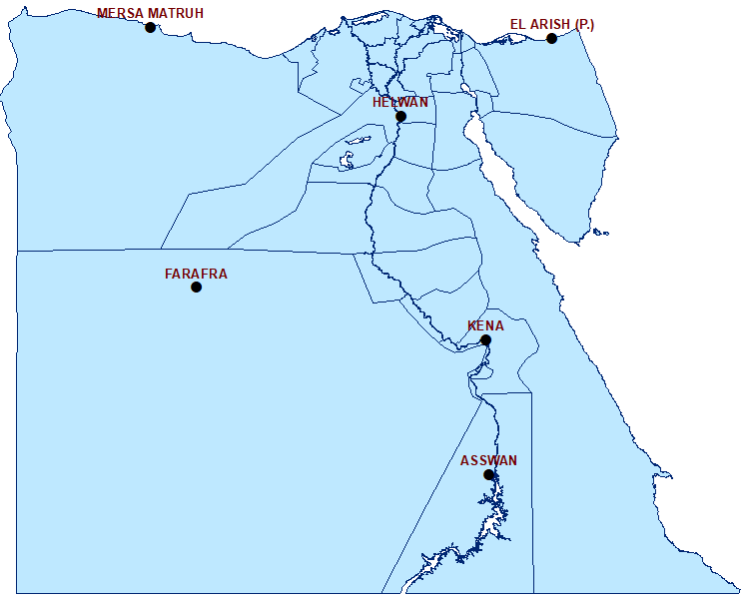
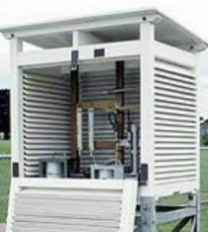
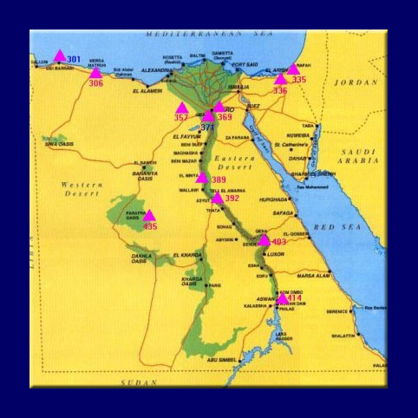
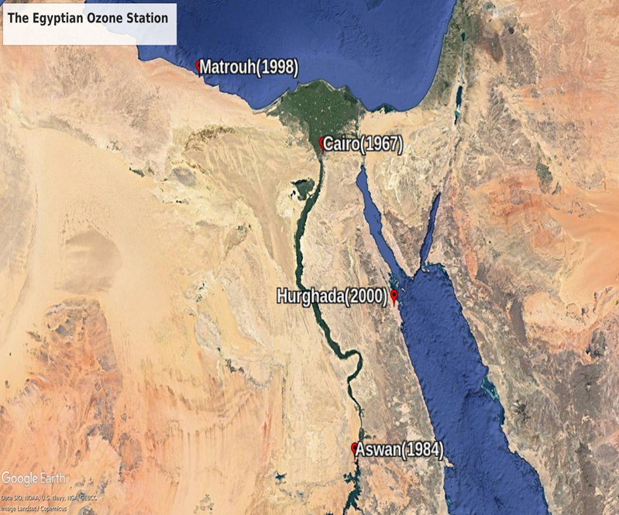
Meteorological Stations Network in EMA

Slide 4
Air Quality System in EMA
Modeling System
Eulerian models (for daily forecast)
MOZART4 (global)
ICTP-RegCM (regional)
Lagrangian models (Dispersion & Trajectory)
HYSPLIT &
FLEXPART &
GRAL
Observations
EMA ground stations & AERONET
Satellite images/data
(EUMETSAT & NASA)
WRF-Chem & CHIMERE (under experiments)
The output is uploaded: nwp.gov.eg
The dust forecast is sent to WMO-SDS regional center in Barcelona
Notes:
Operational models for daily air pollutants concentrations.
Real time observations of air pollutants from ground stations and satellite data sets.

Slide 5
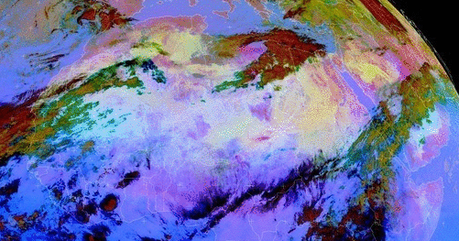
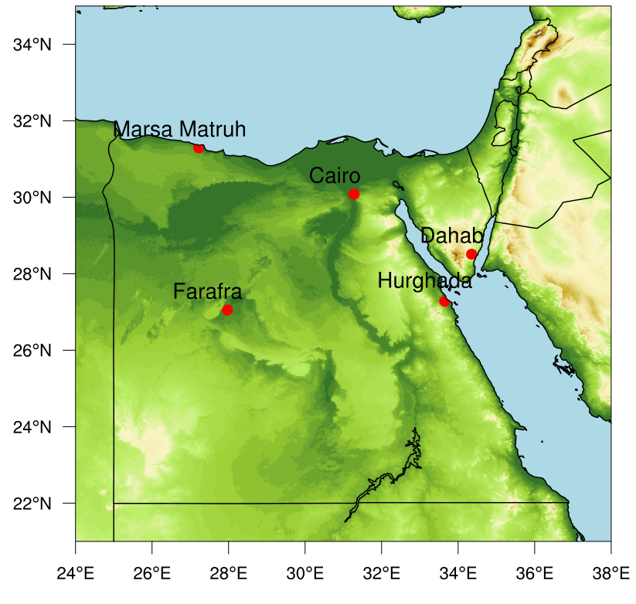
Observations
Meteosat Second Generation (MSG) DUST-RGB: 17/03/2017:00 to 19/03/2017:23
EMA Pollution ground stations for SO2, surface O3, CO, NOx, CO2, PM10, PM2.5,
Sunphotometer

Slide 6
EMA air pollution stations Network
Station | Status | Species
Cairo GAW-regional | Operational | CO2, CO, SO2, O3, NOx, PM10
Farafra GAW-regional | Operational | CO2, SO2, O3, PM10
Hurghada GAW-regional | Operational | CO2, O3, PM10
Marsa Matruh GAW-regional | Operational | SO2, O3, PM(10,2.5,1)
Dahab | Operational | SO2, O3, PM(10,2.5,1)
South-Valley | Closed | CO2, SO2, O3, NOx, PM10

Slide 7
Atmospheric Aerosols and Gases
Emissions derived from POET, REAS, GFED2 and Megan
Global Chemical Transport Model
(MOZART4)
FINN fire emissions from MODIS &VIIRS
Chemical Boundary Conditions
GFS Data (Meteorological Initial and Boundary Conditions)
Regional Air Quality Model
(RegCM4)
Emissions derived from CMIP5 RCP & IIASA & POET
MOZART4 (developed by the NCAR, GFDL, and MPI-Met), Emons et al., 2010
ICTP-RegCM4 (developed by ICTP and staff in EMA), Giorgi et al., 2012
https://www2.acom.ucar.edu/modeling/finn-fire-inventory-ncar

Slide 8
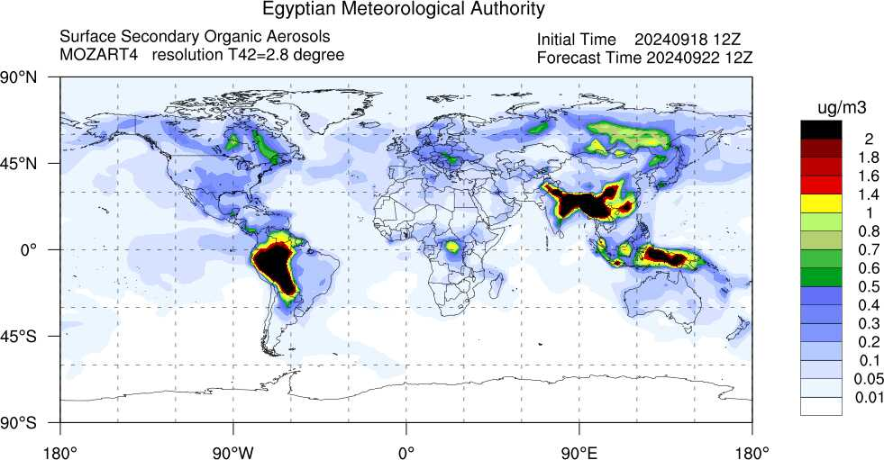
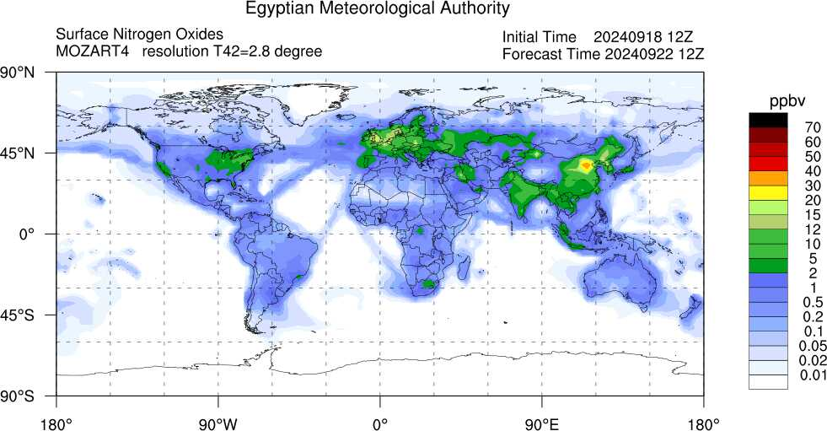
Output of MOZART4
Notes:
Forecast for concentrations of BC, CO, SOA, and NOx

Slide 9
Configuration of RegCM4 (Schemes)
Parameter | Schemes
Meteorological field: Initial and Boundary conditions (ICBC) | GFS (with 1 degree resolution)
Dynamical Core | MM4 Hydrostatic (Giorgi et al., 1993a,b)
Radiation scheme | CCM3 (Kiehl, 1996)
Large-Scale Clouds & Precipitation scheme | SUBEX (Pal et al., 2000)
Cumulus convection scheme | Emanuel (1991) over Ocean & Land
Boundary Layer scheme | Modified Holtslag (Holtslag, 1990)
Land Surface model | BATS (Dickinson et al., 1993)
Interactive Aerosols | OC-BC-SO4 (Solmon et al 2005), Dust (Zakey et al 2006) , Sea Salt (Zakey et al. 2009), Saltation and sandblasting (Zakey, 2006; Marticorena and Bergametti, 1995; Alfaro and Gomes, 2001) (with aerosol feedbacks on radiative, thermodynamic and dynamic fields)
GAS phase chemistry | CBMZ-Sillmann solver (Shalaby et al. 2011)
Notes:
9

Slide 10
Configuration of RegCM4 (Domains)
Parameters | Egypt Domain | African Domain | MENA domain (only dust)
Center latitude Center longitude Number of points in x-axis Number of points in y-axis Projection Horizontal resolution Vertical resolution | 30.00 N 31.00 E 140 100 Lambert Conformal 20 km x 20 km 18 sigma-layers | 00.00 N 15.00 E 200 200 Rotated Mercator 50 km x 50 km 18 sigma-layers | 34.00 N 17.50 E 240 180 Lambert Conformal 45 km x 45 km 18 sigma-layers

Slide 11
Outputs of RegCM4 over Egypt
Notes:
Forecast for concentrations of O3 and BC

Slide 12
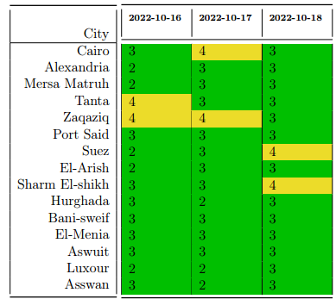
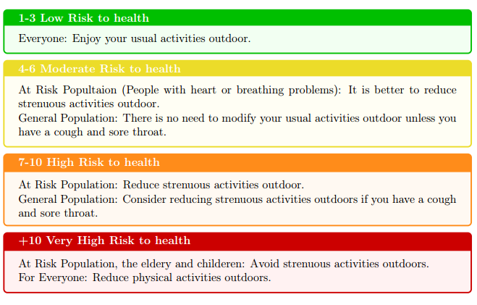
Air Quality Health Index
An indicator that expresses the extent of air quality by giving information on the air pollution and the negative health effects that it may cause to humans. Low values indicate good air quality, while high index values indicate poor air quality.
Its equation based on the concentrations of O3, NO2, SO2 and PM2.5.

Slide 13
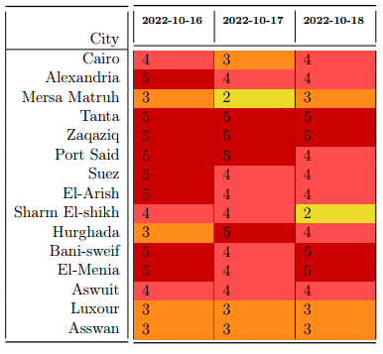
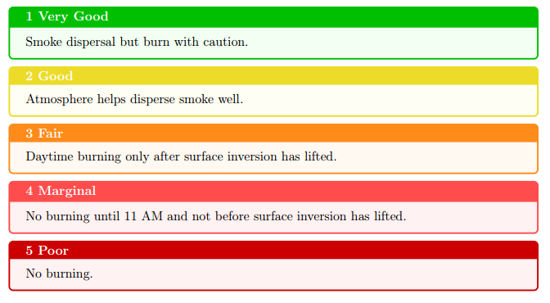
Ventilation Index
Refers to the atmosphere’s ability to disperse pollutants (such as fire and factory smoke) into the upper atmosphere and not concentrate them near the Earth’s surface.
Its equation depends on the wind speed and height of boundary layer.

Slide 14
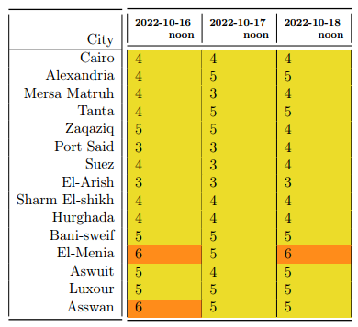
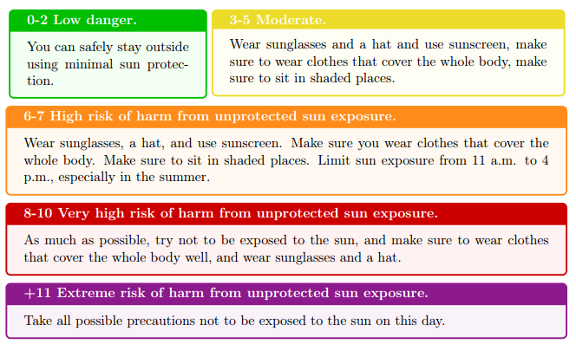
UV Index
This indicator shows how much ultraviolet radiation can cause skin burns. The number given is a prediction of UV levels at noon and when UV rays are at their highest (if the day is sunny).

Slide 15
Outputs of RegCM4 over Africa

Slide 16
Dust Forecast using RegCM4 over MENA

Slide 17
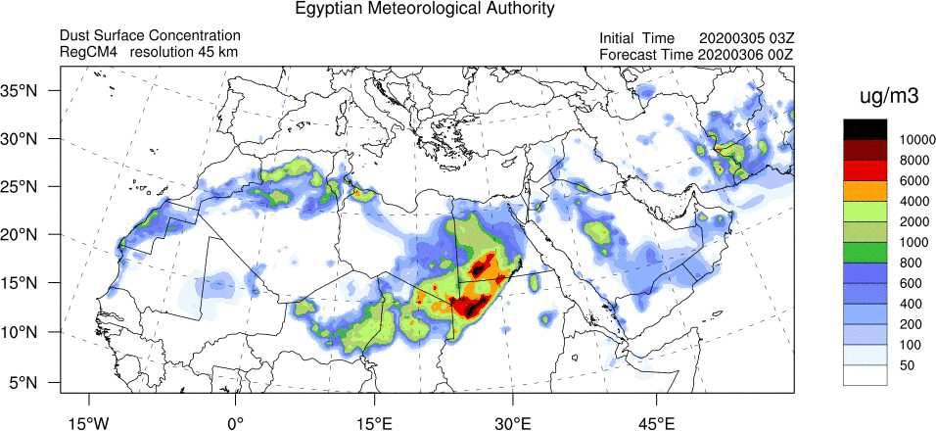
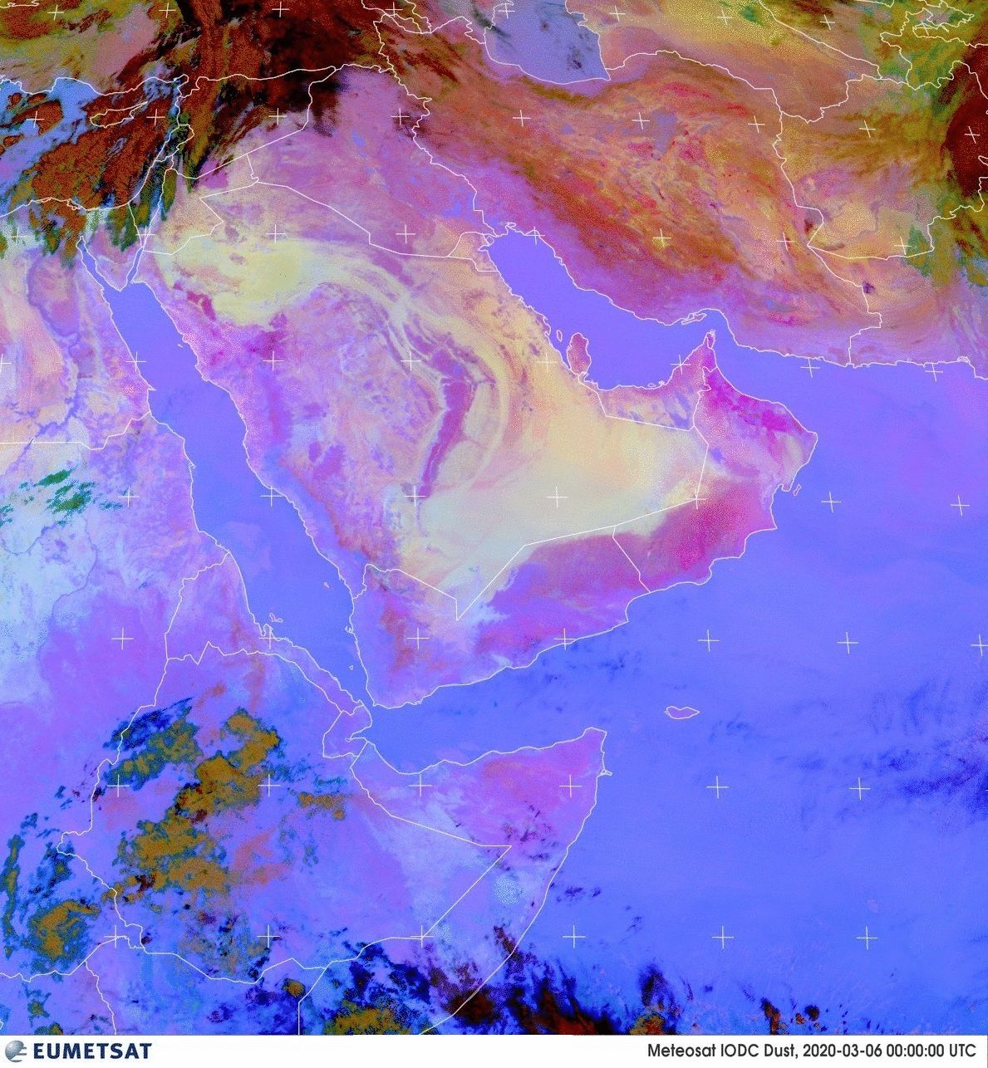
Daily Dust forecast 6/3/2020
Notes:
17

Slide 18
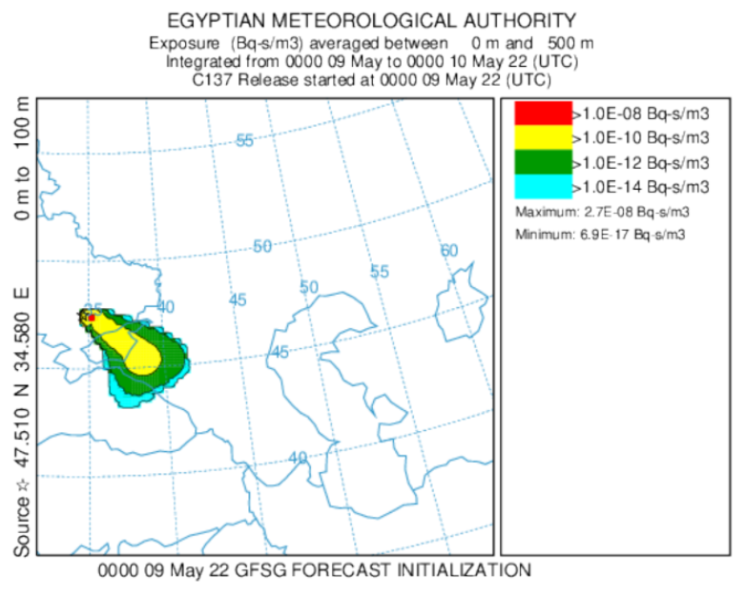
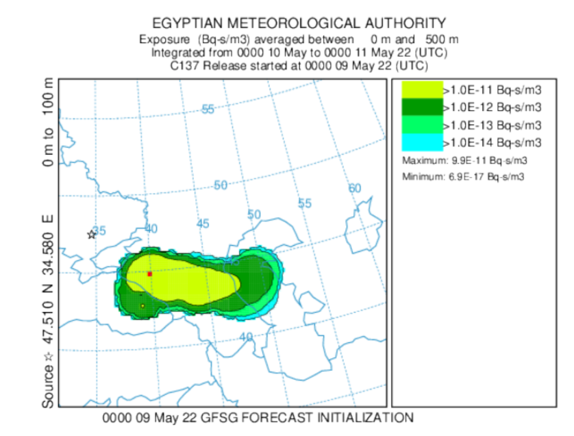
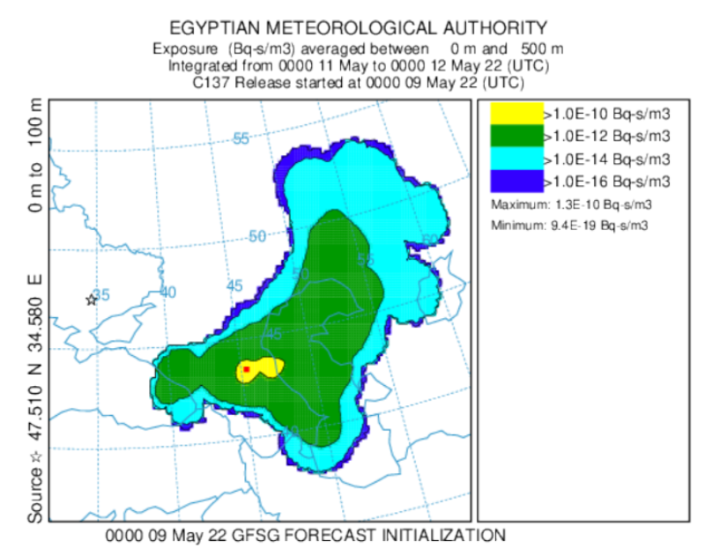
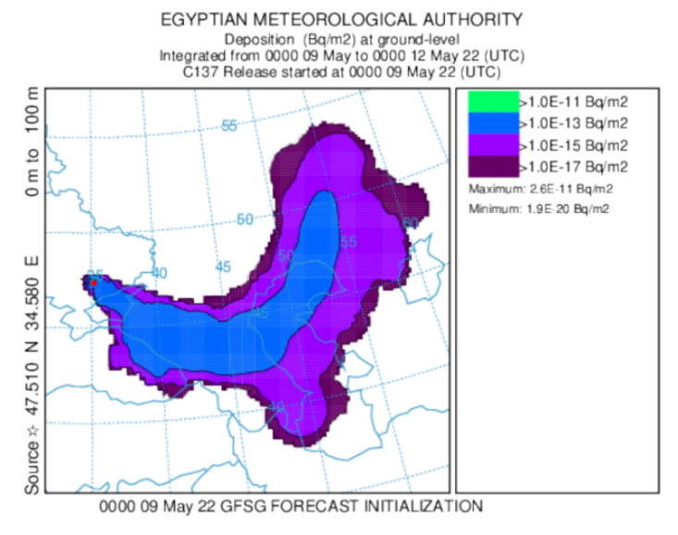
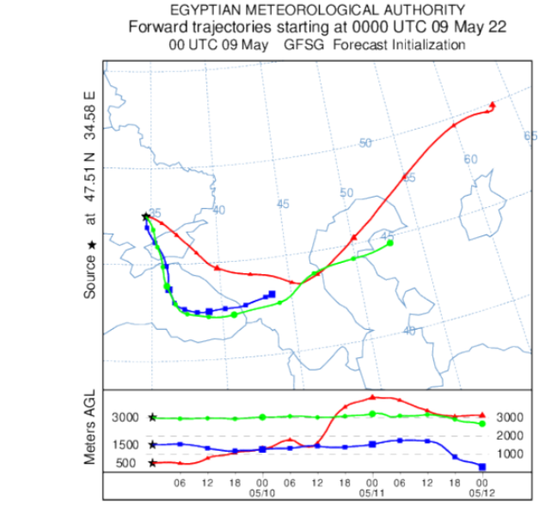
Early warning for nuclear/radiological hazards (Ukrainian power plant) Dispersion of radiological plume
Notes:
18

Slide 19
Development of the System and Future work:
The higher values of dust optical depth were the most noticeable problem in the experiments. The change of the values of the erodibility factor with the dust Scheme#1 caused a significance reduction of AOD on some AERONET stations and comparing with MODIS. (Sensitivity study of daily dust forecast over MENA region using RegCM4 model, (Z. Salah, 2023)

Slide 20
Thank you

