Slide 1
Future Earth Global and Future Earth African Hub Leadership Center
Dr Faten Attig-Bahar (Deputy Director of the FEAHLC)
Training Course on Seamless Prediction of Air Pollution in Africa - El Cairo,Egypt
16 September 2024

Slide 2
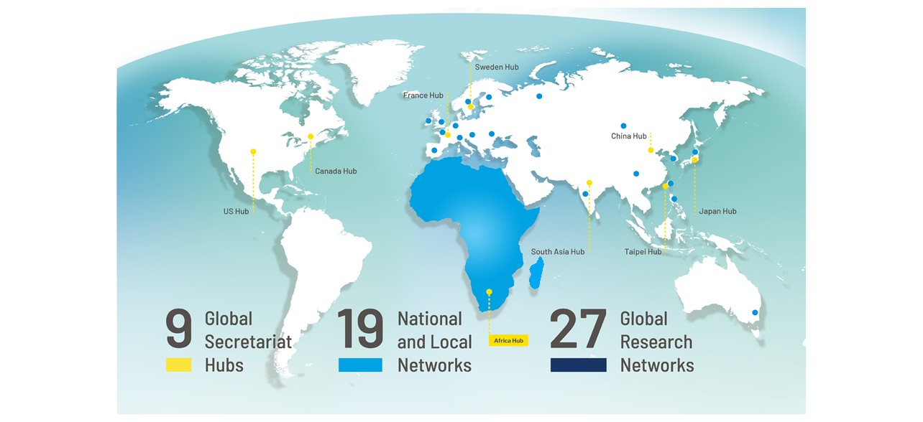
Future Earth Community
Future Earth is a global initiative focused on advancing sustainability science.
Future Earth’s vision is of a sustainable and equitable world for all, where societal decisions are informed by openly-accessible and shared knowledge.
Future Earth’s mission is to advance research in support of transformations to global sustainability.

Slide 3
Future Earth Governance Structure
Notes:
See relevant Assembly and GC TORs: https://futureearth.org/governance/ List of Assembly members: https://futureearth.org/about/who-we-are/general-assembly/
List of GC members: https://futureearth.org/about/who-we-are/governing-council/

Slide 4
Our strategy

Slide 5
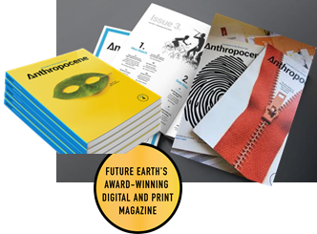
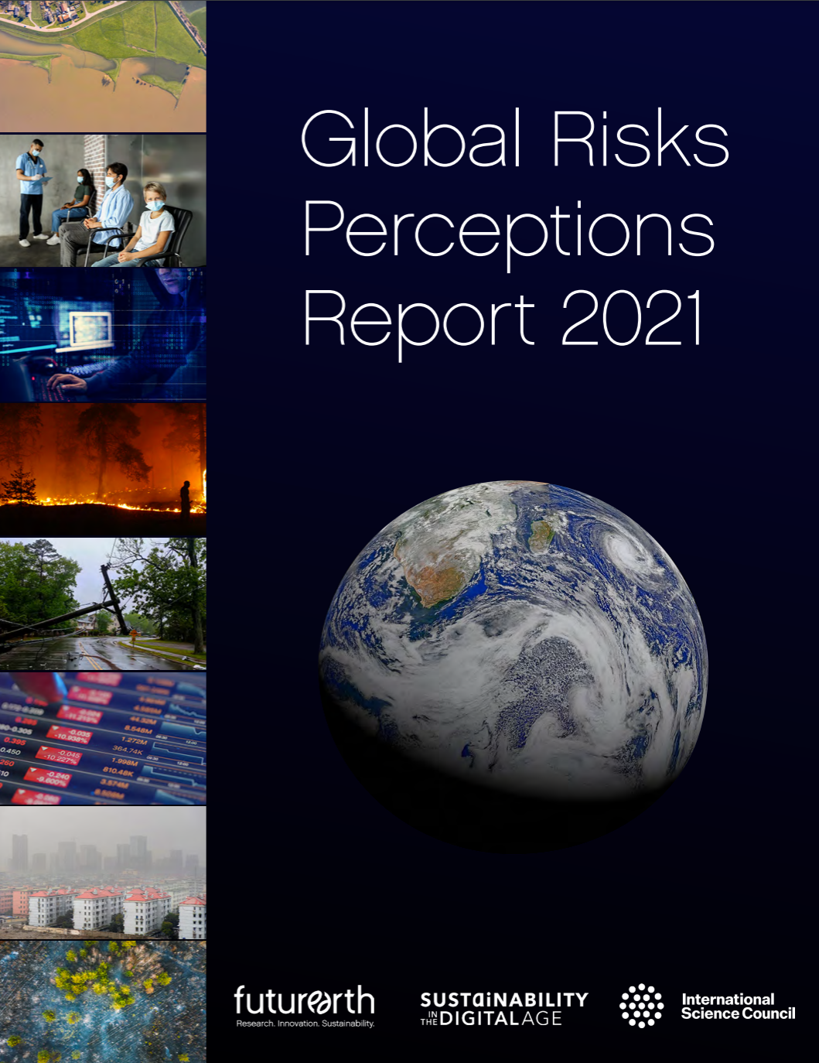
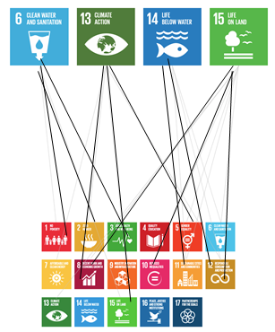
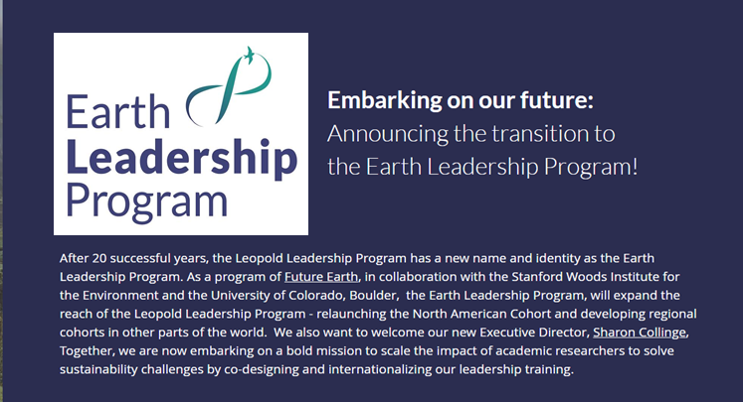
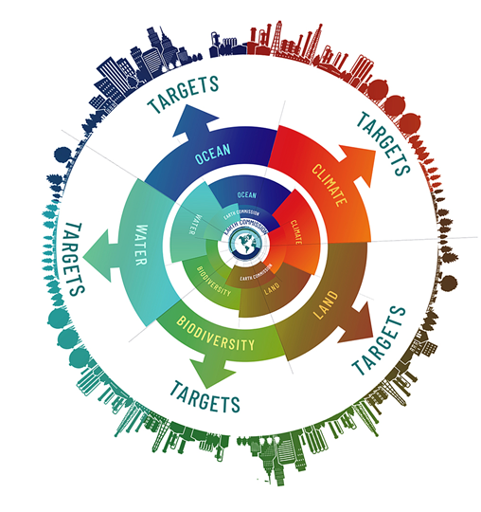
Future Earth’s Integrated Activities
Facilitate Research & Innovation
Build and Mobilize Networks
Shape the Global Narrative
60+ Researchers annually
Earth Commission
Pathways
Notes:
Three pillars of the secretariat functions

Slide 6
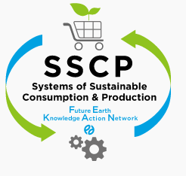
Future Earth covers wide range of Earth System Sciences
and promotes interdisciplinary and transdisciplinary researches
27 Global Research Networks
Biodiversity
Health
Modelling
Carbon emission
Atmosphere
EvolvES
(Evolution for Earth Sustainability)
oneHEALTH
Marine, water
Governance
Risk
Ecosystems
Consumption and Production
Natural Assets KAN
Water-Energy- Food Nexus KAN
Land use
Earth and human history
Monsoon Asia
Urban
Finance & Economics
Finance & Economics KAN

Slide 7
Future Earth Earth Africa Hub and its Leadership Center:
Structure, Governance and Regional Nodes

Slide 8
Future Earth Community
Future Earth is a global initiative focused on advancing sustainability science.
Future Earth’s vision is of a sustainable and equitable world for all, where societal decisions are informed by openly-accessible and shared knowledge.
Future Earth’s mission is to advance research in support of transformations to global sustainability.

Slide 9
Established in 2022
Mandate:
Coordinate and link the various sustainability initiatives across the continental regions.
Create communities of practice that bring African Scientists together in an African Sustainability Ecosystem.
Facilitate strong working connections with society, industry and government.
Play an enabling role within the sustainability landscape by:
Enabling engagements that go beyond the current narrative and rhetoric.
Positioning African scientists to play a leadership role in the global sustainability agendas – influence policy
Articulate a science agenda so that people [ government, NGOs, industry, society and academia] can identify with it
Support Young Scientist Initiative

Slide 10
The Future Earth Africa Hub and its Leadership Centre
Advancing sustainability science in Africa
Sponsors
Implementing Partners
Consortium Partners

Slide 11
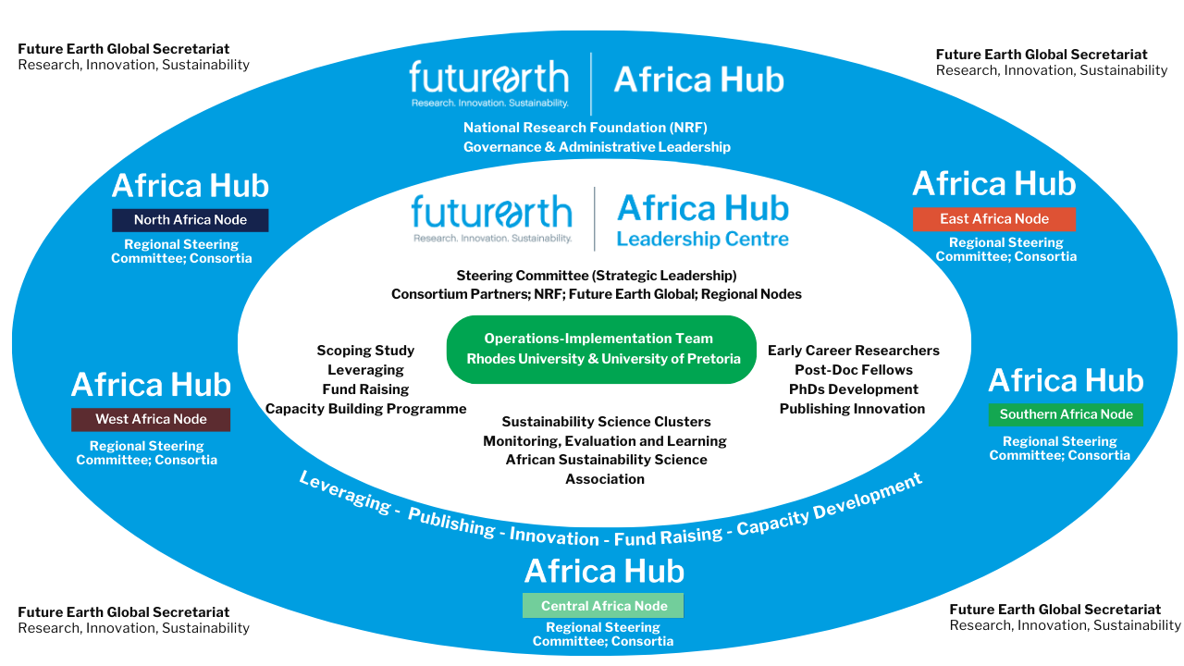
A Visual Configuration of the Future Earth Africa Hub
FEAH Regional Nodes

Slide 12
Future Earth Earth Africa Hub and its Leadership Center:
Facilitating Research and Innovation

Slide 13
Sustainability Science Clusters
Future Earth Africa Hub Leadership Centre Science Clusters
What are the Sustainability Science Clusters (SSCs)? The SSCs are the intellectual engine of the Leadership Centre; are semi-autonomous They are transdisciplinary community of practice organized around a particular thematic field Promote disciplinary excellence, multi- and inter-disciplinary scholarship Active Science Networks – that advance Science Leadership in the area of Scientific Practice

Slide 14
Sustainability Science Clusters
Future Earth Africa Hub Leadership Centre Science Clusters
Objectives of the SSCs Advance, strengthen and deepen Africa inter-, multi- and transdisciplinary sustainability science scholarship, and leadership in priority thematic fields relevant to Africa’s sustainability challenges. Advance the development of transformations and solution-oriented knowledge, networks, foundations, and capacity for advancing Sustainability Sciences and practice on the African continent Connect African Sustainability Sciences to the Future Earth Global Research Networks and other relevant Sustainability Science structures, networks and systems in Africa and internationally. Serve as the science, intellectual base and the scientific exchange networks of the Future Earth Africa Hub, it’s Leadership Centre and regional nodes. Bring together actors in the science-policy-practice domains to advance sustainability transformations in Africa.

Slide 15
Sustainability Science Clusters
Future Earth Africa Hub Leadership Centre Science Clusters
Membership Co-lead approach Co-leads Must be based in Africa Co-leads Must be based in different regions of Africa Consideration: Gender; Career stage; Academic/Practice/policy sector Africa-based scholars/practitioners and policy makers (Academics, NGOs etc.) – a cluster can have members from all regions, a minimum of two region is mandatory. International partners can also be invited to be part of the clusters

Slide 16
Transversal Clusters
Leadership for A transformed World in Africa
Politics of sustainability
African Youth Futures
Transformative science
Transformative leadership
Democracy
Governance
Science-policy-practice interface
Advocacy
Decision-making
Politics and political systems
Policy innovations
Youth futures and the education system
Links to water, biodiversity, environment etc.
Transformative science
The Clusters are cross-cutting in their outlooks
Degrowth and climate justice: intersections of theory, practice and activism
Downscaling of consumption and production
Equitable, resilient and ecologically sustainable - degrowth

Slide 17
Thematic Fields Clusters
Sustainable and equitable Africa climate-resilient water futures
Land and Investments
Transformative research for health ecosystems and sustainable communities for Africa
Water
Biodiversity and environment
Water and climate risk
Water and Health
Water-food-energy nexus
Transformative and transdisciplinary scholarship
Quadruple Helix model – science-policy-industry-society interface
Socio-economic analysis of land use choices
Physical dimension of land
Social, economic and political dimension
Economic and social investments
Decision-making
Politics and political systems
Policy innovations
Waste management
Links to Schools and youth.
Sustainable communities

Slide 18
Sustainability Science Clusters
Initial geographical spread of clusters
Southern Africa – South Africa , Zimbabwe, Mauritius , Malawi, Lesotho , Botswana
East Africa – Kenya, Tanzania, Ethiopia, Uganda
West Africa – Nigeria, Ghana, Senegal, Côte d'Ivoire,
Central Africa – DRC,
North Africa – Tunisia, Algeria, Egypt
International - Netherlands, USA, UK, Germany, Spain
18 African Countries
Southern Africa - 4
East Africa – 4
West Africa – 3
Central Africa – 1
North Africa = 3

Slide 19
Future Earth Earth Africa Hub and its Leadership Center:
Building and Mobilizing the Networks

Slide 20
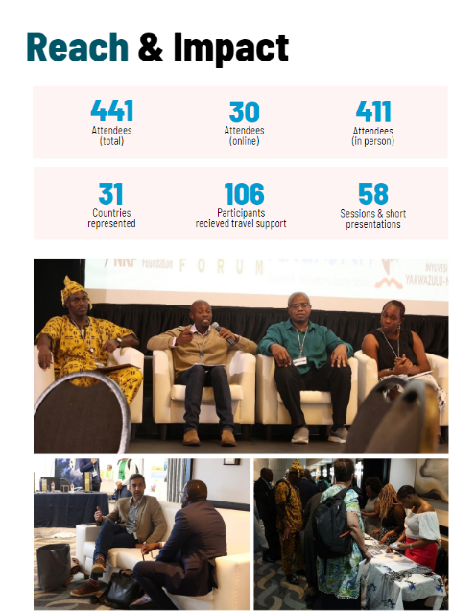
SRI Africa Satellite Event
The Future Earth Africa Hub hosted SRI Africa 2023, 2024 and will host the 2025 edition
The SRI Africa satellite event was a mixture of cross-cutting plenary sessions, parallel thematic sessions, and networking sessions.
05 plenaries, 48 sessions and 5 short presentations at the Forum, in addition to exhibitions and networking opportunities and Belmont Forum Activities
ECRs corner: opportunities to bring early career researchers together within the identified thematic areas of the conference, to reflect on opportunities, challenges

Slide 21
Future Earth Africa Hub and its Leadership center Capacity Building Activities
Our Vision for the Capacity Building Program
Capacity Building Program Covering Different Regions in Africa
Focus Areas:
• Individuals
• Institutions
• Research Infrastructure (as a long-term goal)
Our planned activities cover:
Transdisciplinary training,speciality training, Basic writing, Scientific Grant Writing, Policy-Relevant Writing, Science Diplomacy, Project Management, Funding Mechanisms and Fund-Raising Techniques, Scientific Meetings Management
And much more based on needs identified by the community

Slide 22
Future Earth Africa Hub and its Leadership center Capacity Building Activities
Future Earth Africa Hub and its Leadership center Capacity Building Activities
UNESCO ISTIC and FEAH through its Leadership Center joint Capacity Building
Program
Timeline: 2024 ( October) and 2025 (March)
Format: Hybrid
Target: Early and Mid-career Scientist from Africa and the Global South
Areas: TD, Research Proposal writing, Science Diplomacy,
AXA -NRF-FEAHLC capacity building Fellowship Program
Timeline: ( 2024-2026)
Target: Early career Scientists to be integrated in the Science Clusters and Regional Nodes
Areas: climate, environment and health, waste management, socio-economy and new Tech, sustainable Food system
Notes:
Working on collaboration and partnership with UNESCO
KEEP the training for the future generation - I speak about the online library

Slide 23
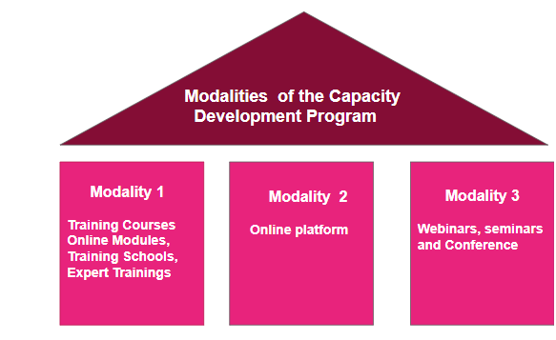
Future Earth Africa Hub and its Leadership center Capacity Building Activities
BELMONT FORUM capacity building program for the Africa Regional Call with the support of Future Earth Africa Hub and its leadership center
Call main Thematics
1- Water – Energy – Food – Health Nexus
2- Disaster Preparedness, Responsiveness, and Recovery
3- Pollution (air, land and ocean)
Notes:
of forecast information for applications in agriculture, health, renewable energy and water resources, especially on subseasonal and longer time scales.

Slide 24
Potential collaborations topics
We propose potential collaboration in the following areas:
1. Connection to the Sustainability Science Cluster: Establishing links with the Sustainability Science Cluster to foster interdisciplinary research and innovation.
2. Capacity Building Activities: Organizing workshops and training sessions to enhance skills and knowledge in the application of weather and climate information in agriculture, health, renewable energy and water resources
3. SRI 2025 and Early Career Researchers (ECRs) Training: Providing training opportunities for early career researchers as part of the Sustainability Research and Innovation (SRI) 2025 initiative.
We believe that collaboration in these areas will significantly contribute to advancing sustainable development goals and improving resilience in urban communities across Africa.
Notes:
Weather and Climate information use and applications in agriculture, health, renewable energy and water resources has been a cross-cutting in all presented activities of the Future Earth Africa Hub and the Leadership Center

Slide 25
Thank you for your Attention
Website:https://futureearth.org/ || https://www.ru.ac.za/feahlc/
@feahlc
@feahlc
@feahlc
@feahlc
Notes:
What would they like to gain from an ECR network?

Slide 26
Th

