Slide 1
AIR QUALITY IN NIGERIA: MONITORING, FORECASTING, MANAGEMENT AND INTERVENTIONS
OLUMIDE OLANIYAN

Slide 2
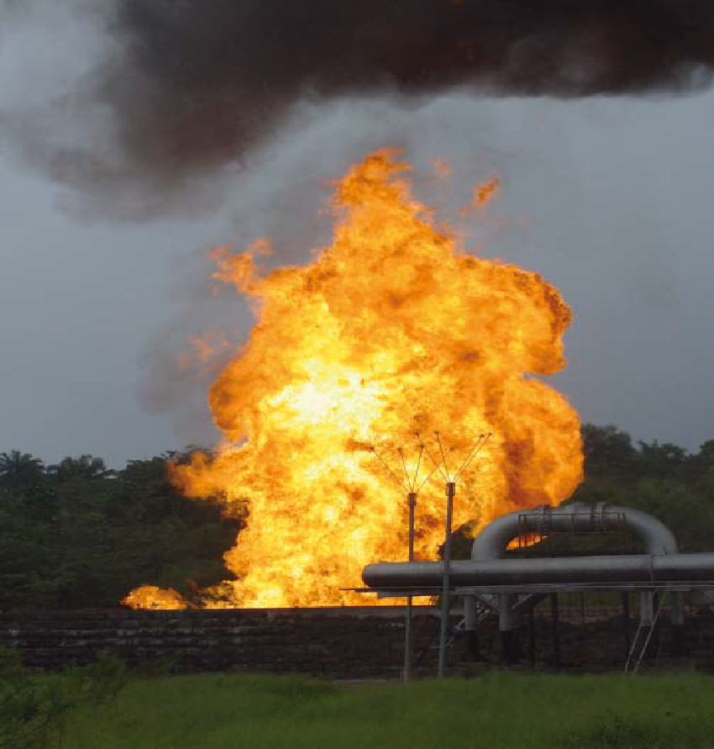
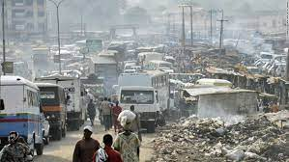
Sources of pollution in Nigeria Ranked the 3rd most polluted country in Africa by the 2021 World air quality report Particulate matter constitutes the major atmospheric pollution problem in Nigeria
Vehicular Emission Lagos
Vehicular Emission
Horizontal distribution and latitudinal variation averaged over 10°W to 10°E across West Africa. (Ogunjo et al. 2022)
Continuous gas flaring in the Niger Delta (Oluwasoye 2016)

Slide 3
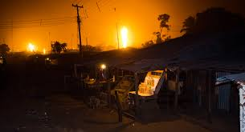
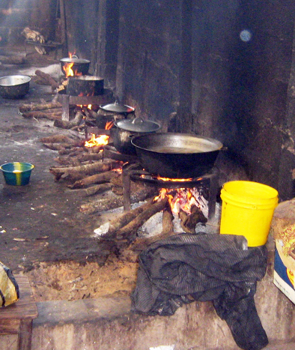
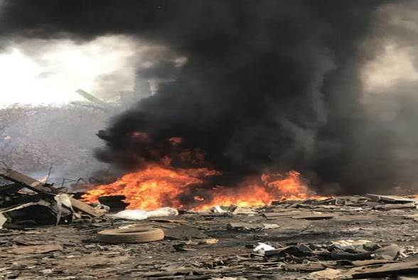
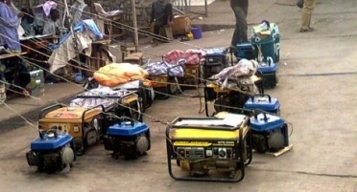
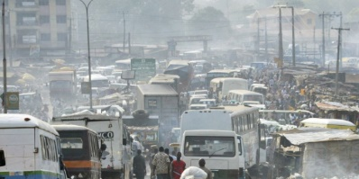
Gas flares overlooking communities. Source: http://www.egyptoil-gas.com/publications/nigerias-unfulfilled-gas-flare-targets/
Firewood cooking.
Source: http://www.atmosfair.de/index.php?id=336_top&L=3
Indiscriminate burning of waste. Source: Mofoluso A. Fagbeja, PhD
Petrol-fuelled generators.
Source: http://saharareporters.com/article/so-you-pass-your-neighbour-part-1-and-2

Slide 4
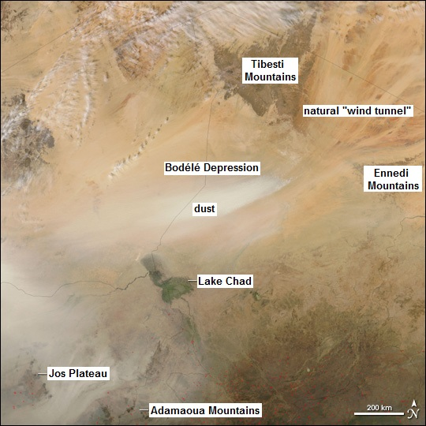
Source of Pollution in Nigeria
Wind-blown desert and mineral dust
Okobaba Saw Mill near Lagos Lagoon

Slide 5
Exploring the possibility of integrating emissions of other pollutants from gas flaring into the Nigeria Gas Flare Tracker
Pollutant | Activity | Volume of Gas (ft³) | Volume of Gas (m³) | Emission Factor | Unit of Emission Factor | Emissions | Units | Emissions (x 10⁶ Tonnes)
CO₂ | Natural gas combustion | 3.13554E+11 | 8,878,859,921 | 1000.000 | kg/10⁶ m³ | 17,047,411,048.558 | kg | 17.04741105
Pb | Natural gas combustion | 13554E+11 | 8,878,859,921 | 0.008 | kg/10⁶ m³ | 71.031 | kg | 0.00000007
N₂O | Natural gas combustion | 3.13554E+11 | 8,878,859,921 | 35.200 | kg/10⁶ m³ | 312,535.869 | kg | 0.00031254
PM₁₀ | Natural gas combustion | 3.13554E+11 | 8,878,859,921 | 121.600 | kg/10⁶ m³ | 1,079,669.366 | kg | 0.00107967
SO₂ | Natural gas combustion | 3.13554E+11 | 8,878,859,921 | 9.600 | kg/10⁶ m³ | 85,237.055 | kg | 0.00008524
TOC | Natural gas combustion | 3.13554E+11 | 8,878,859,921 | 176.000 | kg/10⁶ m³ | 1,562,679.346 | kg | 0.00156268
CH₄ | Natural gas combustion | 3.13554E+11 | 8,878,859,921 | 36.800 | kg/10⁶ m³ | 326,742.045 | kg | 0.00032674
VOC | Natural gas combustion | 3.13554E+11 | 8,878,859,921 | 88.000 | kg/10⁶ m³ | 781,339.673 | kg | 0.00078134
Total HC | Gas flaring | 3.13554E+11 | 8,878,859,921 | 0.140 | lb/10⁶ Btu | 43,897,557.200 | lb | 0.01991159
CO | Gas flaring | 3.13554E+11 | 8,878,859,921 | 0.370 | lb/10⁶ Btu | 116,014,972.600 | lb | 0.05262350
NO_{x} | Gas flaring | 3.13554E+11 | 8,878,859,921 | 0.068 | lb/10⁶ Btu | 21,321,670.640 | lb | 0.00967135
Soot | Gas flaring - Heavy smoke | 3.13554E+11 | 8,878,859,921 | 274.000 | µg/L | 2,432,807,626,292,060.000 | µg | 0.00243281

Slide 6
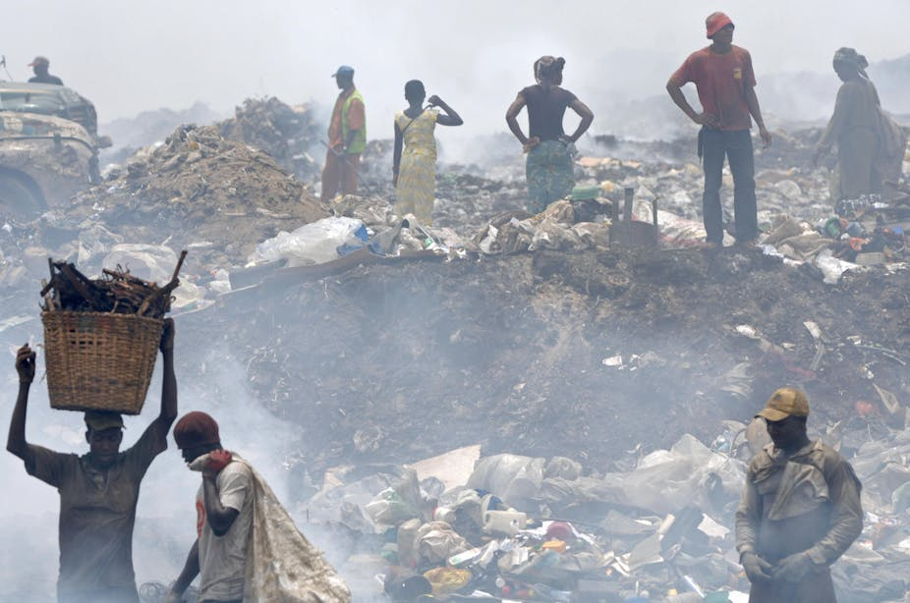
The perpetual burning of trash in and around cities
The Olusosun nigerian dumpsite is a 100-acre dump in Lagos, Lagos State, Nigeria. It is the largest in Africa, and one of the largest in the world. The site receives up to 10,000 tons of rubbish each day (Photo by: Lionel Healing/AFP
In 2023, the average PM2.5 concentration in Nigeria was 4.8 times of the World Health Organization annual air quality guideline value. (Undark Magazine)

Slide 7
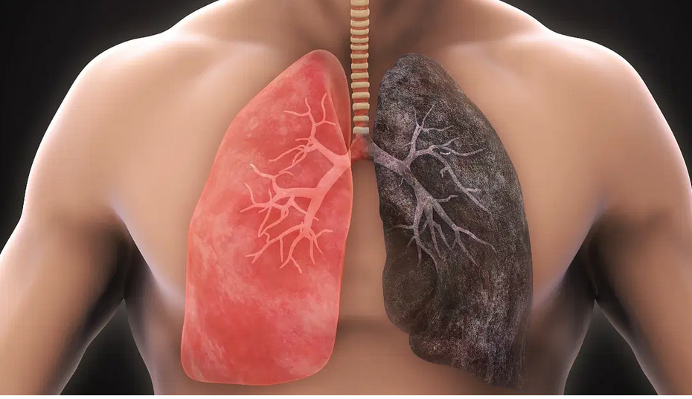
Impacts
Nigeria has the largest number of deaths due to air pollution in Africa, while the country ranked fourth for air pollution across the globe()
Studies have shown that people living in areas with higher particulate burden in Nigeria showed declining lung function. (Ana, 2014)
In Ibadan, Oyo state, Nigeria, exposure to biomass fuel was reported to result in lower birth weight, more preterm infants and high perinatal mortality among pregnant women who used firewood and kerosene for cooking (Alexander et al., 2018).
A link has also been established between biomass fuel usage and asthma development. A higher percentage of potential asthma and severe asthma symptoms were observed in children who came from households where biomass fuel is used (Oluwole et al., 2017).
Also, higher risks of respiratory symptoms such as cough, and lower mental health have been observed in groups of adults who utilize solid fuels at Ile-Ife (Obaseki et al., 2017)

Slide 8
Air Quality Monitoring Unit in NiMeT
Monitor meteorological components of environmental
Observe and predict Air quality Across Nigerian
CLASSIC POLLUTANTS
PM 10 and PM 2.5
Oxides of Nitrogen NOX (NO and NO2)
Carbon Monoxide CO
Tropospheric Ozone O3
Sulphur Dioxide SO2
Carbon Dioxide CO2

Slide 9
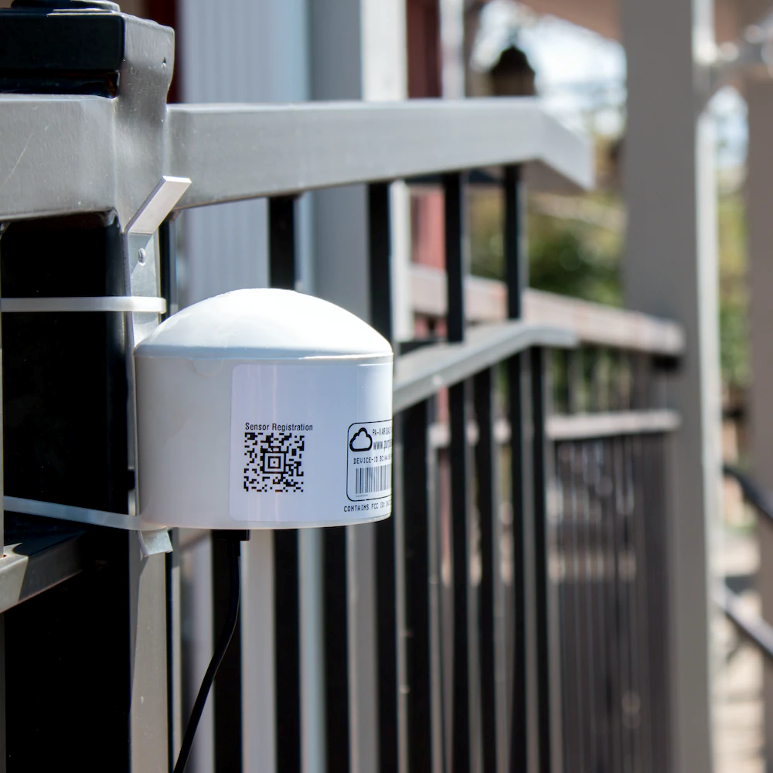
Tools for Air Quality Monitoring
LCS in this report refers to a complete functional sensor system,
i.e. a self-contained apparatus with one or more sensing elements, commonly
referred to as low cost detectors or as original equipment manufacturer (OEM) sensors,
It is usually combined with:
Necessary hardware
software for control
power supply
data management and
packaged enclosure.
In other words, a LCS is a ready to use system, without the need for additional hardware (besides for mounting) or software to make it operable in field deployments (Karagulian et al., 2019).
Purple Air Low cast sensors

Slide 11
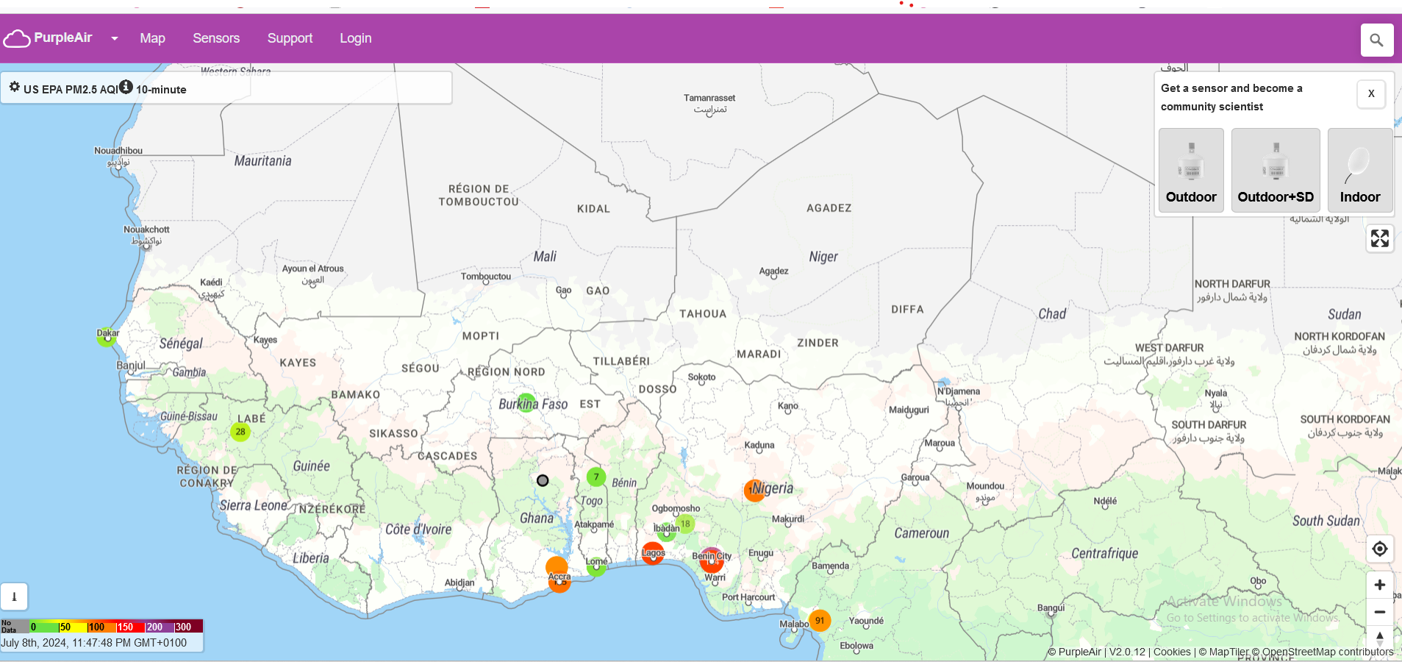

Slide 13
Network of Clarity Devices https://openmap.clarity.io/https://openmap.clarity.io/

Slide 14
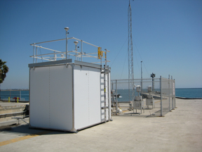
Reference Grade Monitors RGMs
Reference Grade Monitors RGMs are the nationally and internationally accepted systems for directly and accurately measuring ambient air pollutant concentrations at specific locations over time intervals.
RGMs provide highly accurate and reliable air quality data, they come with significant drawbacks compared to LCS (Low Cost Sensors). RGM have higher upfront purchase costs and ongoing operational expenses, along with greater technical requirements for their operation.
They require a secure location and physical infrastructure, including shelters to maintain optimal operational conditions, consistent power supply, and access to spare parts and consumables like calibration gases.
These financial and infrastructural demands have historically limited the widespread deployment of RGM. Reference air quality stations are often limited in number due to their high cost and complex setup.

Slide 15
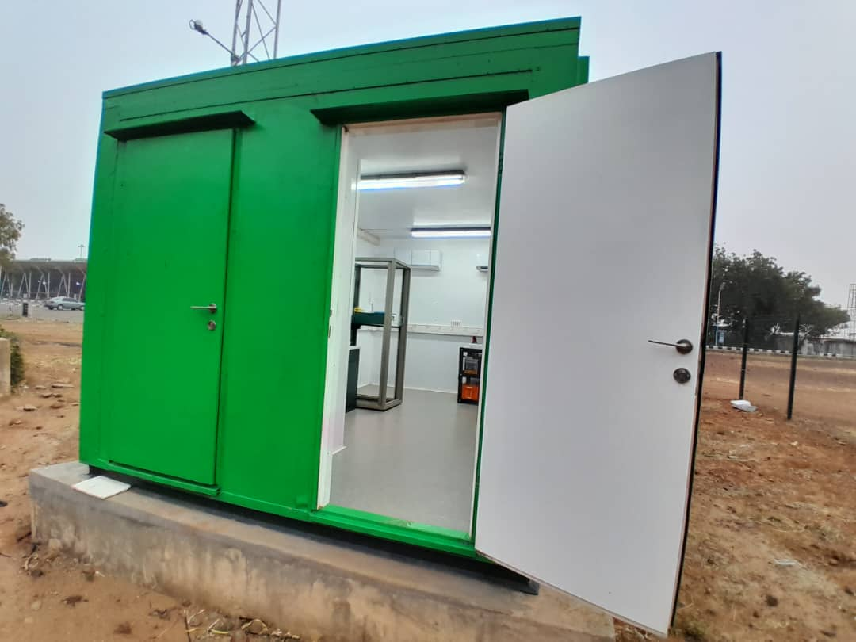
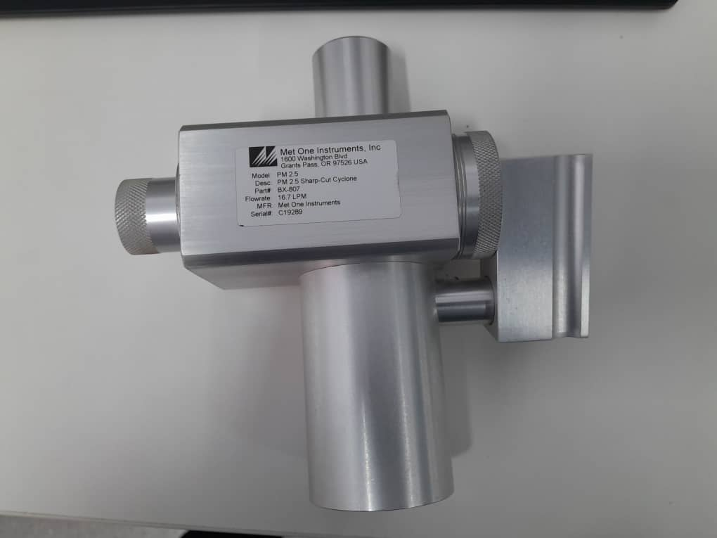
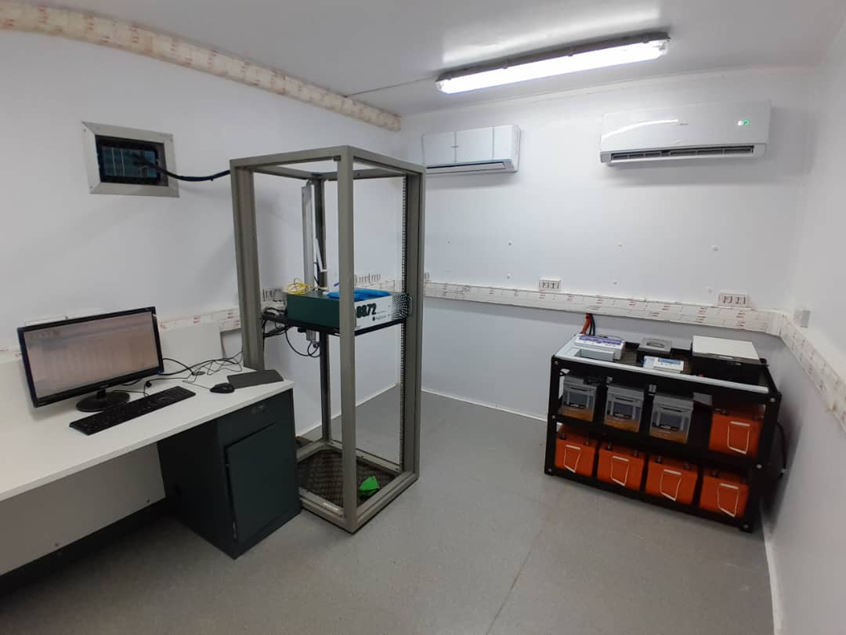
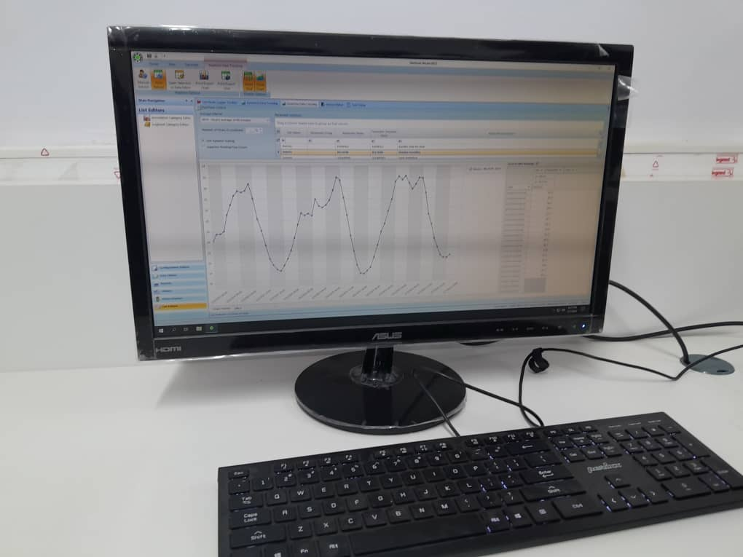
SOKOTO STATION

Slide 16
AIR QUALITY FORECASTING
According to World Meteorological Organization (WMO) National Weather and Hydrological Services (NWHS) well suited to carry out operational CW-AQ forecasting.
Forecasting methods and tools
Air quality monitoring data, Observed data
Weather forecast models,
Satellite images,
computer models/Mathematical Models that estimate how pollution travels on the air.
Forecasters also consider knowledge of how pollution behaves in certain communities to issue the air quality forecast.
Prediction should correlate with data from monitoring stations or satellite data where stations are not readily available.

Slide 17
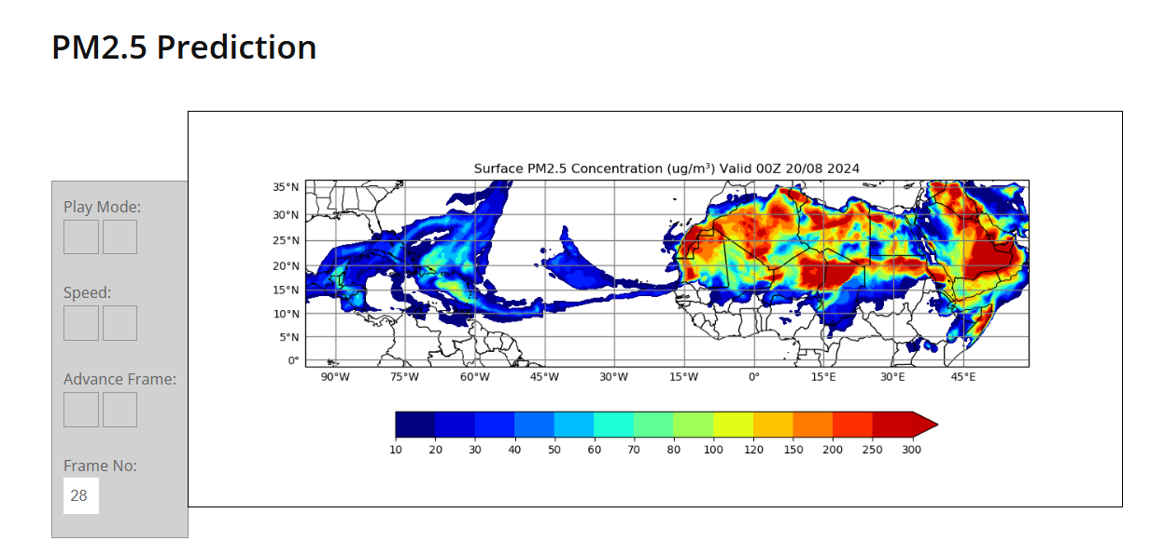
Air Quality Forecasting (AQF) Tools
The Caribbean Institute for Meteorology
and Hydrology https://dafc.cimh.edu.bb/pm25-prediction/

Slide 18
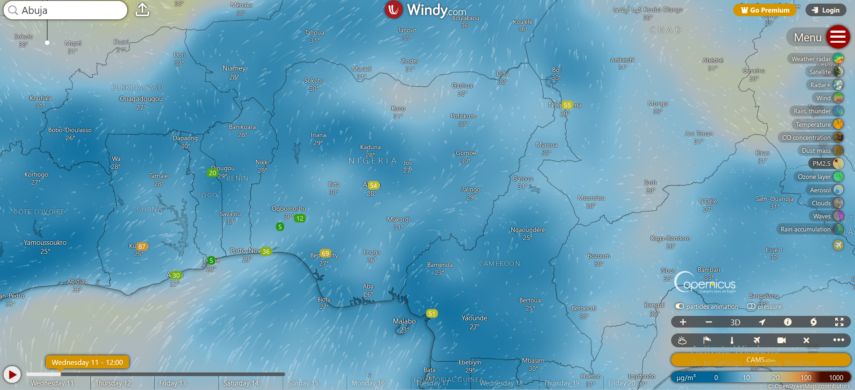

Slide 19
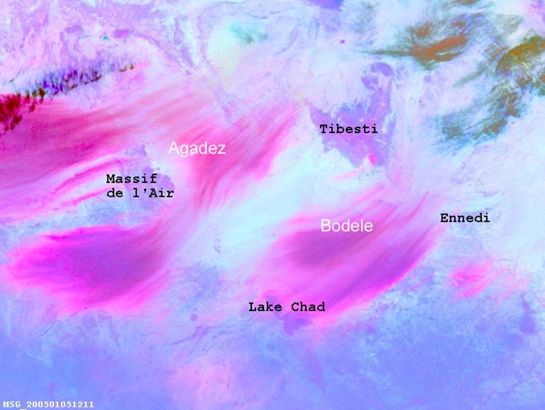
Tracking Dust using Satellite Imageries

Slide 20
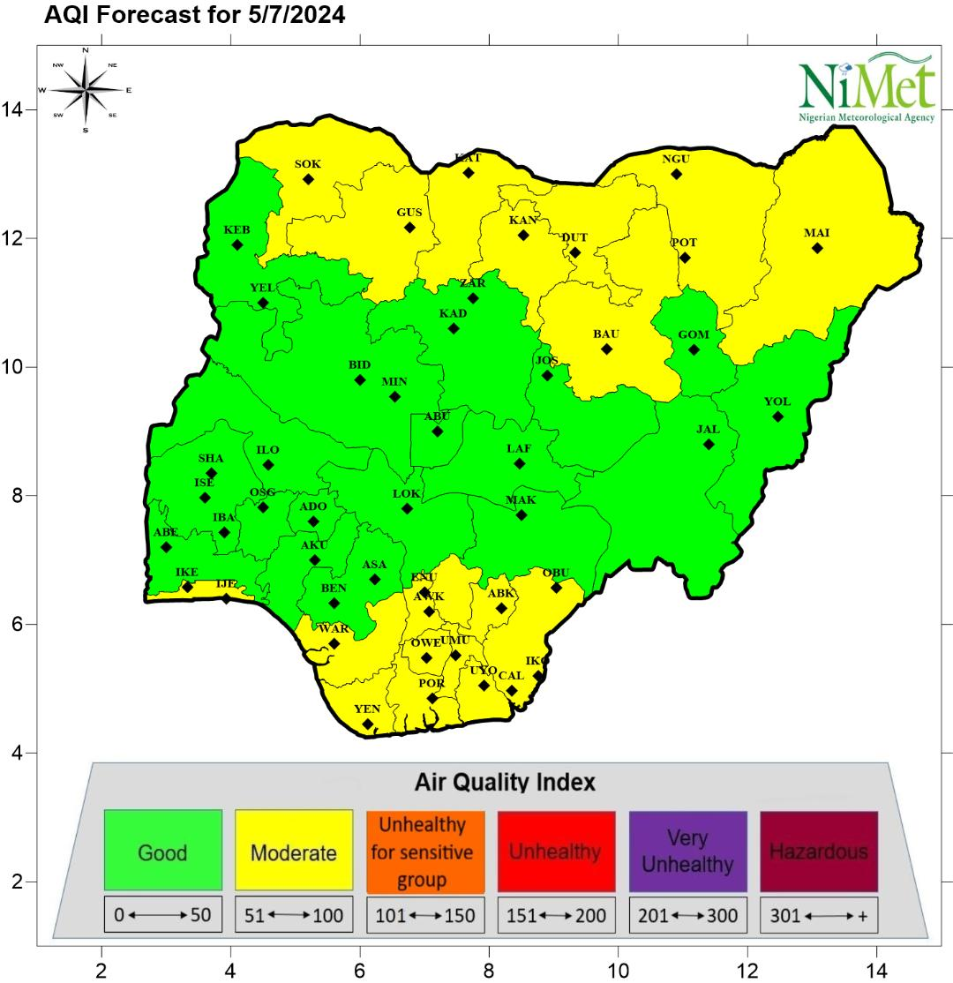
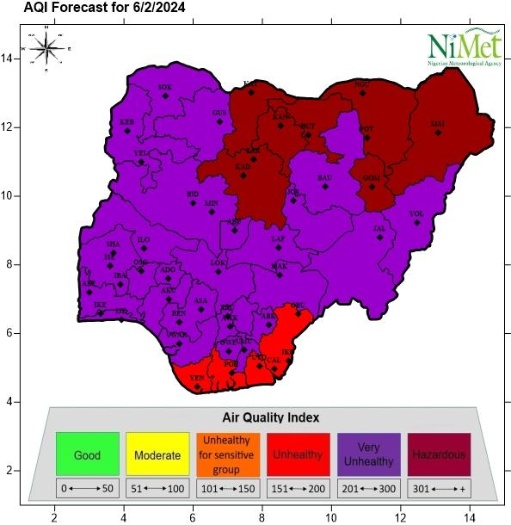
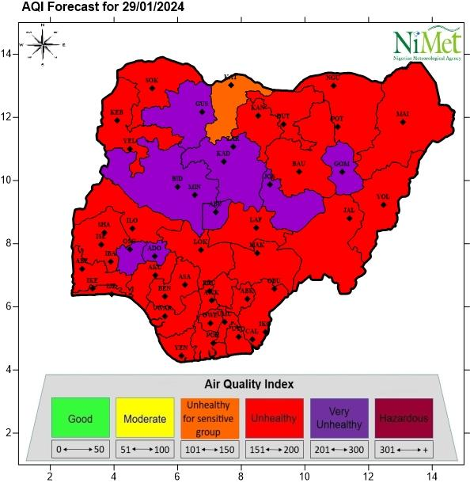
Air Quality Forecasting
NiMet Air Quality Forecasting commenced in 2022 and up till now, the forecast is still on, it can be viewed daily on National Television, Nigerian Television Authority (NTA) 9 pm news with the weather forecast.
It is also available on NiMet Social Media handles such as u tube and Facebook pages, X(Twitter) also on our Website.
https://nimet.gov.ng/

Slide 21
Air Quality Forecast
Daily air quality forecast is provided operationally by NiMet
This forecast can be accessed on our website @ https://nimet.gov.ng/

Slide 23
Six hourly Average Concentration of PM2.5

Slide 24
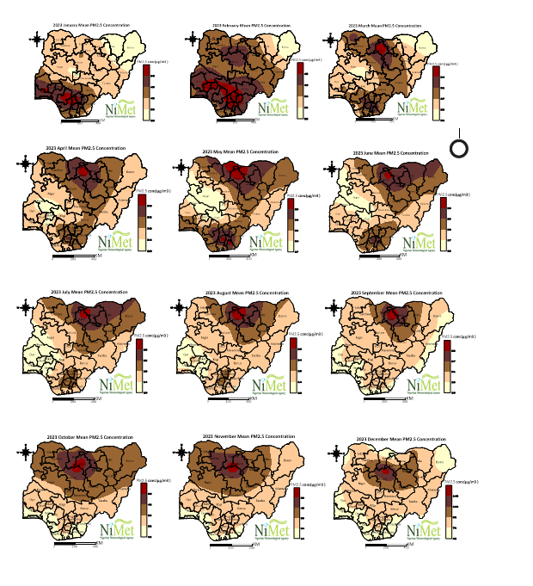
Spatial Distribution of Pm2.5 across Nigeria in 2023

Slide 25
Air Pollution Management in Nigeria
The stakeholders in the management of air pollution in Nigeria include
Government institutions such as the Nigerian Meteorological agency.
Federal Ministries of Environment, Health, Science and Technology. Others are research institutions, and organized private sector.

Slide 26
Challenges of Air quality Monitoring in Nigeria
Within sub-Saharan Africa (SSA), the ratio is just one ground-level monitor per 15.9 million people, despite African cities recording some of the highest air pollution levels worldwide.
Real time data on air pollution remains fragmented and often inaccessible.
Weak enforcement of environmental protection laws and limited.

Slide 27
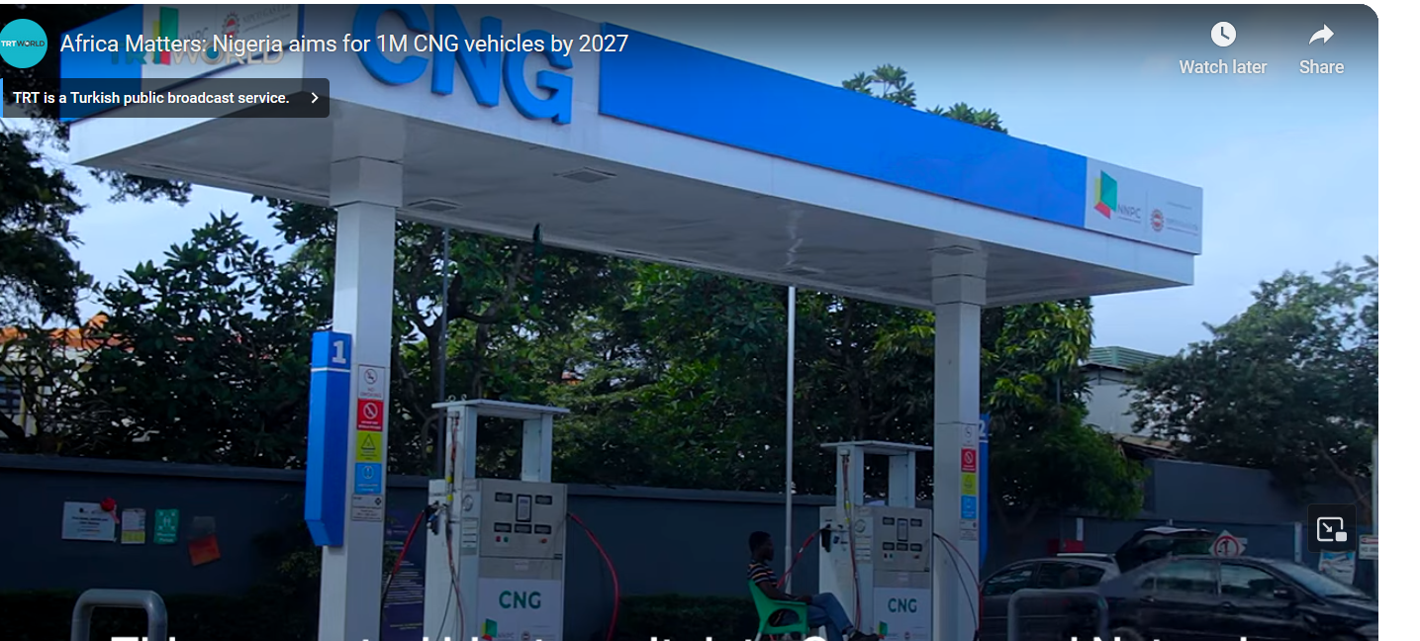
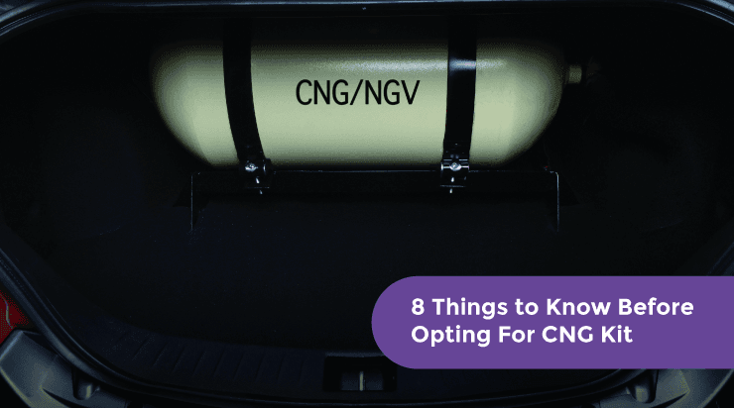
Interventions
Nigeria is gradually shifting towards the adoption of clean energy through the introduction of Compressed Natural Gas.
Nigeria - Develop a national policy on soot-free buses and a national strategy and implementation plan for Compressed Natural Gases (CNG)/electric bus deployment.
The mitigation measures identified include the regulation and enforcement of vehicle emission standards and targeted adoption of natural gas buses.
The Federal Government aims for a minimum of one million Compressed Natural Gas (CNG) vehicles on the road for the usage of Nigerians by the year 2027
The plan aims to reduce 75% of PM2.5 emissions by 2030
The plan also endorses recommendations for the conversion of 25% of all buses to natural gas by 2030.

Slide 28
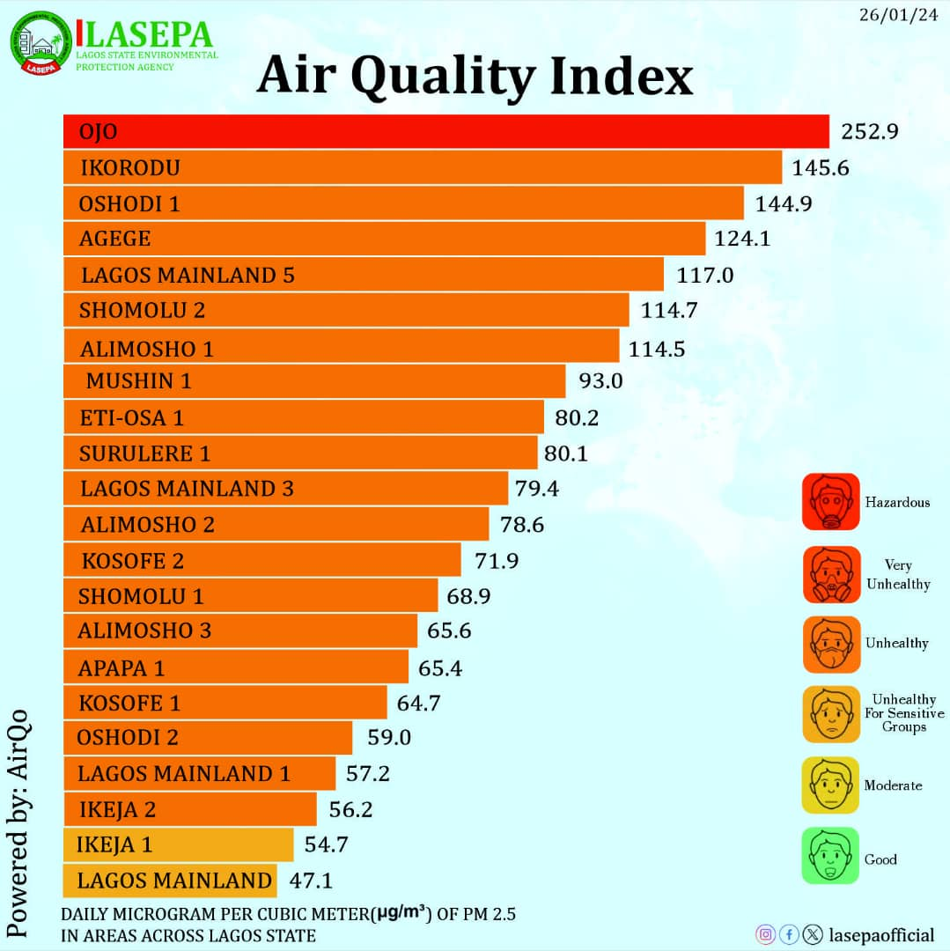
INTERVENTIONS INTERNATIONAL COLLABORATION
There has been collaboration with international organizations and partners to improve air quality monitoring. This includes sharing data, best practices, and technical expertise to enhance monitoring capabilities in the country.
The World Bank Pollution Management and Environment Health Program (PMEH) offers opportunities to collaborate with the Lagos State Government to create incentives and policies that will improve the air quality.
Lagos Nigeria
In Lagos, Nigeria, the World Bank used network with RGMs at six sites for air quality observations, health impact assessments, and model evaluation (Akpokodje et al., 2022). with multiple LCS covering a region of interest
The study recommended expanding the network with a focus on assessing impacts of ports, traffic, and industrial activity using paired upwind and downwind sites. (WMO GAW Report No. 293)
The World Bank Pollution Management and Environment Health Program (PMEH) offers opportunities to collaborate with the Lagos State Government to create incentives and policies that will improve the air quality. (

Slide 29
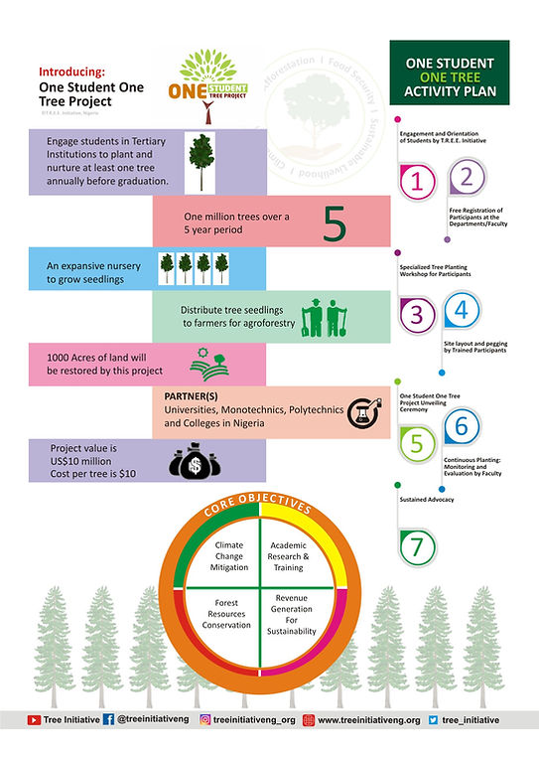
Interventions: Tree Planting Projects
The tree planting campaign is in fulfillment of Nigeria pledge to plant 25 million trees in Nigeria to enhance the country's carbon sink as part of the country's efforts to implement the Paris climate change agreement.
The Rural Environmental Empowerment Initiative
ONE STUDENT ONE TREE PROJECT (OSOTP)
is a collaborative partnership between T.R.E.E. Initiative and tertiary institutions in Nigeria.

Slide 30
There has been Increase awareness on the use of renewable energy At the moment, the use of renewable energy in Nigeria is gradually improving and being accepted, especially among individuals and businesses who use it to power their homes, offices, businesses, etc. One of the most used sources of renewable energy in the country is Solar.

Slide 31
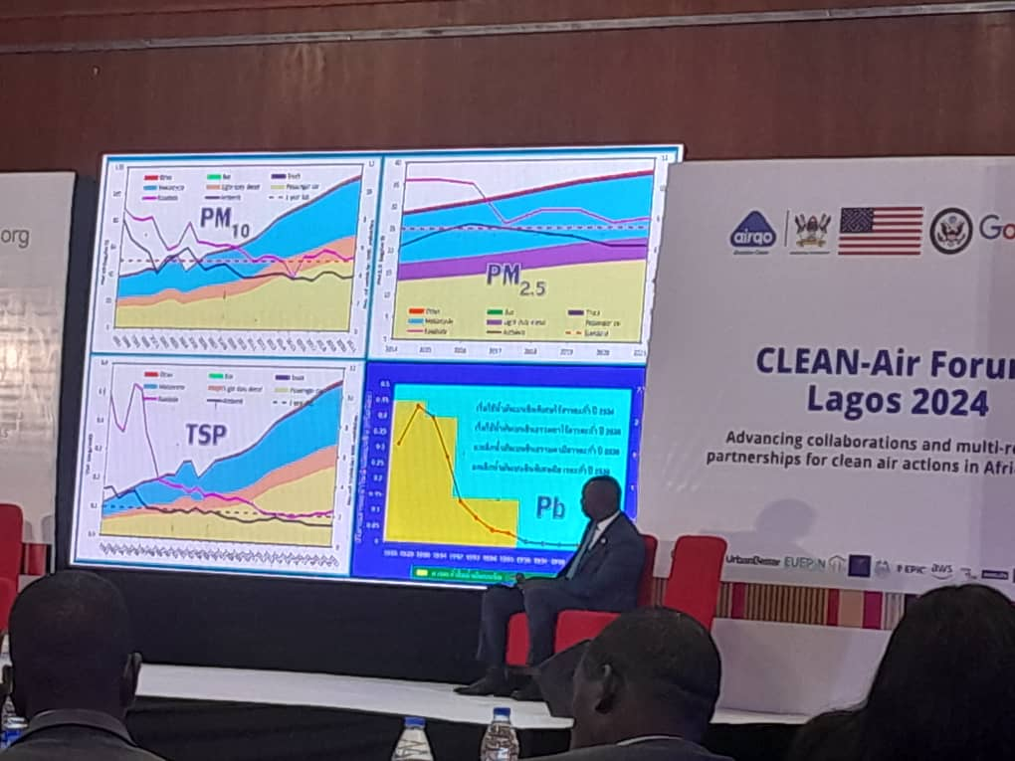
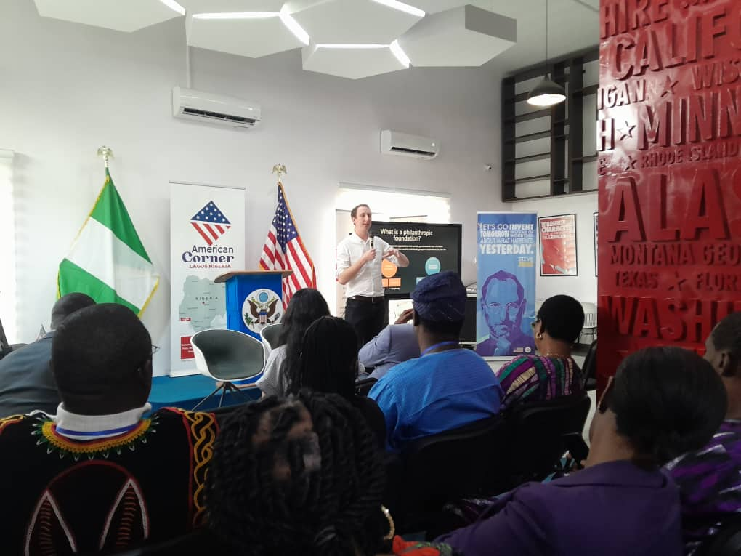
Public Awareness and Education
Efforts have been made to increase public awareness and education about air pollution and its health effects in Nigeria.
This includes campaigns and programs to inform the public about the importance of monitoring air quality and taking steps to reduce pollution.
In recent years, we've seen a significant increase in the frequency of such events, reflecting growing awareness and urgency surrounding air quality issues.
The Lagos State Environmental Protection Agency (LASEPA) and Clean Air Forum hosted a 5-day Clean Air Forum in Lagos State. Knowledge sharing and collaborations to strengthen regional networks for clean air interventions in African cities.
Advancing collaborations and multi-regional partnerships for clean air in African cities

Slide 32
Interventions
Nigeria’s ambitious National Action Plan to Reduce Short-Lived Climate Pollutants is to deliver real health benefits to Nigerians through improved air quality, while helping Nigeria meet its international climate change commitment.
The National Environmental Standards and Regulation Enforcement Agency (NESREA) monitors operations to ensure that citizens are abiding by the pollution regulations.

Slide 33
The Nigerian Meteorological Agency is expanding the Air Quality Observatory in Nigeria.
Two Reference Grade Monitors have been procured for installation in 2 northern cities in Nigeria (Sokoto and Yola)
Sokoto is completed and its already operational while Yola installation is still ongoing.
Proposal has been made for the procurement more portable LCS such as Purple Air , Vaisala devices to argument the RGMs

Slide 34
Thanks for listening

