Slide 1
TRAINING OBJECTIVES
OF THE OJT
Alexandru Hozoc, MET expert

Slide 2
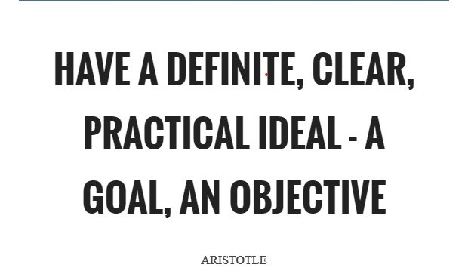
poursuivront un développement durable grâce aux meilleurs services possible, tant sur terre qu’en mer et dans les airs

Slide 3
Content
poursuivront un développement durable grâce aux meilleurs services possible, tant sur terre qu’en mer et dans les airs
Training objectives
(be) SMART
Connecting…

Slide 4
Content
poursuivront un développement durable grâce aux meilleurs services possible, tant sur terre qu’en mer et dans les airs
Training objectives
(be) SMART
Connecting…

Slide 5
Training Objectives
Training objectives are similar to goals or desired outcomes providing value to the people participating in the training event.
Creating meaningful, relatable and effective training objectives is important for the overall success of the trainees.

Slide 6
Training Objectives
Reasons for added attention to the training objectives include:
Giving purpose to the course leads the training design process,
Allow trainees to understand what they need to do to succeed,
Set goals for trainees to achieve in steps toward a larger outcome,
Provide trainers with a clear method of measuring trainees' progress through the program
Support business goals through the completion of training objectives

Slide 7
Content
poursuivront un développement durable grâce aux meilleurs services possible, tant sur terre qu’en mer et dans les airs
Training objectives
(be) SMART
Connecting…

Slide 8
SMART objectives
S
M
A
R
T
pecific / significant
easurable
cceptable / achievable
elevant / realistic
ime acceptable

Slide 9
SPECIFIC
Clear for everyone
Well defined

Slide 10
MEASURABLE
Has to be identified the way they can be achieved
Measures / refferences
Following the progress

Slide 11
ACCEPTABLE
Not very ambitious as time and content
Can be achieved by the participants based on previous knowledge and abilities

Slide 12
REALISTIC
Connected to the operational activities
Connected with training needs
Can be achieved by the instructor in the real environment

Slide 13
TIMING
Can be achieved in the available time
Dead-line for achieving has to be specified
Can be splitted in sections

Slide 14
Content
poursuivront un développement durable grâce aux meilleurs services possible, tant sur terre qu’en mer et dans les airs
Training objectives
(be) SMART
Connecting…

Slide 15
Connecting
Training objectives must be connected with the job description
Effective job descriptions outline the roles and responsibilities for a position, one of the starting points in training is to communicate duties to the employee.
Job descriptions must provide direction for effective formal training programs that emphasize teaching new skills/competencies or improving on existing ones.

