Slide 1
WEATHER CLIMATE WATER | World Meteorological Organization REGIONAL ASSOCIATION VI (EUROPE) Regional WIGOS Centres 04 June 2024 (online)
Welcome to the RA VI Online Training on IMS for RWCs and NFPs-WDQMS 09:30-12:30 CEST/7:30-10:30 UTC
Background for this training:
- Agreed at the Hybrid Training Workshop on RWCs functions and tools (20-22 Nov. 2023, Santander, Spain) as a complementary training on IMS
Expected learning outcomes:
- NFPs for WDQMS and RWCs staff better understand and have their competences improved in identifying, registering and following up on observational issues to resolve them
How to access the IMS:
- IMS-test platform for training purposes = https://ims-test.wmo.int/
o Use the “Officially Nominated WDQMS NFPs” (button)
o Use the username/password text box only if you are not nominated NFP-WDQMS
- IMS-RWCs operational platform = https://jira.wmo.int/
Logistics of the Zoom session:
- follow name convention as “Name/Country/Role”
- mute micros when not speaking; click the little icon () to raise your hand or use the chat box
- for follow up questions/comments go to Discussion Forums in the WIGOS Learning Portal (WMO Moodle) at: https://etrp.wmo.int/mod/forum/view.php?id=10062

Slide 2
WEATHER CLIMATE WATER | World Meteorological Organization REGIONAL ASSOCIATION VI (EUROPE) Online Training on IMS for RWCs and NFPs-WDQMS 04 June 2024 (online)
Tentative programme (09:30-12:30 CEST/7:30-10:30 UTC)
Time min | Agenda item | Presenter
Moderator: Luis Nunes (WMO)
20 | Recap on WDQMS concept and functions | Luis Nunes (WMO)
20 | Recap on RWCs functions, daily tasks and priorities; Roles and responsibilities of relevant NFPs | Rabia Merrouchi (WMO)
15 | Recap of the concept for RWCs in RA VI | Sari Lappi (WMO)
20 | Recap of main features of the IMS and the generic workflow | Ercan Buyukbas (WMO)
5 | Health break
20 | Live demo with practical exercise - Interaction between RWC operator and National Focal Point on WDQMS in IMS | Rabia Merrouchi (WMO)
15 15 30 | Practical examples on registering and following-up on incident tickets with IMS: Manage an incident using the IMS (RWC EUMETNET) Create your own dashboards using IMS (RWC EUMETNET) Identify issues and Manage incidents (RWC Türkiye) | RWC EUMETNET (Stuart Matthews) / RWC Türkiye (Özden Tuten)
20 | Final discussion: Questions and answers Conclusions and actions | All

Slide 3
RA VI Online Training on IMS for RWCs and NFPs-WDQMS
4 June 2024
Recap on WDQMS concept and functions
Luís Nunes, WIGOS Scientific Officer
WIGOS Branch, Infrastructure Department, WMO Secretariat

Slide 4
Topics
Quality monitoring - Why ?
Value Chain and Quality of Weather Observations
Quality monitoring - What?
WDQMS concept and functions
Data availability and data quality issues

Slide 5
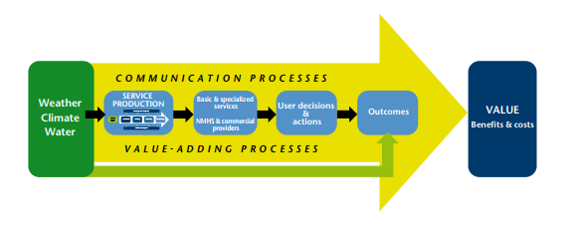
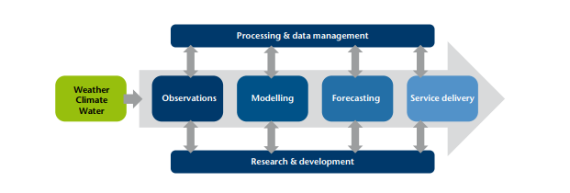
Observations in the Meteorological Value Chain

Slide 6
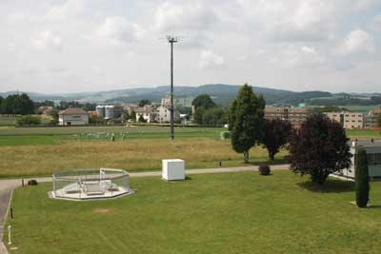
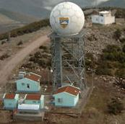
Observations data and their “quality”
The overall purpose of taking weather and climate observations (and others) is to provide information in sufficient detail to meet the users requirements, to ultimately contribute to safety and well being of the people and goods.
Need to ensure that, efforts are made to acquire, transmit, and archive observations with the greatest precision and consistency possible.
However, observed data can be subject to failures and/or errors (e.g. due to human intervention, equipment failures, issues in the data processing, coding, or transmission).
Various means are used to assure data "quality" and availability.

Slide 7
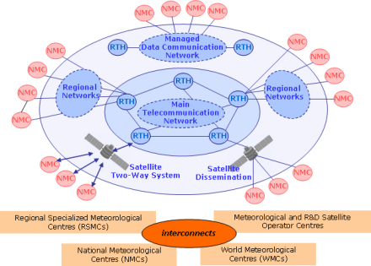
Observations data and their quality
National observing stations
Data transmission from site to NMHS Data Centre or Headquarter (HQ) Office
WDQMS starts here
!
NMHS HQ
GTS/WIS
International users
e.g. global NWP centres
International exchange
to be indicated in

Slide 8
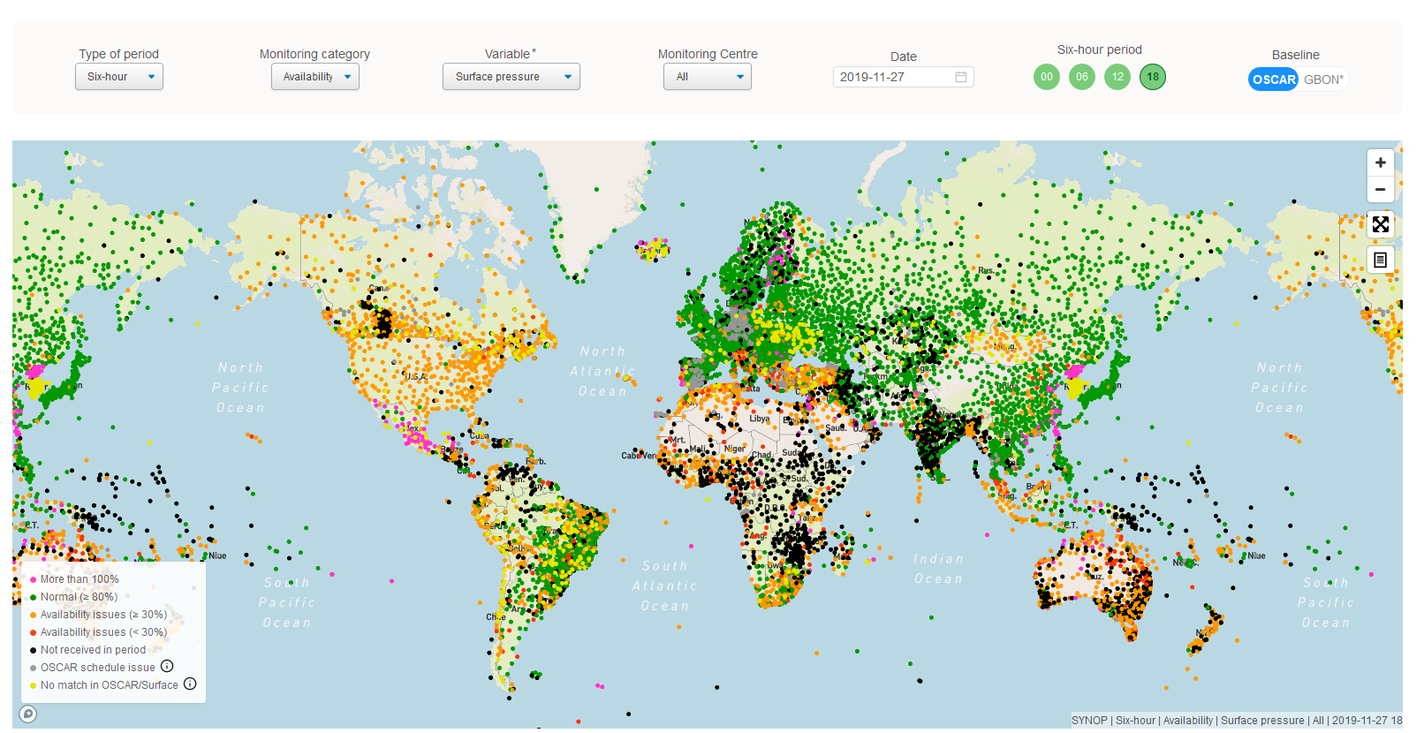
WDQMS Webtool
A web based tool for near-real time monitoring the availability and quality of observations exchanged internationally
Land surface and upper air observations (near-real-time NWP)
Surface and upper air observations of GCOS
Surface and upper air GBON observations
One of the WIGOS Tools, critical for WIGOS implementation/operations
Operational since March 2020
Under evolution based on requirements and expansion of the observations to be monitored
(e.g. marine observations to be made available soon)
Several new releases expected per year
Current release 1.4.6.1
https://wdqms.wmo.int =>
WIGOS Data Quality Monitoring System

Slide 9
WDQMS Webtool
Surface land observ. (availability & quality)
Surface pressure /geopotential height
Air temperature (2m)
Relative humidity (2m)
Wind (10m)
Upper air observations (availability & quality)
Air temperature
Relative humidity
Wind
Completeness of surface land observations (GCOS)
Pressure
Temperature
Max and min temperature
Water vapor
Precipitation
Sunshine duration
Quality of upper air land observations (GCOS)
Pressure
Temperature
Humidity
GBON stations monitor. (surface availability)
Surface pressure /geopotential height
Air temperature (2m)
Relative humidity (2m)
Wind (10m)
GBON stations monitoring (upper air)
Complete soundings

Slide 10
WDQMS Functions
The WIGOS monitoring function - WIGOS Monitoring Centres (Global NWP Centres: ECMWF, NCEP, JMA, DWD):
provide daily monitoring reports (availability/quality/completeness)
provide input to the WIGOS evaluation function
The WIGOS evaluation function generates routine performance reports on the basis of the relevant information
From the daily monitoring reports
From metadata about the observing stations, from the Observing Systems Capability Analysis and Review (OSCAR)/Surface tool,
From the WMO Information System (WIS)
The WIGOS incident management function
takes up the issues that the evaluation function raise as incidents, and follows up actions with the data supplier to resolve the incident

Slide 11
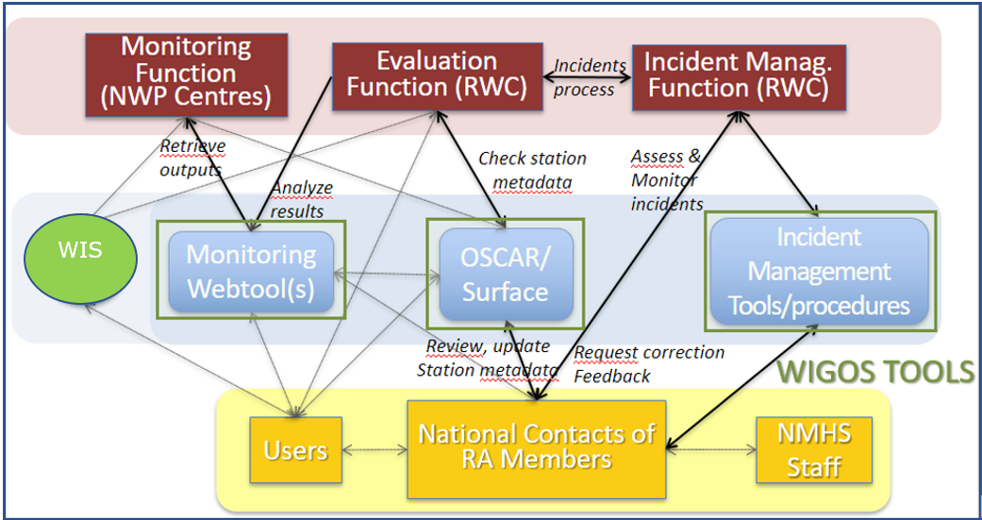
WDQMS Process

Slide 12
WDQMS outputs as part of the WIGOS monitoring and evaluation functions (examples for surface pressure)
The webtool displays maps of monitoring outputs from Monitoring Centres allowing to evaluate the stations performances within a RWC´s responsibility
It serves as part of the WIGOS evaluation function by aggregating the performances on a daily basis or in time series
Data availability
More than 100% (metadata)
Normal (≥ 80%)
Availability issues (≥30%)
Availability issues (<30%)
Not received in period
OSCAR Schedule issue (metadata)
No match in OSCAR/Surface (metadata)
Data quality
Very high O-B
High O-B
Moderate O-B
Small O-B
Very small O-B

Slide 13
Summary and remarks
Importance of data (and metadata) monitoring
Impacts of data availability, quality and timeliness
in weather forecasts, climate monitoring and other downstream products and services
WDQMS process and functions to be performed by RWCs in close interactions with NFPs
WDQMS webtool provides global online monitoring results on surface and upper-air observations:
Near real time NWP contributing stations
GBON stations
GCOS networks (monthly)
WDQMS webtool connects to external systems/tools:
WIS, OSCAR/Surface (retrieves metadata daily, provides monthly reports), GCOS-Lead Centre DWD, OceanOPS,…
WDQMS webtool is WMO’s main source of monitoring results for follow-up actions by RWC
Identify and register any observational issues in Incident Management System,
Track-down observational incidents and assist Members to fix them

Slide 14
Functions of RWCs
The RWCs mandatory functions are as follows:
(Regional) WIGOS metadata management (work with data providers to facilitate collecting, updating and improving the quality of WIGOS metadata in OSCAR/Surface),
(Regional) WIGOS performance monitoring, evaluation and incident management (WIGOS Data Quality Monitoring System – WDQMS) and follow-up with data providers in case of data availability or data quality issues.
Optional functions
Depending on available resources and regional needs, one or more optional functions may be adopted, e.g.:
assistance with the coordination of regional/subregional and national WIGOS projects;
assistance with regional and national observing network management; and
support for regional capacity development activities.

Slide 15
Thank you.
^{wmo.int}

