Slide 1
RA VI Online Training on IMS for RWCs and NFPs-WDQMS
4 June 2024
Incident Management System (IMS)
Practical Session
Rabia Merrouchi, Scientific Officer
WIGOS Branch, Infrastructure Department, WMO Secretariat

Slide 2
Outline
Practical exercises on registering and follow-up on tickets with IMS
Identify an issue
Create a Ticket
Evaluate the issue
Manage the incident
Interact with the assignee
Close the ticket

Slide 3
Workflow steps of the Incident Management Procedure
Step-1: Identify an issue
Anyone (RWC, NFPs, any other person/entity)
Step-2: Create a ticket
RWC, NFPs, relevant centres (WIGOS and GCOS monitoring centres)
Step-3: Evaluate the issue
RWC
Step-4: Initiate incident management process
RWC
Step-5: Select assignee to the ticket
RWC
Step-6: Follow the process
RWC and NFPs
 | 3

Slide 4
Step-1: Identify an issue (Metadata/Canada)
- in principle from OSCAR/Surface and/or from WDQMS Webtool, but could be based on other systems/tools
- brief description of the issue
…
Show screenshots or go live with the tools
 | 4

Slide 5
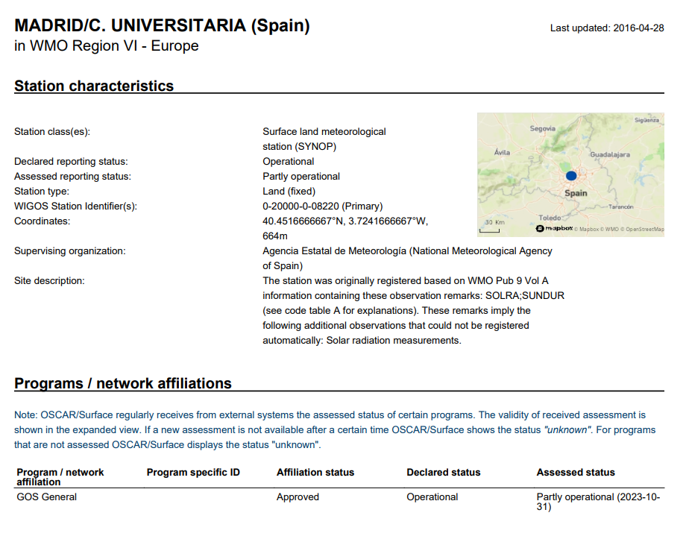
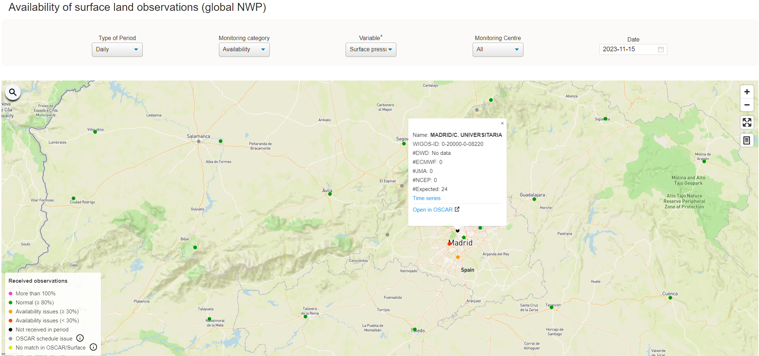
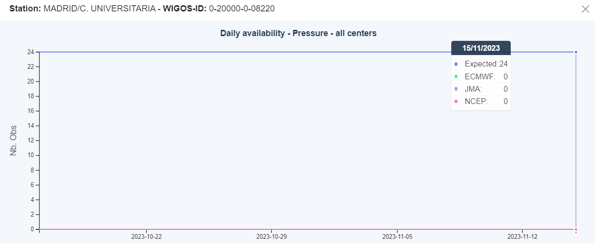
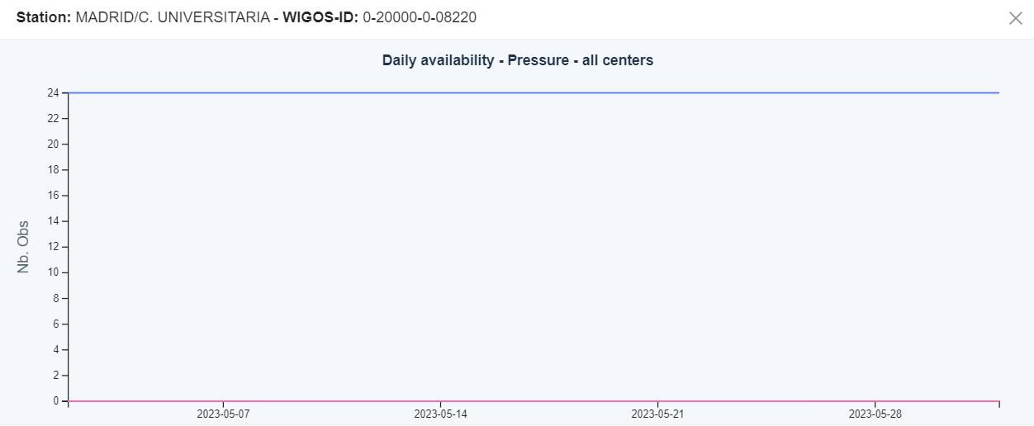
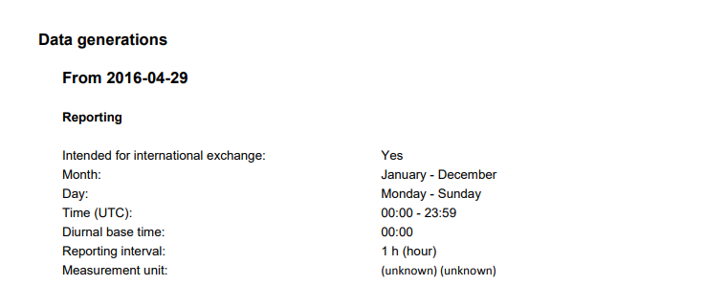
2. Surface data availability issue (Black dots)
As a conclusion:
Missing data for a long period
There is No issue within Metadata

Slide 6
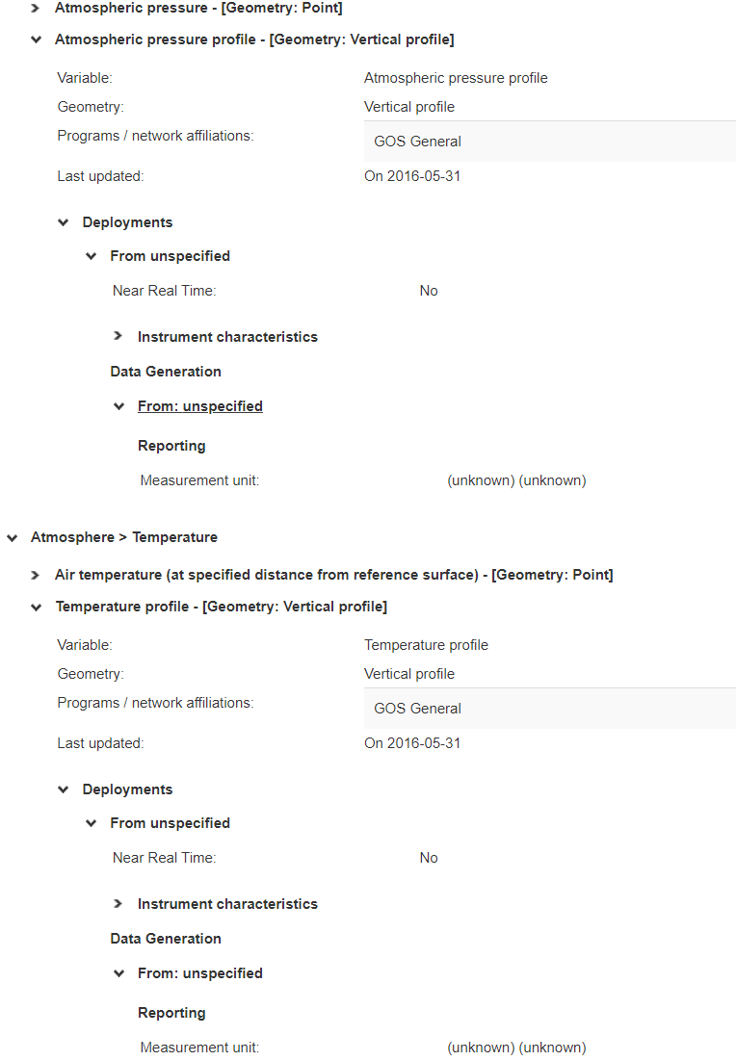
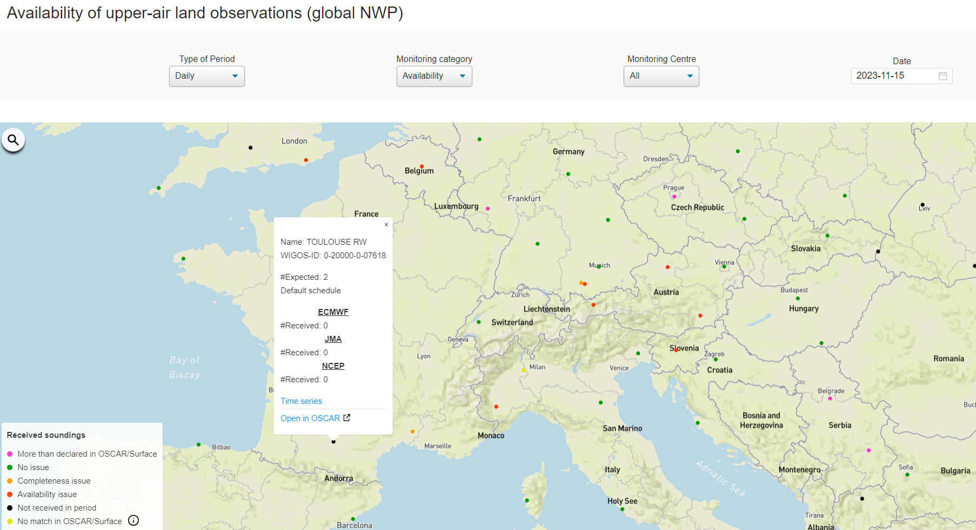
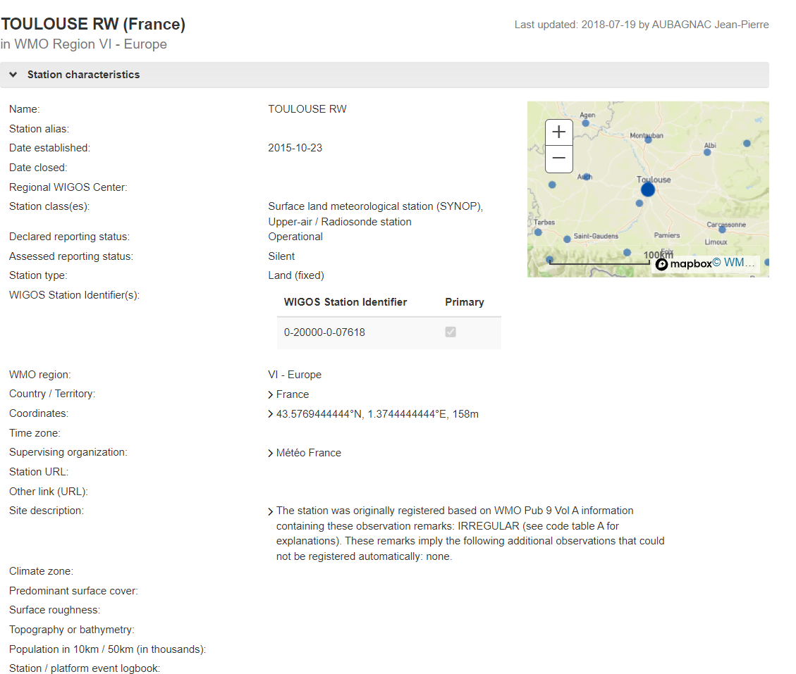
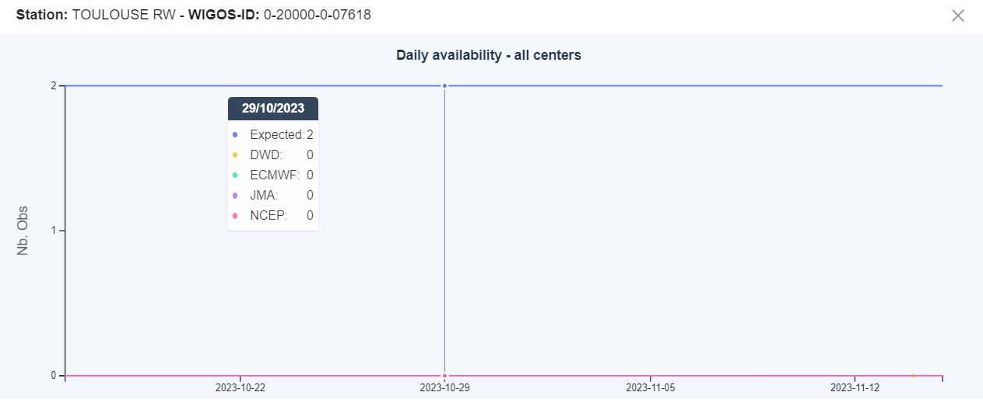
2. Upper-Air data availability issue (Black dots)
As a conclusion:
An issue to be considered: Missing data for a long period

Slide 7
END of Step-1: Identify an issue – what’s next?
Step-2: Create a ticket
(Principal RWC, WDQMS NFP)
Show screenshots or go live with the tools
 | 7

Slide 8
END of Step-1: Identify an issue – what’s next?
Step-2: Create a ticket
(RWCs, NFPs or monitoring centres)
Identify an issue
Create a Ticket
Assign the ticket
Add a comment
Date: 16/11/2023
Station: Madrid Universitaria
Country: Spain
WIGOS ID: 0-20000-0-08220
Associated RWC: RWC EUMETNET
NFP : xxx
Summary: Missing data for a long periode
Issue: availability/quality/timeliness
Surface/upper-air
Priority Level: doc 1224
Description:xxx
Attachements: (optional)
 | 8

Slide 9
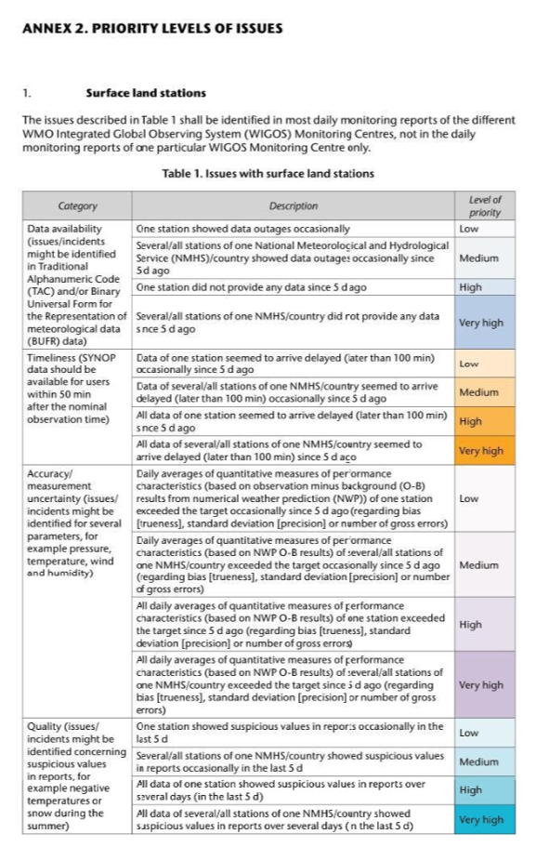
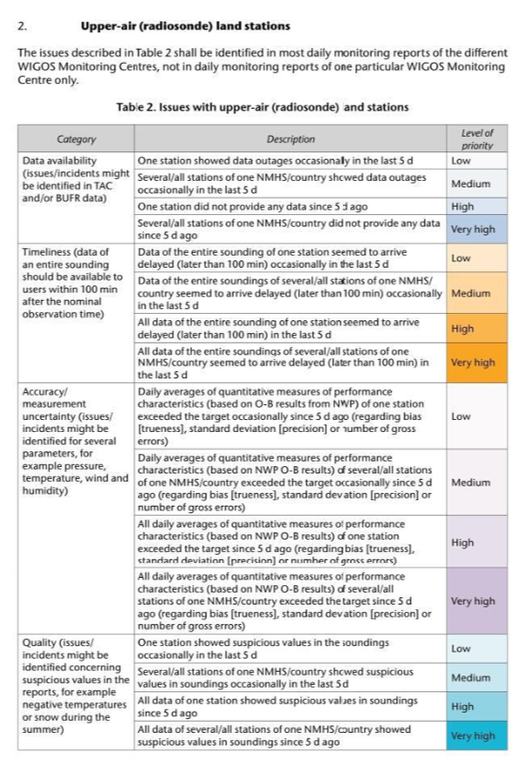
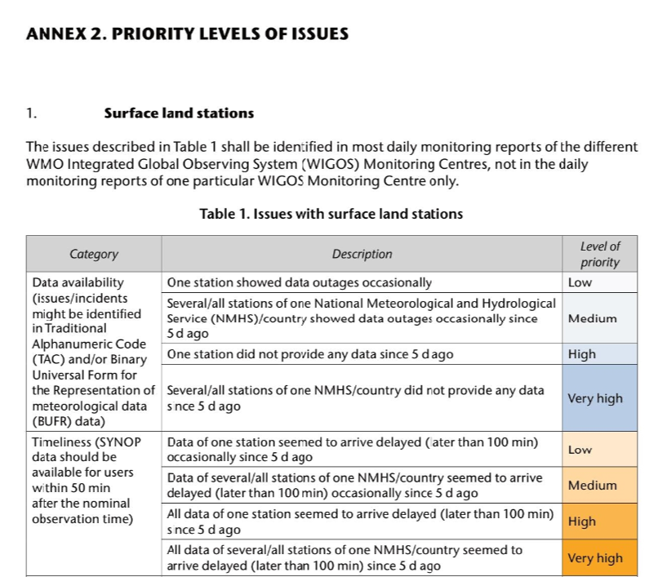
Priority Level

Slide 10
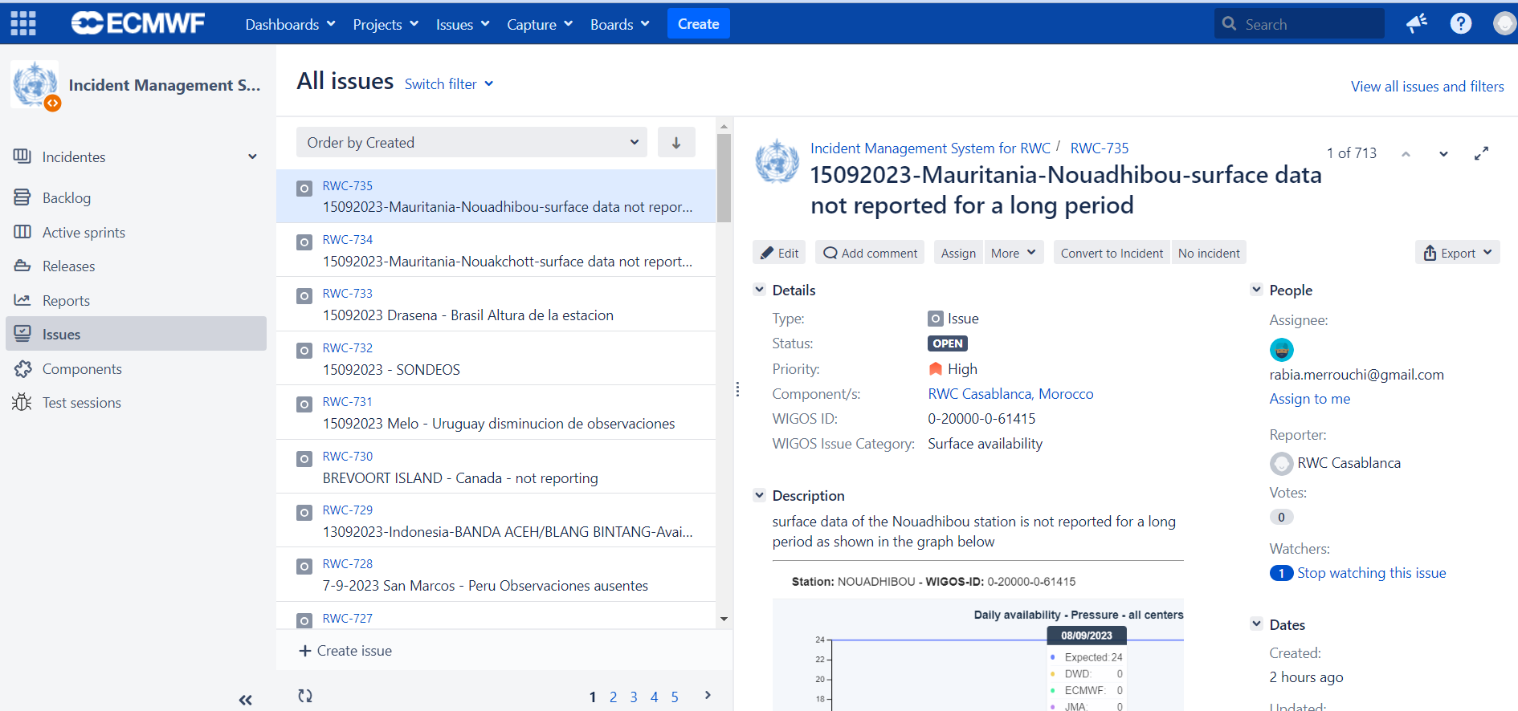
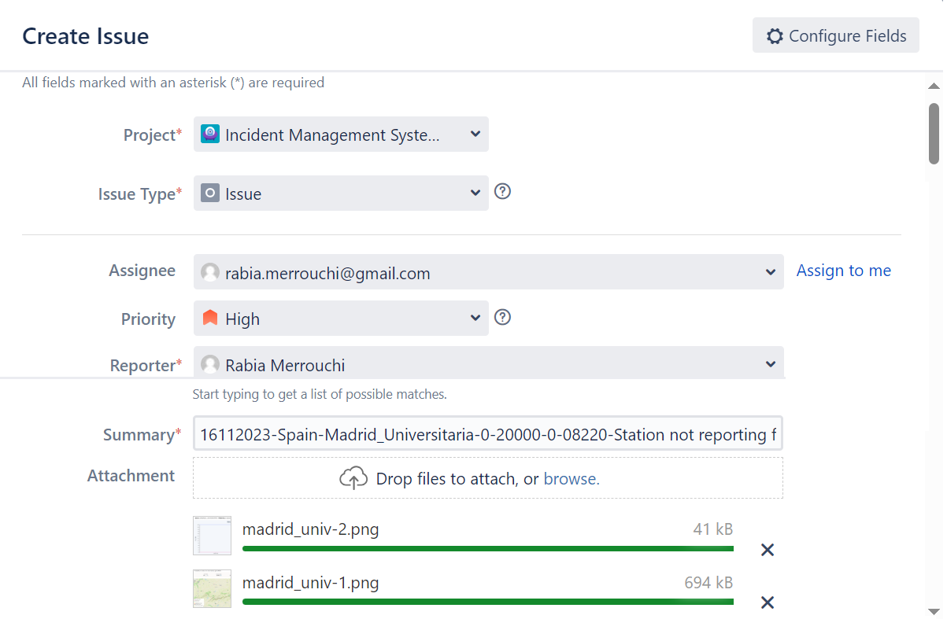
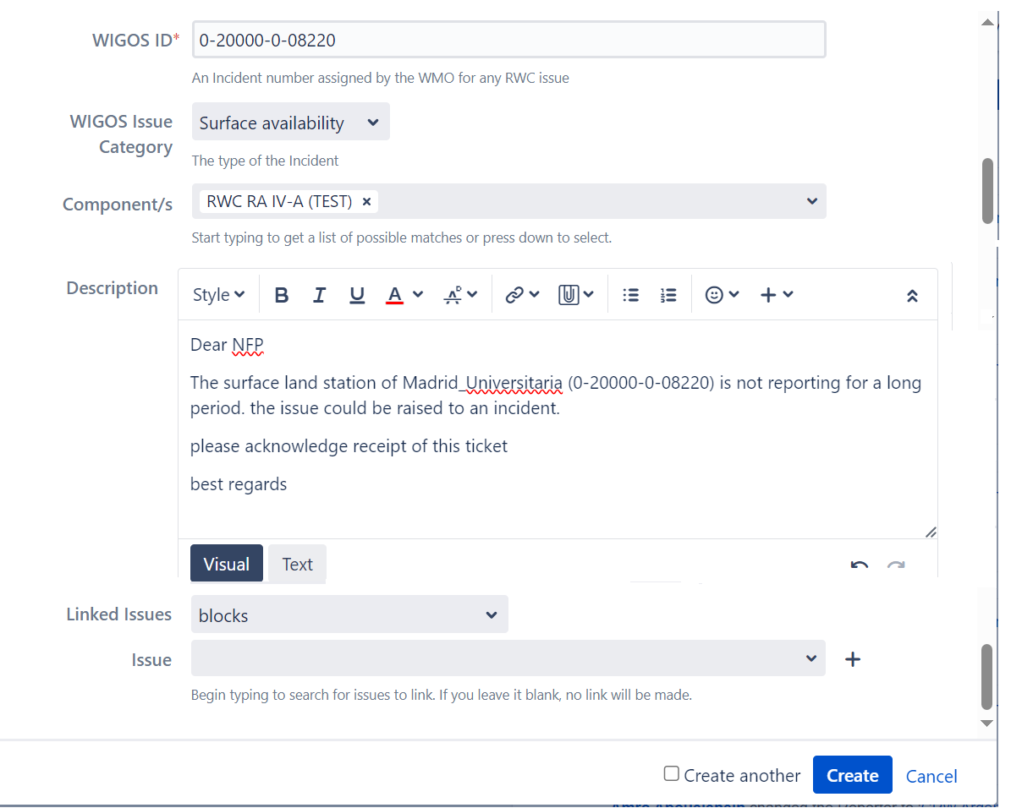
Create a Ticket

Slide 11
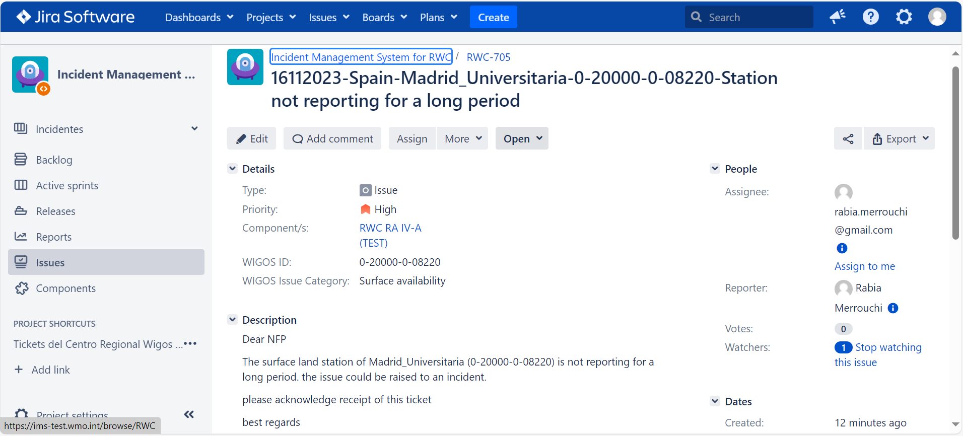
Create a Ticket

Slide 12
END of Step-2: Create a Ticket– what’s next?
Step-3: Assign the ticket
(Principal RWC)
Show screenshots or go live with the tools
 | 12

Slide 13
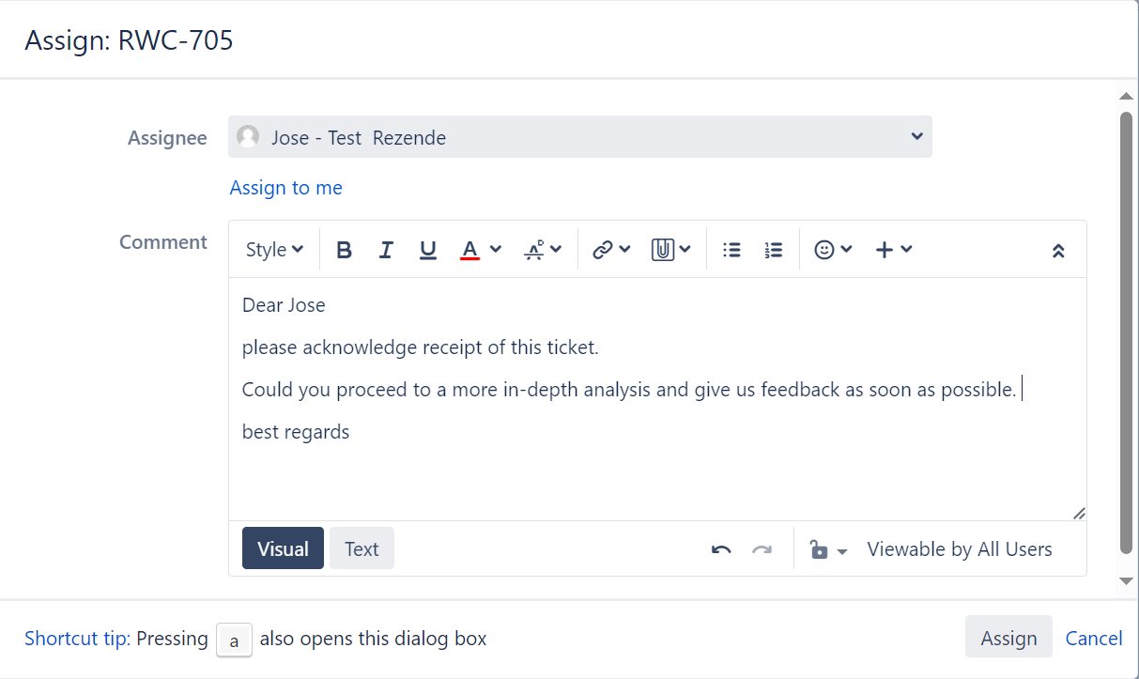
Assign the ticket

Slide 14
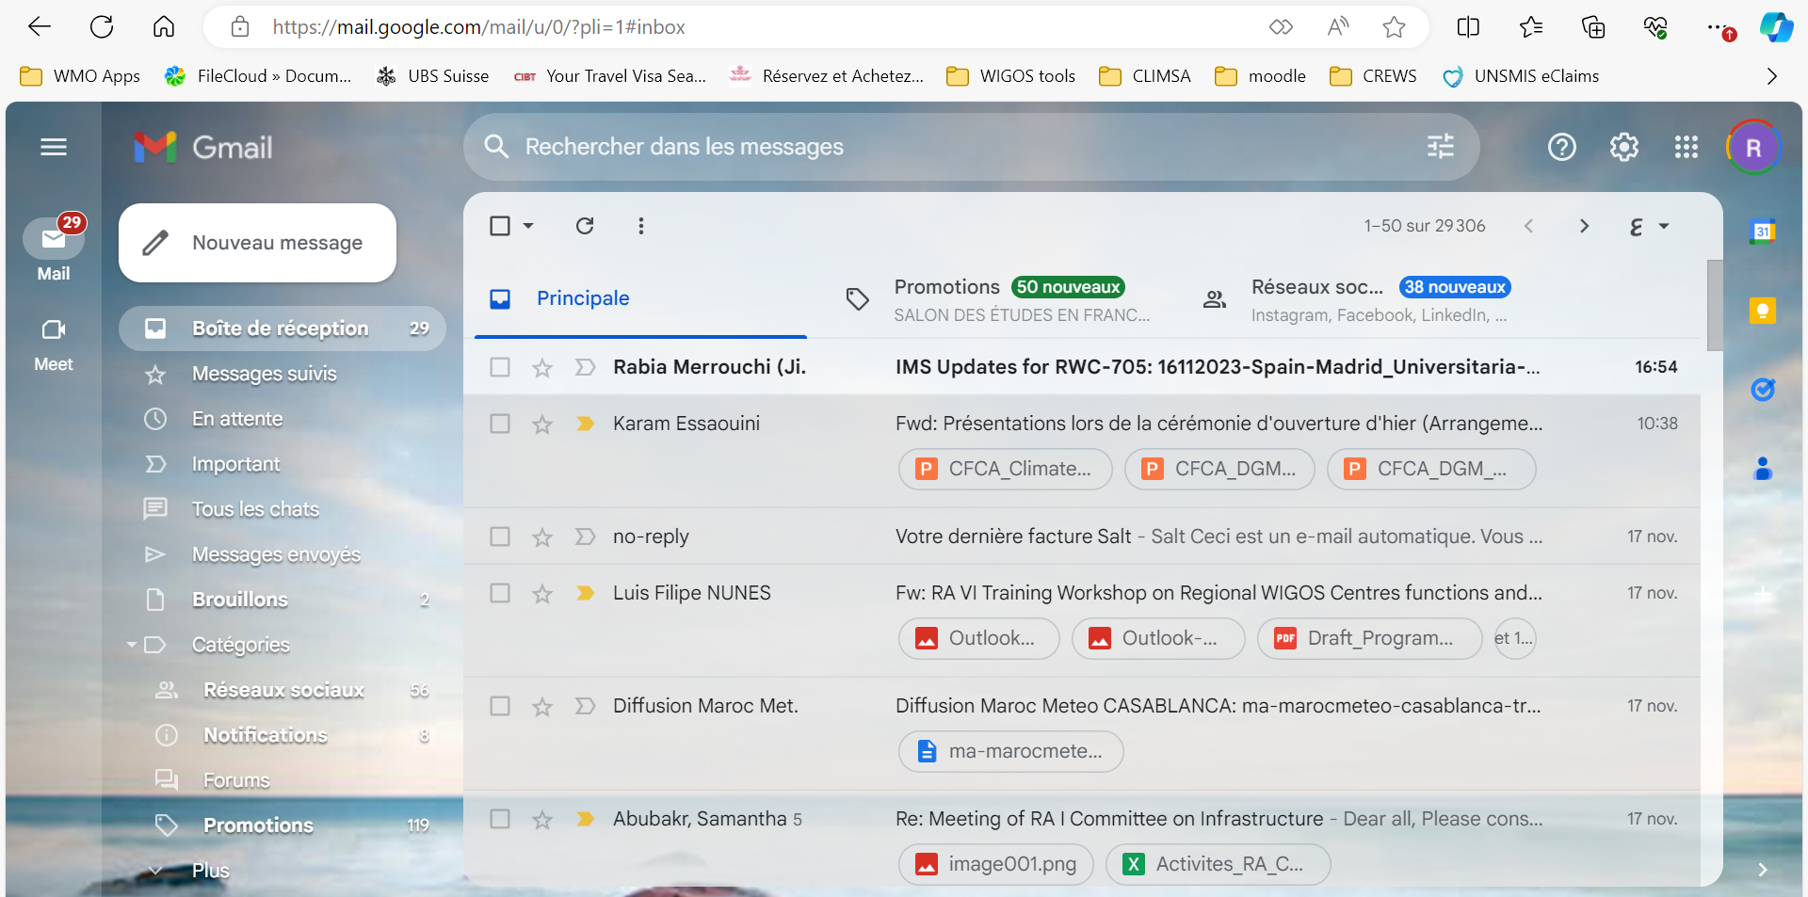
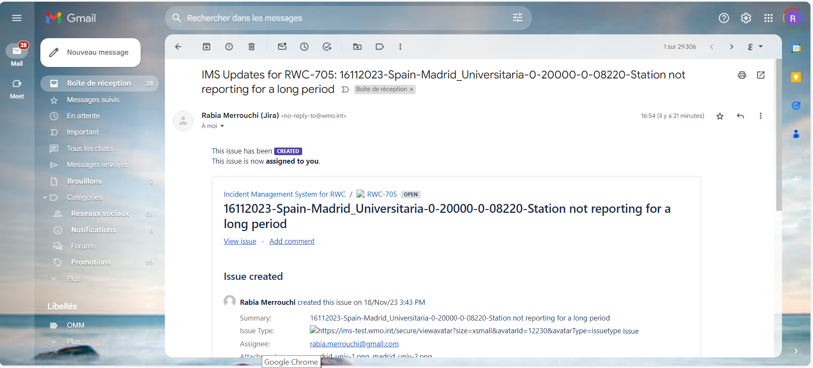
Assign the ticket
Ticket Number and status
Actions
show the ticket
Add a comment

Slide 15
END of Step-3: Assign the Ticket– what’s next?
Step-4: Evaluate the ticket
(Principal RWC)
Show screenshots or go live with the tools
 | 15

Slide 16
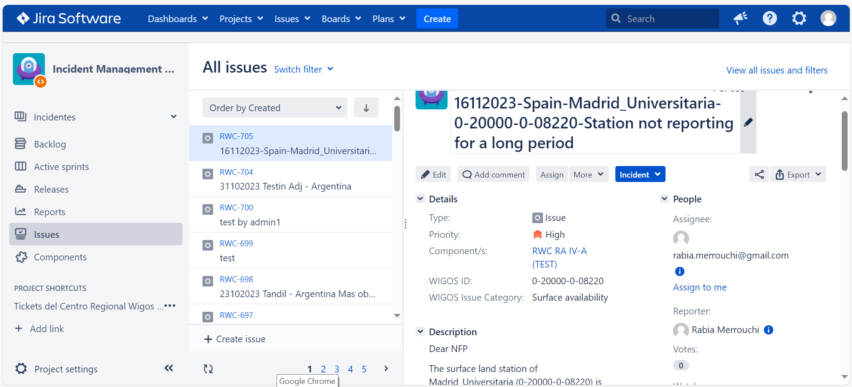
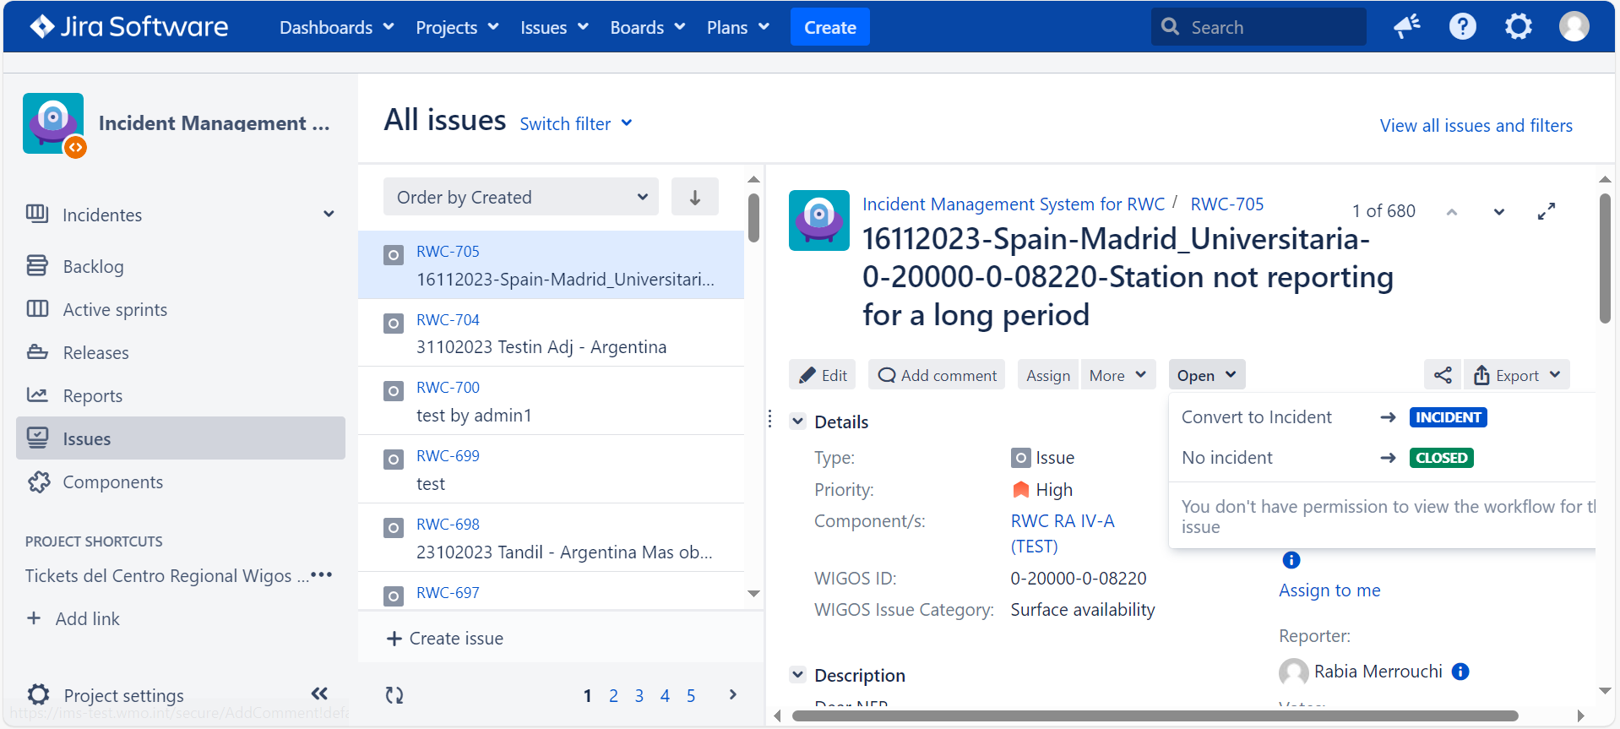
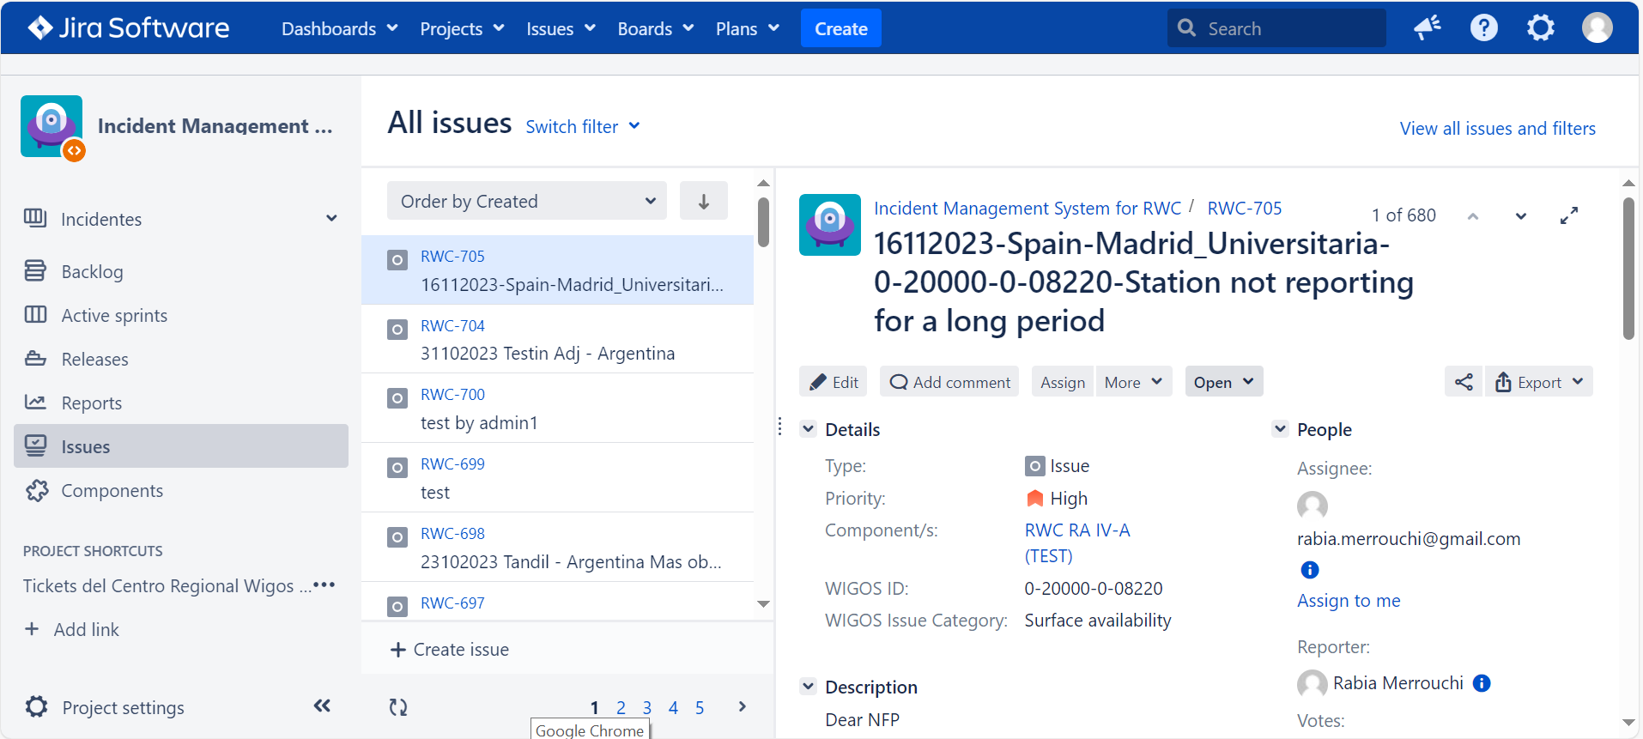
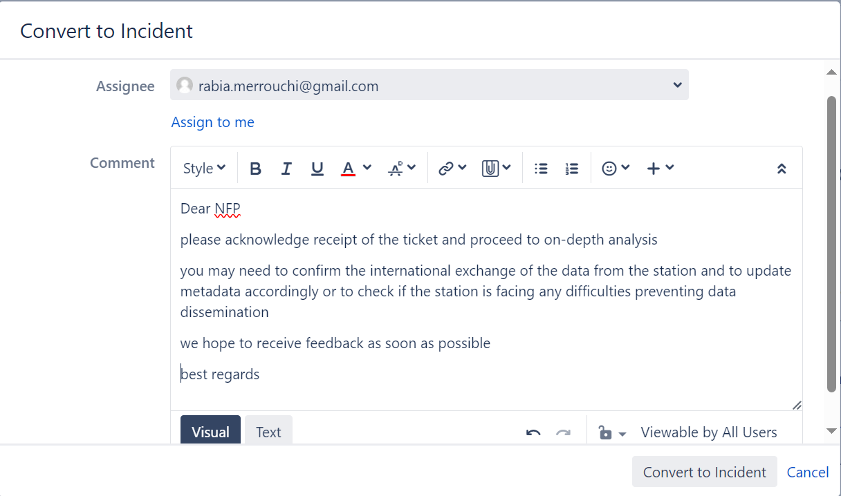
Evaluate the ticket
Based on the evaluation process conducted

Slide 17
END of Step-4: Evaluate the ticket– what’s next?
Step-5: Acknowledge Receipt/Add a comment
(WDQMS NFP)
Show screenshots or go live with the tools
 | 17

Slide 18
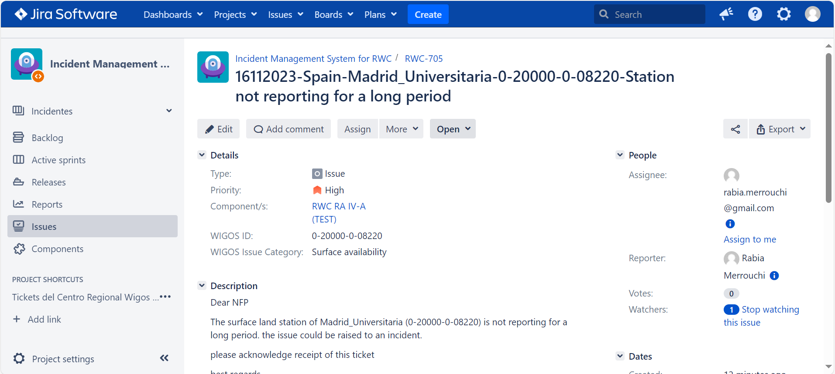
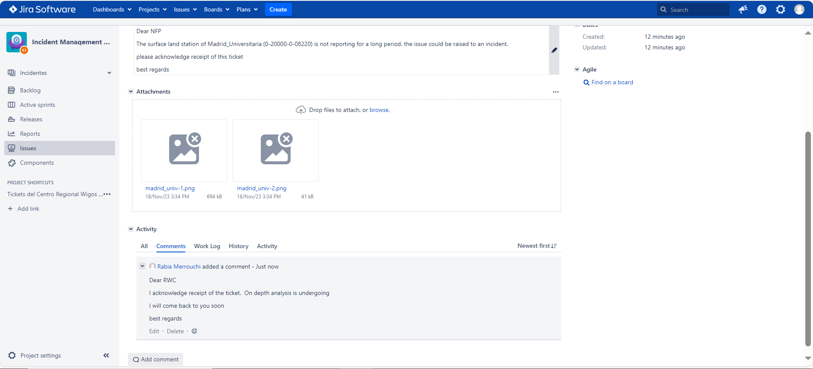
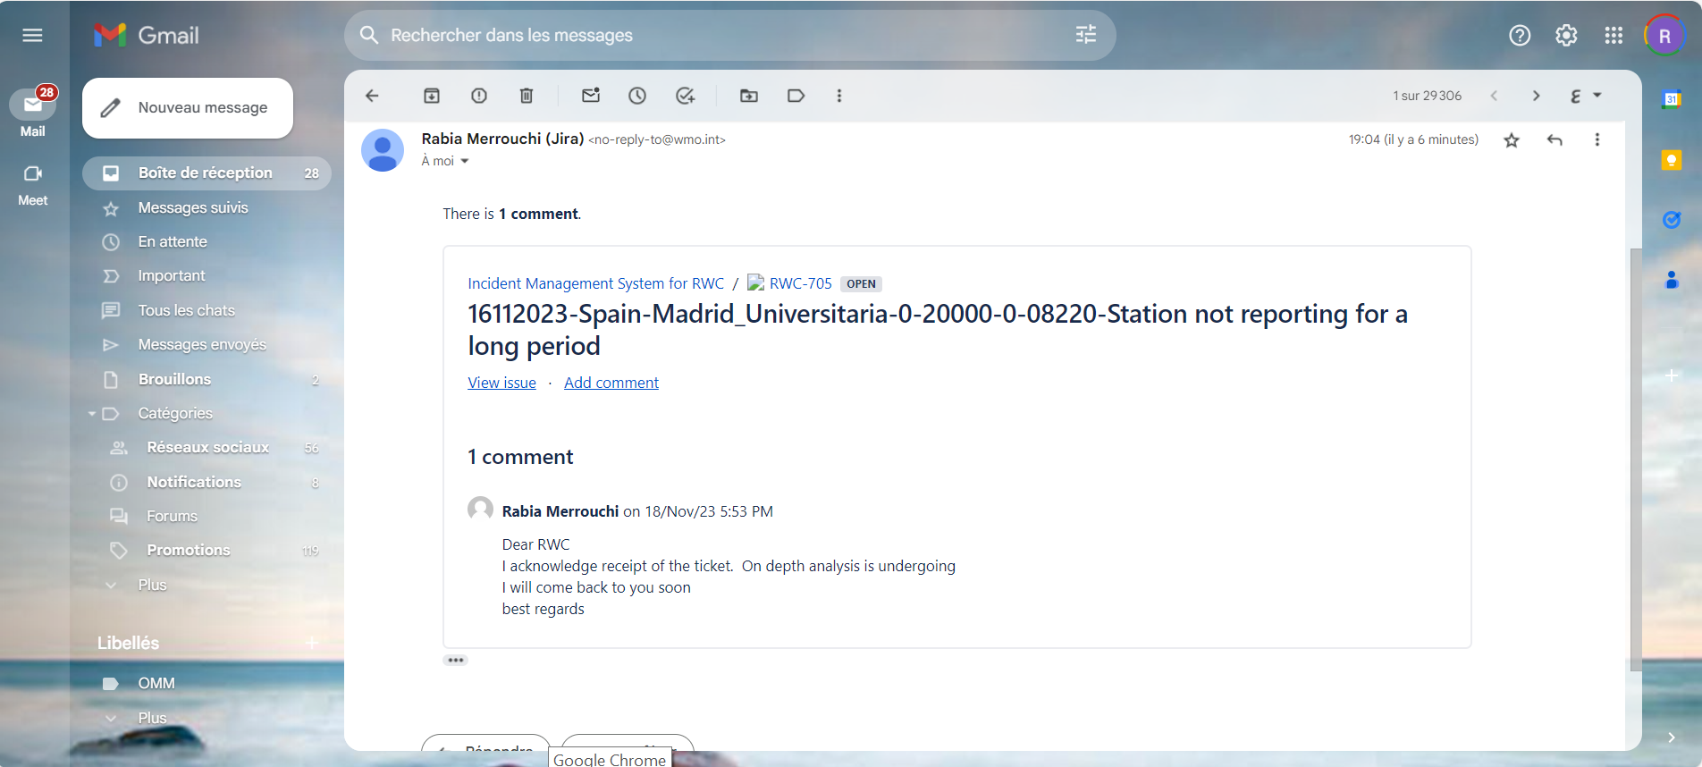
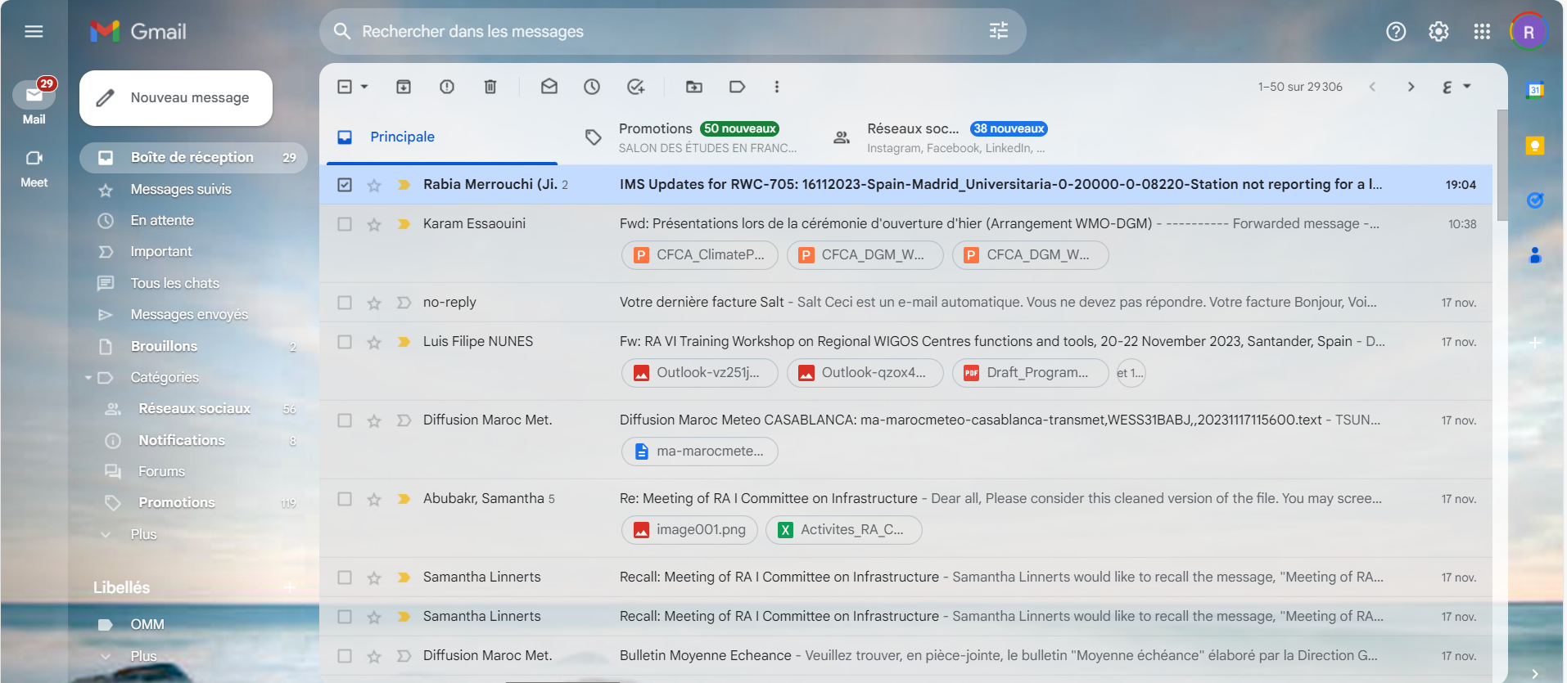
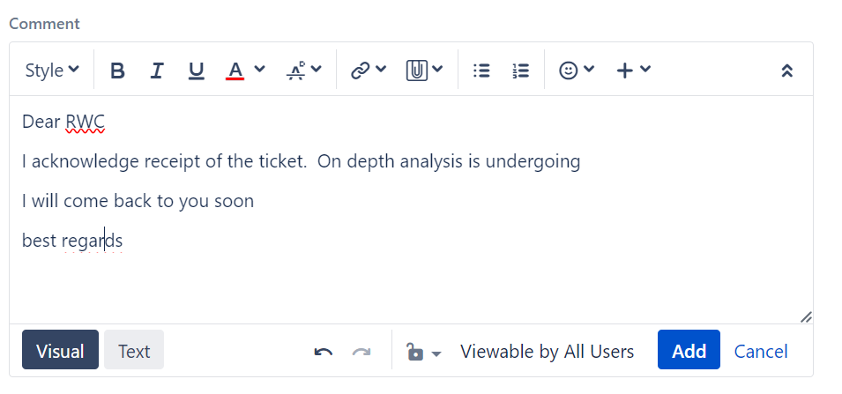
Add comment: Acknowledge receipt of a Ticket (Assignee, NFP)

Slide 19
END of Step-5: Acknowledge Receipt/Add a comment what’s next?
Step-6: Manage the Incident
(Principal RWC)
Show screenshots or go live with the tools
 | 19

Slide 20
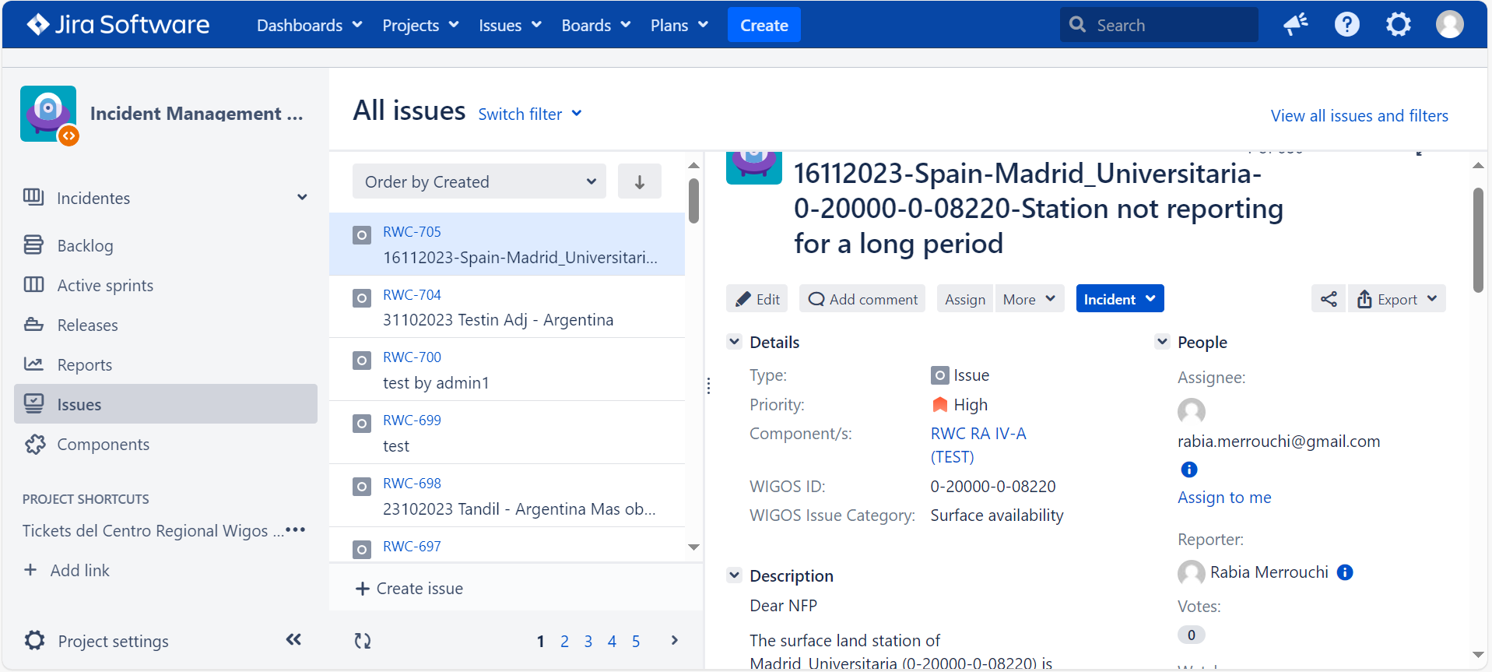
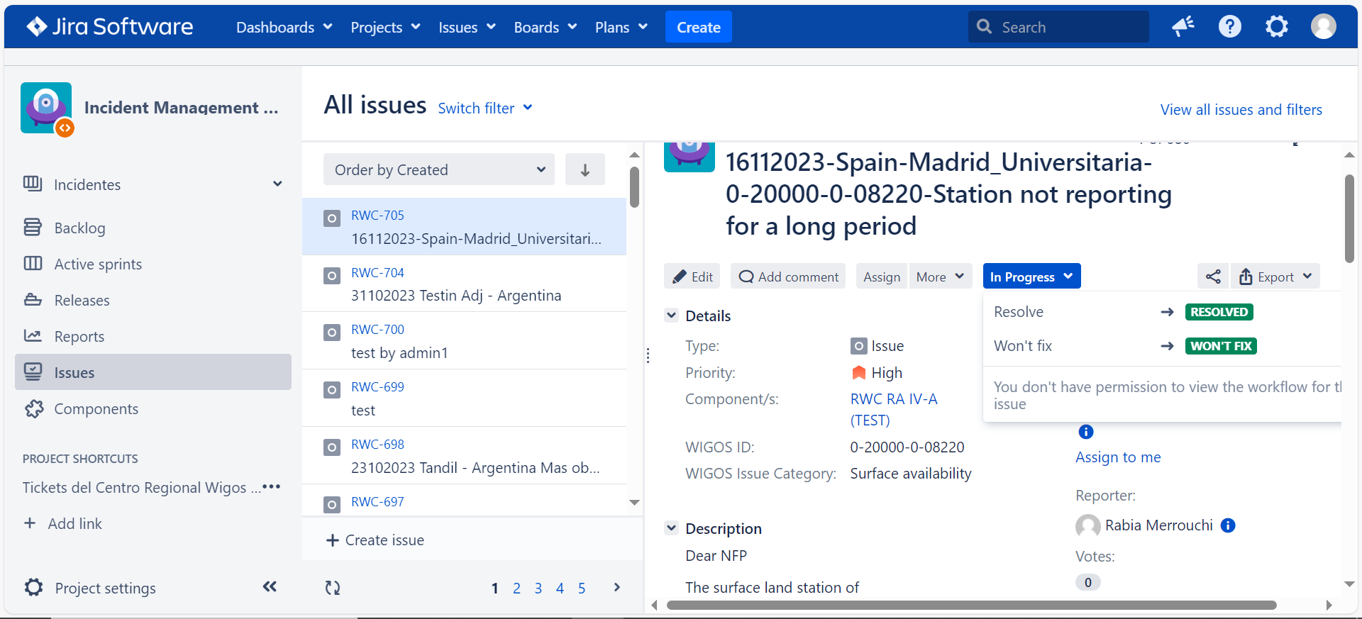
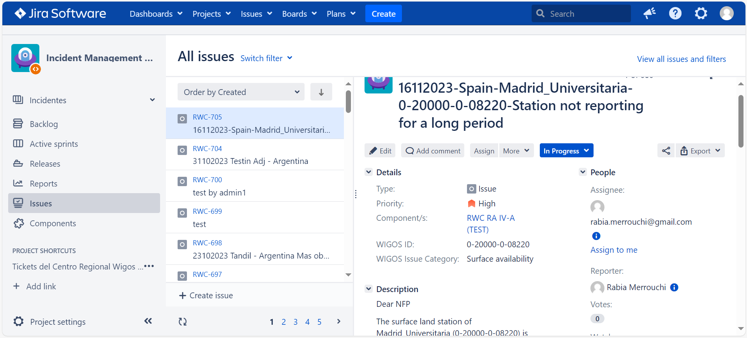
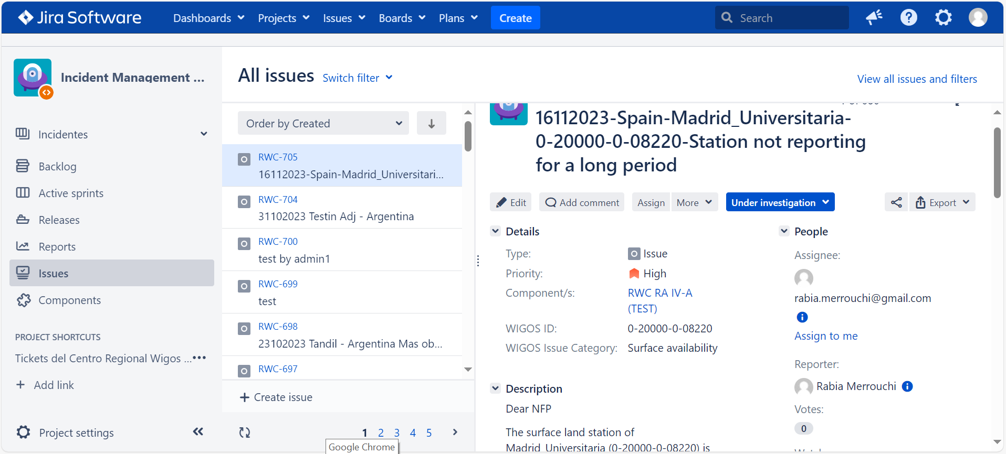
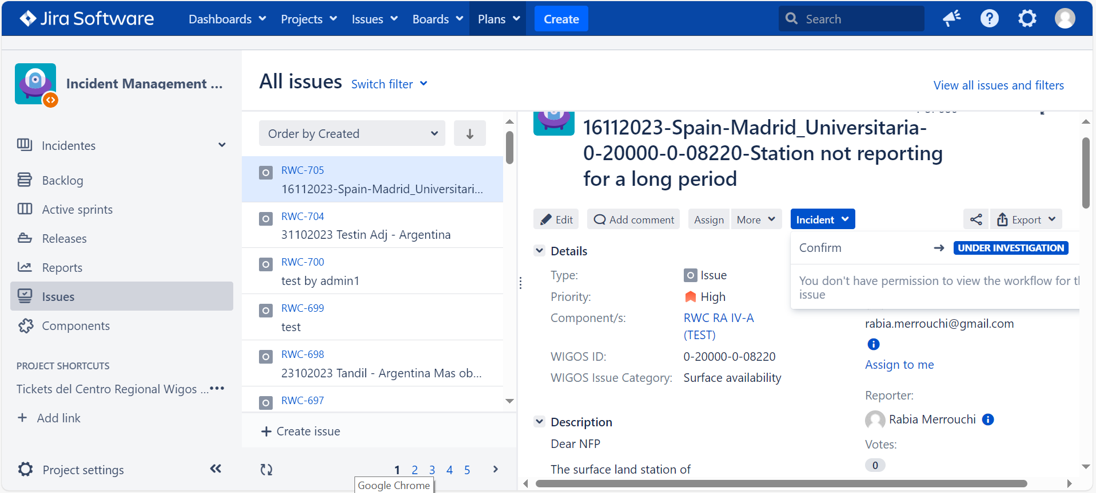
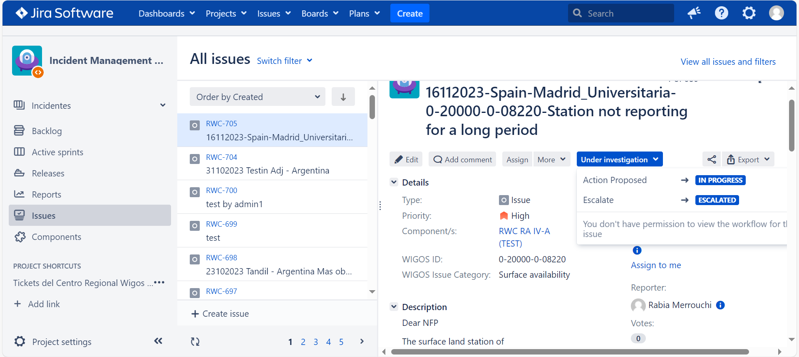
Manage the incident
Based on actions conducted, the issue has been solved
Based on the Feed back from the NFP
No feed back received
The issue will not be resolved in the short term

Slide 21
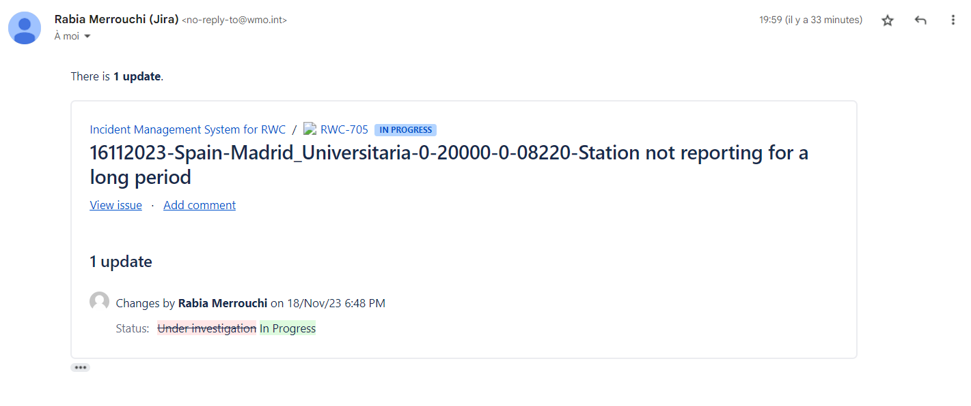
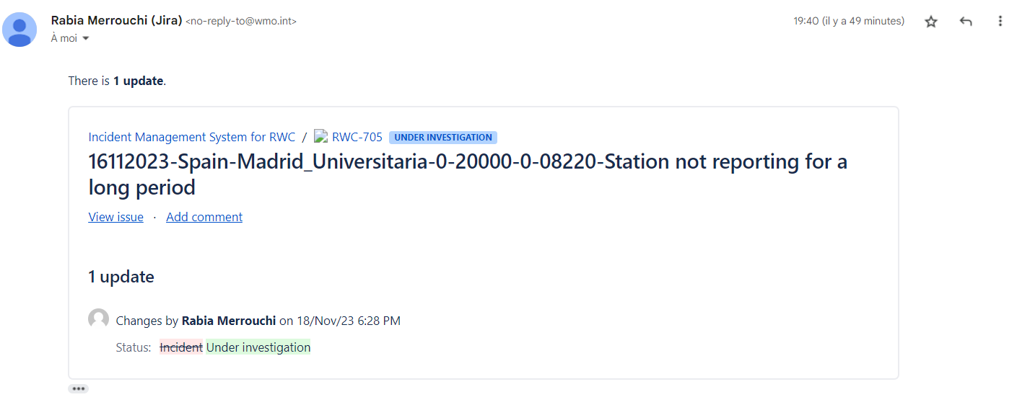
Manage the incident
The ASSIGNEE is notified by email in case of any update on the ticket

Slide 22
END of Step-6: Manage the Incident
what’s next?
Step-7: Close the Ticket
(Principal RWC)
Show screenshots or go live with the tools
 | 22

Slide 23
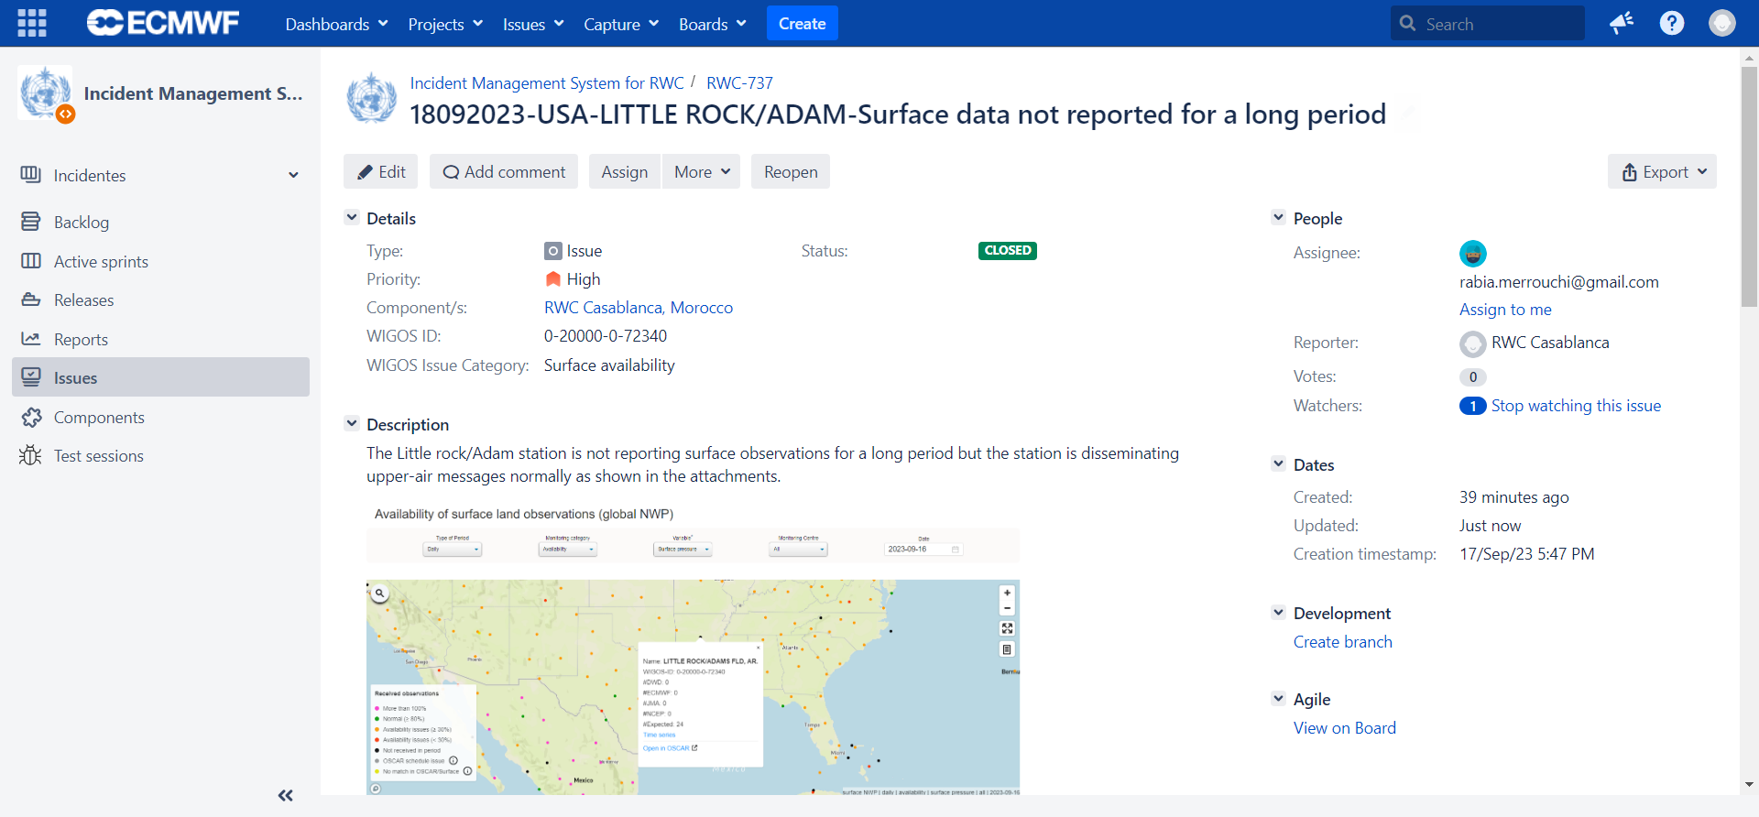
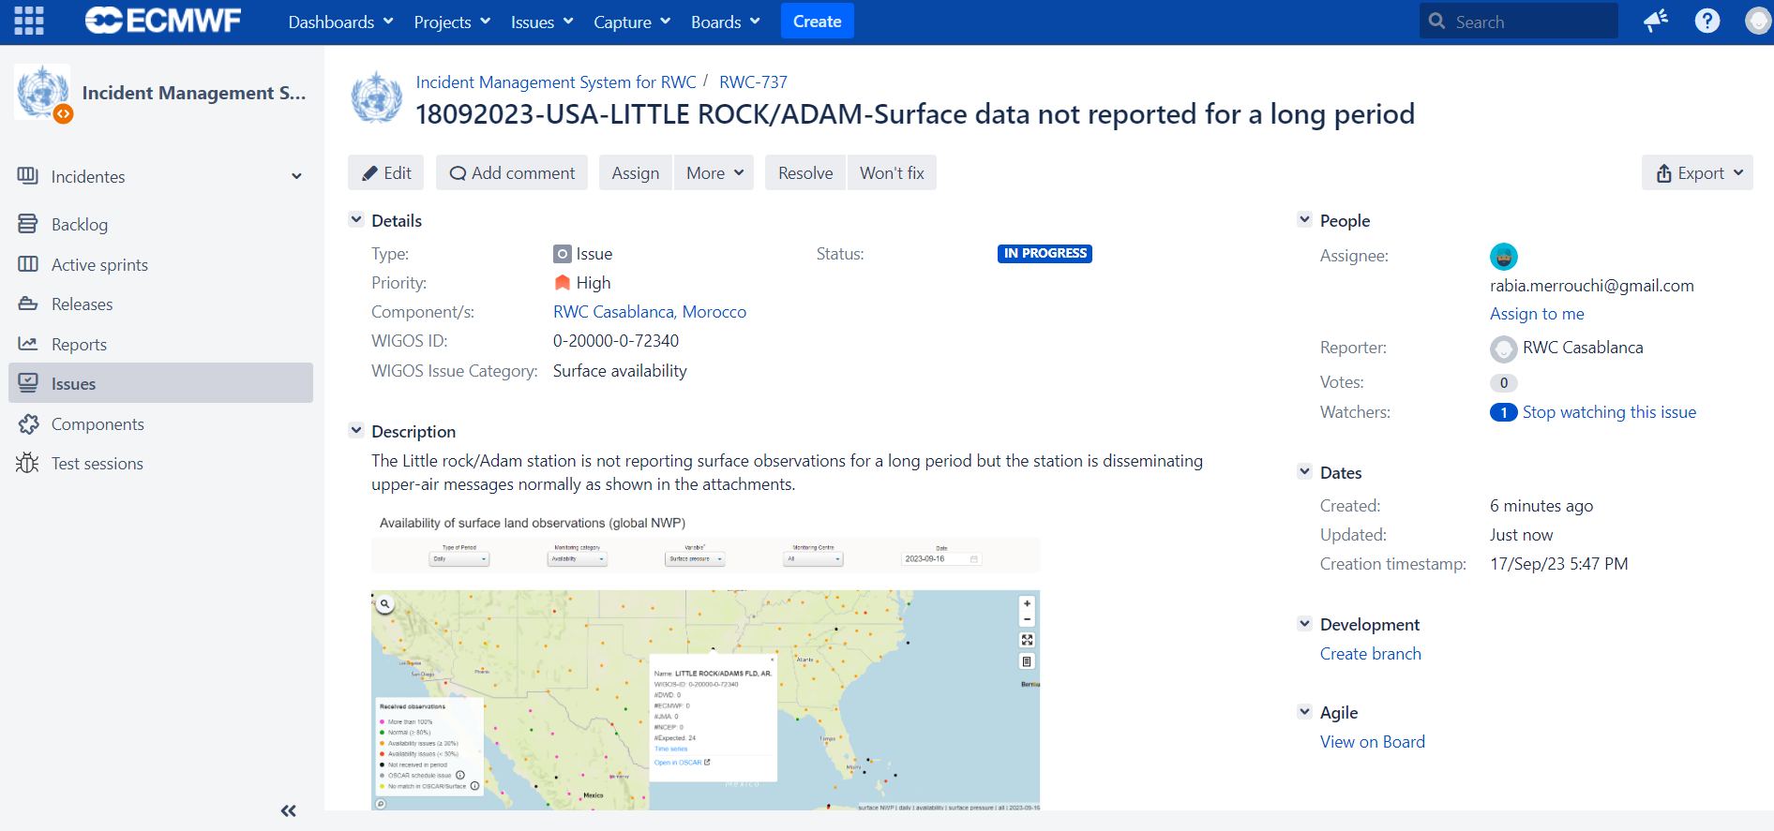
Manage the incident
Based on the actions conducted at the national level
The ticket could be re-opened if the issue appears again

Slide 24
Examples of real Tickets

Slide 25
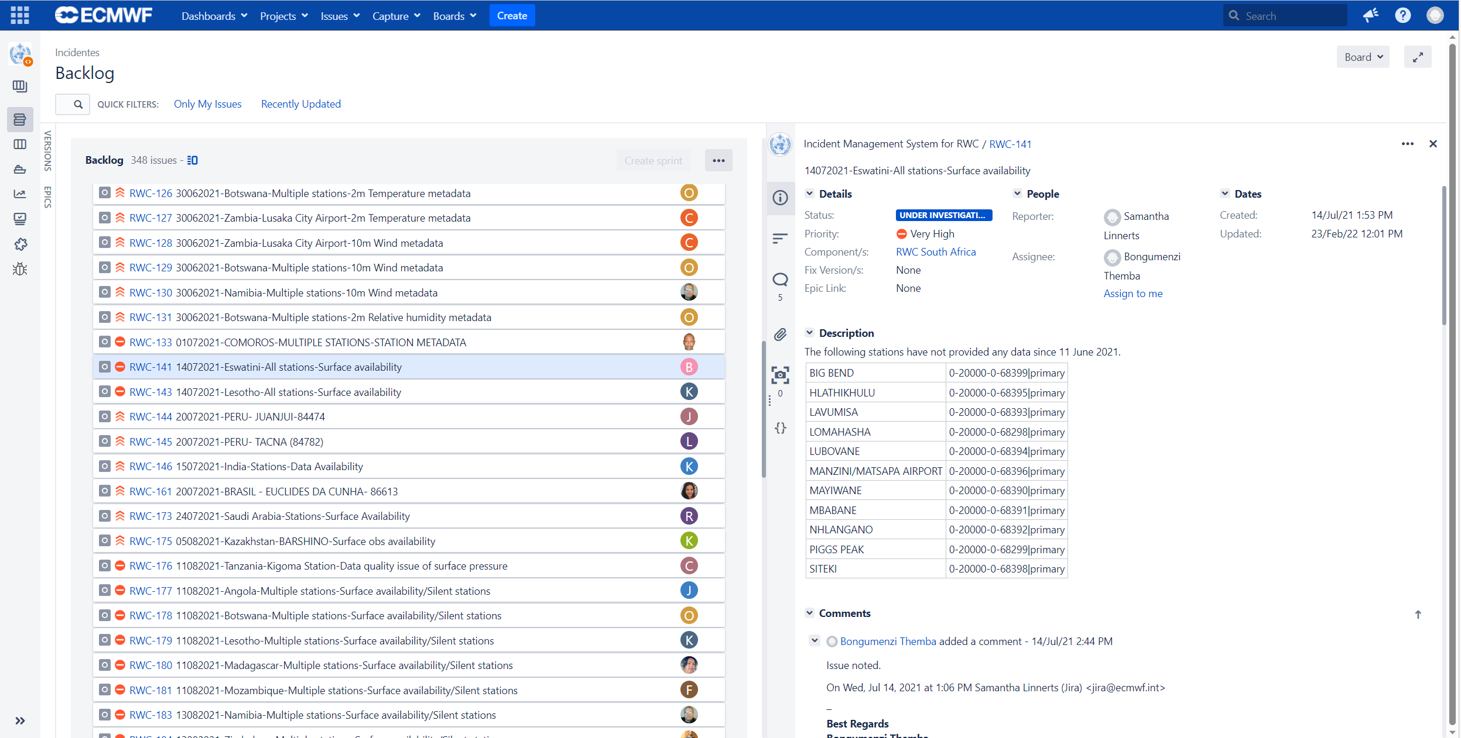
A single ticket could be opened for several stations within a country if they have a common issue

Slide 26
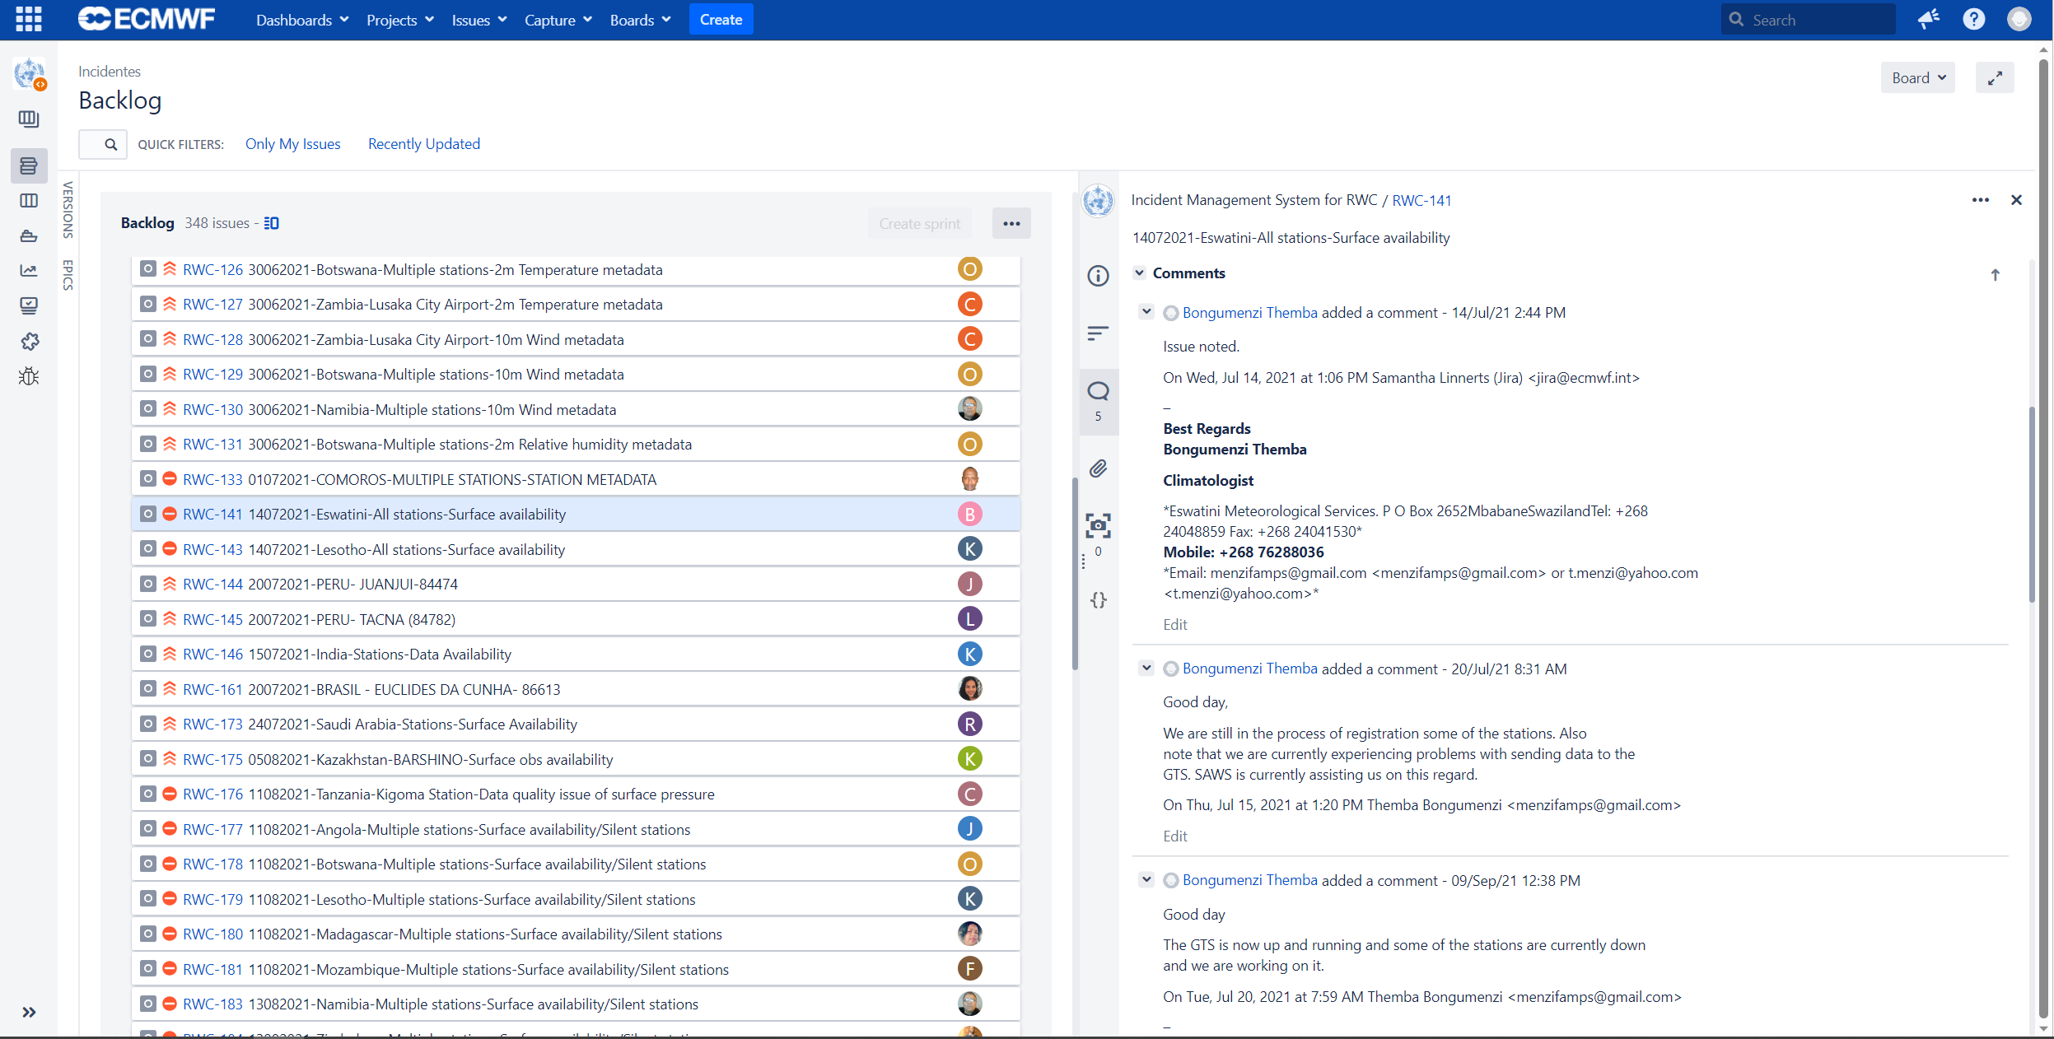
A single ticket could be opened for several stations within a country if they have a common issue
Acknowledgment of receipt of the ticket

Slide 27
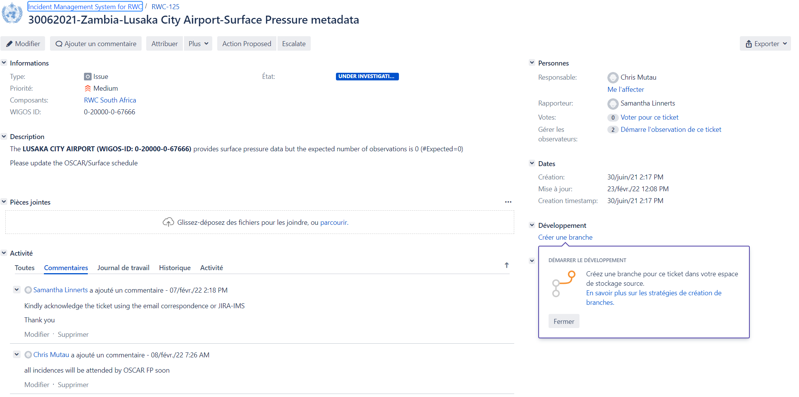
By Using IMS, all your notifications and comments will be recorded

Slide 28
Practical Exercise:
Small group: RWC and NFPs of its AoR
Select one issue identified in the previous exercise related to WDQMS
Create a ticket
Assign the ticket to a NFP
Evaluate the ticket
Add a comment
Acknowledge receipt
Manage the ticket
Provide feed back on actions conducted
Change the status of the ticket

Slide 29
Thank you
Gracias
Merci
^{wmo.int}

