Slide 1
RA VI Online Training on Incident Management System
04 June 2024
Introduction to Regional WIGOS Centres (RWCs)
Rabia Merrouchi
Infrastructure Department/WIGOS Branch
WMO Secretariat

Slide 2
Outline
Introduction
Roles and importance of RWCs
Mandatory and optional functions
Roles and responsibilities of relevant National Focal Points
Daily tasks and priorities of RWCs
Roles and responsibilities of NFPs for WIGOS

Slide 3
1. Introduction
The EC-68 through Decision 30 endorsed the concept note on the establishment of WMO Regional WIGOS Centres as general guidance for regional associations. The overall purpose of RWCs is to provide Members and Regions with support and assistance in national and regional WIGOS implementation and related operational activities. The WMO Regions and Members’ differences need to be taken to into account when establishing and operating RWCs.
The RWCs operate under the governance and guidance of the management group of the respective regional association and with the support of relevant regional working bodies.
RWCs work closely with RA I Members, Existing WMO Centres (GISCs, RICs , RRCs), Regional Training Centres (RTCs) and WMO Secretariat

Slide 4
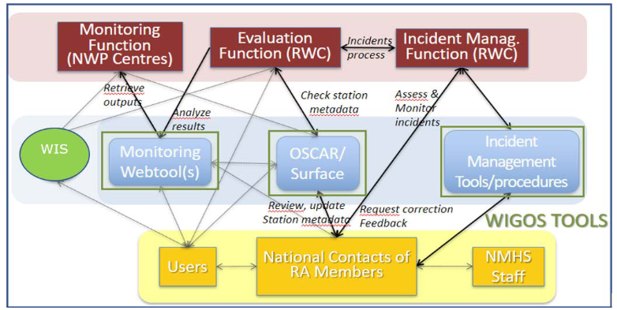
2. Roles and Importance of RWCs
The basic functions of the RWC should be regional coordination, guidance, oversight, and support to WIGOS implementation and operational activities at the regional and national levels, as daily activities.
RWC evaluate the performances and initiate the incident management system in case of non-compliance.
WDQMS Process

Slide 5
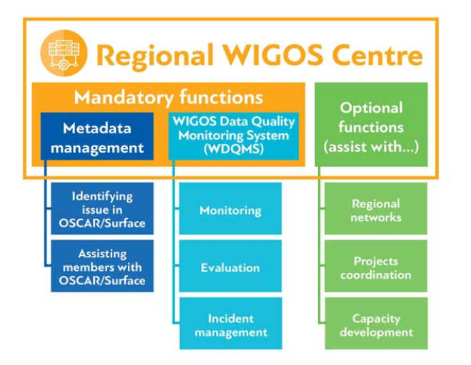
3. Mandatory and Optional functions
.
The following mandatory and optional functions are specified for :
Mandatory functions
(Regional) WIGOS metadata management (work with data providers to facilitate collecting, updating, and improving the quality of WIGOS metadata in OSCAR/Surface); and
(Regional) WIGOS performance monitoring, evaluation and incident management (WIGOS Data Quality Monitoring System – WDQMS) and follow-up with data providers in case of data availability or data quality issues.
Optional functions
Depending on available resources and regional needs, one or more optional functions may be adopted, e.g.:
assistance with the coordination of regional/subregional and national WIGOS projects;
assistance with regional and national observing network management; and
support for regional capacity development activities.

Slide 6
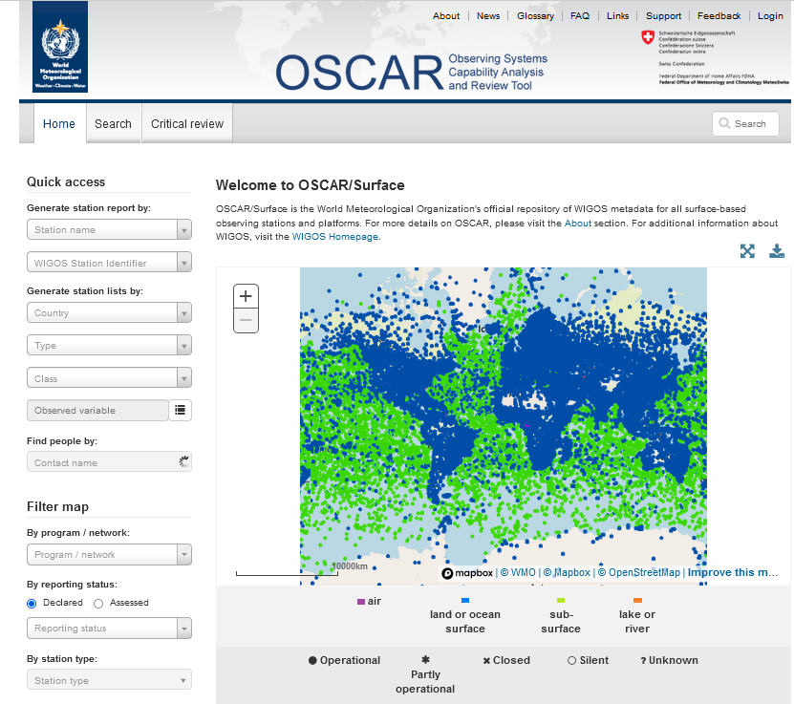
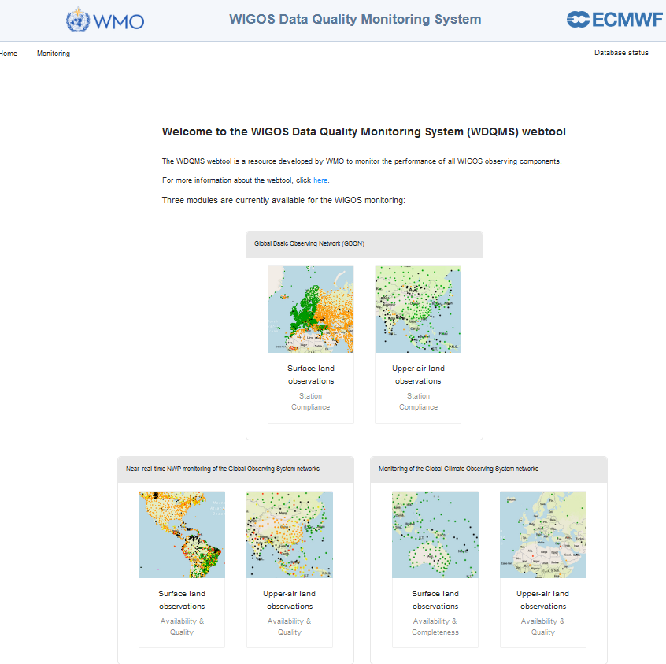
4. Roles and responsibilities of relevant National Focal Points (NFPs)
There are three NFPs related to WIGOS.
1. National Focal Point for WIGOS
2. National Focal Point for OSCAR/Surface
OSCAR/Surface is the Observing Capabilities Analysis and Review (OSCAR) tool for surface-based observations
Intended to register all the observational metadata related to all surface stations (non-space-based)
3. National Focal Point for WDQMS
WDQMS is the WIGOS Data Quality Monitoring System
Provides monitoring results (maps and graphics) in near-real time on the
performance of surface stations (data availability and quality)
It relates closely with the work of Regional WIGOS Centres (RWC)

Slide 7
WIGOS NFP:
leads Member’s communications on WIGOS, with WMO;
Monitors and reports on national status of WIGOS implementation and issues in the country;
Identify and follow-up on WIGOS-related training and capacity development needs;
Member A
National level
WIGOS NFP
WDQMS NFP
OSCAR/Surface NFP
OSCAR/Surface NFP:
Coordinates national activities related to WIGOS metadata towards their availability in OSCAR/Surface;
Coordinates its user accounts at national level;
Promulgates WMO relevant regulatory, guidance and training materials;
Ensures that all accredited users are trained to edit metadata in OSCAR/Surface, including the use of automatic insertion/updates to
OSCAR/Surface; Works closely with the relevant RWC;
Reports on the status of national WIGOS metadata in OSCAR/Surface;
Takes actions to correct erroneous and/or missing metadata in OSCAR/Surface
………..
WDQMS NFP:
Provides timely answers to all queries and tickets sent by the RWC related to issues with observations from the country;
Initiates and coordinates actions to solve those issues as quickly as possible;
Liaises with OSCAR/Surface NFP in relation to stations that exchange data internationally; Promulgates nationally the WDQMS related practices and procedures;
Liaises with other relevant WMO Regional Centres, e.g. RICs, RTCs, to find sustainable solutions for issues identified by the WDQMS;

Slide 8
Regional Level
RWC
Member A
National level
WIGOS NFP
RWC staff:
identify performance issues with observations provided by Members use an incident management system to raise tickets, and to follow-up on them,
using RWC account credits to manage the tickets;
also provide support and assistance to Members and Region for their WIGOS implementation efforts
WDQMS NFP
OSCAR/Surface NFP
………..
Member B
National level
Member C
National level
WIGOS NFP
WIGOS NFP
WDQMS NFP
OSCAR/Surface NFP
WDQMS NFP
OSCAR/Surface NFP
………..
………..

Slide 9
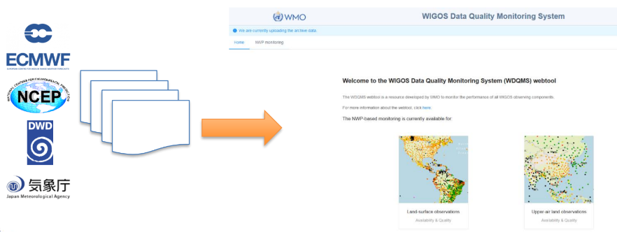
5. Daily tasks and priorities of RWCs
The RWC should evaluate the performance of the GOS and GBON stations of the Members under their responsibility with GBON as the highest priority.
This should be done on a daily basis at least on working days, by reviewing the automated quality monitoring reports from the WIGOS Monitoring Centres on the WDQMS webtool and other monitoring portals for supplementary information.

Slide 10
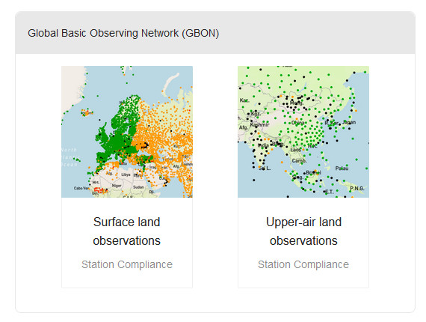
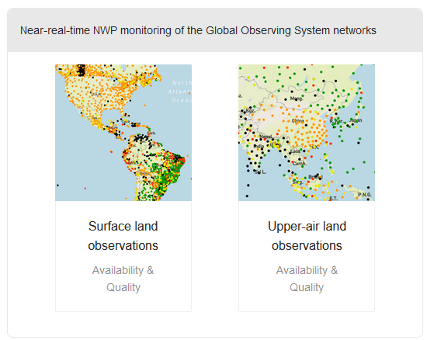
RWC evaluating the performances
Check the performance monitoring concerning the four main categories data availability, timeliness , quality and station metadata.
The same quality evaluation processes if an issue has been reported to the RWC by a user e.g. Global NWP Centre or a Member of a Regional Association.
Tasks should be followed for Surface land and Upper-air land observations
Note: The timeline for issuing an incident for NRT NWP is over 5 days and 2 days for GBON Monitoring. (INFCOM-3/Doc. 8.1(2), Annex 2, Approved)
GBON IMS: planned

Slide 11
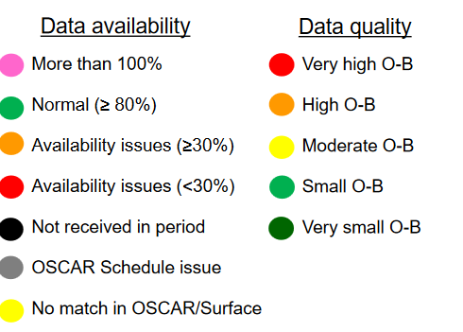
Monitoring of the GOS and GBON networks: Surface land observations
Availability, Timeliness, Quality and Station metadata
The issues described in the table below shall be identified in most daily monitoring reports of the different WIGOS Monitoring Centres, not in the daily monitoring reports of one particular WIGOS Monitoring Centre only (Monitoring centre = All)
Reason for non-compliance | Category
The station did not report any data yesterday | Data availability
The total number of reports is significantly lower than the expected number of observations as defined in the observing schedule for international dissemination in OSCAR/Surface | Data availability
The total number of reports is higher than the expected number of observations defined in the observing schedule for international dissemination in OSCAR/Surface | Metadata
The station is not expected to send reports during the period according to OSCAR/Surface schedule | Metadata
The station send reports but there is no corresponding station ID in OSCAR/Surface. | Metadata
The data arrived with a significant delay, which may lead to a situation where data could not be used in near real-time applications, for example, for nowcasting purposes | Timeliness
The daily averaged measurement uncertainty statistics received from WIGOS Monitoring Centres (for example, derived from O B results from Global NWP Centres) exceed the WMO threshold requirements concerning a particular variable or variables | Quality

Slide 12
Monitoring of the GOS and GBON networks: Upper-air land observations
Availability and Quality
The issues described in the table below shall be identified in most daily monitoring reports of the different WIGOS Monitoring Centres, not in the daily monitoring reports of one particular WIGOS Monitoring Centre only (Monitoring centre = All)
Reason for non-compliance | Category
The station did not report any data yesterday | Data availability
The total number of reports is significantly lower than the expected number of soundings as defined in the observing schedule for international dissemination in OSCAR/Surface | Data availability
The station reported data but has completeness issues | Data availability
The total number of reports is higher than the expected number of soundings as defined in the observing schedule for international dissemination in OSCAR/Surface | Metadata
The station is not expected to report during the period according to OSCAR/Surface schedule | Timeliness
The station reported data but there is no corresponding station ID in OSCAR/Surface | Quality
The data arrived with a significant delay, which may lead to a situation where data could not be used in near real time applications, for example, for nowcasting purposes; | Timeliness
The daily averaged measurement uncertainty statistics received from WIGOS Monitoring Centres (for example, derived from O B results from Global NWP Centres exceed the WMO threshold requirements concerning a particular variable or variables | Accuracy

Slide 13
Roles and responsibilities of NFPs
Role | WIGOS | WDQMS | OSCAR/Surface
National WIGOS Implementation | Contribute to the design of GBON and RBON Monitor and report on the status of the national WIGOS implementation and initial operations Liaise with the WIGOS relevant National Focal Points to support the integration of all WIGOS component observing systems | Liaise with the OSCAR/SURFACE NFP in the country/territory to ensure that metadata from all stations exchanging data internationally are available and updated in OSCAR/SURFACE | Liaise with the National WIGOS FP in the country/territory to ensure that all the operators of the relevant observing systems in the country/territory are aware of OSCAR Perform the critical review and gap analysis at national and regional levels, using the OSCAR/Analysis tool
Capacity Development | Identify and follow-up on WIGOS-related training and capacity development needs | Promulgate nationally the WDQMS related practices and procedures | Promulgate the WMO Technical Regulations relevant to OSCAR ensure that all accredited users of OSCAR are well-trained

Slide 14
Roles and responsibilities of NFPs
Role | WIGOS | WDQMS | OSCAR/Surface
Communication with WMO Secretariat | Take the lead in communications on WIGOS with the WMO Secretariat
Communication RWC and other Region Centres | Report to RWC in coordination with NFP:WDQMS and challenges that might impact the implementation and operations of WIGOS | Liaise with other relevant WMO regional centres of the region to find sustainable solutions for the issues and incidents identified by the WDQMS | Work closely with the established Regional WIGOS Centre (RWC)

Slide 15
Roles and responsibilities of NFPs
Role | WIGOS | WDQMS | OSCAR/Surface
Station Metadata Management | Coordinate the development of national schema(s) for the assigning of WIGOS Station Identifiers |  | Coordinate user account creation in OSCAR Promote the insertion/updates of metadata within OSCAR Upon request, provide the Secretariat and the RWC with an overview of the country/territory WIGOS metadata status in OSCAR Take, without any delay, actions in order to correct any erroneous and/or missing metadata identified in OSCAR

Slide 16
Roles and responsibilities of NFPs
Role | WIGOS | WDQMS | OSCAR/Surface
Incident Management |  | Follow all the procedures agreed at a regional/subregional level in the context of the respective RWC Provide timely answers to all queries and tickets sent by the respective RWC related to issues and incidents with observations from the country/territory Initiate and coordinate actions that need to be performed at a national level, related to issues and incidents with observations

Slide 17
Thank you.
^{wmo.int}

