Slide 1
RA VI Online Training on Incident Management System
INTRODUCTION TO IMS
Ercan Büyükbas
Infrastructure Department/WIGOS Branch/WMO Secretariat
04 June 2024

Slide 2
OUTLINE
Incident Management System (IMS)
IMS Procedure and Roles in IMS
Users Registered in IMS
IMS Workflow
Ticket processing in the IMS
IMS Main Page and Basic Features

Slide 3
IMS
WDQMS Process functions:
Monitoring function by WIGOS Quality Monitoring Centres
Evaluation function by RWCs
Incident management function by RWCs and Members
to assess, monitor and resolve the identified issues by collaboration between RWCs and Members
Incident Management System:
One of the main operational tools used by RWCs, in addition to OSCAR/Surface and WDQMS Webtool
Configured according to the Incident Management Procedure–WMO-No.1224, Technical Guidelines for RWC on WDQMS
Hosted by the European Centre for Medium-Range Weather Forecasts (ECMWF) in JIRA Software until February 2024, now hosted by the WMO
Operation in pilot mode since July 2020 by RWCs

Slide 4
IMS
Incident Management System features and functions:
a web based tool
a ticket system that follows the performing the WDQMS incident management function
allows interaction between RWC, NFPs of Members and the WQMCs to address issues of availability and quality of observational data or metadata in OSCAR/Surface
used by registered users
identifying issues
creating issue and incident tickets with descriptions and additional information
classifying and prioritization of incidents
initiating the incident process
monitoring and updating ticket status
providing historical record of tickets
providing statistics of RWC operations
contributing to identifying and resolving issues for improving data availability and quality

Slide 5
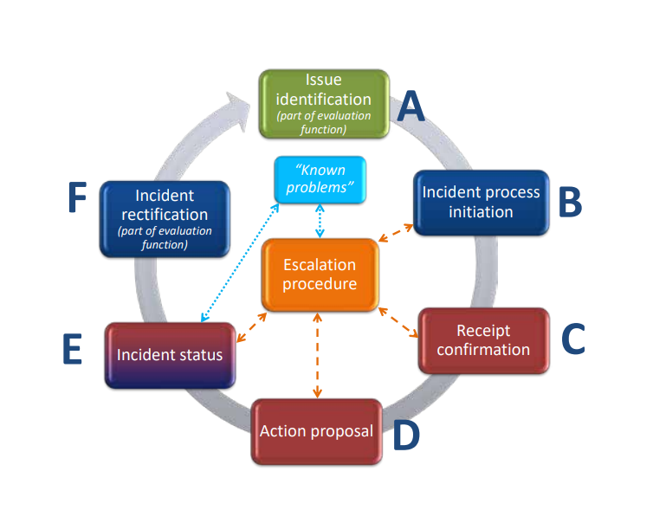
IMS Procedure and Roles in IMS
RWC
if incident has been rectified by the country
If the incident ticket can be closed or keep open based on WDQMS monitoring results
If keep open, ask NFP for further actions
RWCs or data users, e.g NWP Centres.
creating a new ticket by RWC
monitor each issue over 5 working days
RWCs
Initiate incident management process
Notify WDQMS NFP
WDQMS NFP
regularly provide the RWC with summarized updates on the status of the incident
document the updates in the incident ticket
RWC
update the date, ticket status and other relevant parts of the ticket summary (once a week)
WDQMS NFP
a receipt confirmation
WDQMS NFP; OSCAR/Surface NFP, other staff
Identify the cause of the incident and find a solution
Alert the RWC of the proposed actions
Update the incident ticket information and inform RWC

Slide 6
IMS Workflow
The workflow of IMS for RWC is configured according to the Incident Management Procedure – WMO-No.1224, Technical Guidelines for RWC on WDQMS
Tickets opened in the system are grouped by RWC.
Tickets and their details are visible to all registered users regardless of their region
Only RWCs accounts can update ticket status and close tickets. All users can create a new ticket and add comments
The system is in English but users can use a different languages (UN languages) in their ticket details, including in comments
Idenitfy issue
Open
Evaluation
Incident
Escalated
Under Investigation
In Progress
Won’t Fix
Resolved
Closed

Slide 7
Ticket evolution in the IMS
All users can open a new ticket and RWC will evaluate the ticket
RWC will update the ticket status into “Incident ” and assign the ticket to relevant WDQMS NFP or close the ticket if the issue has been resolved or has disappeared
When assigned a ticket, WDQMS NFPs must inform RWC that they are aware with the ticket by writing acknowledgement in the comment field, RWC will update the ticket status into “under investigation”
WDQMS NFP should continuously provide information relevant to the ticket, including propose actions resolving the issue and RWC will update the ticket status into “in progress”
RWC will update the ticket status into “resolved”, then close the ticket if the issue has been resolved
A new ticket opened
Incident
Under investigation
In progress
Wont’fix
Resolved/closed

Slide 8
Won’t fix and escalated tickets
RWC may put a ticket into the log of “Won’t fix” if they found that an incident cannot be rectified because no (immediate) action can be taken.
RWC and/or WDQMS NFP must regularly monitor the ticket put in “Won’t fix” and whenever it is found that an action can be taken to rectify the incident, RWC will bring the ticket back to “in progress”.
If there is no response from WDQMS NFP in IMS, RWCs can escalate the ticket to WMO Secretariat, that will assist in contacting the Member concerned or bring the ticket to a higher level (e.g. PR).
RWCs are encouraged to contact WDQMS NFP using other means of communication before escalating a ticket.

Slide 9
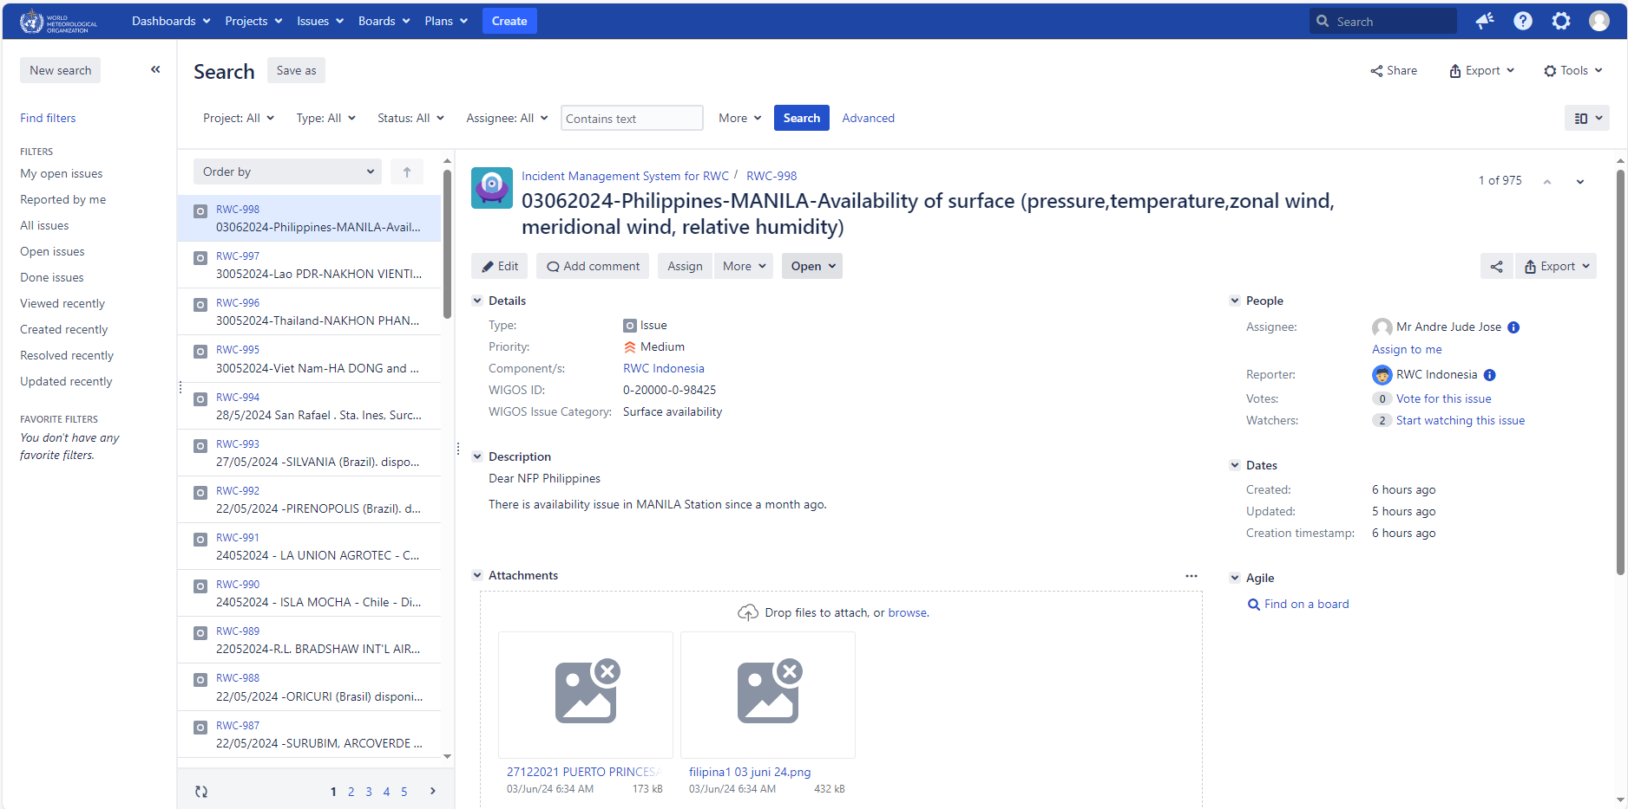
Main page of IMS
List of tickets opened in IMS

Slide 10
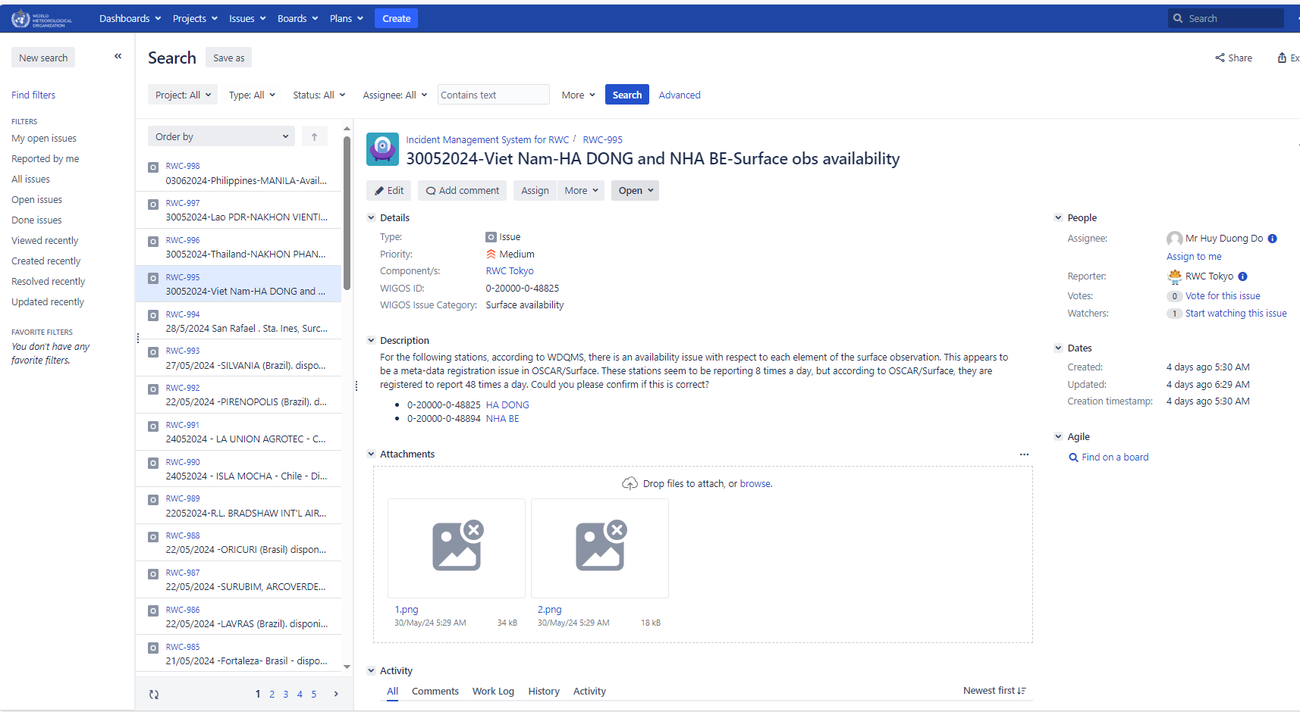
Main page of IMS
Details of a ticket
Reporter and assignee

Slide 11
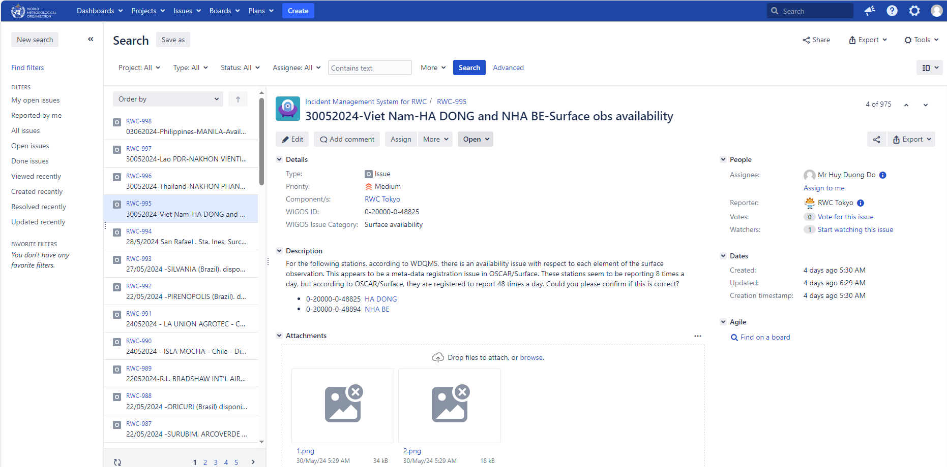
Create a ticket in IMS

Slide 12
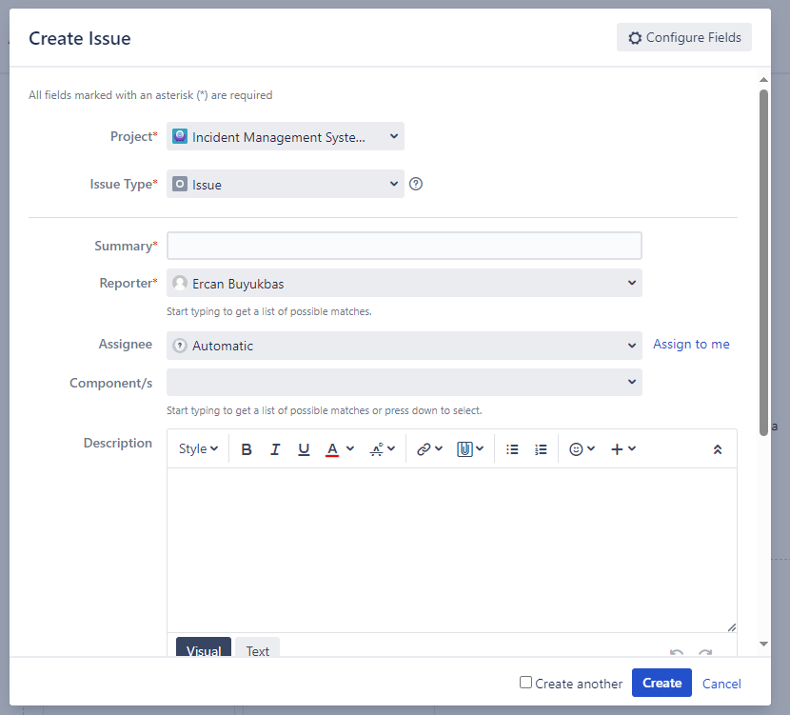
Create a ticket in IMS

Slide 13
Thank you.
^{wmo.int}

