Slide 1
Managing an Incident and Creating a dashboard within the IMS
RA VI Online Training on IMS for RWCs and NFPs-WDQMS
4 June 2024, 09:30-12:30 CEST
Stuart Matthews, EUCOS Operations and Development manager
Alex Priestley, EUCOS Network Manager

Slide 2
RWC EUMETNET background
Part of the EUMETNET Observations Capability Area​
EUMETNET has undertaken activities like those of a RWC for more than 10 years​
Known as EUMETNET Composite Observing Systems (EUCOS) Network Management​
Funded by EUMETNET with activities approved by EUMETNET Assembly​
Team
RWC Project Executive – Jacqueline Sugier​ (UK, Met Office)​
RWC Project manager – Stuart Matthews (UK, Met Office)​
Alex Priestley, EUCOS Network manager (UK, Met Office)​
Tanja Kleinert, Quality Monitoring Portal manager (Germany, DWD)​
EUMETNET RWC Expert Team
First Meeting 20 June
Open to NFP (OSCAR, WIGOS and WDMQS) of EUMETNET members

Slide 3
RWC EUMETNET Responsibilities – 33 EUMETNET members
Austria – GeoSphere
Belgium – RMI
Croatia – DHMZ
Cyprus – CYMET
Czech Republic – CHMI
Denmark – DMI
Estonia – ESTEA
Finland – FMI
France – Météo-France
Germany – DWD
Greece – HNMS
Hungary – HungaroMet
Iceland – IMO
Ireland – Met Éireann
Italy – ItAF-AVIAMM
Latvia – LEGMC
Lithuania - LHMS
Luxemburg – MeteoLux
Malta – MAMO
Montenegro – IHMS
Netherlands – KNMI
Rep. of North Macedonia – HMS-RNM
Norway – MET Norway
Poland – IMGW-PIB
Portugal – IPMA
Romania - NMAR
Serbia – RHMSS
Slovak Republic – SHMU
Slovenia – ARSO
Spain – AEMET
Switzerland - MeteoSwiss
Sweden – SMHI
United Kingdom – Met Office

Slide 4
Infrastructure and Tools used within RWC EUMETNET
OSCAR Surface and WDQMS​
​
QMP – Quality Monitoring Portal (QMP) hosted by DWD​
E-PAP – EUMETNET Tool for visualising summary performance statistics and the generation of performance reports, managed by the Met Office, hosted on Amazon Web Services (AWS)​
​​
Other - Use of EUMETNET Microsoft SharePoint applications for document management, meetings, etc. ​
IMS’s
– National IMS are the primary tools within RWC-EUMETNET area ​
– Very basic IMS operated by EUCOS​
– Plan to migrate to using WMO IMS

Slide 5
Managing an Incident and Creating a dashboard within the IMS
Perform a Live demo using the Test IMS system
Managing an incident using the IMS
How to create a Dashboard (You’ll see an example dashboard during Managing and Incident)
Useful for RWCs to only see the incidents they are responsible for
Useful to know the status of those incidents
NFPs might want to also produce something showing Incidents assigned to them.
I’ve used JIRA in previous jobs, but I’m not an expert!
There are other options within JIRA, for example can create reports of recent incidents.
You can export queries in various formats (e.g., csv) to integrate into your other tools.
How to create a dashboard instructions appear in this slide deck for reference

Slide 6
Any Questions so far?

Slide 7
Creating a Dashboard instructions

Slide 8
Creating a dashboard - Steps
Select the ‘Board’ from the main menu
Select ‘Board’ in the top left and from the drop-down menu select ‘Create board’

Slide 9
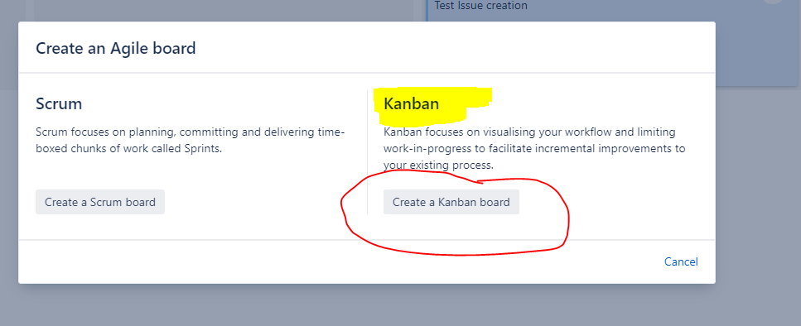
Select the ‘Create a Kanban board’
Kanban is the better option for incident management

Slide 10
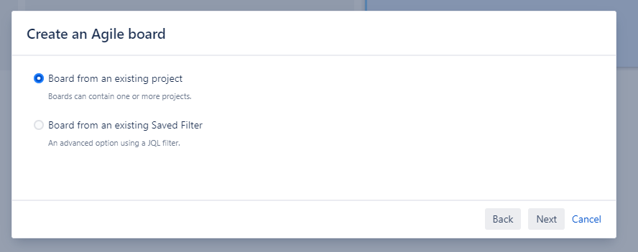
Select the ‘Board from an existing project’ from the main menu
Next

Slide 11
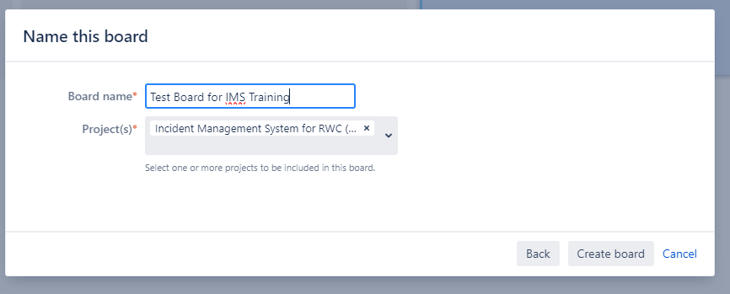
Name the board
There is only one project so no need to change this.
Create board
You now have a dashboard, but it shows all the Incidents in the system
You now need to further configure the board to only show what you want

Slide 12
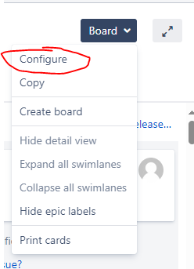
Select the ‘Board’ drop-down menu and
Select ‘Configure’ this time

Slide 13
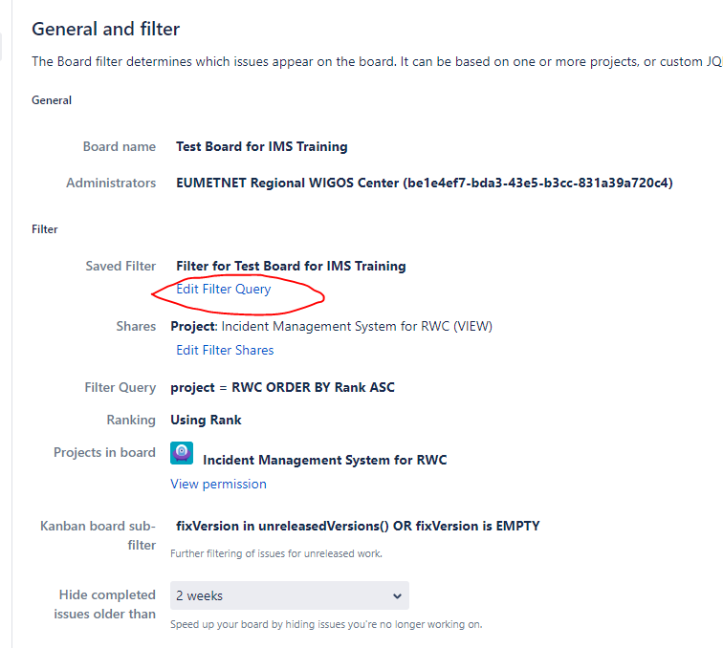
You now must change the dashboard to only show the incidents that apply to you.
Select ‘Edit Filter Query’

Slide 14
In this example we only want to see incidents within RWC EUMETNET
Select the ‘More’ drop-down menu and Select ‘Components’
Note: within the IMS the RWC is recorded as the Component.

Slide 15
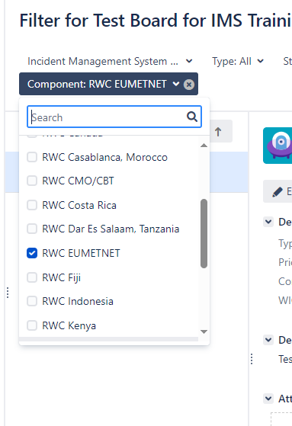
Now select the Components and the RWC(s) you want to see.
You can select as many RWCs as you want
You can also select “No Component” which will show Incidents that are not currently linked to any of the RWCs

Slide 16
Now Save the query that the dashboard is based on.

Slide 17
Now if you go to the ‘Board’ main menu you should see your new board.
Select this to allow you to further configure the board.

Slide 18
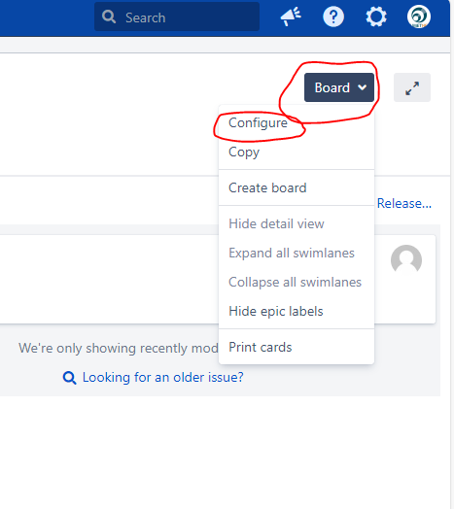
Now you can see your new board.
Select the ‘Board’ drop-down menu again and Select ‘Configure’

Slide 19
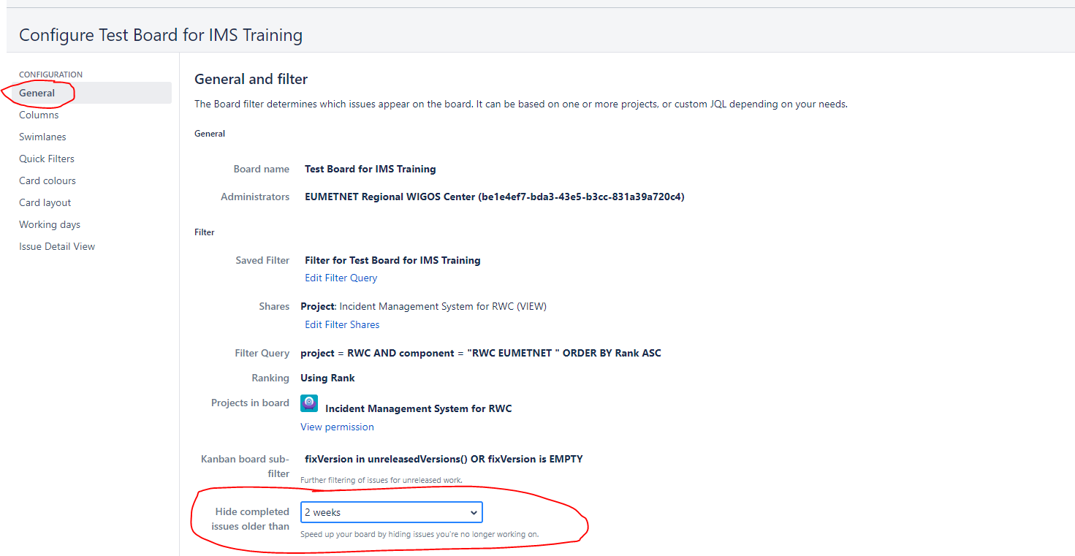
Select ‘General’ from the configuration menu.
You can choose to limit the time resolved incidents appear.
The default is 2 weeks.

Slide 20
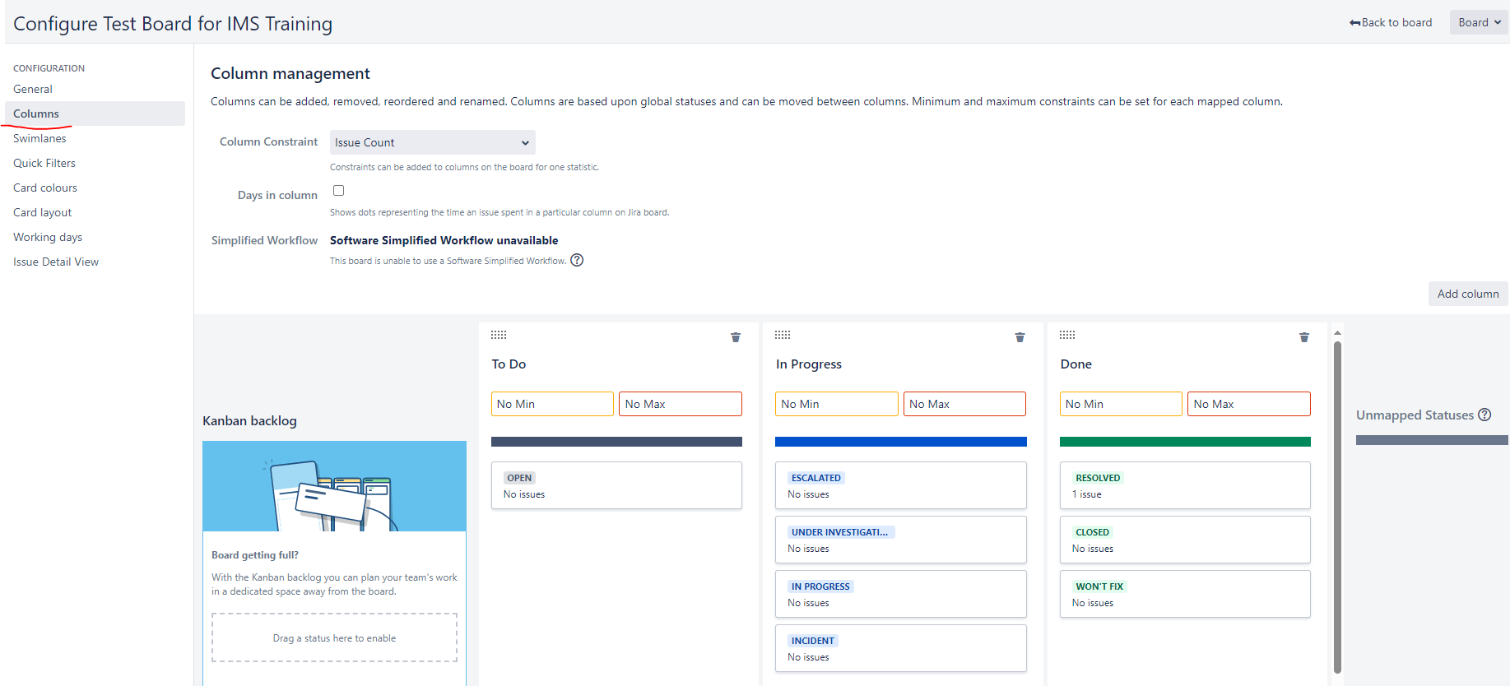
Select ‘Columns’ from the configuration menu.
The default options should be OK to use but you can move where incidents appear. For example, you might want to show ‘Escalated’ incidents in the ‘To Do’ column. Just drag and drop a box into the column you want.
You can also choose not show a status but putting into the ‘Unmapped statues’ column

Slide 21
You might want to colour code the tickets based on one of the variables
In this case tickets are colour coded depending on who the ticket is assigned to
Select ‘Card colours’ from the configuration menu.
You don’t need to use the Card Colour option, but you might find it useful

Slide 22
You can also add some more information to what is displayed on the dashboard
Select ‘Card layout’ from the configuration menu.
In this case the Assignee and the date/time the tickets was created will appear on the dashboard.

Slide 23
This is what you end up with...
Only RWC EUMETNET tickets
The date when the ticket was created
The name of the person the ticket is assigned to
A different colour for that person
Only shows closed tickets, if they were closed in the last 2 weeks.
You can also select to see older tickets

