Slide 1
TCC-PAC Meeting
Regional consultations
22-23 April 2024

Slide 2
RA Inputs
Overview:
Post 22 Nov, 5 December 2023, 21 Feb 2024 TCC meetings- gathered feedback from regional associations and Members
Inputs were used to refine priority hazards and activities for the draft EW4All Implementation Plan.
Different methods of information collection by the Regional Offices- Surveys, Meetings with RA Pres, MG, WG/ Committee members, Individual calls
Summary of the contributions to date.
 | 2

Slide 3
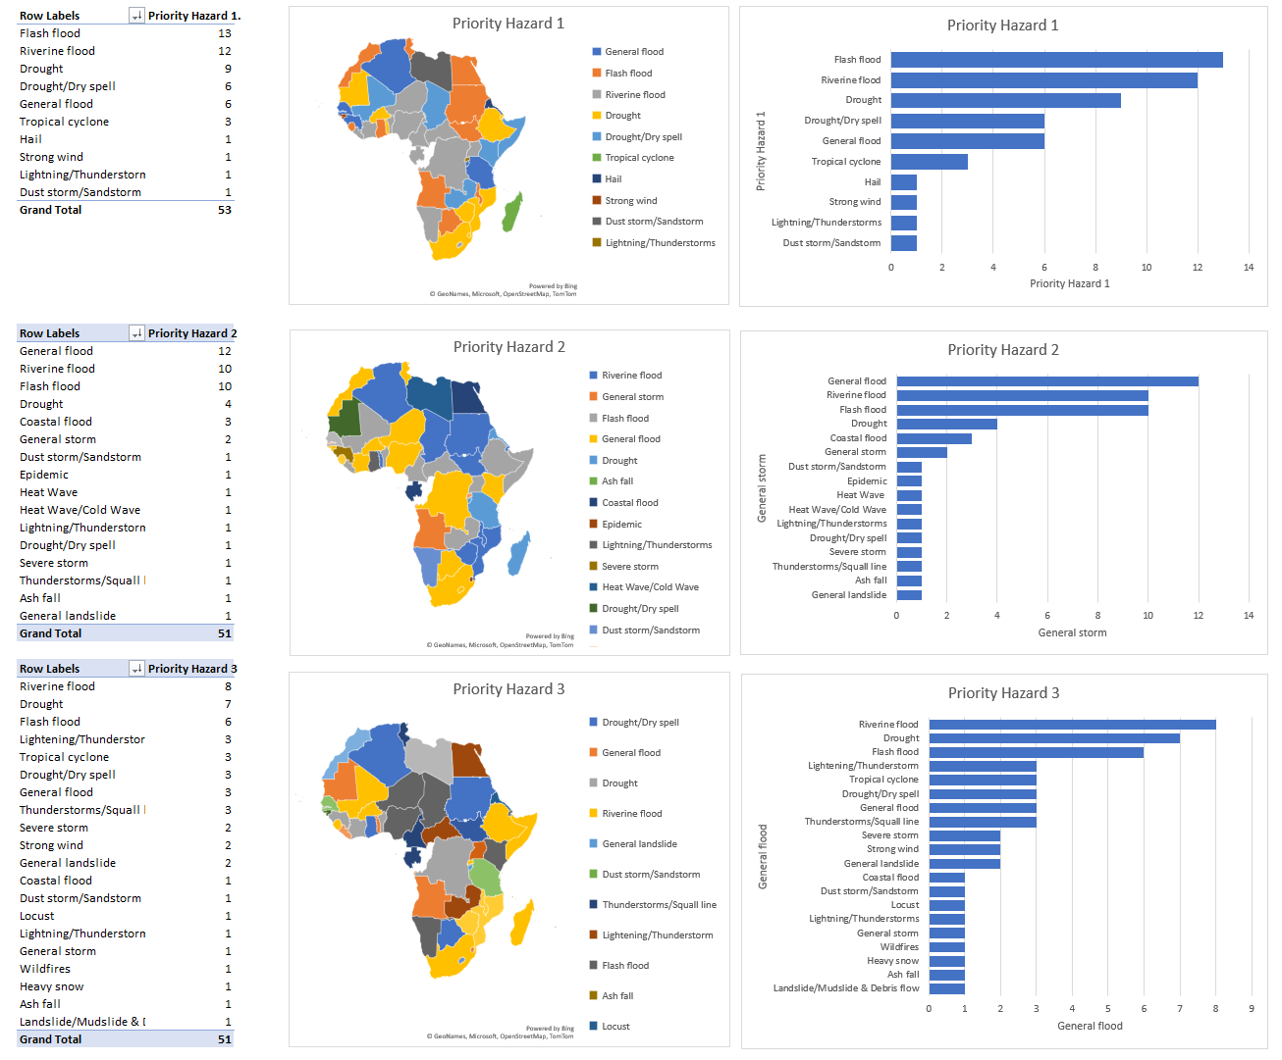
RA I Inputs
Strengthening NMHS Capacity for Effective Warnings
WMO Regional Office for Africa conducted extensive consultations with 86% of Member countries (ie. 45 Members). Variations were found from one country to the other.
 | 3

Slide 4
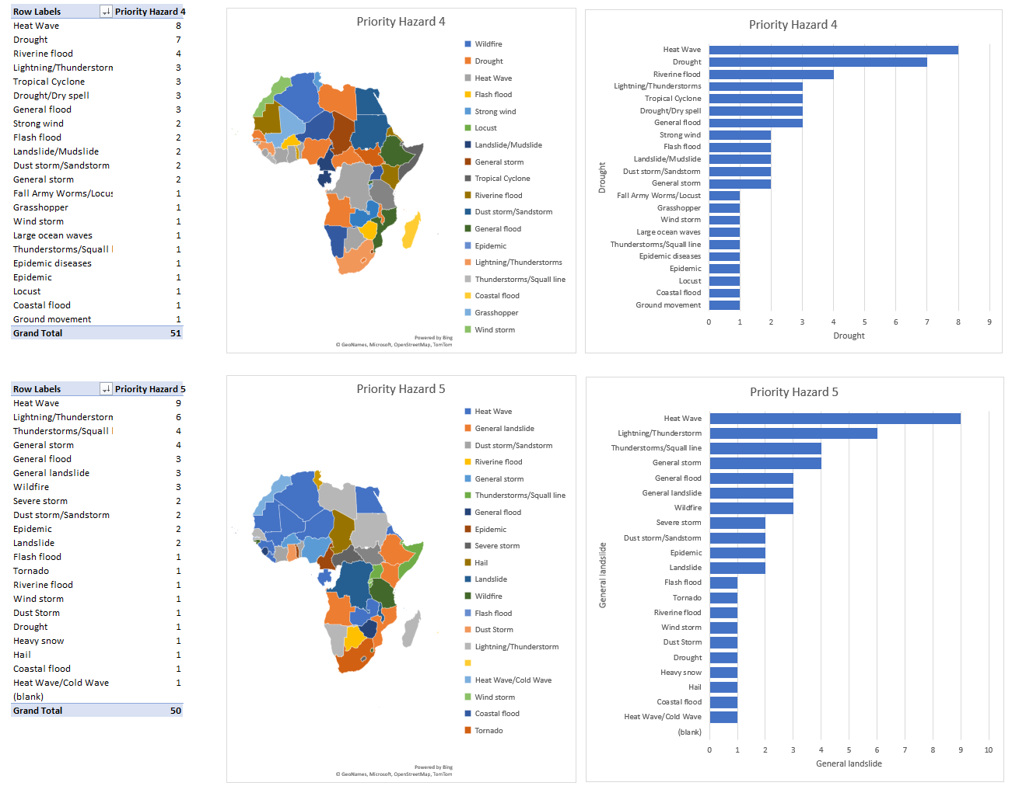
RA I Inputs
Key needs identified:
Strengthening observational networks, calibration and capacity building.
Access to advanced forecasting, visualization tools and training programs.
Technical assistance for digital transformation through value chain of weather and climate services
In CD programmes, Climate Outlook Fora & Research
Generally, priorities differed from country to country and even sub-regionally, with specific hazards being ranked differently by countries
 | 4

Slide 5
RA II & V Inputs
Regional Office for Asia and the South-West Pacific (RAP) in Singapore, with the Representative Office for the South-West Pacific (ROSWP) and Inter-Regional Office for the Arab Region (IROAR) → Specific text inputs into the EW4All “implementation plan” narrative document (December 2023) provided by some Members and RAP
RAP developed a Member feedback template on EW4All priority activities and hazards (SERCOM-3 Inf) → feedback from Members (10 in RA II; 2 in RA V) identified specific hazards and activities for individual countries
WGs and ETs of the RAs → RA II WG Services, ETs and Coordination Panel for Hydrology and Water Resources (CPH) (November 2023) intensely discussed contributions to EW4All (proposal to create a RA II Task Team); RA V MG and ETs (Climate Services, MHEWS) as well (March 2024)
Pacific Regional Coordination Workshop on EW4All and Weather Ready Pacific (WRP) Programme (+ SOFF, CREWS and ClimSA events) in Fiji (10-18 April 2024); and Fiji national EW4All workshop (February 2024) → Needs, gaps, priorities and next steps (national workshop dates, alignment with WRP) identified
Key issues raised:
Tight deadlines → Resulting in low response rates; highlights need for further engagement, especially with SIDS
No systematic and early engagement/role of RAs’ WGs and ETs when drafting EW4All-related constituent body documents (implementation plan/roadmap) → missed opportunity
Hazard ranking → Many Members questioned the initial priority hazards (inclusion/exclusion of specific hazards like sandstorms and wildfires), and the value of a priority list at RA level (rather than one for regions with a similar climate/hazard landscape); Hazard ranking for mortality different than for economic losses
Many EW4All focus countries moving slowly → challenge for WMO HQ/RAP staff to follow-up; consider additional national EW4All coordinators funded by XB projects
Bringing in regional organisations (e.g. ASEAN, ADPC, RIMES) and aligning with existing regional initiatives (e.g. WRP)
 | 5

Slide 6
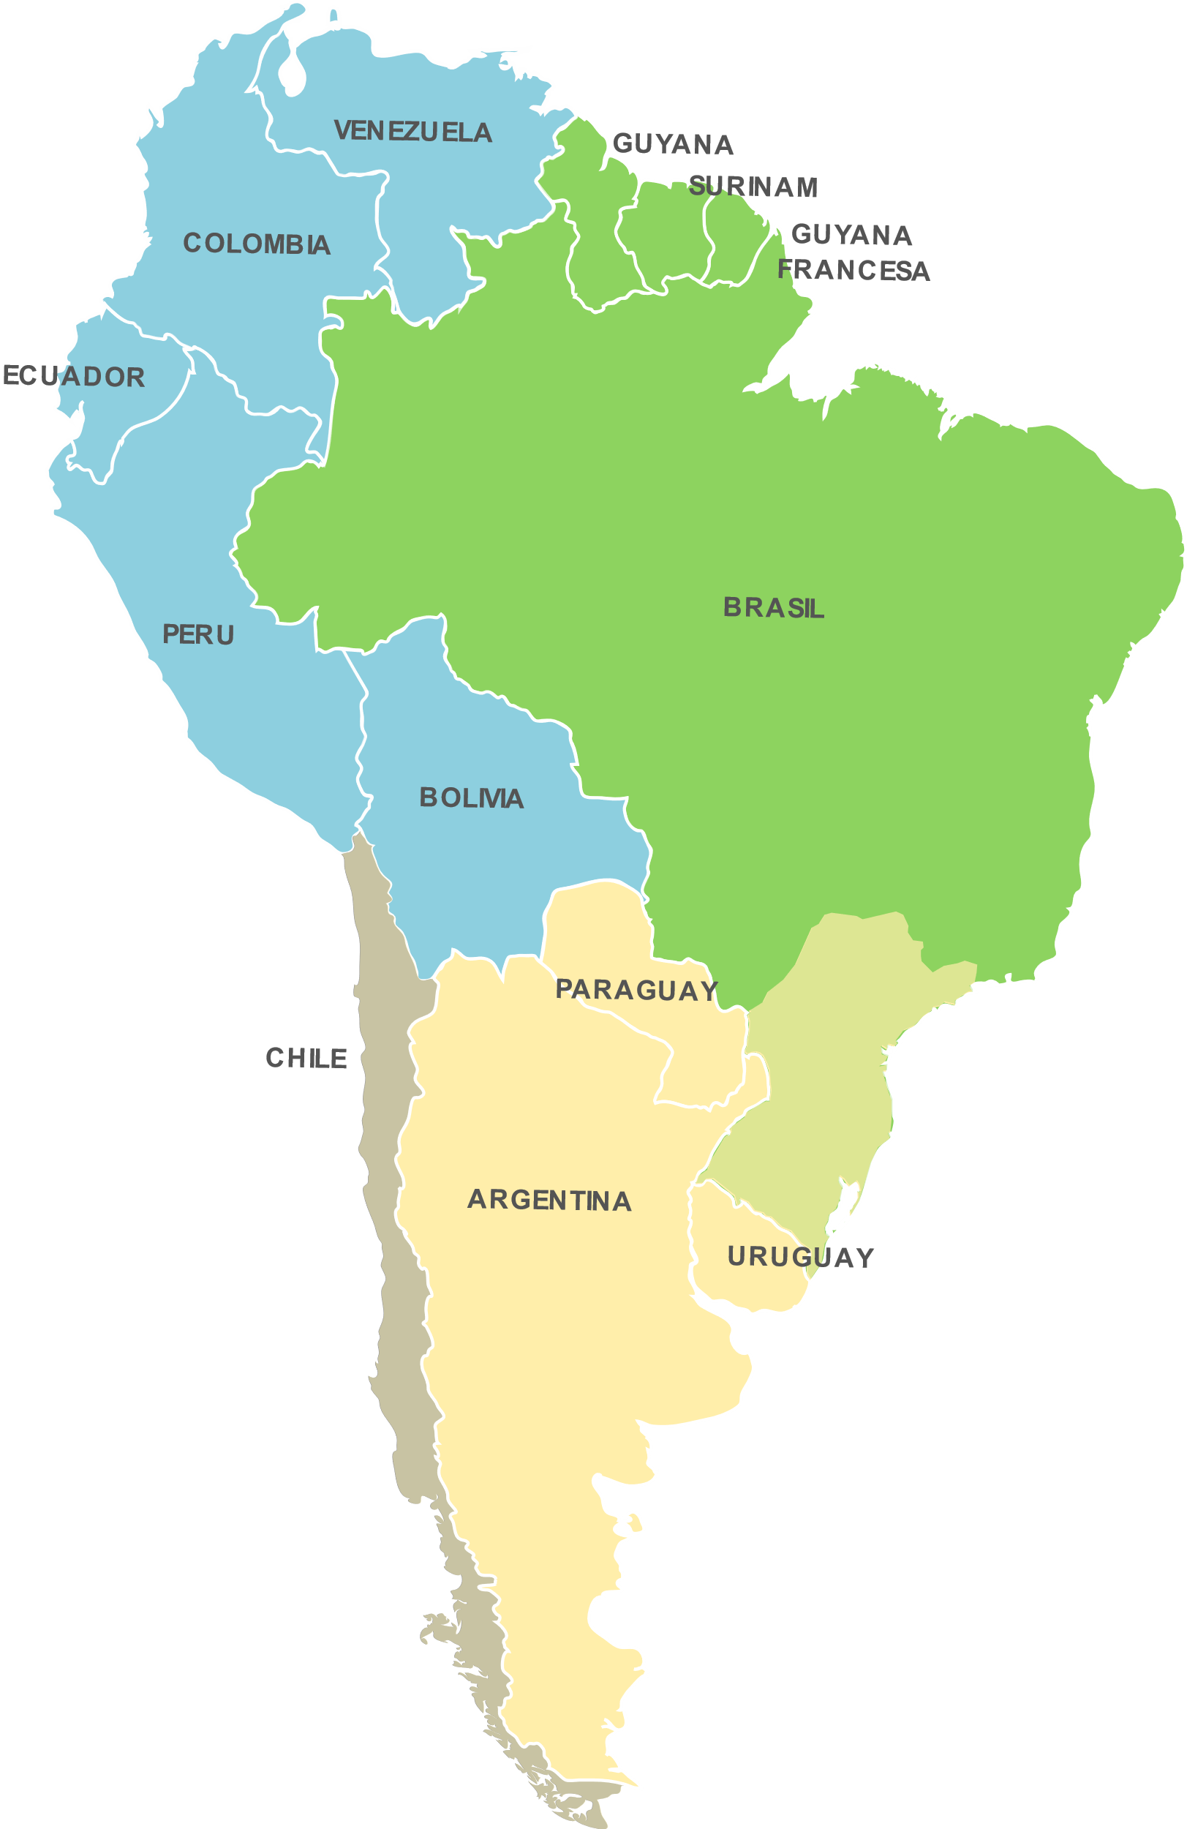
RA III Inputs
During January 2024, a survey was held in the RA III to define the regional priority hazards. At the 29th session of RAIII MG (23rd Jan 2024), this information was analyzed and approved by its members.
Andean countries
Rain/Wet Spell
Drought/Dry Spell
Wind
Landslide/Mudslide & debris Flow
Flash floods
Frost
Northern South America
Rain/Wet Spell
Floods
Drought/Dry Spell
Flash Floods
SUBREGIONAL PRIORITY HAZARDS RA III
Rain/Wet Spell
Drought/Dry spell
Wind
Floods
Flash floods
Thunderstorm/Squall lines
Heatwaves
SECUNDARIES SUBREGIONAL HAZARDS
Frost – Forest Fire - Cold waves – Hail – Heatwaves
Southern Cone
Thunderstorm/Squall lines
Rain/Wet Spell
Heatwaves
Wind
Drought/Dry Spell
 | 6

Slide 7
RA IV Inputs (with recent updates from SERCOM & INFCOM)
On 18th Dec 2023, RA IV provided a list of the regional priority hazards
34th Session of RA IV Management Group (30 Jan 2024)
Based on the recommendations made by the chairs and ET leaders, raise the following matters at SERCOM, INFCOM, TCC-PAC and EC-78:
To establish systematic mechanisms that ensure the interaction and collaboration of the Standing Committees and their subsidiary bodies with RA IV.
To establish a systematic process between the TCs, RAs, and Technical Programs that ensures activities in the Regional Implementation Plans are included in the WMO integrated operating plan and are complementary to the work plans of the TCs.
To request to WMO Secretariat to improve inter-departmental coordination to enable timely funding of regional activities, reducing delays in the logistical process of sending invitations and arranging travel.
 | RA IV Priority Hazards | Risk Levels
1 | Hurricanes
2 | Extreme Temperature & Heat Waves
3 | Tropical Storms
4 | Flash and Riverine Floods
5 | Droughts and Dry Spells
6 | Potential tropical Cyclones
7 | Coastal Flooding and storm surge
8 | Severe Precipitation Storms
9 | Forest, wild and bush fires
10 | Landslides
11 | Lightning and Thunderstorms
12 | Cold waves
13 | Severe Winter conditions
14 | High Winds
15 | Dust Haze
16 | Hail
17 | Sea Level Increases
 | 7

Slide 8
RA IV Inputs
As part of the preparatory activities for RA IV-19 session to be held in February 2025, an Open consultation process on Regional priorities has started.
The consultation is available until 30 April 2024, and the results will be analyzed in RA IV-MG-35 in mid-June 2024.
https://forms.office.com/e/i9VQjvr9eR

Slide 9
RA VI Inputs
EW4All rapid assessment has been carried out for 10 RA VI Members → Many countries in Europe don’t have adequate MHEWS system. The identified biggest challenges:
- Big gaps in the observing, data processing and forecasting systems
- Lack of formal links between the stakeholders in the dissemination chain
- Missing regulatory frameworks that connect early warnings to emergency plans
Encourage coordination and collaboration → build on and scale up existing efforts and capacities (MeteoAlarm, SEE-MHEWS, etc.)
Resource mobilization efforts are ongoing to support South-East Europe and South-Caucasus
EW4All Roadmap has been drafted and discussed by MG
Regional priority hazards have been identified and approved by Members
Specific text inputs was provided by the Members and Regional Office for Europe (ROE) into the EW4All “implementation plan” narrative document
Members feedback on EW4All priority activities and hazards (SERCOM-3 Inf.) has been collected
In April, a subregional EW4All event will be organized for South-East Europe

Slide 10
Conclusion and way forward
Moving Forward: Building a Comprehensive EW4All Roadmap for implementation
Regional Offices have been engaging with Members (and continuing)
Varying response rates
Address concerns regarding low response rates and missing input (Urgent).
Concerns on Regional vs national hazards
Develop a clear roadmap for implementation, resource mobilization and partnership building.
Prioritize training initiatives based on identified development areas.
Regularly monitor progress and adjust the plan as needed, focusing on specific Member needs (iterative process).
Leverage on existing structures and expertise
Second iteration of feedback (on priority hazards and activities) to be collected from Members
Defined methodology to uniform collection of feedback and to increase response rates
Analyze and consolidate feedback on priority hazards and activities into the EW4All Roadmap
 | 10

Slide 11
Thank you
^{wmo.int}

