Slide 1
INF 3.1(2)
Early Warnings for All:
A Rapid Assessment of Country Monitoring and
Forecasting Capacity
TCC-PAC-1 (2024)
23-24 April 2024

Slide 2
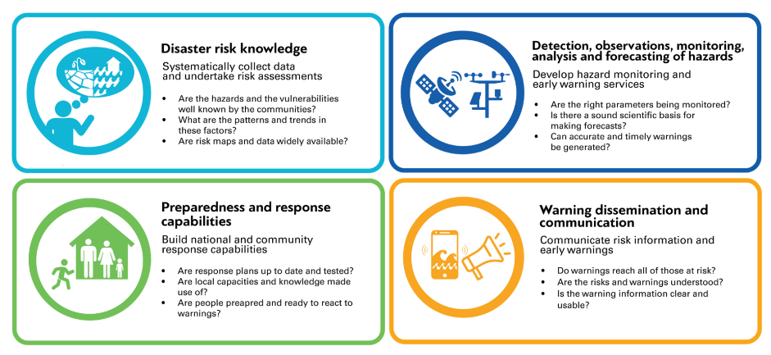
Purpose | Pillar 2 Rapid Assessment
Inform the planning stage of the Early Warnings for All Initiative
Quick baseline data, more granular data
Identify capacity gaps
Guide technical assistance and investments
Develop a tool for monitoring country capacity
Maturity Index
Notes:
2

Slide 3
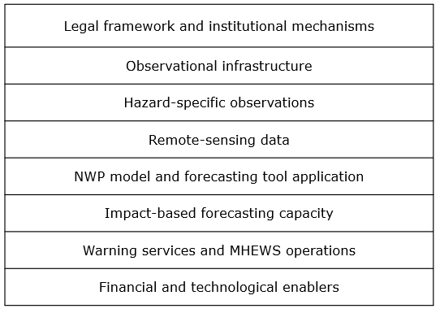
Methodology | Pillar 2 Rapid Assessment
Scope:
8 elements of hydrometeorological value chain
70+ data points
Quantitative and qualitative data
5 priority hazards (based on WMO Catalogue of Hazardous Events )
Approach:
Structured interviews
Response weighting
Analysis of qualitative information
Maturity levels on a scale of 1-5
Based on:
Country Hydromet Diagnostics
MHEWS Checklist
Notes:
3

Slide 4
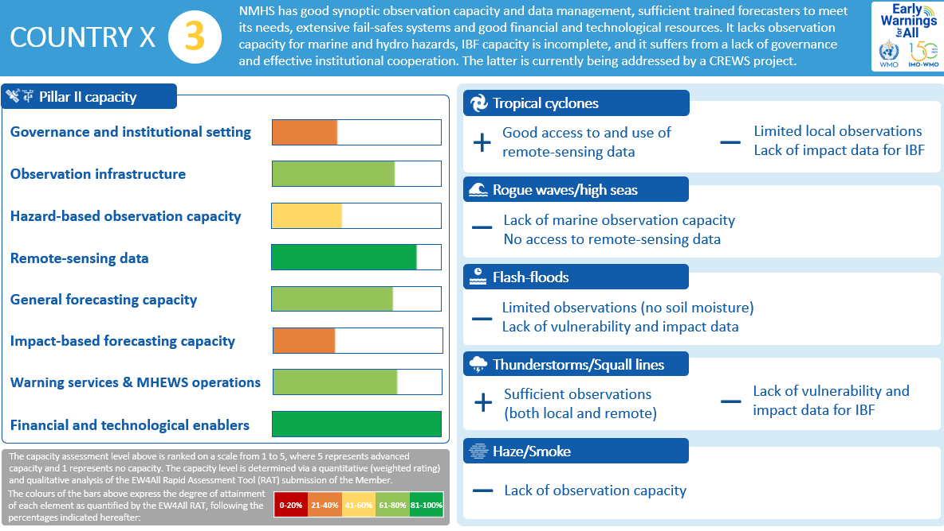
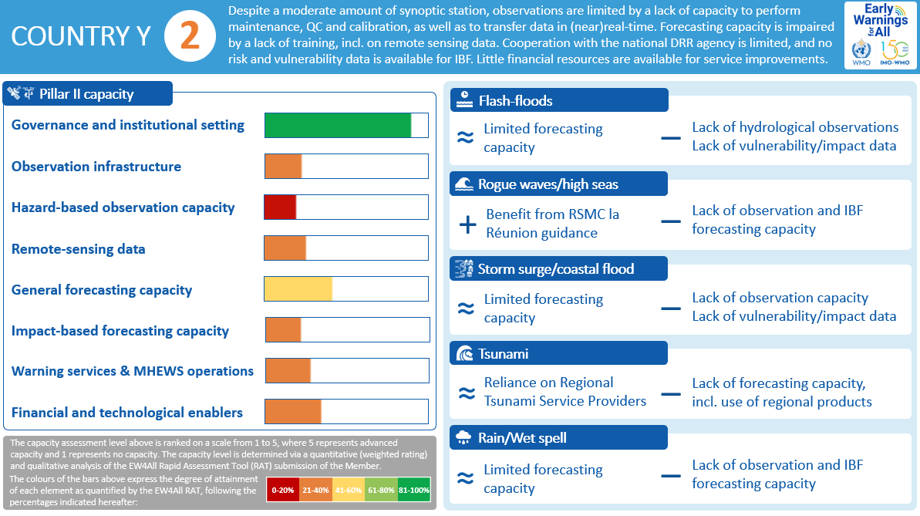
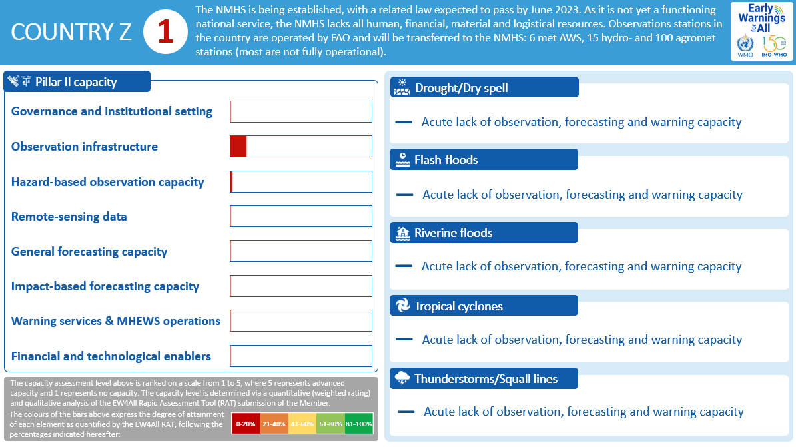
Country Scorecards | Pillar 2 Rapid Assessment

Slide 5
Data Quality Assurance | Pillar 2 Rapid Assessment
Notes:
5

Slide 6
Aggregate Results | Pillar 2 Rapid Assessment
Half of the 30 NMHS operate with basic monitoring and forecasting capacity;
a quarter with less-than-basic capacity
EW4All Pillar 2 capacity levels of 30 selected countries (data collected by WMO, 2023)

Slide 7
Implementation | Pillar 2 Rapid Assessment
Since June 2023 applied to:
41 Members, including
30 initial EW4All focus countries
8 RA VI Members (based on a request from the Management Group)
3 other LDCs and SIDS
Analysis is ongoing on:
8 Members
Notes:
7

Slide 8
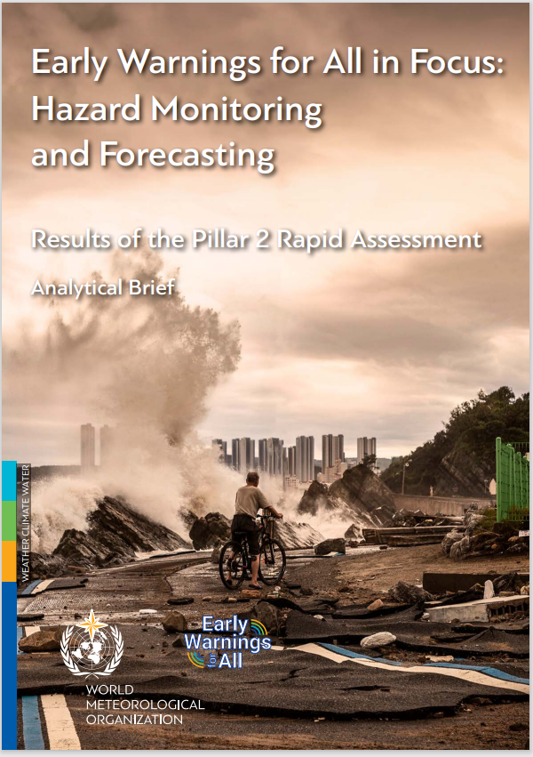
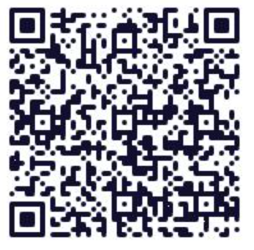
Early Warnings for All in Focus:
A Rapid Assessment of Country Monitoring and Forecasting Capacity

Slide 9
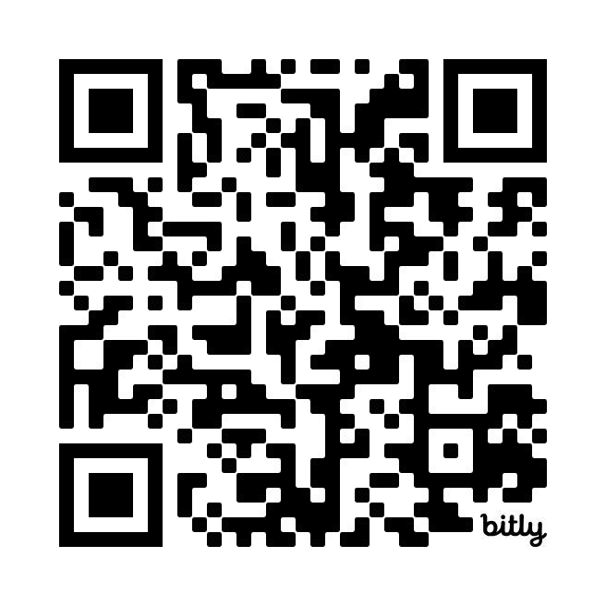
Dashboard

Slide 10
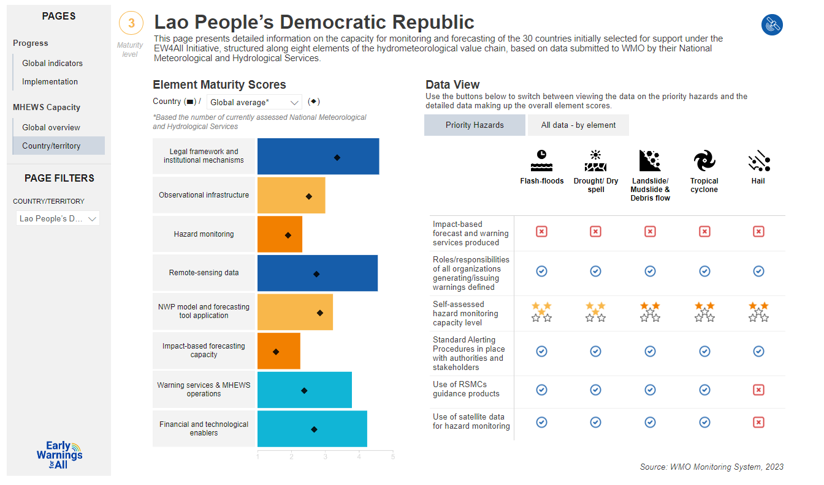

Slide 11
Next Steps | Rapid Assessment
Transfer of know-how to the Regional Offices
Scale up to more Members
Mechanisms :
demand-driven (e.g. Members, Regional Associations)
through the SOFF Readiness Phase, CREWS Multi-Stakeholder Accelerator
Expand beyond Pillar 2
UNDRR testing on Pillar 1
Use in the development of EWS Maturity Index
EW4All Monitoring & Evaluation Working Group (co-chaired by WMO and UNDRR)
Notes:
11

Slide 12
Thank you
Monitoring, Evaluation, Risk and Planning Office
^{merp@wmo.int}
^{wmo.int}

