Slide 1
EC-78 INF. 3.1(1) and Doc 3.1
TCC-2
Cyrille Honoré, Director, Disaster Risk Reduction, MHEWS Office and Public Services Branch
22 April 2024

Slide 2
Review Previous Decisions
Resolution 4 (Cg-19) - United Nations Early Warnings for All initiative
Requests:
The Executive Council to oversee progress on WMO’s contribution to the EW4All Initiative as a matter of highest priority and to provide advice and direction to ensure there is coordination and consolidation of all relevant WMO activities under the EW4All umbrella;
Resolution 1 (EC-77),
Requests the subsidiary bodies of the Executive Council (EC) to also include EW4All as a standing agenda item in each session throughout the next financial period and to report back to EC;
Resolution 7 (EC-77)
Decides:
To retain the following subsidiary bodies:
...
(b) Technical Coordination Committee, with the provisional terms of reference, with a focus on coordination of WMO’s contributions to EW4All, as provided Annex 3 (amendments to Annex (B) to Resolution 35 (EC-70))
…

Slide 3
Key steps in the EW4All Roadmap development
Date | Activity
17-19 October 2023 | TCC-1: request to RAs to consolidate a list of priority hazards, and to TCs and RB of priority activities. First discussion about the table of contents of the Implementation Plan
22 November 2023 | First TCC update meeting. Consolidated list of priority hazards presented and agreed. First list of consolidated activities presented.
15 December 2023 | Second TCC update. Narrative on the consolidated list of proposed priority activities presented and agreed.
January 2024 | Finalization of the narrative on the consolidated list of proposed priority activities. Initial discussions with the consultant on the drafting of the Implementation Plan
January-February 2024 | Narrative on the consolidated list of proposed priority activities circulated to the Regional Associations (through Regional Offices) to collect feedback on priorities
21 February | Third TCC update. Discussion on the draft Implementation Plan, renamed as Roadmap for implementation
4-9 March | Feedback on priorities collected (39 countries). SERCOM-3 debates through Doc 4.5(2) the priorities of SERCOM for the EW4All
13 March | Research Board reviewed list of priority RB activities
18 March | Meeting of EW4All EC Paper Drafting Committee
22 March | Fourth TCC Virtual Update: consideration of the Roadmap and suggestions for its finalization
15-19 April | INFCOM-3 debates through Doc 7.1 the priorities of INFCOM for the EW4All

Slide 4
Roadmap Breakdown into parts
Part I | Part II
Delivered through: Regional Associations Services Commission Infrastructure Commission Research Board Hydrological Coordination Panel | Delivered through: Executive Council Capacity Development Panel Secretariat Partners
Encompassing: Technical and Scientific Activities Global/Regional Scope Funded through core budget | Encompassing: Resource Mobilization Project and program delivery Sub-regional/National Scope Extra-budgetary
Organization of activities: Value Chain/hazard category | Organization of activities: Value chain/national/overarching
Notes:
Roadmap in two parts:
Part I: technical and scientific activities
(under the responsibility of the TCC)
Part II: capacity development, outreach and resource mobilization
(nominally under the responsibility of PAC/CDP)
However, given the request from EC, TCC needs visibility on all activities

Slide 5
Process
List of priority activities
Feedback from Regions
Part I: scientific and technical
TCC overall view
EC overarching responsibility
1
2
3
4
5
6
List of priority hazards
Feedback from TCs, RB
PAC aspects
XB projects (contributing to EW4All)
Part II: Coordination and projects
Coordination and outreach

Slide 6
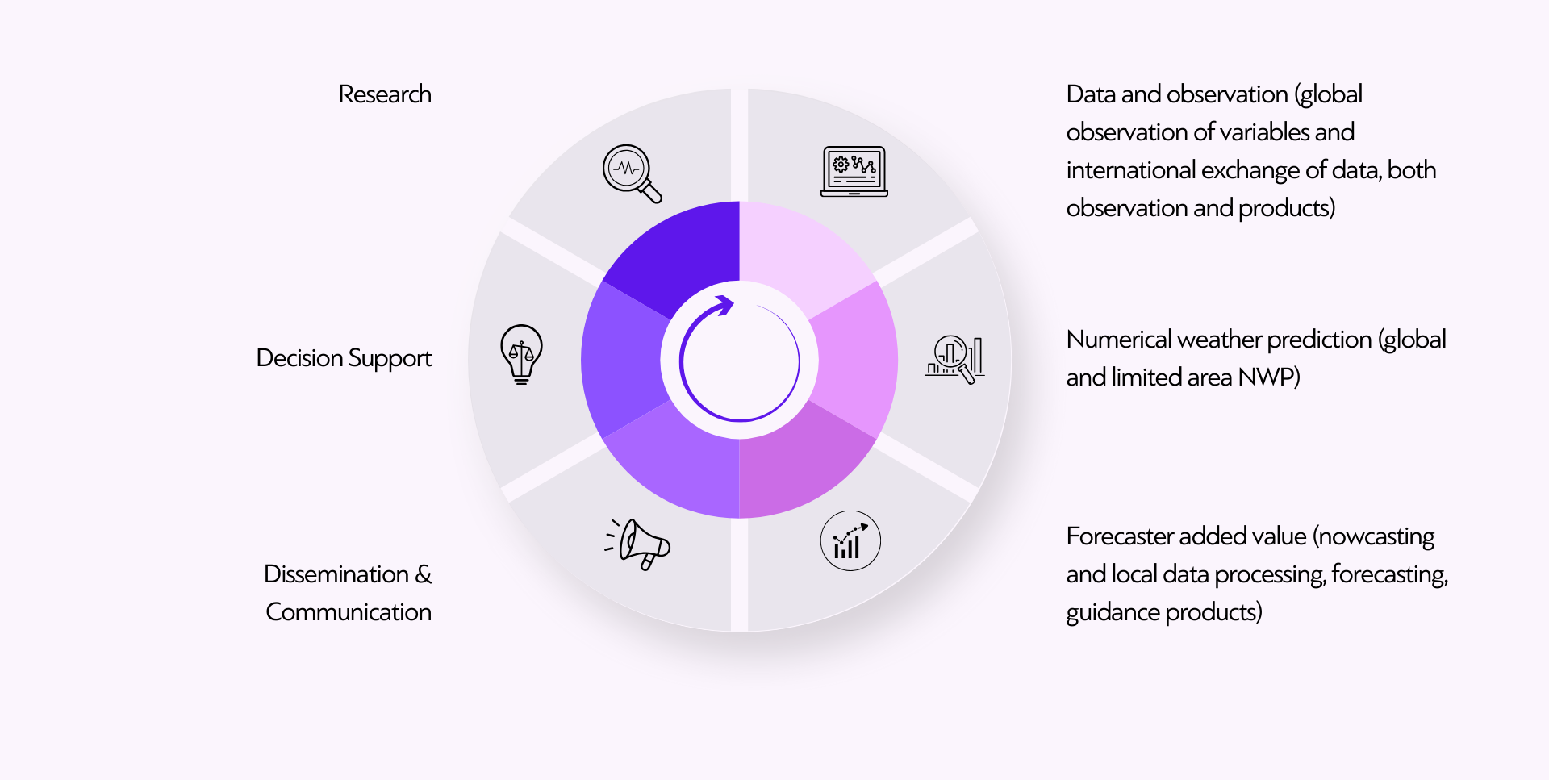
End-to-End Value Cycle of Hydromet Infrastructure and Services

Slide 7
EW4All Roadmap outline
Background
Guiding principles
Development
Major steps and deliverables
Roles and responsibilities
Measures of success and monitoring and evaluation
Part 1 Table of Scientific and technical activities
Part 2 Table of Coordination and project activities
Appendix on XB supported activities

Slide 8
Discussion

Slide 9
EC-78 doc 3.1 Key Points
Endorses the latest version of the EW4All Roadmap, presented in its current form in INF 3.1 and encourages the TCC to now maintain and update the Roadmap as a “living document”, building on the list of priority hazards and priority activities as presented in the annex;

Slide 10
EC-78 doc 3.1 Key Points
Decides:
To renew the assignment of responsibility for overall ongoing coordination at the global and regional level of technical aspects of the WMO contribution to the EW4All initiative to TCC, including voluntary cooperation projects contributing to the EW4All initiative;
(2) To delegate authority for the ongoing development and evolution of the EW4All Roadmap to the TCC;

Slide 11
EC-78 doc 3.1 Key Points
Requests:
(1) The technical commissions and the Research Board, in close coordination, to use the Roadmap to guide their respective EW4All related implementation activities and include EW4All as a standing agenda item in each session throughout the next financial period;
(2) The Regional Associations to establish regional arrangements needed for the successful implementation of the Roadmap and lead the monitoring and evaluation of EW4All related implementation activities, based on the M&E framework developed by the EW4All Monitoring and Evaluation Working Group, and include EW4All as a standing agenda item in each session throughout the next financial period;

Slide 12
EC-78 doc 3.1 Key Points
Requests:
(3) The Secretary-General:
To take all necessary actions to mobilize and allocate the resources necessary to support technical commissions, Research Board, Regional Associations, as well as Secretariat activities contributing to the overall WMO contribution to the EW4All initiative;
(b) To coordinate with UNDRR and other partners to help ensure a coordinated approach with other initiatives contributing to early warnings;

Slide 13
EC-78 doc 3.1 Key Points
Requests:
(3) The Secretary-General (cont.):
(c) To promote coordination and alignment of SOFF, CREWS, and the WMO extrabudgetary portfolio along with contributions of Members, development agencies, multilateral organizations, and global climate funds (like the Green Climate Fund) Multilateral Development Banks to the EW4All through the Alliance for Hydromet Development;
(d) To enhance communication on WMO contribution to the EW4All initiative, including through an overarching communication strategy;
(e) To continue working on a coordinated monitoring approach with the Initiative’s partners, track progress and further enhance the performance indicators and tools;

Slide 14
Discussion

Slide 15
Thank you.
^{wmo.int}

