Slide 1
RWCs in RA IV – online training on IMS, 18 September 2023
Practical examples of issues and tickets in IMS
WMO Secretariat, WIGOS Branch, Regional Office for Americas

Slide 2
Some aspects for consideration

Slide 3
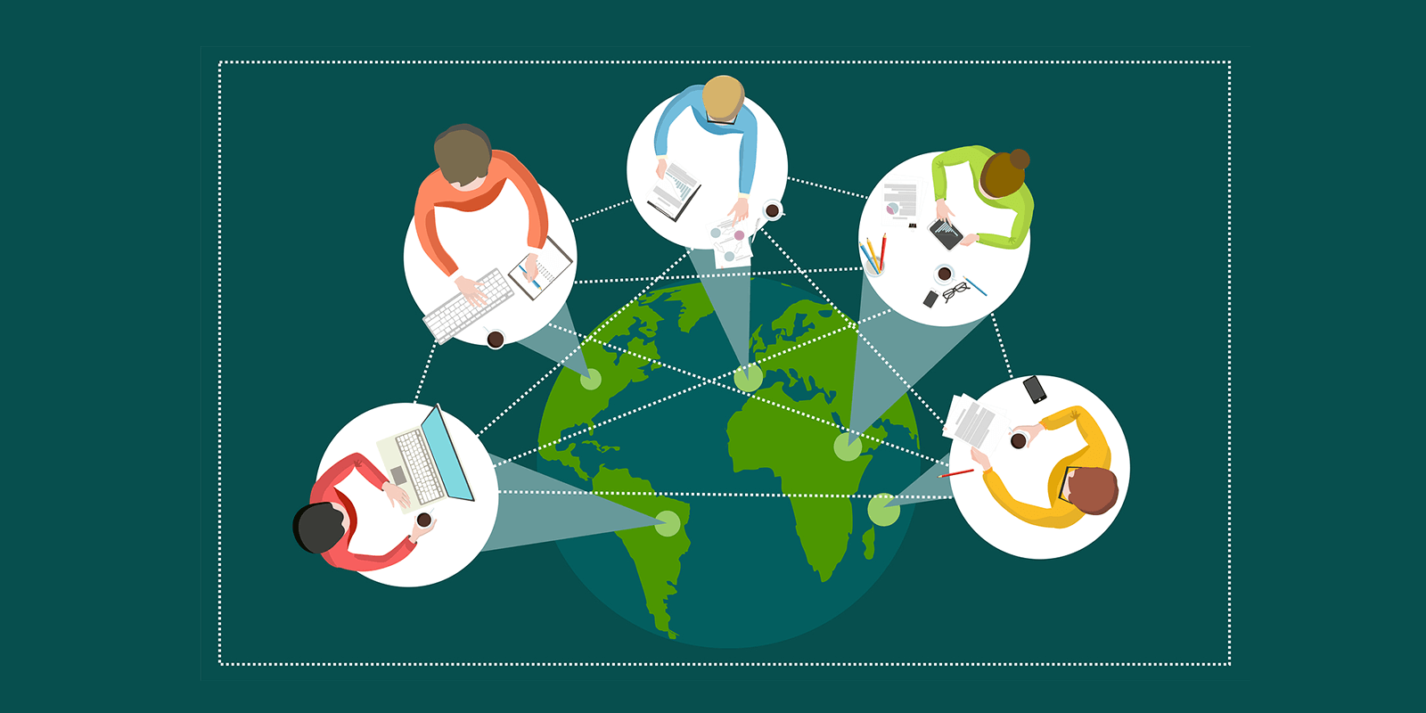
For Regional Wigos Centers
It is useful that the ticket itself contains more details on the incident and points out what is wrong
RWC – NFPs collaboration is highly recommended. It is also useful to have the list of NFPs in your area of responsibility.
Intra-RWC collaboration is very beneficial and encouraged, it is recommended that a RWC have the contact details of the RWC coordinators in its region

Slide 4
At the National Level
It will be wise, at the national level, to have an internal governance process (internal procedures, escalation mechanism...) to report and process, in due time, tickets received.

Slide 5
At the National Level
Make the best use of WIGOS tools to anticipate issues
Actif and Anticipatory role Conduct your own analysis, identify incidents and start addressing them without having to wait for a ticket to be opened
Reckless role
Accumulate a number of incidents deemed similar before starting to deal with them
Passive role
Wait for a ticket to be received and process it

Slide 6
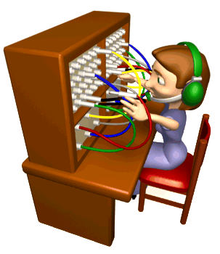
At the National Level
Adopt a professional attitude when handling and resolving incidents
Report to the Hierarchy
Acknowledge receipt and Share the incident with the hierarchy
Actif and Anticipatory role
Carry out an initial diagnosis, establish contacts in order to determine the right persons to contact and transmit the incident to them
Call center role
Acknowledge receipt and transmit the copy to the entity concerned

Slide 7
Open discussion
Questions / Answers

Slide 8
Thank you
Gracias
Merci
^{wmo.int}

