Slide 1
RWCs in RA IV – online training on IMS, 18 September 2023
Practical examples of issues and tickets in IMS
WMO Secretariat, WIGOS Branch, Regional Office for Americas

Slide 2
Outline
Practical exercises on registering and follow-up on tickets with IMS
Metadata issue (Leading Node Canada)
Upper-air/Surface data availability issue (Leading Node USA)
Surface data availability issue (Contributing Node Costa Rica)
Surface data quality issue (Cn BCT and/or Trinidad & Tobago)
 | 2

Slide 3
Workflow steps of the Incident Management Procedure
Step-1: Identify an issue
Anyone (RWC, NFPs, any other person/entity)
Step-2: Create a ticket
RWC, NFPs, relevant centres (WIGOS and GCOS monitoring centres)
Step-3: Evaluate the issue
RWC
Step-4: Initiate incident management process
RWC
Step-5: Select Cn and assignee the ticket
RWC
Step-6: Follow the process
RWC and NFPs
 | 3

Slide 4
Step-1: Identify an issue (Metadata/Canada)
- in principle from OSCAR/Surface and/or from WDQMS Webtool, but could be based on other systems/tools
- brief description of the issue
…
Show screenshots or go live with the tools
 | 4

Slide 5
Issues related to Metadata

Slide 6
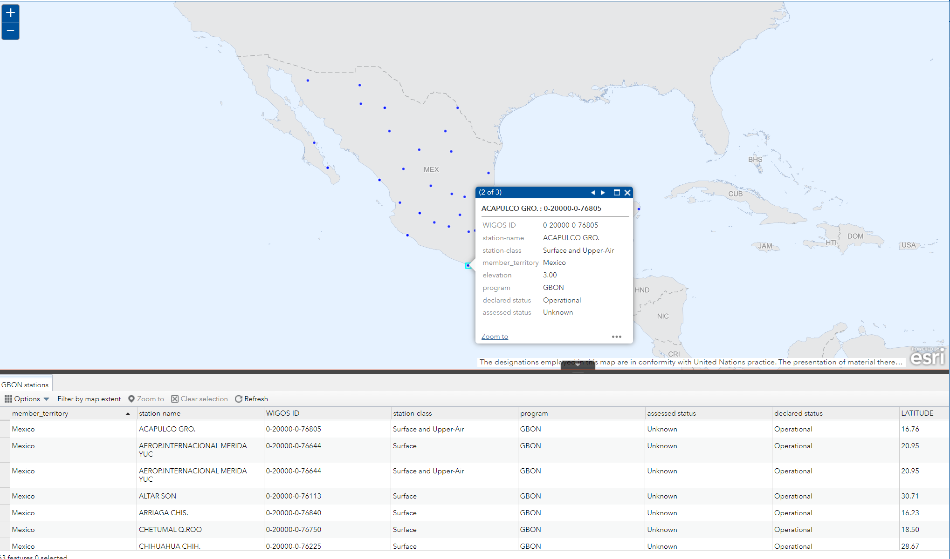
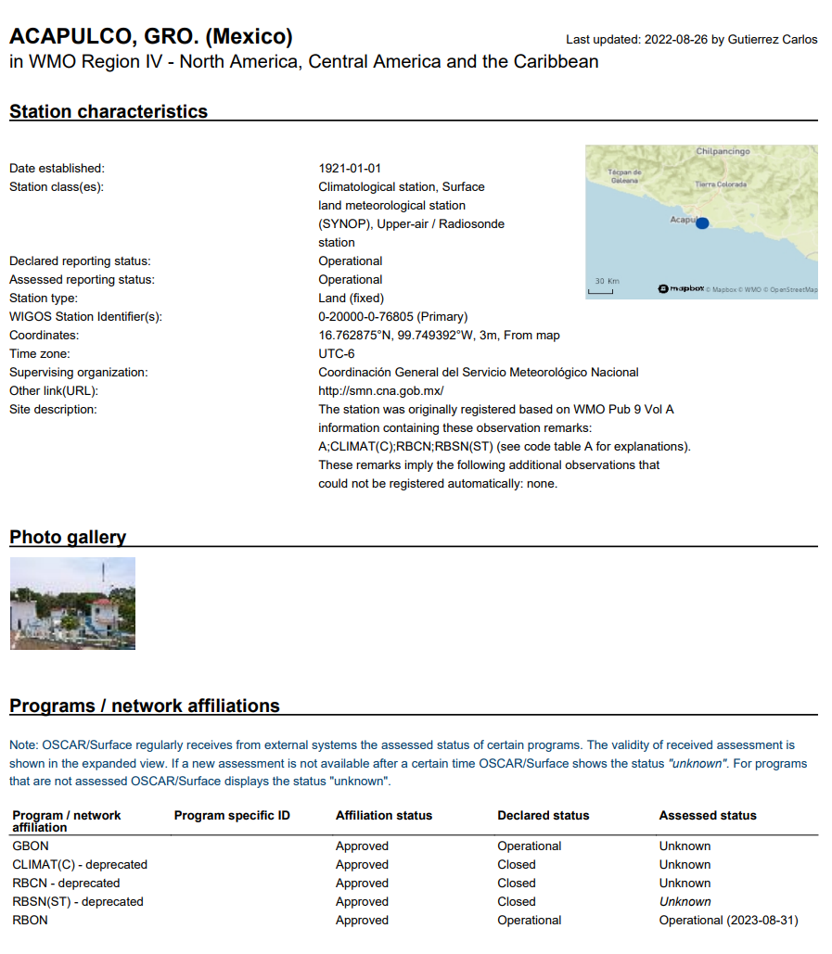
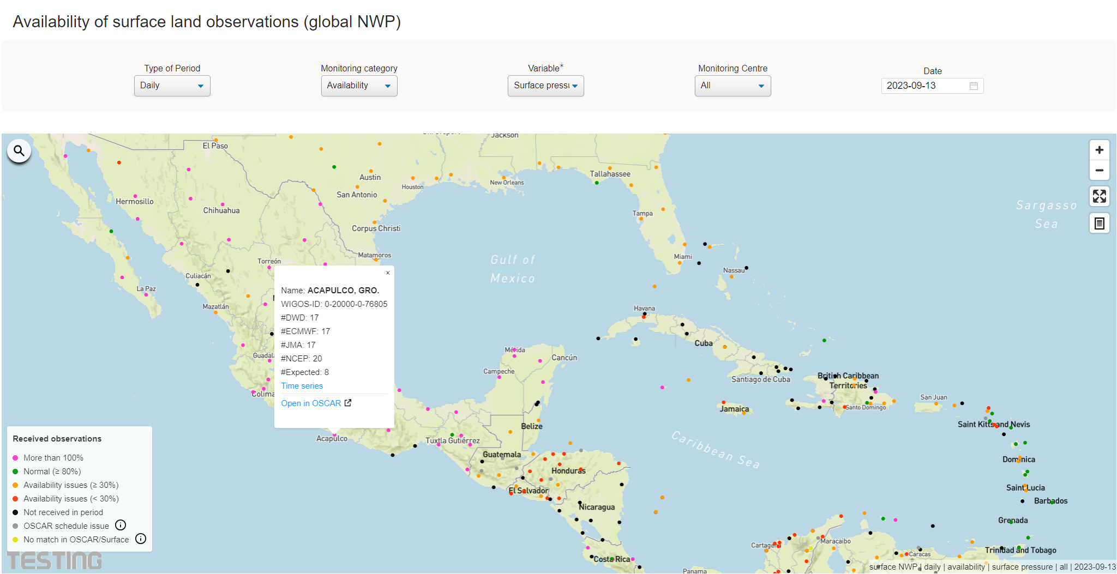
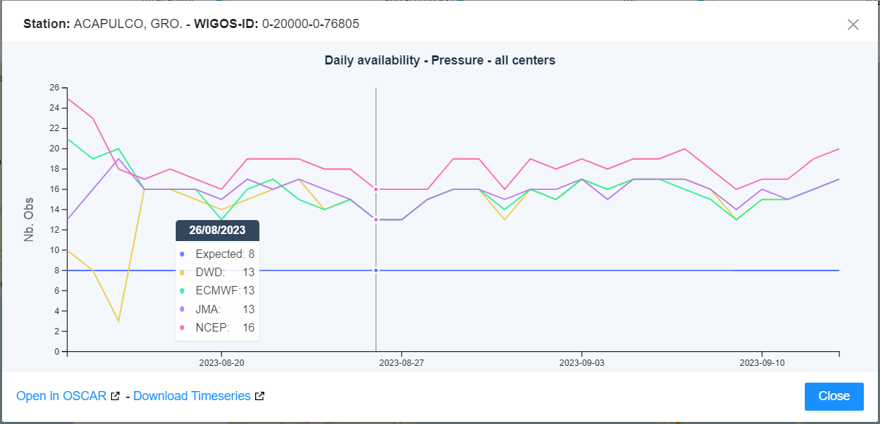
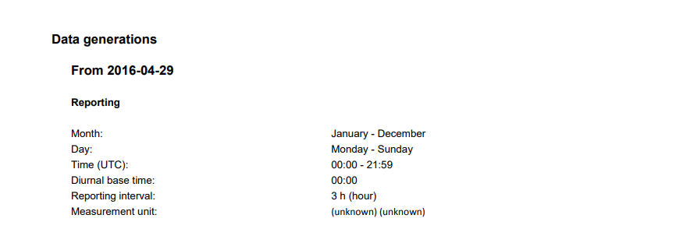
An issue regarding metadata declared in OSCAR that should be updated

Slide 7
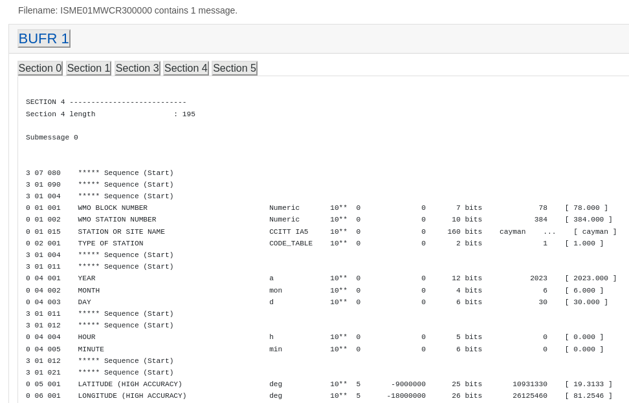
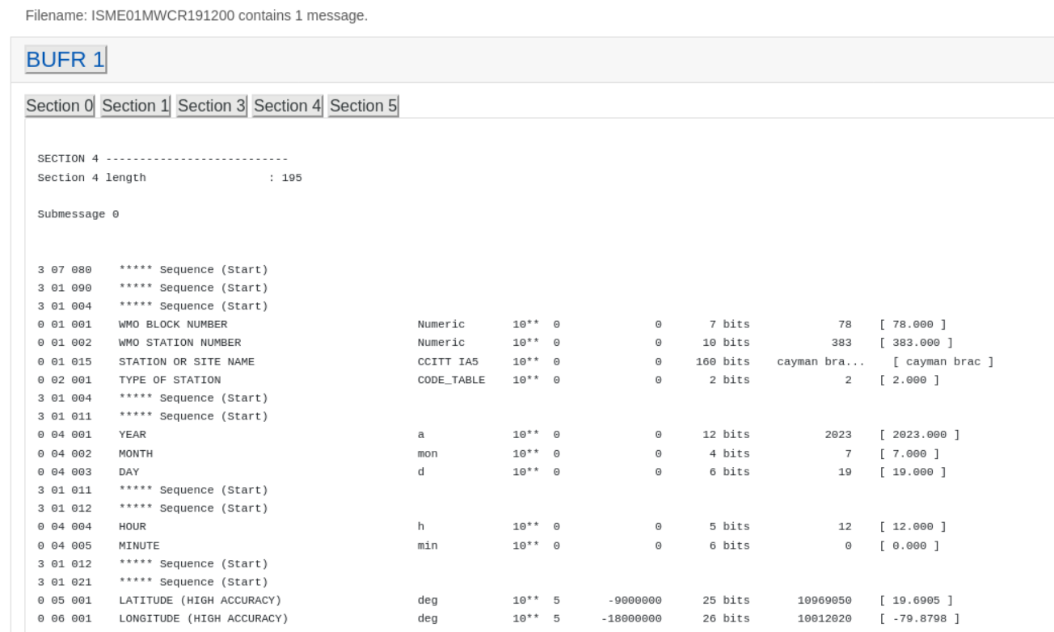
Identifying and addressing a metadata Issues using other Tools (NOAA-BCT)
General Description - NCO received a report that the lat/lon reported for Cayman Islands (MWCR) was incorrect and that the observation was showing up in the middle of India based on real-time plots of the observations.
Identification
Evaluation
Cause analysis in close collaboration
Action plan established
DO
Assess effectiveness
Close
Root cause - The site needed to make a software modification to convert from TAC to BUFR and correct the sign (+/-) of the longitude. 1. One of my DOD partners noted that observations for Cayman Islands (78384) were showing up in India. WMO headers are: ISME01 MWCR, ISNE01 MWCR, ISIE01 MWCR
The process here presented is in line with the automated process in Jira (IMS) as it will be demonstrated
Further diagnose : My team pulled data for those headers to confirm/reproduce the problem. I have attached a file from June 30th where we confirmed the longitude has the incorrect sign. We confirmed this by uploading this file into a couple of different online BUFR decoders. https://kunden.dwd.de/bufrviewer is one we used.
Solution: Once we confirmed the problem we reached out via email to one contact we had for Cayman Islands, but that contact was only in charge of upper air data. Luckily, they knew who we should contact and the site was able to make the appropriate change.
After the fix was in place we were able to repeat the same procedure from above where we pulled down data and put it in the online decoder confirming the change.
Closing action: Once confirmed, we were able to close out this item and let our customer know the issue had been addressed.

Slide 8
Issues related to the data Availability

Slide 9
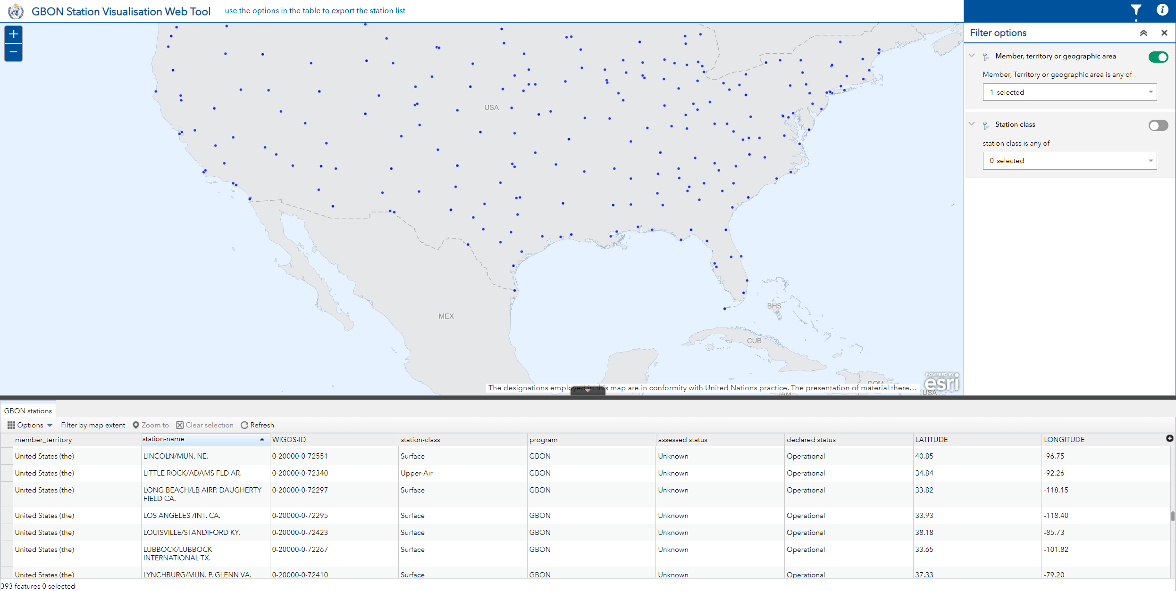
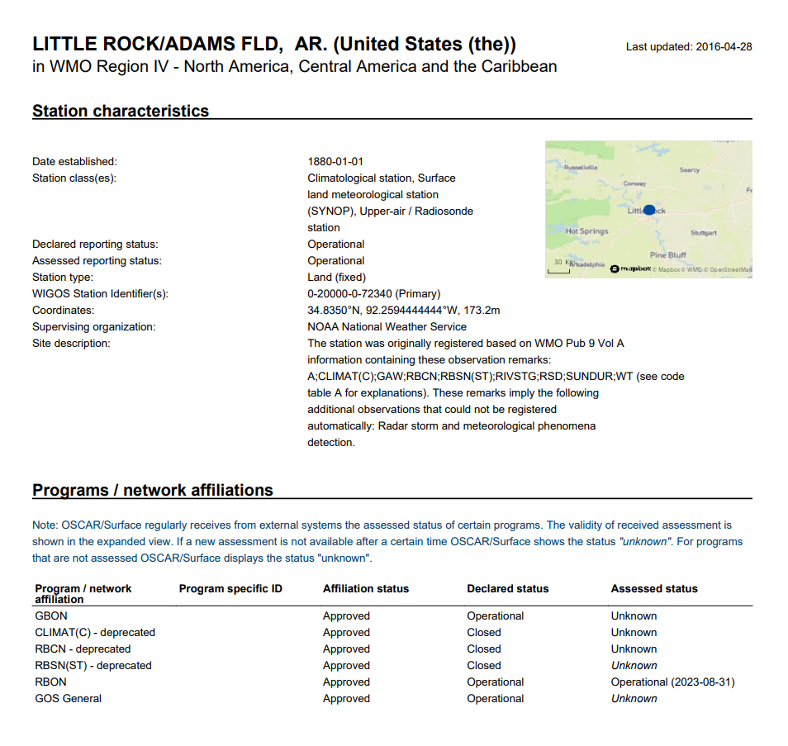
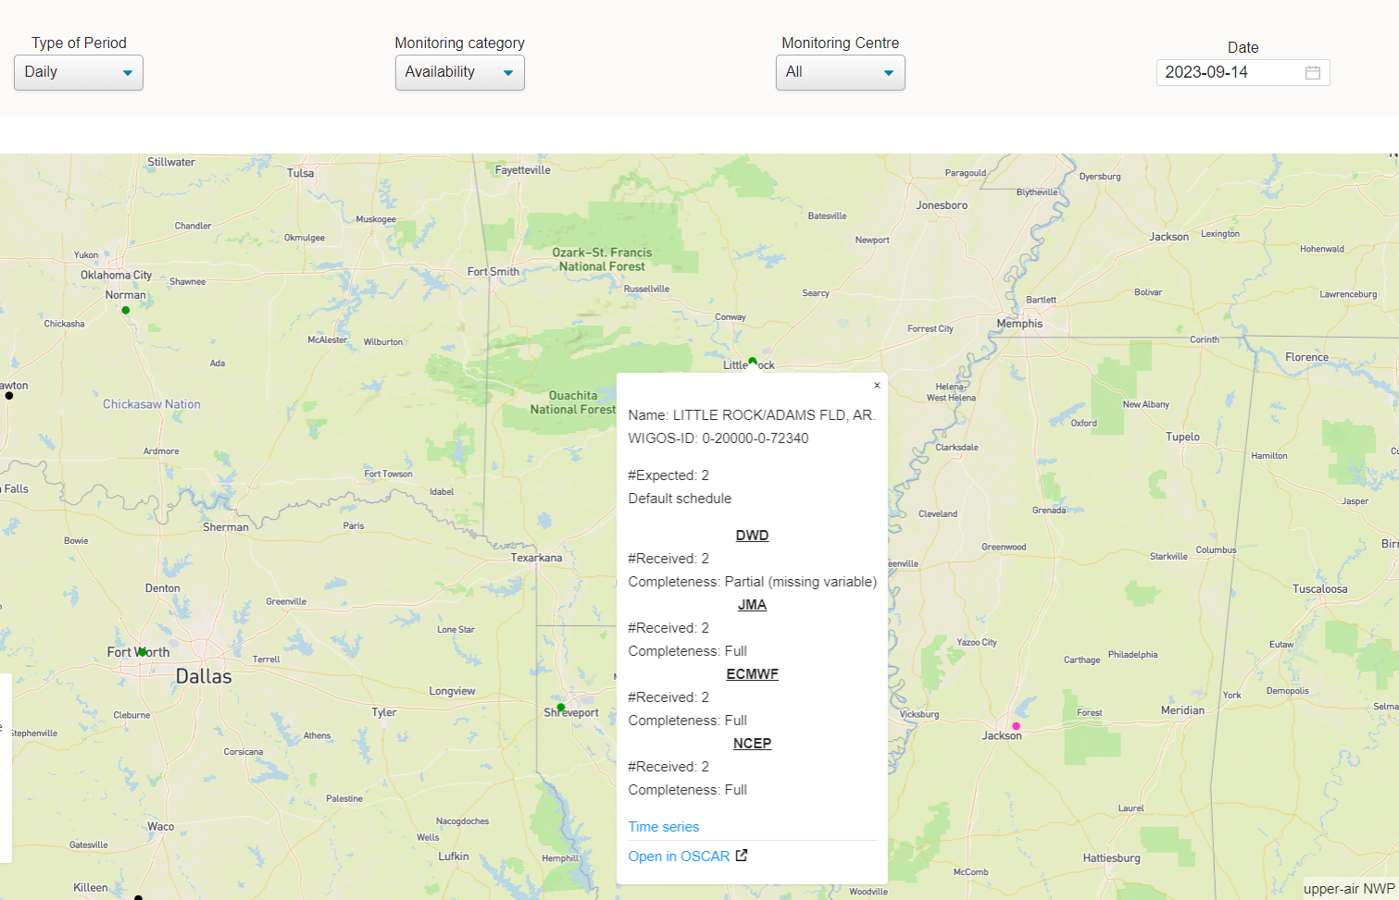
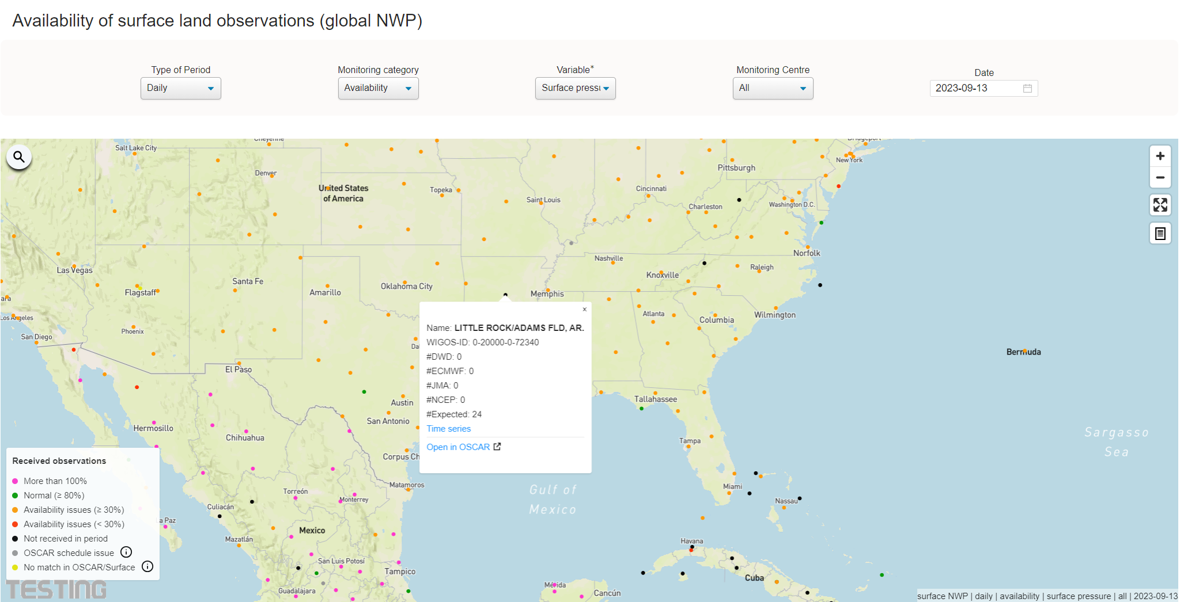
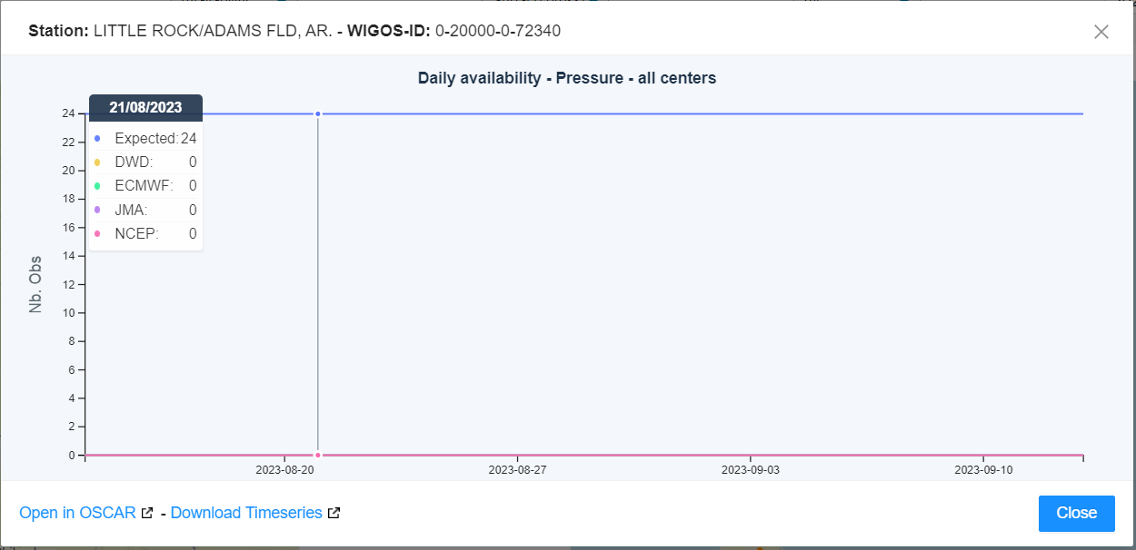
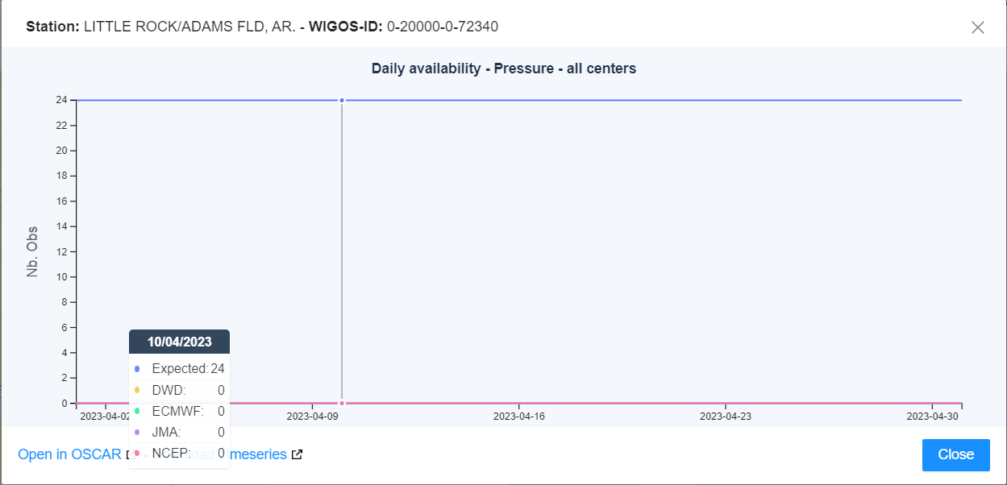
Issue regarding surface data availability for a long period
There is No issue within Metadata

Slide 10
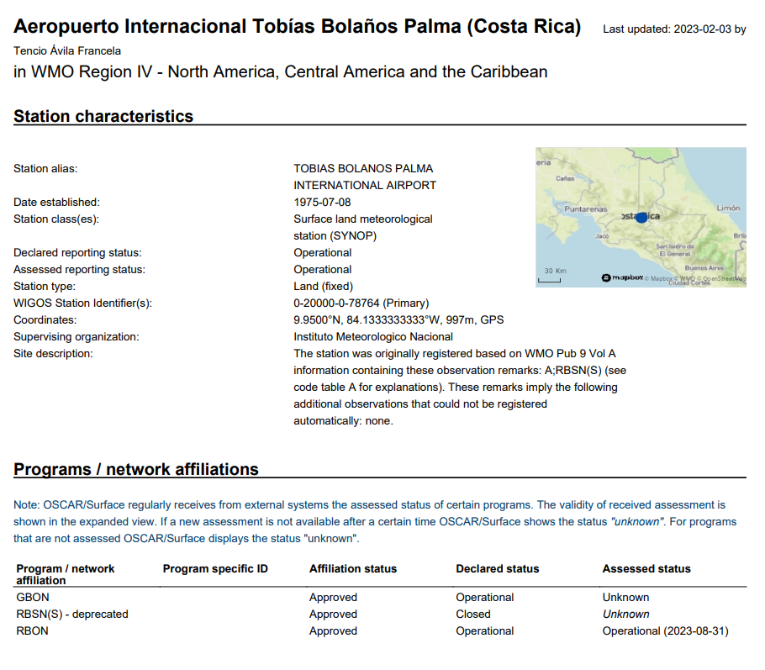
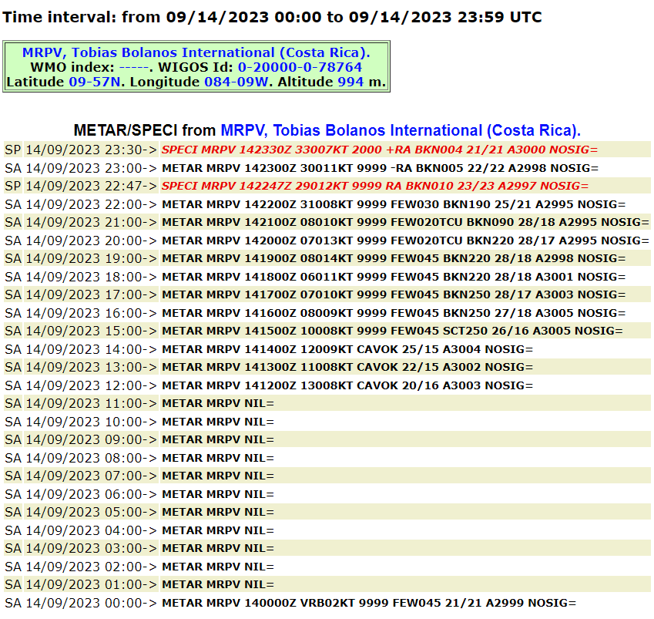
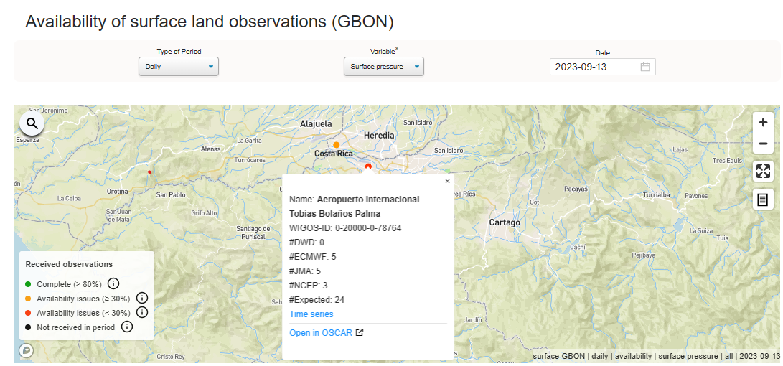
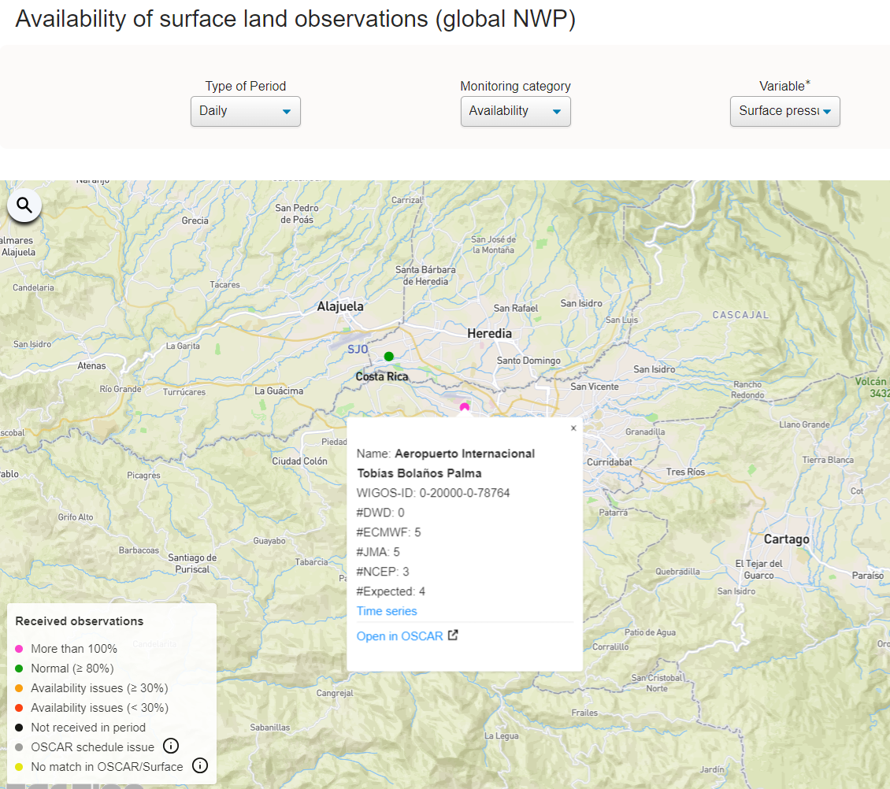
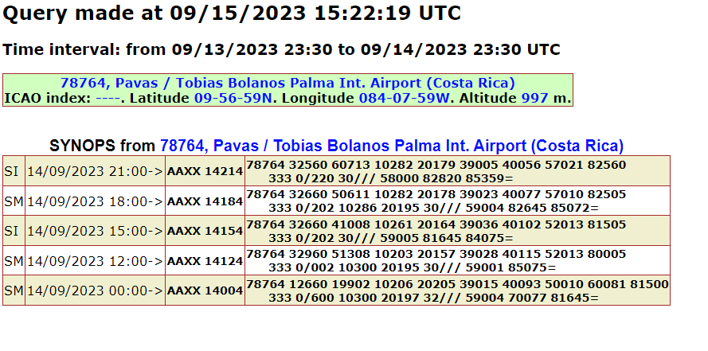
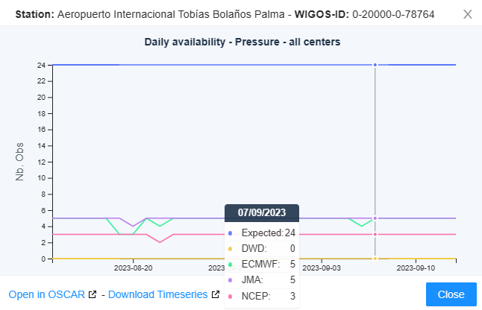
Availability issue reported by Costa Rica
To conclude:
No issue to be reported
But
There is a concern regarding GBON Compliance

Slide 11
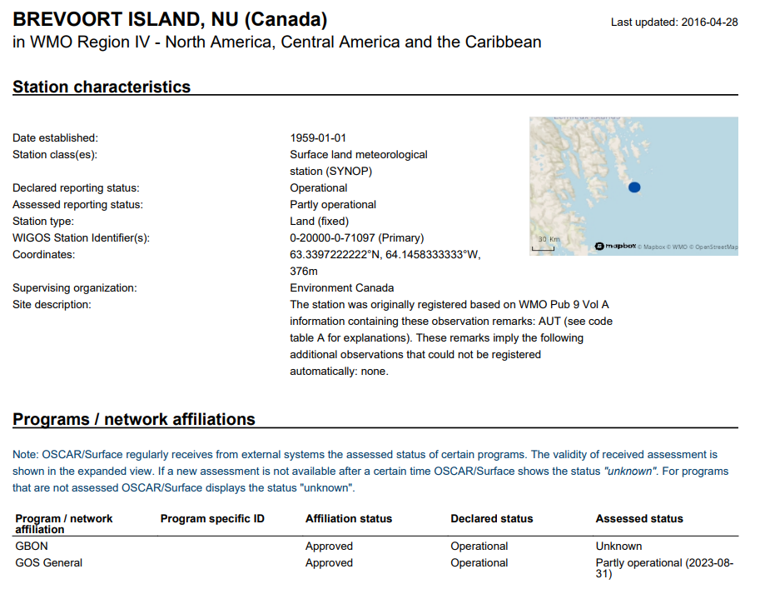
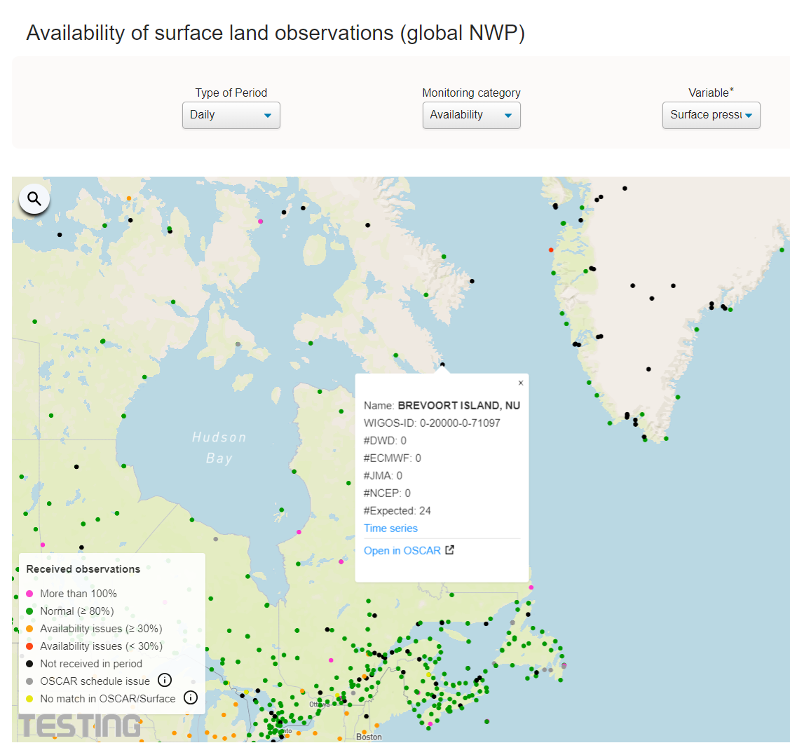
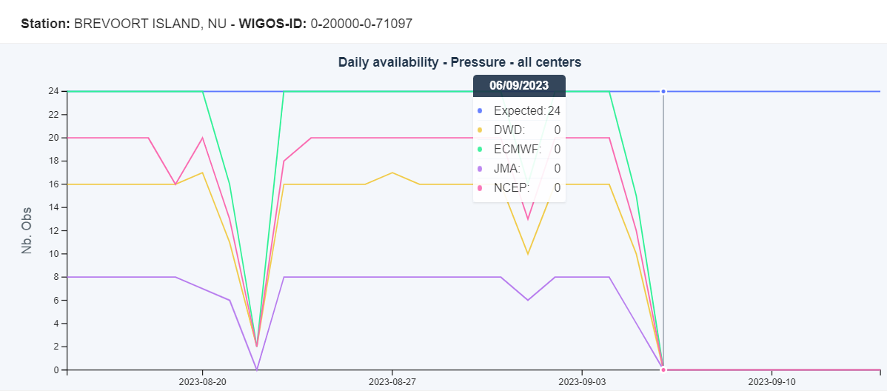
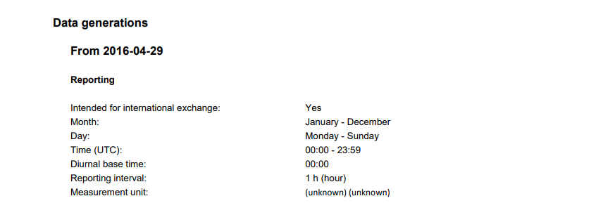
Availability issue reported by Canada
Missing data for more than 5 days

Slide 12
Issues related to the data Quality

Slide 13
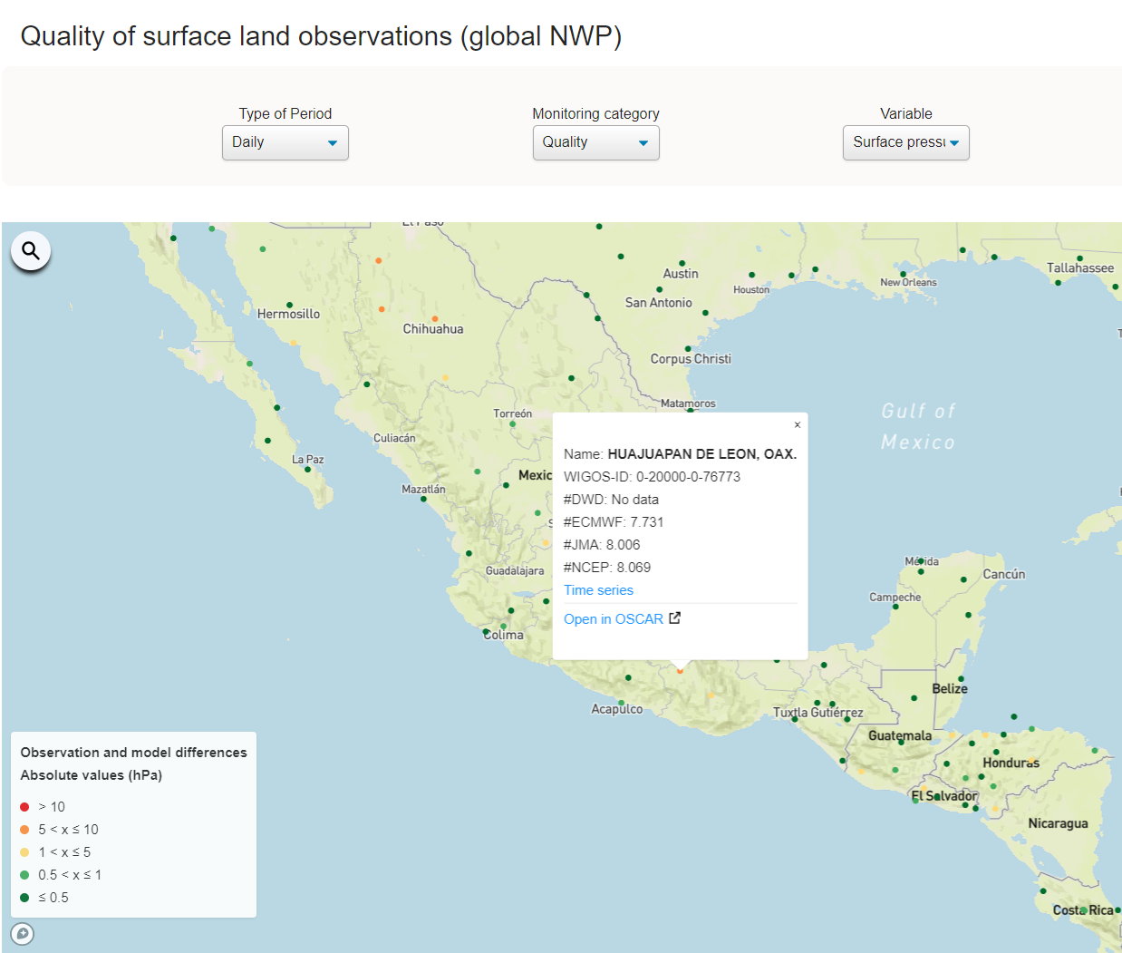
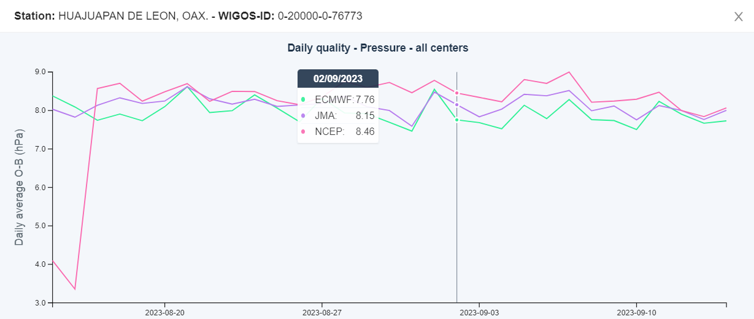
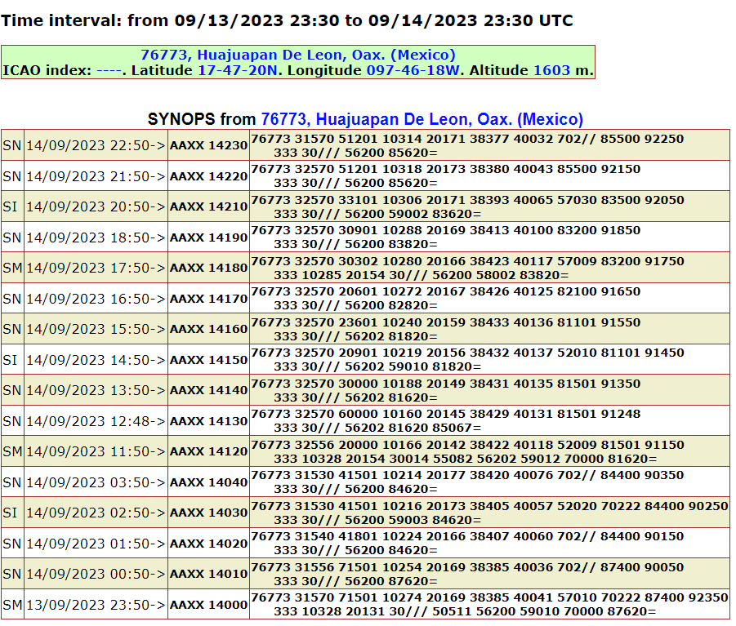
from OSCAR
from google
It could be a serious issue here !

Slide 14
END of Step-1: Identify an issue – what’s next?
Step-2: Create a ticket
(Leading Node - Canada)
Show screenshots or go live with the tools
 | 14

Slide 15
END of Step-1: Identify an issue – what’s next?
Step-2: Create a ticket
(RWCs, NFPs or monitoring centres)
Identify an issue
Create a Ticket
Assign the ticket
Add a comment
Date: 18/09/2023
Station: Acapulco
Country: Mexico
WIGOS ID: 0-20000-0-76805
Associated RWC: RWC Canada
NFP : xxx
Summary: metadata issue
Issue: availability/quality/timeliness
Surface/upper-air
Description:xxx
Attachements: (optional)
 | 15

Slide 16
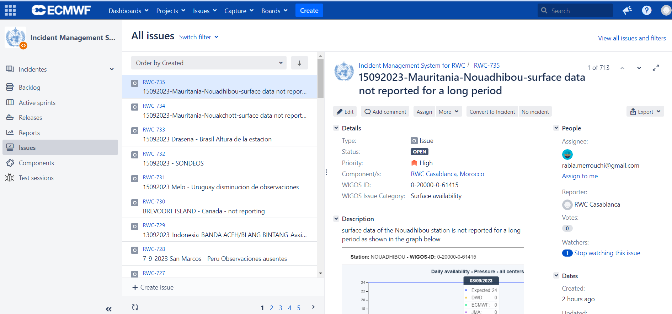
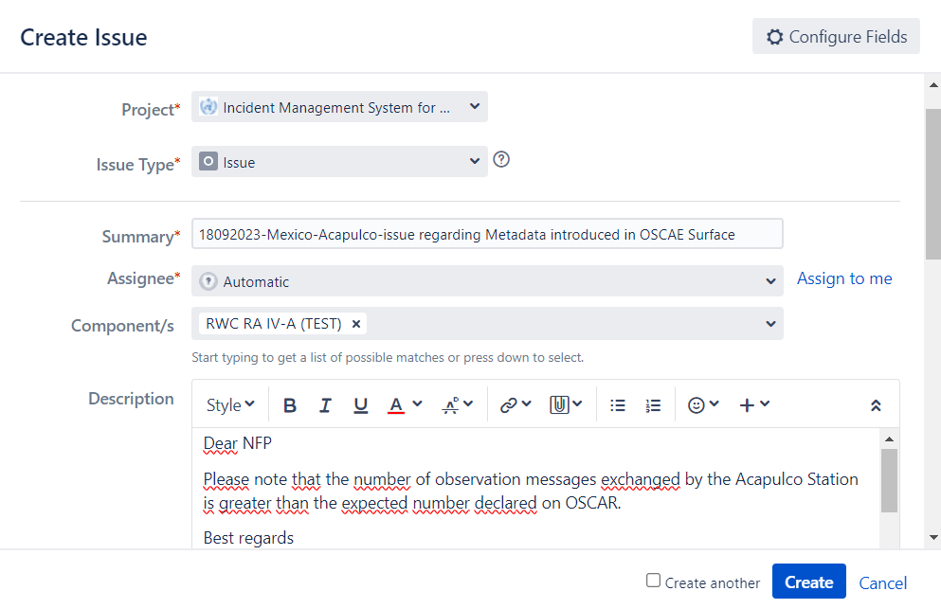
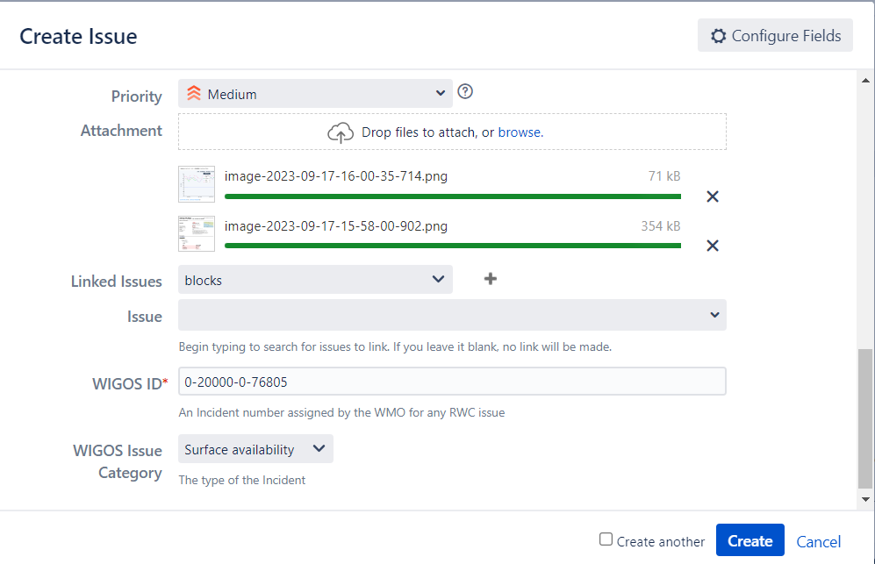
Create a Ticket

Slide 17
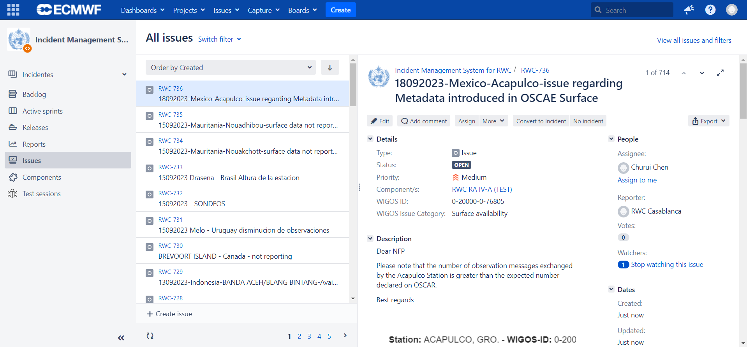
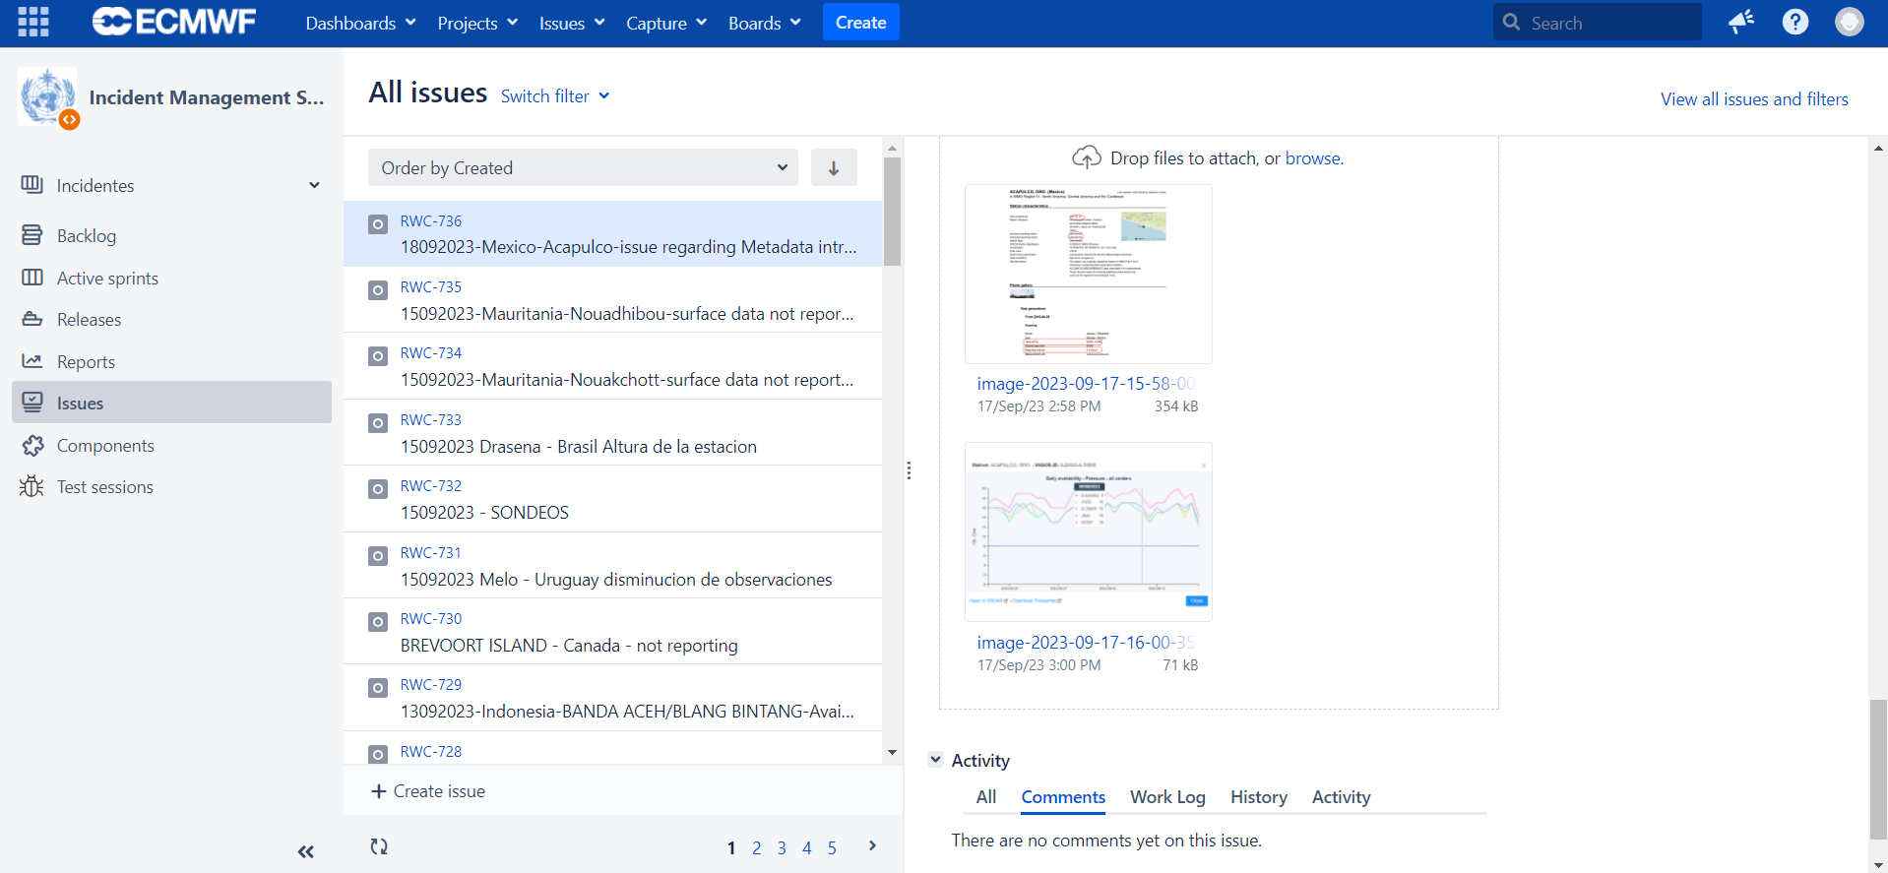
Create a Ticket

Slide 18
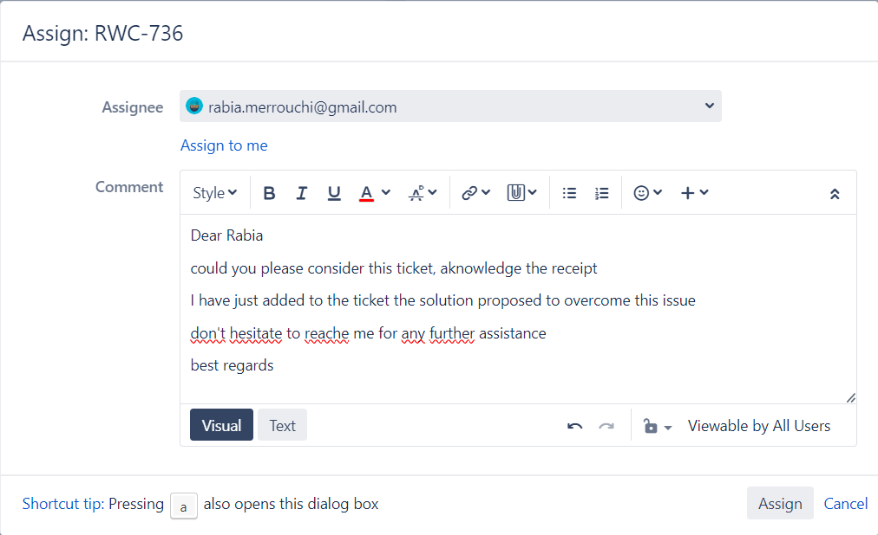
Assign the ticket

Slide 19
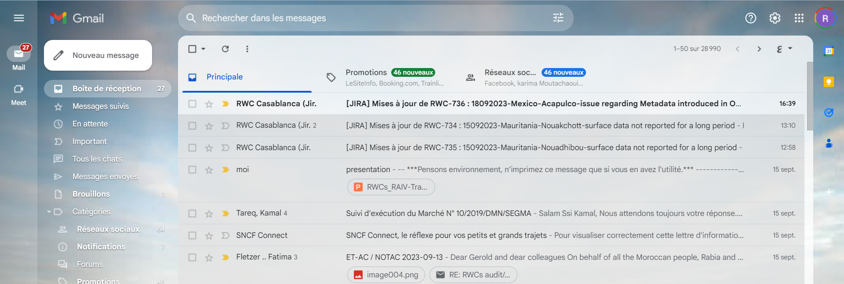
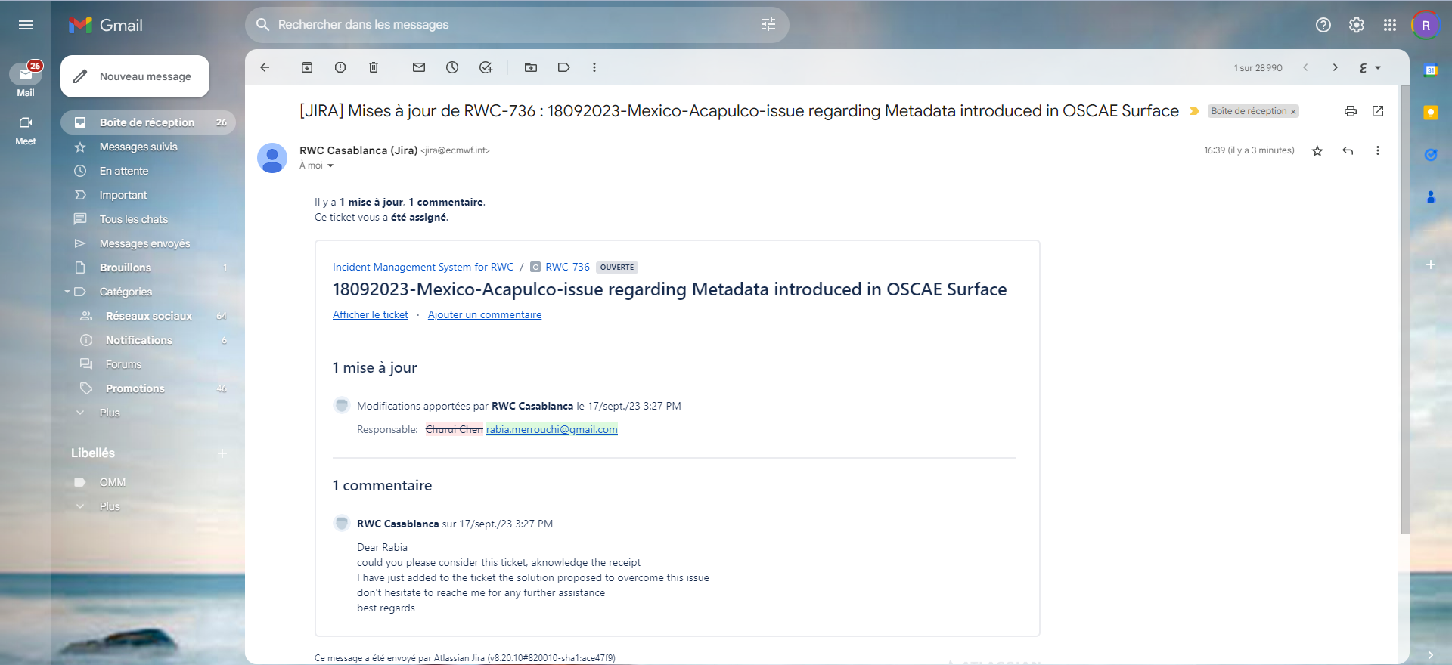
Assign the ticket
Ticket Number and status
Actions
show the ticket
Add a comment
New assignee

Slide 20
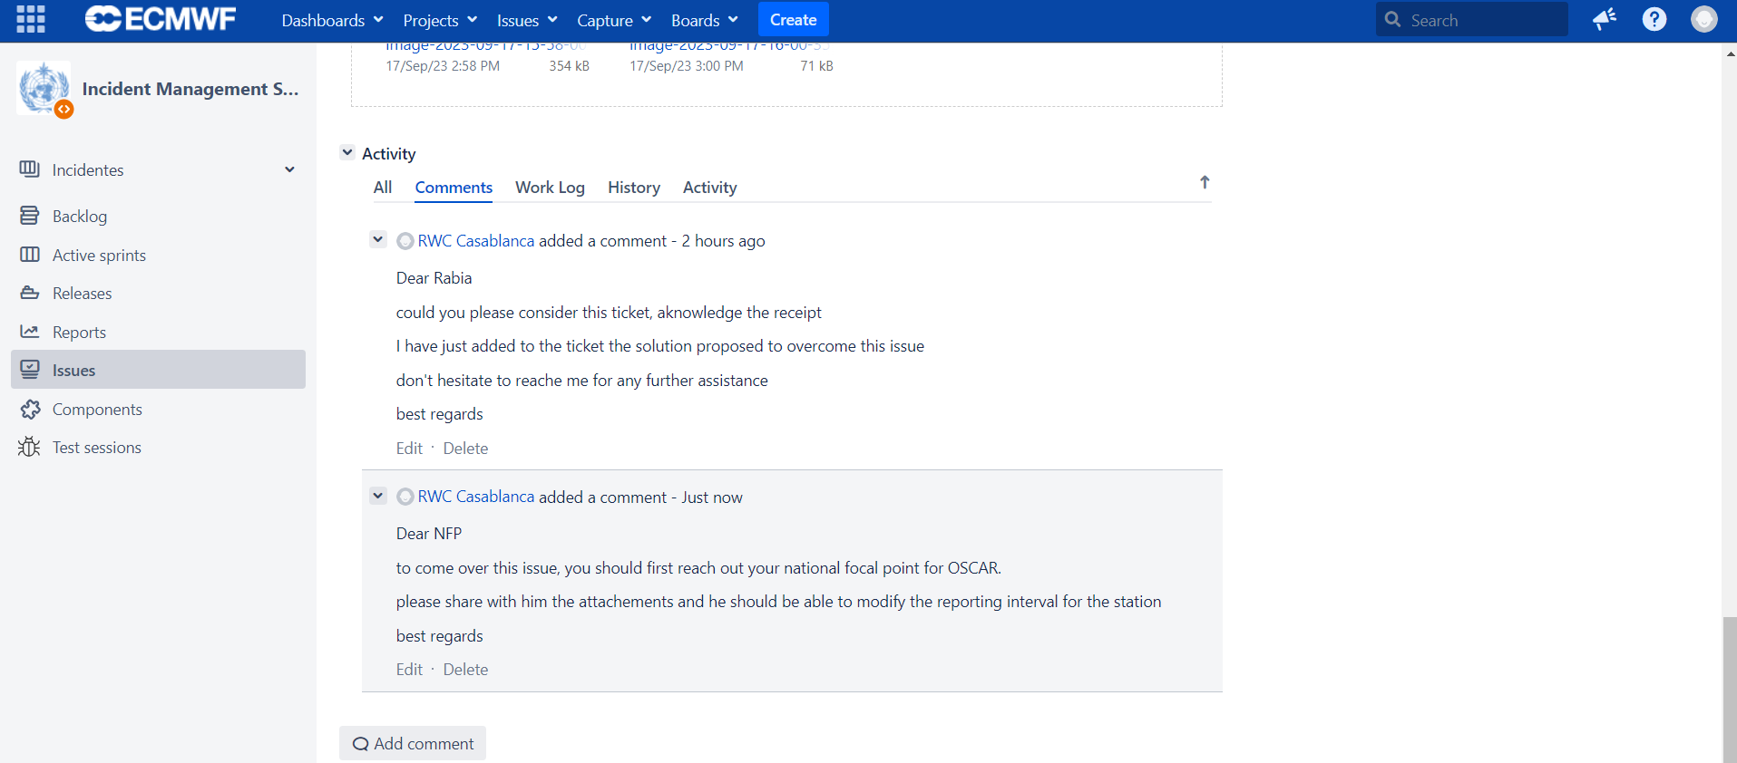
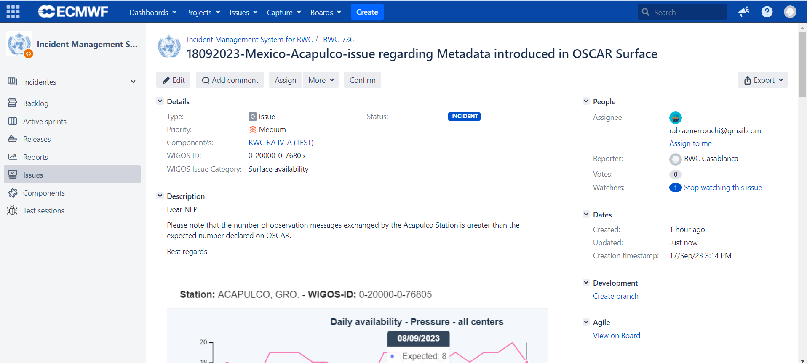
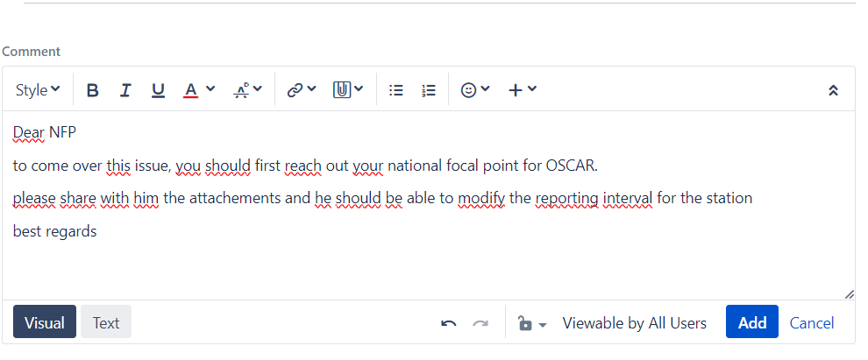
Add a Comment

Slide 21
Step-2 and more: Evaluate and manage an incident
Identify an issue
Create and assign a Ticket
Evaluate the ticket
Rise to incident
Manage the incident
Date: 17/09/2023
Station: LITTLE ROCK/ADAMS FLD
Country: USA
WIGOS ID: 0-20000-0-72340
Associated RWC: RWC USA
NFP : Mrs Holly Uhlenhake
Summary: station not reporting surface data for a long period
Issue category: availability/quality/timeliness
surface/upper-air
Priority Level : WMO 1224
Description:xxx
Attachements: (optional)
 | 21

Slide 22
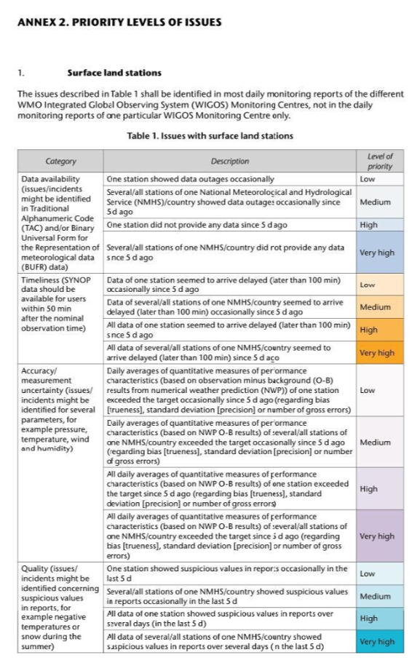
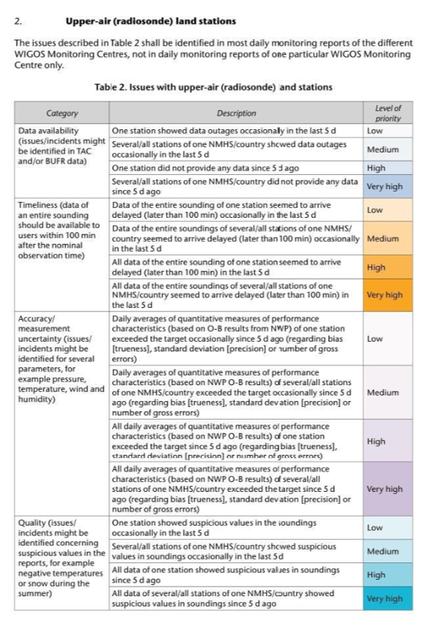
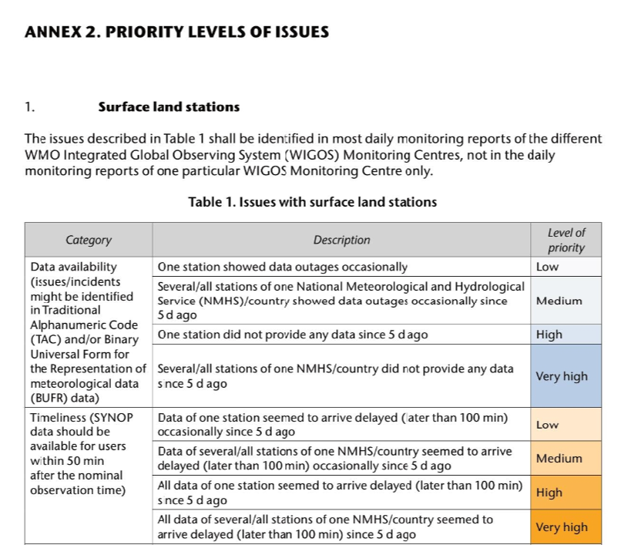
Priority Level

Slide 23
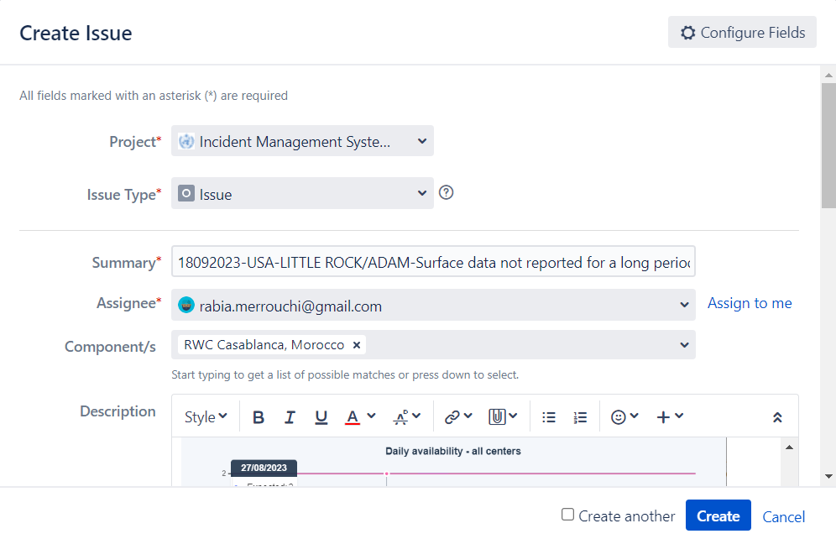
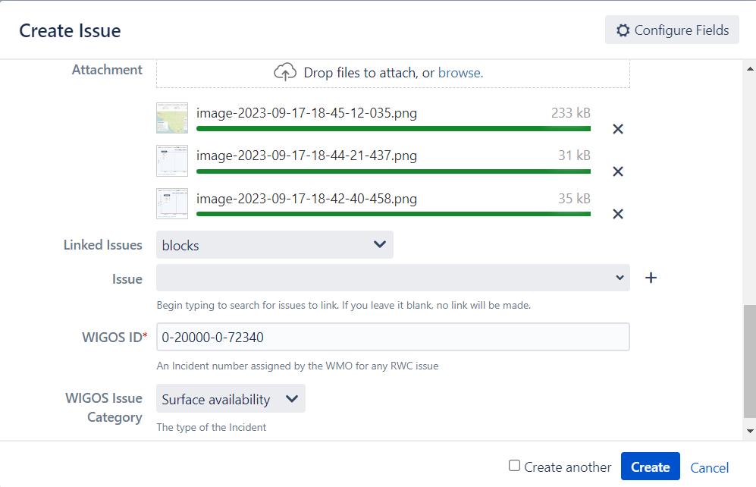
Create and assign a Ticket

Slide 24
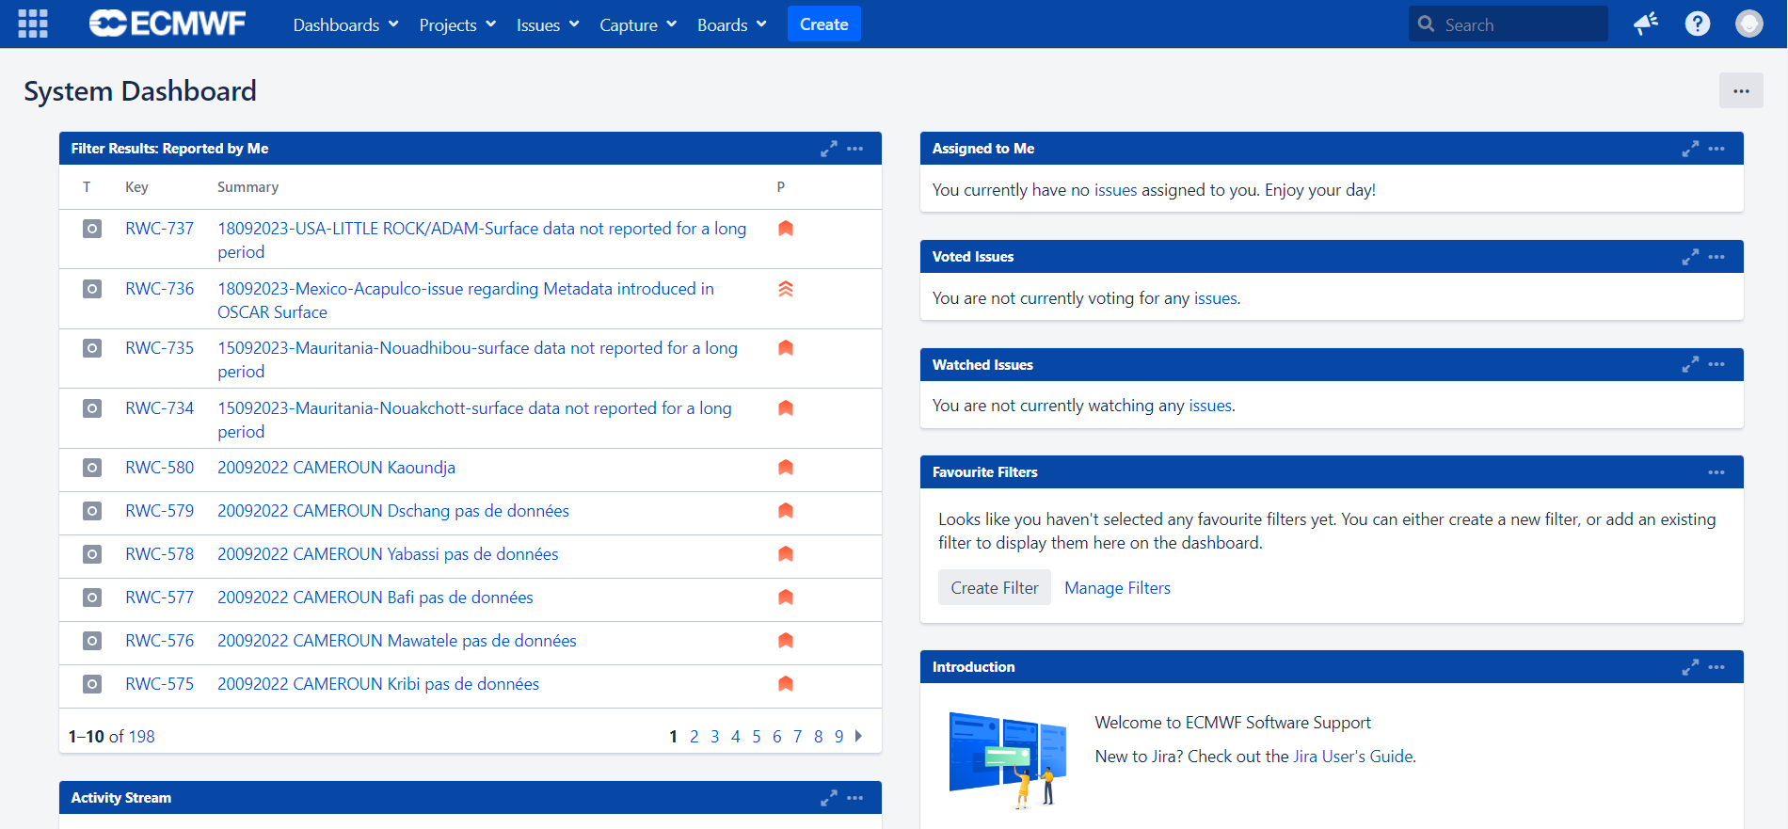
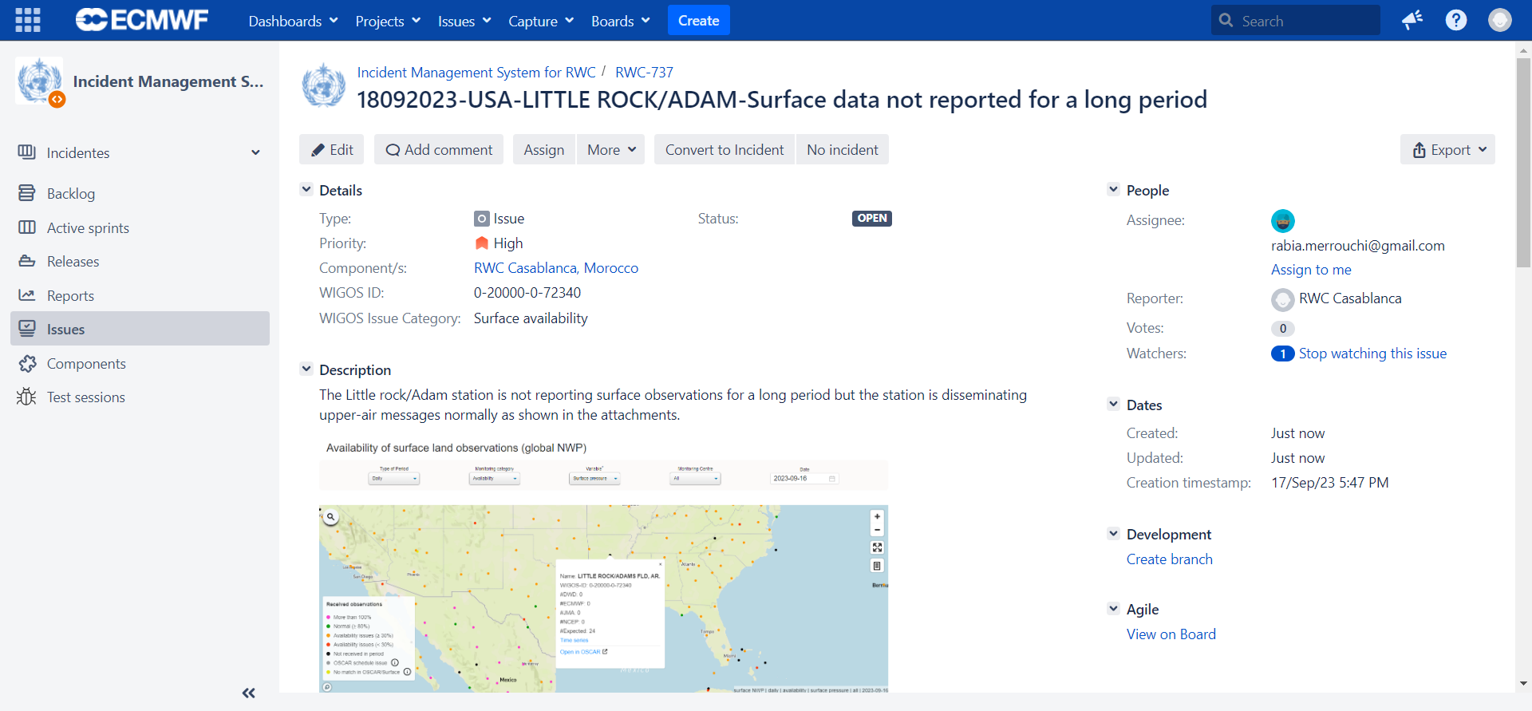
Evaluate the ticket
Based on the evaluation process conducted

Slide 25
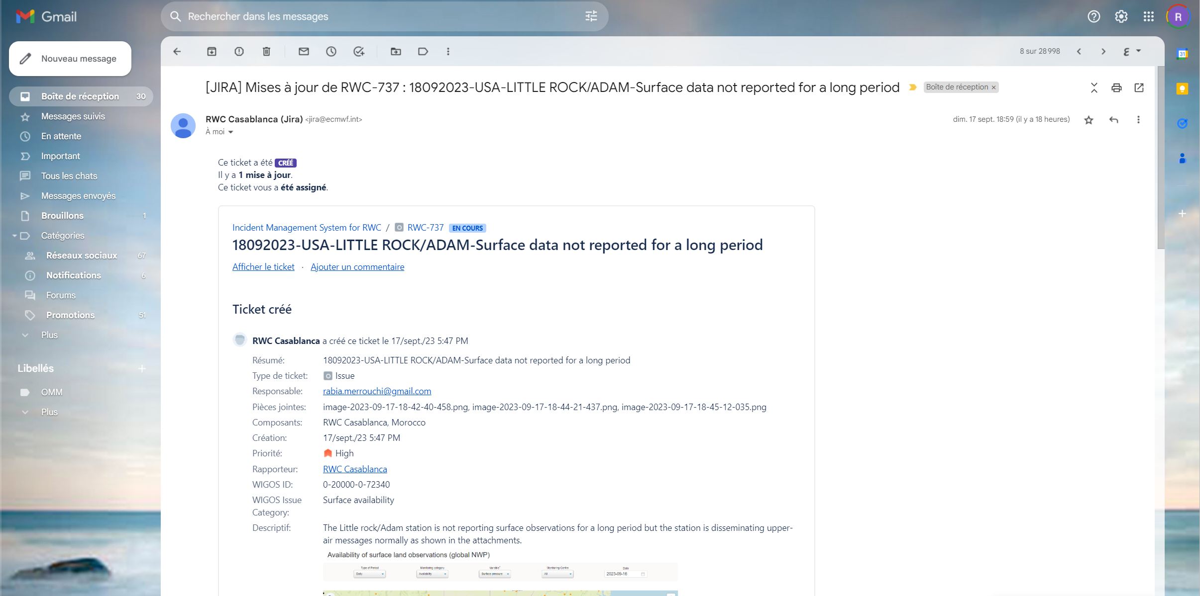
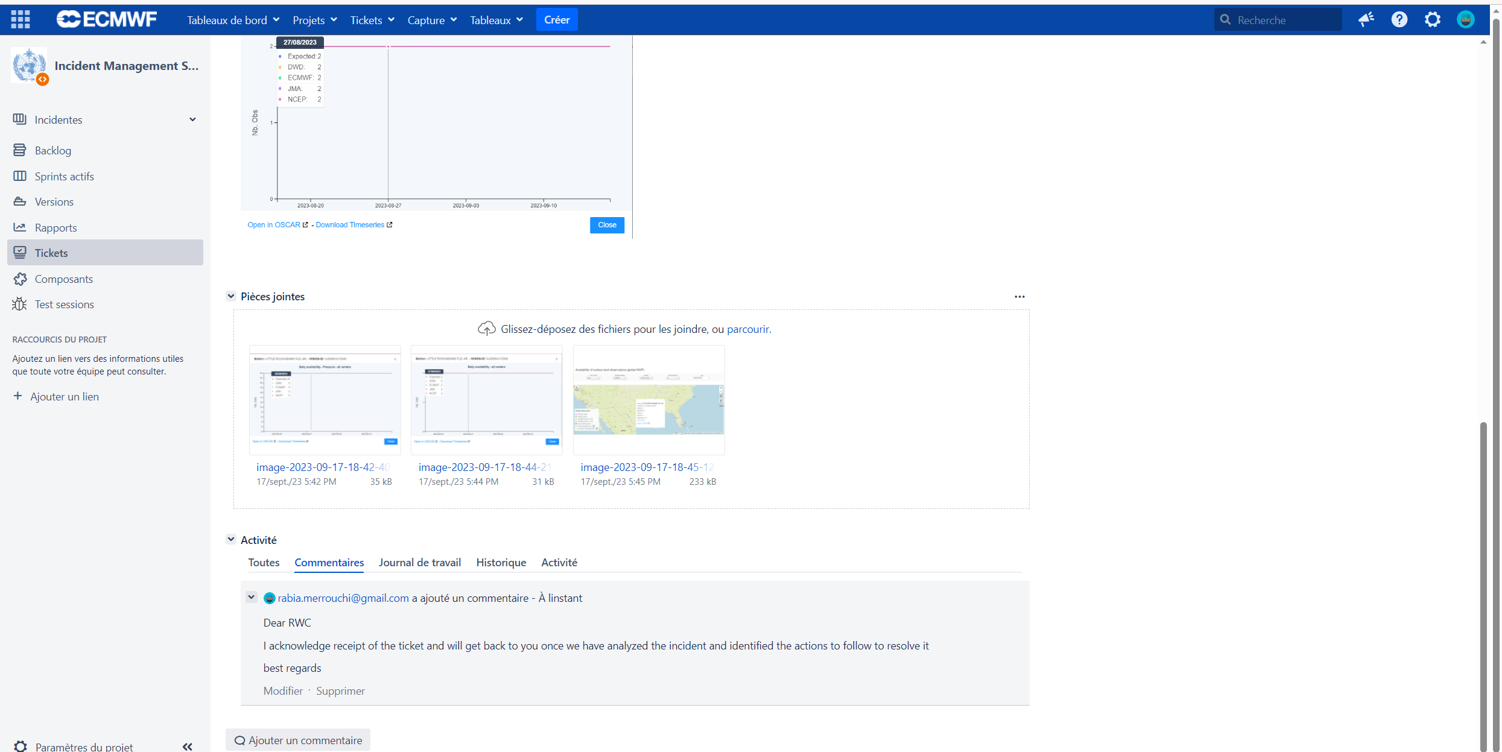
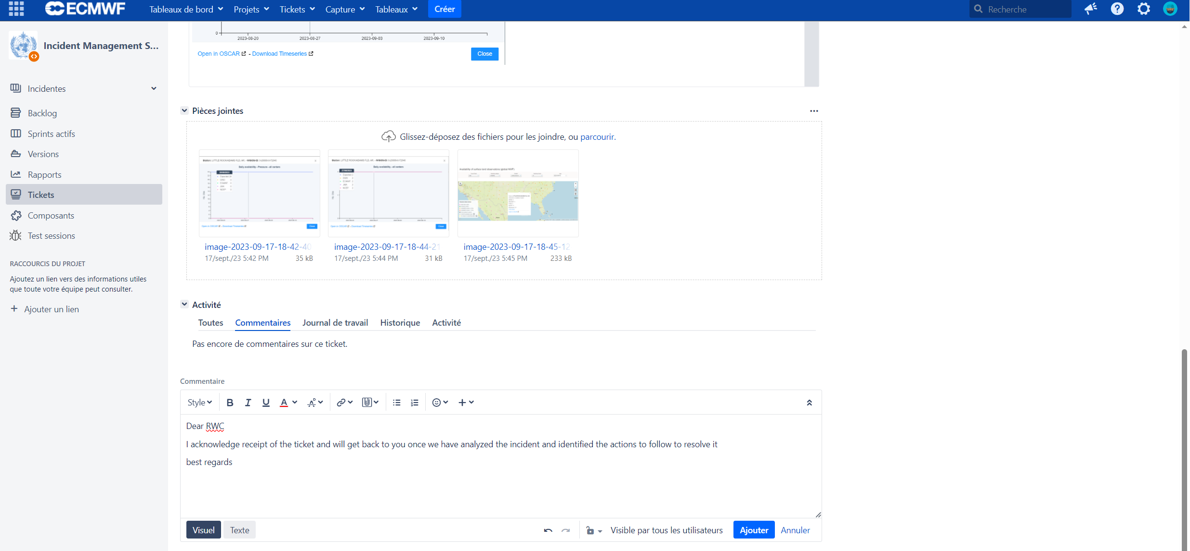
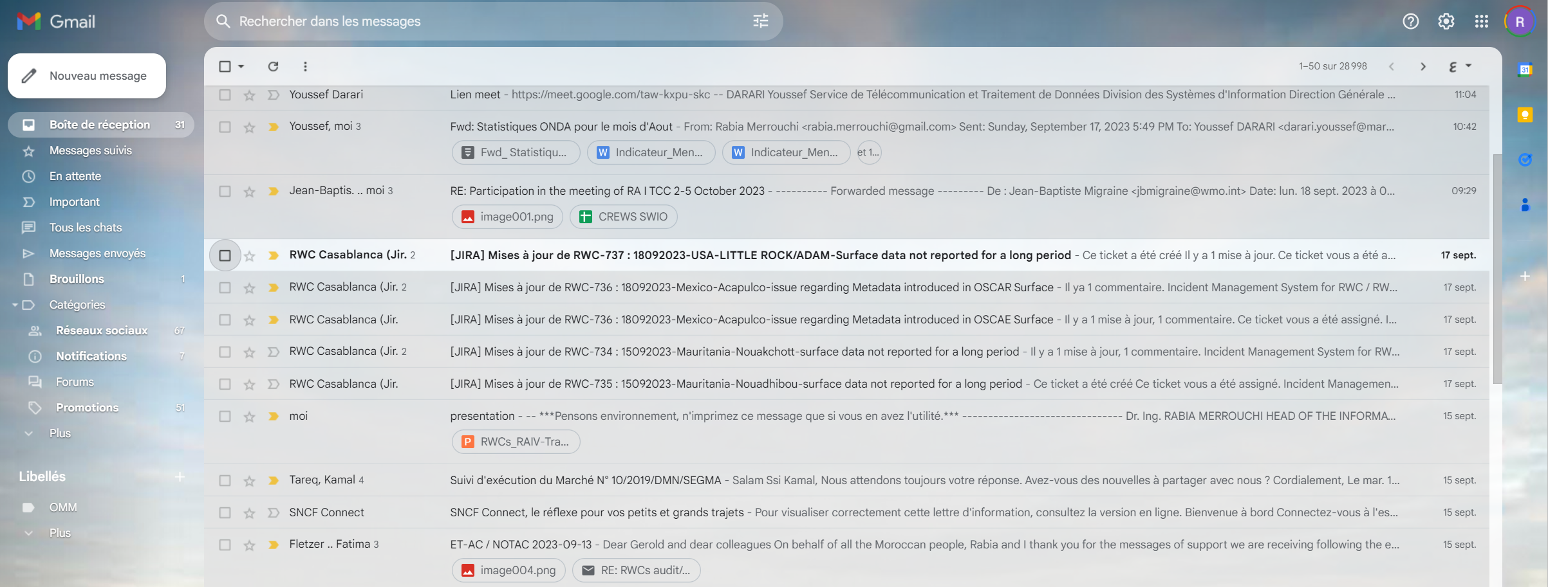
Acknowledge receipt of a Ticket (Assignee, NFP)
Add a comment
Add

Slide 26
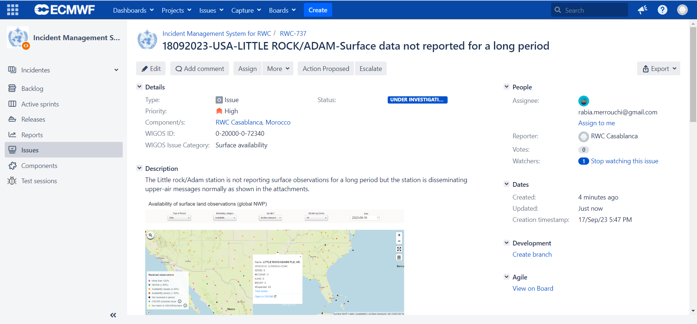
Manage the incident

Slide 27
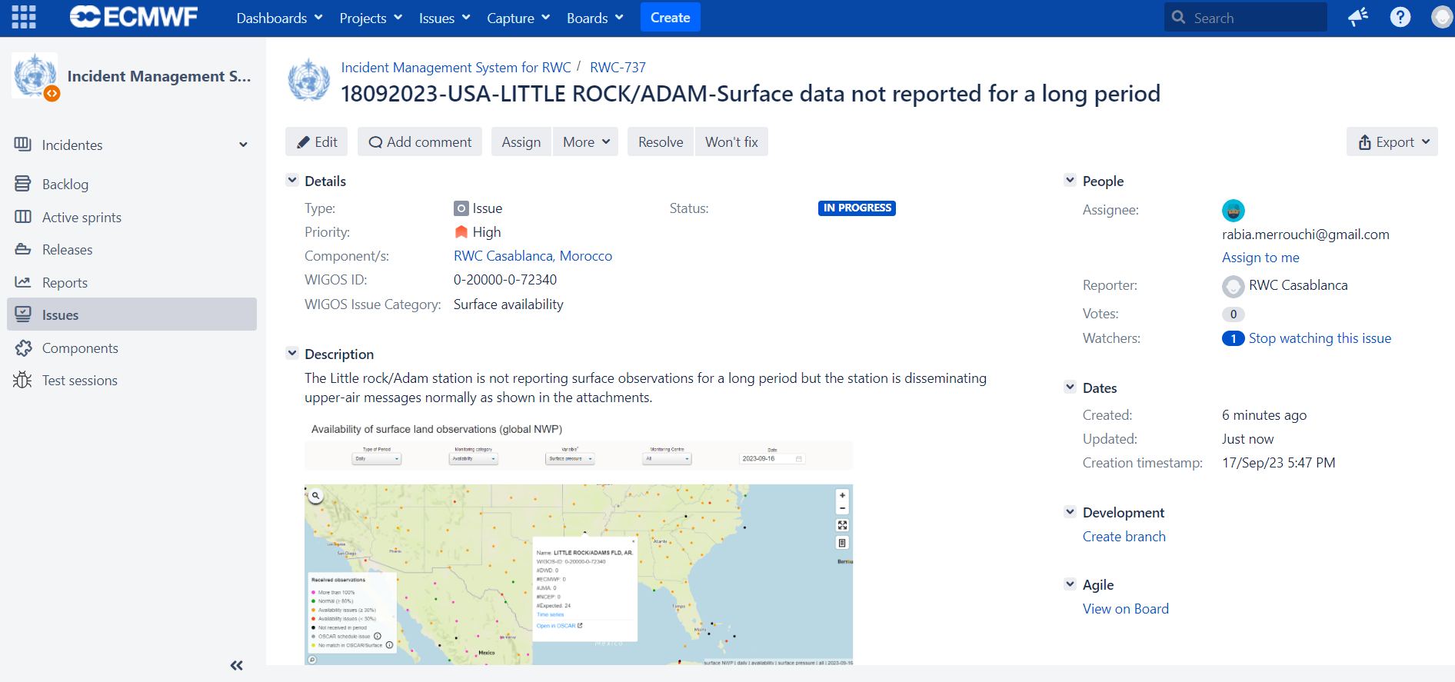
Manage the incident
Based on the Feed back from the NFP
No feed back received

Slide 28
Manage the incident
Based on the actions conducted at the national level
The ticket could be re-opened if the issue appears again

Slide 29
Examples of real Tickets

Slide 30
A single ticket could be opened for several stations within a country if they have a common issue

Slide 31
A single ticket could be opened for several stations within a country if they have a common issue
Acknowledgment of receipt of the ticket

Slide 32
By Using IMS, all your notifications and comments will be recorded

Slide 33
Thank you
Gracias
Merci
^{wmo.int}

