Slide 1
Training Workshop on Incident Management System
For RWCs in RA IV
Online, 18 September 2023
RWC FUNCTIONS WORKFLOWS
&
TASKS FOR RWCs AND MEMBERS
Ercan BÜYÜKBAŞ
WIGOS Branch, Observing Networks and Measurement Division

Slide 2
Outline
RWC Structure in RA IV
Workflow-Quality Monitoring
Workflow-Metadata Management
 | 2

Slide 3
RWC Structure in RA IV
The components of RWC in RA IV :
Canada (Ln/Canada):
Leading Node (Ln) for metadata management
USA (Ln/USA):
Leading Node (Ln) for quality monitoring
Costa Rica (Cn/Costa Rica):
Contributing Node (Cn) for Spanish speaking countries for both metadata management and quality monitoring
Trinidad & Tobago(T&T) (Cn/T&T):
Contributing Node (Cn) for English speaking countries for metadata management
British Caribbean Territories/Caribbean Meteorological Organization (BCT/CMO) (Cn/BCT-CMO):
Contributing Node (Cn) for English speaking countries for quality monitoring
 | 3

Slide 4
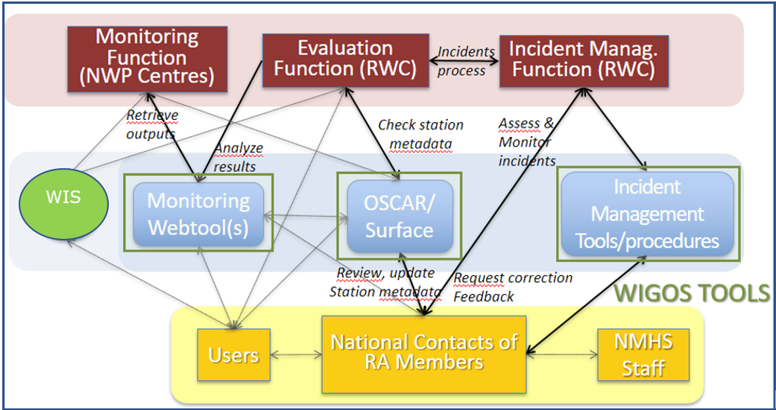
WORKFLOW-Quality Monitoring
WDQMS Process:
A) Monitoring Function; B) Evaluation Function; C) Incident Management Function
Monitoring Function/
Monitoring of the stations in RA IV by WIGOS Quality Monitoring Centres (WQMCs), i.e. Numerical Weather Prediction (NWP) Centres, DWD, ECMWF, JMA and NCEP.
The results of monitoring of surface land and upper air stations WDQMS web tool.
WQMCs
RWCs
 | 4
WDQMS Process

Slide 5
WORKFLOW-Quality Monitoring
Identification of an issue;
Creation of a ticket;
Any user; Ln: Cn
Confirmation
Ln/USA
Confirmation
Cn/Costa Rica (Spanish)
Cn/BCT-CMO (English)
Members (WDQMS NFP)
Receipt Confirmation from Member?
NO (reminding)
Acknowledge by NFP
Evalauate/Follow the issue before initiating IMP
NO (long silence)
Search and find the cause of incident
YES
Need to be raised as an incident?
Update Ticket Status as "Under Investigation"
Regular Reporting on Actions to Cn
NO
Update Ticket Status as "in progress"
YES
Resolving incident
Initiate IMP
Select Cn
Incident Resolved?
YES
NO
Explanation if incident cannot be resolved
 | 5
Close the ticket
Update Ticket Status as “Won’t Fix"
Escalate the ticket to WMO Secretariat

Slide 6
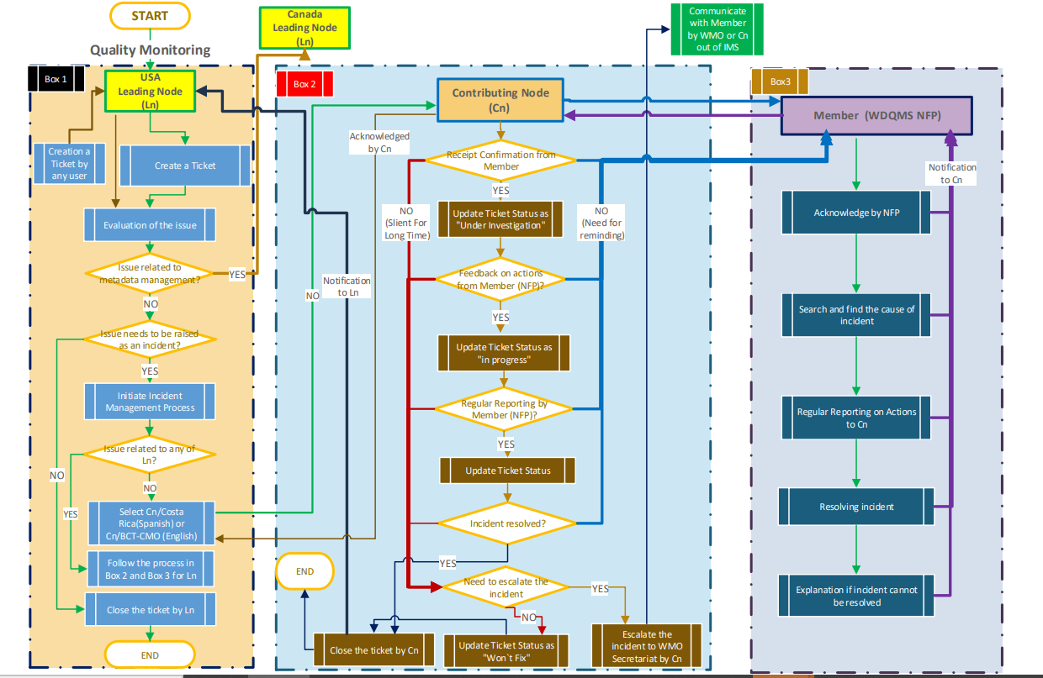
WORKFLOW-Quality Monitoring
 | 6

Slide 7
WORKFLOW-Metadata Management
Identification of an issue;
Creation of a ticket;
Any user; Ln: Cn
Confirmation
Ln/Canada
Confirmation
Cn/Costa Rica (Spanish)
Cn/T&T (English)
Members (WDQMS NFP)
Receipt Confirmation from Member?
NO (reminding)
Acknowledge by NFP
Evalauate/Follow the issue before initiating IMP
NO (long silence)
Search and find the cause of incident
YES
Need to be raised as an incident?
Update Ticket Status as "Under Investigation"
Regular Reporting on Actions to Cn
NO
Update Ticket Status as "in progress"
YES
Resolving incident
Initiate IMP
Select Cn
Incident Resolved?
YES
NO
Explanation if incident cannot be resolved
 | 7
Close the ticket
Update Ticket Status as “Won’t Fix"
Escalate the ticket to WMO Secretariat

Slide 8
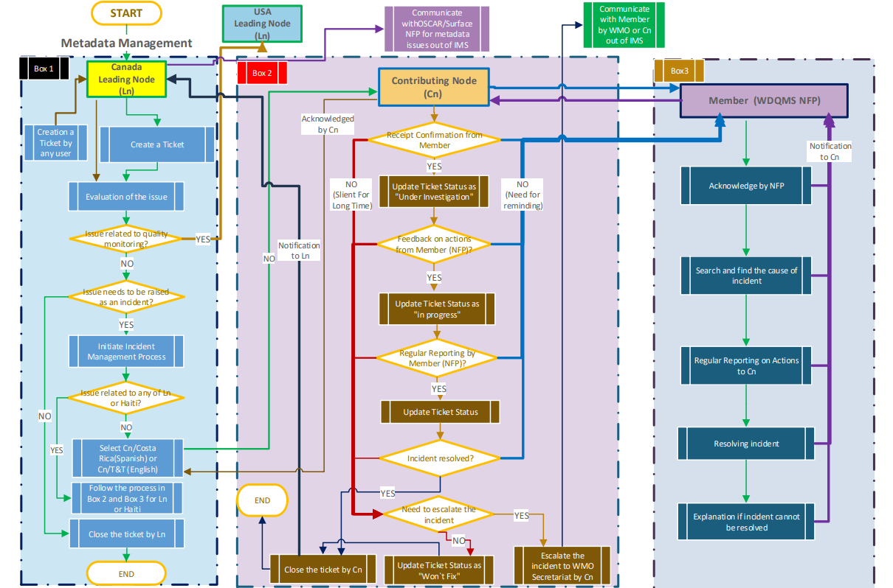
WORKFLOW-Metadata Management
 | 8

Slide 9
Thank you
Gracias
Merci
^{wmo.int}

