Slide 1
Interactive presentation softwares
- trick or treat –
Nuno Moreira acknowledgements: João Rio (IPMA), Manuel João Lopes (IPMA), João Paulo Martins (ECMWF),
Dominik Rukavina (DHMZ), Szofia Kocsis (OMSZ)
CALMET on-line, 13-17 Nov 2023

Slide 2
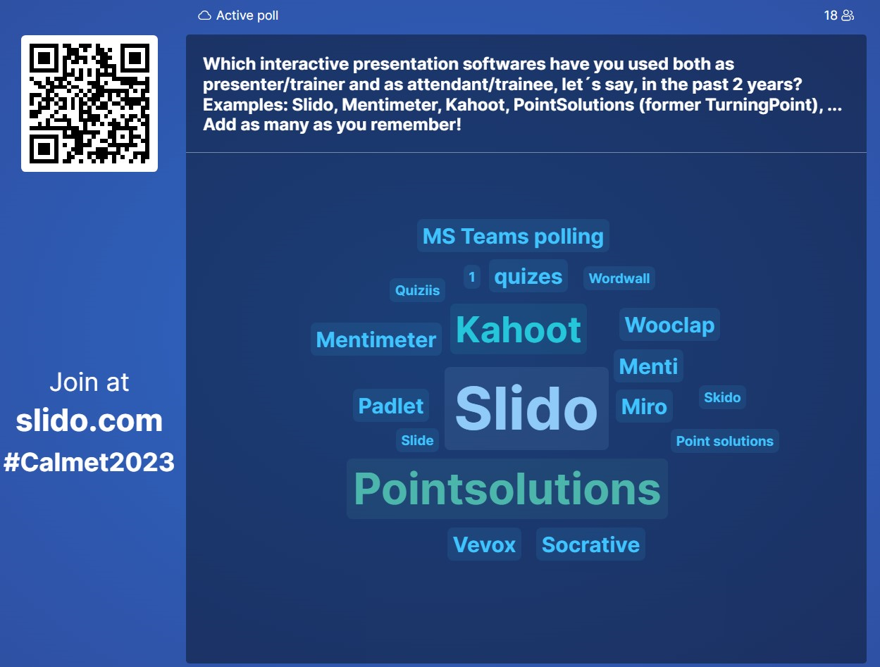
Questionnaire to the audience
Session
with
25
Participations
----
18
Answers
----
Represents
72 %
of the audience

Slide 3
A personal experience during 2023…
- Slido / Mentimeter / Webex
As a presenter/organizer
Face-to-face
Snow
As a participant
Face-to-face
Climate change adaptation
As an organizer
On-line
Heatwaves & Drought
As a participant
On-line
Meteosat 3rd Generation

Slide 4
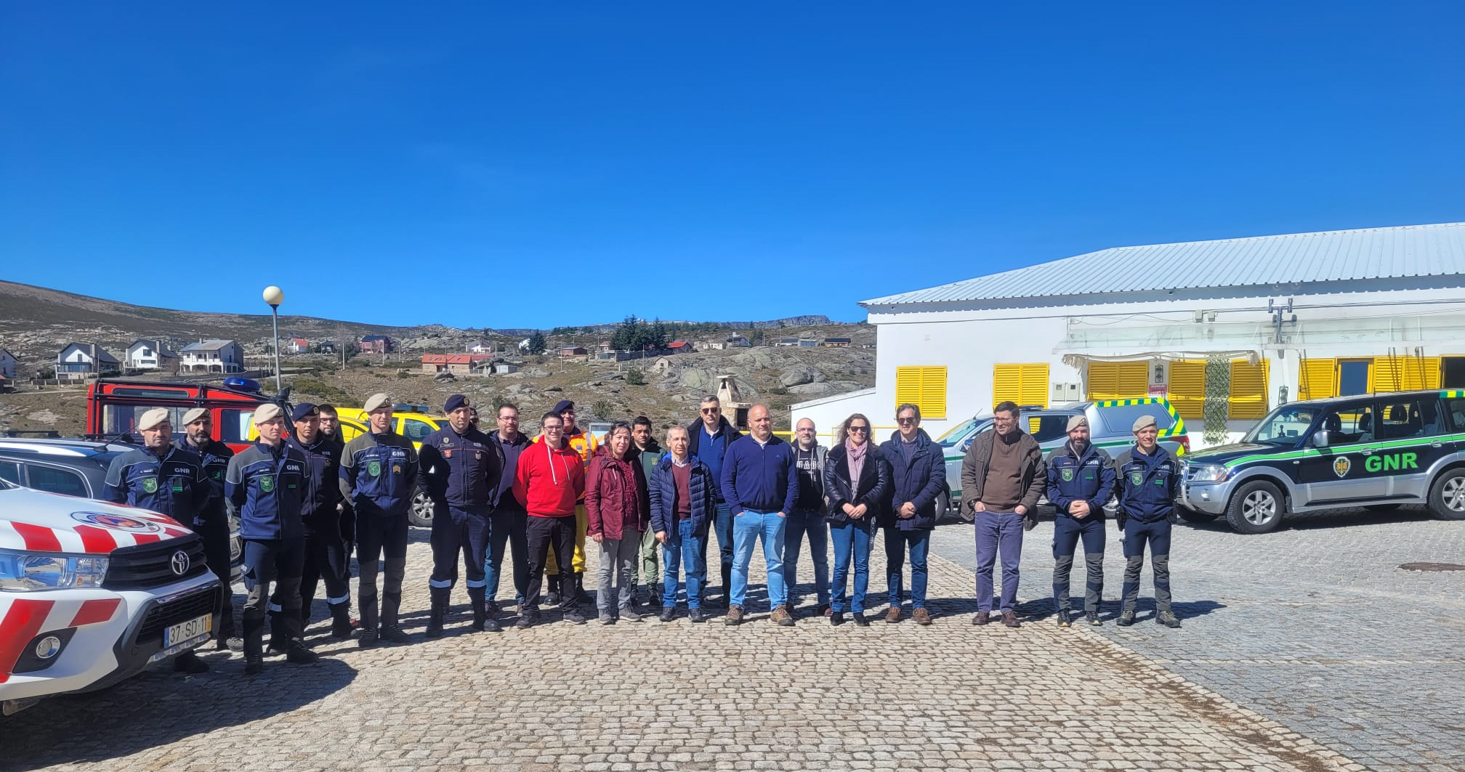

As a presenter/organizer | Face-to-face
Snow | March 2023
Main Menu
3 questions
on impacts of snow
Inside one presentation
on “snow depth measurements
and snow warnings”
During a dissemination event on “Snow – Forecast and observation”
Software
Slido
Duration of session with interactions
20 minutes
Percentage of interactions in the session
25 %
Total Event duration
4 hours
8 sessions
Percentage of interactive session in the event
8 %
Percentage of interactions in the event
2 %
Comments:
During the interactive part of the session there was high enthusiasm from participants, who supplied
valuable information (crowd sourcing)

Slide 5

As a participant | Face-to-face
Climate change adaptation | July 2023
Main Menu
Session fully based on Mentimeter
entitled “Who wants to be an imperfect environmentalist”
during the final conference
of project “Clima.AML”
Software
Mentimeter
Duration of session with interactions
20 minutes
Percentage of interactions in the session
100 %
Event duration
2.5 hours /
5 sessions
Percentage of interactive session in the event
13.3 %
Percentage of interactions in the event
13.3 %
Comments:
The session was inserted
in the middle of the event,
with high participation from participants

Slide 6
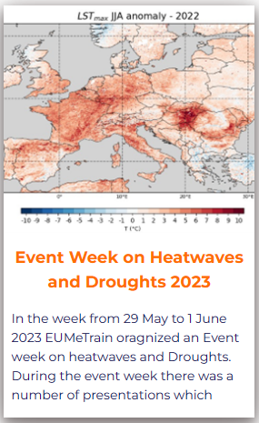
As a organizer | On-line
Heatwaves and Drought| May-June 2023
Main Menu
Software
Slido
Number of sessions with interactions
10
Percentage of interaction in the sessions *
5 - 15 %
Total of sessions of the event
18
Percentage of interactive sessions in the event
55.5 %
Percentage of interactions in the event *
3 - 4 %
Comments:
Slido was used during the preparatory sessions with presenters to encourage them to use it during their sessions
* Duration of interaction (underestimated)
& number of interaction slides

Slide 7
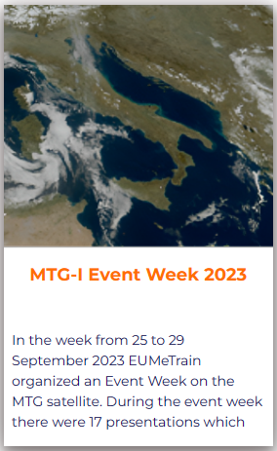
As a participant | On-line
Meteosat 3rd Generation | Sep 2023
Main Menu
Softwares
Slido / webex **
Number of Sessions with interactions
4 slido
+ 1 webex
Percentage of interaction in the sessions *
1 – 10 %
Total of sessions of the event
17
Percentage of interactive sessions in the event
29.4 %
Percentage of interactions in the event *
1 - 2 %
Comments:
Interactive part of the sessions provided information about the audience to the presenters
* Duration of interaction (underestimated)
& number of interaction slides
** Drawing capability in webex

Slide 8
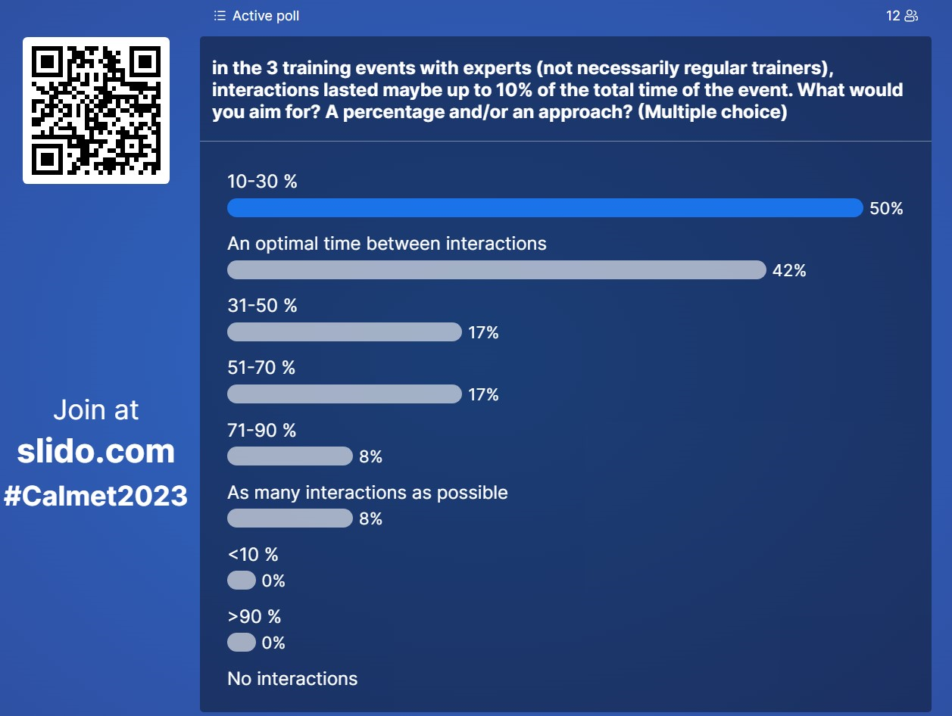
Questionnaire to the audience
Session
with
25
Participations
----
12
Answers
----
Represents
48 %
of the audience

Slide 9
Thank you!

