Slide 1
Affiliating stations/variables in OSCAR/Surface
(focus on GBON)
(25 April 2023)
Luís Nunes¹
Acknowledgements: Etienne Charpentier¹, Timo Pröscholdt², Zulkarnain¹, Churui Chen¹
Lucia Cappelletti³, Franziska Stuerzl³
WMO Secretariat, Infrastructure Department, ¹WIGOS Branch, ²WIS Branch
³Meteoswiss

Slide 2
Outline
GBON requirements for observed variables
Distinguishing surface from upper-air GBON stations
Affiliate stations with a programme/network in OSCAR/Surface
Programme/networks as an element from the WIGOS Metadata Standard
Members NFPs should select which programmes/networks they wish to affiliate their stations with
Affiliate an existing station with GBON (designate a GBON station)
Create a new GBON station using station template
Link to WDQMS webtool – monitoring of stations performance
Only stations with an “international schedule” are visible in the NWP-near-real-time module of WDQMS
All stations affiliated with GBON are visible in the GBON module
Importance of correctly affiliating the observed variables to a programme/network, e.g. GBON
Next steps related to the initial implementation of GBON (first phase)
Final remarks

Slide 3
GBON requirements for observed variables
GBON requirement for surface stations:
- surface pressure, air temperature, air humidity, wind direction and speed, amount of precipitation and snow depth (where applicable)
- hourly reporting (24 reports/day)
GBON requirements for upper-air stations:
- pressure profile, temperature profile, water-vapor profile, wind profile
- 2 soundings/day

Slide 4
Programme/network affiliation Metadata element
A metadata element of the WIGOS Metadata Standard (WMO-No. 1192):
Under category “2. Purpose of observation”
Element number 2-02
(Programme/network affiliation):
Definition = The global, regional or national programme(s)/network(s) that the station/platform is associated with
Obligation = Mandatory
The affiliation with several programmes, e.g. GBON, requires approval

Slide 5
Affiliate existing stations in OSCAR/Surface with a programme/network (focus on GBON)
For a station that is registered in OSCAR/Surface, following these steps:
Login to OSCAR/Surface and identify the intended station
Select the intended station and enter the “Edit mode”
Select the “Add program/network affiliation”, to open a dialogue box
Go to the menu button in front of “Program/network affiliation”, to open the “affiliations tree”:
For GBON follow this path WIGOS/GOS/GOS Surface Networks/GBON and then click “Add”
Select one or more variables to be affiliated to GBON and then click “Insert”
For GBON surface stations: surface pressure is needed variable, although the other GBON variables (temperature, humidity, wind, precipitation and snow) will also be monitored
For GBON upper-air stations: all upper-air variables are needed (pressure profile, temperature profile, water-vapor profile, upper-wind)
The preliminary results will be shown on the Station page (“Station report”)
Finally, select “Save” at the bottom, to make the changes effective

Slide 6
Steps 1, 2

Slide 7
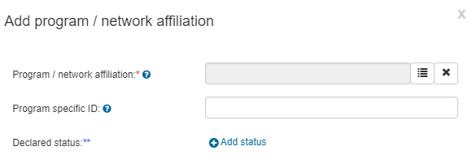
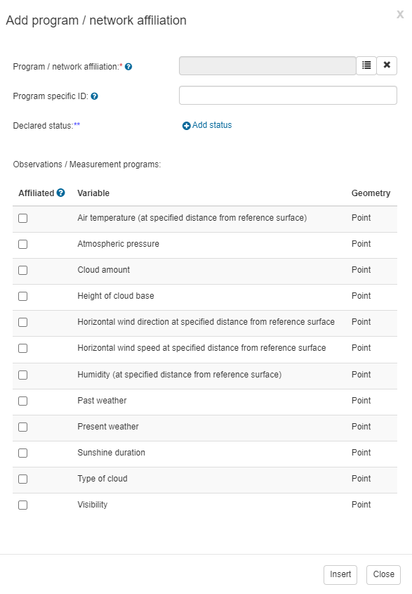
Steps 3, 4

Slide 8
Steps 5, 6, 7

Slide 9
Create a new GBON surface land station using the template (1)
A GBON template is available in OSCAR/Surface to create a new GBON surface station, following these steps:
Login to OSCAR/Surface and select the “Management” tab
On the menu open the “GBON Surface Land Station” template, which contains three sections: top, middle and low parts, each one containing several with input fields:
1st section enter the basic information of the station, which is mandatory to register a station in OSCAR/Surface, such as the station Name, Date established, Country/territory, WIGOS Station Identifier (WSI) and geographic Coordinates
2nd section (middle of the screen) check the list of all variables that are required to be measured/observed and reported from a GBON Surface Land station, with ‘Snow depth’ being a conditional required variable to locations where snow is expected
For each variable the corresponding observing method can be chosen from a prefiltered tree
3rd section, use the interface shown in lower part of the template to set reporting schedule
According to the GBON requirements a GBON Surface Land station should report hourly (reporting interval), all year round (period of reporting=24/7)

Slide 10
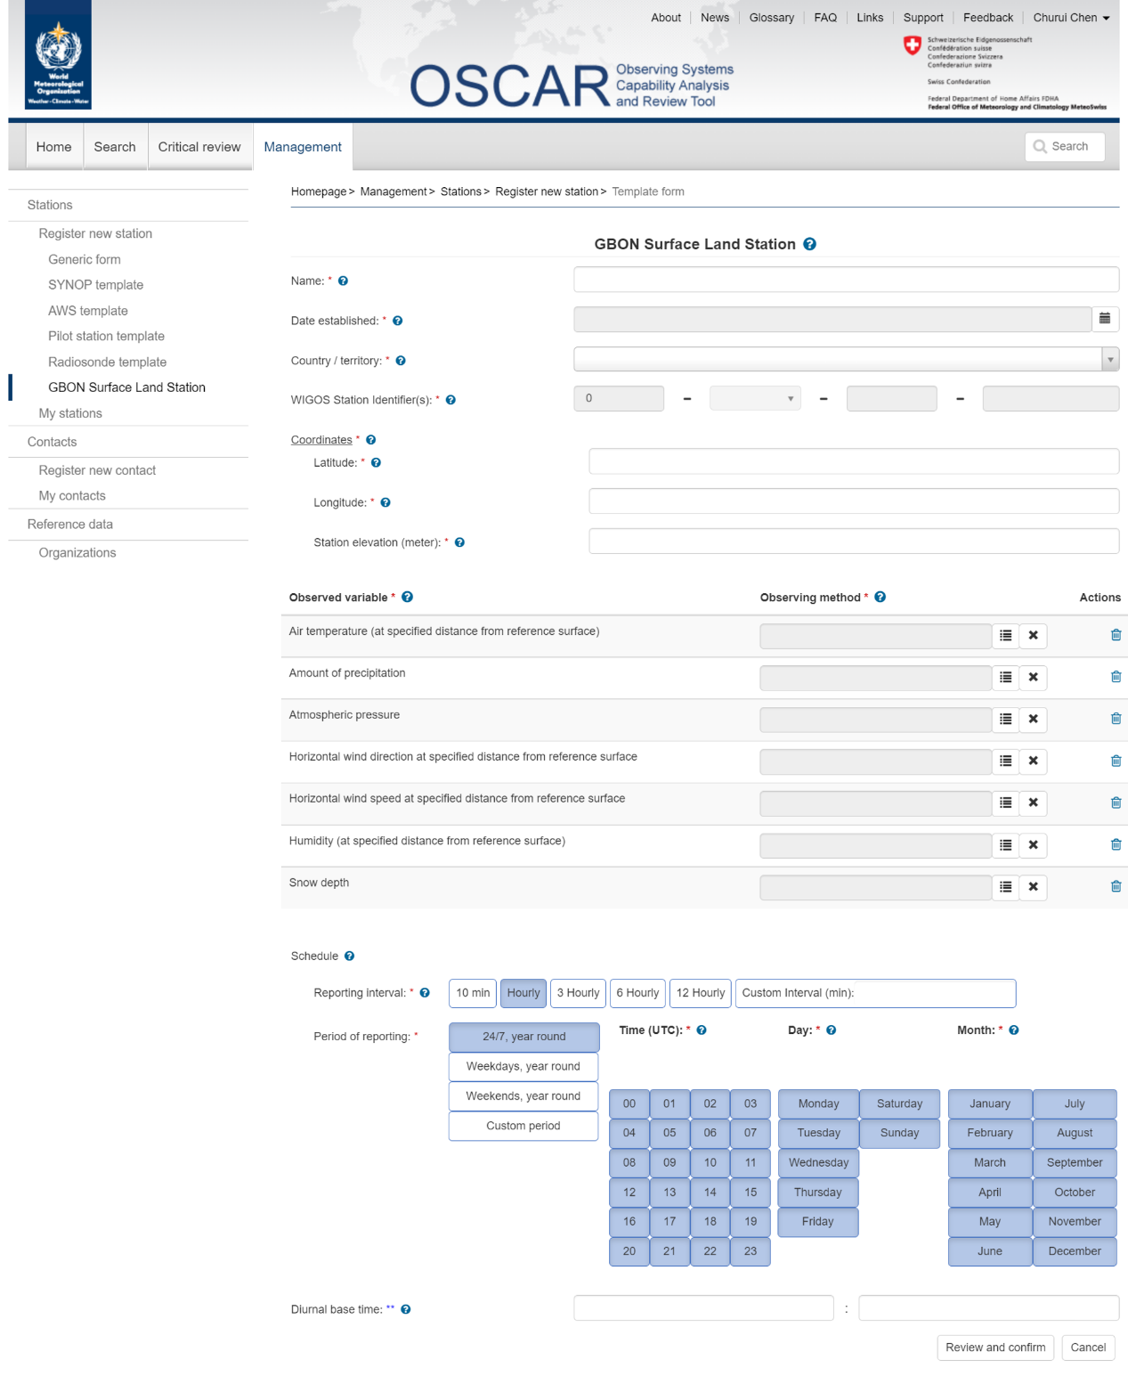
How to create a new GBON surface land station using the GBON template (1)

Slide 11
How to create a new GBON surface land station using the GBON template (1)

Slide 12
How to create a new GBON surface land station using the GBON template (1)

Slide 13
How to create a new GBON surface land station using the GBON template (2)
Confirm completion of the template with the “Review and confirm” button
It opens the Generic form prefilled with all the information that was entered in the template form, as well as with other automatically prefilled mandatory fields, based on requirements for GBON surface land station, such as “station type”, “program/network affiliation”
This Generic form allows editing of any of those fields; It is also possible to go back to the template form by selecting “Edit as template”. However, any information that was changed in the Generic form will be lost when going back to the template form
Finally, select “Submit” at the bottom to complete the registration of the station
An error message will appear if the information is incomplete, indicating that some elements are missing, and the missing fields and section headers are highlighted in red
It is possible to save the station information, already provided, as a draft for later editing

Slide 14
How to create a new GBON surface land station using the GBON template (2a)

Slide 15
How to create a new GBON surface land station using the GBON template (2a)

Slide 16
How to create a new GBON surface land station using the GBON template (2b)

Slide 17
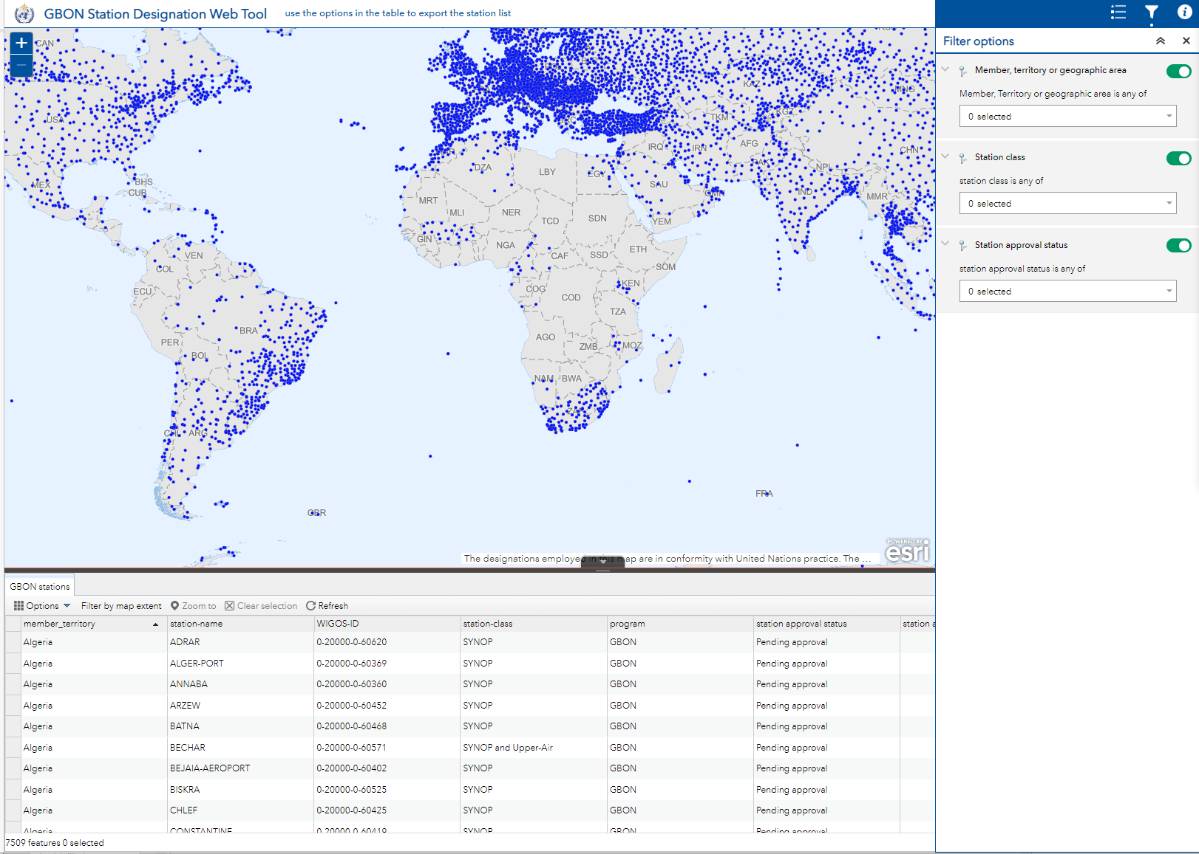
GBON Webtool https://wmo.maps.arcgis.com/apps/webappviewer/index.html?id=795bbc05ca8a4da7a5f5f0aebb210aa8&locale=en

Slide 18
Link to WDQMS webtool - monitoring stations performance NWP near real-time module
WDQMS obtains station information from OSCAR/Surface
Surface stations
Station Type: land (fixed), land (mobile), land (on ice) and others …
International Exchange = True
Observes one of the variables assimilated by WIGOS monitoring Centres (pressure, temperature, humidity, wind)
Upper Air stations
Station Class = upper-air radiosonde, upper-air pilot
AND (for both surface and upper-air):
Stations with "data generation" and "deployment" declared without "end date" (closing date)​
Stations with declared status “operational” or “partly operational”
Declared status (defined by the Member NFP) is different from the Assessed status (computed by WDQMS)

Slide 19
Link to WDQMS webtool - monitoring stations performance GBON module
WDQMS obtains station information from OSCAR/Surface – currently:
Surface stations
Station Type: land (fixed), land (mobile)
International Exchange = True
Observes at least atmospheric pressure
Upper Air stations
Station Class = upper-air radiosonde, upper-air pilot
AND (for both surface and upper-air):
Stations affiliated with GBON; Relevant variables affiliated with GBON
Stations with "data generation" and "deployment" declared without "end date" (closing date)​
Stations with declared status “operational” or “partly operational”

Slide 20
WDQMS Webtool (GBON module not published yet) https://wdqms.wmo.int

Slide 21
Next steps
On April 30th 2023, the list of GBON nominated stations will be frozen for submission to Congress-19 (22 May to 2 June 2023)
Relevant session: “Infrastructure Day” on Wed 24 May
Members through their NFPs may continue to update their stations metadata in OSCAR/Surface
Including nominating GBON stations until the relevant Cg session
GBON Designation webtool
A new version is being finalized which will allow distinguishing properly upper-air GBON only from surface GBON only stations
WDQMS webtool
A new GBON module is being finalized which will allow monitoring the performance of GBON surface GBON and GBON upper-air stations

Slide 22
Final Remarks
The role of National Focal Points is critical - all Members are required to nominate/update them
The NFPs on WIGOS coordinate the implementation of WIGOS at National level, including the GBON
NFPs on OSCAR/Surface coordinate the metadata in OSCAR/Surface for their country
NFPs on OSCAR/Surface as well as Metadata Editors (ME) manage their country’s metadata, including GBON stations, e.g.:
Affiliate/de-affiliate existing stations in OSCAR/Surface with GBON network
Create new GBON stations in OSCAR/Surface
More detailed and comprehensive guidance is available from:
OSCAR/Surface Users manual (2022 Edition, Release 1.8.3)
GBON Guide (as part of the Guide to WIGOS)
Additional learning material and recordings of webinars/online workshops are also available, from the WIGOS Learning Portal:
Webinars on OSCAR/Surface and WDQMS; GBON Webinars

Slide 23
Thank You

