Slide 1
Webinar #32: Affiliate stations/variables to GBON in OSCAR/Surface
25 April 2023
Case in South Africa
Samantha Linnerts

Slide 2
Outline
WMO Letter on GBON Implementation (15 August 2022)
Results from the Global Gap Analysis – South Africa
Summary of the GBON requirements
South Africa: Analysis of surface land and upper-air stations
Designate a station to GBON
Remove (Un-assign) a station from GBON
Monitoring of GBON affiliation using WDQMS

Slide 3
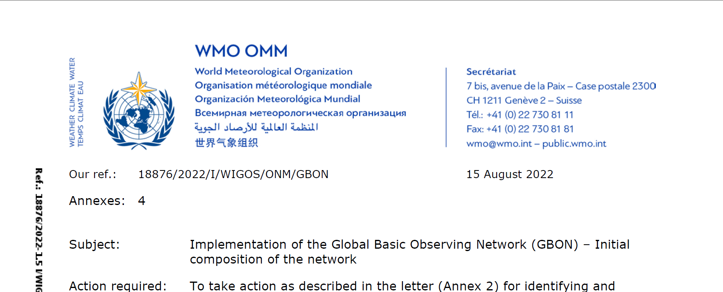
WMO Letter on GBON Implementation
Content of the letter:
References to GBON Material
Required action by members to prepare for the initial composition of GBON
Results from the global gap analysis (South Africa)

Slide 4
Final designation of existing observing stations to be included in GBON (see description of the initial seeding process in Annex 3). To facilitate this process, on 8 September 2022. The stations identified by TT-GBON for initial seeding will be assigned to GBON in OSCAR/Surface with “Pending Approval” status.
If the WMO Member wishes to object to the designation of any of these stations in GBON, the National Focal Point for OSCAR/Surface (NFP) may remove the assignment of such stations from GBON in OSCAR/Surface (see points 4 and 5 on next slide).
No action by the NFP before 15 November 2022 will be understood as concurrence of the Permanent Representative concerning the designation of such stations in GBON.
REQUIRED ACTION BY MEMBERS
TO PREPARE FOR THE INITIAL COMPOSITION OF GBON

Slide 5
CRITERIA FOR THE INITIAL SEEDING OF GBON
All existing surface and upper-air stations (including former RBSN1 then RBON2 stations) that are considered to meet GBON requirements closely enough, and are operating and reporting (i.e., the green and orange stations in WDQMS for data availability) will be seeded into the initial draft list of GBON stations, subject to subsequent adjustments, including deletion where needed, by Members
Members have the final authority to decide which of their stations to include in GBON, on the basis of the global gap analysis or one performed by them.
Minor changes to the composition of GBON can be decided by the President of WMO on the basis of Members' proposed commitment
Gap analysis will allow identifying areas where additional efforts will be needed for more stations to be eventually committed into GBON.
This process will provide the following station lists:
• GBON-Surface-Land (Initial)
• GBON-Surface-Marine (Initial)
• GBON-Upper-Air-Land (Initial)
• GBON-Upper-Air-Marine (Initial).

Slide 6
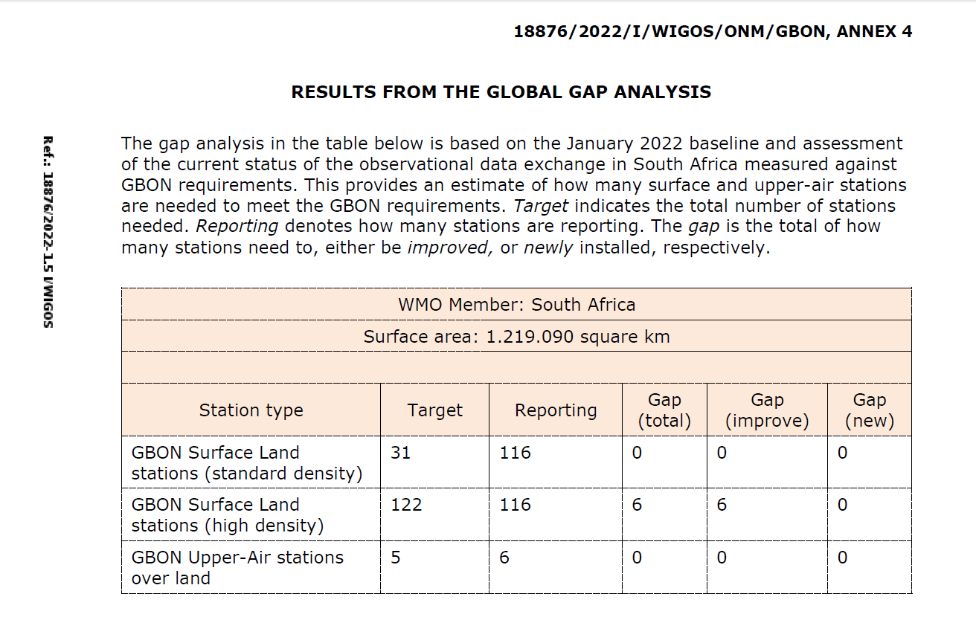
South Africa designated to GBON 122 Surface Land stations (high density) and 5 Upper-Air stations over land.

Slide 7
Summary of GBON requirements ‘shall’ provisions in bold type
 | Horizontal Resolution | Vertical Resolution | Observing cycle | Variables | Other requirements
Surface land stations | 200 km 100 km | n/a | 1 h | SLP, T, H, W, P, SD | Exchanged in real time through WIS2
Upper-air stations operated from land | 500 km 200 km¹ | 100 m | 2/24 h | T, H, W | Up to 30 hPa, exchanged in real time through WIS-2
“Standard density” refers to the GBON regulation for horizontal resolution of surface land stations, with 200 km maximum spacing between stations, and which applies to all Members (except SIDS). For SIDS, the EEZ area has been added to the total surface area which is the basis for the target number of stations
“High Density” refers to the GBON regulation for horizontal resolution of surface land stations, with 100 km maximum spacing between stations, and which applies to Members operating their networks at a density of 100 km or higher, for whom data exchange at 100 km density is mandatory and exchange up to a density of 15 km is recommended.

Slide 8
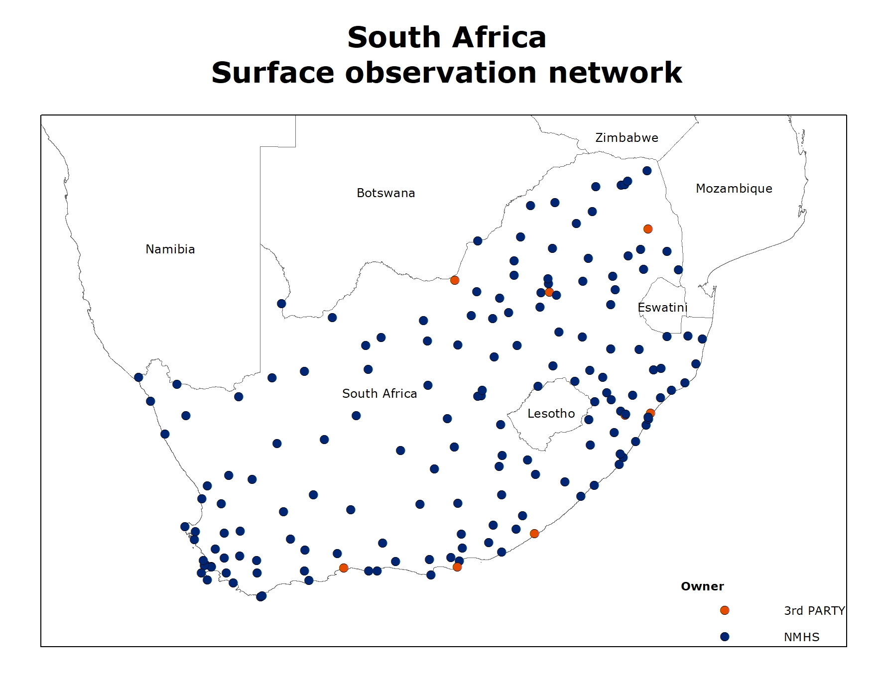
South Africa: Surface land stations
Criteria used to nominate the surface land stations for GBON Network
Programme/network affiliation (for example RBSN, GOS)
Data availability and quality performance
Spatial analysis (“high density”= 100km)

Slide 9
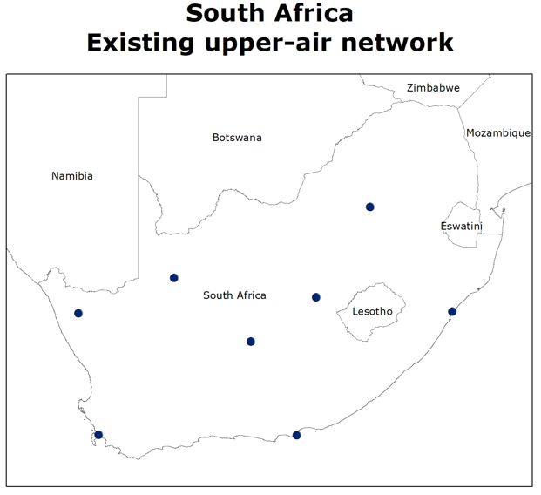
South Africa: Upper-air (radiosonde ) stations
Criteria used to nominate the upper-air (radiosonde) stations for GBON Network
Programme/network affiliation (for example GUAN)
Data availability performance
Spatial analysis (“high density”= 500km)

Slide 10
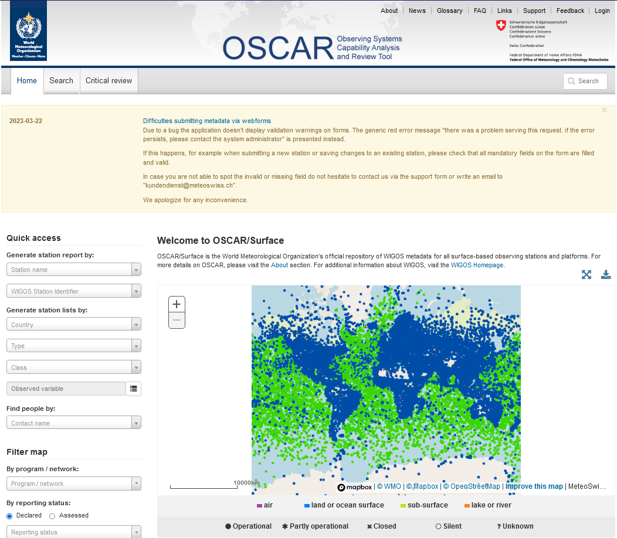
Designate a GBON station

Slide 11
How to designate a GBON station: Surface land Upper-air (radiosonde) stations
For a station that is registered in OSCAR/Surface, following these steps:
Login to OSCAR/Surface and identify the intended station
Select the intended station and enter the “Edit mode”
Select the “Add program/network affiliation”, to open a dialogue box
Go to the menu button in front of “Program/network affiliation”, to open the “affiliations tree”:
For GBON follow this path WIGOS/GOS/GOS Surface Networks/GBON and then click “Add”
Select one or more variables to be affiliated to GBON and then click “Insert”
For GBON surface stations: surface pressure is needed variable, although the other GBON variables (temperature, humidity, wind, precipitation and snow) will also be monitored
For GBON upper-air stations: all upper-air variables are needed (pressure profile, temperature profile, water-vapor profile, upper-wind)
Click on “Edit data generation information” to update the reporting schedule (Observations/measurements, variables, Deployments, Data generation). Click “update”.
The preliminary results will be shown on the Station page (“Station report”)
Finally, select “Save” at the bottom, to make the changes effective

Slide 12
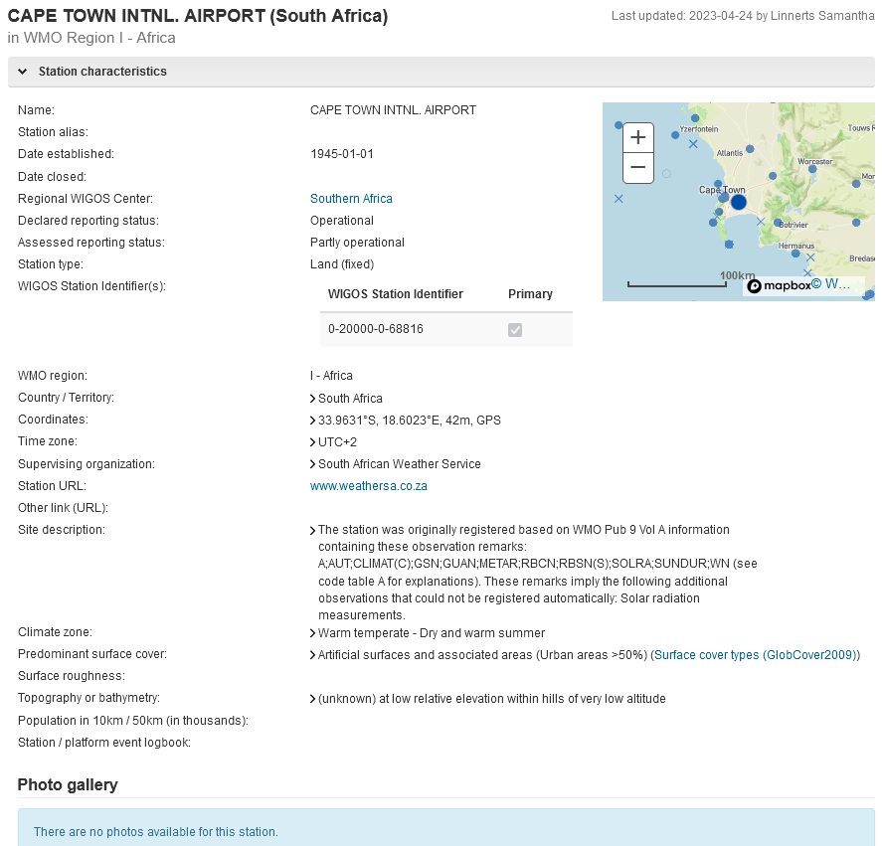

Slide 13
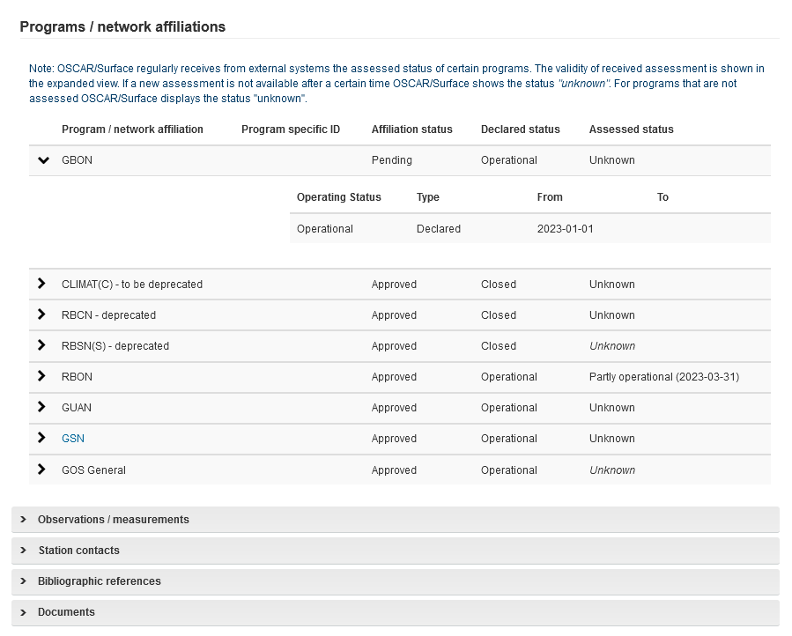
Program/network affiliation added

Slide 14
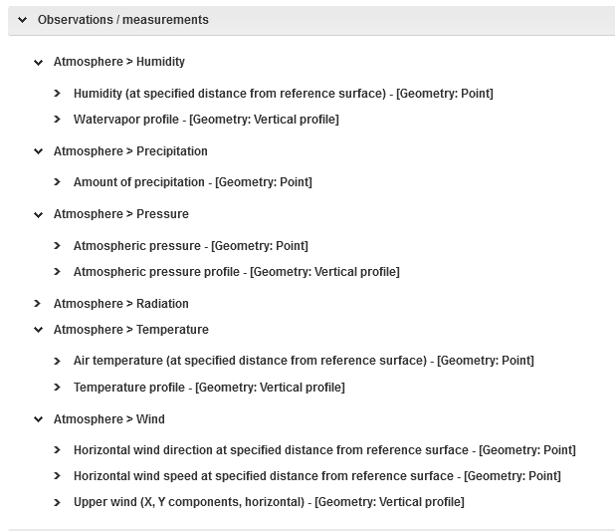
GBON requirements: Variables
Surface land station
No snow depth sensor

Slide 15
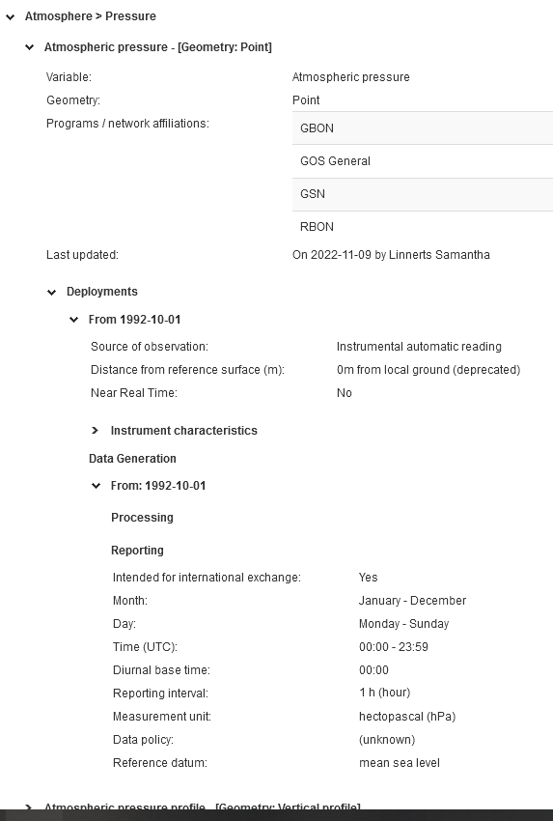
GBON requirements: Reporting schedule -
Surface land station
24 observations per day

Slide 16
GBON requirements: Variables
Upper-air (radiosonde) station

Slide 17
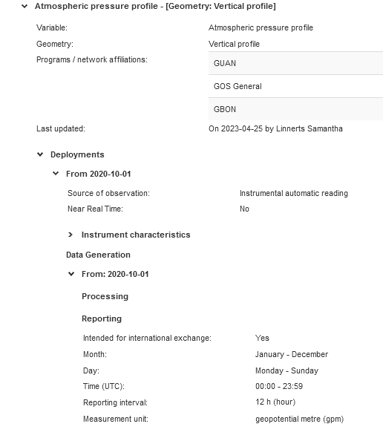
GBON requirements: Reporting schedule -
Upper-air (radiosonde) station
2 ascents per day

Slide 18
How to remove (un-assign) a station from GBON
This is the same as removing the affiliation of a station already pre-assigned to the GBON “programme/network”, in OSCAR/Surface:
Login to OSCAR/Surface and identify the intended station
Open the station and go into Edit mode
Under the list of “Program/network affiliations”:
Click on Delete GBON program/network affiliation, on the respective line (under “Actions”)
Or, select one or more variables that are affiliated to GBON and click “Delete”
On each case, a dialogue box will pop up asking for confirmation
Finally, select “Save” at the bottom to make the changes go into effect

Slide 19
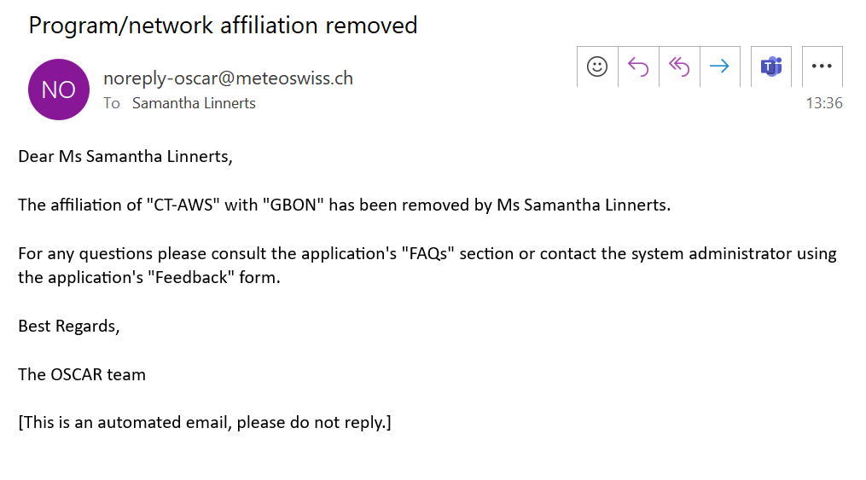
Email notification when removing affiliation

Slide 20
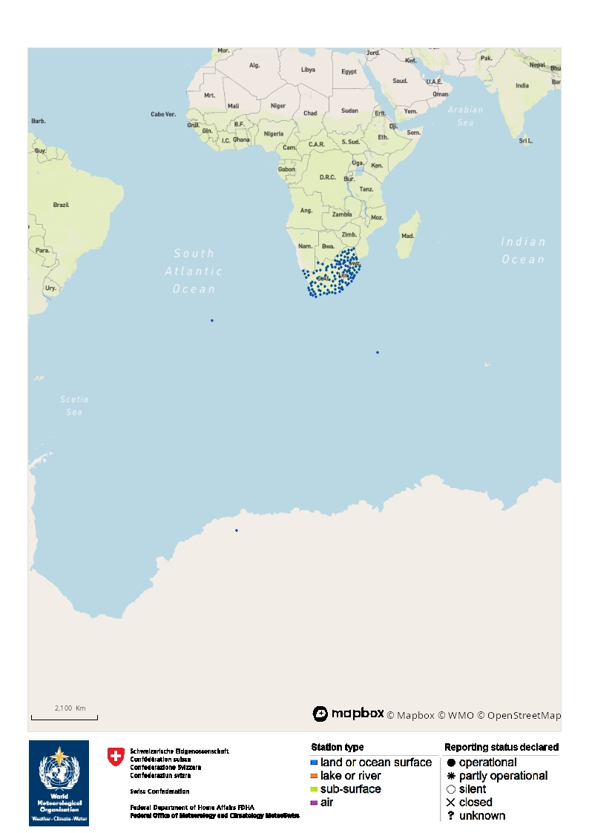
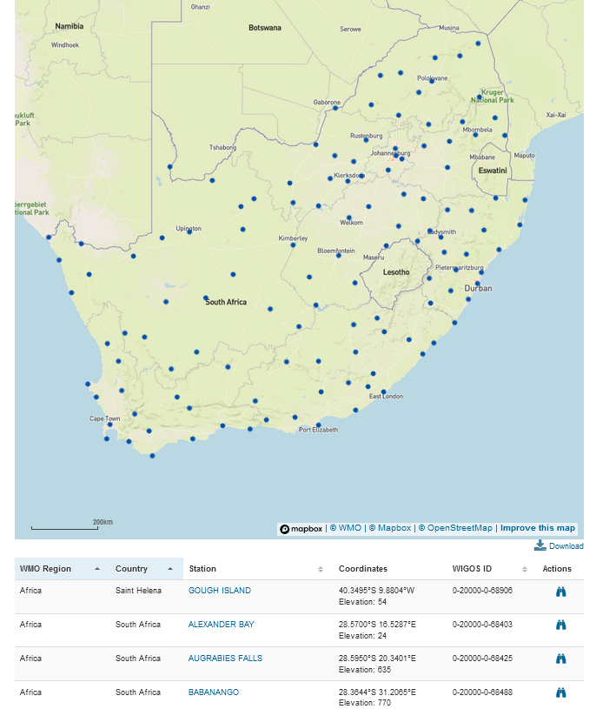
OSCAR/Surface
Visualization of stations using OSCAR/Surface Tool

Slide 21
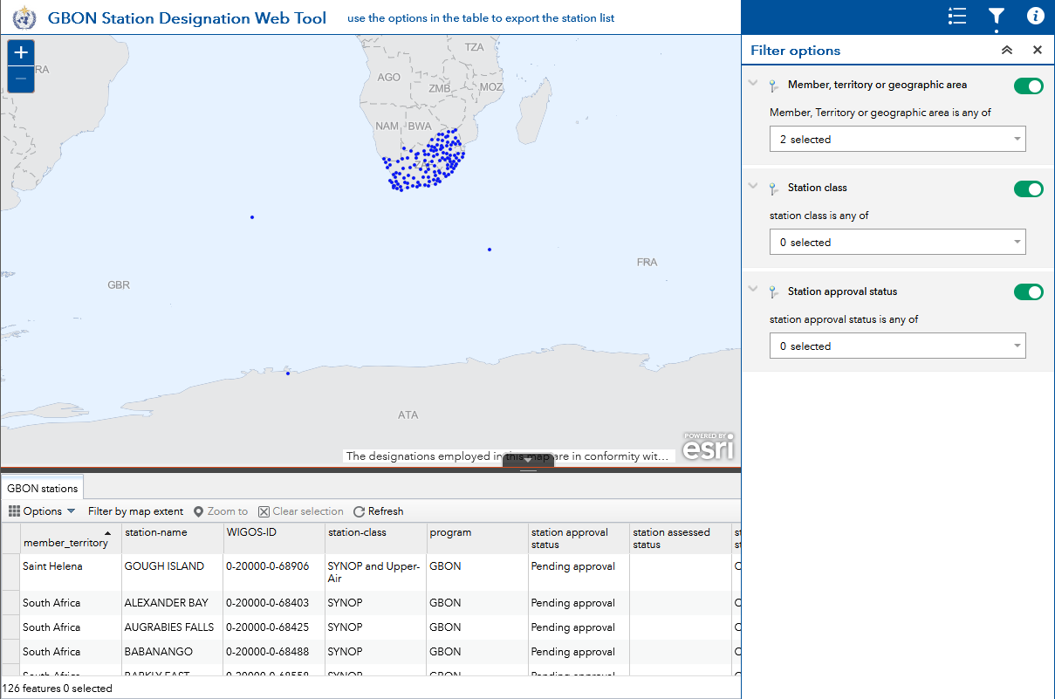
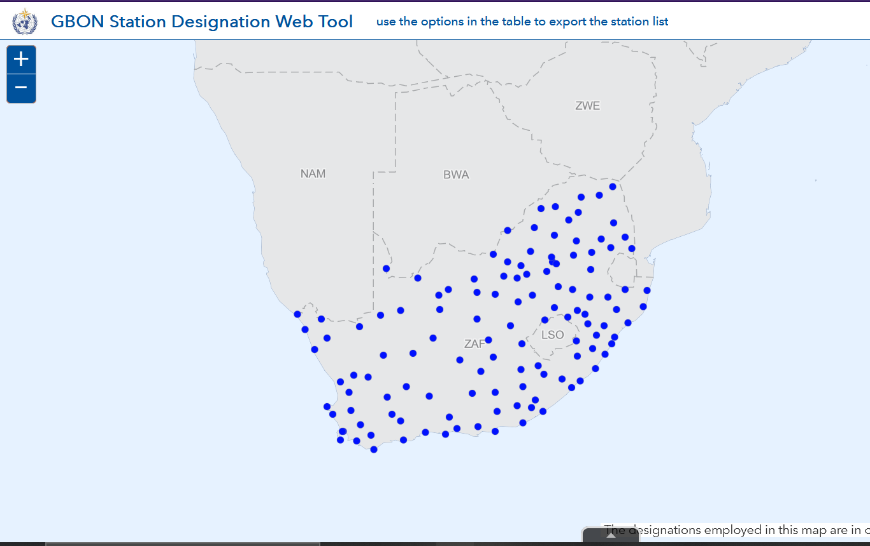
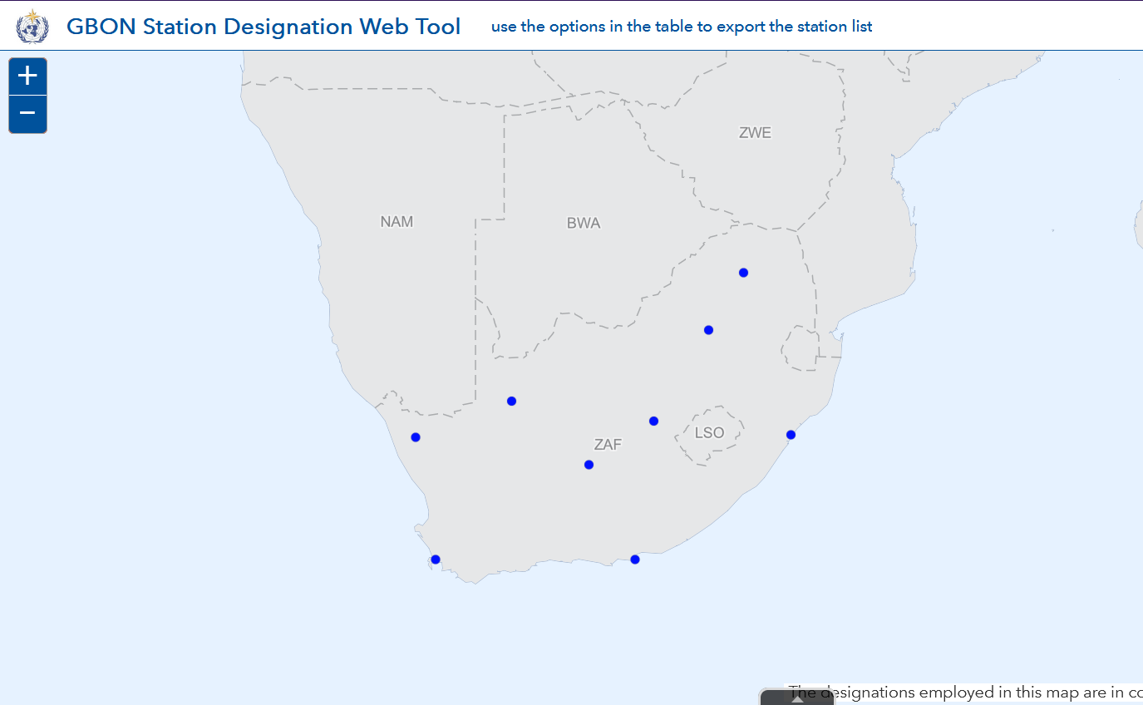
GBON Webtool
Visualization of stations using GBON webtool

Slide 22
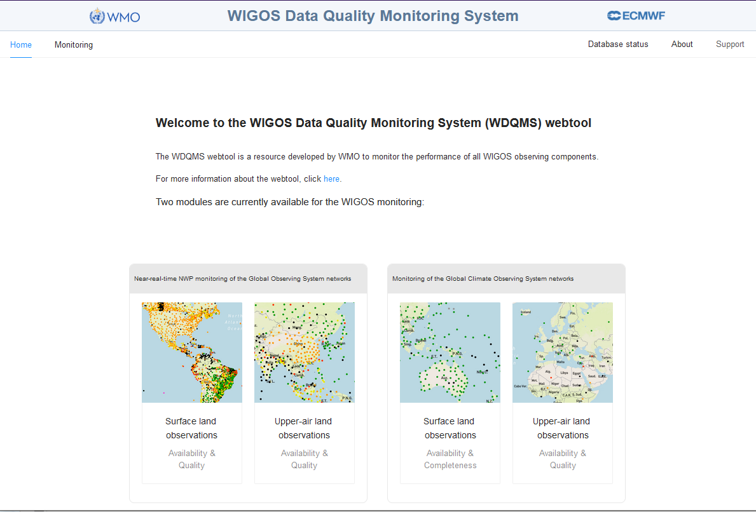
Link to WDQMS webtool https://wdqms.wmo.int/

Slide 23
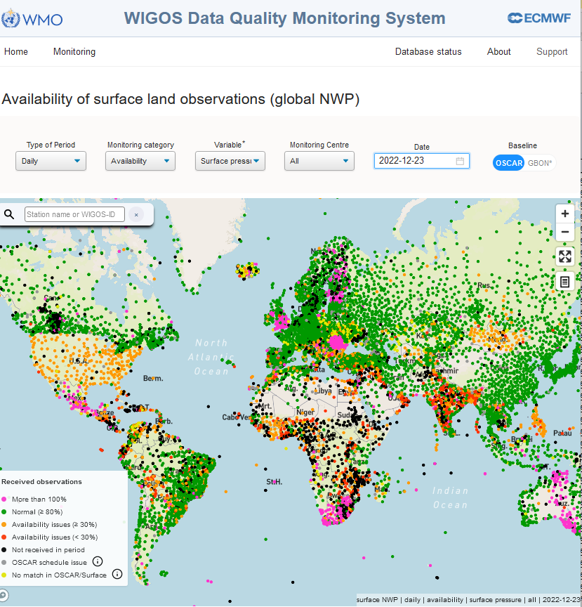
Stations affiliated to GBON
Hourly data exchanged for all stations and not according to the affiliation and reporting schedule declared in OSCAR/Surface
GOS: 3 hourly
GBON: Hourly

Slide 24
Bulletins corrected.
Grey dots - OSCAR/Surface schedule issue: Stations/Variables lost their GOS affiliation.

Slide 25
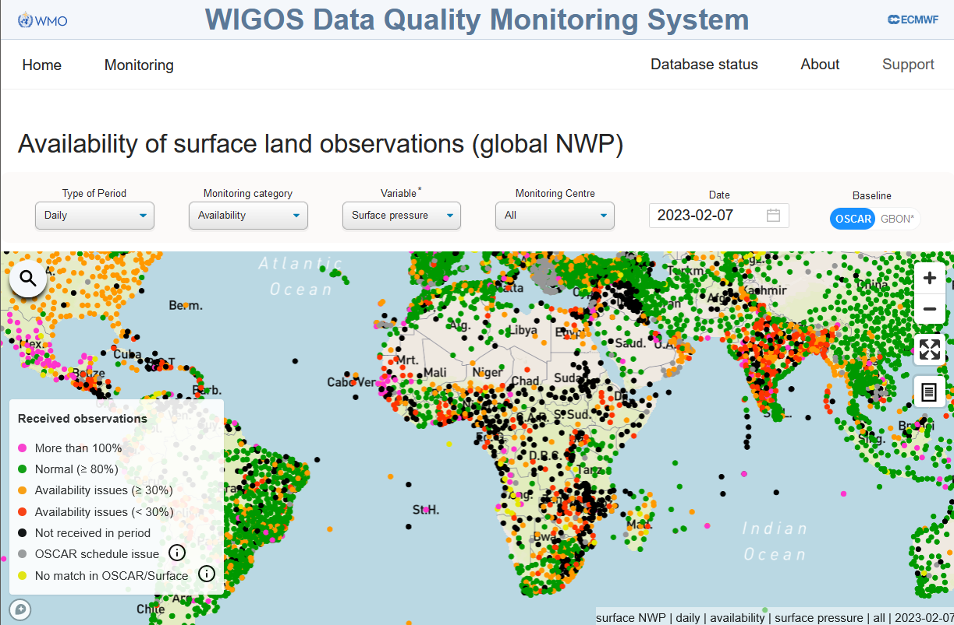
Station metadata corrected and bulletins aligned to the reporting schedule

Slide 26
Remarks
The role of NFPs WIGOS and NFPs OSCAR/Surface is critical.
NFP OSCAR/Surface to use the OSCAR/Surface webtool and “GBON Station Designation Webtool” (GBON Webtool) to visualize station affiliation (Confirm if the affiliation was successful)
Changes to the reporting schedules need to be communicated to the NFP WIS to allow the update of GTS/WIS bulletins
Align organizational data management systems (DMS) to reporting schedule declared in OSCAR/Surface (Hourly observation in OSCAR/Surface = Hourly observation report generation on National DMS)

Slide 27
Thank you

