Slide 1
Webinars on the process for the designation of GBON Stations, part 2
(5 January 2023)
Available GBON material (GBON Guide and
release schedule, GBON website and WIGOS Learning Portal
Zulkarnain
Credits: Etienne Charpentier, Luis Nunes, Igor Zahumensky

Slide 2
Stand alone GBON Guide
Timeline
23 Jan.2023: Draft endorsed by P/INFCOM;
25-31 Jan.2023: Draft Resolution ##/1 (EC-76) Guide to the Global Basic Observing Network submitted for internal approval process and translation;
27 February to 3 March 2023: Adopted by WMO EC-76
Draft list of contents:
Introduction
GBON Requirements: GBON standard requirements, GBON high density network requirements)
Designation of GBON Stations: Process for the designation of GBON stations, Removal of GBON affiliation
GBON Compliance: General considerations, Station-level compliance monitoring, Member-level compliance monitoring, Compliance status and reporting, Exemption per Article 9 Of WMO Convention
Management of GBON: Roles and Responsibilities, National GAP analysis, National GBON contribution plan
Regulations for Reporting GBON Parameters: Reporting of hourly observations, Additional WIS guidance
GBON Specific Metadata in OSCAR/Surface: Searching for GBON stations, Registering a new GBON station, Editing the metadata of a GBON registered station, Program/network affiliation of GBON stations
WDQMS Performance Monitoring

Slide 3
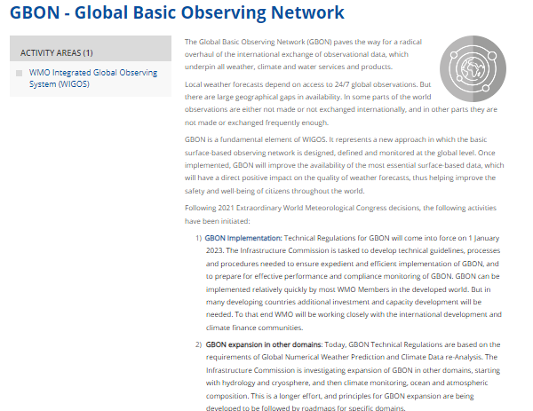
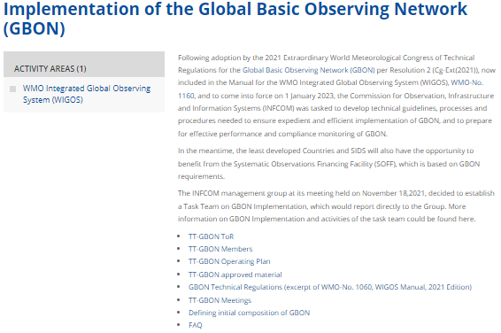
GBON webpage on the WMO Community platfrom
Main GBON webpage: https://community.wmo.int/activity-areas/wigos/gbon
GBON implementation webpage: https://community.wmo.int/activity-areas/wigos/gbon/implementation-global-basic-observing-network-gbon

Slide 4
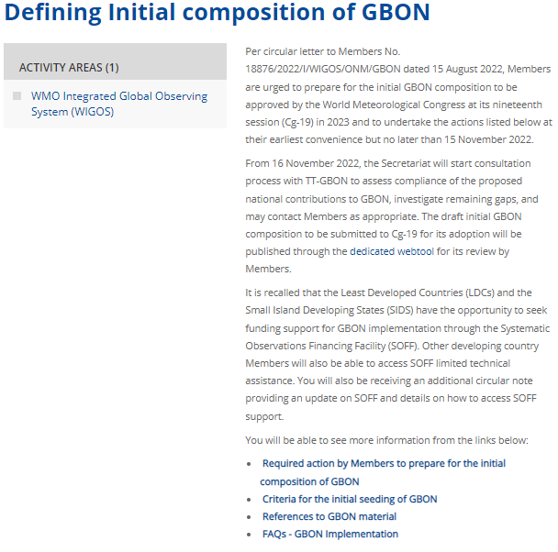
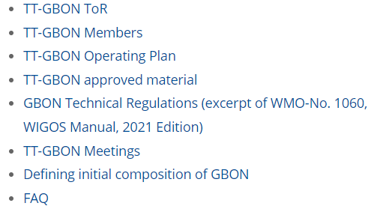
GBON webpage on the WMO Community platfrom
In the Implementation of GBON webpage, these information are available:

Slide 5
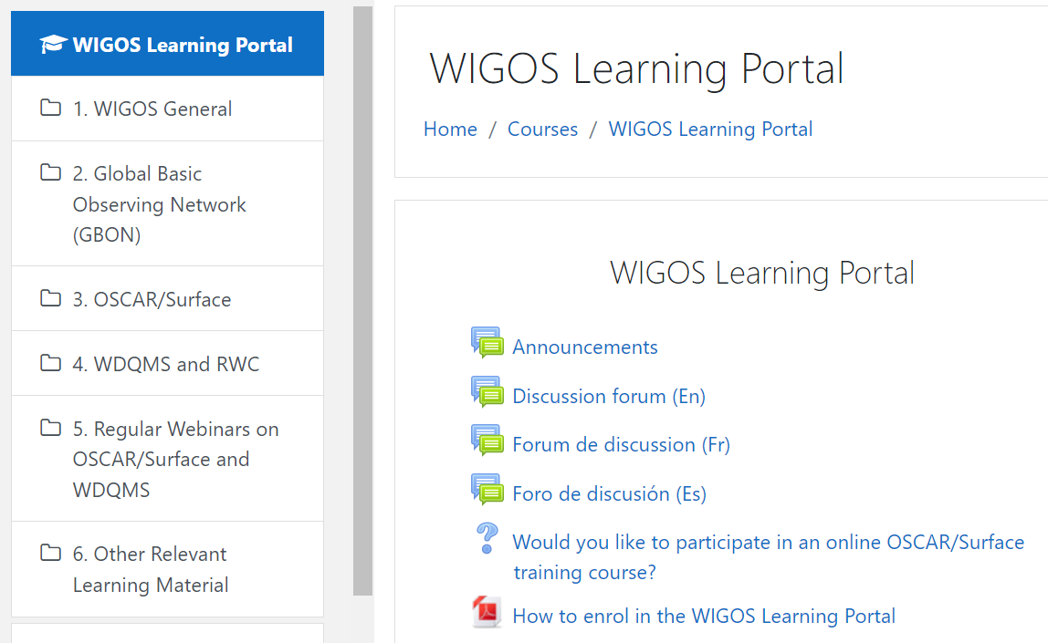
GBON Training Materials on the WIGOS Learning Portal
WIGOS Learning Portal: https://etrp.wmo.int/course/view.php?id=146. All learning materials can be accesses without login
GBON Learning materials are available in section 2 of the portal, currently it contains recording of previous GBON webinar in October 2022, as well as materials presented at the webinar
By enrolling into the portal, you will be able to contribute to the discussion forum and receive notifications when there are new messages in the discussion forum or new announcements, including invitation to WIGOS monthly webinar
Self Enrolment key to the WIGOS Learning Portal: #WIGOS@wmo@21#sec

Slide 6
Thank You

