Slide 1
Webinars on the process for the designation of GBON Stations
(5 January 2023)
Pascal Waniha (Tanzania)
Chair INFCOM Task Team on GBON Implementation

Slide 2
Importance of global NWP systems
Numerical Weather Prediction is a foundational capability for nearly all weather and climate applications
Of the 14 application areas currently included in the WMO Rolling Review of Requirements (RRR), 13 are thus either fully or partly dependent of the availability of robust Global NWP input
Global NWP is a pre-requisite for high resolution NWP and related methods used for nowcasting and short-range weather prediction
Global NWP shares many of its requirements with high resolution NWP, except the latter are even more stringent
Regional NWP may fail if the global model providing the boundary conditions sees a different set of observations from that used by the inner model
Most weather prediction products available to users world- wide are based on or depend on global NWP guidance
Without local observations, the NWP guidance will be of poor quality, especially in the tropics

Slide 3
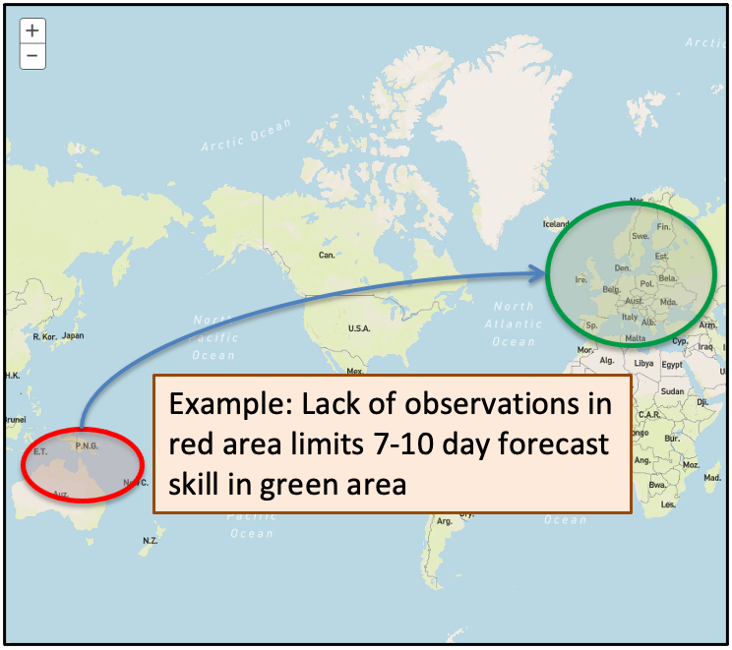
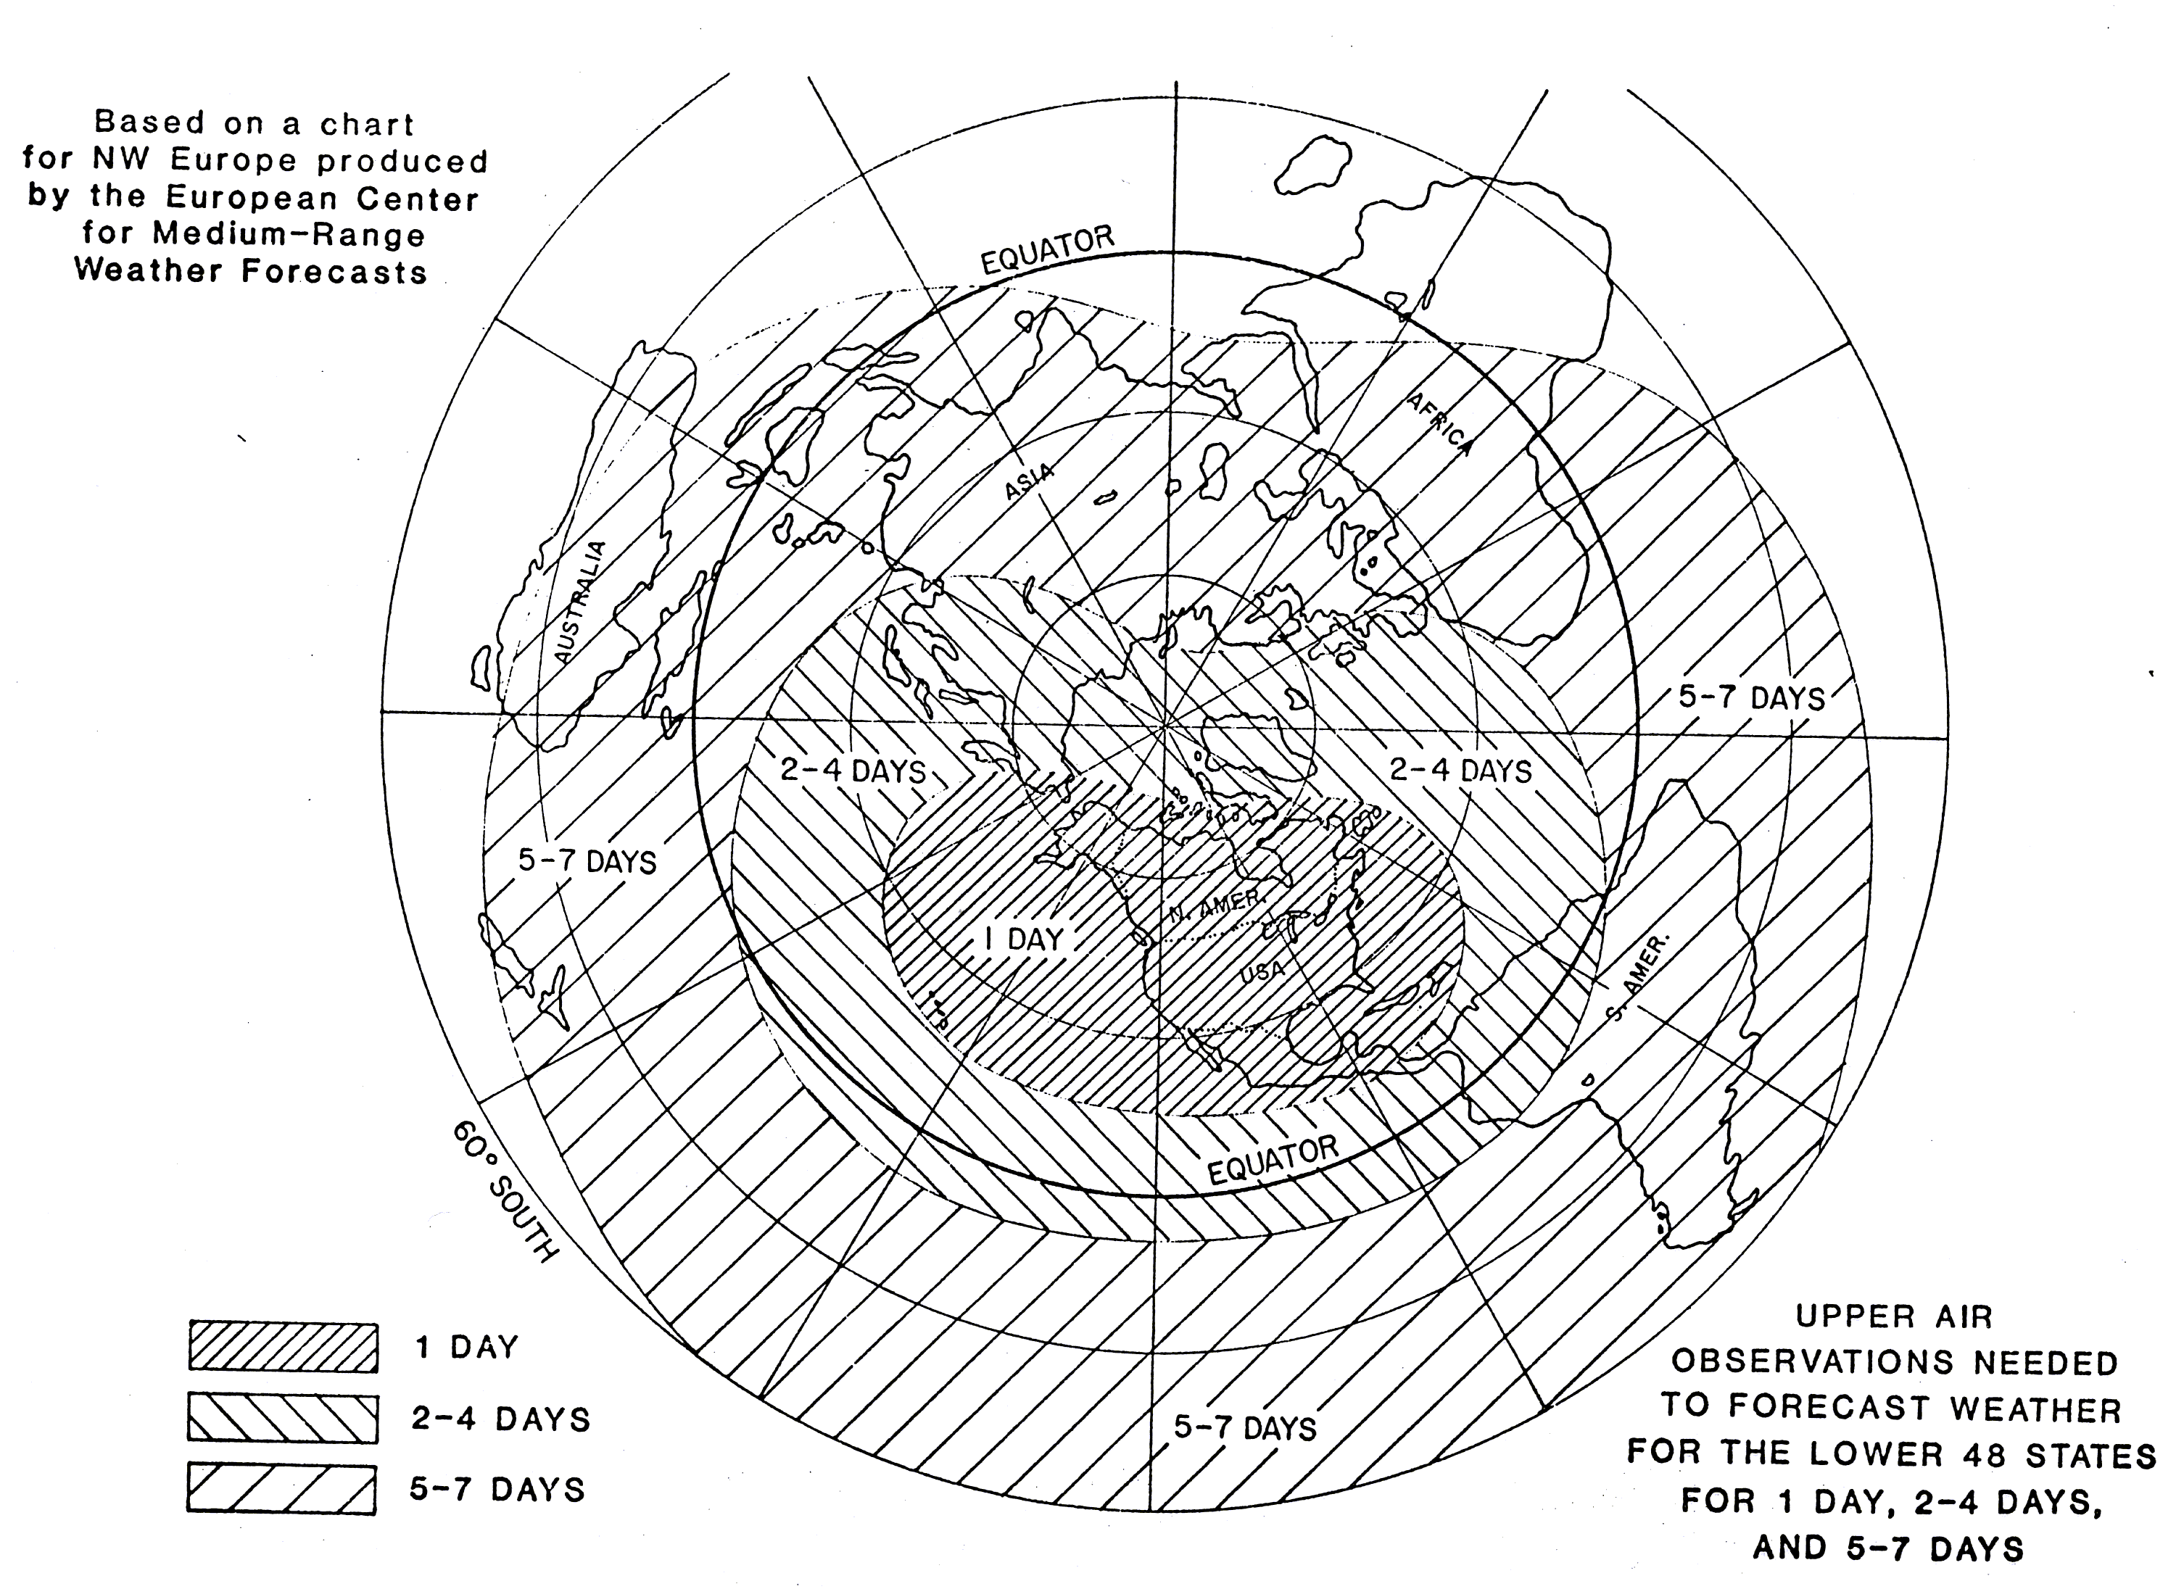
Importance of Surface Observation to NWP,
Observations are valuable, BUT
Single, isolated observations are not a useful basis for prediction;
Jigsaw puzzle analogy: Individual pieces are useless; many pieces together can form a picture;
In meteorology the puzzle is global, requiring international data exchange;
Many extremely important observations are made not for local users, but for the benefit of fellow WMO Members, especially at longer forecast ranges;
International exchange important even for localized NWP: Limited Area Models cannot be run effectively inside a global model if the two see different sets of observations;
5-7 days
2-4 days
1 day

Slide 4
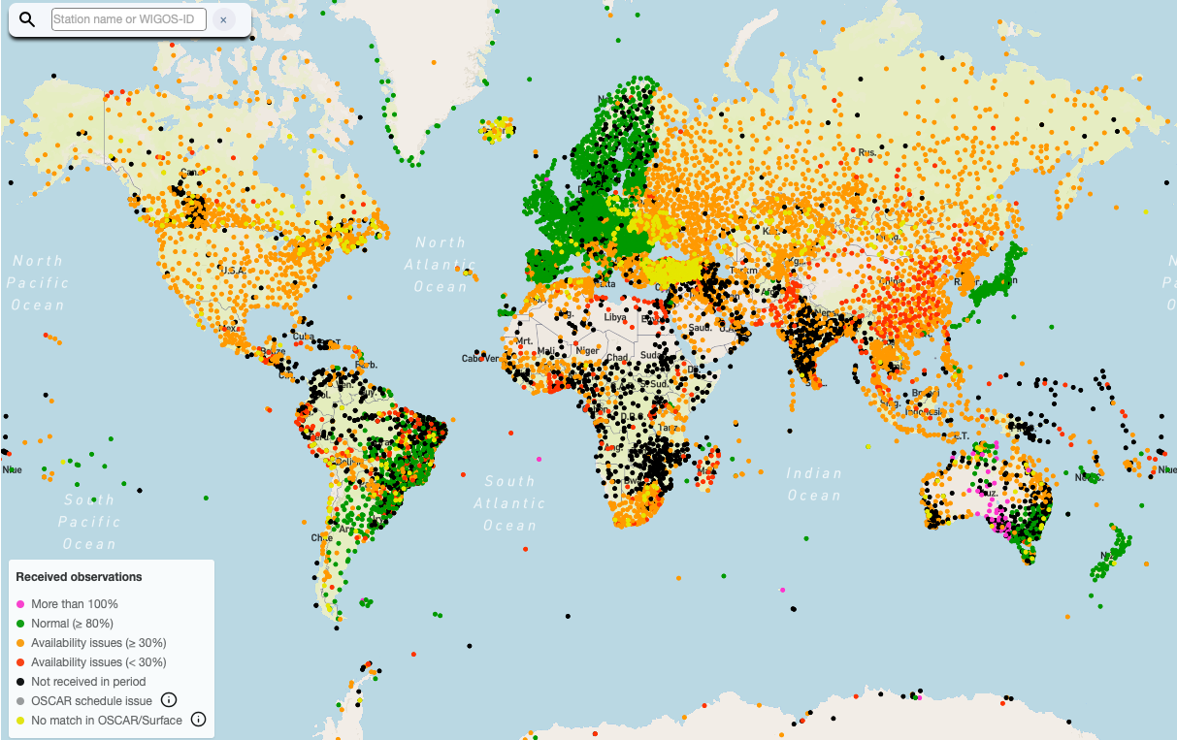
Gap in data coverage
In many areas the exchange of surface-based observations has been stagnant or declining since 1995 (Res. 40); red/black areas are gaps, as per draft GBON provisions, building on two decades of CBS recommendations.
Meanwhile model resolutions have increased by factors of 1,000-10,000!
Surface pressure observations received by global NWP Centers on Oct 13 2020, 18Z)
(source: WIGOS Data Quality Monitoring System)
Notes:
Ground truth Especially in areas dominated by red or black, quality of model data used for weather and climate prediction and monitoring will be relatively poor, and the possibility of verification will be limited

Slide 5
What is GBON
In order to increase the observational input to global NWP,
In 2019, the World Meteorological Congress and its 193 member countries and territories agreed to establish the Global Basic Observing Network (GBON) .
GBON sets out an obligation and clear requirements for all WMO Members to acquire and internationally exchange the most essential surface-based observational data at a minimum level of spatial resolution and time interval.
GBON is a landmark agreement and offers a new approach in which the basic surface-based observing network is designed, defined and monitored at the global level ( resolution – temporal and spatial)

Slide 6
The WMO process regarding GBON implementation
In response to the gaps in observational data coverage, Congress-18 adopted the GBON Concept;
Technical Regulations adopted by Extraordinary Congress 2021 to come into force on 1 January 2023
INFCOM established task team TT-GBON to provide oversight for GBON Implementation during 2022
Adopted comprehensive operating plan
Prepared draft INFCOM-2 Recommendations on GBON Guide and Initial Composition of GBON
Guided Secretariat for preparing material & promoting the process

Slide 7
What is expected outcome of GBON ?
New observing network replacing the former Regional Basic Synoptic and Climatological Networks (RBSN and RBCN)
Introduces more stringent requirements which WMO Members shall meet
Focused on surface land stations, upper air stations, and marine stations in Exclusive Economic Zones
Addresses the requirements of Global Numerical Weather Prediction (GNWP) and Climate Data re-Analysis
Filling the identified gaps
Making data of existing stations available
High quality NWP guidance
Complements the new Regional Basic Observing Network (RBON)
All GBON stations are also RBON stations by definition
RBON stations addressing additional requirements as decided by the regional associations

Slide 8
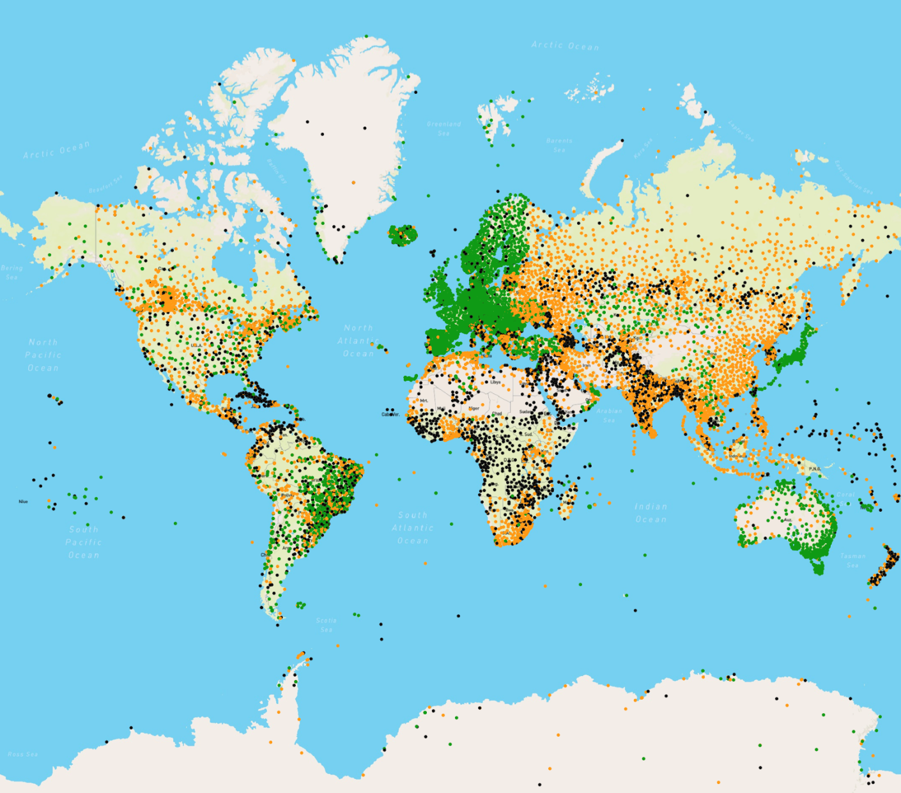
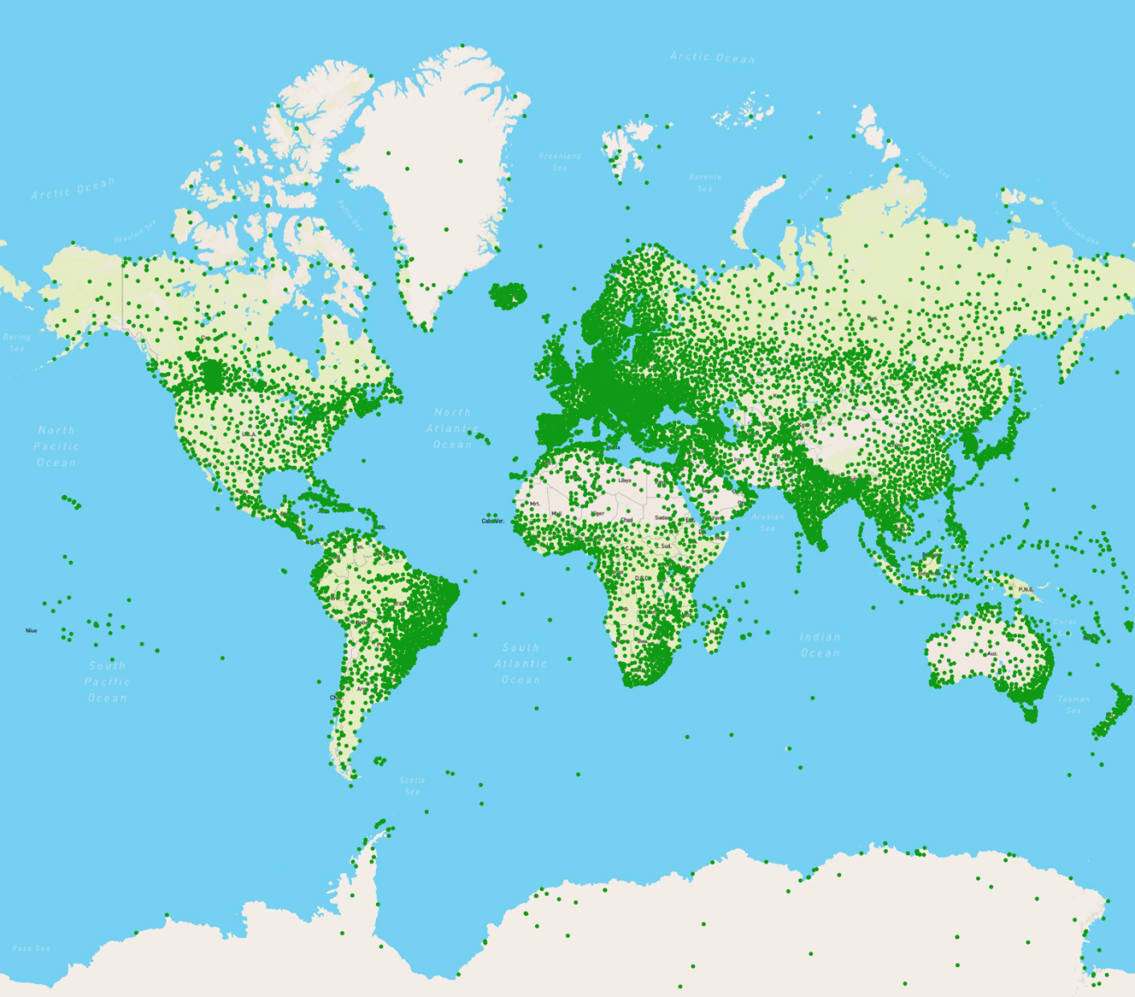
GBON Concept in a nutshell: “Turn the map green and fill in the missing dots”
Improved local observations; High quality NWP guidance and products

Slide 9
Thank You

