Slide 1
The use of OSCAR/Surface to designate GBON stations, including GBON template
(5 January 2023)
Luís Nunes
WIGOS Scientific Officer¹
Thanks to: Lucia Cappelletti², Franziska Stuerzl², Churui Chen¹
¹WMO Secretariat, Infrastructure Department, WIGOS Branch
²Meteoswiss

Slide 2
How to designate an existing station as GBON
This is the same as affiliating a station, that is already registered in OSCAR/Surface, to the GBON “programme/netwok”, following these steps:
Login to OSCAR/Surface and identify the intended station
Open the station and enter the “Edit mode”
Select the “Add program/network affiliation”, to open a dialogue box
Go to the menu button in front of “Program/network affiliation”, to open the “affiliations tree” and select GBON under WIGOS/GOS/GOS Surface Networks/, then click “Add”
Select one or more variables to be affiliated to GBON and then click “Insert”
The preliminary results will be shown on the Station page (“Station report”)
Finally, select “Save” at the bottom, to make the changes effective

Slide 3
How to create a new GBON surface land station using the GBON template (1)
A GBON template is available in OSCAR/Surface to create a new GBON surface station, following these steps:
Login to OSCAR/Surface and select the “Management” tab
On the menu open the “GBON Surface Land Station” template, which contains three sections: top, middle and low parts, each one containing several with input fields:
In the first section enter the basic information of the station, which is mandatory to register a station in OSCAR/Surface, such as the station Name, Date established, Country/territory, WIGOS Station Identifier (WSI) and geographic Coordinates
In the second section (middle of the screen) check the list of all variables that are required to be measured/observed and reported from a GBON Surface Land station, with ‘Snow depth’ being a conditional required variable to locations where snow is expected
For each variable the corresponding observing method can be chosen from a prefiltered tree
In the third section, use the schedule interface shown in lower part of the template to set the reporting schedule. According to the GBON requirements a GBON Surface Land station should report hourly (reporting interval), all year round (period of reporting=24/7)

Slide 4
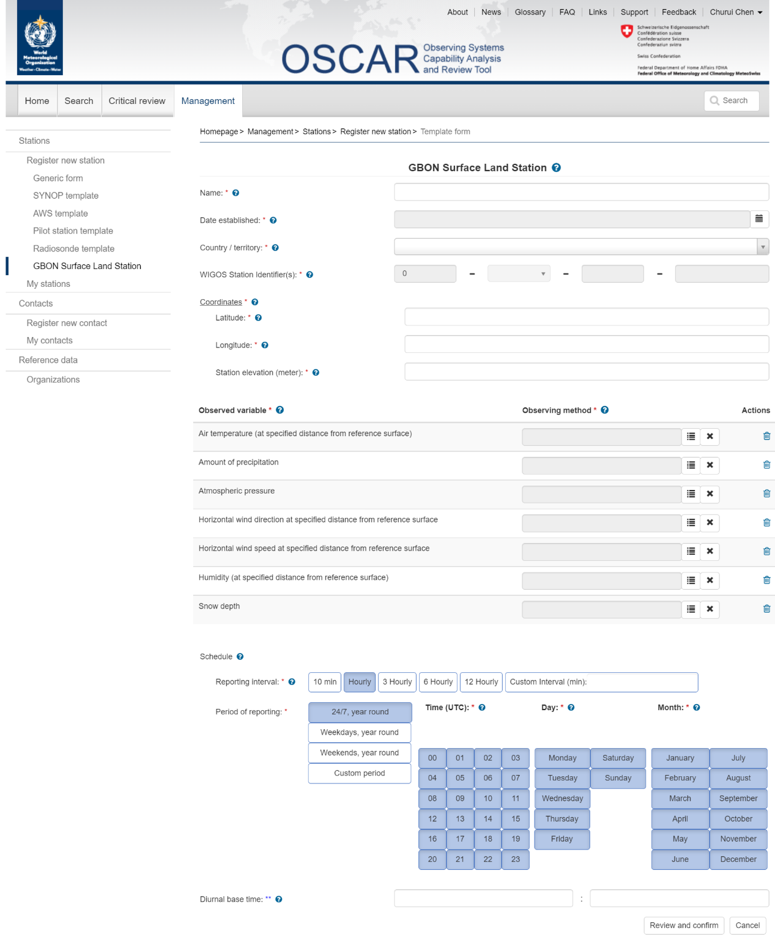
How to create a new GBON surface land station using the GBON template (1)

Slide 5
How to create a new GBON surface land station using the GBON template (1)

Slide 6
How to create a new GBON surface land station using the GBON template (1)

Slide 7
How to create a new GBON surface land station using the GBON template (2)
Confirm completion of the template with the “Review and confirm” button
It opens the Generic form prefilled with all the information that was entered in the template form, as well as with other automatically prefilled mandatory fields, based on requirements for GBON surface land station, such as “station type”, “program/network affiliation”
This Generic form allows editing of any of those fields; It is also possible to go back to the template form by selecting “Edit as template”. However, any information that was changed in the Generic form will be lost when going back to the template form
Finally, select “Submit” at the bottom to complete the registration of the station
An error message will appear if the information is incomplete, indicating that some elements are missing, and the missing fields and section headers are highlighted in red
It is possible to save the station information, already provided, as a draft for later editing

Slide 8
How to create a new GBON surface land station using the GBON template (2a)

Slide 9
How to create a new GBON surface land station using the GBON template (2a)

Slide 10
How to create a new GBON surface land station using the GBON template (2b)

Slide 11
Final Remarks
The role of National Focal Points is critical - all Members are required to nominate/update them
The NFPs on WIGOS coordinate the implementation of WIGOS at National level, including the GBON and the national schema for WIGOS Station Identifiers (WSI)
NFPs on OSCAR/Surface coordinate the metadata in OSCAR/Surface for their country
NFPs on OSCAR/Surface as well as Metadata Editors (ME) manage their country’s metadata, including GBON stations, e.g.:
Affiliate/de-affiliate existing stations in OSCAR/Surface with GBON network
Register (create) new GBON stations in OSCAR/Surface
Update and maintain records of GBON stations in OSCAR/Surface
This presentation covers mostly the use of a specific template to register new stations in OSCAR/Surface
More detailed and comprehensive guidance is available:
OSCAR/Surface Users manual (2022 Edition, Release 1.8.3)
Additional learning material and recordings of webinars/online workshops are also available, from the WIGOS Learning Portal:
Webinars on OSCAR/Surface and WDQMS
GBON Webinars

Slide 12
Thank You

