Slide 1
GBON compliance criteria, compliance monitoring, and the WDQMS webtool
(5 January 2023)
Luís Nunes¹
(WIGOS Scientific Officer)
Credits to: Timo Proescholdt², Etienne Charpentier¹
WMO Secretariat, Infrastructure Department:
¹WIGOS Branch; ²WIS Branch

Slide 2
GBON compliance criteria
Established by INFCOM/TT-GBON, described in the GBON guide
Based on stations that:
Are registered in OSCAR/Surface with approved GBON affiliation
Exchange BUFR or TAC reports internationally
By station:
Based on Sea Level Pressure reports for surface stations
Based on Temperature profiles for upper air stations
Computed using monthly monitoring of GBON availability statistics per station for
Availability (≥>0% of required reports per month) – to be made available online from the WDQMS Webtool
Timeliness (<5% late reports i.e. after cut off)
Quality (<5% rejected reports)
By WMO Member:
Counting the number of compliant stations (criteria above)
Number of compliant stations greater than or equal to the required number of stations from the GBON global gap analysis in the month (see GBON letter, September 2022, Annex 4)
Monthly results from WDQMS-Webtool used to compute quarterly reports
Each Member assessed against the quarterly reports on annual basis
Also considers additional information, such as Member invoking Art.9

Slide 3
Monitoring the GBON compliance criteria - WDQMS Webtool
Role of WDQMS Webtool
Communicate online near-real time station level compliance monitoring results
Every 6-hours (surface),
Daily (surface and upper-air),
Monthly (surface and upper-air)
Data source for quarterly GBON compliance monitoring, including SOFF
Applied criteria
Consider all observations received (TAC and BUFR)
Observation counts if it reaches any of the (NWP) monitoring centers
80% or more of expected observations:
Hourly (24 reports) per day from surface stations
2 upper-air reports per day

Slide 4
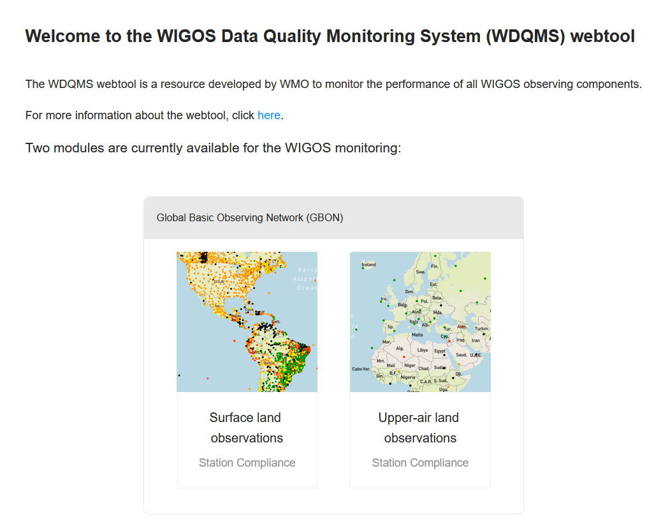
GBON module in WDQMS Webtool
Development finished based on GBON compliance criteria
Testing underway

Slide 5
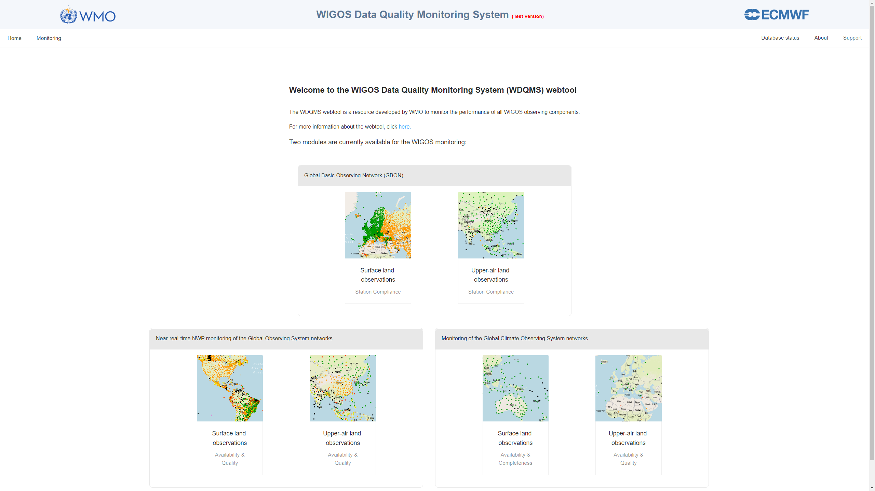

Slide 6
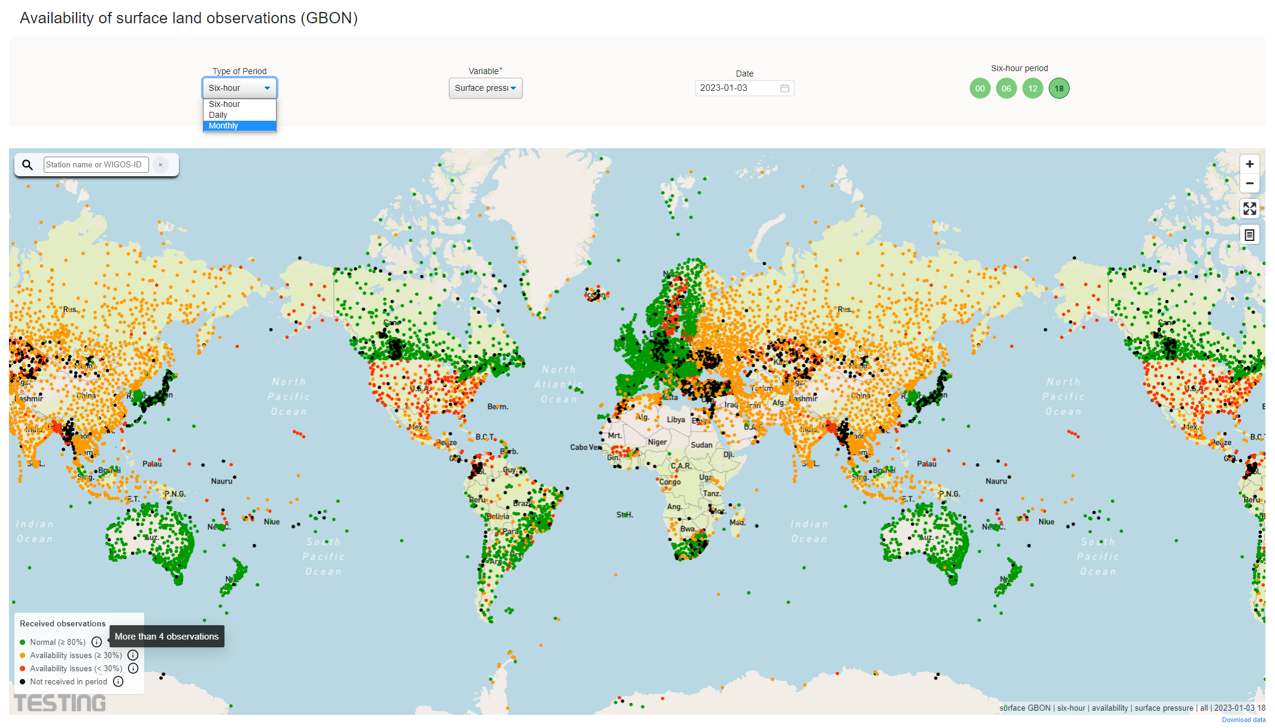

Slide 7
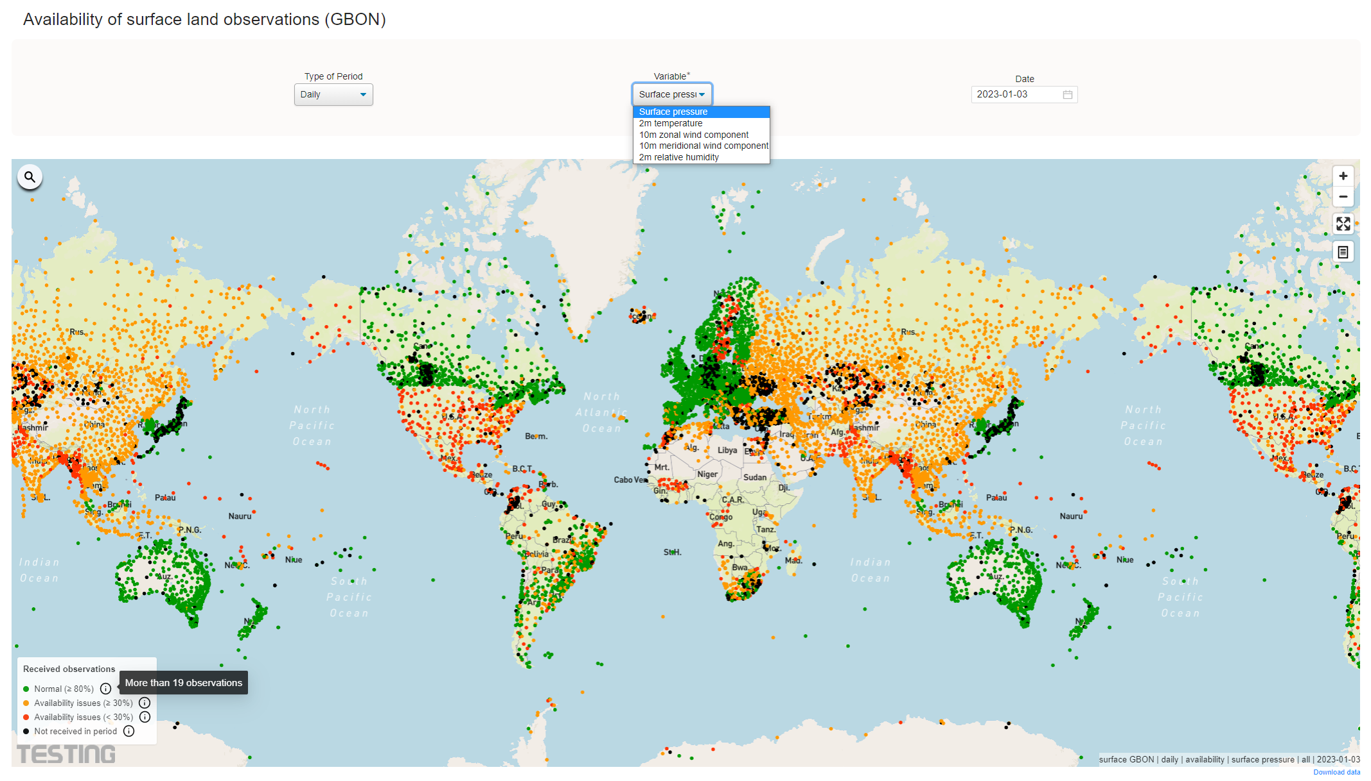

Slide 8
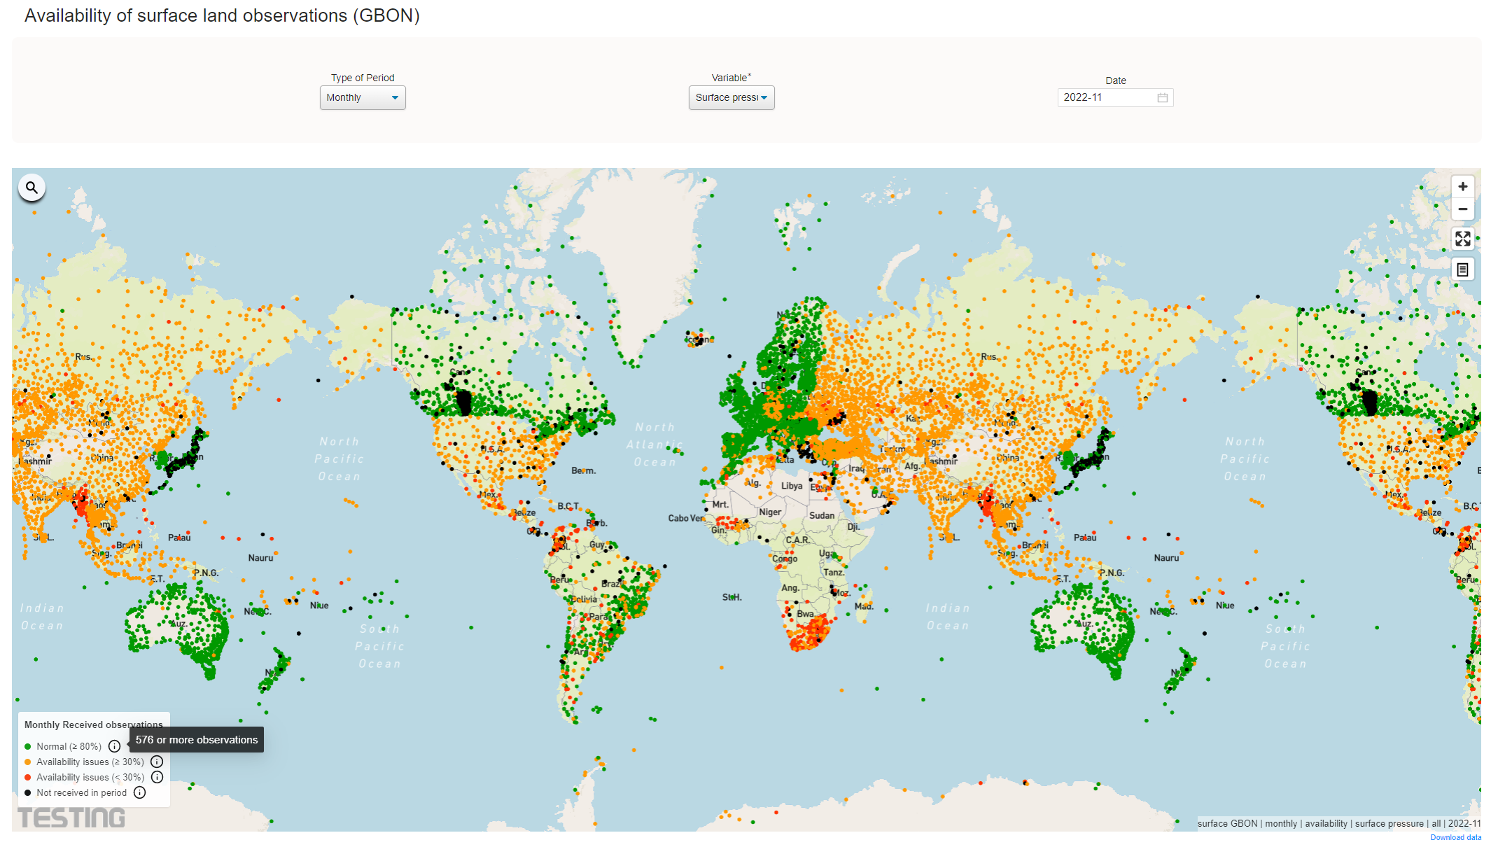

Slide 9
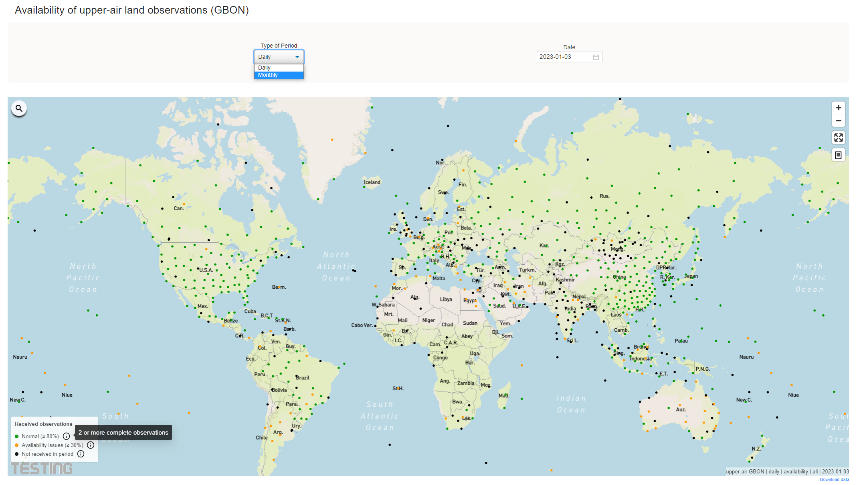

Slide 10
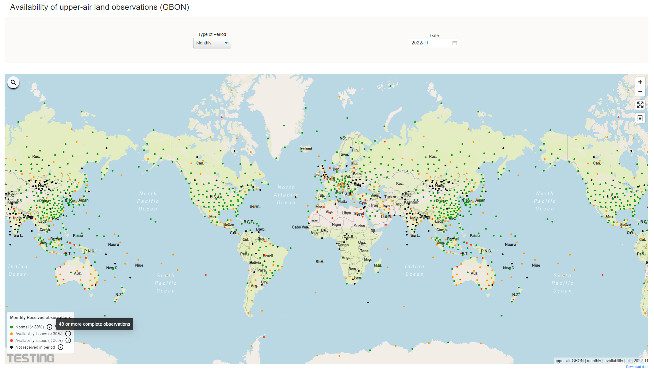

Slide 11
Thank You

