Slide 1
WIGOS Data Quality Monitoring System
(WDQMS)
Regional WIGOS Centres daily tasks

Slide 2
Regional WIGOS Centres daily tasks
Regional WIGOS Centres (RWC) should evaluate the performance of stations of countries under their responsibility.
This should be done on a daily basis by reviewing the automated quality monitoring reports received from the WIGOS Monitoring Centres (global NWP centres) which are displayed in the available web tool outputs.
Check the performance concerning the three main categories data availability, timeliness and accuracy (bias as the measure of trueness, standard deviation as the quantitative measure of precision) regarding the WDQMS performance targets.
Follow the same quality evaluation processes if an issue has been reported to the RWC by a user (e.g. by a Global NWP Centre or a Member of a Regional Association).

Slide 3
Identify stations showing non-compliance
Reasons for non-compliance might be
The station did not report any data yesterday (category: data availability);
The total number of reports is significantly lower than the expected number of observations as defined in the observing schedule in WIS and OSCAR/Surface (category: data availability);
The data arrived with a significant delay, which may lead to a situation where data could not be used in near-real-time applications, e.g. for nowcasting purposes (category: timeliness);
The daily averaged accuracy statistics exceed the WMO threshold requirements concerning a particular variable or variables, e.g. for GBON stations or according to OSCAR/Requirement (category: accuracy).

Slide 4
Issues identified in previous days
If an issue has been identified this should be recorded in the Incident Management System as part of the incident management process (issue identification - part A)
Check the status of issues identified (e.g. if the station did not report any or suspicious data) in the following days.
Stations with identified issues should be checked again as to whether the performance improved, e.g.
did the station start reporting again,
did the station report as many reports as expected again,
did the data start arriving without delays again or
did the measurement uncertainty of observations improved again and therefore remained within the agreed targets on a daily average

Slide 5
Incident tickets in case of non-compliances
In the case of an ongoing non-compliance of a particular station raise an incident ticket by describing the incident, according to the incident management procedure.
The results from various WIGOS Monitoring Centres might differ. Hence, initiate an incident management procedure only if most WIGOS Monitoring Centres show similar results (e.g. data are missing in most Global NWP Centres).
When several stations of a country show the same non-compliance, one incident ticket might be raised for all the stations
If an issue continued for 5 (or more) days an Incident management process (IMP) should be initiated by giving the incident ticket an incident ticket number and to contact the data provider asking for incident rectification.

Slide 6
RWC evaluation background and priorities
The RWC should base their evaluation of the data availability and accuracy performances on the performance targets according to the ‘Technical Guidelines for Regional WIGOS Centres on the WIGOS Data Quality Monitoring System’ (WMO-No. 1124) or on particular performance targets, e.g. concerning GBON requirements or other network or regional requirements.
Frequent issues according to WMO-No. 1124 (→ see Moodle platform).
The incident management process shall be prioritized according to the priority levels for surface land stations and radiosonde stations according to WMO-No. 1124, e.g. giving very high priority if several or all stations of a country are affected (→ see Moodle platform).

Slide 7
Issues which “disappeared”
If an issue “disappears” within the 5 days of monitoring because the performance of the station improved again, no formal incident management process has to be initiated (no incident ticket number has to be defined) and the issue will be closed.
In this case, the issue reporter should be informed about the improved performance and the closure of the issue.

Slide 8
Monitoring of raised incident tickets
RWC should monitor the status of raised incident tickets on a daily basis, and ensure that the country to which an incident has been reported:
Confirmed the reception of a new incident ticket;
Provided an appropriate action proposal containing details of the cause of the incident, proposed actions and a timeline to resolve the incident;
Provided weekly updates and even “no change” reports;
Reported on incident rectification.
Close an incident ticket after the national contact of the country has reported incident rectification, check the improvement in performance of the station in question, confirm successful rectification of the incident, and inform issue reporters about successful incident rectification and closure of the report.

Slide 9
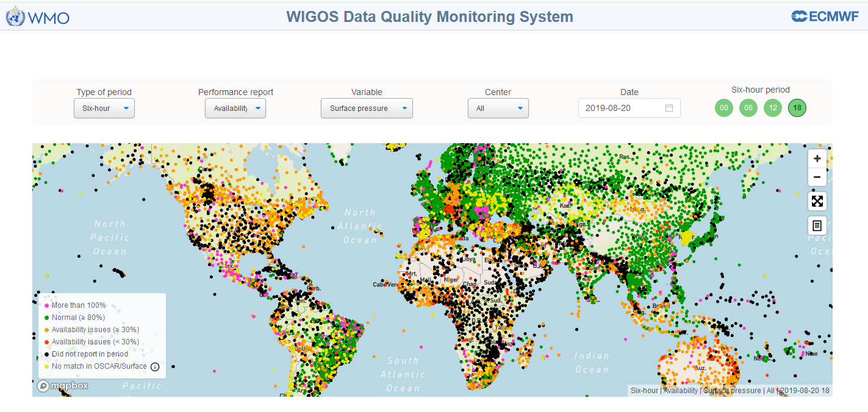
How to do the work in practice…
How to fulfil the above mentioned tasks and which background information is required can be found on the Moodle platform
https://etrp.wmo.int/course/view.php?id=173

Slide 10
Thank you
Tanja.Kleinert@dwd.de
www.wmo.int/wigos

