Slide 1
RA V Training Workshop on WDQMS for RWCs
Nadi, Fiji, 12 – 14 October 2022
How to evaluate the data availability performance of surface land stations

Slide 2
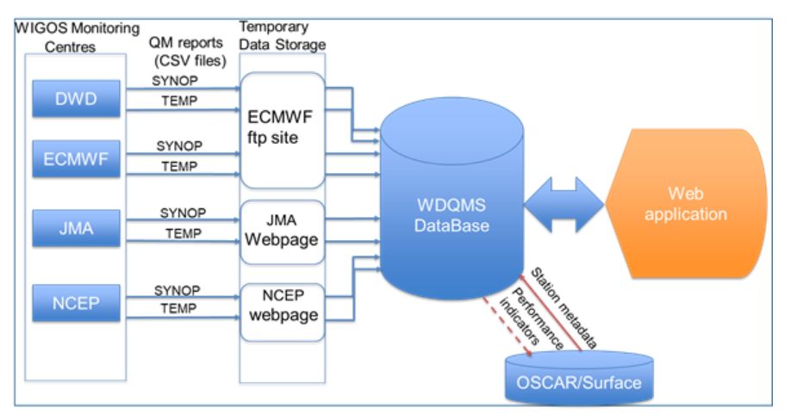
Category ‘Availability’ in comparison to OSCAR/Surface metadata
The monitoring of data availability of the surface-based network is based on performance figures of WIGOS Monitoring Centres (MC) obtained from comparing the observations received from the network to those required and expected to be ingested to the WMO Information System (WIS) according to the schedule of international exchange determined from OSCAR/Surface metadata or GBON requirement.

Slide 3
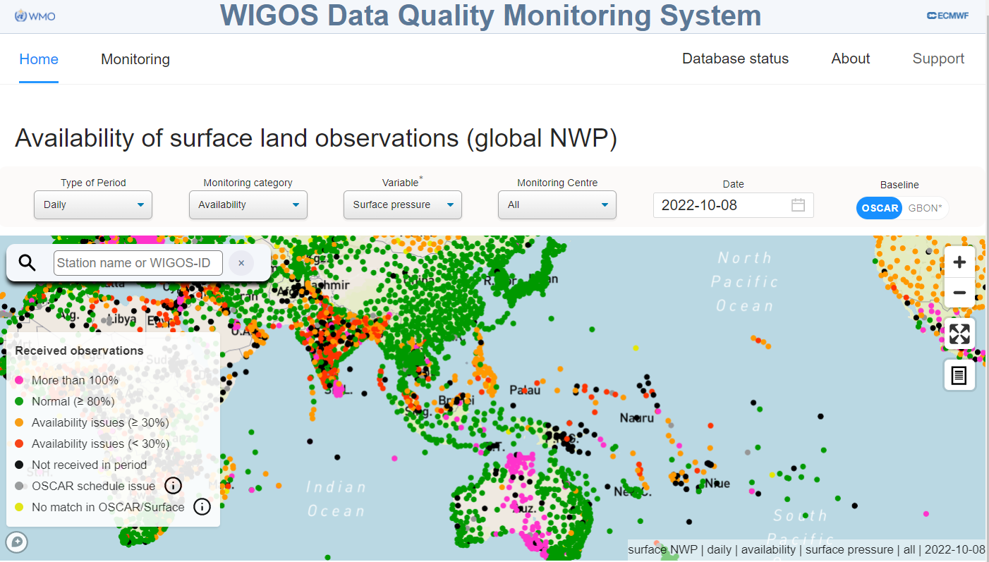
Category ‘Availability’ – highlighting observational issues
The WDQMS web tool gives near-real time information about the status of the observational network in terms of availability, highlighting the stations with observational issues, e.g. from not reporting at all to reporting less frequently than expected, and even showing stations that are not registered in OSCAR/Surface.

Slide 4
Different WIGOS MCs → different results
The differences in the WIGOS Monitoring Centre results occur mainly due to the fact that the data assimilation characteristics of each of the different WIGOS Monitoring Centres (NWP systems) differ
If at least one WIGOS Monitoring Centre shows ‘Normal’ (green) and others show different results, e.g. ‘Availability issues’ (orange or red), no action required by RWC

Slide 5
Display of ‘All’ centers
The WDQMS web tool allows selecting results of a particular WIGOS Monitoring Centre or the aggregation of all centres.
If ‘All’ is selected the results of all WIGOS MCs are combined into one figure concerning ‘Availability’.
The WIGOS MC results might differ due to various reasons
Hence, the daily summary combining all availability reports will be generated by selecting the best of all WIGOS MCs, i.e. the maximum availability result will be retained in the combined availability performance maps.

Slide 6
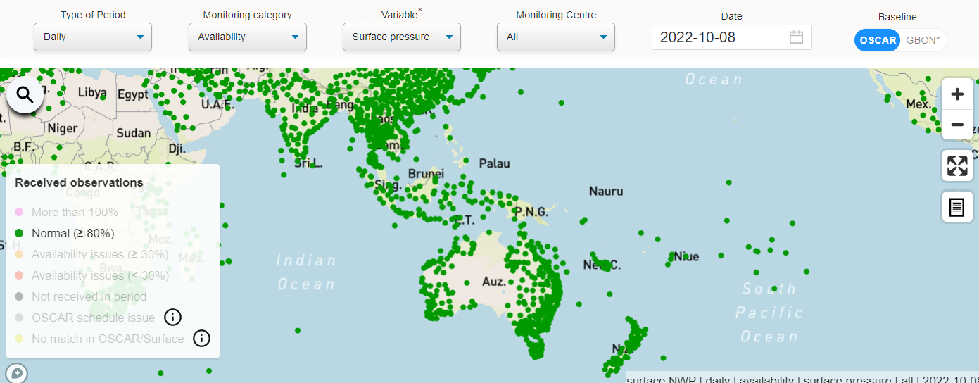
Normal (≥ 80%)
Stations shown as green dots
Normal (≥ 80%) – station is performing well ➔ no action required

Slide 7
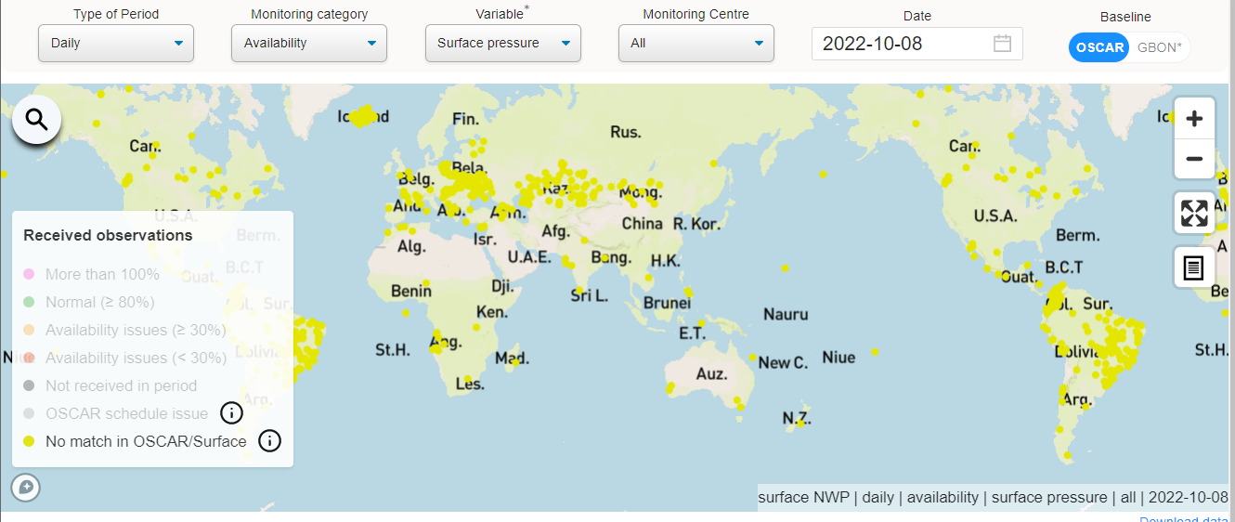
No match in OSCAR/Surface
No match in OSCAR/Surface – although data available on WIS!
Stations shown as yellow dots, are reporting but has not been registered in OSCAR/Surface so far, or at least there is not a match of the station ID ➔ action: RWC to initiate an incident management process (IMP) asking WDQMS NFP to contact OSCAR/Surface NFP

Slide 8
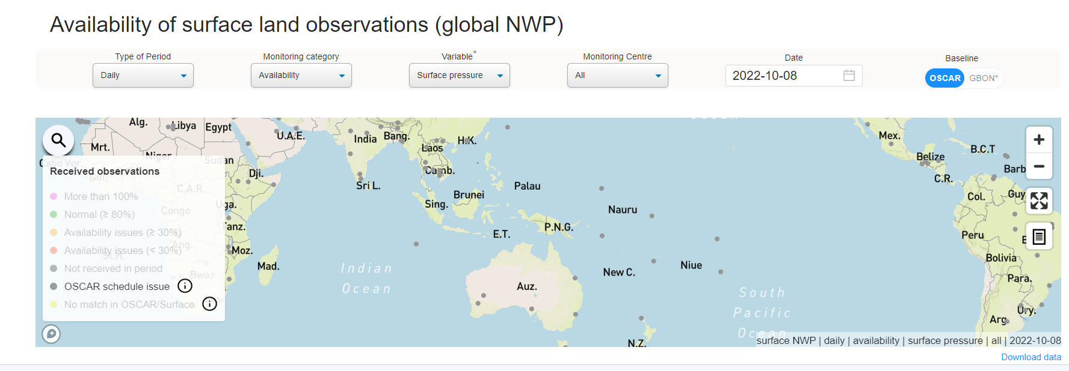
OSCAR schedule issue
Stations shown as grey dots, are reporting but there seem to be issues in the OSCAR schedule (potential reason: NMHS might report higher temporal resolution but didn´t set the field ‘international exchange’ correctly). ➔ action: RWC to initiate an incident management process (IMP) asking WDQMS NFP to contact OSCAR/Surface NFP

Slide 9
More than 100%
Stations shown as pink dots
More than 100% - actually a ‘happy problem’ because more data are shared internationally than indicated in OSCAR/Surface
Most likely there is an issue with the expected number of measurements in the metadata field ‘Reporting interval’ in OSCAR/Surface for this particular variable
➔ action: RWC to initiate an IMP asking WDQMS NFP to contact OSCAR/Surface NFP to make corresponding changes in OSCAR/Surface metadata

Slide 10
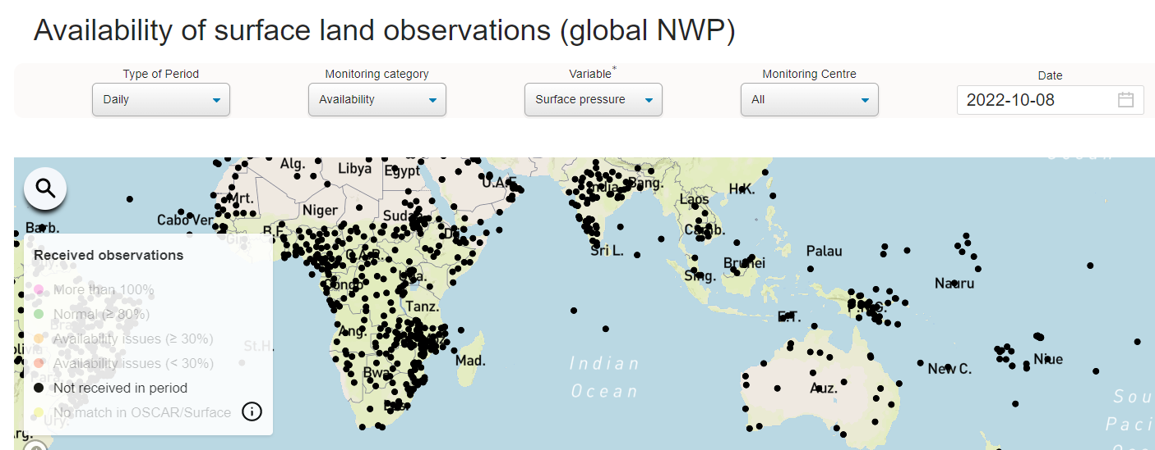
Not received in period
Data from stations shown as black dots were ‘Not received in period ‘ – this is shown especially when selecting ‘All’ Centers and the ‘Daily’ or ‘Alert’ display
If data of this station were not received since a longer period of time (more than 5 days) it is a ‘silent station’ ➔ action: RWC to initiate an IMP asking WDQMS NFP to take actions to investigate the cause of the incident and to find a solution

Slide 11
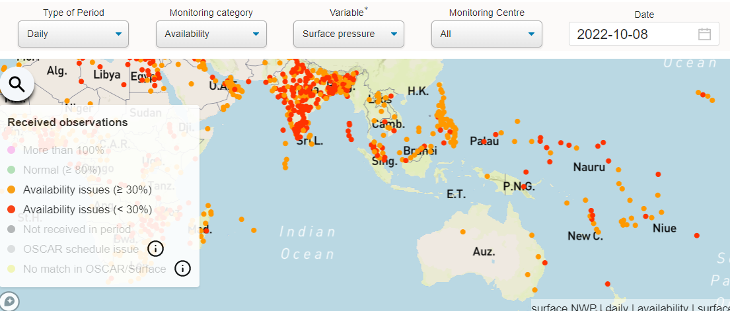
Availability issues (≥30%) and (<30%)
Stations showing orange or red dots have availability issues
If they continue to appear having ‘Availability issues‘ especially when selecting ‘All’ Centers and the ‘Daily’ or ‘Alert’ display ➔ action: RWC to initiate an IMP asking WDQMS NFP to take actions to investigate the cause of the incident and to find a solution

Slide 12
Reasons for data availability issues
There are several reasons for no or less data being received by the WIGOS Monitoring Centres. The causes for these issues have to be clarified by the country concerned; these could be for example:
Station is not intended to report to WIS (only national use of the data intended) – most likely shown as ‘Not received in period’ in the WDQMS web tool action ➔ WDQMS NFP together with OSCAR/Surface NFP to check GOS affiliation in OSCAR/Surface
Station is reporting less frequently to WIS as compared to what is declared/*GBON requirement– most likely shown as ‘Availability issue (≥ 30% or < 30%)’ or action ➔ WDQMS NFP together with OSCAR/Surface NFP to check reporting schedule for international exchange in OSCAR/Surface

Slide 13
Reasons for data availability issues (cont.)
The following reasons for no/less data being received by the WIGOS Monitoring Centres are most likely shown as ‘Not received in period’ or ‘Availability issues’ or in the WDQMS web tool:
Station data is expected in the WIS but no data available action ➔ WDQMS NFP to work with WIS NFP to check WIS dissemination, data transfer from site to RTH hub
No data received at RTH hub due to technical issue at site (data transmission or sensor malfunctioning or others) action ➔ WDQMS NFP to work with WIS NFP and/or maintenance technician to check data transfer from site or sensors at site

Slide 14
RWC starting to operationalize…
When a RWC is starting its WDQMS operations they should initiate incident management processes for long-term ongoing issues of the following types of issues before getting into detail with special incidents of particular stations:
No match in OSCAR/Surface
Stations which didn´t report for a longer period of time (i.e. so-called ‘silent stations’)
Stations reporting more than 100%

Slide 15
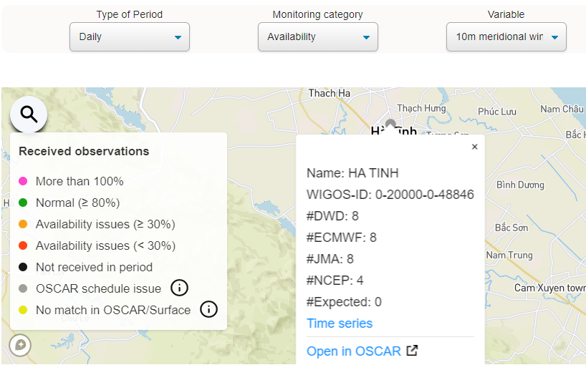
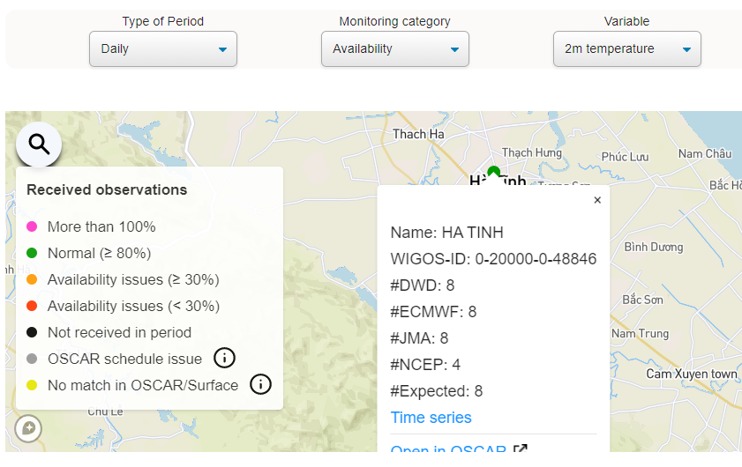
Examples of Data Availability
Station HA TINH (WIGOS-ID: 0-20000-0-48846) appears as grey dot (OSCAR Schedule issue) for 10m wind variable (15 July 2022)
Other variables appear as green dot

Slide 16
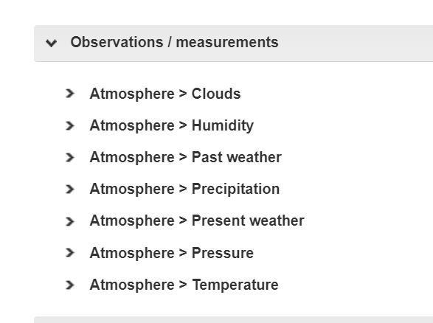
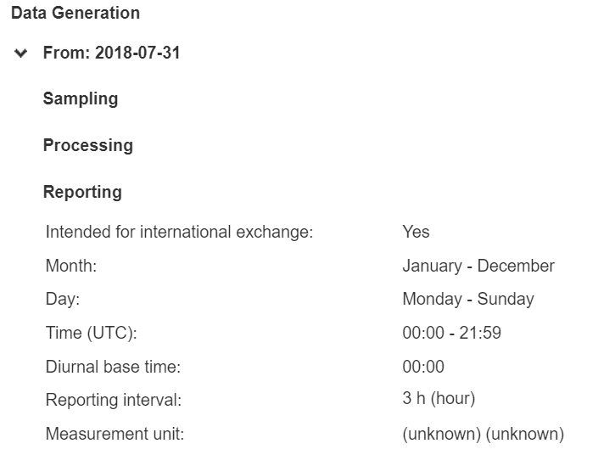
Examples of Data Availability
Data generation of temperature
No ‘wind’ measurement declared in OSCAR/Surface

Slide 17
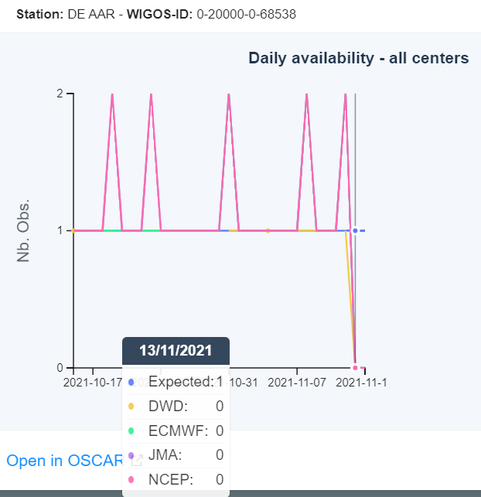
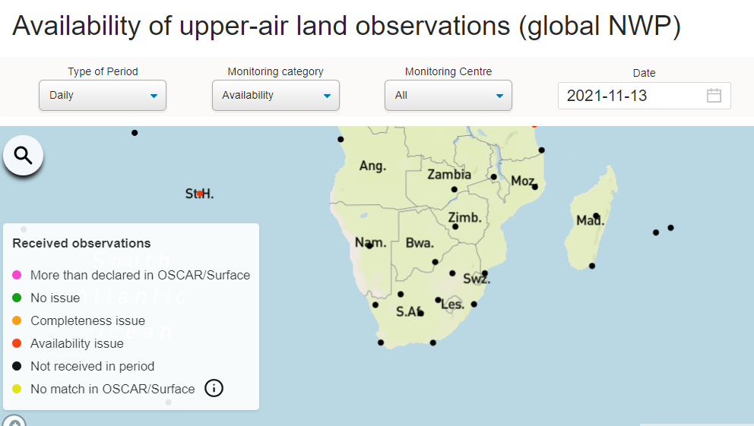
Another example
Upper air data outage since in SA Region since 13 Nov 2021

Slide 18
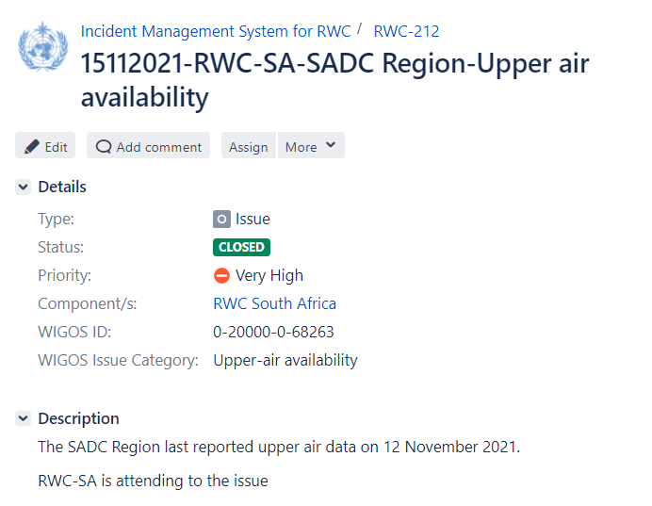
Another example (cont)
RWC Southern Africa evaluated the issue, then informed WMO Global Information System Centres (GISC) Pretoria about the issue
GISC Pretoria resolved the network issue
*In many cases, RWC should collaborate closely with other relevant centres, for example with RTH or GISC for data exchange issue
**By reporting the issue in the IMS, Members would be aware that it had been followed up and it’s documented

Slide 19
Thank you

