Slide 1
RA V Training Workshop on WDQMS for RWCs
Nadi, Fiji, 12 – 14 October 2022
Examples and Discussion Potential Different Resof WIGOS Monitoring Centre

Slide 2
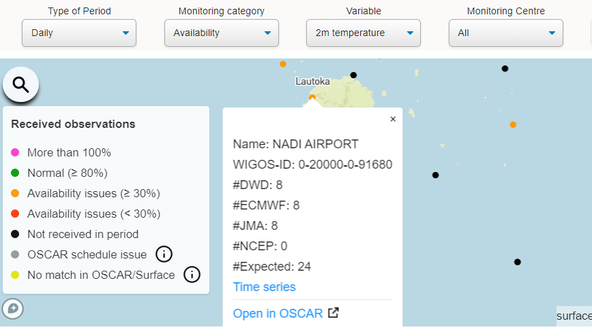
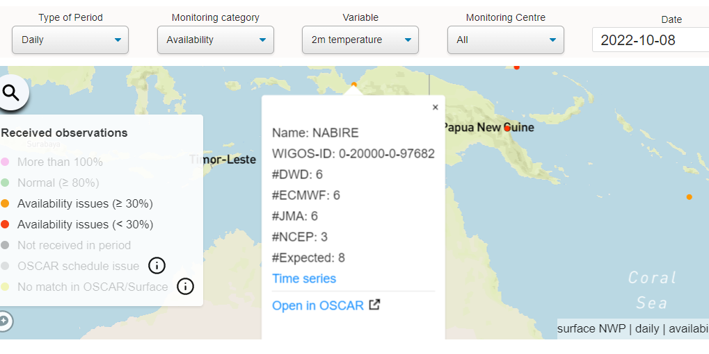
Example 1
NCEP shows lower data availability
NCEP monitoring reports show only the data that pass a quality control step prior to DA, therefore part of the data available that is deemed to be of poor quality or duplicate is filtered out and not available to the DA.

Slide 3
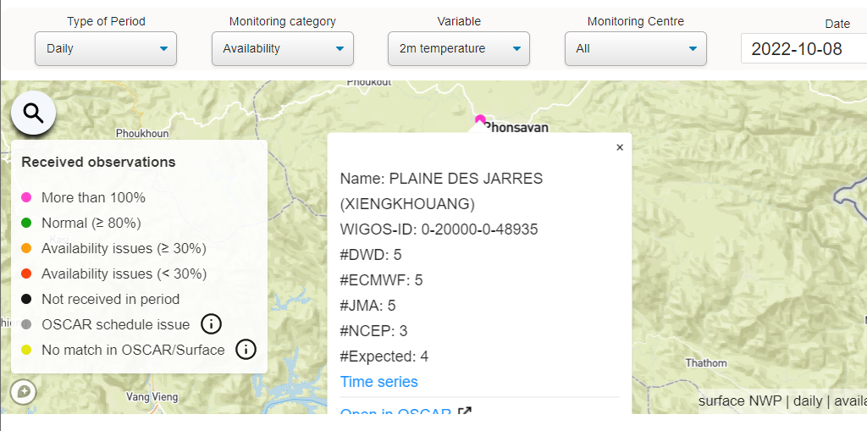
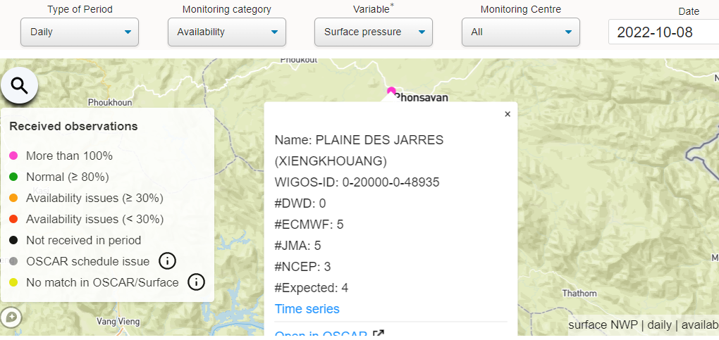
Example 2
DWD provides monitoring information for all observations available to their DA system. However, in the case of surface pressure the model background value is not available if that observation is not used in the assimilation.
Therefore, the surface pressure O-B departures cannot be calculated for that particular observation, and the O-B departures field is flagged (has missing value in the monitoring report) despite the fact that the observation itself has been made.

Slide 4
Thank you

