Slide 1
RA V Training Workshop on WDQMS for RWCs
Nadi, Fiji, 12 – 14 October 2022
Data Exchange between OSCAR/Surface and WDQMS

Slide 2
WIGOS Data Quality Monitoring System (WDQMS)
Operational since March 2020
Monitor availablity, quality, completeness and timeliness* of WIGOS component observing systems
First phase, GOS networks: surface and upper-air stations
Second phase Global Climate Observing Systems stations: GSN and GUAN (added since March 2021, version 1.3.1)
Monitoring reflects observations as seen by WIGOS monitoring centers. Currently: DWD, ECWMF, NCEP and JMA
Monitoring by 6h and daily intervals (monthly to be implemented)

Slide 3
When will station appear in WDQMS Webtool?
The WIGOS Data Quality Monitoring System webtool retrieves metadata information from OSCAR/Surface on a daily basis.
if the metadata has been updated today, tomorrow's maps should reflect that change. If a new station is added to OSCAR/Surface, it should appear on the WDQMS availability map on the next day.
If that does not happen, it means that some fields may have not been correctly populated in OSCAR/Surface and this needs to be reported to the RWCs.

Slide 4
Which stations are monitored?
WDQMS obtains station information from OSCAR/Surface
Surface stations
facilityType: seaFixed, lakeRiverFixed, lakeRiverMobile, landFixed, landMobile, landOnIce and airFixed
International Exchange == True
Observes one of the variables monitored (pressure, temperature, precipitation, wind)
Upper Air stations
StationClass: upperAirRadiosonde, upperAirPilot
Only currently «operational» or «partlyOperational» stations are considered.
The operating status of the network/program affiliated with the variable is used

Slide 5
Status/color of a station in WDQMS Webtool
The number of observations received at monitoring centers is compared either, to
OSCAR/Surface schedule metadata
A provisional GBON baseline (1h surface and 12h upper-air observations)
OSCAR/Surface schedules
schedules for the variable and compute number expected for given 6-h period
Default schedule applied if not declared in OSCAR/Surface (3h for surface and 12h for upper air)

Slide 6
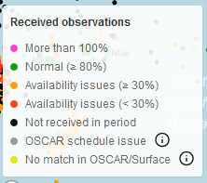
Status/color of a station in WDQMS Webtool (cont)
Number received is compared with number expected (green, orange, red, black, pink)
Yellow: data received by monitoring center but no entry in OSCAR/Surface
Grey: data received by monitoring center & OSCAR/Surface entry, but schedule indicated no report
Examples:
number expected 6, number received 3 => orange (50%)
Number expected 6, number received 7 => pink (>100%)

Slide 7
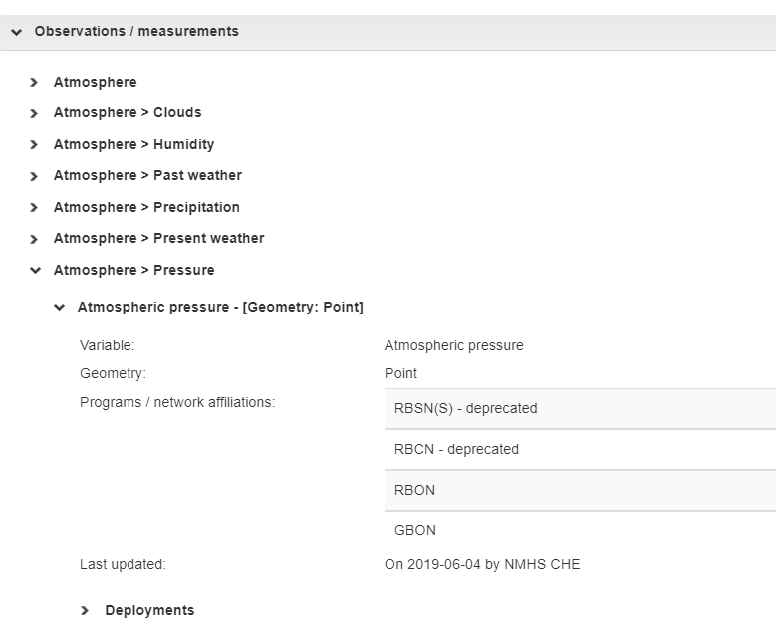
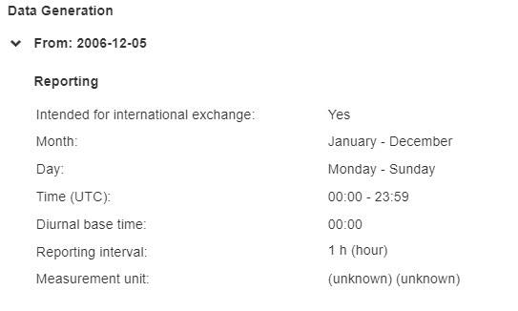
Critical elements in OSCAR/Surface

Slide 8
FAQ
Why is my station being monitored in WDQMS?
Check international exchange flag
You are observing a variable tracked by WDQMS (pressure, temperature, wind, humidity)
Deployment not closed?
Operating status of affiliated network?
Reporting interval in data generation
Why is my station red/orange but I am making all the observations
Observations get lost in transit
Schedule information in OSCAR/Surface not correct

Slide 9
Thank you

