Slide 1
Israel National Flood Forecasting Center
structure and operation
State of Israel
Water Authority

Slide 2
Flood prediction challenges
Most of the population is situated along the coast
In the arid regions there are roads and hiking routes
Armon et al., 2018

Slide 3
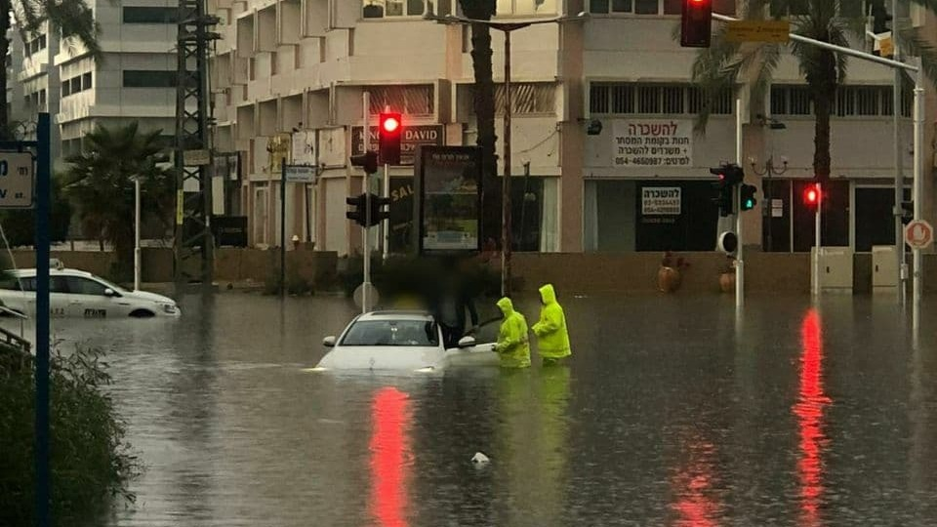
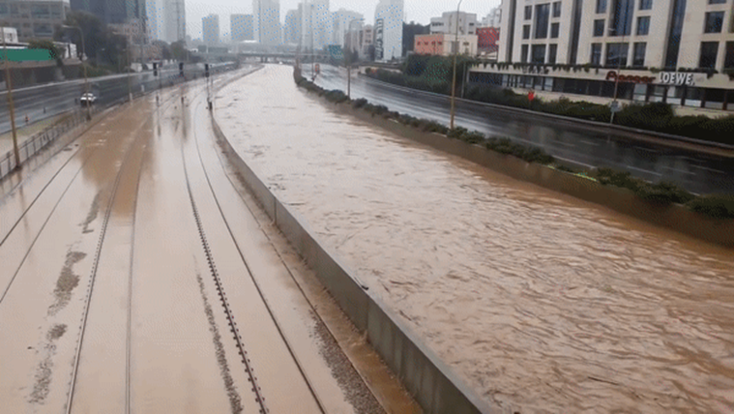
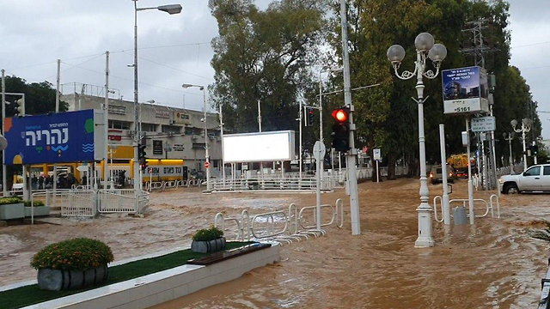
Ness Ziona – 2020
Urban areas
Tel Aviv – 2013
Nahariya – 2020

Slide 4
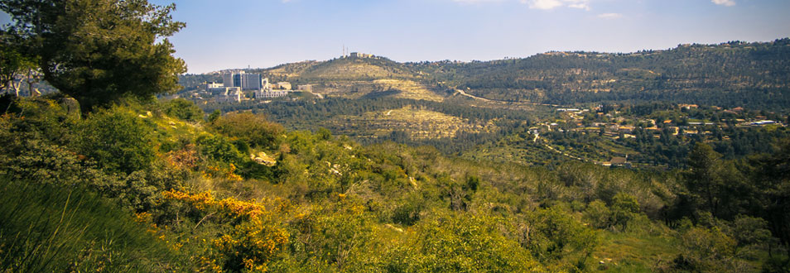
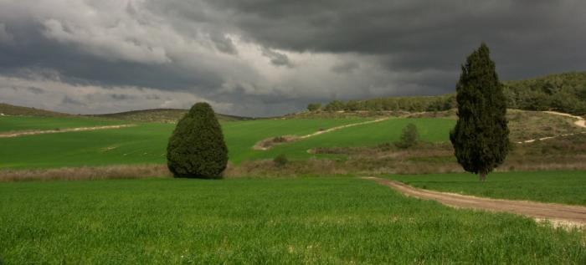
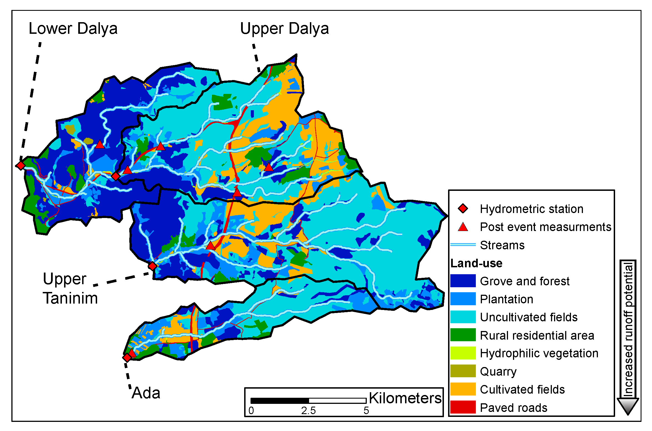
Mediterranean areas

Slide 5
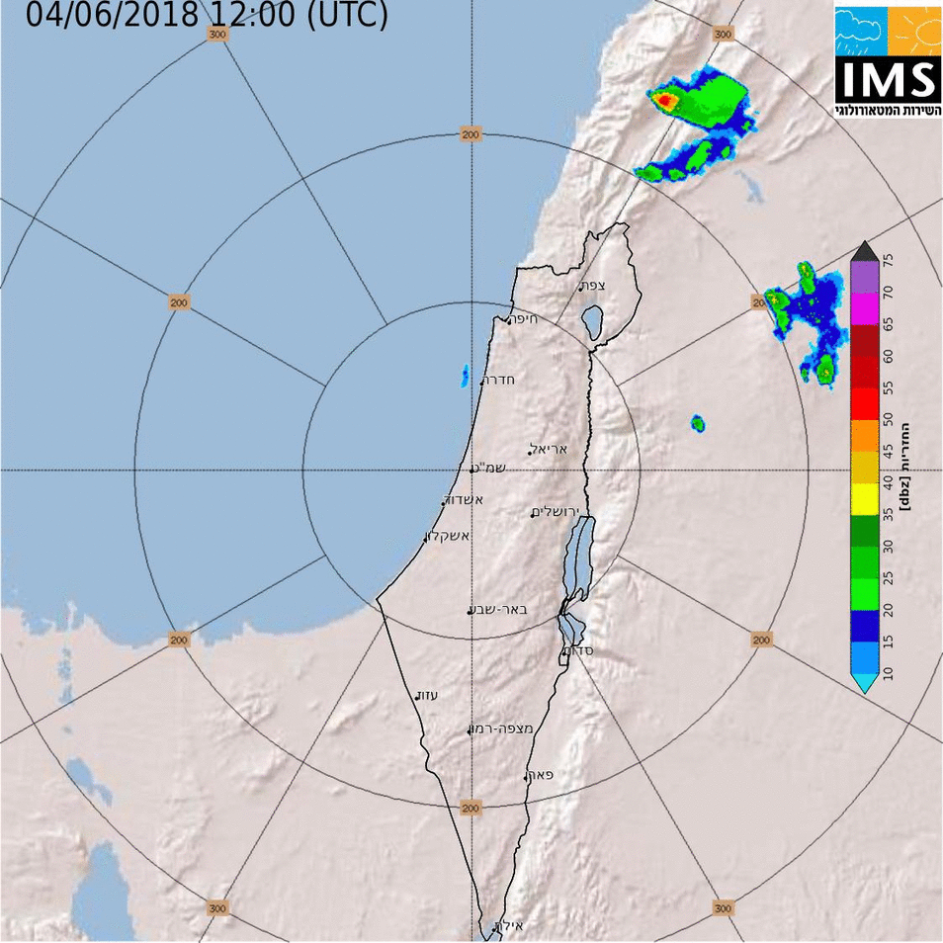
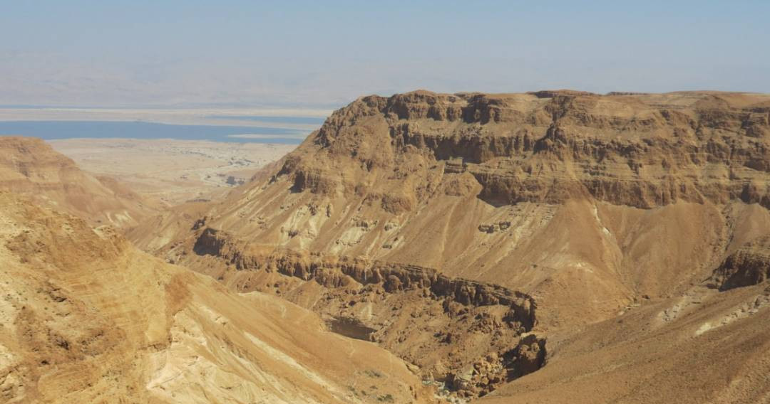
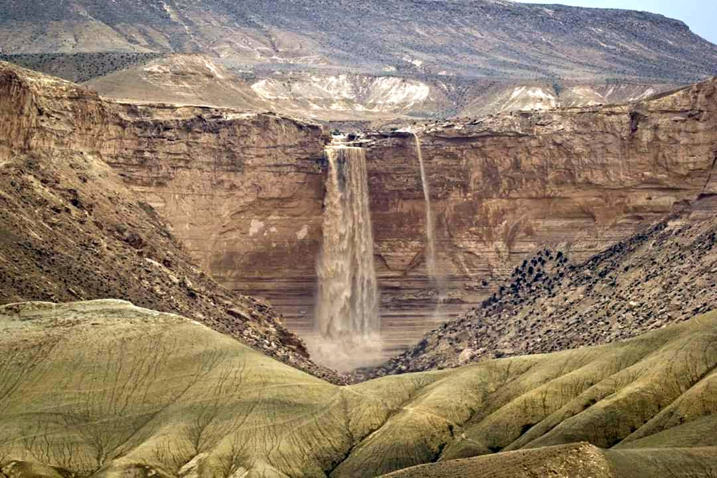
Arid areas
Photo: Reuters
Notes:
45 cacualties in 2018

Slide 6
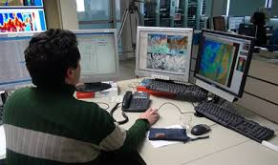
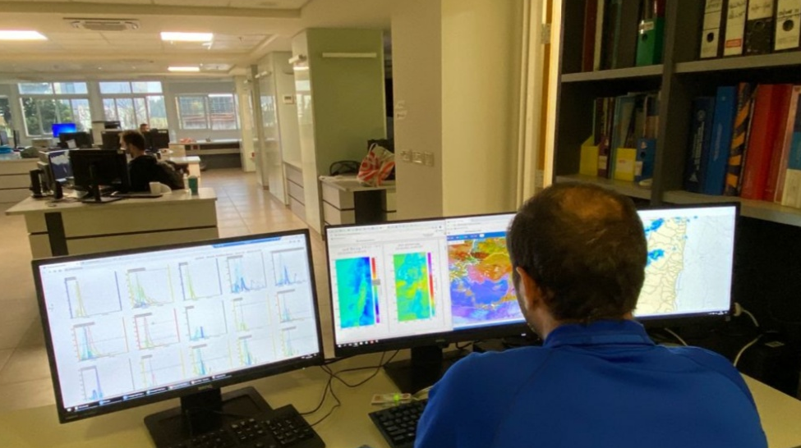
Israel needs a National Flood Center
Protecting lives and property
Distribute hydrological forecasts and warnings
Fully support civil protection agencies
Monitor rainfall and discharge and distribute constant updates
Notes:
45 cacualties in 2018

Slide 7
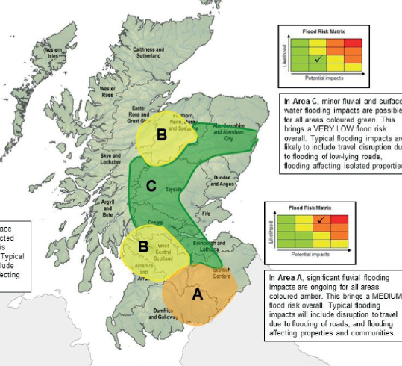
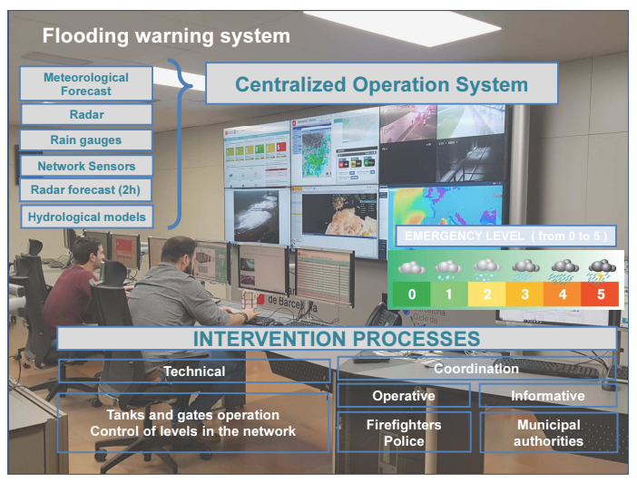
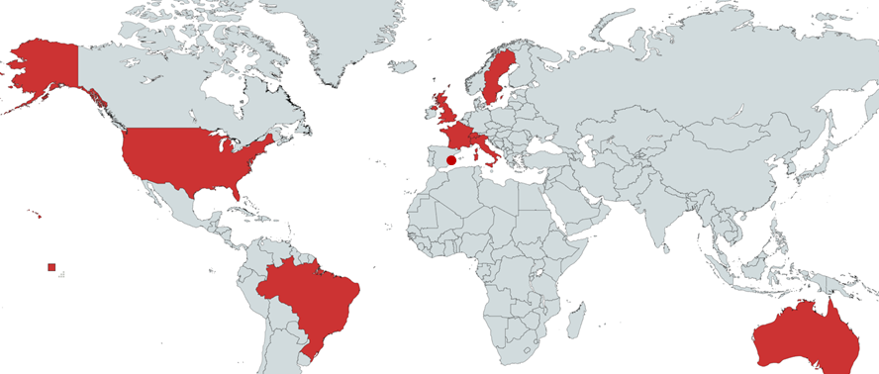
Forecast centers and tools survey (13)

Slide 8
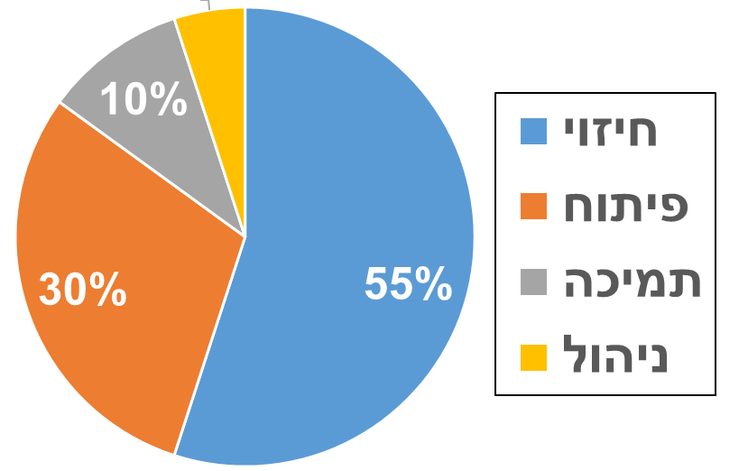
Review main findings:
In each country
2-3 hydrological developing centers
Central + regional flood forecasting centers with 8-15 people
Each centers operates 2-4 hydrological models
WMO – suggest 24 personals for management, forecasting, development and support
Forecast
Develop
Support
Manage

Slide 9
IMS
NWP
Drainage authorities
Impact assessment
IHS
Hydrological models
Dissemination to the public
Forecast and warnings
Feedbacks
Discharge monitoring
precipitation monitoring
Joint effort - interoffice cooperation
Notes:
45 cacualties in 2018

Slide 10
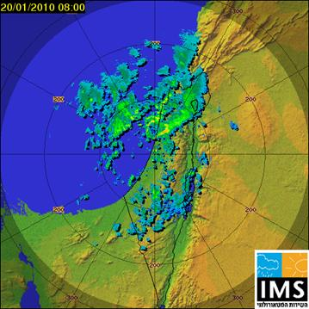
Forecasting making process
Emergency forces
Government agencies
Hydro- models
Web site
Meteorological forecasters
Data & Analysis system
Hydro -forecasters
General Public
Expert consultation

Slide 11
Personal
HYDRO
Hydrological modeling
HEC
RC
Surface water and hydrometeorology
Head of flash flood center
Main forecaster
Head of forecasters
Forecasters X 3

Slide 12
Operational scheme
Observations
Hydrological models
IMS + HIS discussion
Estimate impacts
NWP models
Forecast distribution & updates
Feedbacks + review
Daily / sub-daily

Slide 13
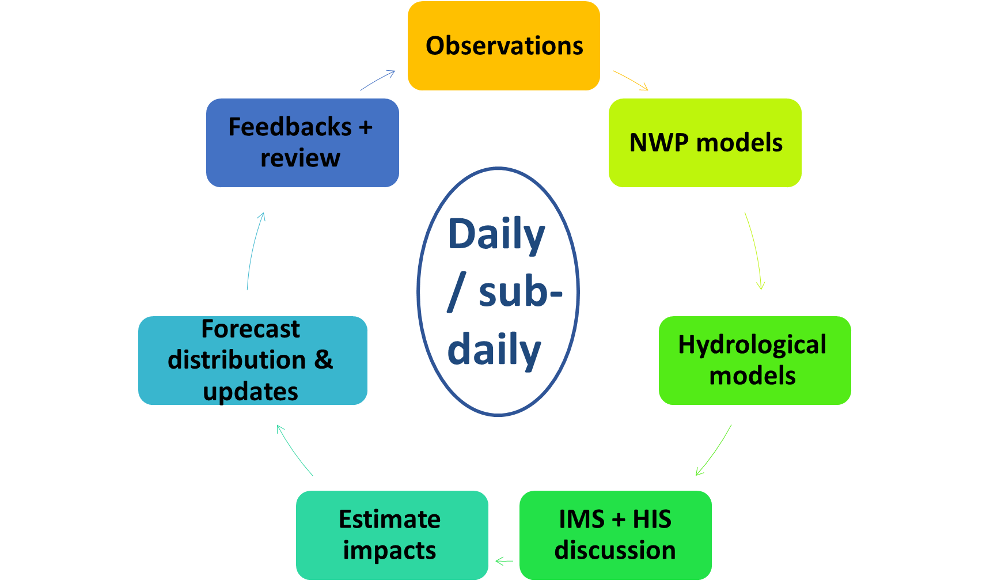
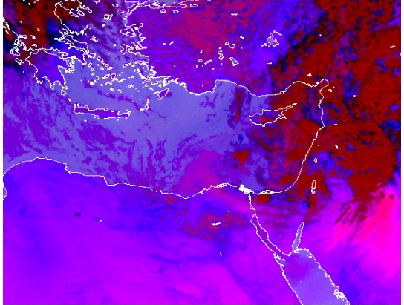
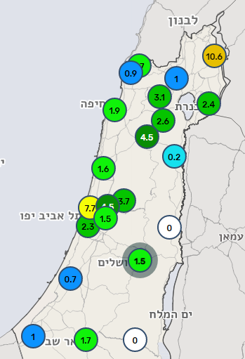
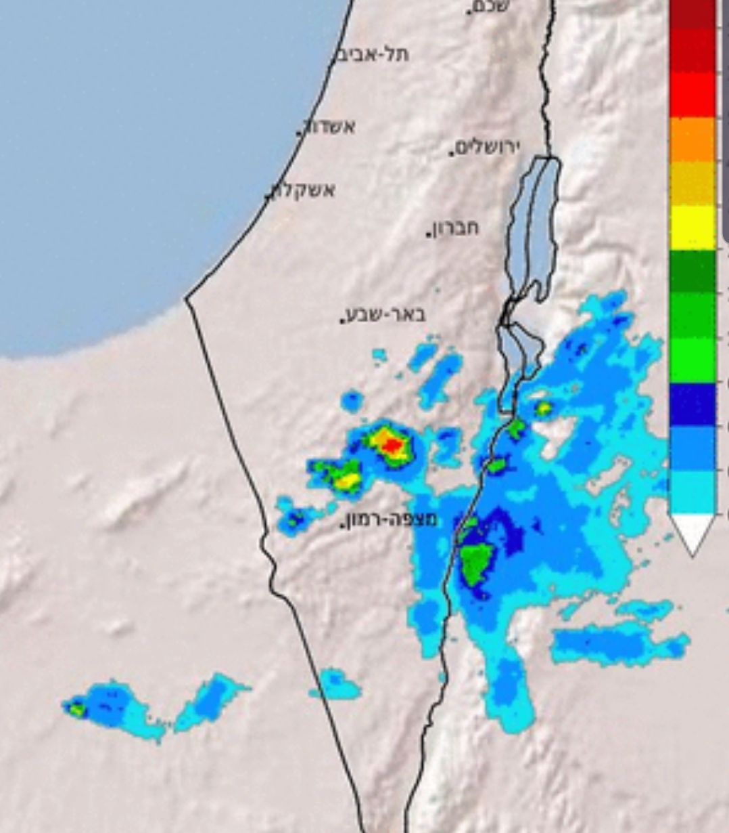
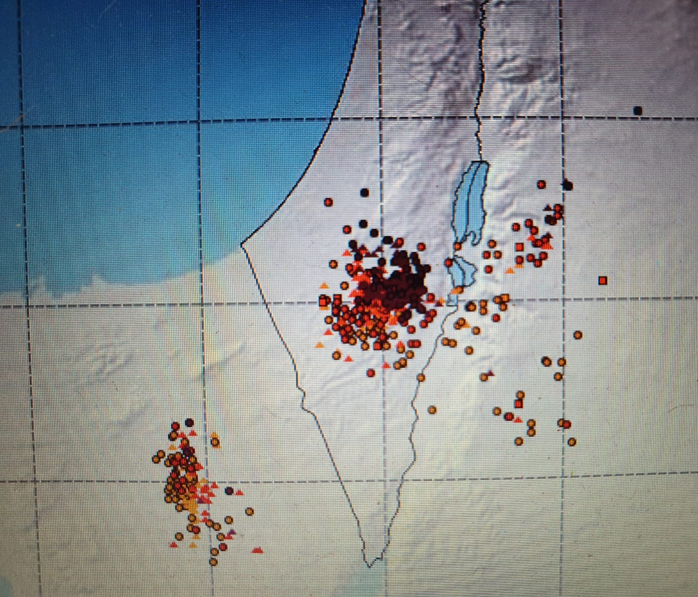
Observations precipitation
Satellite products
Rain gages
Radar
Lightning detection

Slide 14
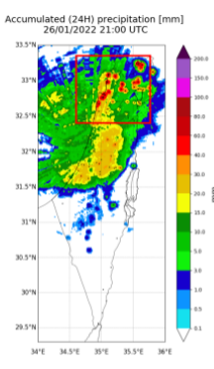
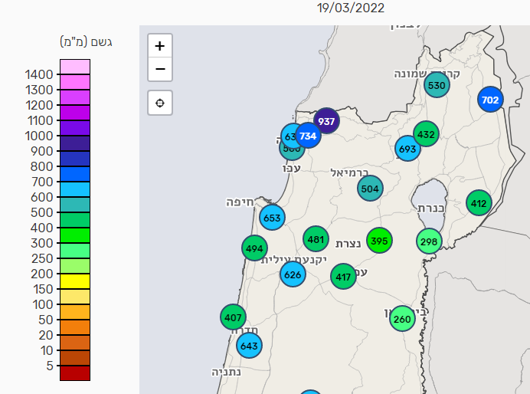
Observations - accumulated precipitation and soil moisture
Soil moisture
Accumulated rain from radar
Accumulated rain from gages

Slide 15
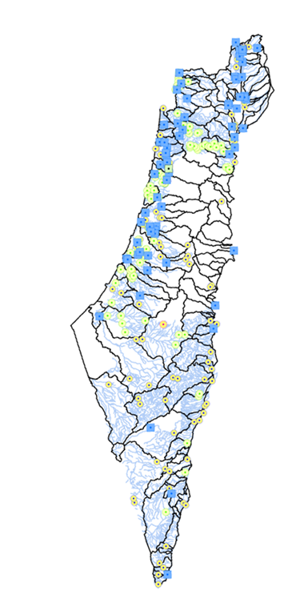
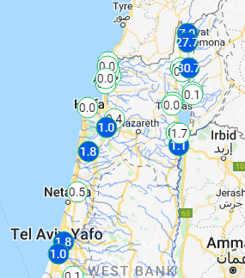
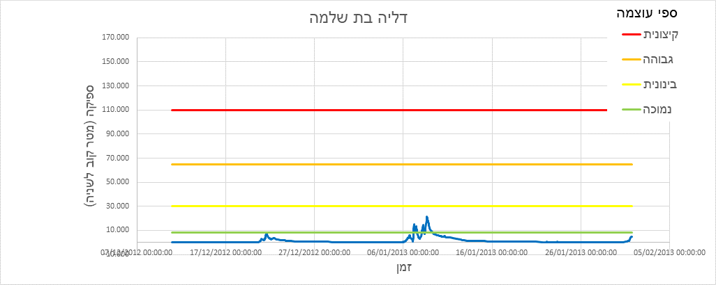
Observations discharge
170 Discharge gages out of which 100 (blue) broadcast
Broadcast resolution varies from 15’ to 60’

Slide 16
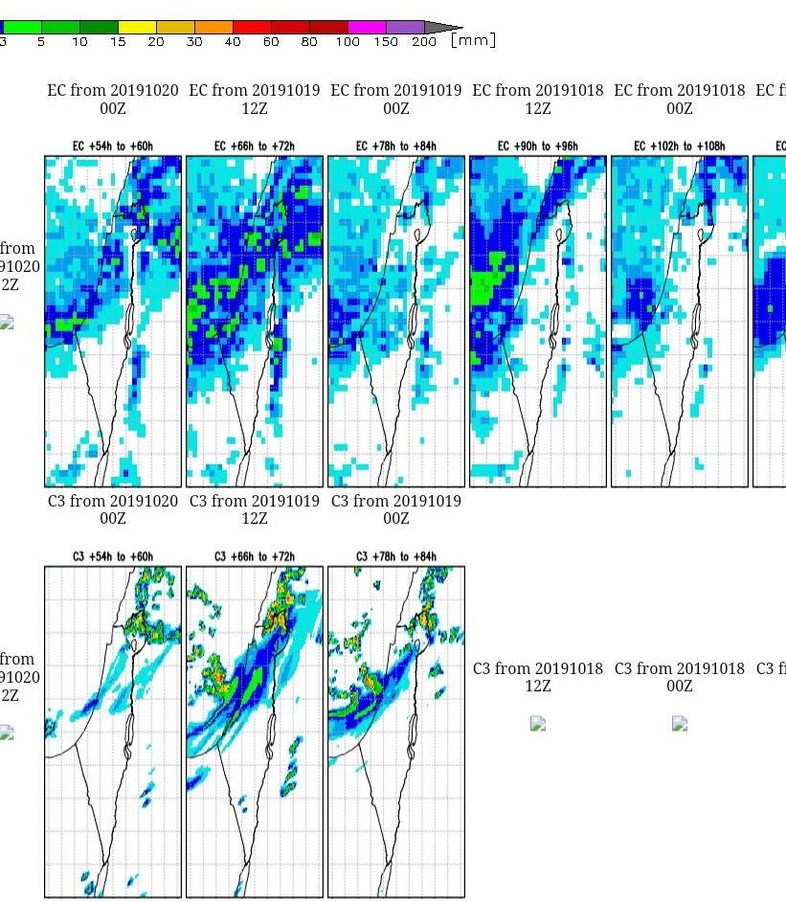
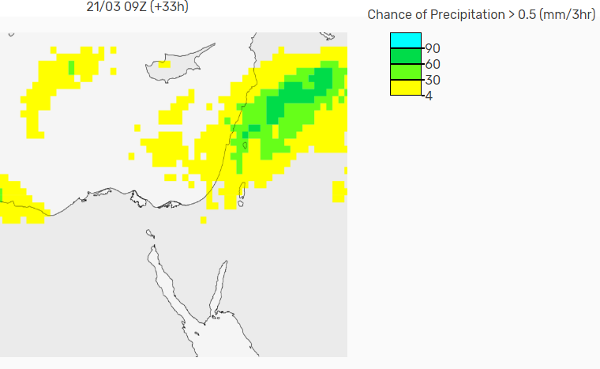
NWP models

Slide 17
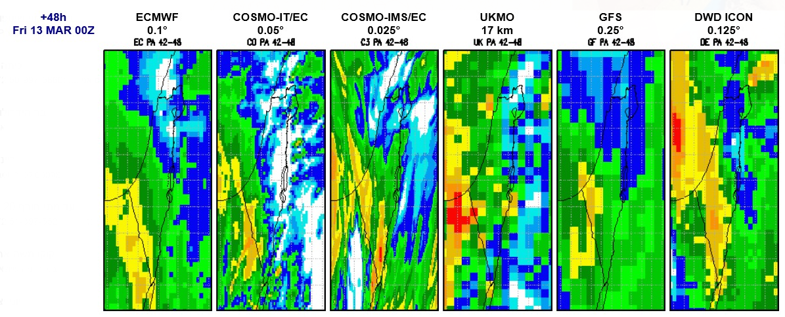
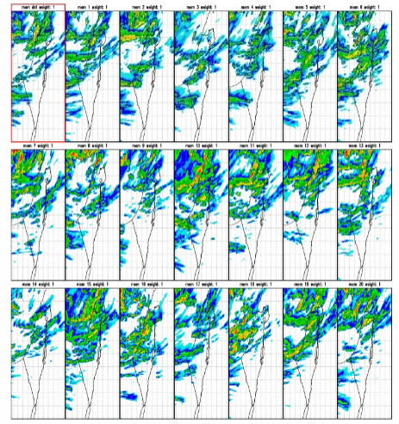
NWP models
Eilat

Slide 18
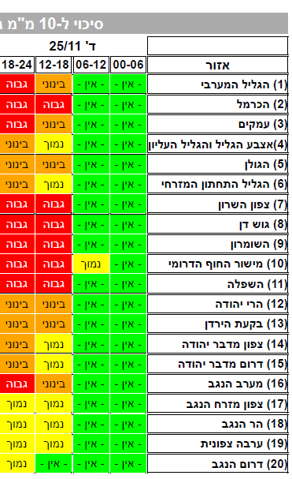
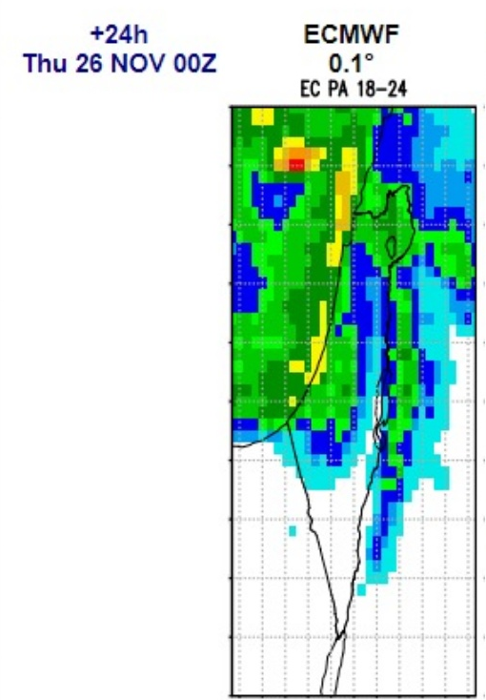
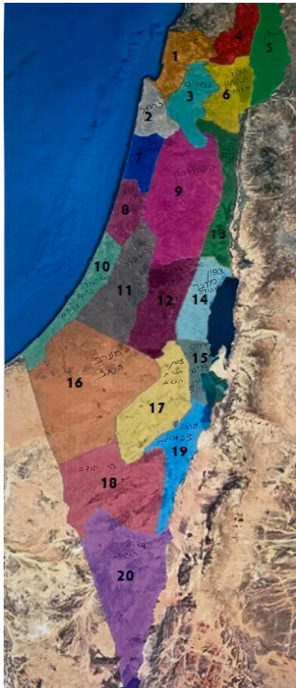
NWP models
Exceed 10 mm

Slide 19
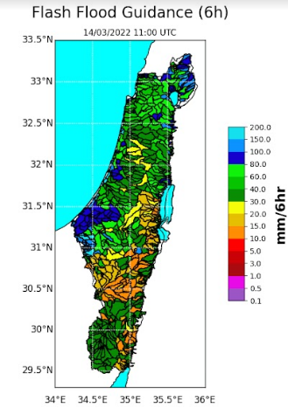
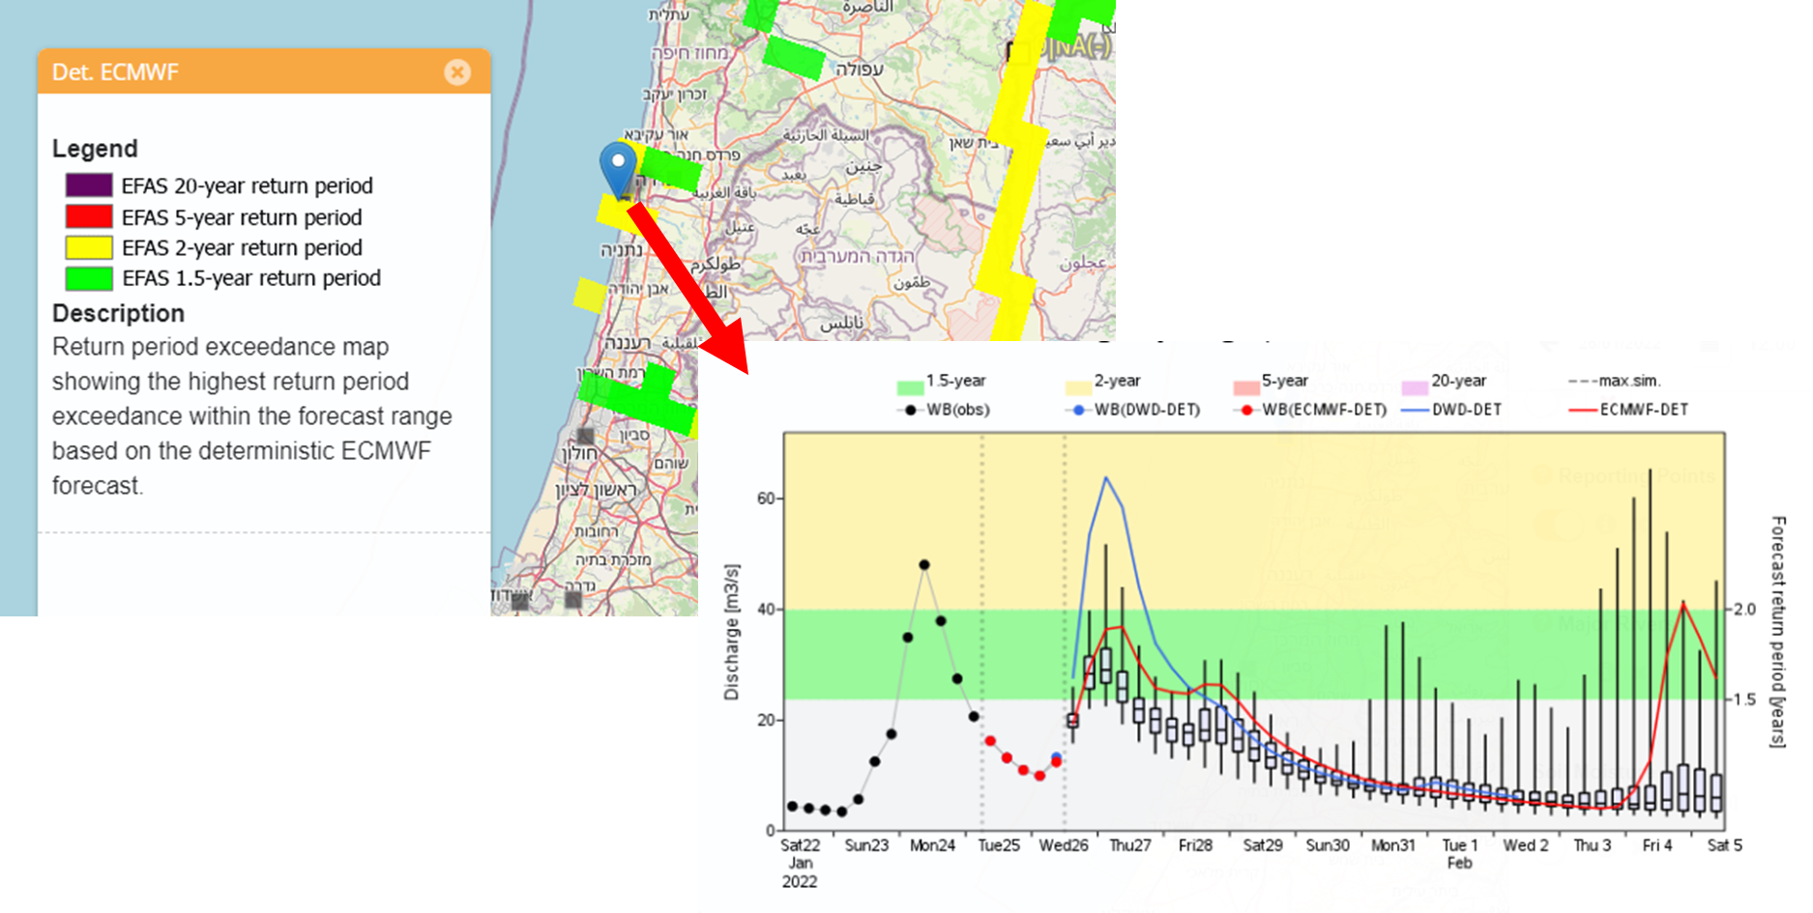
Hydrological models

Slide 20
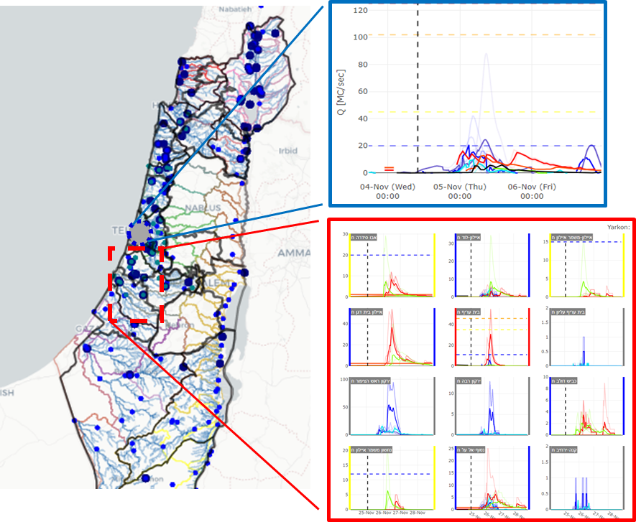
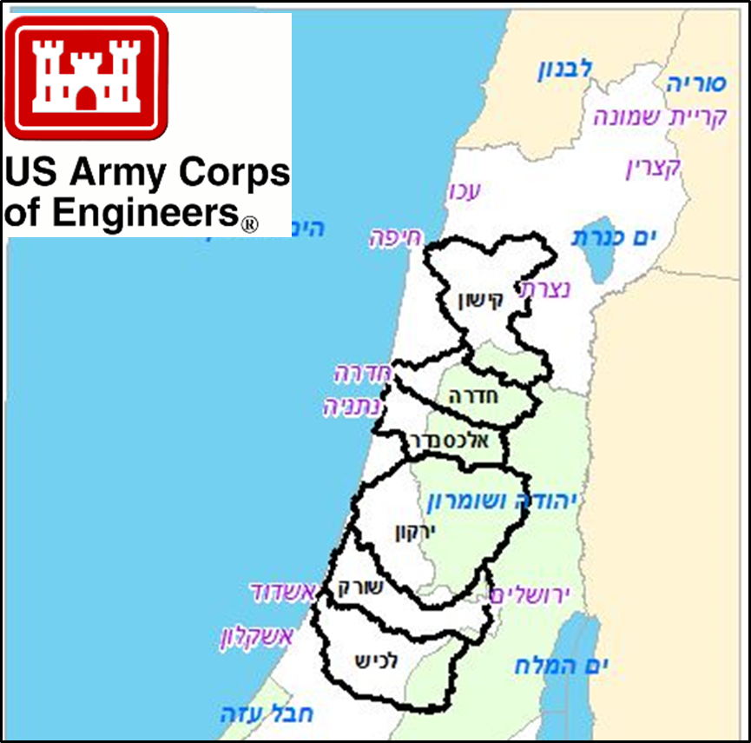
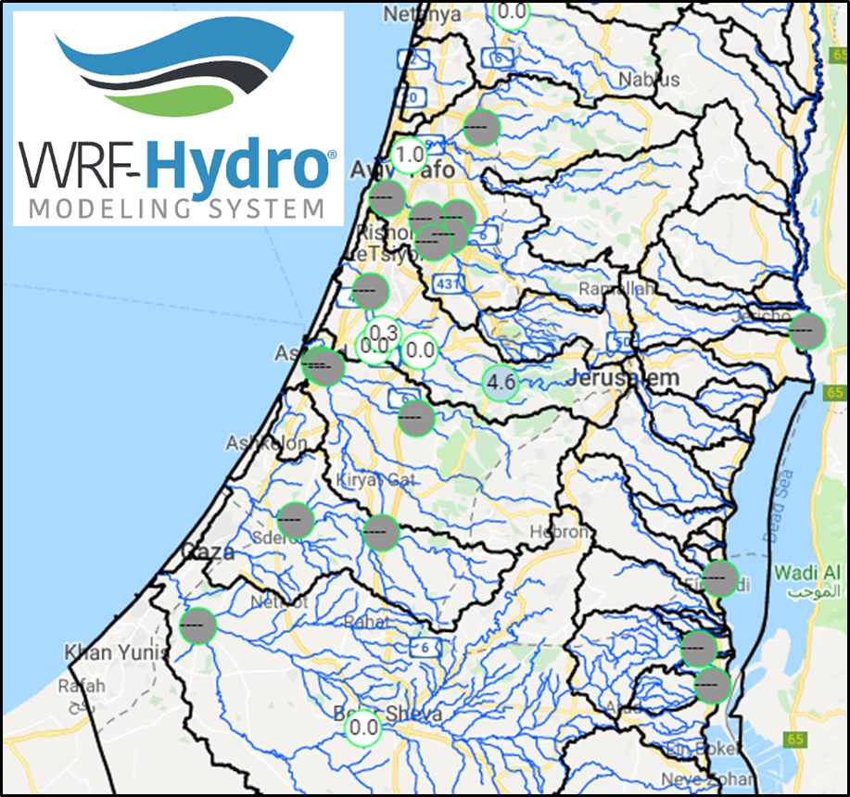
Hydrological models

Slide 21
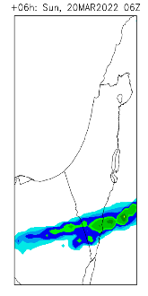
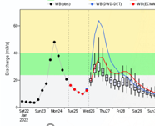
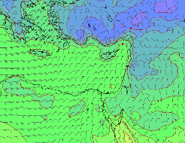
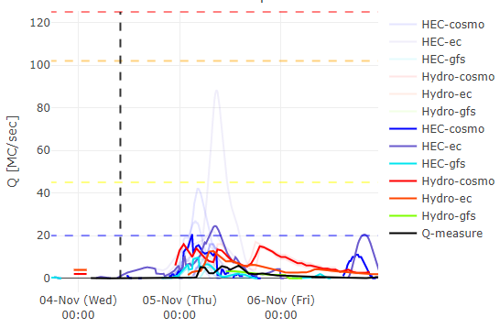
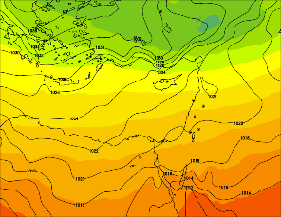
IMS + HIS discussion
Daily synoptic discussion

Slide 22
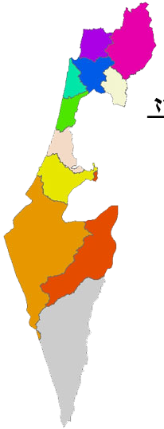
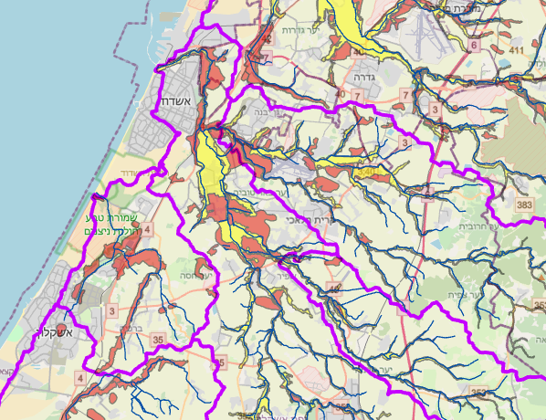
Estimate impacts

Slide 23
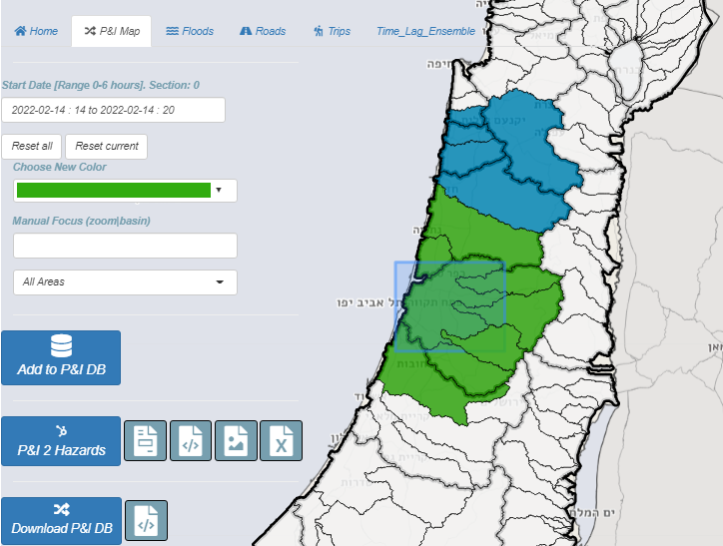
Forecast distribution & updates
Daily forecast
Detailed forecast + maps – 36h lead time with 6h resolution + 84h outlook
Continuous updates throughout the event
Dissemination to the civil protection forces
Dissemination to the general public via the IMS webpage

Slide 24
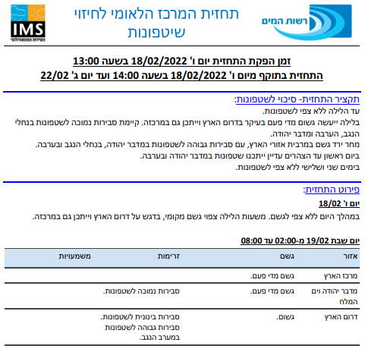
Forecast distribution & updates

Slide 25
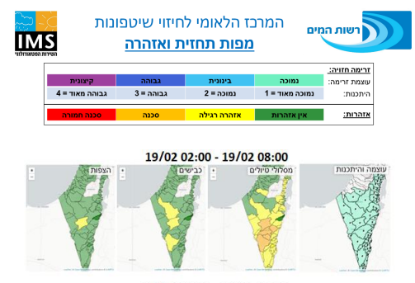
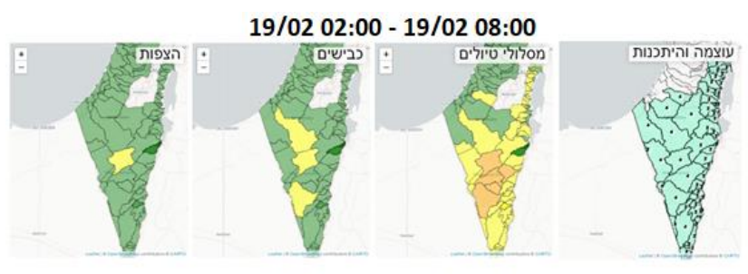
Forecast distribution & updates

Slide 26
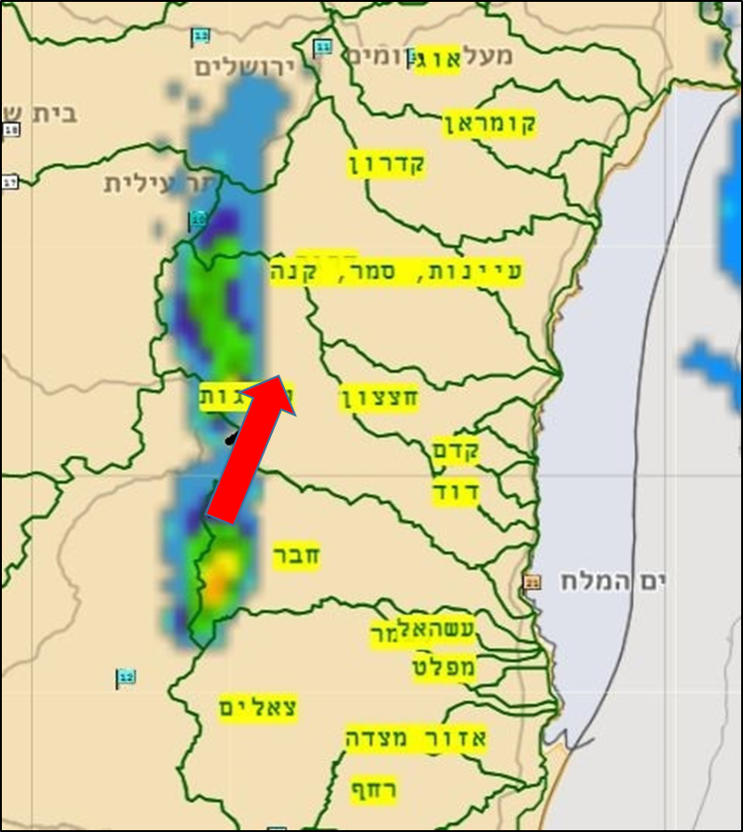
Forecast distribution & updates
01/02/2022 13:33
Intense rainfall over central dead-sea basins
01/02/2022 15:33
Alert: high water level was detected at Hever basin – flood is expected at road 90 within 20 minutes

Slide 27
Forecast distribution & updates
Wednesday 01.08.2020:
07:30: Intense rainfall at the north (see attached figures)
09:30: Moderate stream flow was detected at the western Galilee and is expected to rise.
11:00: Steams flows are on the rise. Immediate flooding is expected in Nahariya
12:30: Flooding in Nahariya

Slide 28
Feedbacks + review
Report about current conditions from drainage authorities
Feedbacks form the field

Slide 29
Feedbacks + review
Collect reports from media:
Collect reports from data other sources

Slide 30
Feedbacks + review
Event report
Draw conclusions and recommendations

Slide 31
Work plan, personal
Recruit hydrological forecasters
Recruit urban hydrology modeler
Recruit hydrological modelers

Slide 32
Work plan, hydrological models and tools
Apply data assimilation to HEC
Improve HYDRO
Moving to hydrological ensemble
Improve nowcasting or short-runs
Testing other models (GRP, HYPE…)
Strengthen collaboration with Efas
Calculate rainfall and discharge thresholds
Calculate flood response times
Map flood plains and hazards

Slide 33
Work plan, forecast dissemination and tools
Public forecast dissemination on the IMS web-site
Build civil protection forces user interface
Forecasts
Warnings
Updates
Feedbacks
Improve forecaster user interface
Improved model presentation
Auto warnings and alerts

Slide 34
Work plan, urban pluvial flooding
Literature review + urban flood forecasting centers and tools review
Map hazards and flood sensitives regions with the municipalities
Semi-auto alerts and warnings
Adopt and apply models and tools

Slide 35
Water Authority

