Slide 1
Israel National Flood Forecasting Center
Hydrological Models and Tools
State of Israel
Water Authority

Slide 2
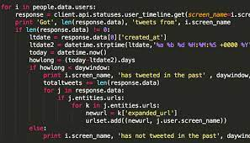
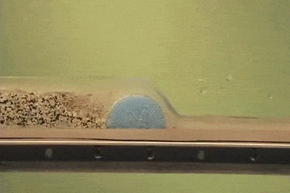
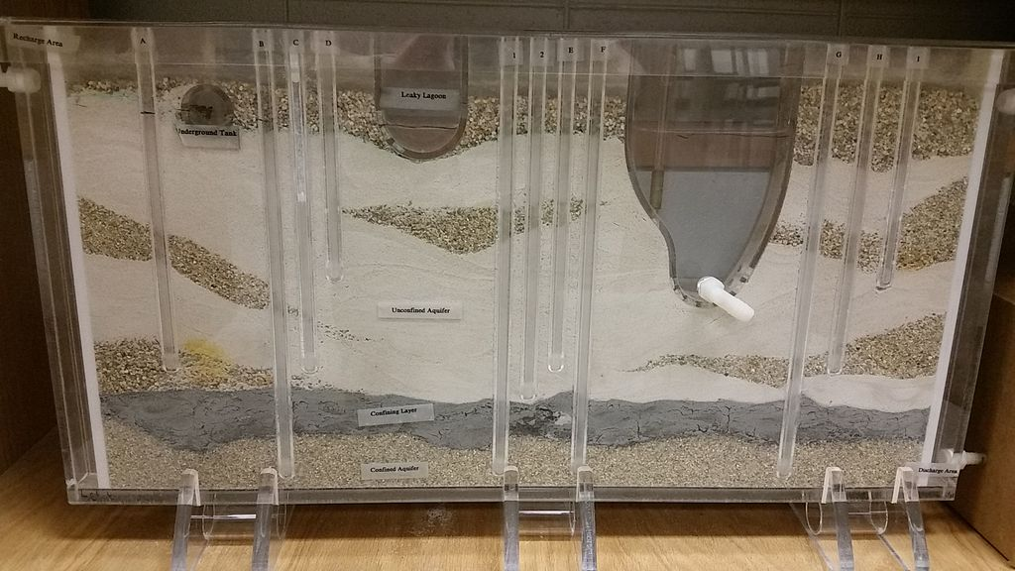
What’s an hydrological model? (quick reminder)
Some tool (computer program / instrumental setting) that simplifies and describes natural system and help us to study, simulate and predict

Slide 3
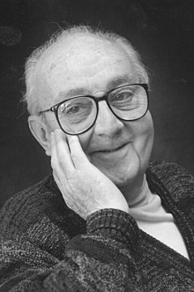
What’s an hydrological model? (quick reminder)
All models are wrong but some are useful (George Box, 1976)
https://en.wikipedia.org/

Slide 4
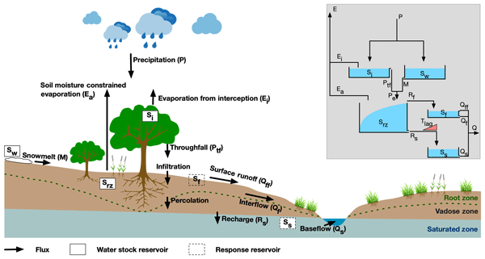
Hydrological models? (quick reminder)

Slide 5
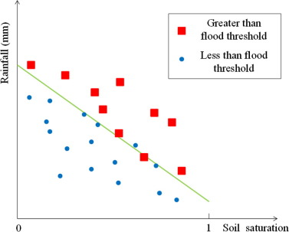
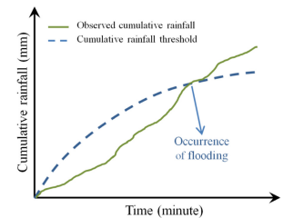
Hydrological models? (quick reminder)
Threshold based tools:
Ke et al., 2020
Qinghua et al., 2016

Slide 6
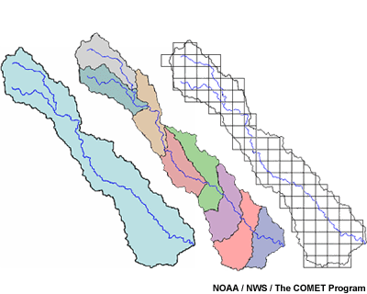
Hydrological models? (quick reminder)
Lumped
Semi distributed
Distributed

Slide 7
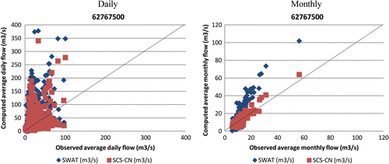
Hydrological models? (quick reminder)
Complicated is not always better
מורכב
פשטני

Slide 8
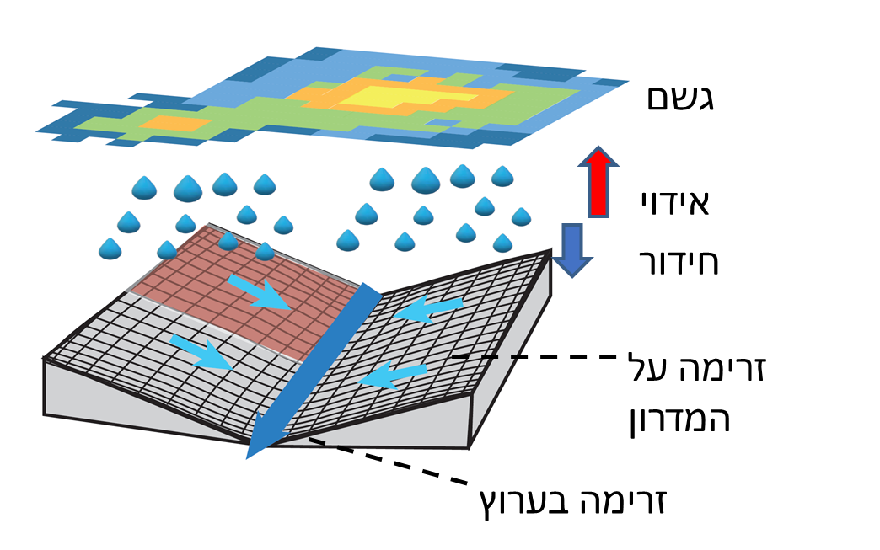
What’s an hydrological model? (quick reminder)
Rainfall
Evaporation
Infiltration
Overflow
Stream flow

Slide 9
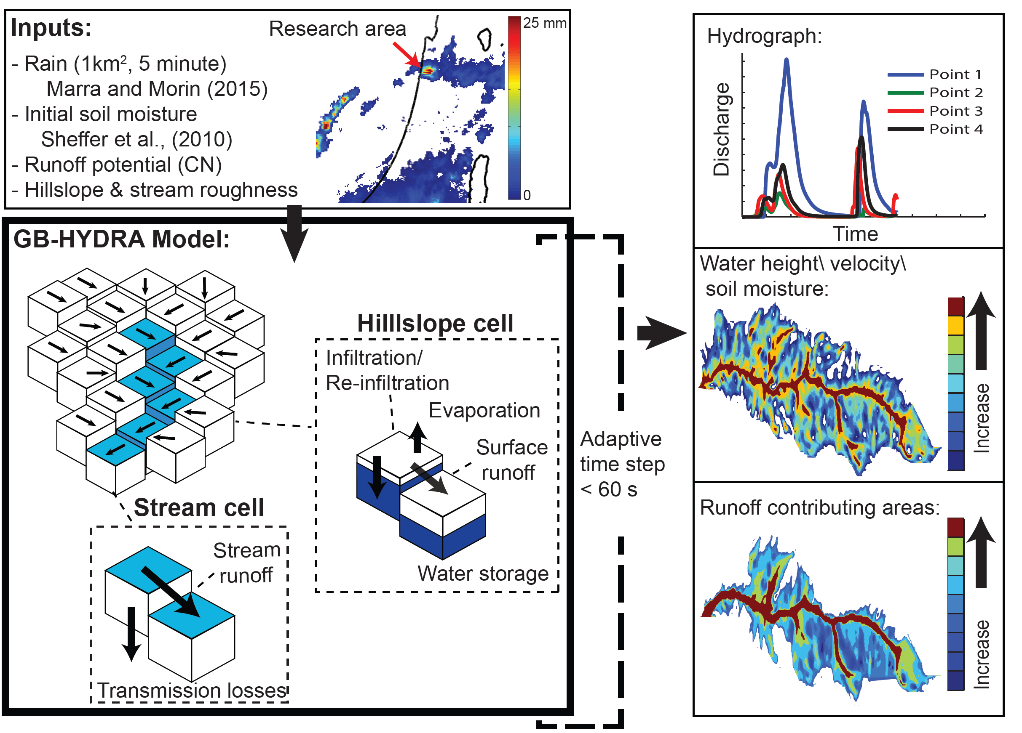
What’s an hydrological model? (quick reminder)

Slide 10
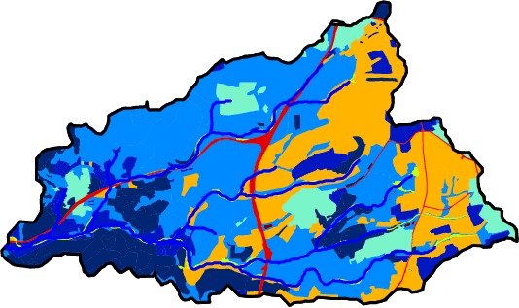
Model simulation
Evolution of runoff contributing areas
Runoff contributing areas
Contribution increase
Hourly time resolution
Notes:
לומר כבר פה שכשאנחנו מסתכלים על תהליכים הידרולוגים הרבה פעמים אנחנו צריכים לומר עבור איזה משך
לדוגמא כשנדווח על עוצמת גשם מסויימת נצטרך לומר על איזה משך אנחנו ממצעים אותה, כי המשמעות של עוצמה של 60 ממ לשעה בשעה שונה לחלוטין מ60 ממ לשעה בדקה אחת...
אותו הדבר כשאנחנו מסתכלים על שטח תורם נצטרך לקבוע את זמן הרלוונטי עבורו. הזמן הזה נקבע מתכונות האגן ניקוז ומהגשם, כך שזרימה פוטנציאלית מהאזור המרוחק ביותר במדרון תצליח להגיע למערכת ערוצים או למוצא

Slide 11
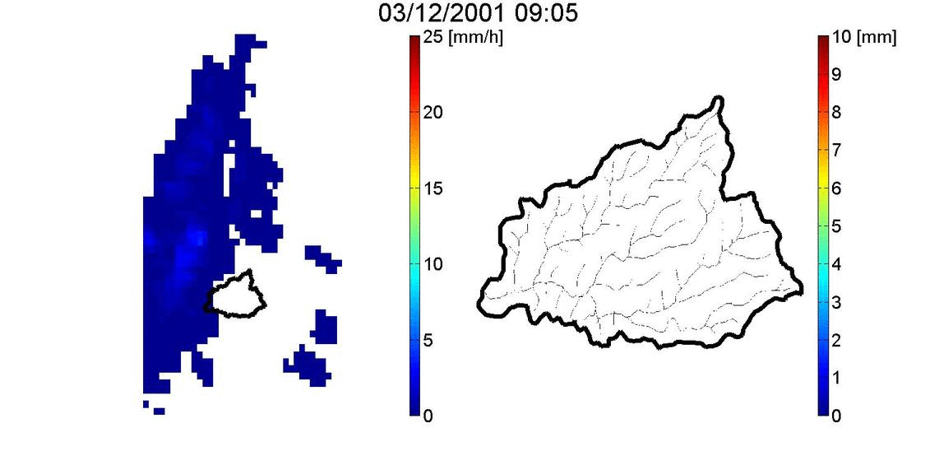
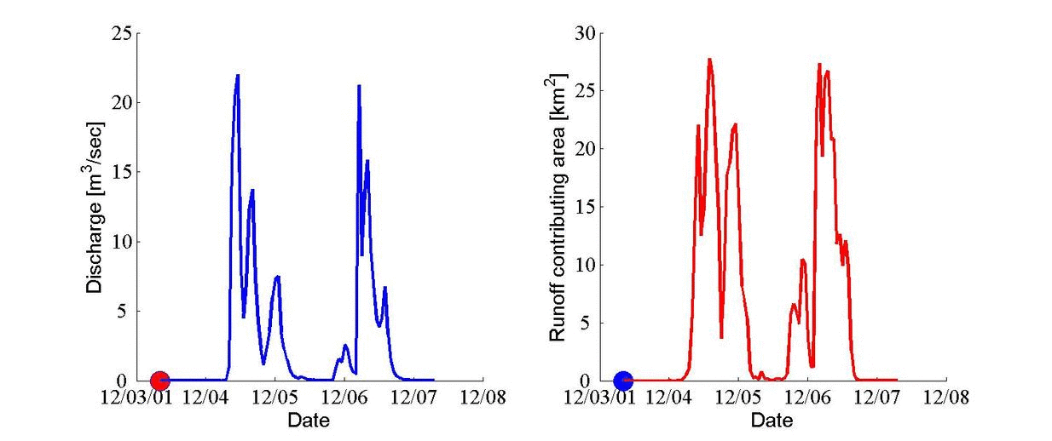
Model simulation
Rain rate
Runoff contributing areas
Contribution increase
Hydrograph
Runoff contributing areas
Hourly time resolution

Slide 12
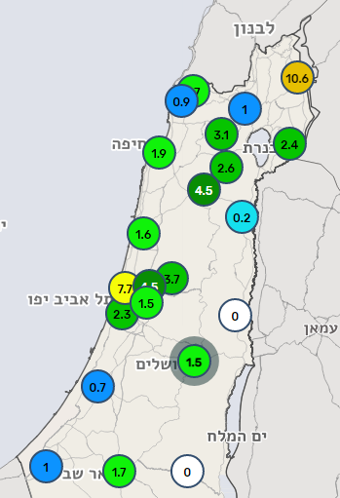
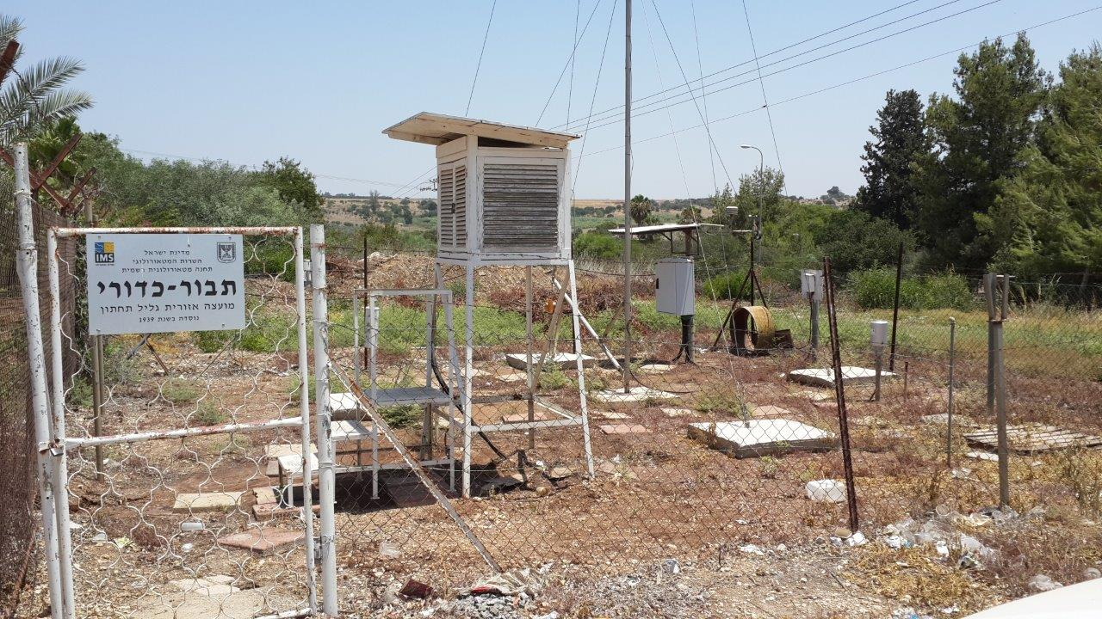
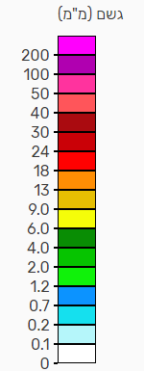
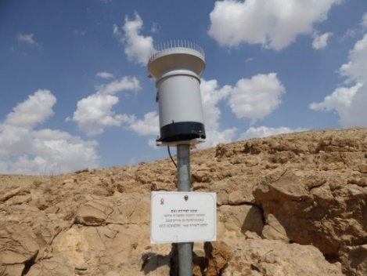
Model input - Rain gages
Hundreds of automatic (10-min) & daily rain stations

Slide 13
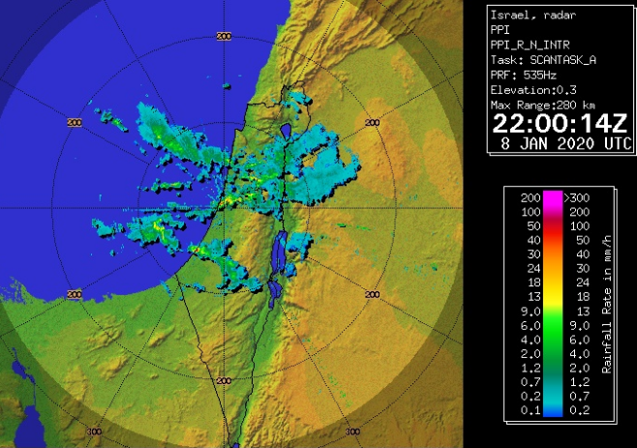
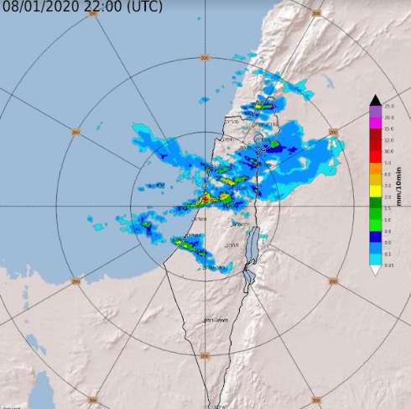
Model input - Rain radar
10-min QPE

Slide 14
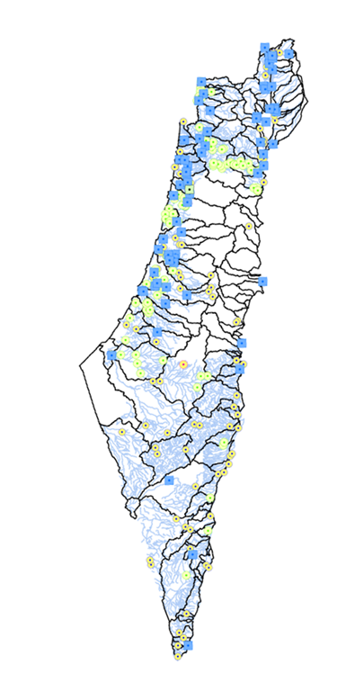
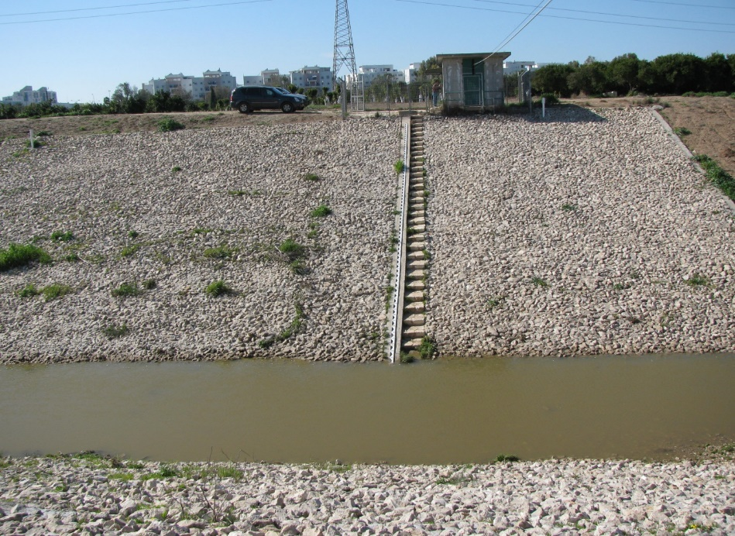
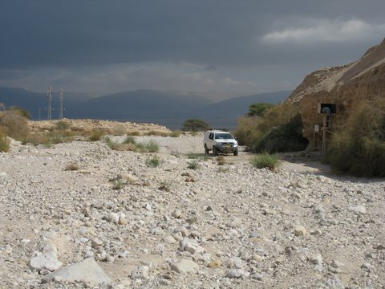
Model input - Discharge
170 Discharge gages out of which 100 (blue) broadcast
Broadcast resolution varies from 15’ to 60’

Slide 15
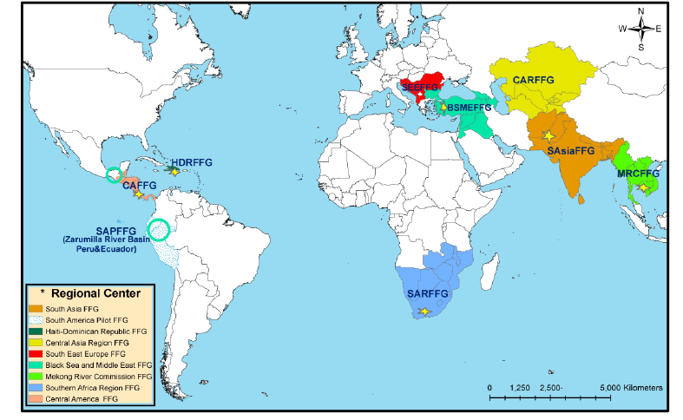
Flash flood guidance

Slide 16
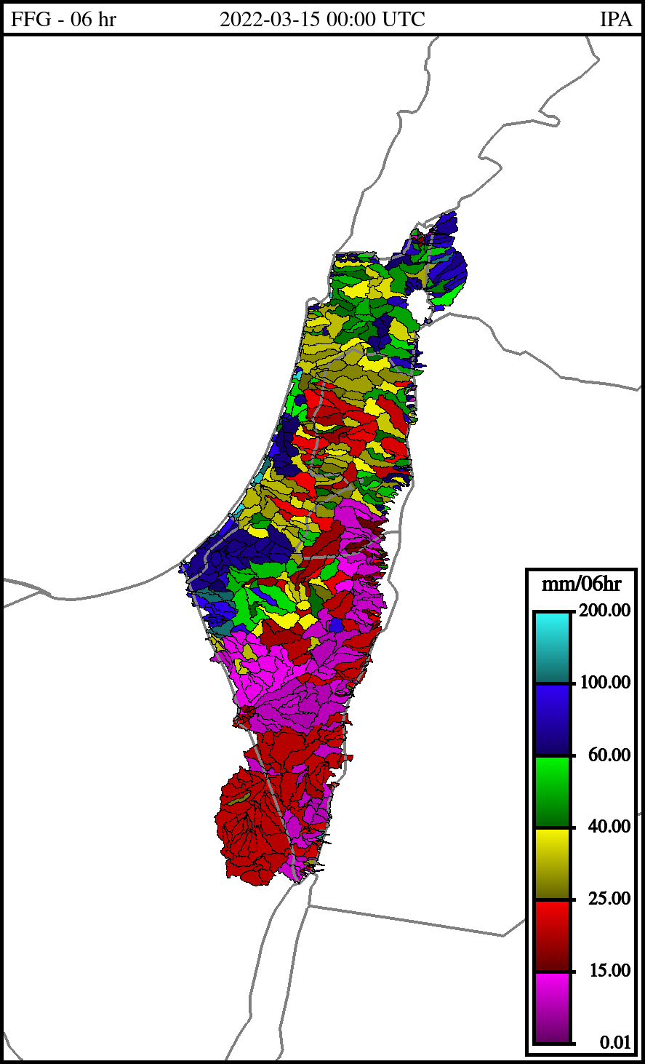
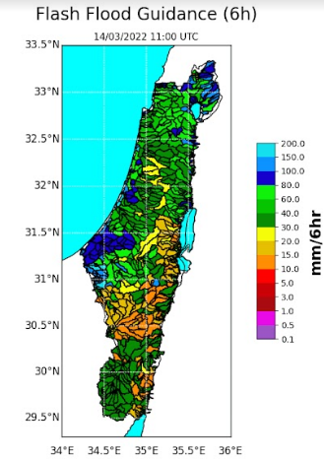
Flash flood guidance

Slide 17
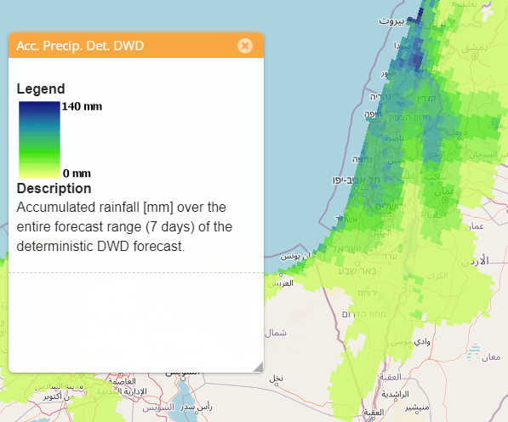
European flood awareness system - EFAS
Provides:
Seasonal forecast
Medium range forecast
Hydrological forecast
Flash flood indicator
Flood mapping

Slide 18
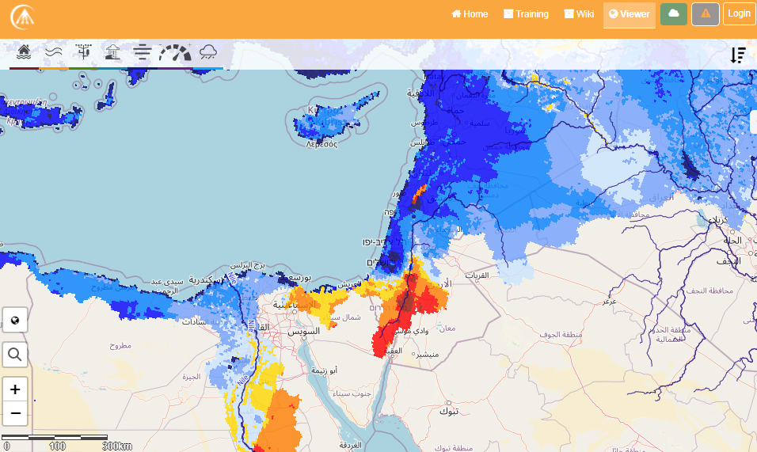
European flood awareness system - EFAS
Soil moisture

Slide 19
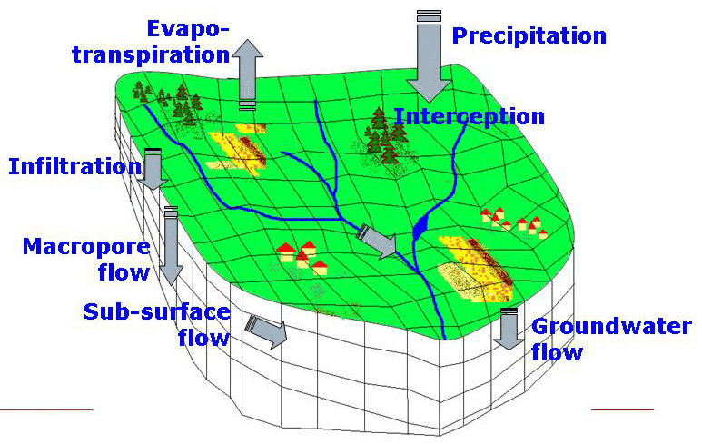
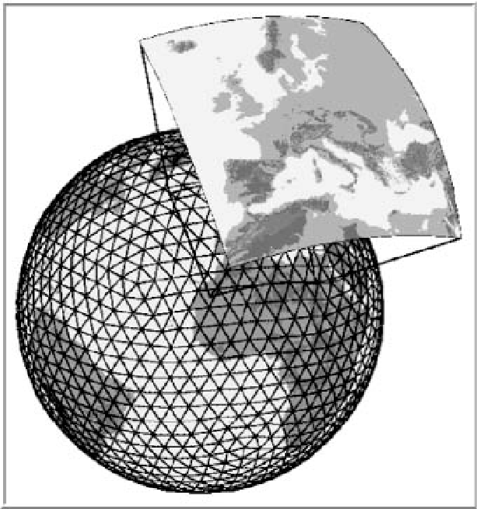
European flood awareness system - EFAS
ECMWF – IFS
Listflood
DWD – ICON COSMO-LEPS

Slide 20
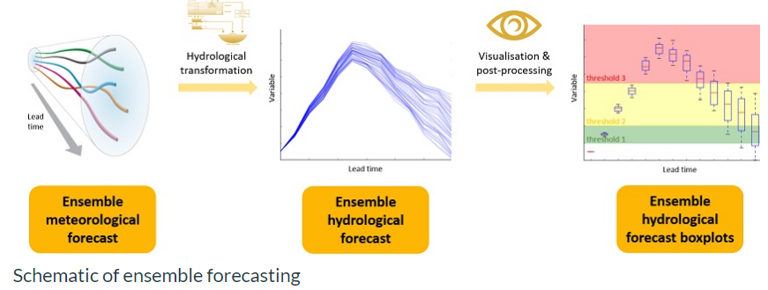
European flood awareness system - EFAS

Slide 21
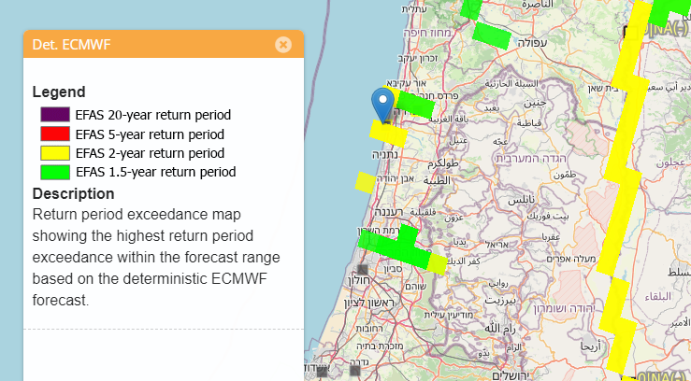
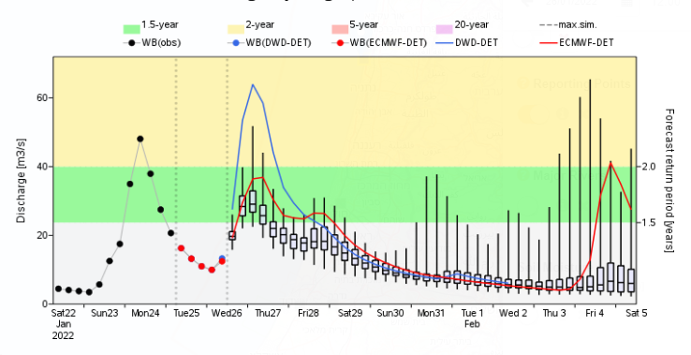
European flood awareness system - EFAS
Hydrological forecast + ensemble

Slide 22
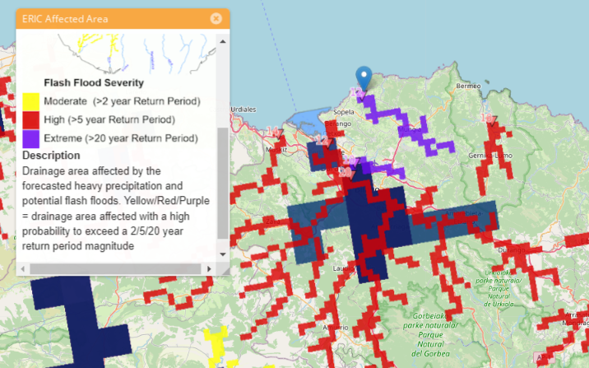
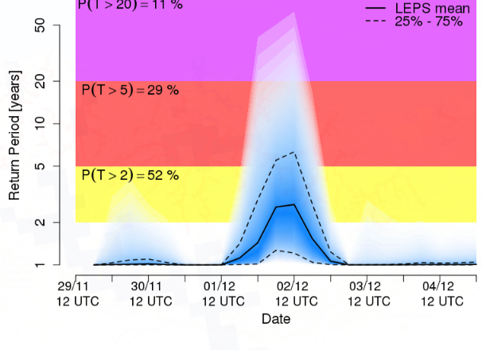
European flood awareness system - EFAS
Flash flood indicator

Slide 23
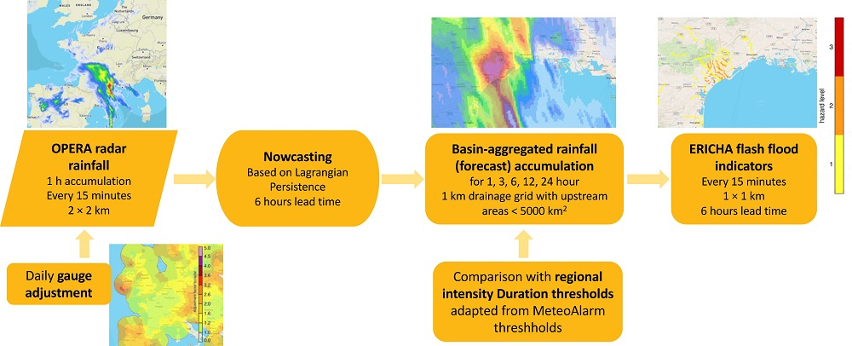
European flood awareness system - EFAS
Nowcasting

Slide 24
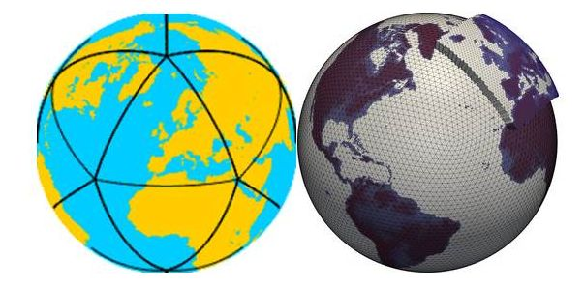
Model input – domestic models
3 NWP models
X 20 ensemble

Slide 25
Model input – domestic models
Meteorological
Obs
Forecast
time
Hydrological
Obs
Forecast
time

Slide 26
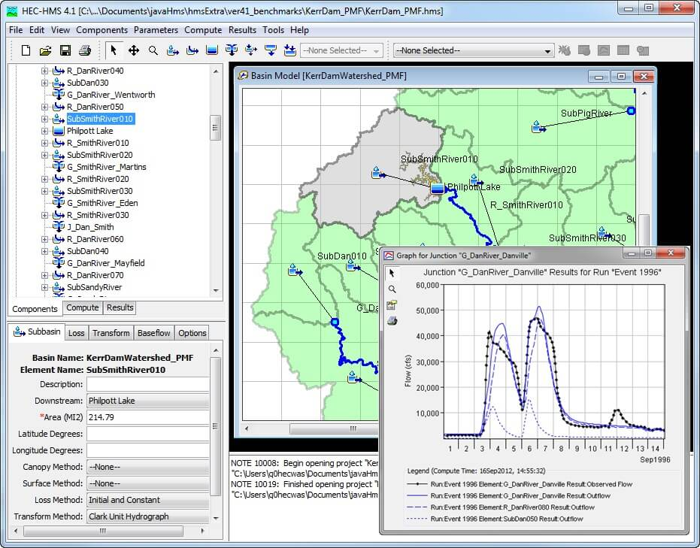
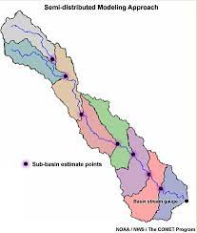
HEC – HMS models

Slide 27
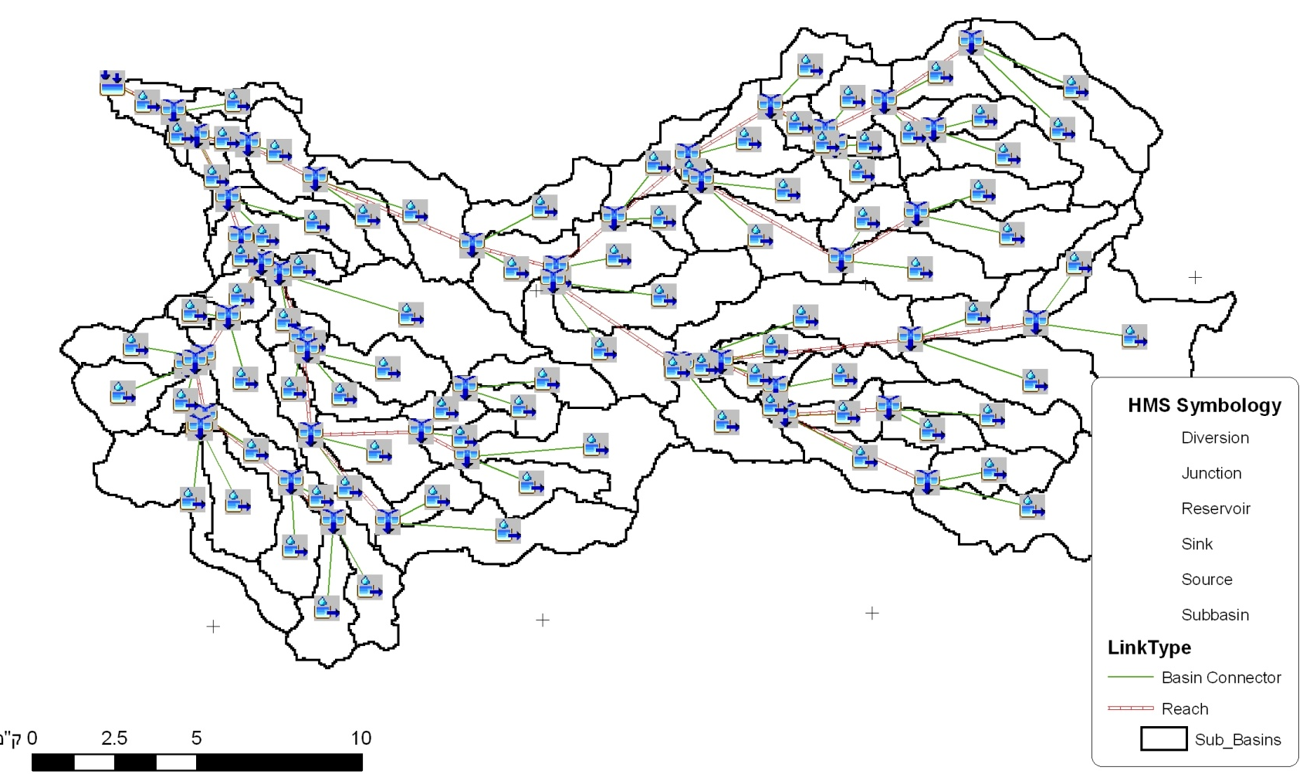
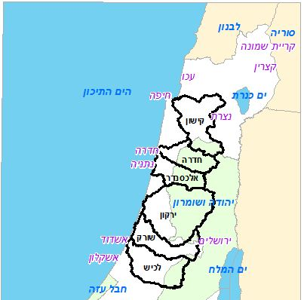
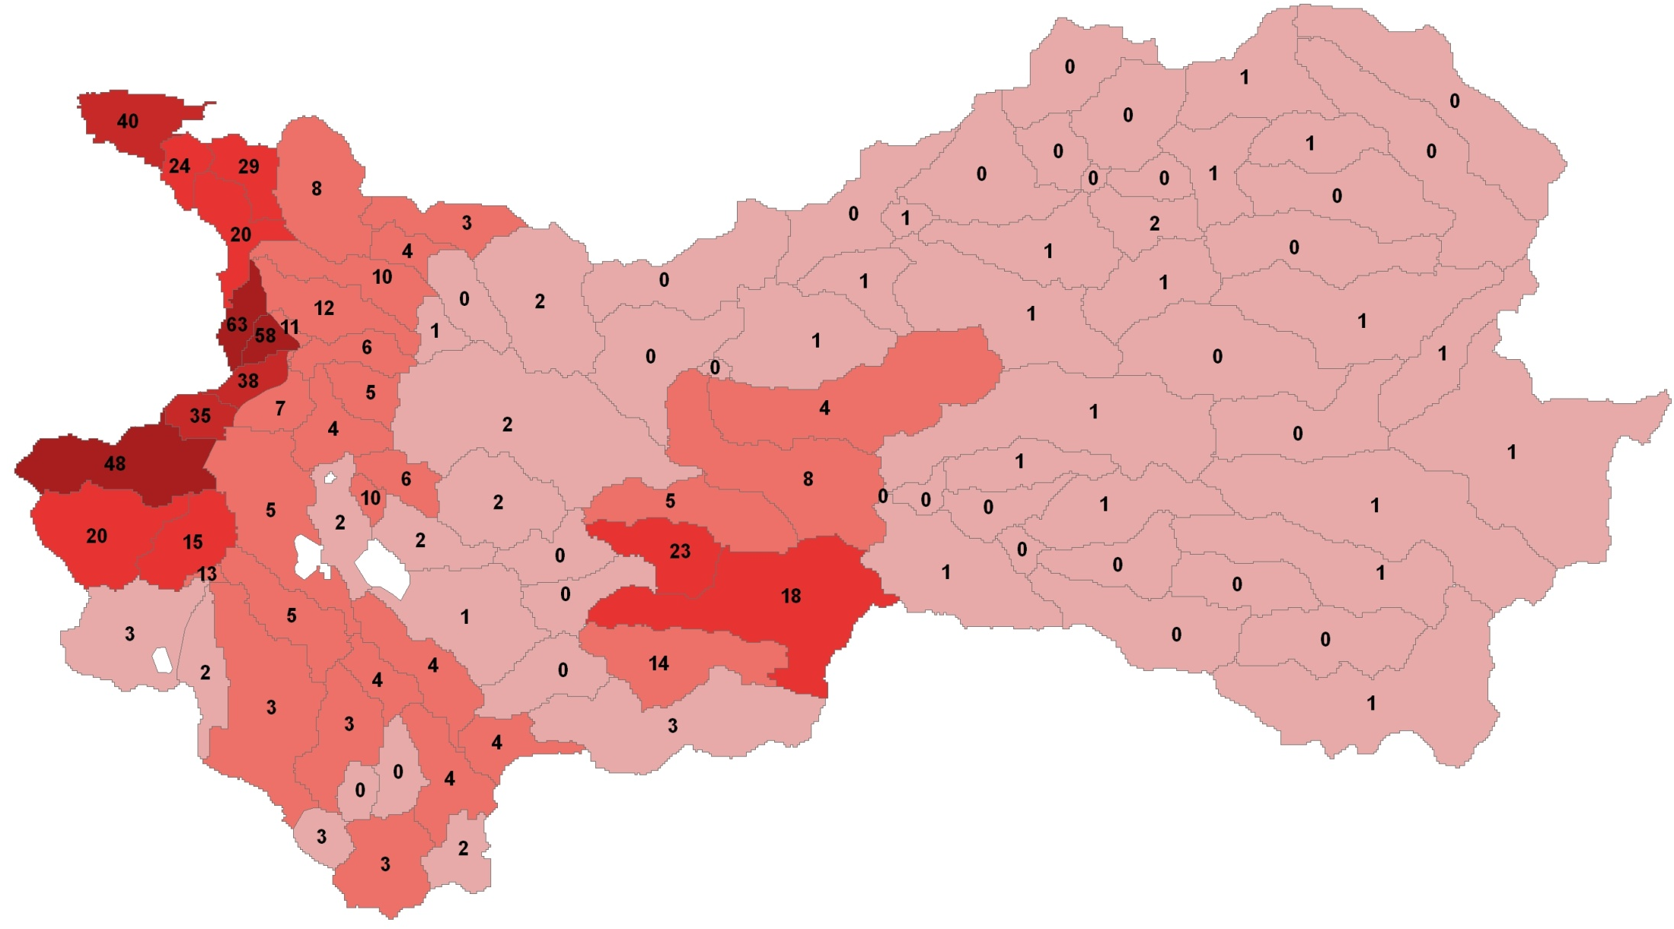
HEC – HMS models

Slide 28
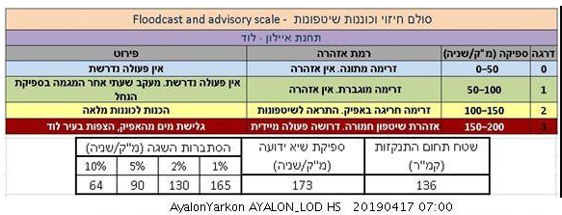
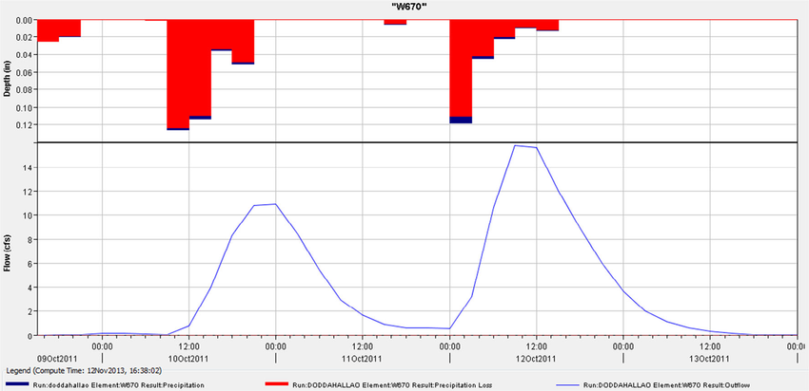
HEC – HMS models

Slide 29
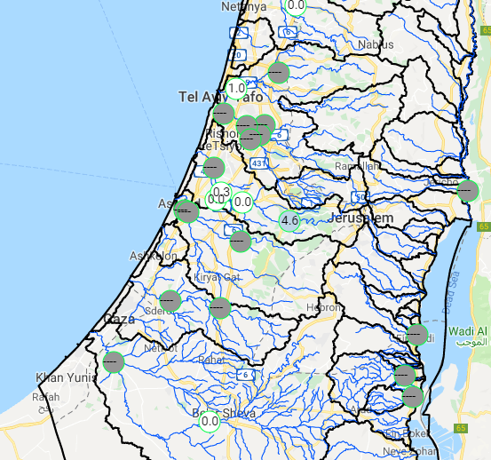
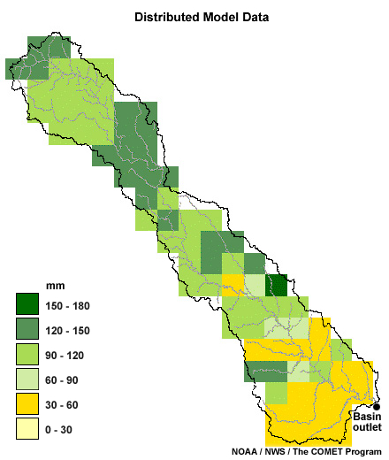
WRF – HYDRO
Distributed model
Domain – all Israel
Soil moisture from GFS
90 m, 1h

Slide 30
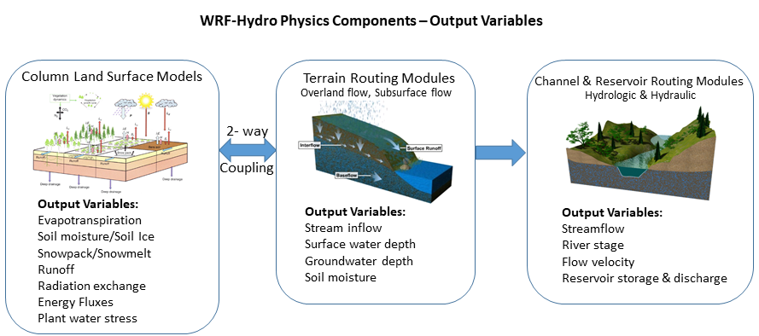
WRF – HYDRO

Slide 31
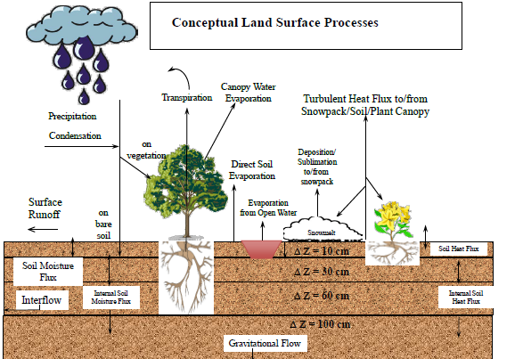
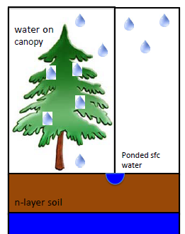
WRF – HYDRO

Slide 32
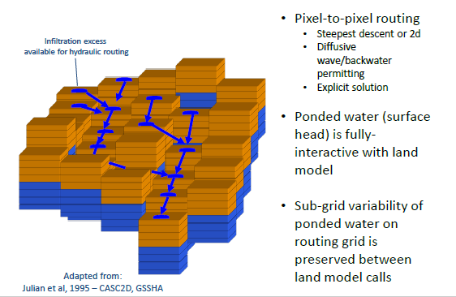
WRF – HYDRO

Slide 33
WRF – HYDRO
Max discharge at all stream channels

Slide 34
WRF – HYDRO
Hydrographs at selected points

Slide 35
Forecaster user interface - Hydrograph
Measured + all forecasted hydrographs projected on return period estimation
Color coded outline
Discharge
Time

Slide 36
Forecaster user interface
Measured + all forecasted hydrographs projected on return period estimation
Color coded outline

Slide 37
Forecaster user interface
Prepare forecast maps + warnings

Slide 38
Warnings and alerts - coding

Slide 39
Warnings and alerts

Slide 40
Warnings and alerts
Flood warning
Flood frequency

Slide 41
Warnings and alerts

Slide 42
Work plan, improving the models
Civil protection forces user interface
Updating and improving Hydro
Testing other models (HYPE, GRP)
Full ensemble runs
Improve nowcasting
Map and detect rain and discharge flood-initiating-thresholds

Slide 43
Water Authority
State of Israel

