Slide 1


Activities & Operations of Regional WIGOS Centre(Beijing)
(RWC-Beijing)
LIN Xuejiao
Meteorological Observation Centre of
China Meteorological Administration

Slide 2
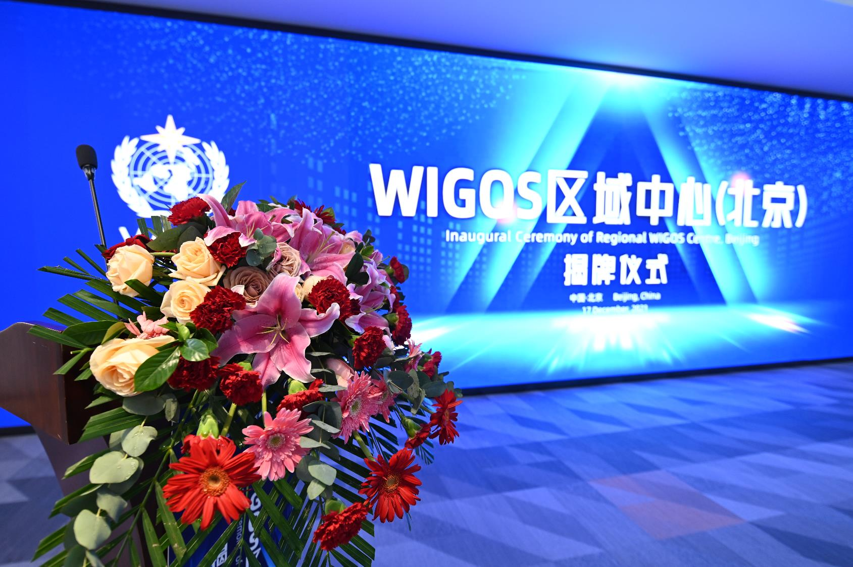
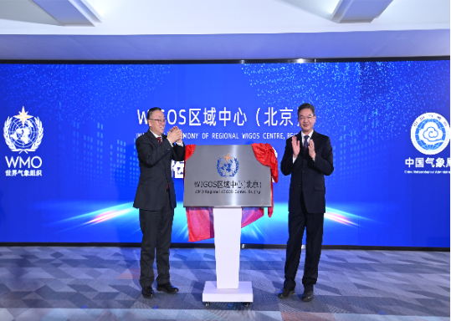
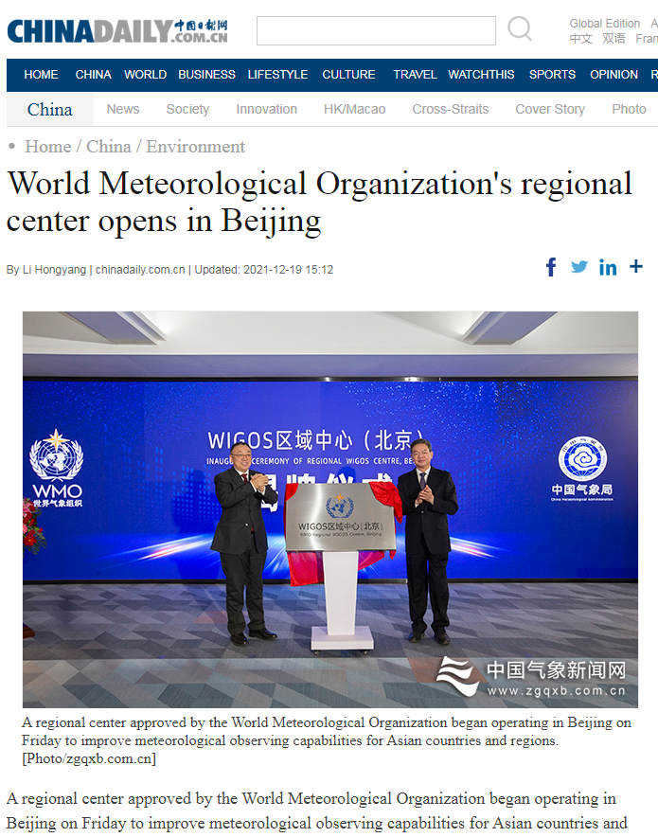


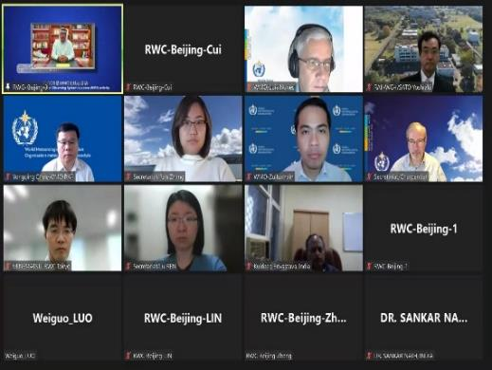






Inaugural ceremony of RWC-Beijing
17 Dec, 2021
Beijing, China

Slide 3

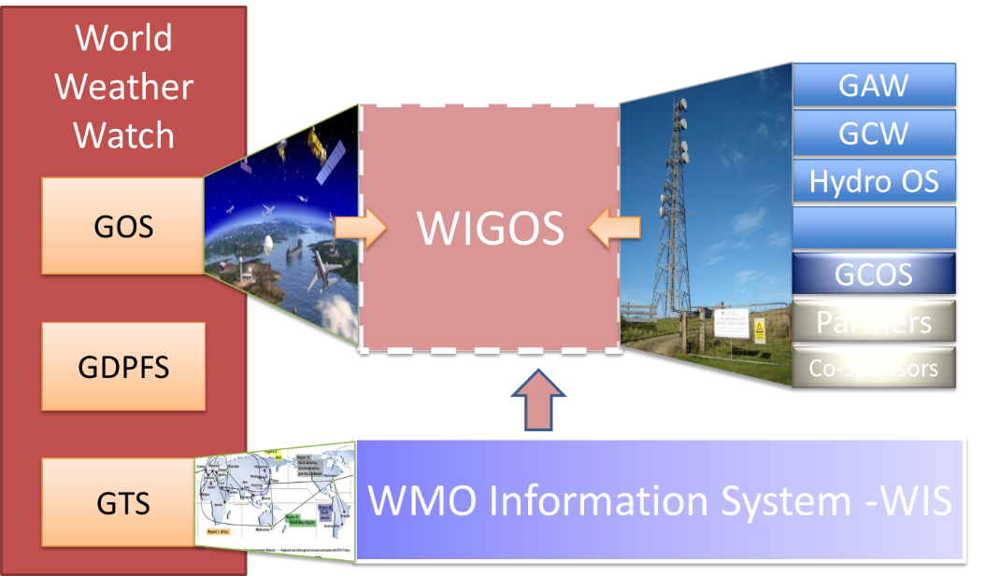
Background
Component of WIGOS
In recent years, the World Meteorological Organization Integrated Global Observing System (WIGOS) has been always listed as WMO highest priority, and its Regional Associations are encouraged to set up Regional WIGOS Centers (RWC) to help their Members accelerate WIGOS implementation.

Slide 4
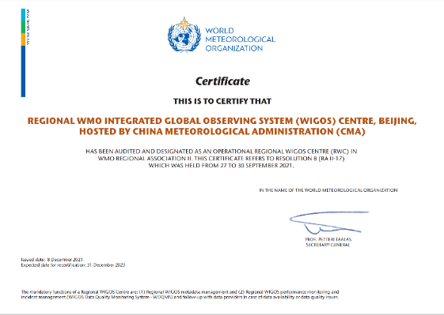
Milestones of RWC-Beijing
RWC-Beijing was recognized as one of the first operational RWCs in the world.
2021
2020
    Transition from pilot phase to operational phase.
2019
    RWC-Beijing upgraded of operation capability.
2018
    RWC-Beijing started the pilot operation.
2017
    Applied to establish RWC-Beijing.

Slide 5
Functions
Regional coordination, guidance, oversight and support of WIGOS implementation and operational activities at the regional and national levels (day-to-day level of activities).
Mandatory Functions
1. Regional WIGOS metadata management (work with data providers to facilitate collection, updating and provision of quality control for WIGOS metadata in OSCAR/Surface);
2. Regional WIGOS performance monitoring and incident management (WIGOS Data Quality Monitoring System;WDQMS) and follow-up with data providers on availability/quality issues.
Optional Functions
(a) assistance with the coordination of regional/sub-regional and national WIGOS projects;
(b) assistance with regional and national observing network management;
(c) support for regional capacity development activities.
RWC-Beijing covers both mandatory and optional functions

Slide 6
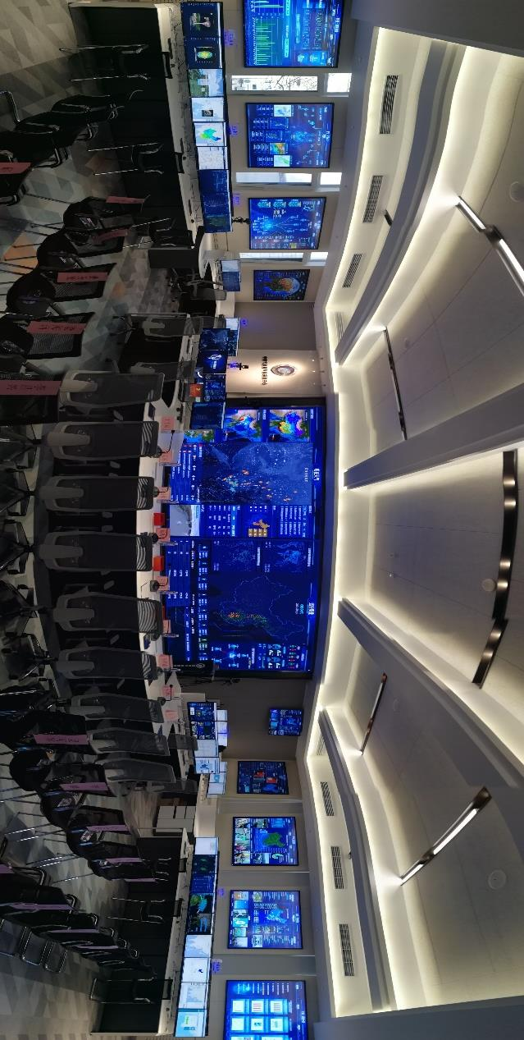
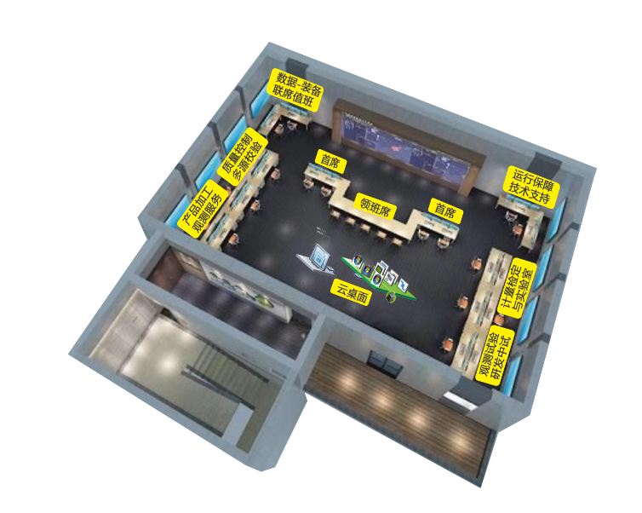
Basic & Technical Infrastructure
National Meteorological Observation Operation Platform
7 * 24 duty tasks
Monitor data quality in real time
Quickly find and solve problems
Adequate, secure, fully-equipped
adequate information technology facilities and infrastructure
Powerful processing ability and storage

Slide 7
Human Resources & Operating Mechanism
Management
CMA
Management Team
Technical Management
Foreign Affairs Management
Management
Specialists
    MOC of CMA
    Real-time on Duty
Operation Office
Operation Office
OSCAR/Surface
RRR
Quality Evaluation
AMDAR
Radiosonde
Land-Surface
RIC Beijing
Ocean
Responsibility | Number
The chief on duty | 12
Staff on duty | 22
Staff on guarantee for operation and maintenance | 3
GISC, WMC, RIC, RCC, RTC
    ……
Collaboration

Slide 8
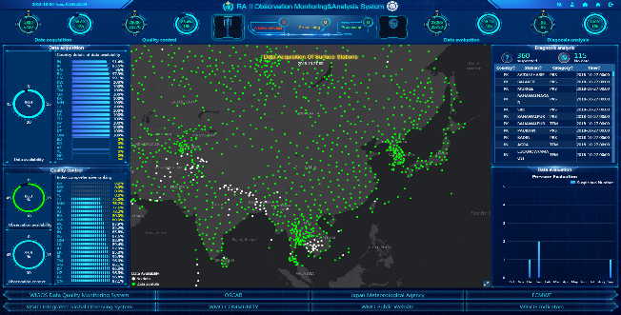
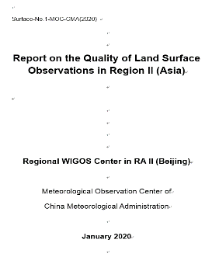
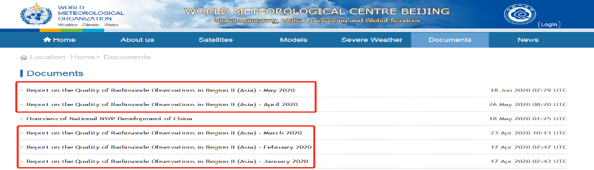
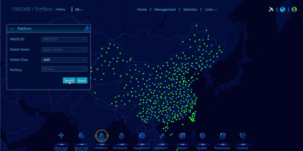
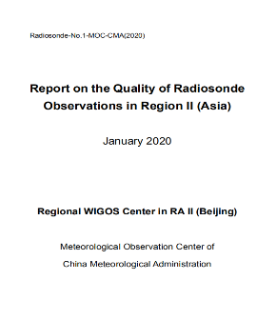
RA II Monitoring & Analysis
Land Surface Report
RA II Monitoring & Analysis System
Website
http://www.wmcbj.net/publish/cms/documents/index.html)
Email the RA II National Focal Points
rwc-bj@cma.gov.cn
Metadata Management System
Radiosonde Report

Slide 9
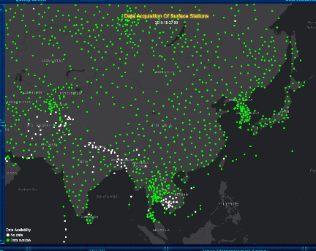
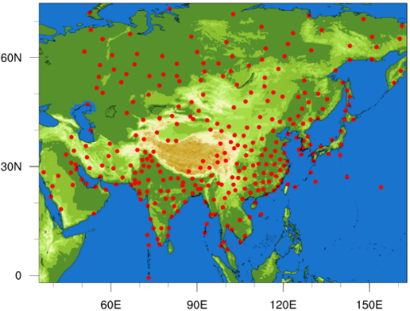
Data Quality Monitoring and Evaluation Technology
CMA numerical weather forecast
Land Surface
Station number：3000+
Times：00、06、12、18
Elements：Mean sea level pressure、Geopotential height
Radiosonde
Station number：289
Times：00、12（UTC）
Elements & levels：Geopotential height 14 levels
Wind direction 6 levels
Vector wind 11 levels
Land Surface stations
Combined with results from https://wdqms.wmo.int/
Radiosonde stations

Slide 10
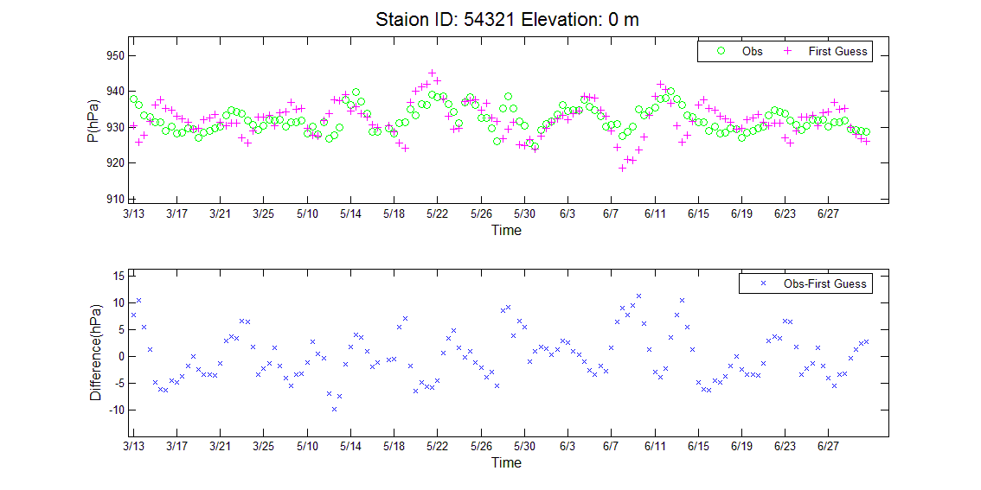
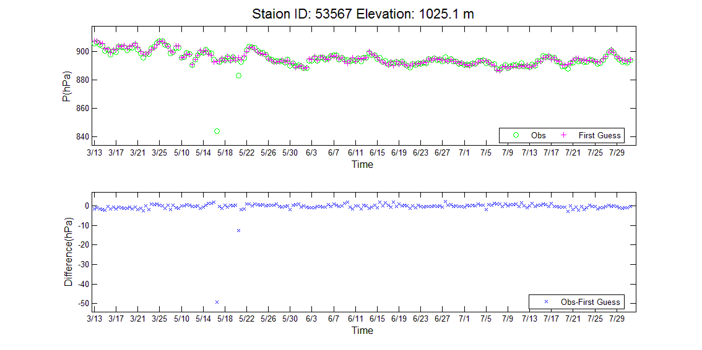
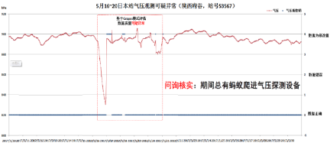
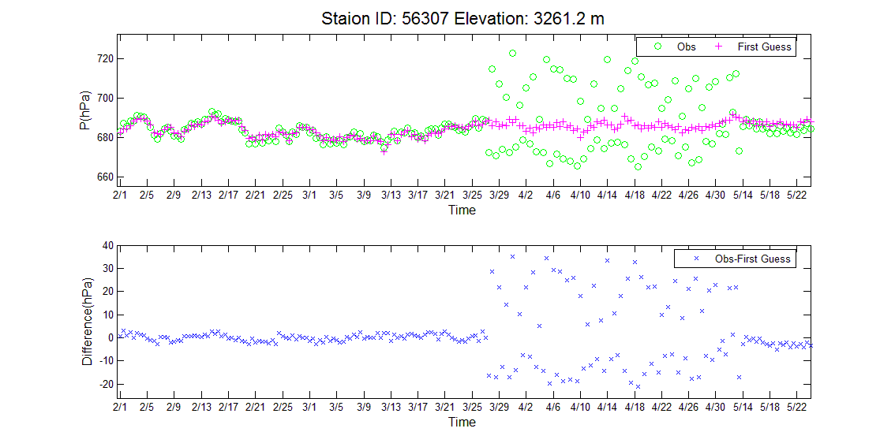
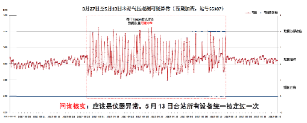
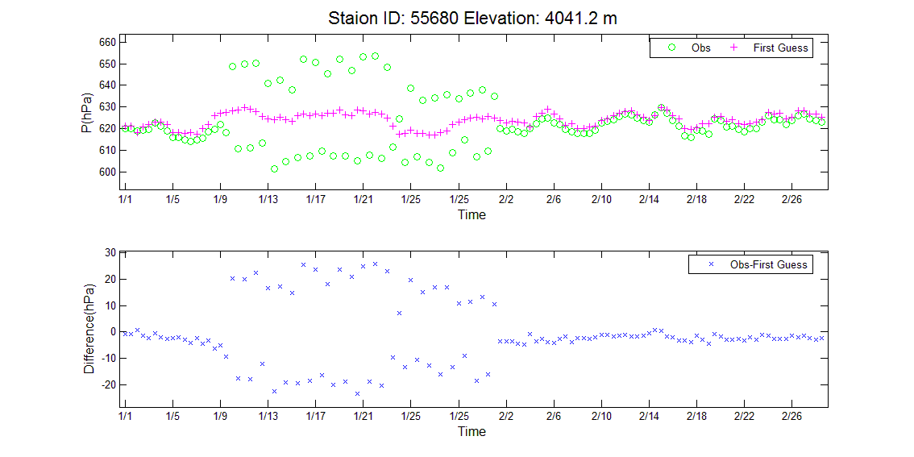
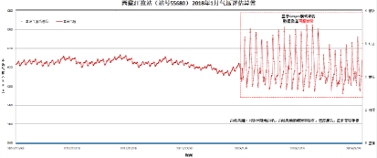
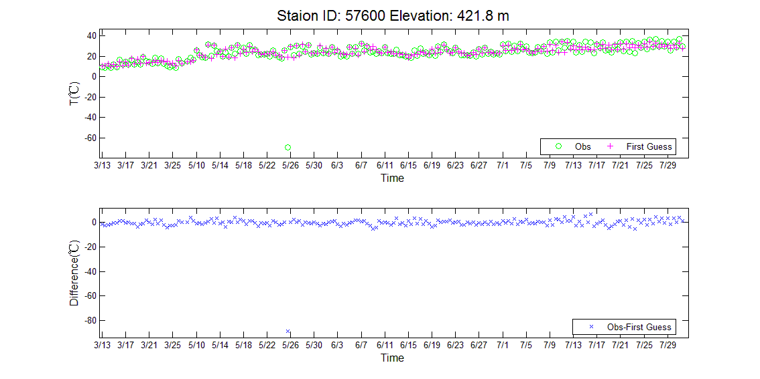
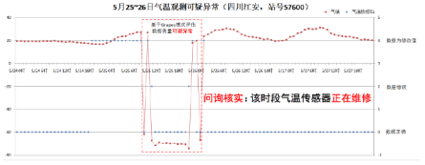
Issue Types
    Latitude and longitude error
Biological interference
Land Surface
Pressure
sensor issue
Temperature sensor maintenance

Slide 11
Monitoring, Evaluation and Incident Management
List of Suspicious Stations (July–December 2021)
Monitoring
Members (Group A) | Land surface |  |  | Radiosonde
 | Monitored Suspicious Stations | Quality improved | Remaining Suspicious | Monitored Suspicious Stations | Quality improved | Remaining Suspicious
Afghanistan | 5 |  | 5 | 2 |  | 2
Bahrain
Bangladesh
Bhutan
India | 31 | 5 | 26 | 11 | 1 | 10
Iraq | 2 |  | 2 | 2 |  | 2
Islamic Republic of Iran | 51 |  | 51 | 1 |  | 1
Kuwait | 2 |  | 2 | 1 |  | 1
Maldives
Nepal | 4 | 3 | 1
Oman | 26 | 22 | 4
Pakistan | 6 |  | 6 | 6 |  | 6
Qatar | 2 |  | 2
Saudi Arabia | 8 | 1 | 7 | 1 | 1 | 0
Sri Lanka | 2 |  | 2
United Arab Emirates
Yemen | 4 |  | 4 | 2 |  | 2
Evaluation
Feedback
Tracking
Improvement

Slide 12
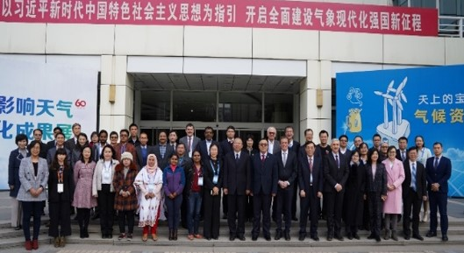
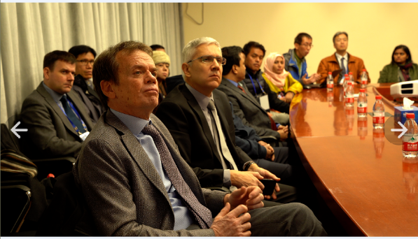
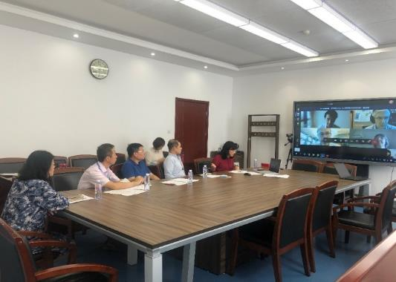
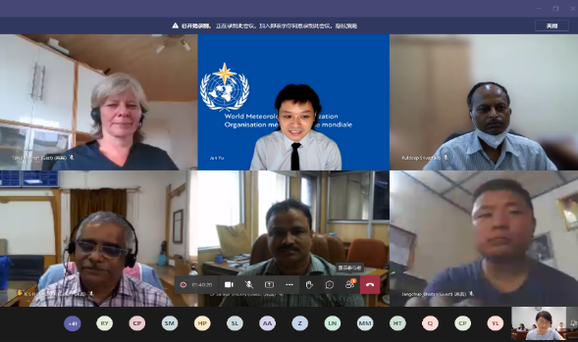
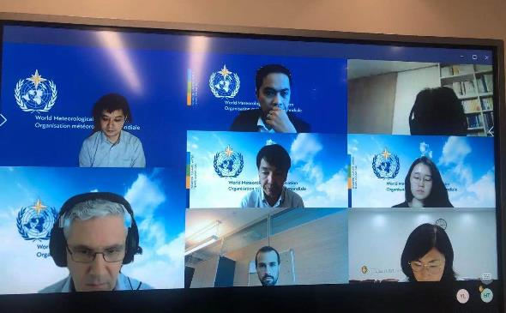
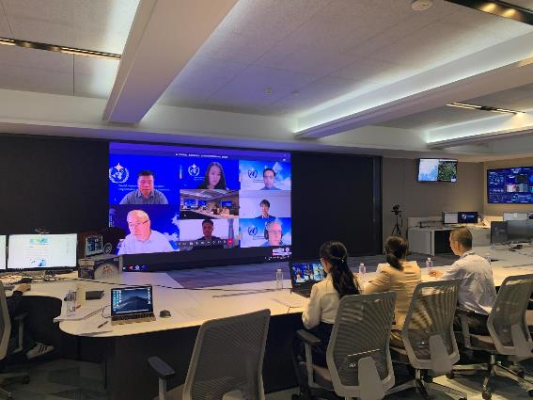
International WIGOS Workshops

Slide 13
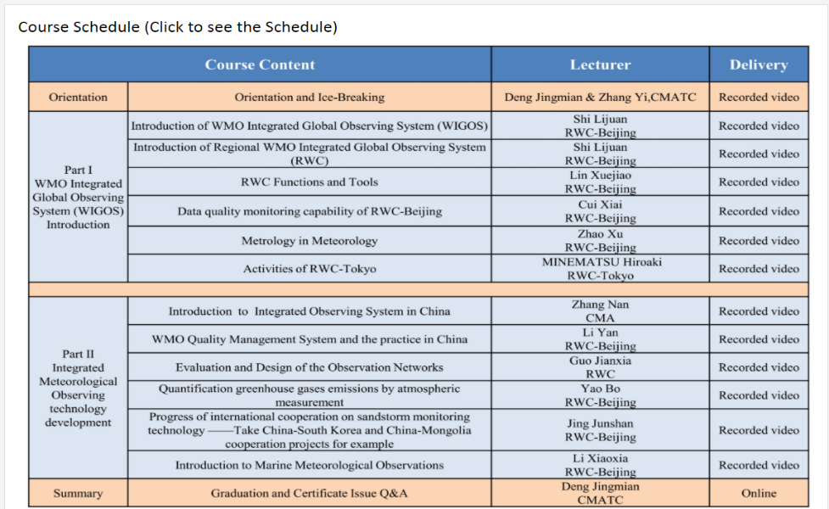
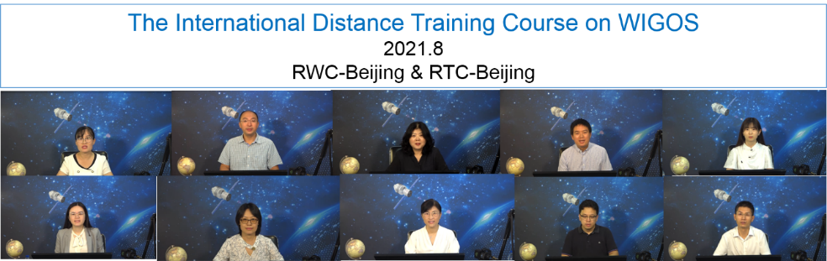
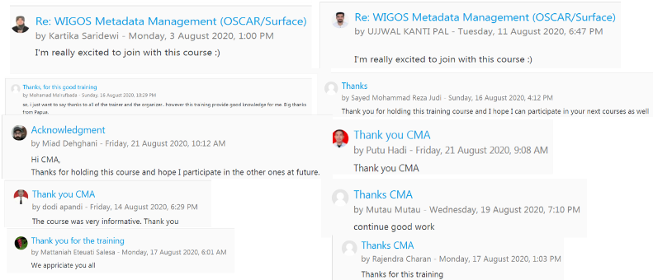
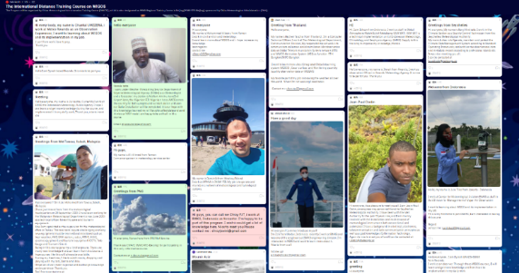
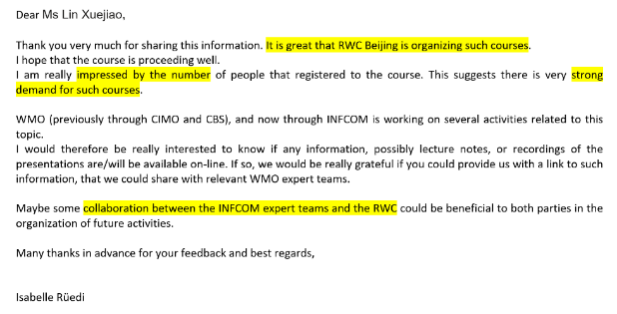
685 candidates, from 74 Members, including RA I， II， III， IV， V， VI . More than 400 trainees (60% of the total numbers) have completed the main courses.
The International Distance Training Course on the Instruments
RWC-BJ & RTC-BJ (08.2020)
The International Distance Training Course on WIGOS
RWC-BJ & RTC-BJ (08.2021)
251 candidates, from 54 Members, including RA I， II， III， IV， V， VI .
List of the training course
Messages from trainees
Email from WMO

Slide 14
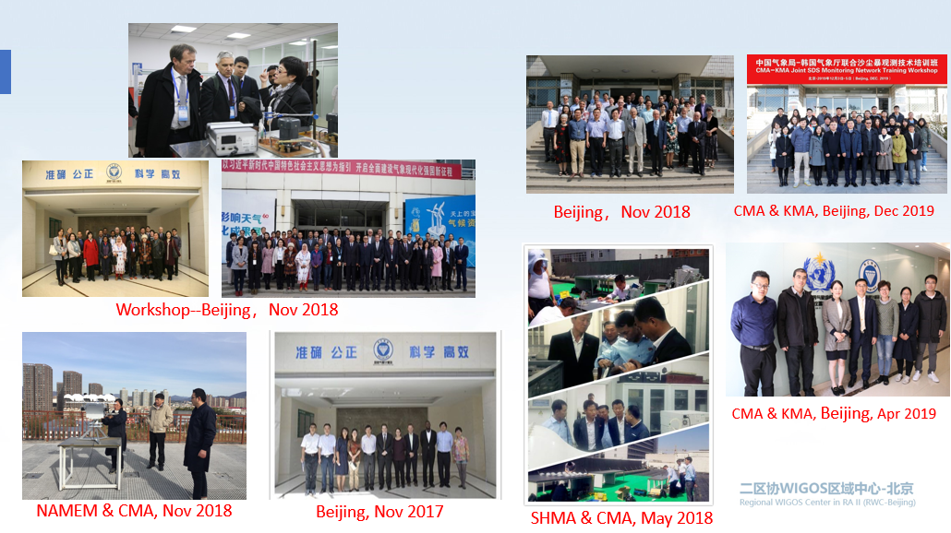
International Technical Training, Comparison and Technology Exchange
RWC-Beijing & Regional Instrument Centre(Beijing)
Time | Country | Event
2016.5 | Indonesia Democratic People's Republic of Korea | Technical Training International Comparison
2016.9 | Mongolia | International Comparison
2017.9 | Multi-Country Mission | Technology Exchange
2017.9 | United States | Technology Exchange
2018.5 | Multi-Country Mission | Technology Exchange
2018.11 | RA II Members | Workshop
2018.11 | Pakistan | International Comparison
2018.11 | Mongolia | International Comparison
2019.4 | Republic of Koera | Technical Training
2019.12 | Republic of Koera | Technical Training

Slide 15
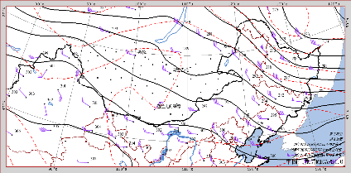
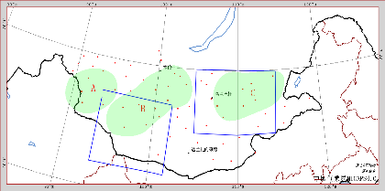
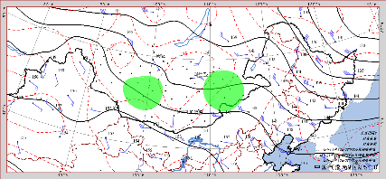
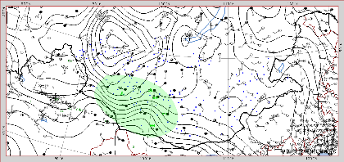
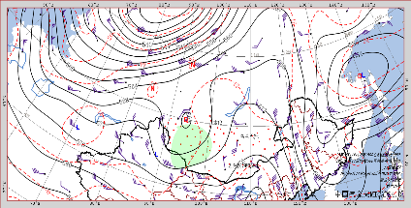
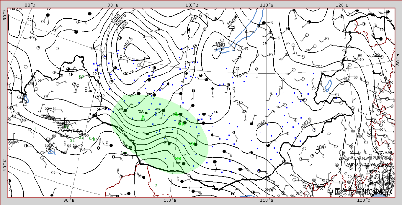
The Practices of Rolling Review of Requirements Process
Helped Mongolia and Lao.P.D.R design network layout(2019-2020)
It is recommended to add 50 land surface stations.
land surface stations
It is recommended to add 6 upper-air stations.
upper-air stations
upper-air stations-It is recommended to increase the station density to at least below 80km.
land surface stations-
It is suggested to add 3 stations.
It is recommended to add 20 lightning observation stations and 3 wind-profiling radar .
lightning observation and wind-profiling radar

Slide 16






Links to other WMO Entities
RIC-Beijing: Regional Instrument Centre
Metrology knowledge training and instrument calibration
GISC-Beijing: Global Information System Centre
International data exchange and data support(WIS,GTS)
WMC-BJ: World Meteorological Centre
Models and forecasts.
RTC-Nanjing / Beijing : Regional Training Centre
Training courses
RCC-BJ: Regional Climate Centre
Long-range forecasts and products

Slide 17
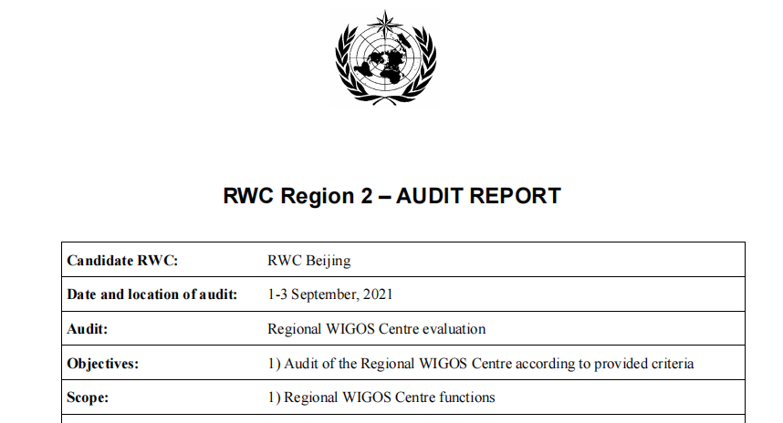
Evaluation by INFCOM
---twice, Nov 2020 and Aug 2021
“After assessing each of the findings of this audit, the auditors confirm that the system conforms to the specification of a RWC as described in the audit criteria.”

Slide 18
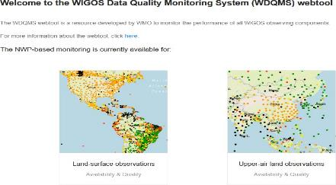
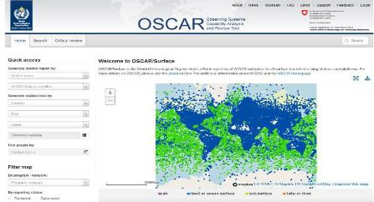
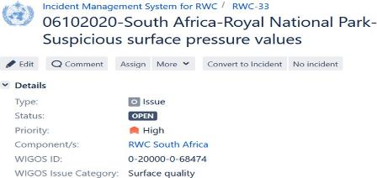
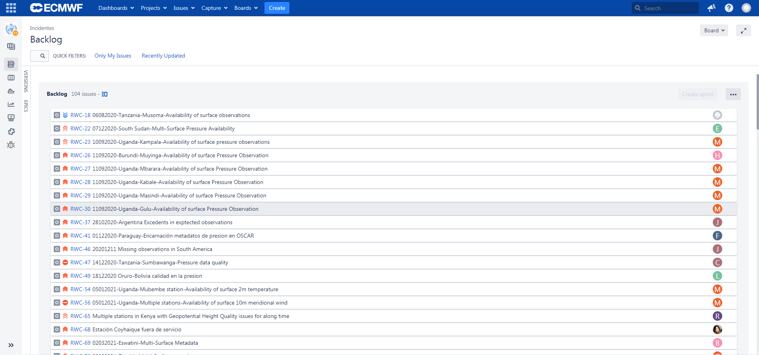
Incident Management System (IMS)
WIGOS Data Quality Monitoring System (WDQMS)
real time monitoring
Find
&
Analysis
Observing Systems Capability Analysis and Review tool (OSCAR/Surface)
metadata management
solve
problem tracking& improvement

Slide 19
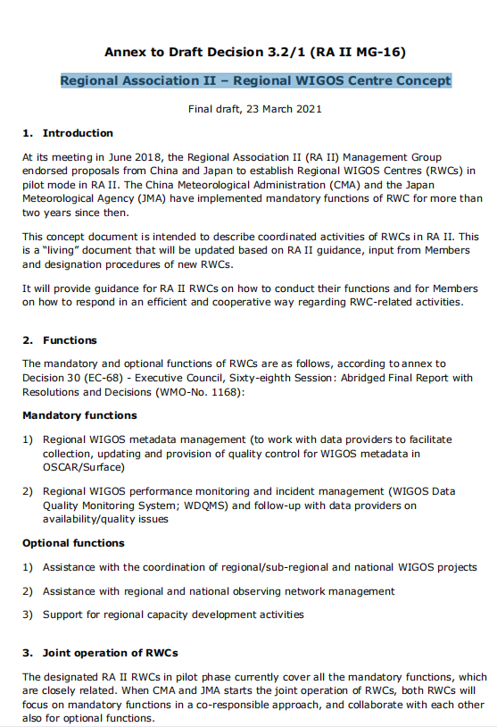
RA II-MG 16
30 March 2021
Regional Association II – Regional WIGOS Centre Concept by RWC-Tokyo and RWC-Beijing
Mandatory Functions
1. Regional WIGOS metadata management (work with data providers to facilitate collection, updating and provision of quality control for WIGOS metadata in OSCAR/Surface);
2. Regional WIGOS performance monitoring and incident management (WIGOS Data Quality Monitoring System;WDQMS) and follow-up with data providers on availability/quality issues.

Slide 20
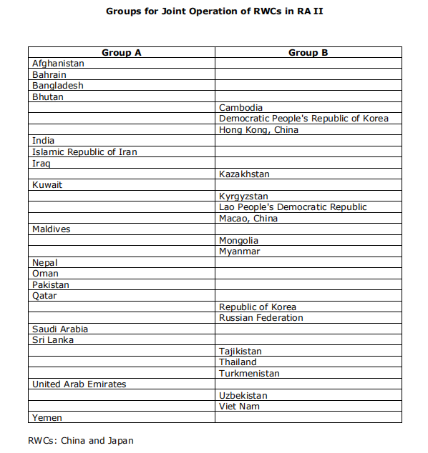
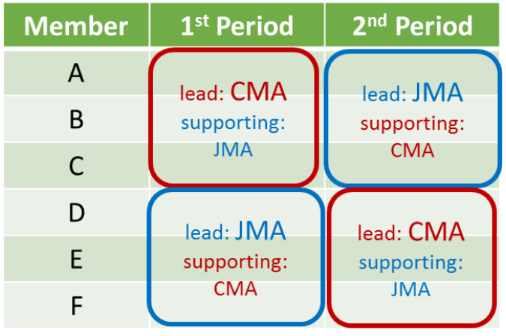
Joint operation of RWCs
Period 1: from July to December
Period 2: from January to June

Slide 21



RWC-Beijing has been providing mandatory and optional
RWC functions for Group A Members during the period from July to December 2021.
Transition of operation between RWC-Tokyo and RWC-Beijing, Dec 10, 2021
Many thanks to Members for their positive interaction with us!

Slide 22

RWC Monitoring Report
I. WDQMS incident tickets (Closed)
Eighteen incident tickets issued to NMHSs in India, Nepal et al. have been successfully
closed. As a result, data from 27 stations have become available, data from 13 stations have
become available periodically, and 5 stations have improved the data quality.
II. WDQMS incident tickets (Won’t fix)
One incident ticket issued to Afghanistan was concluded as “Won’t fix”.
III. WDQMS incident tickets (Ongoing)
Seven incident tickets issued to NMHSs in Sri Lanka, Islamic Republic of Iran et al. are in
progress. Those incidents will be continuously managed by RWC-Beijing in the coming term,
first half of 2022.

Slide 23
WIGOS Data Quality Monitoring System (WDQMS)
https://wdqms.wmo.int/
User guide: https://confluence.ecmwf.int/display/WIGOSWT

Slide 24




Meteorological observations and their quality
To ensure that the data meets all needs, efforts are made to acquire, transmit, and archive observations with the greatest precision and consistency possible.
Data must be as accurate as possible. However, observed data can be subject to errors (e.g. human error, sensor error or failure, issues in the data processing, coding, or transmission).
Various means are used to "quality assure" the data.
to monitor the performance of all WIGOS observing components.
-WDQMS
2

Slide 25


























International data exchange essential for WDQMS
National observing stations
!
International users
e.g. global NWP centres
WDQMS
starts here
NMHS
Head Quarters
GTS
International exchange
to be indicated in

Slide 26













































The WDQMS process
Monitoring Function (NWP Centres)
Evaluation Function (RWC)
Incidents process
Incident Manag. Function (RWC)
Retrieve outputs
Assess & Monitor incidents
Check station metadata
Analyze results
Monitoring Webtool(s)
Incident Management Tools/procedures
GTS
OSCAR/
Surface
Review, update Station metadata
Request correction Feedback
National Contacts of RA Members
NMHS
Staff
Users
WDQMS will describe how well WIGOS is functioning

Slide 27



WDQMS web tool: Landing Page
Monitoring Page

Slide 28
OSCAR/Surface
https://oscar.wmo.int/surface//index.html#/
User guide: https://library.wmo.int/index.php?lvl=notice_display&id=20824#.Yd_qE_nd6Bn

Slide 29

Members shall share metadata …
WIGOS Manual

Slide 30
10 WIGOS metadata categories
Observed variable
Purpose of observation
Station/platform
Environment
Instruments and method of observation
Sampling
Data processing and reporting
Data quality
Ownership and data policy
Contact

Slide 31


OSCAR/Surface website

Slide 32




OSCAR quick access & reports
Quick access
&
Map filter
+ click
=
Detailed station report

Slide 33


OSCAR/Surface Station Report
Name
Date established
Date closed:
Declared reporting status
Calculated reporting status
Station type
WIGOS Station ID
WMO region
Country / Territory
RWC-Beijing summarized the common problems in OSCAR/Surface:
Errors in longitude, latitude or altitude
Errors in declared reporting status
Errors in observations/measurements
Programs/network affiliations
Observations/measurements
Station contacts

Slide 34
Incident Management System
https://jira.ecmwf.int/browse/RWC
User guide:
https://library.wmo.int/index.php?lvl=notice_display&id=21892#.Yd_qePnd6Bm

Slide 35


National Focal Point on WIGOS, OSCAR/Surface, WDQMS
work together with RWCs in IMS
Some Members have not yet nominated the NFPs.
WDQMS NFPs need to be registered in IMS, but some Members have not yet registered.

Slide 36

Users role
RWCs
Monitoring Centres
NFPs (Members)
Each role could issue a new ticket.
Issue new ticket
Issue new ticket
Issue new ticket
Update the ticket status into incident, under investigation, in progress, resolved, won’t fix, or escalated
Propose resolve actions
through comments
Add comments to the
ticket, as necessary
Only RWCs could raise the ticket into incident and close the ticket.
Add comments to the
ticket, as necessary
NFPs and MCs need to follow up the ticket.
Close ticket
Reopen a closed ticket

Slide 37






IMS for RWCs workflow
More details on user guide:
https://library.wmo.int/index.php?lvl=notice_display&id=21892#.Yd_qePnd6Bm
ticket
All users can open a new ticket
RWC is repsonsible to evaluate the issue
WDQMS NFPs acknowledges the ticket
RWC updates the ticket into under investigation
RWC converts the issue into incident if it is deemed serious enough
RWC assigns the ticket to relevant WDQMS NFP
WDQMS NFP receives notifcation
nominate an assignee
WDQMS NFP proposes action plan
to solve the incidents
RWC updates the ticket into under investigation
During this process, WDQMS NFP may need to provide some comments to the ticket or RWC may need to request update from WDQMS NFP
WDQMS NFP informs the RWC if the incident has been rectified
RWC will check whether the incident ticket can be closed or has to be kept open due to ongoing non-compliance

Slide 38


IMS-Create Issue

Slide 39


RWC and WDQMS NFP could add comments to communicate.

Slide 40

Example: Successful case
No. | Date of issue raised | Staion Name/WIGOS ID | Performance category | Member | Updated station status
RWC-188 | 24/Aug/2021 | SHIMLA(0-20000-0-42083)/TEHRI(0-20000-0-42114) | Surface Quality | India | The latitude, longitude and altitude of the stations in OSCAR/Surface was was rectified.
RWC-189 | 24/Aug/2021 | DIPAYAL(0-20000-0-44406)/JUMLA(0-20000-0-44424) | Surface Quality | Nepal | The latitude, longitude and altitude of the stations in OSCAR/Surface was was rectified.
RWC-199 | 13/Sep/2021 | DANG(0-20000-0-44429) | Surface Quality | Nepal | The latitude, longitude and altitude of the stations in OSCAR/Surface was was rectified.

Slide 41




Closed(Resolved)-Quality
Comments
RWC-188
A good example of quick finding, positive communication and quick solution!
After

Slide 42




Closed(Resolved)-Quality
Comments
RWC-189
The fastest closed ticket so far!
After

Slide 43








Closed(Resolved)-Availability
RWC-153
RWC-170
Before
After
Before
After

Slide 44
Example: Ongoing case
No. | Date of issue raised | Staion Name/WIGOS ID | Performance category | Remarks | IMS Status
RWC-146 | 15/Jul/2021 | 42704/43353/42916/42832/42638 | Surface Availability | These stations (42704/43353/42916/42832/42638) show yellow dot in WDQMS, which means they don't match in OSCAR/Surface. | Under Investigation
RWC-151 | 20/Jul/2021 | Jolfa(0-364-0-40702)/Astara(0-364-0-40709)/Kalibar(0-364-0-40711)/ etc. | Surface Availability | These stations show black dots in WDQMS(see the appendix for detail),which means no data has been received in period.Please check whether these stations are running and uploading data normally. | No Response
RWC-165 | 24/Jul/2021 | BANDARABBASS(0-20000-0-40875) | Upper-air Availability | This station(40875) shows black dot in WDQMS, which means no data has been received in period(12 June-12 July). Please check whether this station is running and uploading data normally. | No Response
RWC-173 | 24/Jul/2021 | HAFRAL-BATIN(0-20000-0-40377)/KHAYBER(0-20000-0-40410)/etc. | Surface Availability | These stations show black dots in WDQMS (see the appendix for details), which means no data has been received in period. Please check whether these stations are running and uploading data normally. | Couldn't Raise an Incident
RWC-192 | 01/Sep/2021 | TRINCOMALEE(0-20000-0-43418)/BADULLA(0-20000-0-43479) | Surface Quality | The latitude, longitude or altitude of the station in OSCAR/Surface is possibly incorrect. | Under Investigation
RWC-193 | 01/Sep/2021 | FASA(0-20000-0-40859) | Surface Quality | The latitude, longitude or altitude of the station in OSCAR/Surface is possibly incorrect. | No Response
ticket
nominate an assignee

Slide 45

RA II Monitoring & Analysis System
Based on criteria developed by WMO.
Automatically output a list of abnormal stations.
By comparing WDQMS and CMA data acquisition from GTS.
Filter out the stations - need to be managed in IMS and issue the tickets in IMS.

Slide 46

THANKS
Please contact us at any time.
Reference:WMO training materials
https://etrp.wmo.int/course/view.php?id=146
Regional Association II:
https://community.wmo.int/governance/Regional-Association/RA-II
WMO Language resources https://public.wmo.int/en/resources/meteoterm
Regional WIGOS Centre, Beijing (RWC-Beijing)
Meteorological Observation Centre of CMA
rwc-bj@cma.gov.cn

