Slide 1
Regional Working Group Discussions RA-VI and II (Russian)
Chair: Dr Anna Timofeeva,
EC Capacity Development Panel,
Director, Institute for Continuous Education, RSHU
Rapporteur: prof Sergiy stepanenko,
Rector, osenU/head, ujmhs
ukraine
14th WMO Symposium on Education and Training
22-25 November 2021, online

Slide 2
Recommendation
Improving meteorological and hydrological services requires developing the skills of NMHS personnel to transform meteorological and hydrological data (forecast model outputs, reanalysis data, including in situ data, remote sensing) into meteorological and hydrological products and services.

Slide 3
Recommendation
Such services require, as part of the NMHS, at least:
professional forecasters with their own competencies, which are well known and regulated, including by WMO documents
- specialists in information technologies, technologies of information transmission systems
- as well as professionals who are directly involved in the provision of meteorological and hydrological services to sectors of the economy, municipalities and the population (communicators and administrators) with their specific professional and “soft” competencies.

Slide 4
Recommendation
This is practically a new multidisciplinary group of specialists in the hydrometeorological service, professionals who must have at least sufficient knowledge and skills in the field of:
basic concepts of hydrology and meteorology,
the impact of meteorological and hydrological phenomena on certain sectors of the economy and population groups, including their vulnerability associated with hazardous hydrological and meteorological phenomena
management of natural risks associated with hazardous hydrological and meteorological events, including the definition and improvement of contingency plans

Slide 5
Recommendation
3) creating specific hydrological and meteorological products that meet the needs of end users, transforming meteorological and hydrological data into meteorological and hydrological products and services, as well as mastering methodologies for determining the changing requirements of users, methods and technologies for providing services
4) developing and delivering, in partnership with users, specific applications to facilitate the understanding and use of meteorological and hydrological products and services
5) broad communication skills of working with end users and knowledge of social psychology.

Slide 6
Recommendation
It is assumed that training and advanced training of such specialists should be carried out within the framework of separate interdisciplinary educational programs "Provision of hydrological and meteorological services", as well as through self-education in the WMO Global Campus system.
It seems that this is an important component of the response of the meteorological education system to the challenges that humanity poses in the context of rapid changes.

Slide 7
Suggestions for Themes
Theme #2: Newly proposed WMO ETR Education and Training Board
- Approve the establishment of the Board for the further development of the WMO Global Campus
Theme #3: Micro-credentials and credit transfer, how could we proceed
- We support proposals for offsetting loans received in the system of non-formal and informal education
Theme #6: Supporting the lifecycle of professionals: From the decision to enter the discipline, to continuous learning, to maintaining job satisfaction and competency
- Consider/promote implementation of the Work-Based Learning model approach for degree programmes developed jointly by NMHSs and universities

Slide 8
Suggestions for Themes
Theme #7: What are the content area expertise gaps within our academic teaching staff members? How do we identify and fill these?
We believe that practice-oriented teaching at universities requires a deeper immersion of teachers in the operational work of the NHMS and scientific organizations - the organization of courses for teachers at the enterprises of the NHMS and scientific organizations becomes a need for their development and more effective training of students
Theme #8: Update to the WMO Capacity Development Strategy
- Approve capacity development strategy

Slide 9
Suggestions for Themes
Theme #9: How do we identify the critical regional needs for the professional development of operational staff? How do we ensure that appropriately qualified participants attend our training events?
We propose to conduct, together with human resources services, a preliminary assessment of the state of the personnel potential of the NMHS in the region. For this purpose, we propose to conduct a qualified questioning and interviewing of NMHS employees on the topics of advanced training that are most relevant to them. And also more clearly formulate the requirements for the initial qualifications of students in a particular course

Slide 10
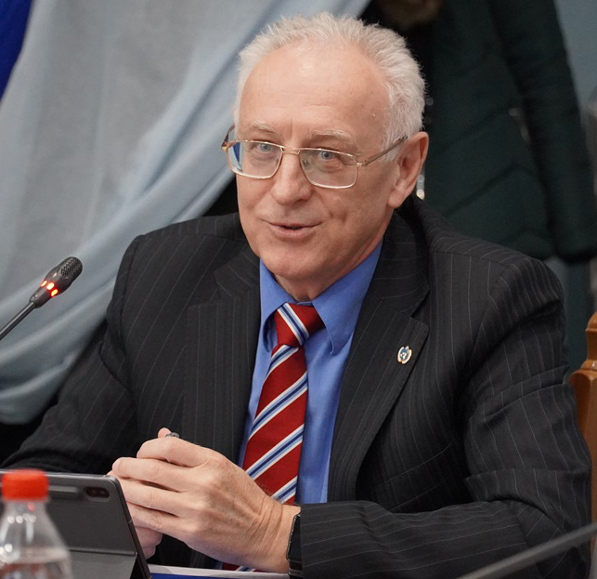
Thank you for your attention!
Sergiy Stepanenko
stepanenko@odeku.edu.ua

