Slide 1





^{4th} International Distance Learning Course
in Advance topics in Hydraulics , Hydrological Sciences and Hydrometeorology for RA II- 2021
for Asian Region (WMO RA-II)
( 31 May 2021 to 16 July 2021 )
CONCLUDING WEBINAR ON 23 JULY 2021
Organized by National Water Academy, India
in association with World Meteorological Organisation (WMO) & COMET , UCAR

Slide 2



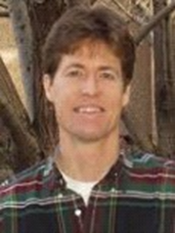

Course Facilitators from
WMO & COMET
Mustafa Adiguzel
WMO
Claudio Caponi
WMO
Matthew Kelsch
UCAR
Nirina Ravalitera
WMO
Thomas Hopson
UCAR

Slide 3
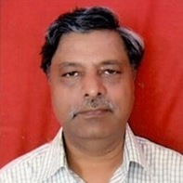
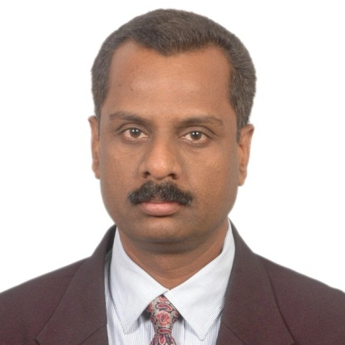

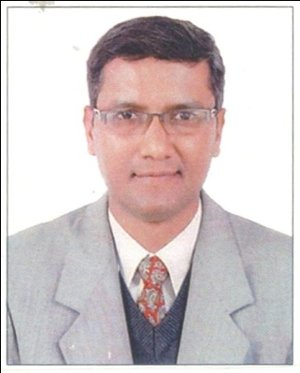
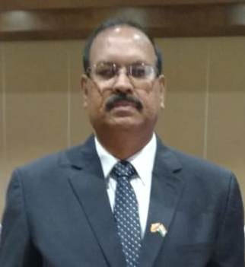
Course Instructors from NWA, CWC,
Ministry of Jal Shakti, Government of India
A K. Srivastava
Senior Joint Commissioner
N K Mathur
Former Member, CWC
Datta Kumar Chaskar
Director
N N Rai
Director
S N PANDE
Director & Course Coordinator

Slide 4
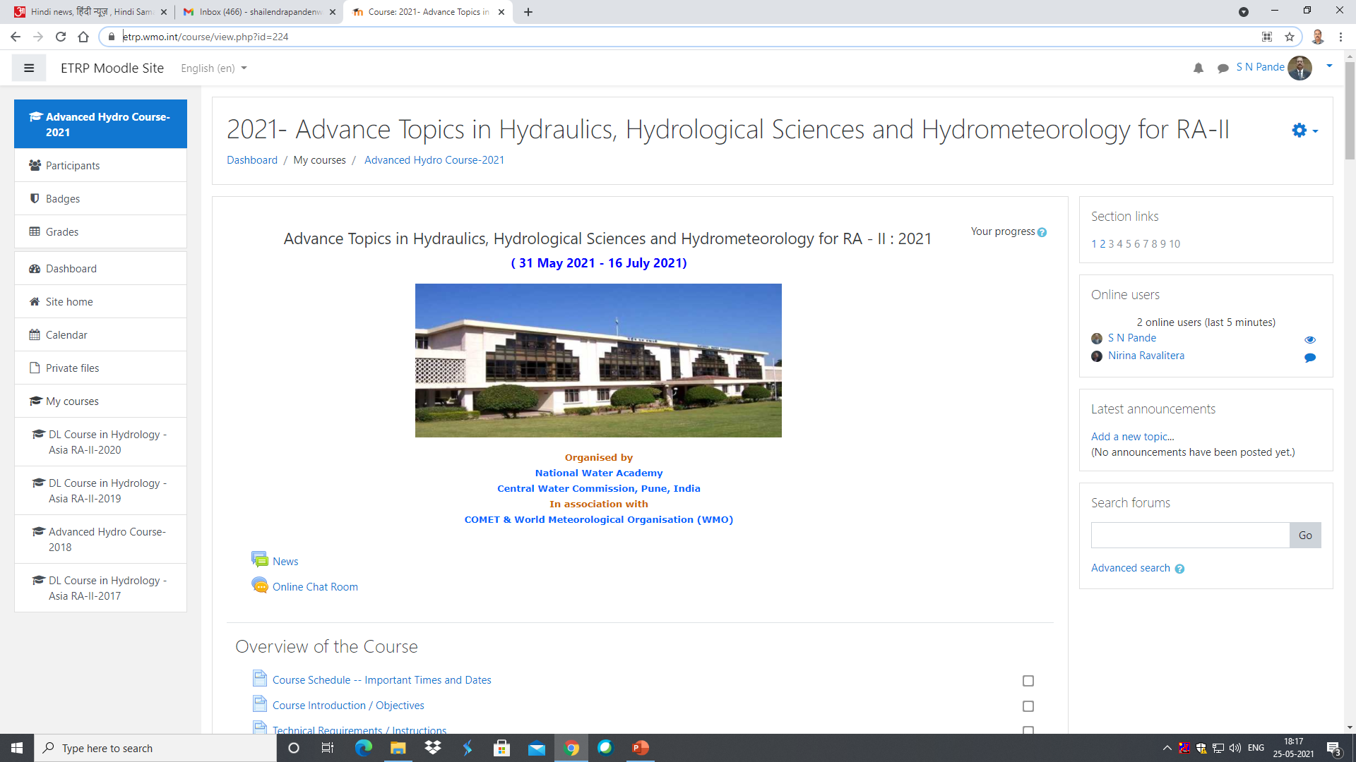
Course Website
https://etrp.wmo.int/course/view.php?id=224

Slide 5
The Course
The course was designed to meet the needs of hydrological forecasters who require more advanced training in selected hydraulic and hydrological modelling topics
The course was specifically for participants who have successfully completed the Basic course on Hydrology earlier or who have requisite knowledge on the subject

Slide 6
Goals of the Course
Upon completion of this course, participants will be able to:
Describe basic features of dams, dam failure modelling and river hydraulics;
Explain the advantages of using distributed hydrological models, associated data requirements and possible limitations;
Define key motivations and purposes of performing forecast verification;
Explain techniques for measuring rainfall and processes leading to rainfall, including climate cycles

Slide 7
Course Components
Set up your profile (Pre-course Activity)
Pre course activity for those participants who have not participated in Basic Hydrology course earlier.
  Complete the module on “Understanding the Hydrological Cycle: International Edition https://www.meted.ucar.edu/education_training/lesson/791
  Complete the module “ Runoff Processes : International Edition “https://www.meted.ucar.edu/education_training/lesson/805
Live Orientation Webinar on 31 May 2021at 1100 hrs Indian Standard Time
10+1 (11) Distance Learning Modules and Quizzes
  10 modules are mandatory
  At least 1 module out of 4 optional modules
Optional Reading

Slide 8
..Course Components
A MANDATORY short final writing assignment
Live Concluding Webinar ( 23 July 2021, 1100 Hrs Indian Standard Time)
Participate on the Course forum – at least twice weekly
Completing all of these was necessary to earn you a Certificate of Completion for the course

Slide 9
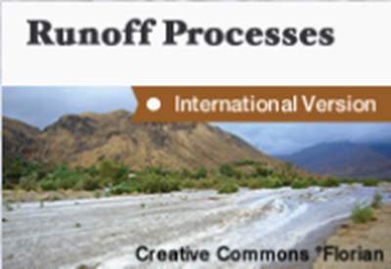
Required Modules
Pre-Course Activity

Slide 10
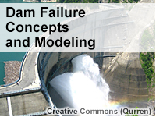
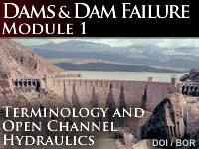

Required Modules
Week 1 & 2 : Three modules and Reading material
Av Grade 86 % 83% 82%
Participants 82 77 70

Slide 11

Required Modules
Week 1 & 2 : Three modules and Reading material
Introductory Reading and Resources on Dam Failure
( Reading material Only )
Case Study on Dam Break analysis
( Reading material Only )

Slide 12


Required Modules
Week 3 : Two Modules
Av Grade 88 % 87%
Participants 80 68

Slide 13
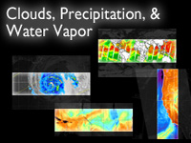


Required Modules
Week 4 : Three Modules
Av Grade 77 % 71% 83%
Participants 66 65 61

Slide 14

Elective Modules
Week 5 : 2 required + at least 1 from 4 optional modules
NWA:
Flood forecasting Techniques
Av Grade 89 % 79%
Participants 58 58

Slide 15

Elective Modules
Week 5 : 2 required + at least 1 from 4 optional modules
Chapter 2: Tropical Remote Sensing Applications
Chapter 3
Global Circulation
Chapter 4
Tropical Variability
Chapter 5
Distribution of Moisture & Precipitation
Av Grade 61 % 64% 70% 81%
Participants 39 13 12 27

Slide 16
Week 6
Completing all the required & optional modules
&
Starting with Final writing Assignment

Slide 17
Required Modules
Week 7
Submission of Final writing Assignment
Course Evaluation Survey
Concluding Webinar

Slide 18
Final Writing Assignment
Choose one topic area:
Option A: Describe a modeling project. Do you use distributed modeling, or lumped, or some other variation? Do you produce an ensemble of output? Is your modeling approach different depending on the watershed focus?
Option B: The Dams and Dam Failure lesson showed statistics of dams (type and age) in the United States. Prepare a report that describes the dams in your area, the primary use of those dams, and the biggest challenges. If you are in an area where Glacial Lake Outburst Floods (GLOFs) are possible, does your knowledge of dam failure enhance your understanding or effect your ability to analyze GLOF's?

Slide 19
…Final Writing Assignment
Choose one topic area:
Option C: Perform a verification study using model forecast results and data from your region. Describe the data available for verifying your current hydrologic forecasts. Use at least two verification scores and explain your results. What are the strengths and weaknesses of your model?
Option D: Describe the impacts, variability, and uncertainty regarding precipitation in your area associated with climate cycles such as ENSO, MJO, or seasonal monsoons. What are trends and future projections? Week four modules in option 2 and or 3 will assist with this written assignment.

Slide 20
Participation Guidelines
DON’T forget to take the online quiz associated with each of the modules
  You must pass each quiz with at least 70 % marks to receive credit for the module.
  You may re-take a quiz as many times as it takes to succeed

Slide 21
Concluding Webinar Session
Scheduled for 23 July 2021 , 1100 hrs Indian Standard Time, Review main themes covered in written assignments
Discuss questions/topics/issues from the discussion forums
Answer any final questions (you may post these in advance in the course forum)

Slide 22
PARTICIPANTS
Kingdom of Bhutan
India
Republic of Indonesia
Kazakhstan
Republic of the Union of Myanmar
Republic of the Philippines
Republic of Singapore
Thailand
Uzbekistan
Socialist Republic of Vietnam

Slide 23
NUMBER OF PARTICIPANTS
Countrywise number of participants |  |  |  | Participants who requested for opting out due to unavoidable circumstances |  | Participants who didnot participate during the duration of the course | Participants eligible for Course certificate
Kingdom of Bhutan |  | 6 |  |  |  |  | 1
India |  | 71 |  | 2 |  | 4 | 29
Republic of Indonesia |  | 2 |  |  |  |  | 2
Kazakhstan |  | 1
Republic of the Union of Myanmar |  | 3 |  |  |  |  | 2
Republic of the Philippines |  | 2 |  |  |  | 1
Republic of Singapore |  | 1 |  |  |  |  | 1
Thailand |  | 2 |  |  |  |  | 1
Uzbekistan |  | 2 |  |  |  |  | 1
Socialist Republic of Vietnam |  | 1
Total |  | 91 |  | 89 |  | 5 | 37

Slide 24
List of participants eligible for Course certificate as on 23.07.2021 (Tentative)
Sl. No. |  | Name of participant
1 |  | Cherie Aw
2 |  | Dr Anand B
3 |  | Gaikwad Sangram Babasaheb
4 |  | Arun Balu I
5 |  | Nilesh Gurunath Bhoir
6 |  | Jayant kumar Bisen
7 |  | M A Jose Jerald Das
8 |  | Vijaykumar S Divate
9 |  | Siddaraj H P
10 |  | N M Ashwaq Hussain
11 |  | Usha K
12 |  | Salauat Kalabaev
13 |  | Vikas Prabhakar Kaledhonkar
14 |  | Manjeet Kaur
15 |  | Rachana Kulkarni
16 |  | M Rajesh Kumar

Slide 25
List of participants eligible for Course certificate as on 23.07.2021
( Contd..)
Sl. No. |  | Name of participant
17 |  | TEJU KUMAR N
18 |  | Kailash Lakhe
19 |  | Dr Thenmozhi M
20 |  | Yogesha M
21 |  | Suryansh Mandloi
22 |  | Fatah Masthawee
23 |  | Mohanan P
24 |  | Sangeetha Parthasarthy
25 |  | Priyanka S
26 |  | Senthil S
27 |  | Naveen Singhal
28 |  | A .D. Sivananda
29 |  | Shailaja Atul Sulakhe
30 |  | Thajuddin Ubaid B M
31 |  | Sindhu R Varne
32 |  | V Veeralakshmi
33 |  | Pema Wangdi

Slide 26
List of participants eligible for Course certificate as on 23.07.2021
( Contd..)
Sl. No. |  | Name of participant
34 |  | Myot Myat Thu
35 |  | Yin Yin San
36 |  | Levina Levina
37 |  | Brigita Diaz

Slide 27
FEEDBACK
Wide appreciation of the modules & format of the course
The course content is elaborate and the duration of the course is very short
More number of video lectures could be added.
Generally this course is very informative and challenging as well . It worked well with busy scheduling, and the expectations were clear. I just have to recommend that there should be more samples specially the topic that involve calculations

Slide 28
FEEDBACK
Since the topics in the syllabus are quite advanced, more time is needed for understanding the concept. As this course is being conducted for professionals, minimum of three months time period is required for satisfactory completion of the course with no urgency
Microwave modules can be improved with more explanations. A separate module may be created to present real time applications of microwave remote sensing and evaluation may be made accordingly

Slide 29
FEEDBACK
Since the topics in the syllabus are quite advanced, more time is needed for understanding the concept. As this course is being conducted for professionals, minimum of three months time period is required for satisfactory completion of the course with no urgency
A topic on Numerical solution of unsteady flow equations (Finite Difference approach)

Slide 30
FEEDBACK
Modelling concepts and dam break analysis methods that are being used in India
Software
Allow a longer buffer time for the completion of the final assignment
Urban flood management topics
Climate Change and Nature-Based solutions

Slide 31
PLEASE REMEMBER
The website will be accessible.
All modules will be accessible

Slide 32
BEST WISHES

