Slide 1
WMO Training Workshop - Integrating Climate Information for Adaptation (ClimAdapt): 8-19 November 2021- Assignment Country: Iran
Ebrahim Asadi Oskouei, Farnaz Pourasghar, Yashar Flamarzi,
Morteza Pakdaman, Zohreh Javanshiri

Slide 2
What capacity needs you have identified?
Increasing the amount of financial and human resources;
Improve integration or coordination of governance;
Strengthening connections with other relevant organizations ;
Strengthening planning or Implementation;
Providing tools for calculation of sector specific indices;
Providing tools for monitoring adaptation effectiveness;
Private sector support in developing the country's meteorological technical capacity;

Slide 3
How you can involves more people?
Lots of other governmental organizations, public and private sectors could be involved, but the most important ones are:
Ministry of energy (responsible for monitoring and managing water resources), Ministry of agriculture, Department of Environment, Hydrological services, Ministry of Health; Farmers, Factories, Transportations, Municipalities; NGOs, …

Slide 4
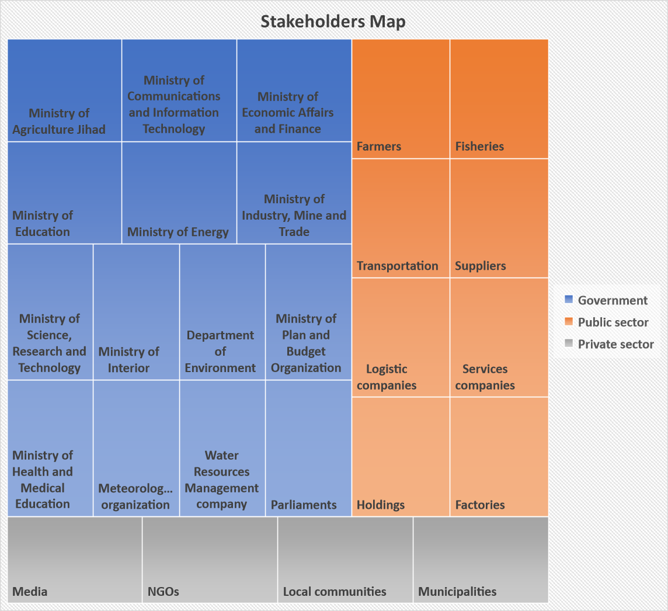

Slide 5
Action planning to overcome those challenges
Step 1: Assessing the baseline on climate services
Identifying Key stakeholders in climate services
Analysis of current user interface platforms, climate services and gaps
Step 2: Organizing a national stakeholder consultation workshop on climate services
Set the objectives of the national consultation workshop
Running the national consultation workshop
Step 3: Developing a national strategic plan and action plan for the National Framework for Climate Services
Step 4: Endorsing the national strategic plan and action plan for the National Framework for Climate Services
Step 5: Launching a National Framework for Climate Services

Slide 6
THREE PRIORITY ACTION
IRIMO's flood forecast system ( Saving life and property)
Drought monitoring by NDWMC (Agriculture, water resources management, food security)
Seasonal climate forecast (Planning Agriculture and water resources management strategies)

