Slide 1
South Africa – Capacity needs
Innocent Mbokodo
Lebohang Melato
Lucky Dlamini
Sandile Ngwenya

Slide 2
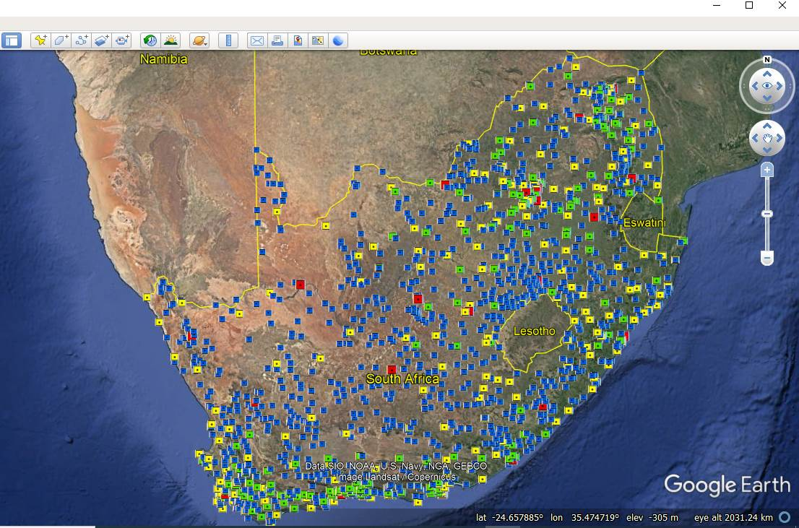
Infrastructure (invest in other source of energy such as solar to power our station because we lose a lot of data due to loadshedding)
Legend
Red: Weather Office measures rain, temperature, humidity, pressure, sunshine hours, cloud cover, wind speed, direction and wet bulb temperature.
Yellow: Automatic weather station measures rain, temperature, humidity, pressure, wind speed, direction and wet bulb temperature.
Green: Automatic rainfall station measures only rainfall
Blue: manual rainfall station measure only rainfall at 8am

Slide 3
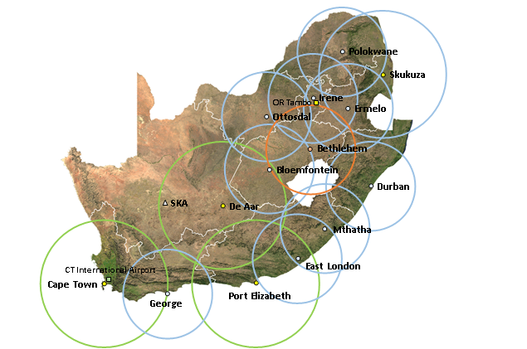
Skills development (e.g. radar we have resources but due to lack of skills we due to use our instruments to it maximum capacity)
The current SAWS operational Weather Radar Network that consists of 14 radars. Blue rings (±200 km radius) and green rings (±300 km radius) represent S-band (10 cm frequency – Doppler and Single-Polarization) and C-band (5 cm frequency – non-Doppler) radars, respectively. The orange dot radar at Bethlehem has both Doppler and Dual-Polarization capabilities. The additional C-band radar at Irene and the two X-band (3 cm) radars at CT International Airport and OR Tambo International Airport are not shown since they are not operational.

Slide 4
Modelling training (We actually attending a CCAM workshop last week)
Not enough personnel
We don’t have a platform that links the user and the provider so that our products speaks to our clients needs.
Our products are too scientific thus should be interpreted and translated into layman's terms.

Slide 5
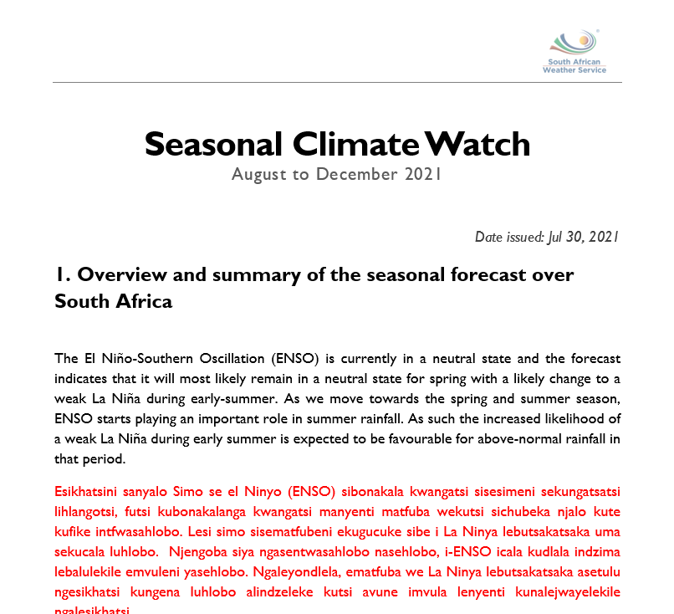
Translation of our reports from English to indigenous languages

Slide 6
Stakeholder Map
SAWS
Scientific Research Institutions
Government departments
Independent Research Consultants (Commercial clients)
Universities
Media
NGOs
CSIR
Water and Sanitation
Working on fire (WOF)
Research departments under insurance companies e.g. Santam or Old Mutual
ARC
Agriculture
Environmental

Slide 7
What can be done to overcome the obstacles
Strict data sharing policy - Make raw data freely available but have a clause that it shouldn’t be used for financial gain. This can assist SAWS to get feedback on how to improve (QC) the data and product/Service generated from it.
Not enough personnel – we will have many people working on these datasets
Establish MoU with academic institutions – we can get training to improve on our analysis (e.g. Modelling and QC procedures)
Infrastructure - invest in other sources of energy, renewable energy (solar/wind) to power our station because we lose a lot of data due to loadshedding

Slide 8
Platform that links the user and the provider so that our products speaks to our clients needs - Clients survey on how we can improve our products
Before covid, community outreach was planned on how to improve our reports so that they are not too scientific.
Job shadowing to students to create awareness – It has since stopped due to covid.
Collaborations with other institutions offering similar services in the country so that we don’t duplicate efforts and compete for same funding.

