Slide 1
Hello
Bonjour
OSCAR/Surface webinar Release 1.6.0
26. April 2021
Alexander Scheid
(WMO Secretariat)

Slide 2
Agenda
Timeline releases 1.6.0 and 1.7.0
Minor changes within release 1.6.0
Removal of uniqueness of station names
Legend for mandatory fields in OSCAR/Surface
Automatic station closure
Station Templates: A new simple way to create stations
Improved reporting schedule interface

Slide 3
1. Timeline releases 1.6.0 and 1.7.0

Slide 4
1. Timeline releases 1.6.0 and 1.7.0
Release 1.5.4
Release 1.6.0
Release 1.7.0
01
02
03
04
05
06
07
08
09
23.03.2021

Slide 5
2. Minor changes within release 1.6.0

Slide 6
2. Minor changes within release 1.6.0
Removal of uniqueness of station names
The uniqueness of the station name in OSCAR/Surface is not mandatory anymore.
A station is uniquely identified by its WIGOS ID.
Wherever there is a station name dropdown in OSCAR/Surface, it now includes always the primary WIGOS ID in parenthesis to identify the station.

Slide 7
2. Minor changes within release 1.6.0
Legend for mandatory fields in OSCAR/Surface

Slide 8
2. Minor changes within release 1.6.0
Automatic station closure
Improved functionalities to close different parts of a station that can be used in cascade.
If closure dates are entered on one level, checks are performed and the closure dates for its children are set automatically. E.g. the closure of a program affiliation will automatically close all its deployments including all data generations.
Pop-ups show details and will warn users of the resulting affects on other closure dates on other levels.
Close
station
Close program affiliation
Close deployment
Check
Check

Slide 9
3. Station Templates

Slide 10
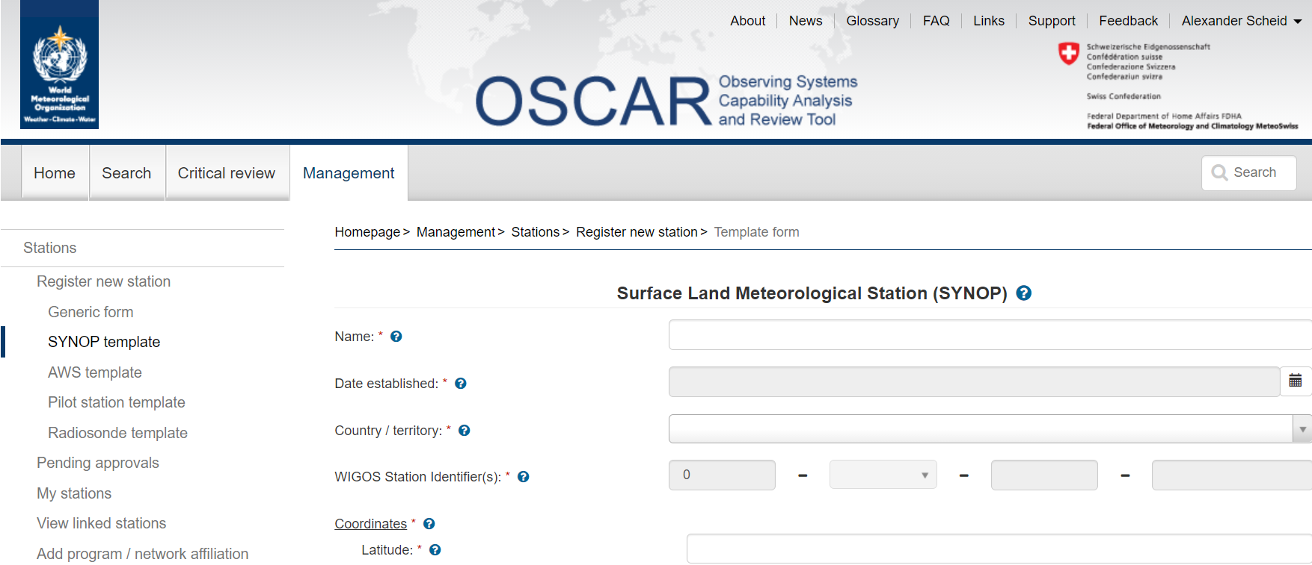
3. Station Templates
New feature to facilitate the process of registering a station
Four template forms available with release 1.6.0
Templates only show the most important and mandatory fields for this station type in order to be able to save the station in OSCAR/Surface.
Provide more guidance to users by only showing prefiltered options for dropdowns/menus and by automatically calculating additional OSCAR/Surface fields in the background depending on the information that is entered.

Slide 11
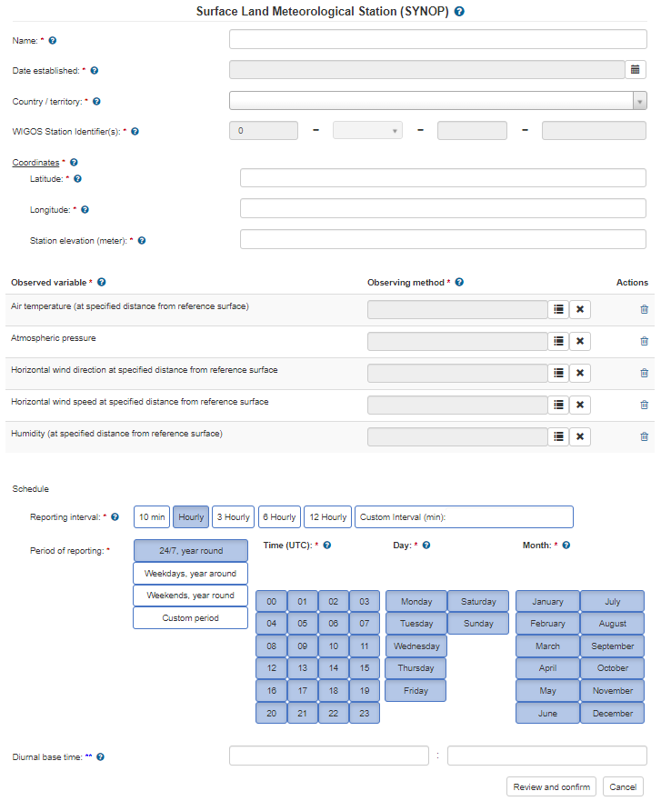
3. Station Templates - SYNOP
Basic information
WIGOS ID dropdown shows ISO country code of entered country/territory
Coordinates
Time zone, climate zone, surface cover, topography, population and WMO region fields are calculated based on the coordinates
Observed variables and methods
Pre-affiliated with GOS
Observing geometry: point
Choose the accurate observing method from the prefiltered tree.
Delete the whole variable if not observed at this station.
Reporting schedule
Use for international reporting: always

Slide 12
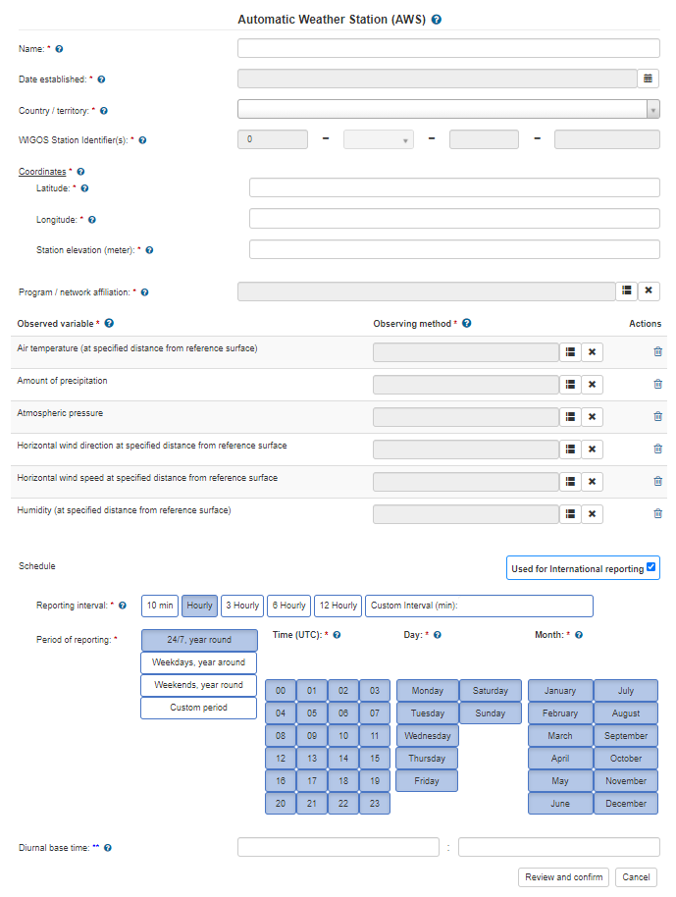
3. Station Templates - AWS
Basic information
WIGOS ID dropdown shows ISO country code of entered country/territory
Coordinates
Time zone, climate zone, surface cover, topography, population and WMO region fields are calculated based on the coordinates
Observed variables and methods
No pre-affiliation. User can choose accurate affiliation.
Observing geometry: point
Reporting schedule
Use for international reporting: optional

Slide 13
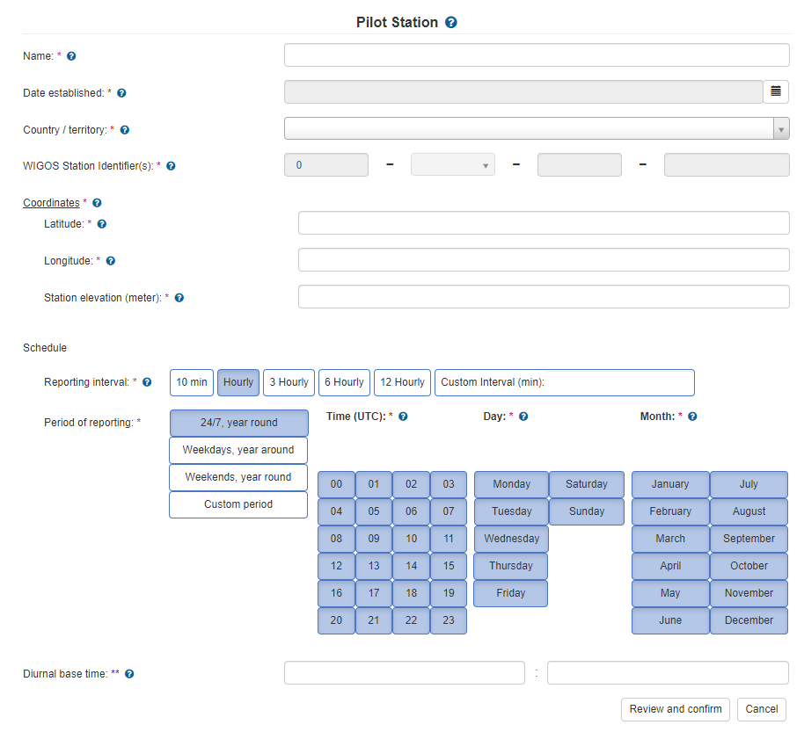
3. Station Templates - Pilot Station
Basic information
WIGOS ID dropdown shows ISO country code of entered country/territory
Coordinates
Time zone, climate zone, surface cover, topography, population and WMO region fields are calculated based on the coordinates
Observed variables and methods
Not visible for Pilot Station because pre-defined (Upper-wind with Radiosonde (tracking unspecified))
Pre-affiliated with GOS
Observing geometry: vertical profile
Reporting schedule
Use for international reporting: always

Slide 14
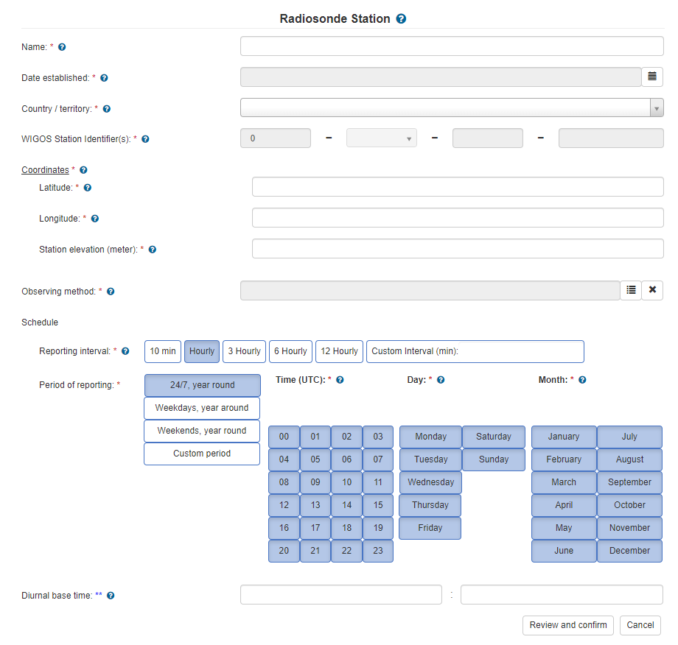
3. Station Templates - Radiosonde
Basic information
WIGOS ID dropdown shows ISO country code of entered country/territory
Coordinates
Time zone, climate zone, surface cover, topography, population and WMO region fields are calculated based on the coordinates
Observed variables and methods
Chose the accurate observing method
Pre-affiliated with GOS
Observing geometry: vertical profile
Reporting schedule
Use for international reporting: always

Slide 15
3. Station Templates - Template Management
Station template management allows administrators to adjust templates or to create new ones for other station types.
The templates are based on a modular concept which allows to easily create other templates by defining a configuration file in OSCAR/Surface with the desired fields, values and arrays for filtered dropdowns and menus.
More station templates expected to be released in the future.

Slide 16
4. Improved reporting schedule interface

Slide 17
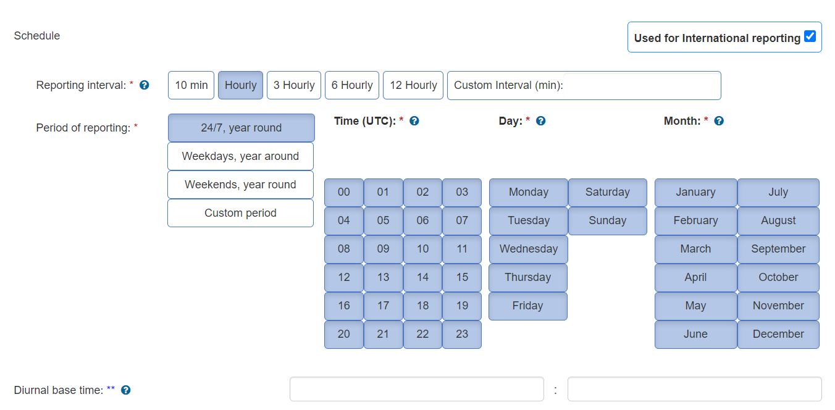
4. Improved reporting schedule interface

Slide 18
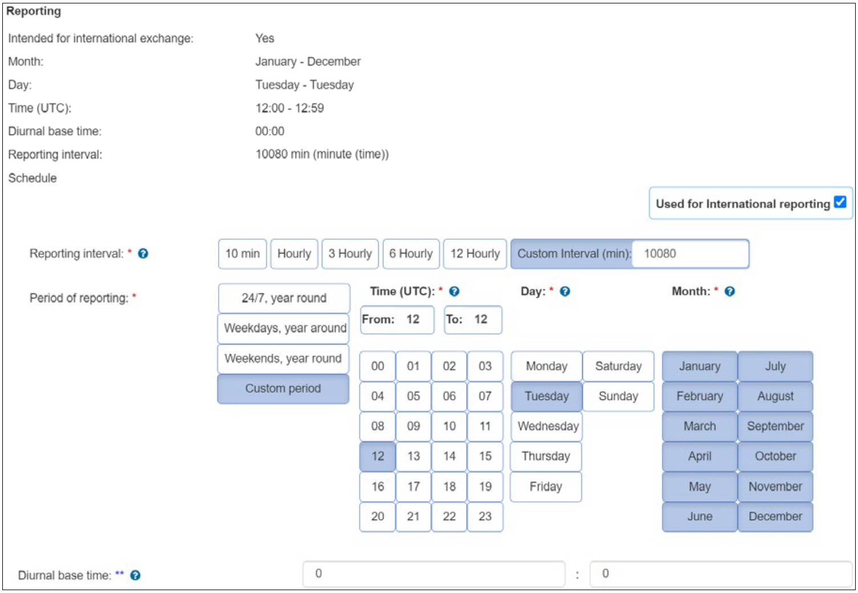
4. Improved reporting schedule interface
Example 1
One sounding per day (e.g. for pilot stations) - at 12 a.m.,
Tuesdays, year - round

Slide 19
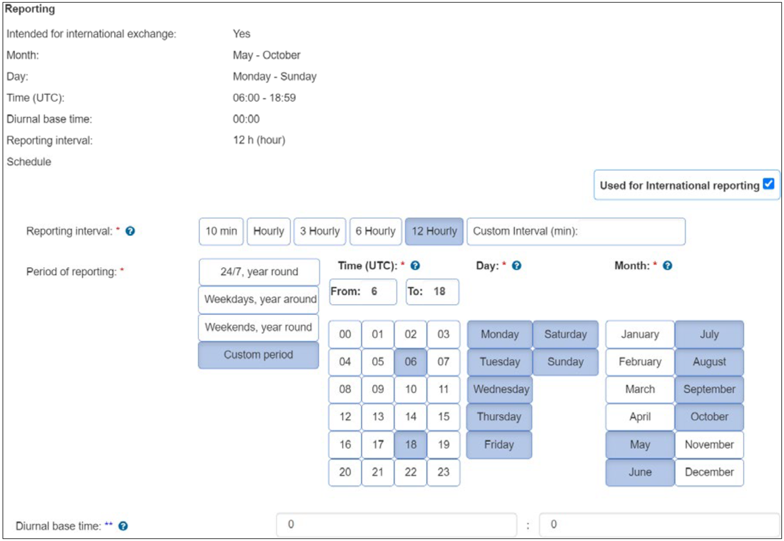
4. Improved reporting schedule interface
Example 2
Two soundings per day (e.g. for pilot stations) - at 6 a.m. and 6 p.m., daily,
May - October

Slide 20
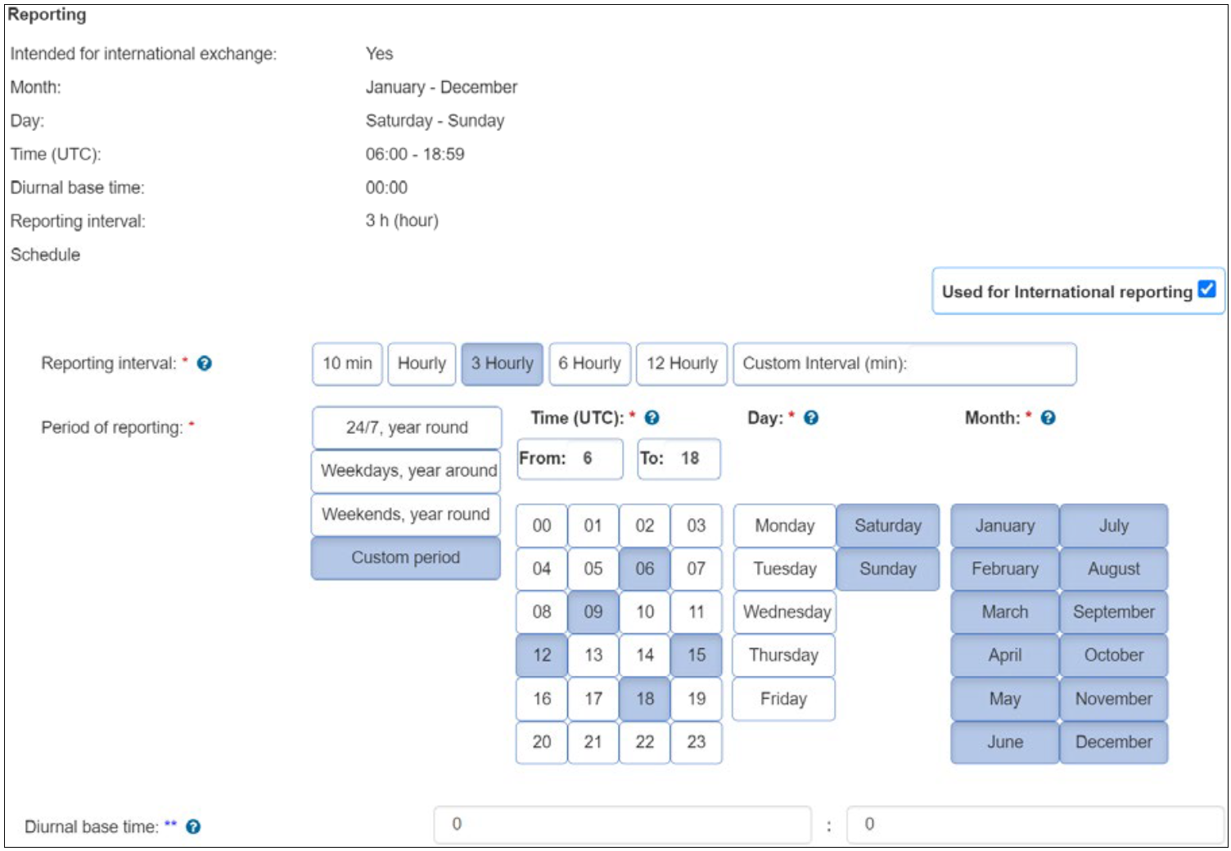
4. Improved reporting schedule interface
Example 3
Every three hours between 6 a.m. and 6 p.m., weekends, year - round

Slide 21
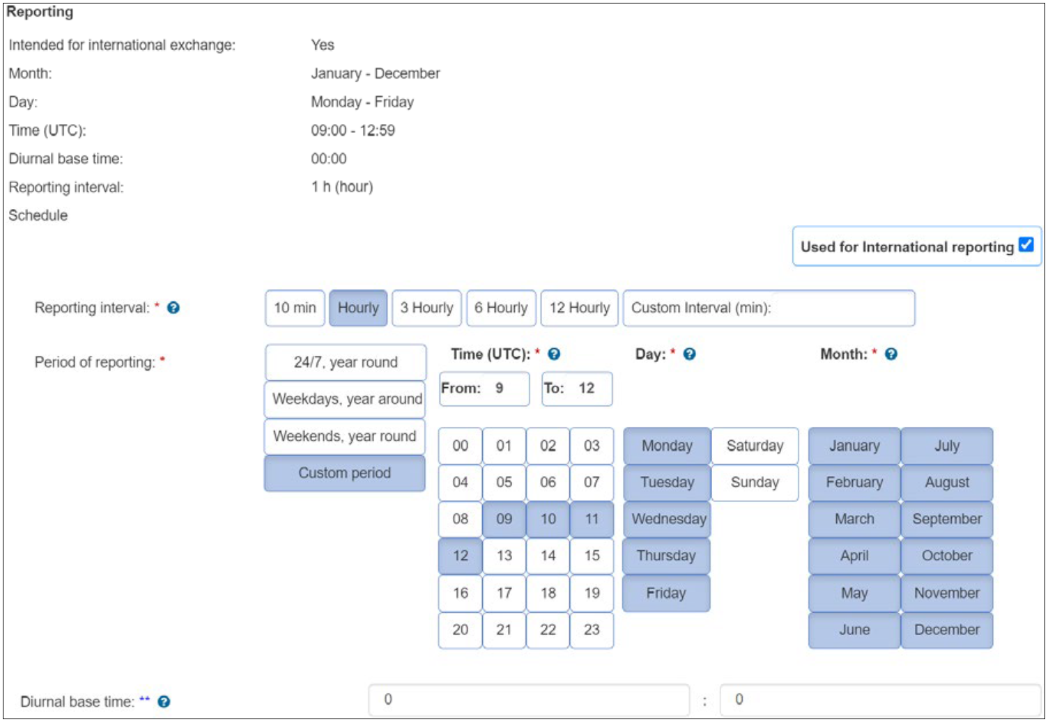
4. Improved reporting schedule interface
Example 4
Hourly between 9 a.m. and 12 a.m., weekdays, year - round

Slide 22
Further Information
Further information on all new developments of release 1.6.0 can be found in the OSCAR/Surface user manual: OSCAR/Surface User Manual Release 1.6.0
Check out the Station Templates and the new reporting schedule at OSCAR/Surface DEPL: https://oscardepl.wmo.int/surface
The recording and the presentation of this webinar will be made available in the WIGOS Learning Portal: https://etrp.wmo.int/course/view.php?id=146&section=4

Slide 23
Hello
Bonjour
Thank you
Merci

