Slide 1
Hello
Bonjour

Slide 2
Today
The OSCAR/Surface web-client (https://oscar.tools.wmo.int/web-client)
Practical demo
Outlook

Slide 3
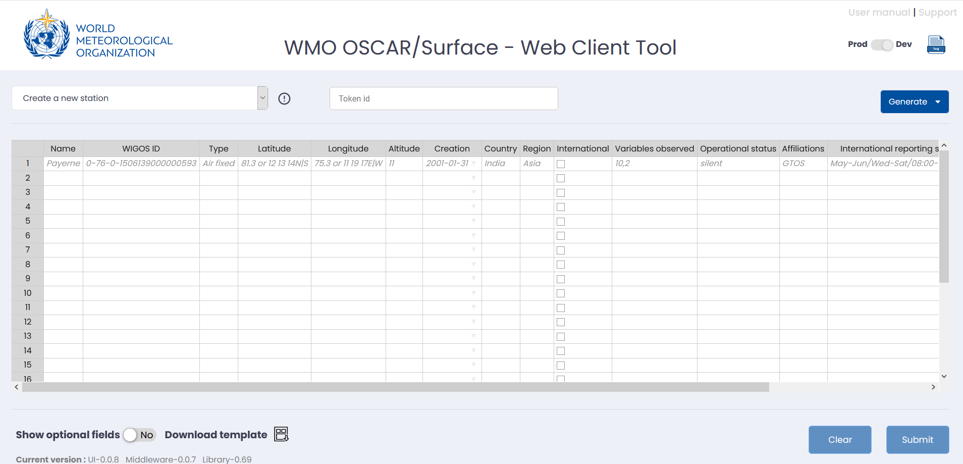
The OSCAR/Surface web-client
Perform batch operations
Currently supports
Create stations
Change WIGOS identifiers
Change schedule
Add affiliation

Slide 4
The OSCAR/Surface web-client – general idea
Load XML files from OSCAR/Surface, perform changes and upload
Web-client allows to perform standard actions on batches of stations
Stations are identified by their WIGOS ID
Queuing system to process large batches without timeout

Slide 5
Web-client frontend
Browser
REST API
OSCAR/Surface
Offical OSCAR/Surface API (WMDR XML)
Web-client
backend
Oscar-lib

Slide 6
OSCAR/Surface web-client - access
The web-client uses the official API
Need an API token to access it
Get your token from OSCAR/Surface (DEPL or PROD). Need to be NFP or metadata editor
Supply the token to web-client
Remember the DEPL token gets overwritten with the PROD one every week

Slide 7
OSCAR/Surface web-client - operations
Create station
Create new stations. No load, only submit
Need to populate basic fields (name, coordinates, variables, type etc). Supports additional “optional” fields
Add WIGOS Identifier
Add WIGOS ID to station and/or change primary WIGOS ID
Canot remove WIGOS IDs (not supported by OSCAR/Surface)
Change schedule
Load all schedules of one or more stations (optional step)
Edit in user interface or Excel
Upload all or subset of schedules
No new schedules supported
Add affiliation
Affiliate a station with one or more WMO programmes/networks
Optionally affiliate with existing variables (no new variables supported)

Slide 8
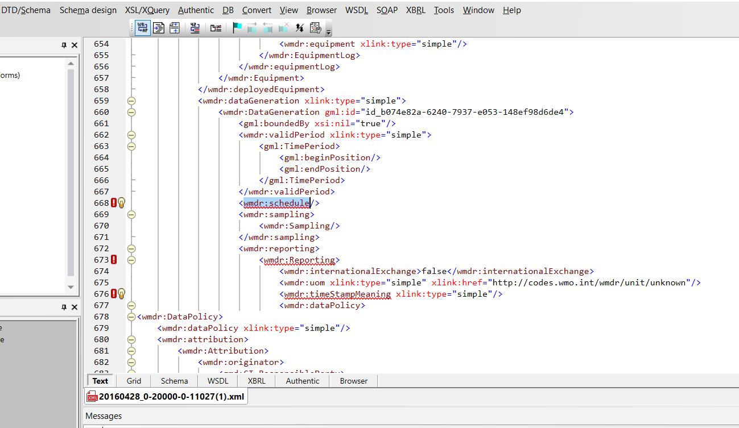
Side-discussion: invalid XML
OSCAR/Surface sometimes outputs invalid XML records
This is related to missing information, mostly schedule related
Web-client can “fix” such schedules

Slide 10
Support and outline
Web-client is an experimental tool, developed by the WMO Secertariat
Support via the WIGOS Learning Portal
Try on DEPL before using on PROD
Source-code can be made available
Possible extensions
Contacts management
Add schedules / variables
Edit stations
??

Slide 11
Thank you
Merci

