Slide 1
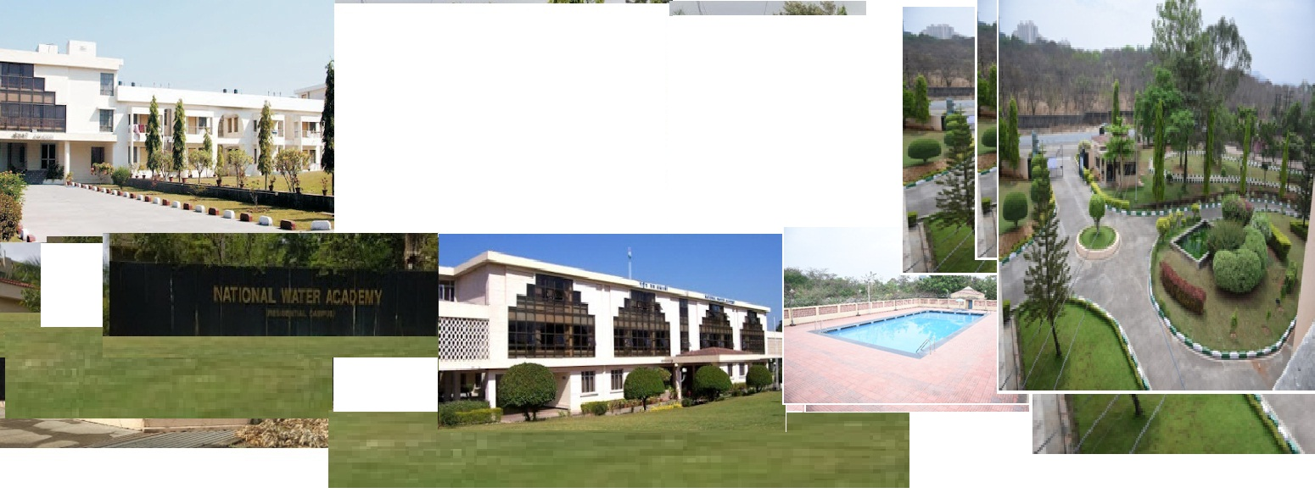

Responding to Challenges Beyond the New Normal: A WMO Global Campus Collaborative Webinar Event
National Water Academy, Pune, India
(since 1988)
20 to 22 January 2021

Slide 2
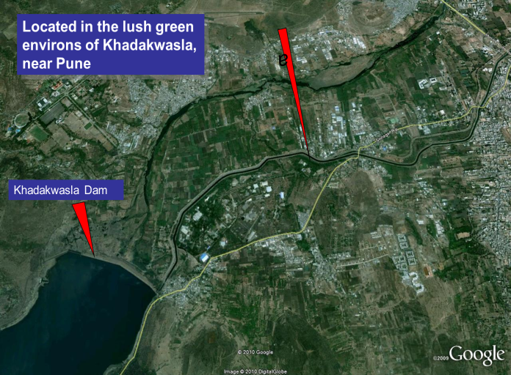
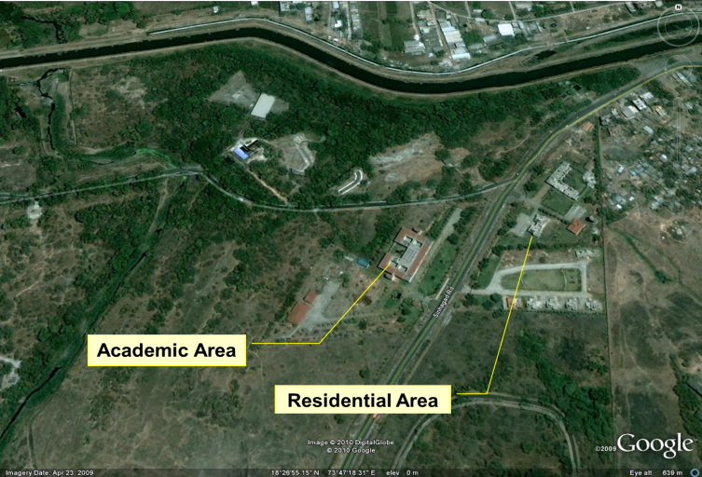
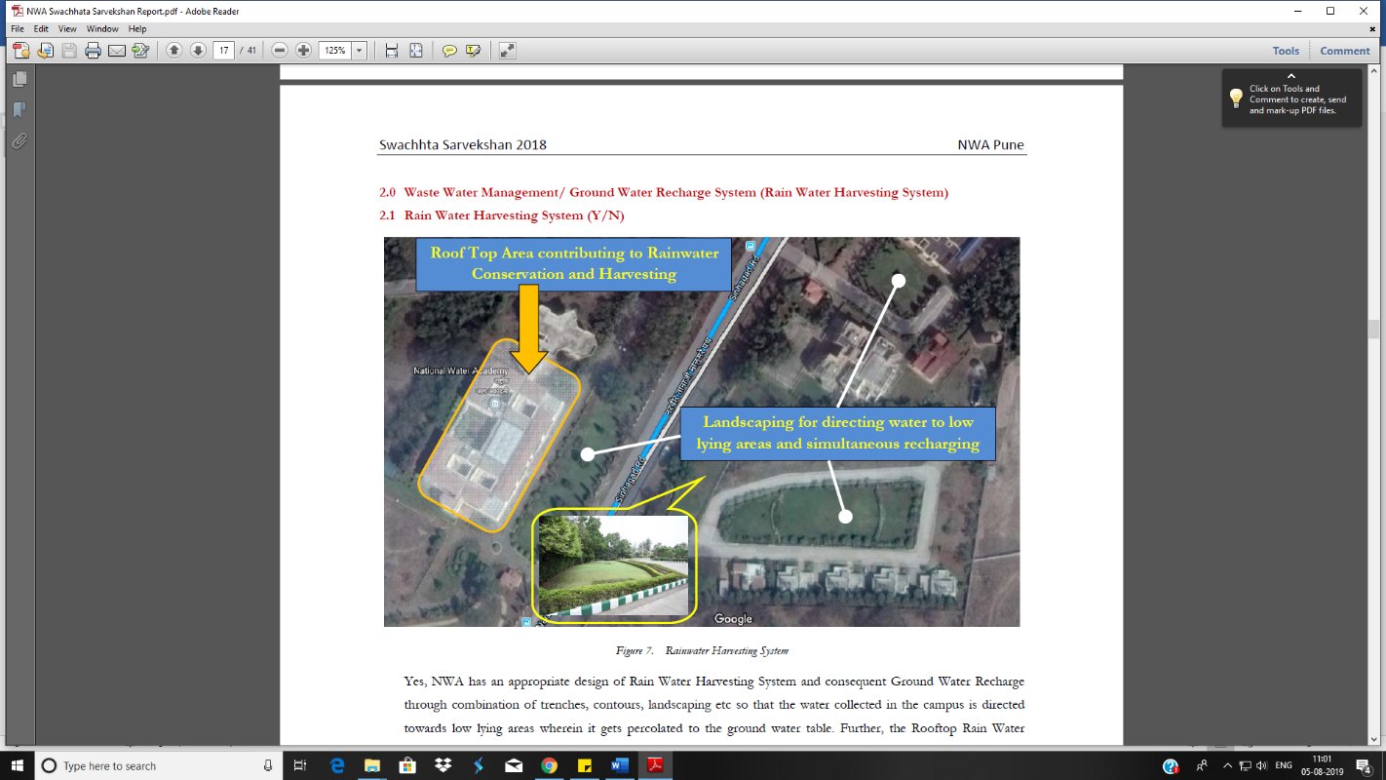
National Water Academy: Mission
National Water Academy: Mandate & Role
Mission of Central Water Commission “to promote integrated and sustainable development and management of India’s water resources by using state-of-art technology and competency and by coordinating all stakeholders”
In follow up of above, NWA strive “to educate all stakeholders to manage water resources issues and overcome problems faced in water sector in an integrated and sustainable manner”

Slide 3
Areas of Trainings
Designs | Designs of all kinds required in WR Projects, Dams, Barrages, Canals, FEM and other advanced design techniques etc.
Project Development | Survey, Investigation, preparation of DPR
Hydrological Sciences | Operational and Project Hydrology including HIS and Telemetry
Irrigation Management & Agriculture | Agronomy, irrigation, drainage, performance evaluation and benchmarking, PIM and WUA etc.
Information Technology | GIS, Remote Sensing and various software applications in Water Resources sector
River Management | Flood Management, Flood Forecasting, Morphology, Hydro-meteorological data collection, Water Quality Management etc.

Slide 4
Areas of Trainings
Basin Planning & Management | Integrated Water Resources Management, River Basin Organisation, Reservoir Operation, Water Assessment etc.
Water Supply, Sanitation & Waste Water Treatment | Urban and Rural water supply systems, waste water treatment etc.
Coastal Management | Coastal Erosion & Protection
Water Policy & Legal Issues | National Water Policy; Water Law at National & International Level; Water Governance
Environmental Aspects | Environmental impact of river valley projects, EIA, Climate Change etc.
Social Aspects | Social impacts of river valley projects, mandatory public hearing, gender issues
Economic aspects | Economic and financial aspects of river valley projects, financial sustainability of infrastructure

Slide 5
Number of Training and Other Programmes
Total number of training conducted = 725

Slide 6
Number of Beneficiaries

Slide 7
International Trainings
World Meteorological Organisation: NWA is a component of the WMO Regional Training Centre of India since 2012 with further Collaboration with COMET, USA
Distance Learning courses on Moodle platform on:
  International Trainings through ITEC Scheme of MEA including for African countries (4 no.)
  Royal Govt of Bhutan: Demand based trainings to Officials (4 no.)
  International Commission on Irrigation and Drainage: collaboration initiated for three programs
    (a) Micro Irrigation System; (b) Flood Forecasting and (c) Irrigation Planning
Basic Hydrological Sciences | 10 courses | 492 Indian participants from State, Central, PSU, Academic, NGOs etc. 189 Foreign participants from countries of Regional Association – II, WMO (Asian Countries) Total participants = 681
Advanced topics in Hydraulics and Hydrological Sciences | 3 courses

Slide 8
Challenges in COVID-19 Situation
Seeing is believing: Lack of project/ field visit experience
Difficulties in conducting hands on practical session, particularly for design of various components of Water Resources Projects, and other modelling tools which require commercial / proprietary software
Difficulties in conducting evaluation/ examination particularly maintaining requisite integrity of processes
Network connectivity and speed issues during online classes/exams
Difficulty in attendance management of participants
Managing subject matter experts to get associated in online training mode
Capacity development for trainers on standardized online training methodologies, tools and technologies needed
Though training time, in online mode, in hours remained same but number of training days increased

Slide 9

Thanks

